Slide 1
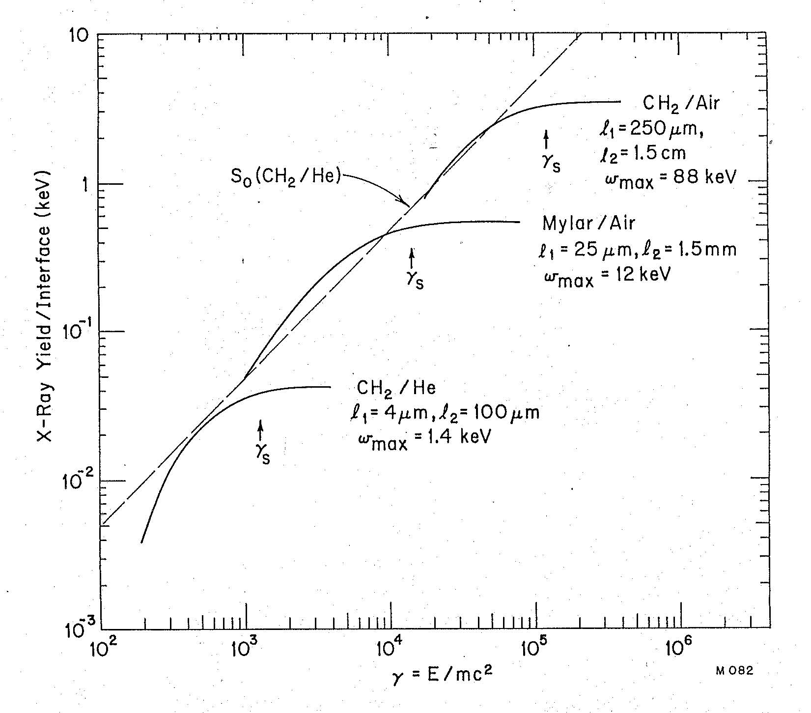
Basic approach:
Use saturation gamma γ_{s} ~ ω₁ (l₁l₂)^{1/2}
Constraints:
Total grammage << 100 g/cm²
Total length < 4 m
Because high γ_{s} ➔ high frequencies,
high ω₁, high grammage, look at
Compton scattering to the side

Slide 2
10 identical modules
Radiator + Xe + Compton scintillators
1″ BGO
1″ BGO
1″ BGO
1″ BGO
1″ BGO
1 cm Xe #10
1 cm Xe #10
1 cm Xe #10
1 cm Xe #10
1 cm Xe #1
Radiator 10
Radiator 10
Radiator 10
Radiator 1
Radiator 1
Beam
1″ BGO
1″ BGO
1″ BGO
1″ BGO
1″ BGO

Slide 3
10 modules, N=400 Teflon foils, 20 μm/3 mm γ_{s} = 2.1 x 10⁴ Grammage = 17 g/cm² Length = 12 m
E (TeV) | γ_{s,p} | γ_{s,K} | γ_{s,π}± | γ_{s,π}o
1 | 1.07E+03 | 2.02E+03 | 7.16E+03 | 7.41E+03
2 | 2.13E+03 | 4.05E+03 | 1.43E+04 | 1.48E+04
4 | 4.26E+03 | 8.10E+03 | 2.87E+04 | 2.96E+04
8 | 8.53E+03 | 1.62E+04 | 5.73E+04 | 5.93E+04

Slide 4
γ_{s} = 3.4 x 10⁴ Grammage = 22 g/cm² Length = 6 m
8 TeV Teflon – 10 modules, 200 foils, 50 μm/3 mm, 2.54 cm BGO
Last detector only.

Slide 5
10 modules, N=200 Al foils, 40 μm/4 mm γ_{s} = 4 x 10⁴ Grammage = 22 g/cm² Length = 8 m

