Slide 1

Development of heavy ion accelerators in JINR
Развитие ускорителей в ОИЯИ
Boris Sharkov / Борис Шарков
ОИЯИ Дубна
НИЯУ МИФИ
НИЯУ МИФИ

Slide 2
Motivation
Facilities goals : pushing the “intensity” and the “precision frontiers” to the extremes – not “energy frontier”!
Full range of ion beam species: p+ - 239U ;
Highest beam intensities & luminosities;
Generation of ‘Precision beams’: sophisticated beam manipulation methods-stochastic and electron cooling of ion beams, also applicable to the secondary radioactive and antiproton beams;
Rings as accelerator structures of choice: capability to store, cool, bunch, and stretch beams ;
Substantial increase in beam energy variation: by a factor of 20 in energy for beams as heavy as Uranium .

Slide 3
Intermediate Charge State Heavy Ions
Existing and planned Heavy Ion Accelerators operated with intermediate charge states worldwide
AGS Booster | BNL | 5x10⁹ | Au³¹⁺
LEIR | CERN | 1x10⁹ | Pb⁵⁴⁺
Nuclotron | JINR | 4x10⁹ | Au³²⁺
SIS18 | GSI/FAIR | 1.5x10¹¹ | U²⁸⁺
HIFL | IMP | > 10⁹ | U³⁴⁺
SIS100 | FAIR | 5x10¹¹ | U²⁸⁺
HIAF | HIAF | >10¹¹ | U⁷²⁺
NICA (collider) | JINR | 2×10⁹ | Au⁷⁹⁺

Slide 4
Accelerator Technology Issues
High current injection,
Acceleration - Stacking
      Accumulation / Beam Cooling
      Bunch compression,
IBS and vacuum instabilities
Fast extraction
Beam transport and focusing
Beam diagnostic

Slide 5
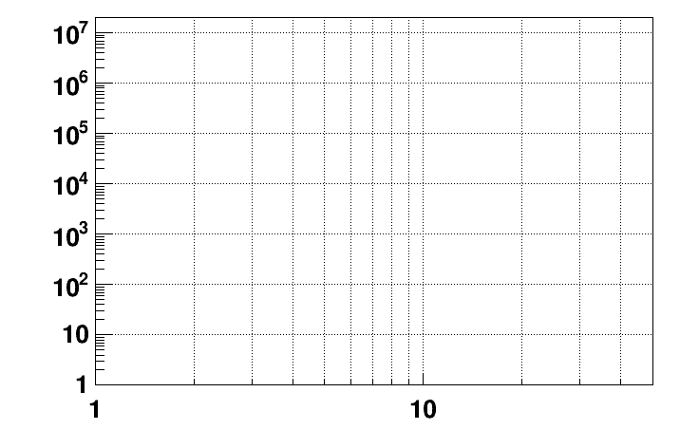
Present and future HI experiments/machines for super-dense
nuclear matter physics
CBM
energy region of max.
baryonic density
SIS-100 SIS-300
NICA/BM@N II
NICA/BM@N I
HADES
NICA/MPD
Interaction rate [Hz]
STAR F.T.
STAR BES II
NA-61/SHINE
Collision energy √S [GeV]
NN

Slide 6
Experiments on super-dense nuclear matter
Experiment | Energy range (Au/Pb) | Reaction rates (Hz)
STAR@RHIC (BNL) | √s_{NN} = 7 – 200 GeV | 1 – 800
NA61@SPS (CERN) | √s_{NN}= 6.4 – 17.4 GeV | 80
MPD@NICA | √s_{NN}= 4.0 – 11.0 GeV | ~6000
BM@Nuclotron | E_{kin}= 2.0 – 4.5 A GeV | 10⁵
CBM@FAIR | √s_{NN}= 2.7 – 8.3 GeV E_{kin}= 2.0 – 35 A GeV | 10⁵ – 10⁷
Experiment | Observables (Au+Au at √s_{NN} = 8 GeV)
STAR@RHIC (BNL) | Pions, kaons, protons, hyperons
NA61@SPS (CERN) | Pions, kaons, protons, hyperons
MPD@NICA | Pions, kaons, protons, gammas, (multi-strange) hyperons, electron pairs ?
CBM@FAIR | Pions, kaons, protons, gammas, (multi-strange) hyperons, electron pairs, open charm, charmonium
Complimentary research program FAIR - NICA

Slide 7


Status of NICA
NICA
Volga
river
Notes:
Good afternoon! First of all I would like to express my gratitude to organizers for the opportunity to give a short presentations on the NICA project

Slide 8
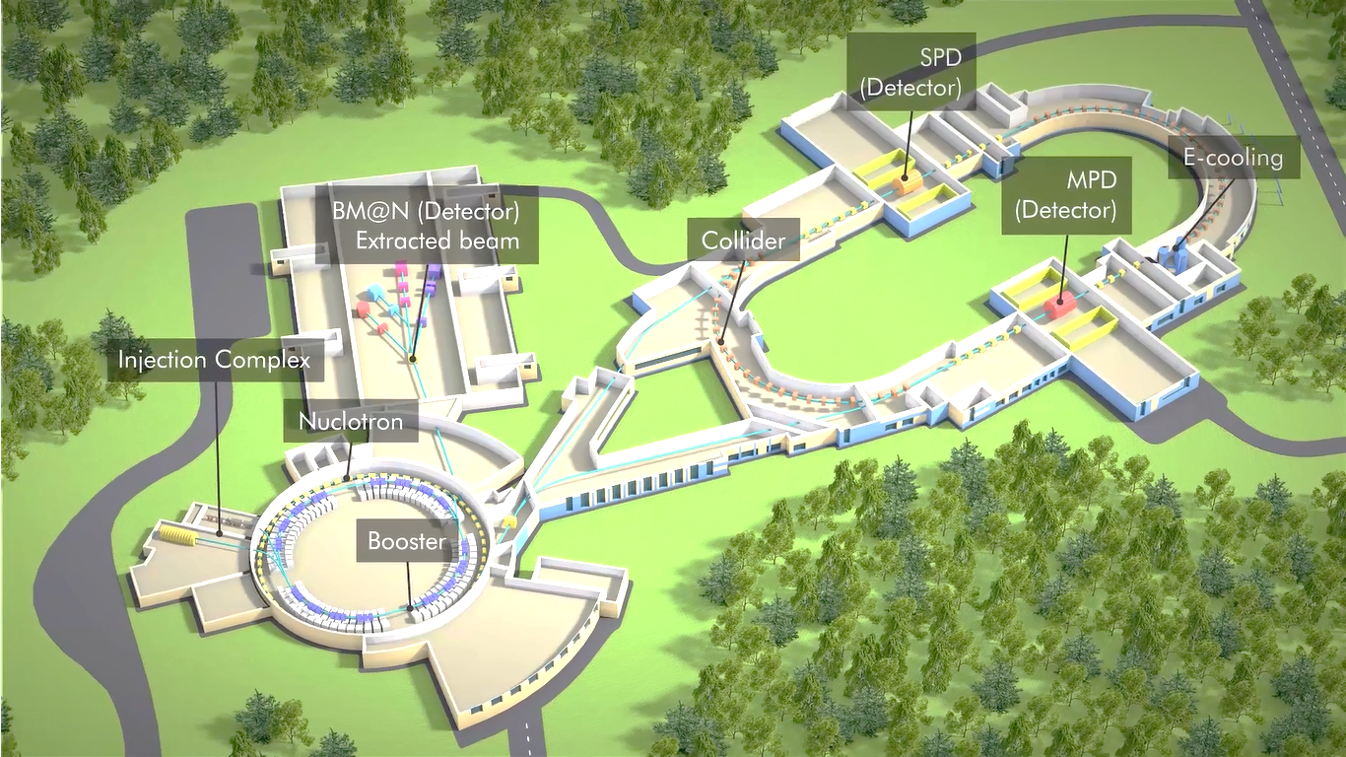

NICA Collider : Search for the Mixed Phase and New Physics
In Heavy Ions’ Collisions
MPD
BM@N Detector
Collider
Injection complex
Nuclotron upgrade
BT Line N-C
Channel B=>N
Booster
I.Meshkov NICA MAC

Slide 9
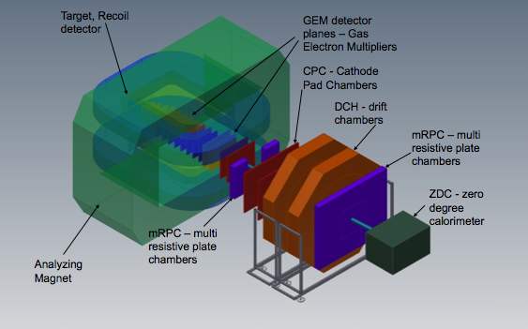
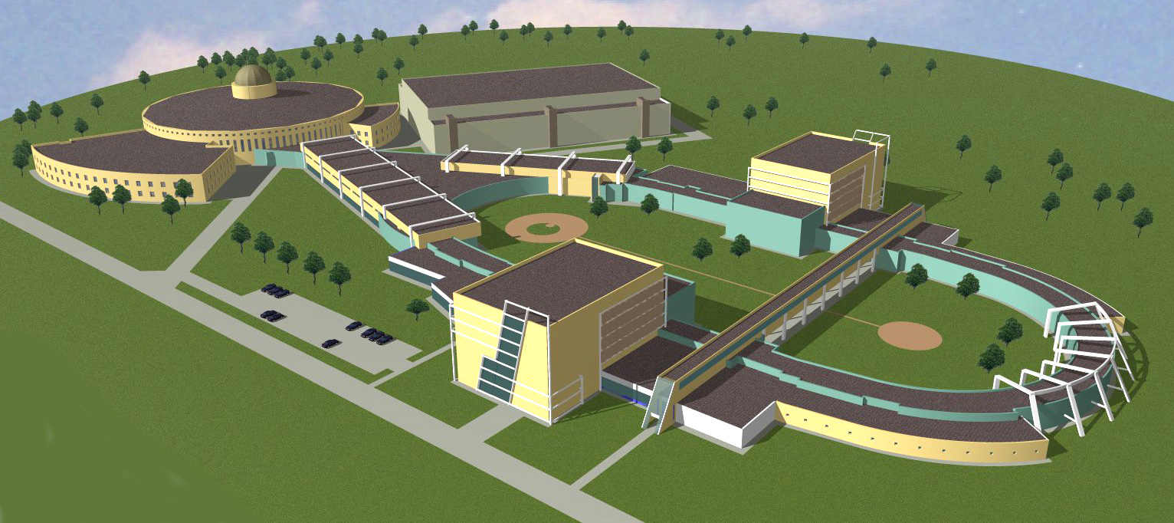
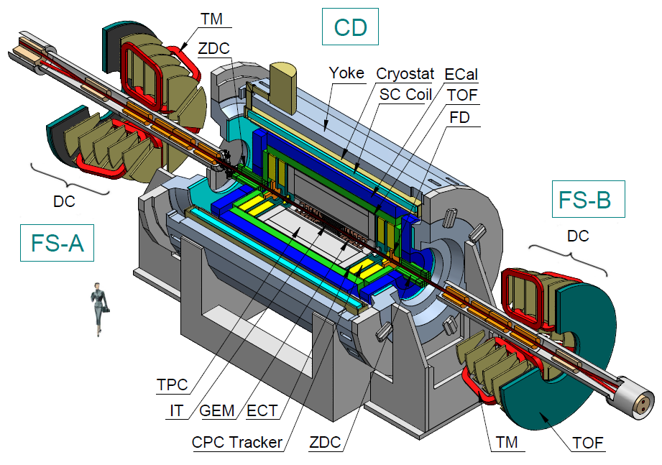
The NICA Complex
existing facility
to be constructed
KRION-6T+ HILac (3MeV/u)
BM@N
PS & LU-20 (5MeV/u)
hall for fixed target
experiments
SPD hall
Booster
(600 MeV/u)
MPD hall
NUCLOTRON 0.6-4.5 GeV/u
MPD
Collider

Slide 10
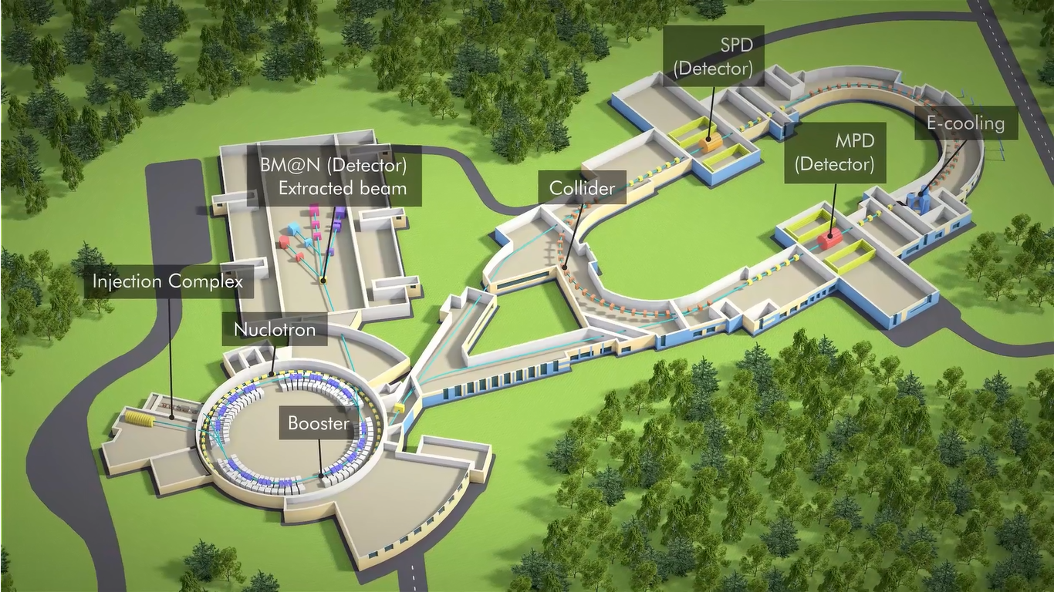
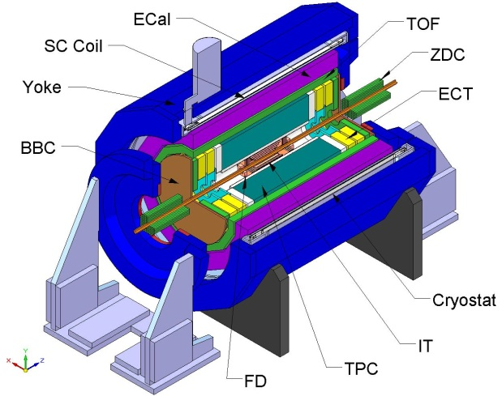
The NICA basic facility
BM@N
Collider ring (c=503 m)
MPD
Nuclotron ring (c=251,5 m)
Notes:
This is a view of major NICA facilities. The Nuclotron – supercoducting synchrotron with circumference of 250 meters was put in operation 24 years ago. The beams from Nuclotron are extracted to the experimental hall, where the first experiment of NICA program BM@N is located. The plan is to put in operation a booster in 2019, and collider - in 2020 simultaneously with the MPD.

Slide 11
NICA – Heavy Ion Collider
Facility operation scenario
Linac HILac
KRION
Booster (25 Tm)
1(2-3) single-turn injection,
storage of (2 ÷ 4)×10⁹ ions,
acceleration up to 100 MeV/u,
electron cooling, acceleration
up to 600 MeV/u
Ion sources
Linac LU-20
Fixed Target Area
BM@N experiment
Stripping (80%) ¹⁹⁷Au³¹⁺ => ¹⁹⁷Au⁷⁹⁺
~ 2 x 22 injection cycles
22 bunches per ring
IP-2 SPD
Nuclotron (45 Tm)
injection of one bunch
of ≤ 2×10⁹ ions,
acceleration up to
1 - 4.5 GeV/u max.
Two SC
collider rings
L ≥ 10²⁷ см⁻²с⁻¹
IP-1 (MPD)
11

Slide 12
Key Parameters of The NICA Collider
Ring circumference, m | 503,04
Number of bunches | 22
R.m.s. bunch length, m | 0.6
Ring acceptance, π⋅mm⋅mrad | 40.0
Long. Acceptance, Δp/p | ≤ 0.01
γ_{transition} (E_{transition}, GeV/u) | 7.091 (5.72)
β*, m | 0.35
Ion Energy, GeV/u | 1.0 | 3.0 | 4.5
Ion number/bunch, 1e9 | 0.275 | 2.4 | 2.2
R.m.s. emittance, h/v π⋅mm⋅mrad | 1.1/1.0 | 1.1/0.9 | 1.1/0.76
R.m.s. Δp/p, 1e-3 | 0.62 | 1.25 | 1.65
IBS growth time, s | 190 | 700 | 2500
Peak luminosity, cm⁻²⋅s⁻¹ | 1.1e25 | 1e27 | 1e27
Collider lattice:
FODO,
12 cells x 90⁰ each arc,

Slide 13
Structure of the NICA injector complex
Transfer to collider rings
Nuclotron
SPP
SPP
RFQ
LU-20
LIS
p↑, d↑, ions z/A>0.3 5 MeV/u
stripping
HILac
Booster
KRION-6T
ESIS
RFQ
IH1
IH2
Au³¹⁺ 3.2 MeV/u
low emittance < 1 π·mm·mrad, high intensity >10 mA , high transmission >90%

Slide 14
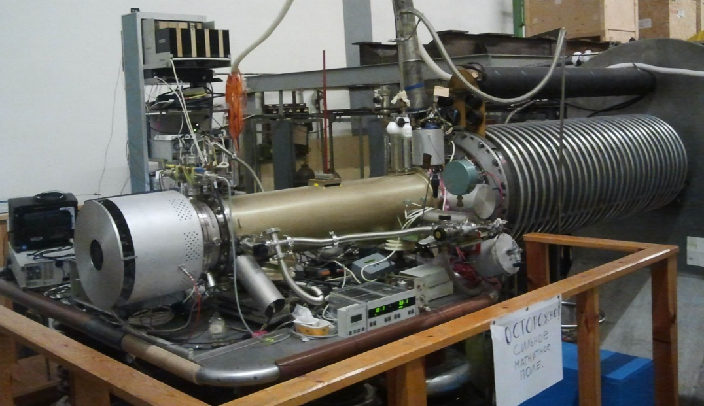
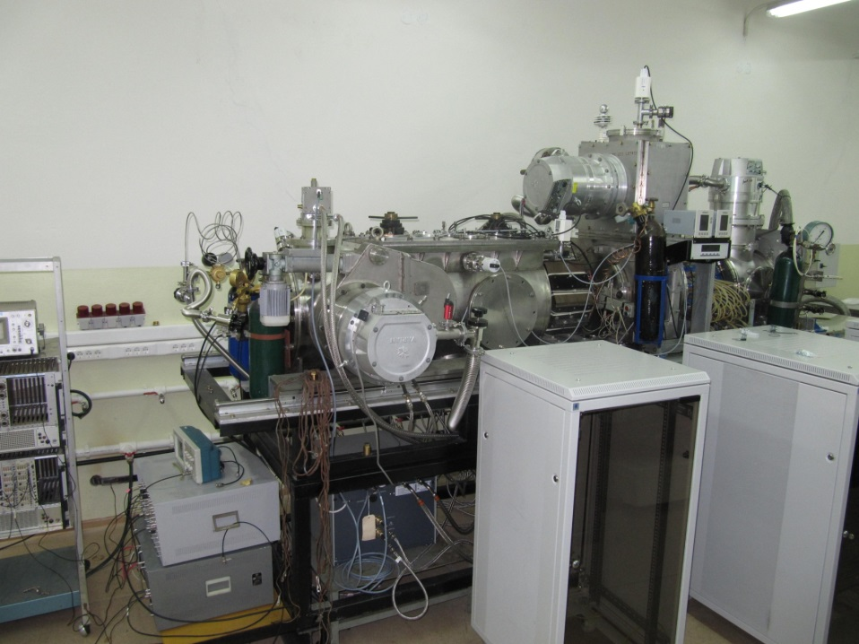
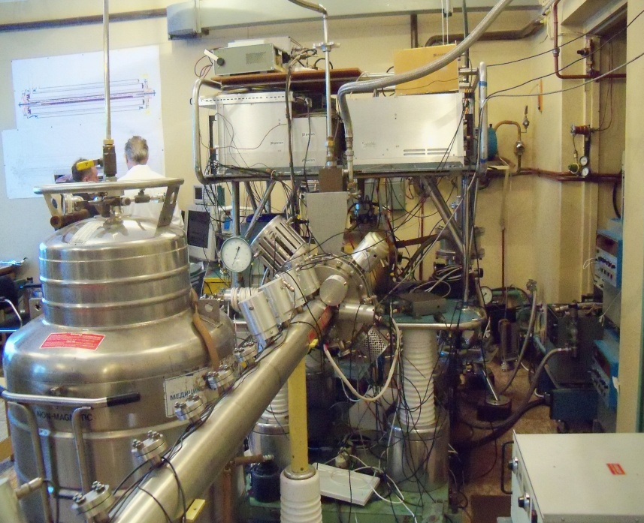
Injection complex: 4 ion sources
Source | KRION-6T | Laser | Douplasmatron | SPI new !
particles | Au³¹⁺ | up to Mg¹⁰⁺ | p, d, He²⁺ | p, d
particle/cycle | ~2.5 10⁹ | ~10¹¹ | p, d ~5 10¹² He²⁺ ~10¹¹ | 5 10¹¹
repetition, Hz | 10 | 0,5 | 1 | 0,2
to be commissioned
commissioning: June ‘16
SPI
KRION
Notes:
The injection complex comprises 4 ion sources. The source of polarized particles was commissioned in June 2016. It provides polarized protons and deuterons. The source for gold ions KRION is close to the final commissioning.

Slide 15
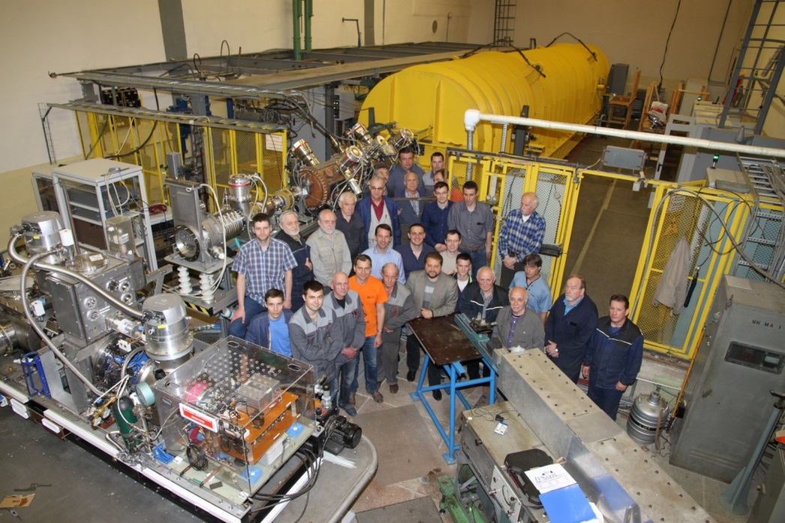
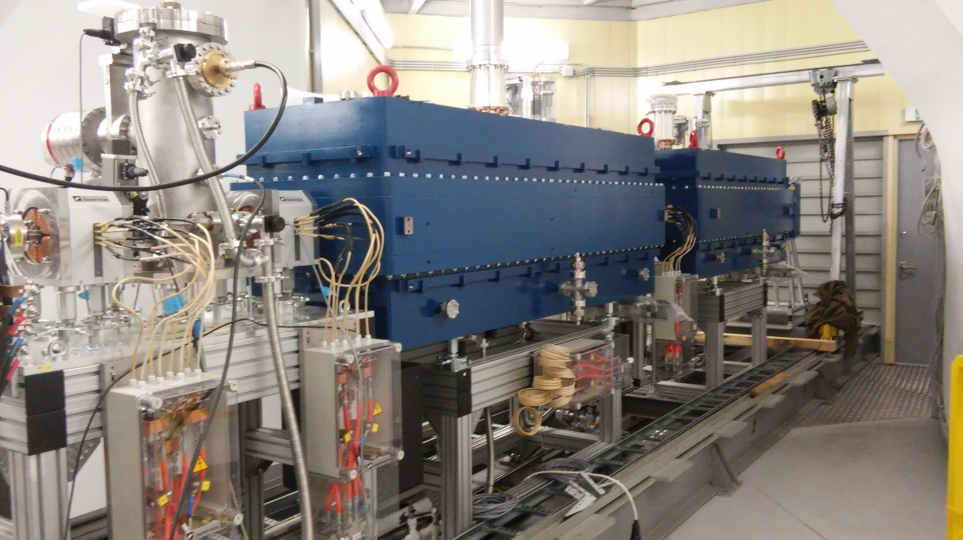
Injection complex: 2 Linacs
Linac | LU-20 | HILAC new !
structure (section number) | RFQ + Alvarez type | RFQ + IH DTL(2)
mass to charge ratio A/Z | 1-3 | 1-6
injection energy, keV/amu | 150 for A/Z 1-3 | 17
extraction energy, MeV/amu | 5 (A/Z 1-3) | 3.24 (A/Z=6)
input current, mA | up to 20 | up to 10
LU-20 – new fore-injector: JINR, INR, ITEP, MEPHI
HILAC: “BEVATECH OHG”
the first Linac with
transistor RF amplifier
commissioning: May ‘16
commissioning: Oct. ‘16
Notes:
We have two linacs. The old one, LU-20, is for polarized particles and light ions. Last year it was upgraded with a new fore-injector. The ions from LU-20 are injected directly to the NUCLOTRON.
The new linac, HILAc, dedicated for heavy ions, was fully commissioned in October 2016. The heavy ions will be injected to the booster.

Slide 16
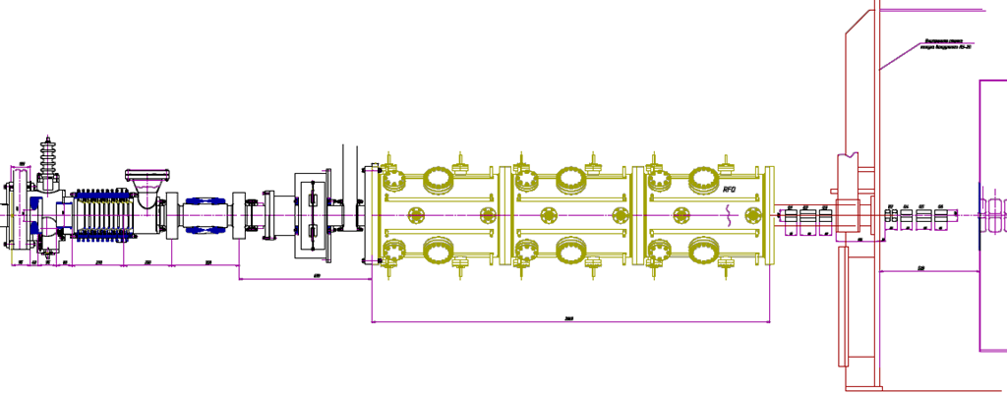
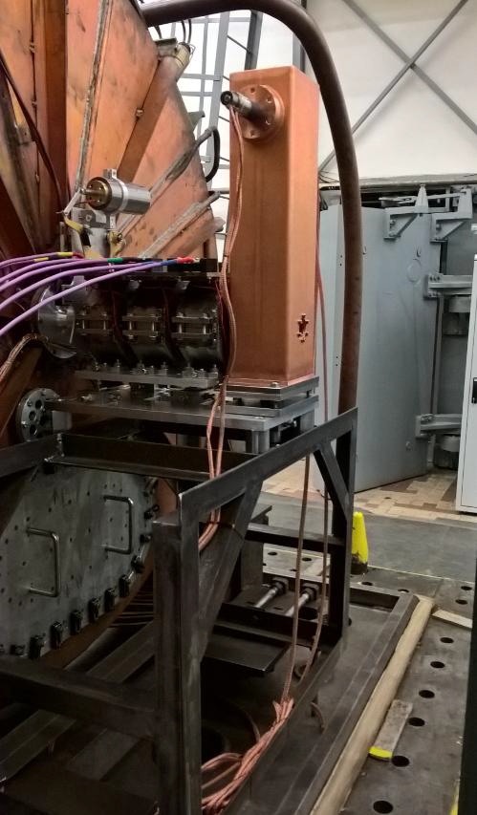
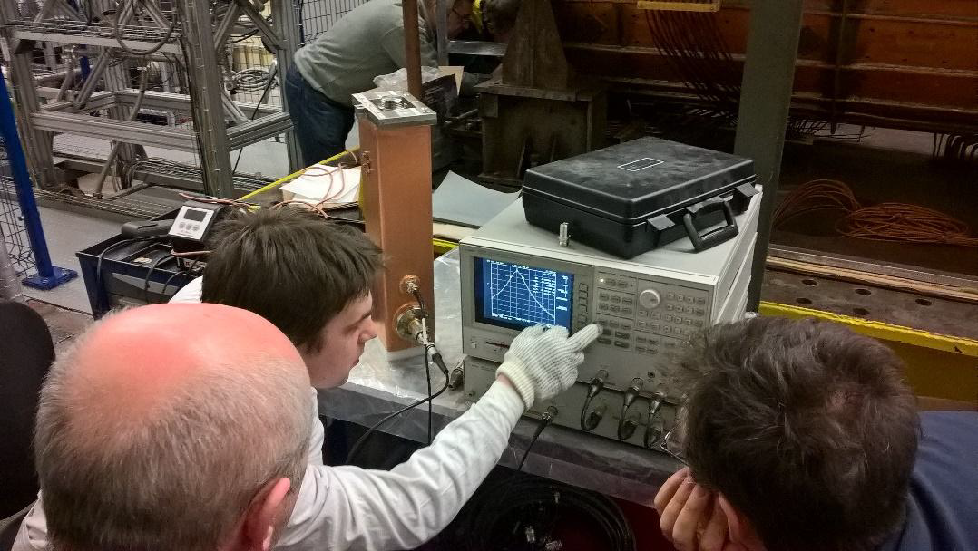
LU-20 – new fore-injector
LEBT + Buncher
4 wane RFQ
(3 sections)
MEBT LU-20
QT + Bu +QT
The MEBT includes two triplets of quadrupole lenses
and Buncher
First stage – without the Buncher
(theory transmission ~ 20%, achieved up to 10%)
The buncher is prepared to the run 55:
expected gain in
transmission
is ~ 3 times

Slide 17
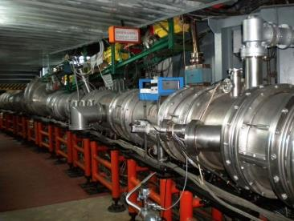
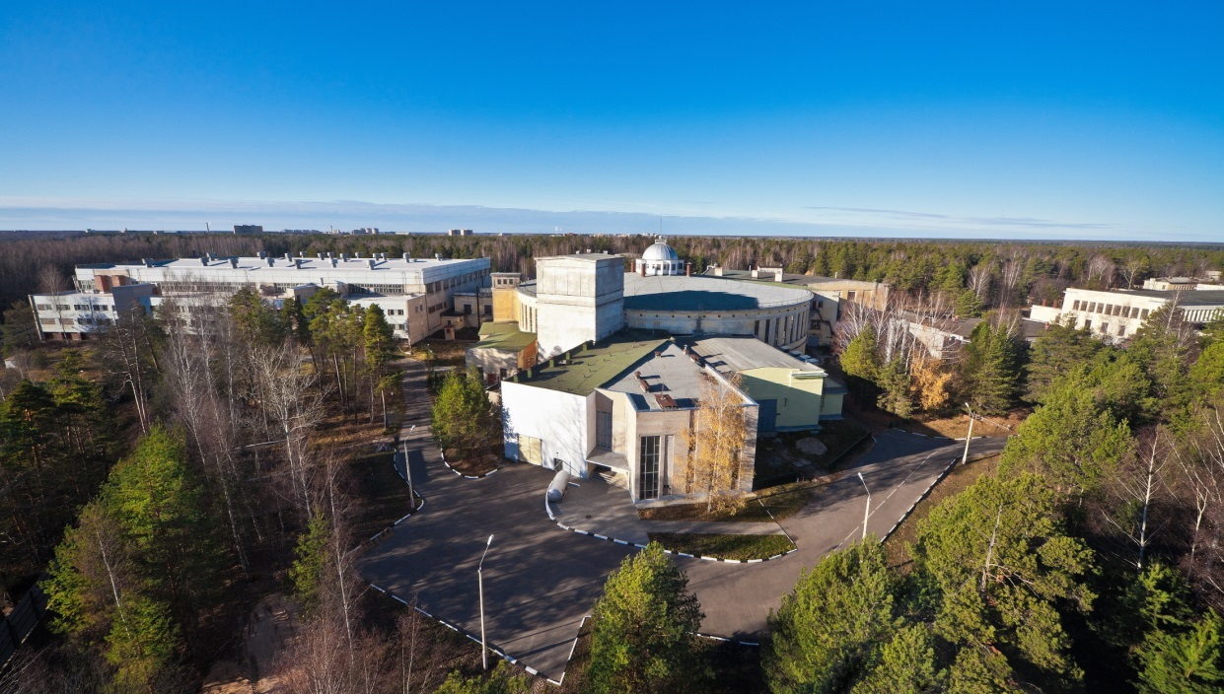
Machines: Nuclotron (in operation since 1993)
Parameters | Nuclotron
type | SC synchrotron
particles | p, d, nuclei
injection energy, MeV/u | 5 ( p, d) 570-685 (Au)
max. kin. energy, GeV/u | 12.07 ( p); 5.62 ( d) 4.38 (Au)
magnetic rigidity, T m | 25 – 43.25
circumference, m | 251.52
cycle for collider mode, s | 1.5-4.2 (active); 5.0 (total)
vacuum, Torr | 10⁻⁹
intensity, Au ions/pulse | 1 10⁹
transition energy, GeV/u | 7.0
RF range, MHz | 0.6 -6.9 ( p, d) 0.947 – 1.147 (nuclei)
spill of slow extraction, s | up to 10
modernized in 2010-2015
Notes:
The Nuclotron, synchrotron based on the SC magnets developed at JINR, was put in operation in 1993. In was essentially modernized in 2010-2015. It will provide acceleration of gold ions up to kinetic energy 4,4 GeV/u, and protons up to 12 GeV.

Slide 18
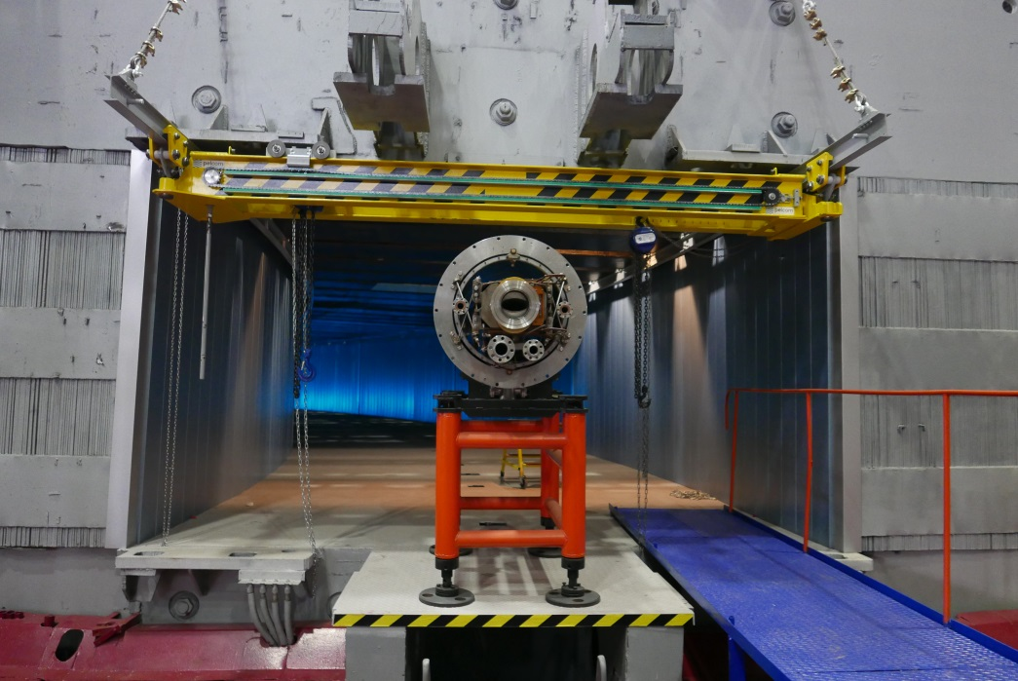
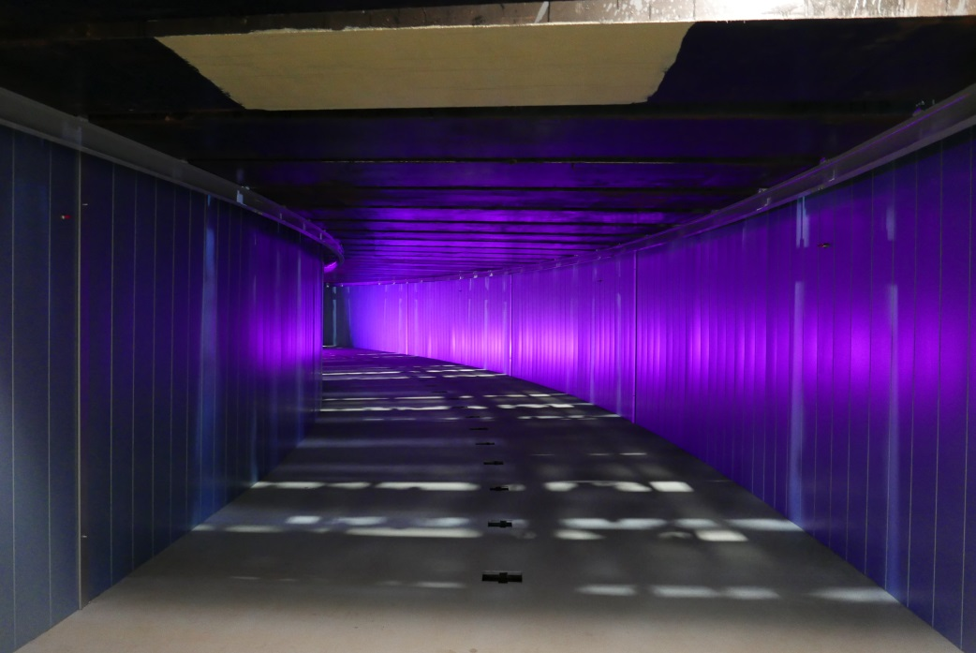
Machines: Booster (under construction)
Parameter | Booster
type | SC synchrotron
particles | ions A/Z < 3
injection energy, MeV/u | 3.2
maximum energy, GeV/u | 0.6
magnetic rigidity, T m | 1.6 – 25.0
circumference, m | 210.96
cycle for collider mode, s | 4.02 (active); 5.0 (total)
vacuum, Torr | 10⁻¹¹
intensity, Au ions/pulse | 1.5 10⁹
transition energy, GeV/u | 3.25
RF range, MHz | 0.5 -2.53
spill of slow extraction, s | up to 10
tunnel for Booster
Commissioning starts in 2018
Notes:
The Booster will be allocated inside the Yoke of the famous Synchrophasotron, which was emptied few years ago. Now the tunnel is close to completion.

Slide 19
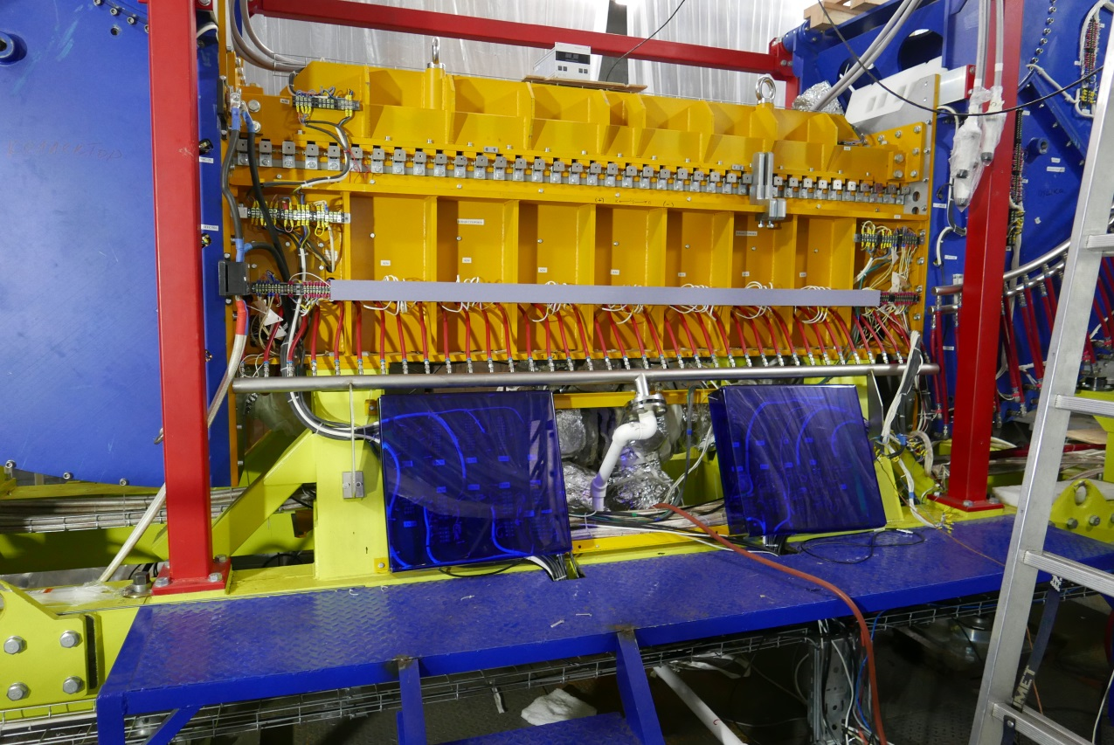
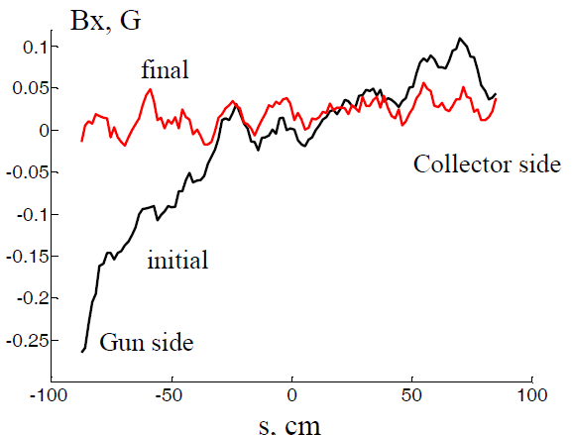
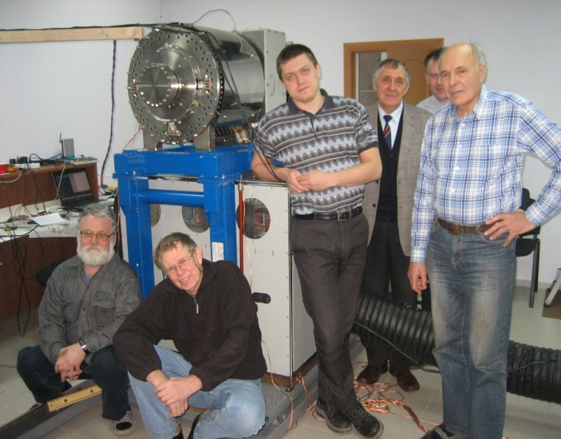
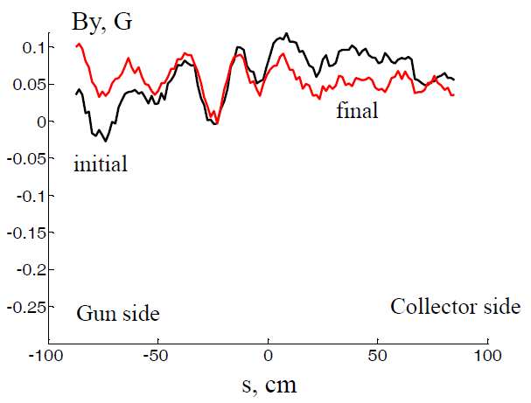
Booster: electron cooling system; RF (BINP)
ECS in Dubna
magnetic field quality at B= 1 kG
tuning, May ’17, Dubna
rms(Bx) = 1,6 10⁻⁵
project status:
on schedule
rms(By) = 2,0 10⁻⁵
2 RF stations
tested at JINR
ready for commissioning
May 2017

Slide 20
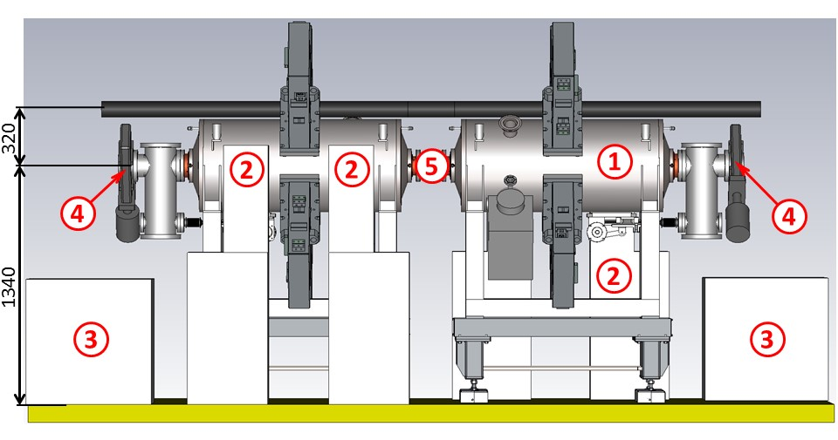
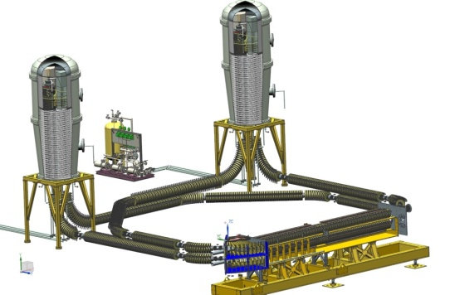
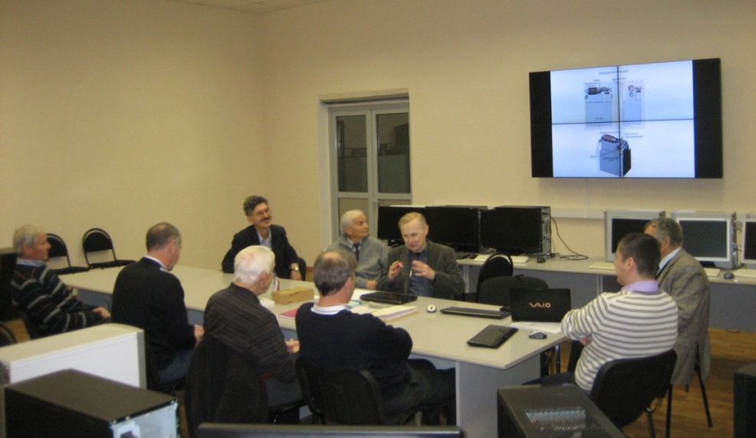
BINP contribution to the NICA Collider
RF: Leader A.Tribendis
(stage of working design)
Electron Cooler
Leader ac. V. Parkhomchuk
(stage of working design)
BINP – JINR meeting at JINR
Electron energy, max., MeV | 2.5
Electron beam current, А | 0.1 – 1.0
Notes:
Several projects are developed at the Budker Institute: the RF systems and the Electron Cooler for the collider.

Slide 21
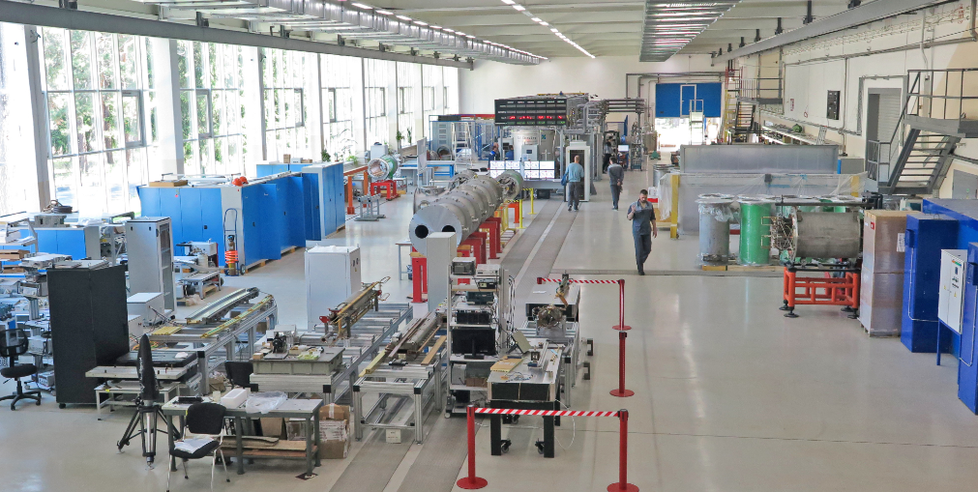
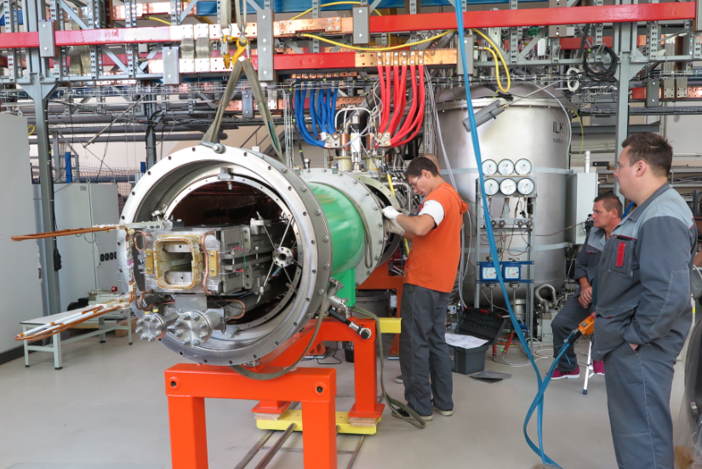
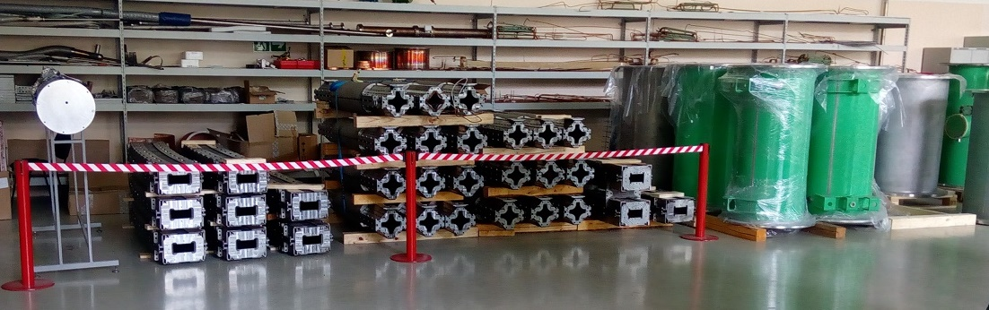
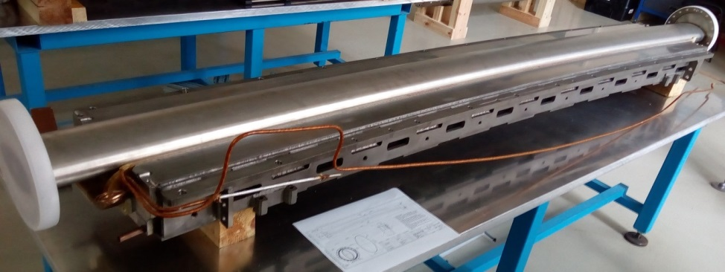
SC Magnets for NICA & SIS-100/FAIR workshop at VBLHEP
(bld. 217) was put in operation (full configuration) in Nov. 2016
Serial tests of Booster magnets have started
status of booster magnet fabrication 15.09.2017
magnet type | required | produced |  | tested
 |  | yokes | coils
dipoles | 40 | 40 | 41 | 26
quadrupole doublets | 24 | 24 | 20 | 3
correcting | 32 | 32 | - | -
fabrication of magnet systems is in progress
Notes:
The technological line for magnet assembly and test has been put in operation. In total almost 450 magnets will be fabricated for NICA and FAIR /SIS100 accelerators. The booster magnet fabrication is going well.
80% of yokes are already produced and delivered.

Slide 22


MultiPurpose Detector (MPD)
Main target:
- study of hot and dense baryonic matter at the energy range of max net baryonic density
expression
of interest by:
ITS
CERN;
DF, US, Mexico;
ICN UNA; Mexico;
DF, CIEA del I.P.N, Mexico;
FCF-M UAS, Sinaloa, Mexico;
FCF-MB UAP, Puebla, Mexico;
PI Az.AS, Baku, Azerbaijan;
ITEP, NC KI, Moscow, Russia;
PNPI NC KI, Saint Petersburg, Russia;
CPPT USTC, Hefei, China;
SS, HU, Huzhou, Republic of South Africa.
TPC
MPD Collaboration:
JINR, Dubna;
Tsinghua University, Beijing, China;
MEPhI, Moscow, Russia.
INR, RAS, Russia;
PPC BSU, Minsk, Belarus;
WUT, Warsaw, Poland;
Notes:
The MPD will be the fist detector operated at the Collider. Main target is …..
The collaboration is permanently growing.

Slide 23
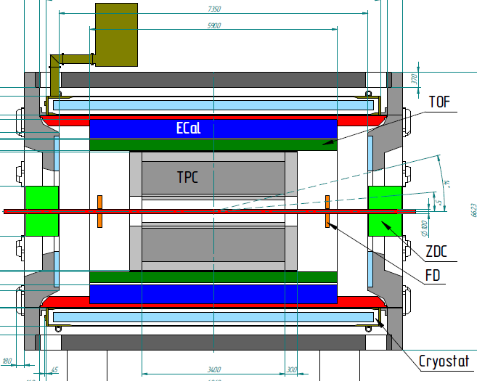
Multi Purpose Detector @
Tracking: up to |η|<1.8 (TPC)
PID: hadrons, e, γ (TOF, TPC, ECAL)
Event characterization:
centrality & event plane (FHCal)
Stage 1 (2020): TPC, FHCal, FFD,
Barrel (TOF, Ecal)
Stage 2 (2023): ITS (JINR+ CERN),
EndCaps (tracker, TOF, Ecal)
ITS
FHCal
FFD
Status od stage 1:
technical design report – completed / close to completion;
preparation for the mass production
Notes:
The MPD will be put in operation at two stages. At the first one the barrel part will be equipped with major tracking detector TPC, TOF end ECAL. FHC and FD will be operational as well. TDRs for most of the part are completed. The status is readiness for mass production.
At the second stage the detector will be supplemented with IT and end cap subdetectors.

Slide 24
NICA – Luminosity
Two operation regimes
Electron and stochastic cooling application!
10
L(E_{i})
1e27 cm⁻²⋅s⁻¹
1.0
0.1
0.01
10
Ion/bunch,
1E9
1.0
0.1
0.01
Emittance reduction with energy:
N_{opt}
N_{max}
Equilibrium beam emittance vs E_{ion} , π⋅mm⋅mrad
L_{opt} L_{max}
1.2
ε(E_{i})
0.8
0.4
0
1 2 3 4
Ion energy, GeV/u
ε_{opt}
ε_{max}
Space charge IBS
dominated dominated
regimes
1 2 3 4
Ion energy, GeV/u

Slide 25
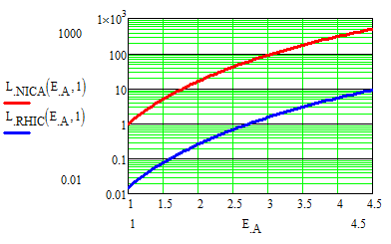
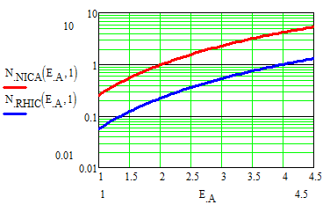
NICA –Lumnosity 2
Intriguing question: Why RHIC has low luminosity
at the energy where luminosity of NICA is relatively high?
The reason is the beam space charge (single bunch problem!):
N_{bunch} ∝ 1/C_{ring ,} L ∝ (N_{bunch})² ∝ 1/(C_{ring})² !
C_{RHIC}/C_{NICA} = 7.62 , L_{NICA} / L_{RHIC} = (C_{RHIC}/C_{NICA})² ≥ 58.1
Parameter | RHIC | NICA
C_{Ring}, m | 3834 | 503
Bunch length, m | 1.0 | 0.6
Beam emittance, π⋅mm⋅mrad | 1.0 | 1.0
Number of intersections | 6 | 2
β*, m | 1.0 | 0.35
Hour-glass factor | 0.8 | 0.6
!!
1000
100
10
1
0.1
0.01
Luminosity vs ion energy
10
1
0.1
0.01
L_{NICA}(E_{ion})
L_{RHIC}(E_{ion})
1e25 cm⁻²⋅s⁻¹
N_{NICA}(E_{ion})
N_{RHIC}(E_{ion})
Ion number per bunch vs ion energy, 1e9
2 3 4 4.5
E_{ion} , GeV/u
2 3 4 4.5
E_{ion} , GeV/u

Slide 26
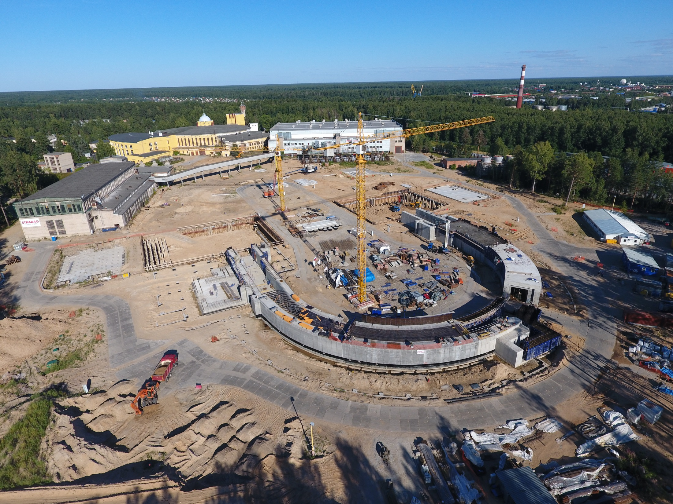
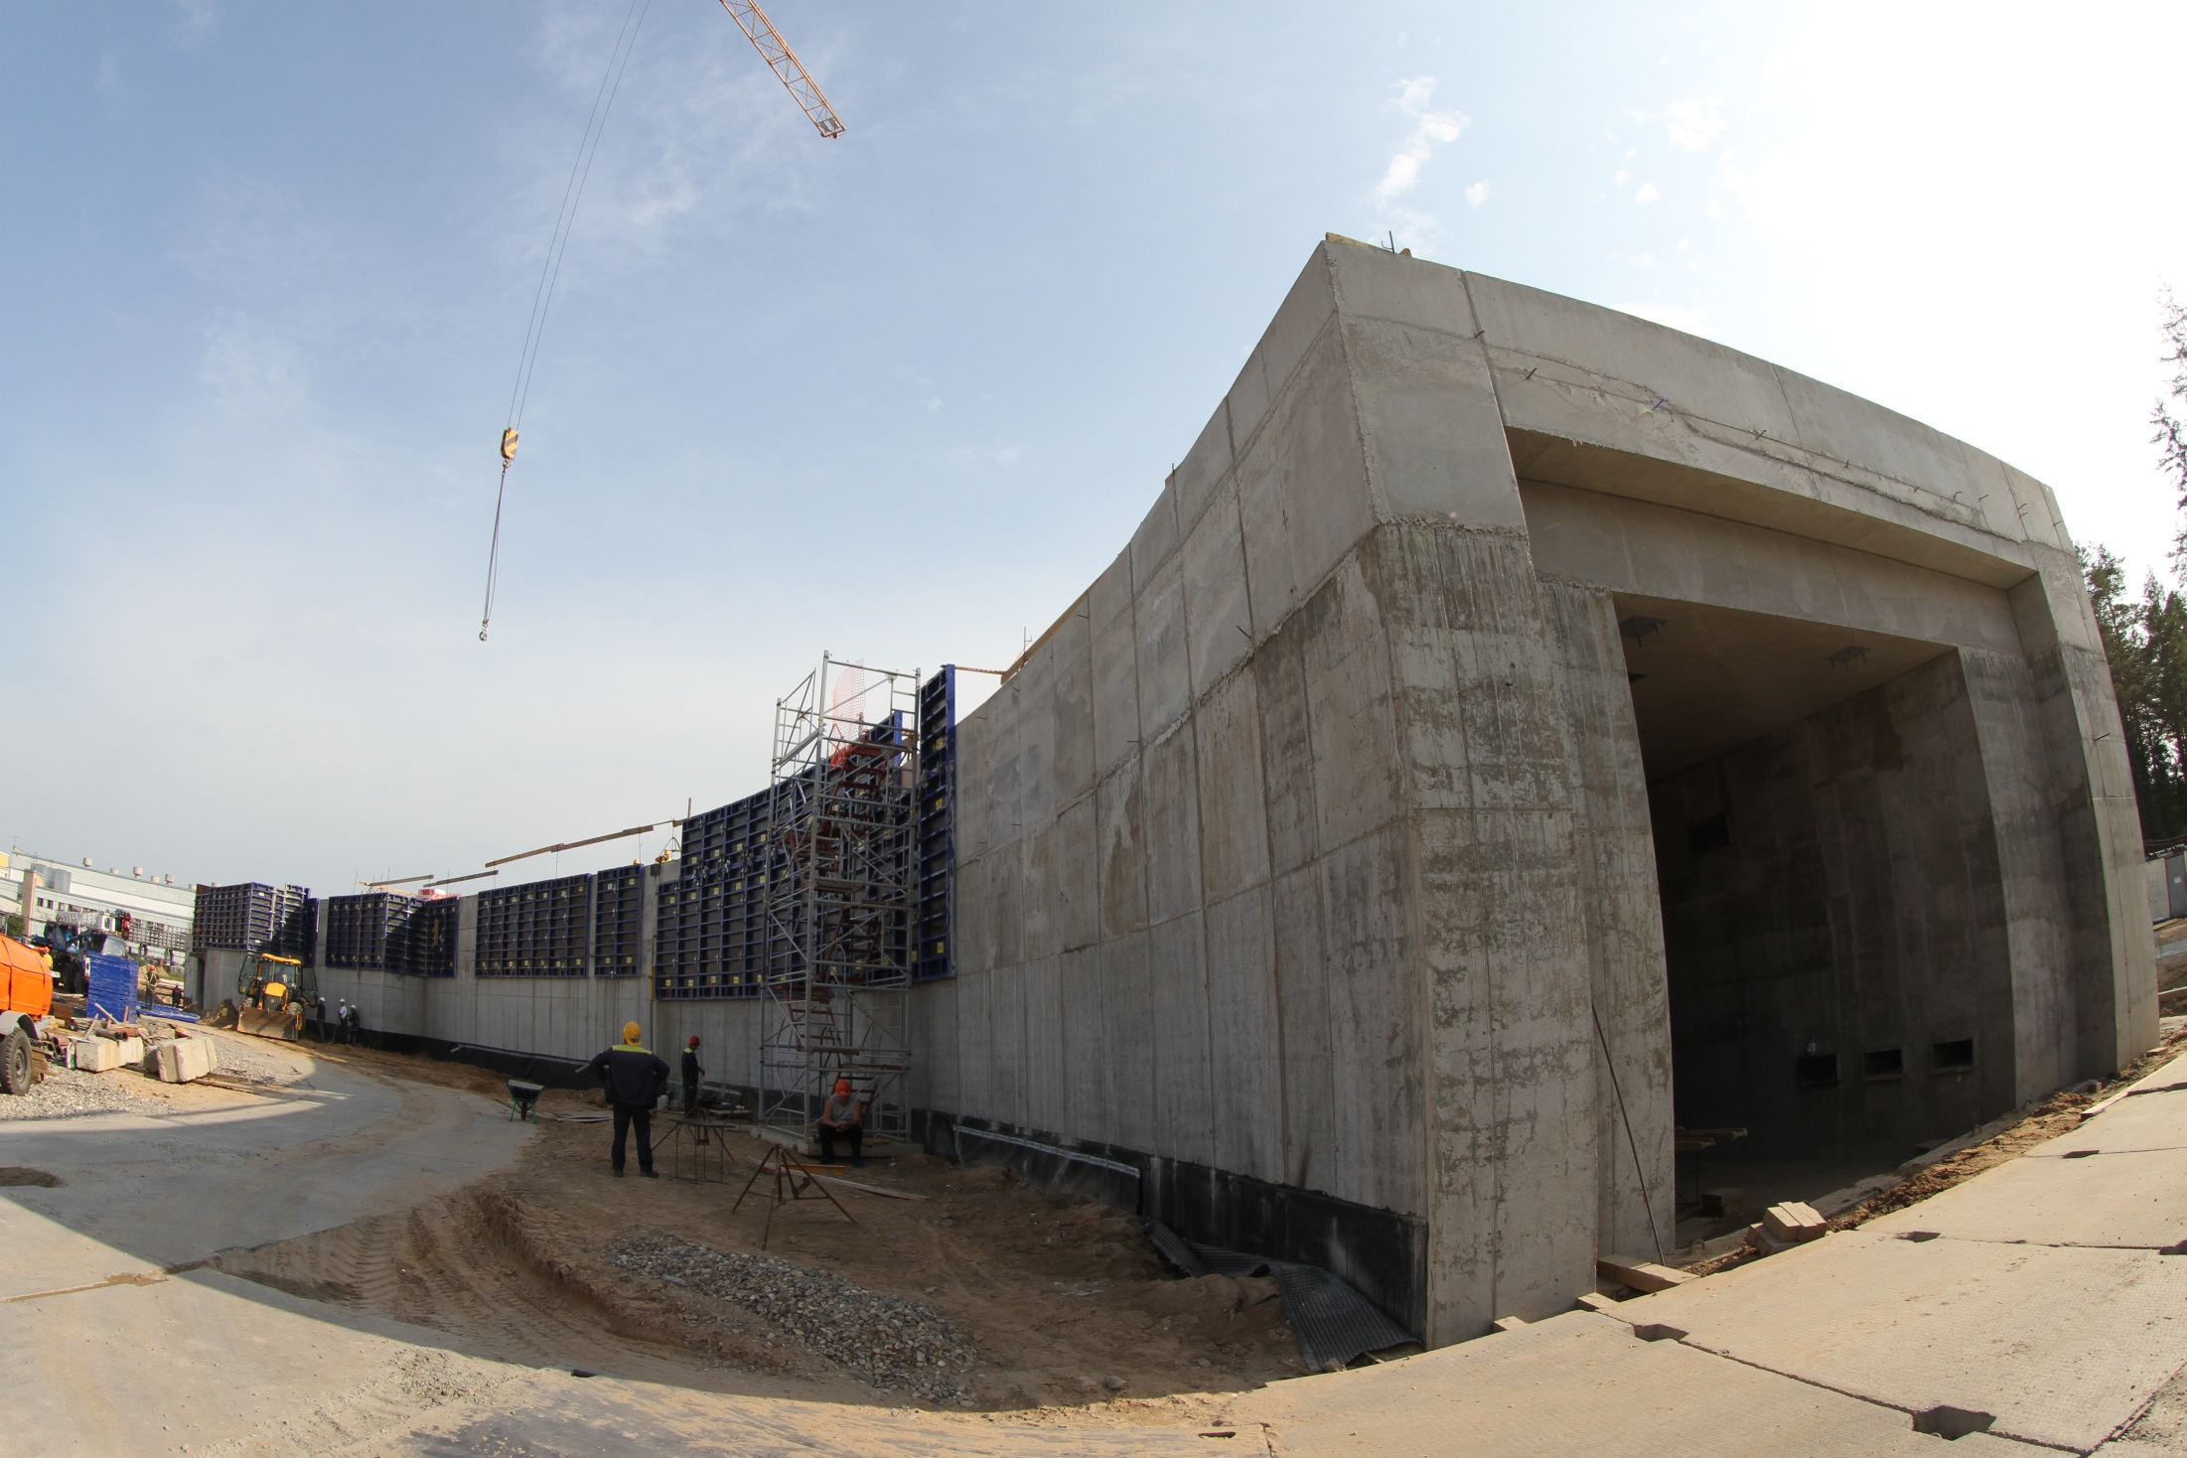
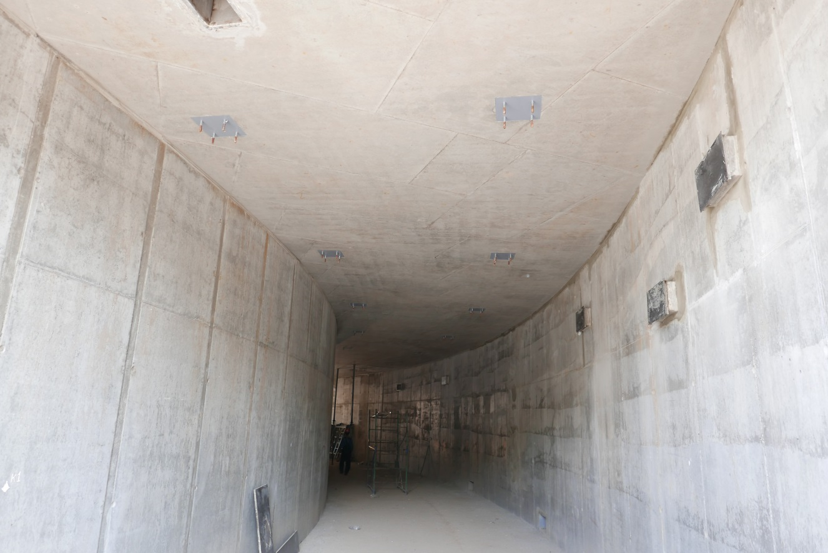
Civil Construction bld.17
> 4200 piles are already pressed in
concrete works are in progress
metal construction – subcontractor
has chosen
west tunnel
Notes:
The civil construction of the collider complex is going on in accordance with the plans. the MPD hall will be ready by the summer of 2018, and the entire complex will be completed in 2019.

Slide 27
NICA schedule
 | 2015 |  |  |  | 2016 |  |  |  | 2017 |  |  |  | 2018 |  |  |  | 2019 |  |  |  | 2020 |  |  |  | 2021 |  |  |  | 2022 |  |  |  | 2023
Injection complex
Lu-20 upgrade
HI Source
HI Linac
Nuclotron
general development
extracted channels
Booster
Collider
startup configuration
design configuration
BM@N
I stage
II stage
MPD
solenoid
TPC, TOF, Ecal (barrel)
Upgrade: end-caps +ITS
Civil constructions
MPD Hall
SPD Hall
collider tunnel
HEBT Nuclotron-collider
Center NICA
Cryogenic
for Booster
for Collider
running time
Notes:
The NICA schedule foresees:
- Start of the physics program with BM@N experiment already in this year and first colliding beams in the MPD - in 2021

Slide 28
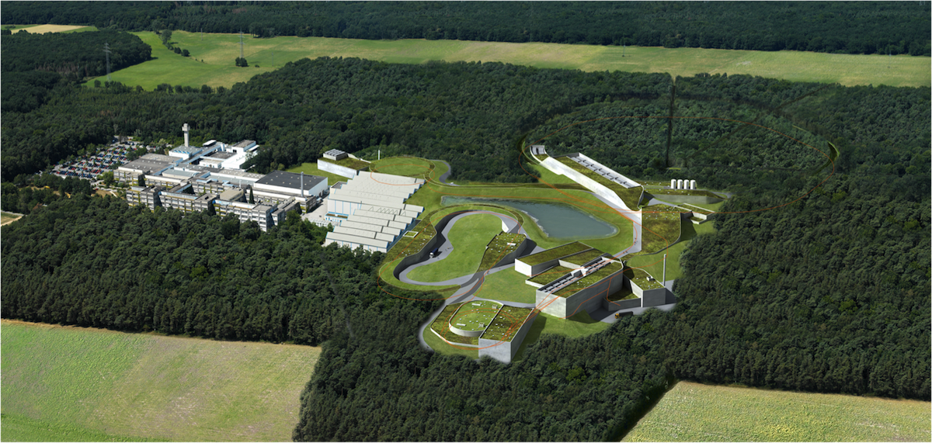












The International FAIR Project in Darmstadt
Finland
France
Germany
India
Poland
Romania
Russia
Slovenia
Sweden
UK

Slide 29

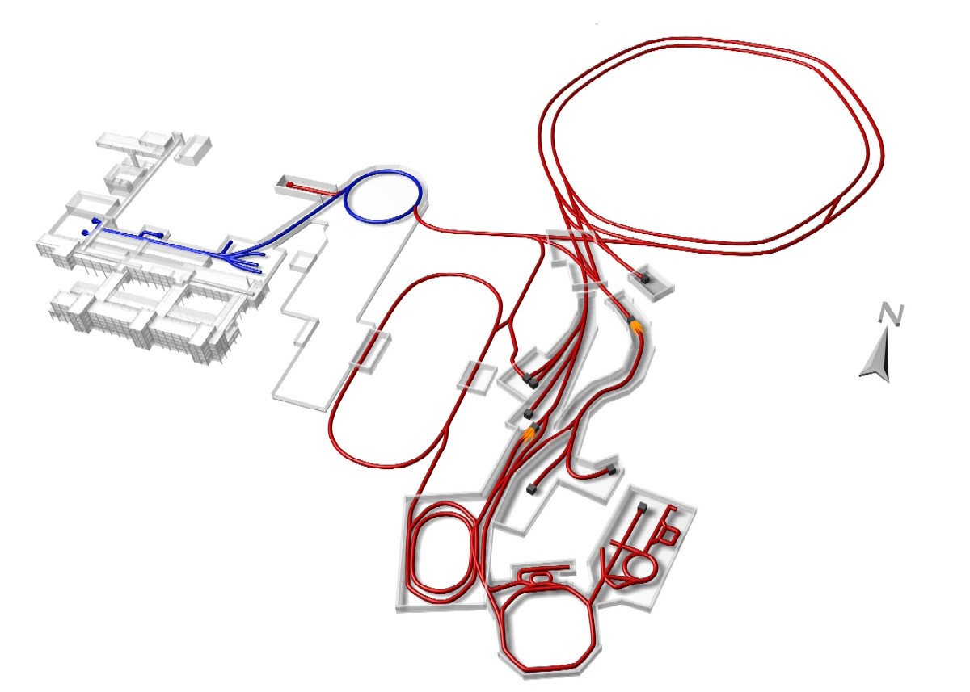
Facility for Antiproton and Ions Research –
the light tower of the ESFRI Roadmap
New accelerator systems entered the construction phase in Darmstadt
Synchrotrons
SIS100 SIS300
p - LINAC
300m
Rare Isotope
Production Target
Antiproton
Production Target
High-Energy Storage Ring
HESR
Superconducting
large-acceptance Fragment Separator
Super-FRS
Collector Ring
CR
Recycled Exp. Storage Ring RESR
New Experimental Storage Ring
NESR

Slide 30
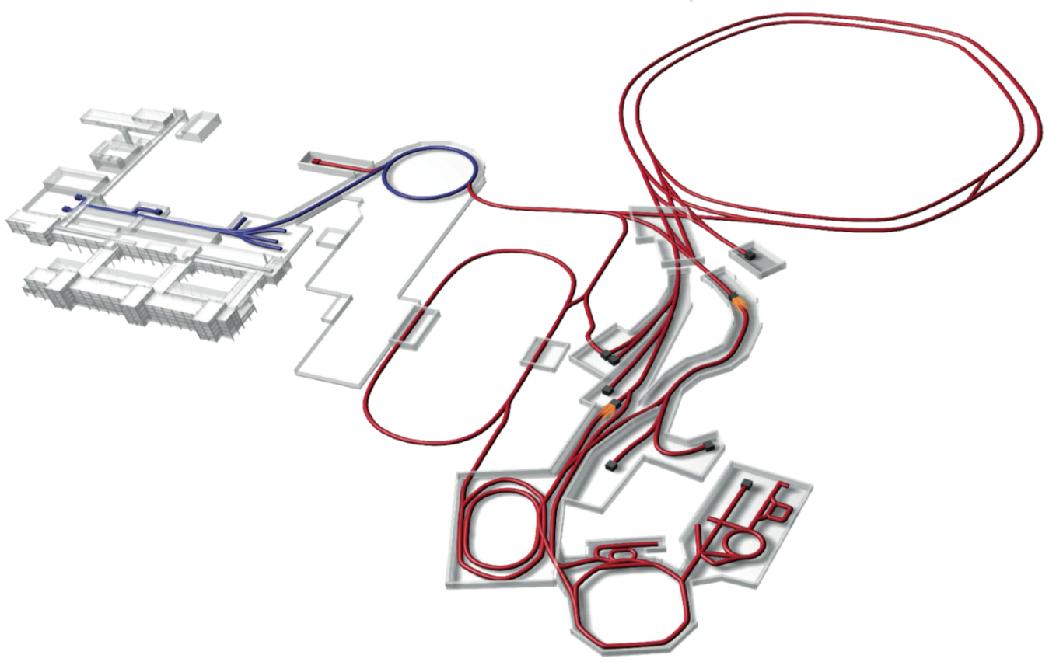


Facility for Antiproton and Ion Research
Primary Beams
5x10¹¹/s; 1.5 GeV/u; ²³⁸U²⁸⁺
10¹⁰/s ²³⁸U⁷³⁺ up to 35 GeV/u
3x10¹³/s 30 GeV protons
p-Linac
SIS18
SIS100/300
UNILAC
Secondary Beams
range of radioactive beams up to
1.5 - 2 GeV/u; up to factor 10 000 higher in intensity than presently
antiprotons 3 - 30 GeV
HESR
Rare-Isotope
Production Target
Anti-Proton
Production Target
Storage and Cooler Rings
radioactive beams
10¹¹ antiprotons 1.5 - 15 GeV/c,
stored and cooled
CR &
RESR
Cryring
NESR
100 m
Technical Challenges
cooled beams, rapid cycling superconducting magnets
Notes:
FAIR accelerator will generate beams of heavy ions, protons and antiprotons of unprecedented intensity, brightness and luminousity.

Slide 31
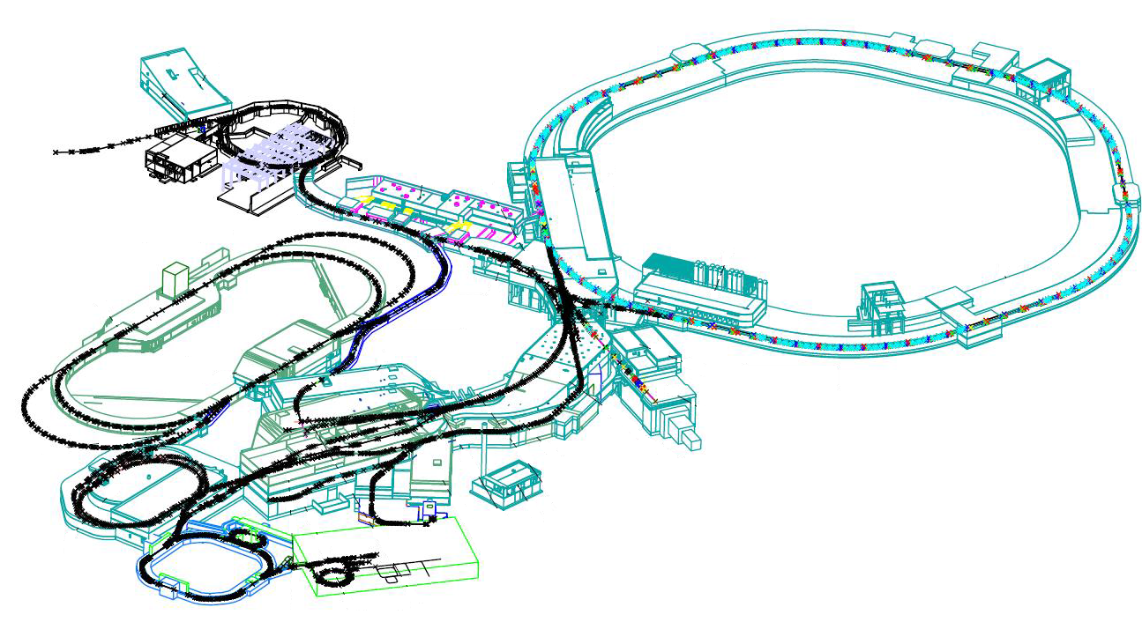
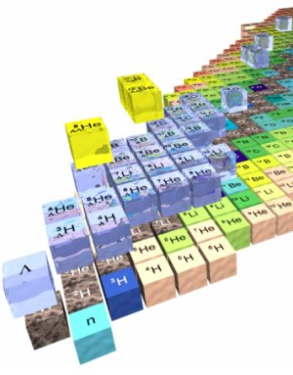
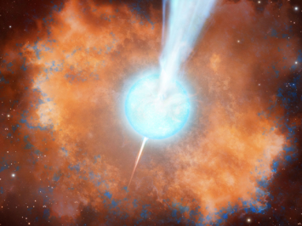
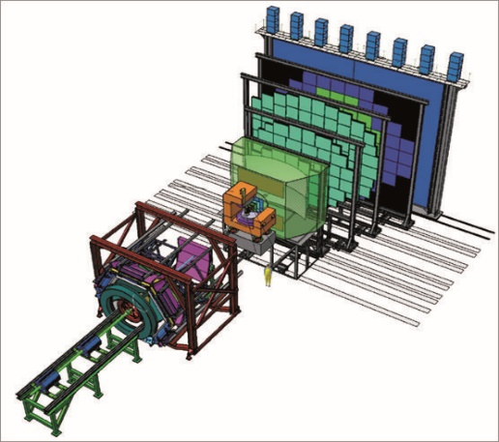
Heavy ion accelerator chain
SIS18
SIS 100
NuSTAR
Collector Ring
CBM
Super-FRS
Plasma Physics
cave
CBM
31

Slide 32
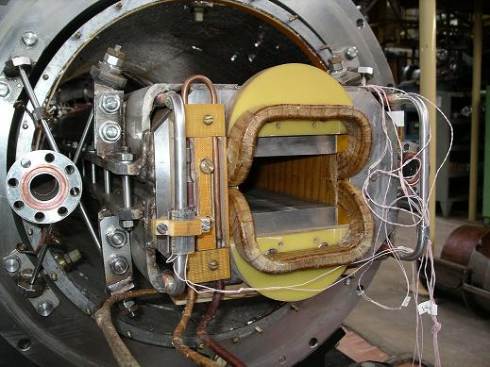
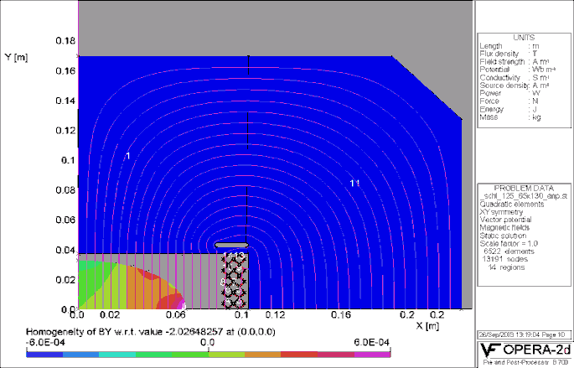
SIS100 Fast Ramped S.C. Magnets (JINR design)
R&D Goals
Reduction of eddy / persistent current effects at 4K
(3D field, AC loss)
Improvement of DC/AC-field quality
        Guarantee of long term mechanical stability
        (≥ 2⋅10⁸ cycles )
  Activities
  AC Loss Reduction (exp. tests, FEM)
  2D/3D Magnetic Field Calculations (OPERA, ANSYS, etc.)
  Mechanical Analysis and Coil Restraint (design, ANSYS)
  (>Fatigue of the conductor and precise positioning)
Experimental studies with modified Nuclotron magnets in JINR

Slide 33
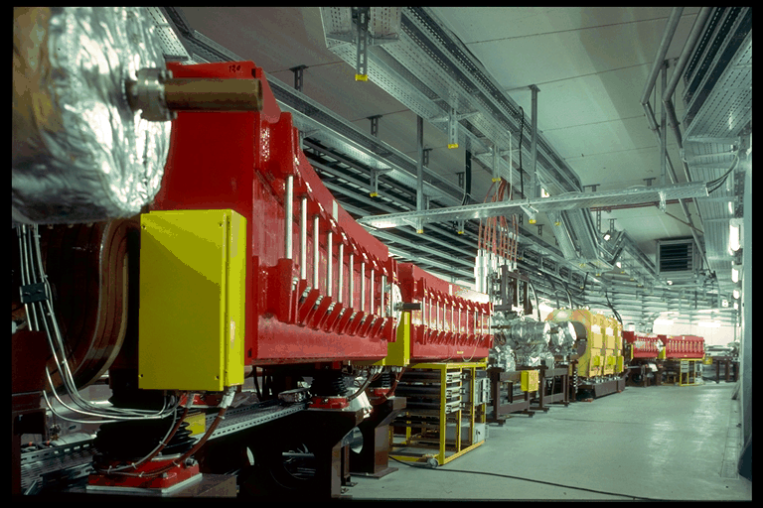
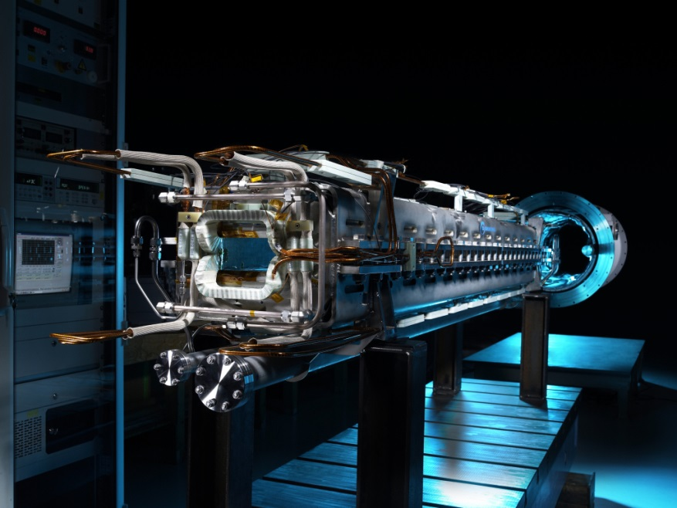
Rapid/fast ramping dipole magnets
Examples
Ramping rates (Bdot):
SIS-18 dipoles: 10 T/s
J-PARC RCS dipoles: 40 T/s
Large apertures
SIS-18 dipoles: 20 cm x 8 cm
J-PARC RCS: 25 cm x 19 cm
Fast ramping (3 Hz) SIS-18 dipoles
Max. B-Field
SIS-18: 1.8 T
J-PARC RCS: 1.1 T
SIS-100 superferric dipole:
13 cm x 6 cm
Bdot = 4 T/s
B_{max}= 1.9 T
pipe at 20 K
(as cryo-
pump)
Fast ramping ‘cold’ magnet
of the nuclotron-type
J-PARC RCS (25 Hz) dipole
cryostat
magnet
33

Slide 34
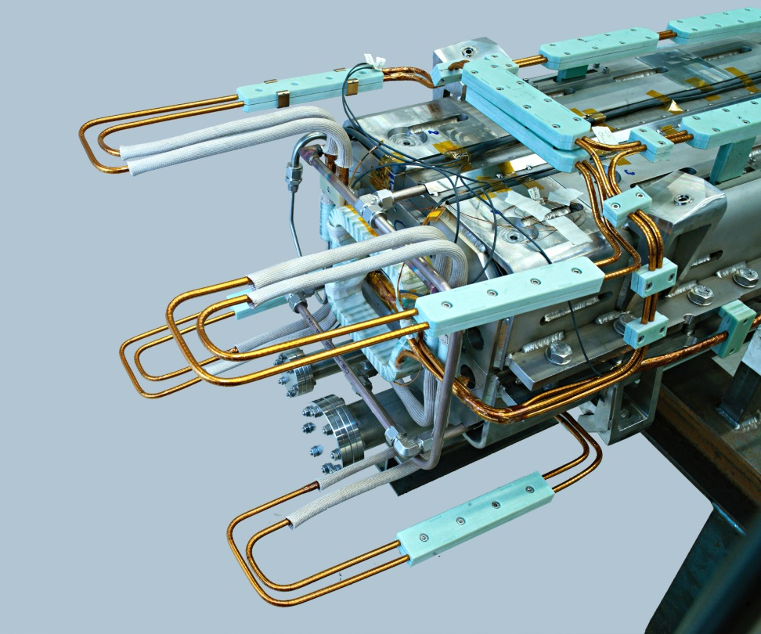
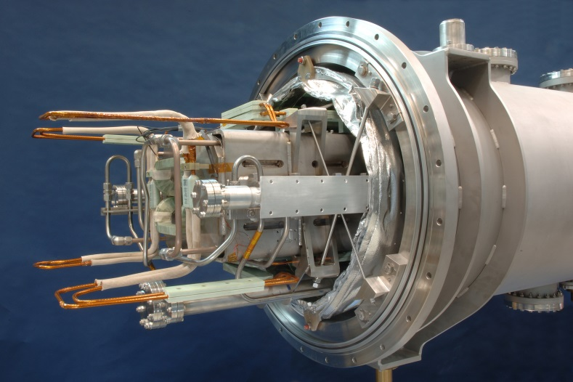
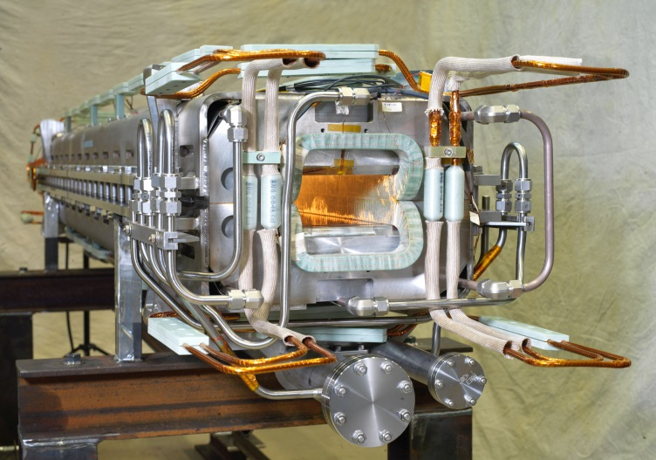
Full Length SIS100 Dipole
Manufactured by BNG (Würzburg)
Dipole and quadrupole under manufacturing at JINR and BNG

Slide 35




The workshop started magnet production in JINR
cable machine has been put in operation
the I-st arm has been put in operation
workshop is ready for coil production
28 Aug. 2014
450 SC magnets for NICA & SIS-100 Fair
Notes:
more than 450 SC magnets must be assembled & tested
in the workshop for NICA & SIS-100 Fair

Slide 36

Acc. Performance for FAIR Experiments
Beam Intensities:
  intensities of primary beams: x 100 – x 1000
  intensities of secondary beams: x 10.000
Beam Energies:
  energies: x 30
Unprecedented Variety of Ions:
  antiprotons
  protons to Uranium, radioactive beams
Beam Quality:
  cooled antiprotons
  intense cooled RIBs
Pulse Structure:
  extremely short pulses (70 ns) to slow extraction (quasi CW)
Parallel Operation:
  (Finally) operation of up to four experiments simultaneously

Slide 37
The 4 Scientific Pillars of FAIR
APPA: Atomic, Plasma Physics and Applications
CBM: Compressed Baryonic Matter
NUSTAR: Nuclear Structure, Astrophysics and Reactions
PANDA: Antiproton Annihilations at Darmstadt
  MSV provides for outstanding and
  world-leading research programmes
  in all four scientific areas,
  Biomedicine and Materials Science
  for in total 2500 - 3000 users
  Scientific program is competitive and world class

Slide 38



FAIR + NICA : complimentary research program
NICA/MPD
Nuclotron-based Ion Collider fAcility
FAIR/CBM
E_{lab} ~ 34 GeV/n
sNN = 8.5 GeV
Particle intensity
(for U) up to 10¹¹ ppp
E_{lab} < 60 GeV/n
sNN = 4  11.0 GeV/n
Average luminosity
10²⁷sm⁻²s⁻¹ Au x Au
Boris Sharkov JINR Dubna
38

Slide 39
Status of the Factory of Superheavy Elements
(SHE-factory)

Slide 40



May 2012:
Official approval of the name Flerovium for element 114
and the name Livermorium for element 116
30th December 2015:
Approval of the discovery of new elements 113, 115, 117, and 118
International Union of Pure
and Applied Chemistry
element 113: RIKEN (Japan)
elements 115 and 117: JINR - LLNL – ORNL - VU collaboration
element 118: JINR – LLNL collaboration.
28th November 2016:
IUPAC formally approved names and symbols of new elements:
  Nihonium (Nh) for element 113,
  Moscovium (Mc) for element 115,
  Tennessine (Ts) for element 117, and
  Oganesson (Og) for element 118.
Notes:
One of the main achievements of the JINR last seven-year period was the synthesis of element 117 in 2009-2010, as well as a series of successful experiments on the synthesis and study of chemical and nuclear properties of superheavy elements with atomic numbers 113-118. It is resulted in recognition of the JINR priority in collaboration with the USA scientific centers in the discovery of the 5 heaviest elements of D.I. Mendeleev’s Periodic table.
In 2012, the IUPAC approved the names Flerovium of element 114 and Livermorium for element 116.
On November 28, 2016, the IUPAC formally approved the names of the chemical elements with atomic numbers 115, 117 and 118. The following names have been assigned:
Moscovium, symbol Mc, for element 115;
Tennessine, symbol Ts, symbol for element 117;
Oganesson, symbol Og, the symbol for element 118.
Thus, all the five chemical elements discovered in recent years completing the seventh periods of D.I. Mendeleev’s Periodic Table received their final names.

Slide 41


Slide 42

Region of super heavy nuclei

Slide 43



SHE Factory
SHE Factory Building
High-current cyclotron DC-280
New facilities:
New gas-filled separator
Preseparator
SHELS
Notes:
The project of the SHE factory includes three principal components: i) high current accelerator, ii) new experimental hall and iii) a number of the next generation facilities.

Slide 44
DC-280 cyclotron – stand-alone SHE factory
DC280 (expected) E=4÷8 MeV/A
Ion | Ion energy [MeV/A] | Output intensity
⁷Li | 4 | 1×10¹⁴
¹⁸O | 8 | 1×10¹⁴
⁴⁰Ar | 5 | 6×10¹³
⁴⁸Ca | 5 | 0,6-1,2×10¹⁴
⁵⁴Cr | 5 | 2×10¹³
⁵⁸Fe | 5 | 1×10¹³
¹²⁴Sn | 5 | 2×10¹²
¹³⁶Xe | 5 | 1×10¹⁴
²³⁸U | 7 | 5×10¹⁰
Synthesis and study of properties of superheavy elements.
Search for new reactions for SHE-synthesis.
Chemistry of new elements.

Slide 45
DC-280
Main Parameters
Ion source | DECRIS-4 - 14 GHz DECRIS-SC3 - 18 GHz
Injecting beam potential | Up to 100 kV
A/Z range | 4÷7
Energy | 4÷8 MeV/n
Magnetic field level | 0.6÷1.35 T
K factor | 280
Gap between plugs | 400 mm
Valley/hill gap | 500/208 mm/mm
Magnet weight | 1000 t
Magnet power | 300 kW
Dee voltage | 2x130 kV
RF power consumption | 2x30 kW
Flat-top dee voltage | 2x14 kV

Slide 46

Magnet of DC280 cyclotron – ready for testing
18.01.2017 http://lideo.ru/embed/4655

Slide 47
Expected beam parameters of the DC-280
ION | Z | Beam Intensity from ECR |  | HV platform N | Efficiency of acceleration | Expected beam intensities of (4÷8) MeV/n ions on targets pps
 |  | eμA | pps
20Ne | 3 | 150 | 3.10¹⁴ | 1 | 50% | 1.5·10¹⁴
40Ar | 7 | 300 | 3.10¹⁴ | 1 | 50% | 1.5·10¹⁴
48Са | 7/8 | 160 | 1.10¹⁴ | 1 | 50% | 6.2·10¹³
⁵⁰Ti | 8/9 | 75 | 5.10¹³ | 1 | 50% | 3.1.10¹³
⁵⁴Cr | 9 | 125 | 8.10¹³ | 1 | 50% | 4.10¹³
58Fe | 9/10 | 125 | 8.10¹³ | 1 | 50% | 4·10¹³
64Ni | 10/11 | 125 | 8.10¹³ | 1 | 50% | 4·10¹³
70Zn | 11/12 | 100 | 5.10¹³ | 1 | 50% | 2,5.10¹³
136Хе | 22/23 | 150 | 4.10¹³ | 1 | 50% | 2·10¹³

Slide 48

Assembled high voltage platform - June 2017
June – September – assemblage of the axial injection system
October 2017 – installation of DECRIS-PM at the cyclotron

Slide 49


New FLNR gas-filled separator (contracted)
Technical Design
Report No 412923
Reaction | Transmission
²⁴⁴Pu(⁴⁸Ca,3n)²⁸⁹114 | 60 %
²⁴⁴Pu(⁵⁸Fe,4n)²⁹⁸120 | 75 %

Slide 50

First experiments at SHE Factory
Synthesis of new elements 119 and 120

Slide 51


Superheavy Element Factory schedule
DC-280
SHE Factory Building: Completion - Dec 2017
DC-280 cyclotron: Assembling – Dec 2017; commissioning – Jan - June 2018
Gas-Filled Separator: Installation – Dec 2017; commissioning – Jan -June 2018 Getting of licenses for accelerator, experimental hall and laboratories - 2017–2018;
Onset of day-1 experiments – Sept 2018

Slide 52
Concept of DERICA (Dubna Electron – Radioactive Ion Collider fAcility) project
Experimental hall EH-1: Application science
50 m
LINAC–100 (E_{HI}: 100 AMeV)
Ion Sources
DERICA Fragment Separator DFS
Fast Ramping Ring Synchrotron FRR: E_{RIB} ≤ 300 AMeV
Gas jet target
p,d,^{3,4}He
Velocity filter
Electron cooler
e-RIB collider
- Gas cell - Ion trap
- Charge breeder
Collector Ring CR:
E_{RIB} ≤ 300 AMeV
Electron
Ring ER
Experimental hall EH-2: RIBs 15–70 AMeV
LINAC–30 (E_{RIB}: 30 AMeV)
Stage 0: LoI, CDR, R&D etc. 2018-2019
Stage 1: Buildings, LINAC–100, DFS, EH-1,2 2020-2024
Stage 2: Gas cell etc., LINAC–30, FRR, EH-3 2022-2027
Stage 3: CR, e-RIB collider, ring experiments 2025-2030
Neutron source
≥ 10⁸ n/cm²
e-LINAC (E_{e}: 500 MeV)
Experimental hall EH-3: reaccelerated RIBs
5 – 300 AMeV

Slide 53


Superconducting?
Superconducting magnets and RF structures are widely used in modern accelerators.
Superconducting CW machines like SNS in the USA or j-Parc in Japan reach high acceleration efficiency in their RF structures (>50% efficiency from wall plug to beam is possible in SC CW linacs including refirigerator.).
Pulsed superconducting RF delivers often no higher energy efficiency compared to NC due to the longer RF pulse required or high complexity and cost for low gain.
Losses, caused for example by ramped synchrotron magnets, must be cooled by liquid helium with a typical efficiency of 1 W cooling power for 250 W of refrigerator/ liquefier.

Slide 54




Superconducting technologies (Т=4.5 К, Т=77К)
R&D and construction of high-temperature superconducting current leads (HTSC @ 77К), conductors and elements. (20кА х 200 V = 4 МW).
Power saving factor of ~ 20-30
R&D, serial production of compact fast-cycling superconducting (5 Hz, 4-8 T/s) magnets (dipoles, quadrupoles, multipoles). Compactification with factor
of ~2-3 in geometrical sizes in comparison to “warm” magnets.

Slide 55
Summary
JINR-Dubna and FAIR/GSI have conducted successfully major pioneering R&D on HI accelerator key components, providing surpassing and unique performance not only for NICA and FAIR, but also for the next generation of heavy ion particle accelerators world wide.
Highest intensities of low charge state heavy unique modern accelerator technologies are developed in JINR, FAIR/GSI and BINP and used worldwide.
Construction of new generation of heavy ion accelerator facilities is progressing well and forefront accelerator technologies are under development in JINR .

Slide 56




Accelerator Challenges
Compact & cost effective accelerators
Fast cycling superconducting magnets
dB/dt ~ 4T/s
Fast acceleration
High gradient, variable frequency
Ferrite & MA loaded cavities
XHV @ high beam intensities
Extremely high vacuum ~10⁻¹² mbar
Precision beams
Electron & stochastic cooling
Acknowledgement: I.Meshkov , V.Kekelidze,
S.Dmitriev and Peter Spiller
Notes:
Accelerator components are being manufactured in high-tech industrial plants in partner countries. A big fraction of them are manufactured in Russia (JINR, Budker, Efremov etc….)

Slide 58
Summary - for experiments
Generation of intense “precision beams” : sophisticated beam manipulation methods-stochastic and electron cooling of ion beams, also applicable to the secondary radioactive and antiproton beams;
Rings as accelerator structures of choice: capability to store, cool, bunch, and stretch beams ;
Full range of ion beam species: p+ - 239U ;
Highest beam intensities & luminosities;
Superconducting magnets and RF structures are widely used in modern accelerators.
Superconducting CW linac machines reach high acceleration efficiency in their RF structures (>50% efficiency from wall plug to beam is possible in SC CW linacs).

Slide 59
Heavy Ion Accelerators & Colliders
in NICA Energy Range
Fixed target:
L - limited by
detectors
Colliders: scale of L,
in cm⁻²⋅s⁻¹
Future HI Machines
10²⁷
10²⁵
10²³
Expected region of phase transition at
max baryonic density
20??
SIS-300 (FAIR)
2019
SIS-100 (FAIR)
2019
NICA (JINR)
Booster NICA (JINR) 2017
Existing HI Machines
¹⁹⁷Au⁷⁹⁺×¹⁹⁷Au⁷⁹⁺
We are not alone!
Nuclotron-M (JINR)
BES @ RHIC
RHIC (BNL)
SPS (NA-49/61, CERN)
AGS (BNL)
SIS-18 (GSI)
√S_{NN}, GeV
2
4
6
8
20
40
60
80
for Au+Au
1
10
10²
Ускорительный комплекс NICA И.Мешков, Г.Трубников Сессия СЯФ ОФН РАН ОИЯИ 12.04.2016

Slide 60




Cryomagnetic Quadrupole Modules for SIS100 (JINR)
Manufacturing design of first of series module, completed by GSI design department
Design service contract for overall cryomagnetic quadrupole module system signed and progressing
In-kind & R&D contract for production and testing of quadrupole units with JINR signed
Production of FoS unis until end of 2017 in JINR
Design of FoS modul and components by GSI Design Office
SIS100
Design of QM module including end boxes (link to local cryogenics)

