Slide 1

Neutrino Physics at Kalinin Nuclear Power Plant
2002 – 2017
Alexander Starostin*
for the GEMMA and DANSS collaboration: ITEP(Moscow) + LNP JINR(Dubna)
*RNC KI ITEP

Slide 2
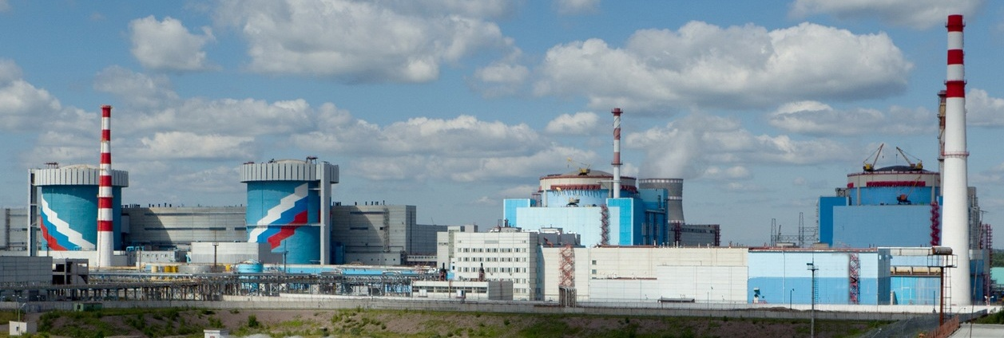
Neutrino researches at KNPP
GEMMA I
GEMMA II
DANSS
Kalininskaya nuclear power plant (KNPP) is located in Тver region, about 350 km from Moscow.
There are 4 energy units with thermal power of 3100 MWt each at KNPP.
ITEP and LNP JINR started experiments on neutrino physics at KNPP fifteen years ago.
The scope of our projects includes both fundamental and applied directions.
The experiments on the search for neutrino magnetic moment GEMMA I and GEMMA II (Germanium Experiment on the measurement of Magnetic Moment of Antineutrino) cover the period 2005 – 2017.
The project DANSS (Detector Anti Neutrino based on Solid Scintillator) aimed at measurements of reactor parameters and fundamental researches covers the period 2009 – 2017.

Slide 3
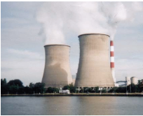
Reactor as a source of antineutrino
  The average figures for LWR:
  Fuel composition→ ²³⁵U , ²³⁹Pu , ²³⁸U , ²⁴¹Pu
  Average energy per fission E_{f} = 205.3 MeV.
  Number of the fiss. / sec N_{f} = W/ E_{f} = 9.14×10 ¹⁹ f/s
  n_{ν} per fiss. = 7.2 → 6.0 ( fiss. fragments) + 1.2 ( ²³⁸U n,γ ²³⁹U → ²³⁹Np → ²³⁹Pu)
  F_{ν} = n_{ν} W/E = 6.4 × 10 ²⁰ ν/3GWth/sec
  At R = 10 m f_{ν} ≈ 5.7 × 10 ¹³ ν/cm ² ⋅sec
Antineutrino spectrum

Slide 4
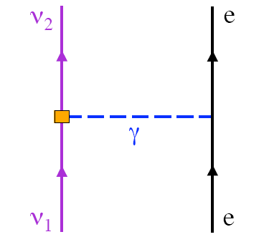
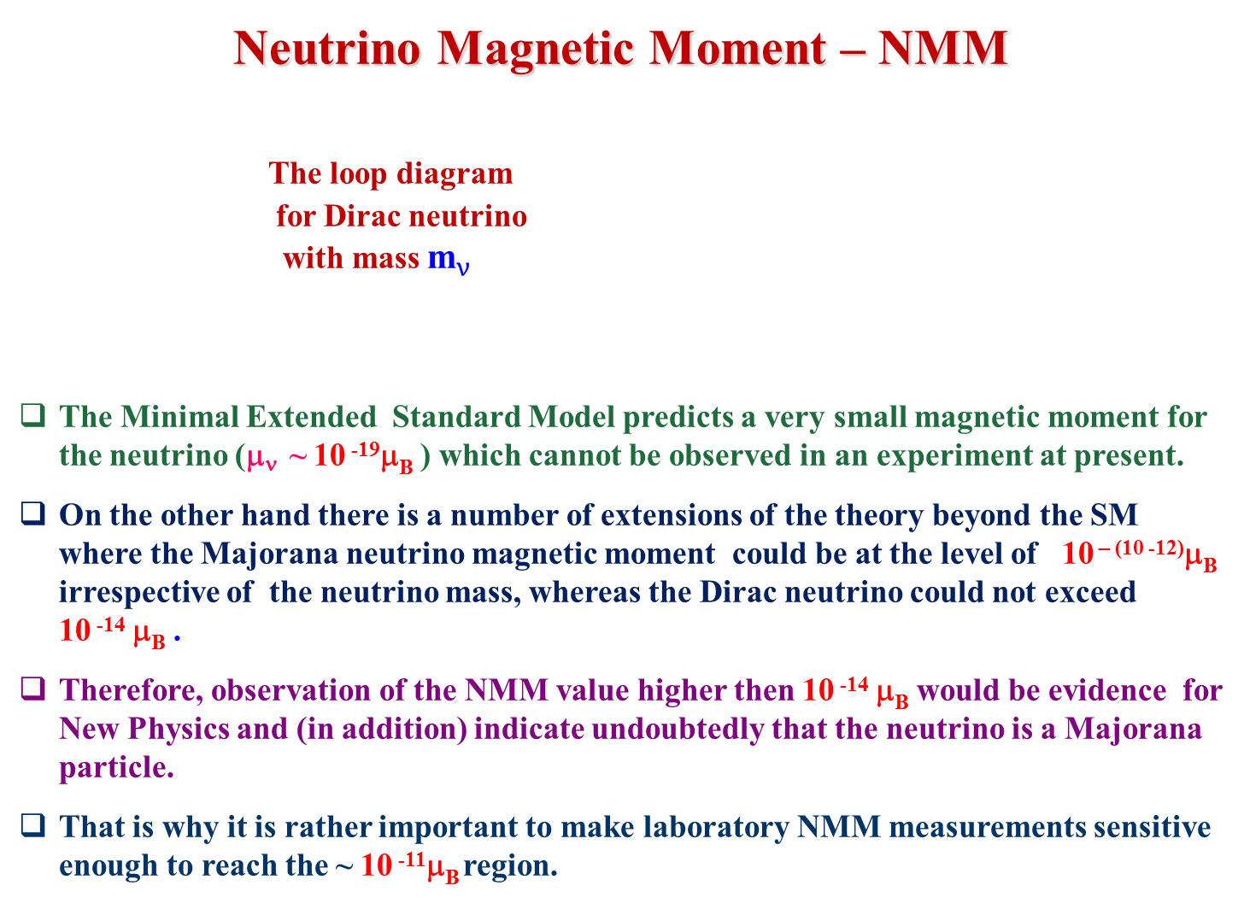
Neutrino Magnetic Moment – NMM
The loop diagram
for Dirac neutrino
with mass ${\text{m}}_{ν}$
The Minimal Extended Standard Model predicts a very small magnetic moment for the neutrino (μ_{ν} ~ 10 ⁻¹⁹μ_{B} ) which cannot be observed in an experiment at present.
On the other hand there is a number of extensions of the theory beyond the SM where the Majorana neutrino magnetic moment could be at the level of 10 ^{– (10 -12)}μ_{B} irrespective of the neutrino mass, whereas the Dirac neutrino could not exceed 10 ⁻¹⁴ μ_{B} .
Therefore, observation of the NMM value higher then 10 ⁻¹⁴ μ_{B} would be evidence for New Physics and (in addition) indicate undoubtedly that the neutrino is a Majorana particle.
That is why it is rather important to make laboratory NMM measurements sensitive enough to reach the ~ 10 ⁻¹¹μ_{B} region.
The Majorana neutrino can have
Non vanishing transition MM arising at flower transitions.

Slide 5
Measurements of the Neutrino Magnetic Moment
The effects of μ_{ν} can be searched for in the recoil electron spectrum (T) from the ν-e scattering. The total cross-section dσ/dT is a sum of two parts which depend on the recoil electron energy T in different ways.
(dσ/dT)_{weak} + (dσ/dT)_{EL}
At low recoil energy (T<<E_{ν}) the value of (dσ/dT)_{weak} becomes almost constant while (dσ/dT)_{EL} increases as T^{–1}, so that lowering of the detector threshold leads to considerable increase of μ_{ν} effect with respect to the weak unremovable contribution

Slide 6
Experiment GEMMA I
(Germanium Experiment for measurement of Magnetic Moment of Antineutrino)
The measurement of NMM was performed at the second unit of Kalininskaya NPP
Spectrometer includes a HPGe detector of 1.5 kg installed within NaI active shielding.
HPGe + NaI are surrounded with multi-layer passive shielding consisting of copper and lead.
The set up was located directly under reactor at distance 14 m from its center.
The data set was collected at operating “on” and shut down “off ” states of the reactor during four years.
Analysis of the data resulted in the upper limit on the value of NMM - μ_{ν} <2.9⋅10 ⁻¹¹μ_{B} . Up to now it’s the best result in the world.

Slide 7
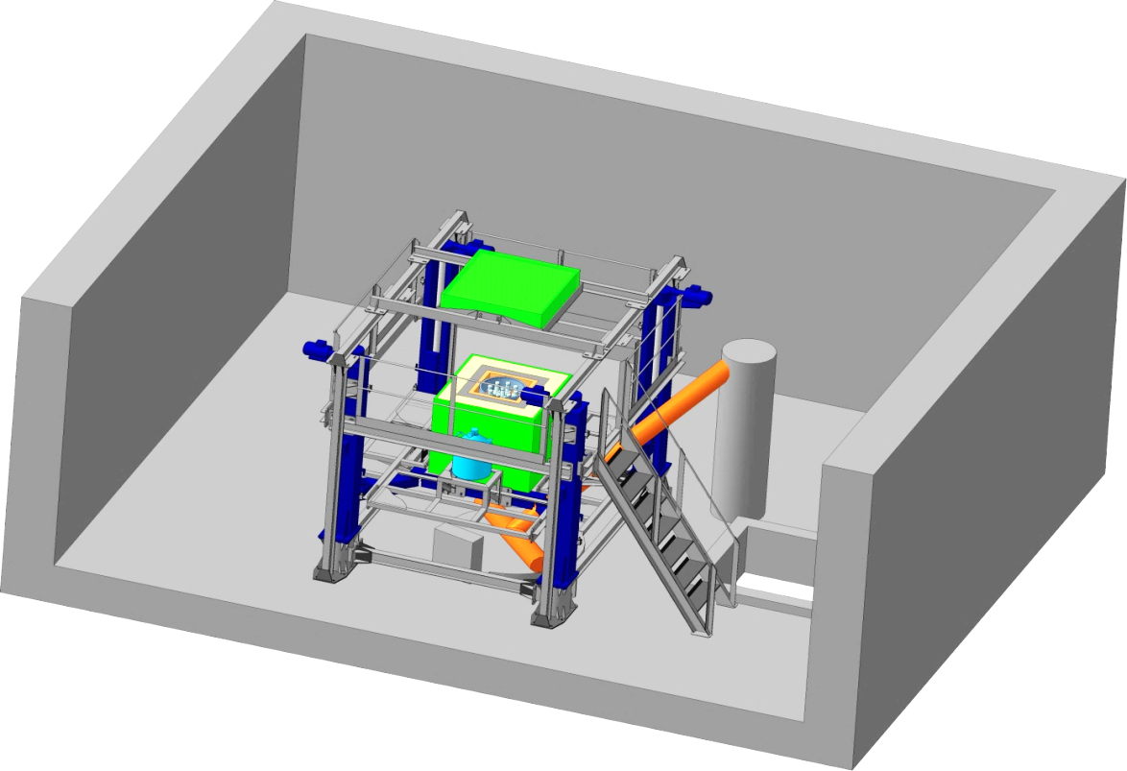
Experiment GEMMA II
Preparation of the experiment GEMMA II is in progress now.
The measurements will be performed at third unit of KNPP. The detector is installed directly under the core of an industrial 3.1 GW reactor
The distance to the core center as low as 10.7 m can be reached by means of a movable platform.
At that distance the density of the antineutrino flow is 5.4×10¹³ см⁻²с⁻¹.
Four point-contact HPGe detectors (~400 g. each detector) produced at LNP JINR will be used for antineutrino registration. The energy threshold is 300-350 eV
Sensitivity down to μ_{ν} ≤ 1 × 10^{–11} μ_{B} is expected to be achieved within 2 years of operating
The set up GEMMA II at movable platform
Point contact HPGe detector produced at JINR (Dubna) (~400 g. each detector).
The energy threshold from 300-350 eV

Slide 8
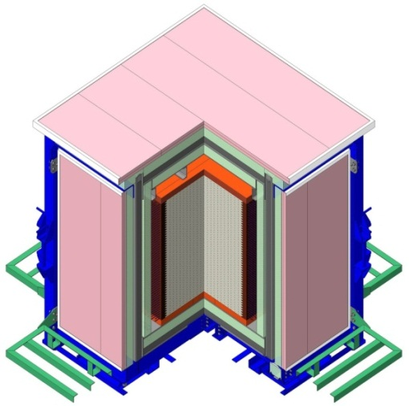
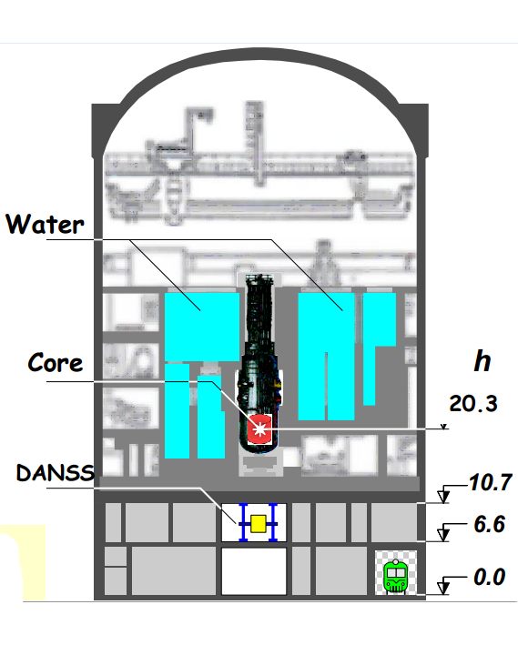
The DANSS project
Active muon veto
The DANSS project is aimed to create a relatively compact neutrino spectrometer for carrying out fundamental and applied experiments
Fundamental physics
  Probe of short-range reactor antineutrino oscillations to the sterile state.
Applied physics
  On-line reactor monitoring by measuring the reactor power.
  Measurements of reactor fuel composition.
The DANSS is located at Kalininskaya NPP (KNPP) under 3GW WWER reactor, which provides ~ 50 m.w.e. shield against cosmic muons (6-times muon reduction and no cosmic neutrons).
The detector is built on a movable platform. Data are taken at 3 distances 10.7 m (Up), 11.7 m (Middle), and 12.7 m (Down) from the reactor (center to center).
Segmented solid scintillator
Multi-layer passive shielding
Detector in shield
DANSS position at KNPP

Slide 9
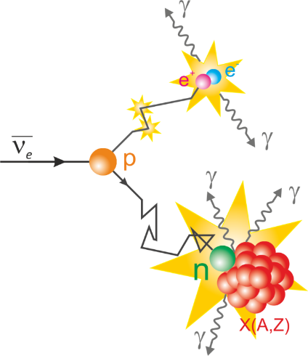
Detection of the antineutrino through the reaction of inverse β-decay (IBD)
+ p → e ⁺ + n Тe ⁺ = Еν – 1.8 MeV
For B.G. suppression method of the delayed coincidences is used
Positron: Prompt signal E > 0.7 MeV arises from positron ionization and annihilation
Neutron: delayed signal arises after neutrons thermalization (~5 μs) and up to ~50 μs travel before Gd capture with γ-emission
Separate recording of positron and neutron candidates is carrying out during “off line” data treatment
Instantaneous continuous ionization
Instantaneous annihilation
Prompt
Delayed
Ee = Eν – 1806 MeV
Thermalization and wandering
~50 μs max
Capture with Gd and
γ-emission
e⁺
2 μs < T < 50 μs
(n,γ)

Slide 10
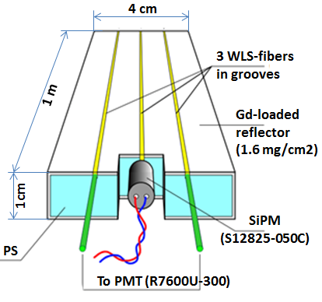
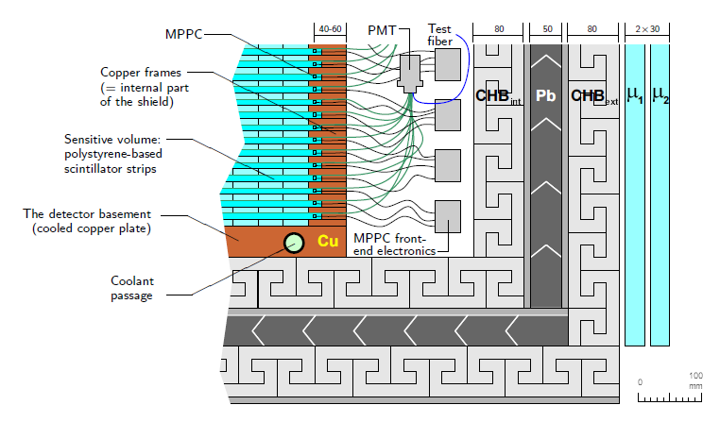
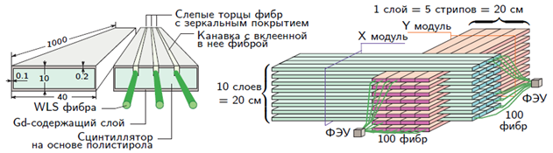
The DANSS design
Cubic meter highly segmented neutrino spectrometer made of 2500 PS strips viewed by 2500 SiPMs & 50 PMTs.
Scintillation strips 10x40x1000 mm³ with Gd-dopped coating
Multilayer passive shielding consist from: electrolytic copper frame ~5 cm, borated polyethylene 8 cm, lead 5 cm, borated polyethylene 8 cm
Active muon veto made of double layer 3 cm PS plates from 5 sides.
Single detection strip
1 layer = 5 strips = 20 cm
Y-Module
X-Module
10 layers = 20 cm
PMT
100 fibers
PMT
100 fibers
Modules
Shield

Slide 11
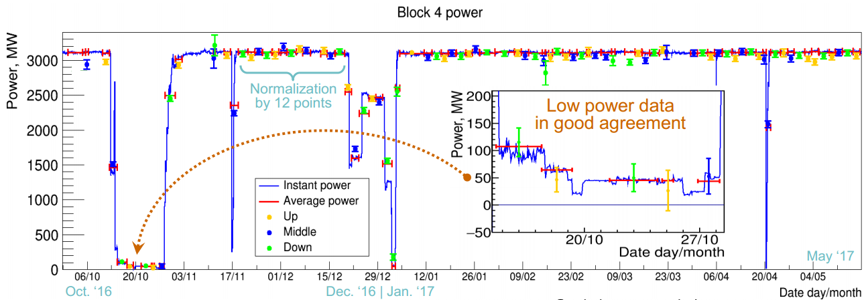
Measurement of the reactor thermal power
Count rate of the neutrino detector - N_{ν} it’s posible to represent through the reactor thermal power - W_{th} :
(1+k) – correction for nuclear fuel composition
γ – coefficient of proportionality
DANSS is monitoring the reactor power since October 2016.
Count rate is about 5000 IBD events/day, background < 1%
Accuracy of the measurements W_{th} for day ~ 1.5%
Statistics accumulated reactor ON @ 100%: ~170 days

Slide 12

Searching for “sterile” neutrino
There are several indications in favor of existence of the 4th neutrino flavor - “sterile” neutrino seen in oscillations
Expected parameters (G. Mention et al. Phys. Rev D83 073006 (2011):
DANSS: Measure ratio of neutrino spectra at different distance from the reactor core – both spectra are measured in the same experiment with the same detector. No dependence on the theory, absolute detector efficiency or other experiments.
Naïve ratio without smearing by the detector resolution

Slide 13
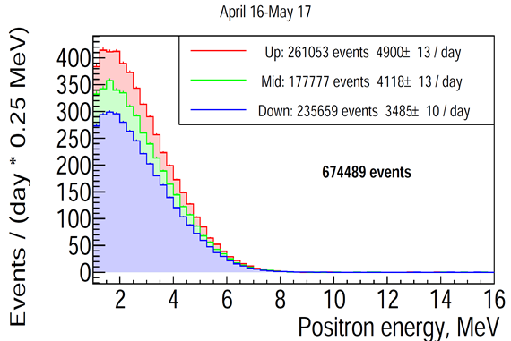
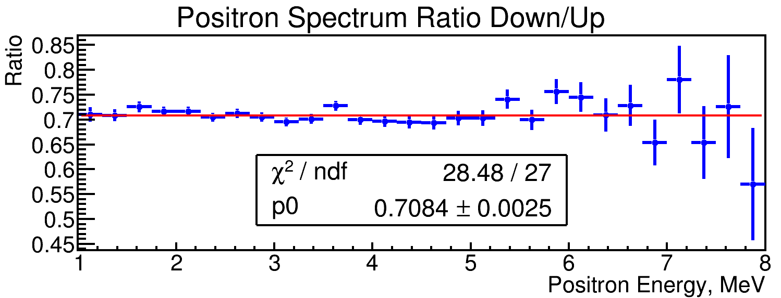
Positron spectra
3 detector positions
Pure positron kinetic energy (annihilation photons not included)
About 5000 neutrino events/day in detector fiducial volume of 78% (‘Up’ position closest to the reactor)
Down/Up spectrum ratio does not contradict to straight line with current statistics

Slide 14
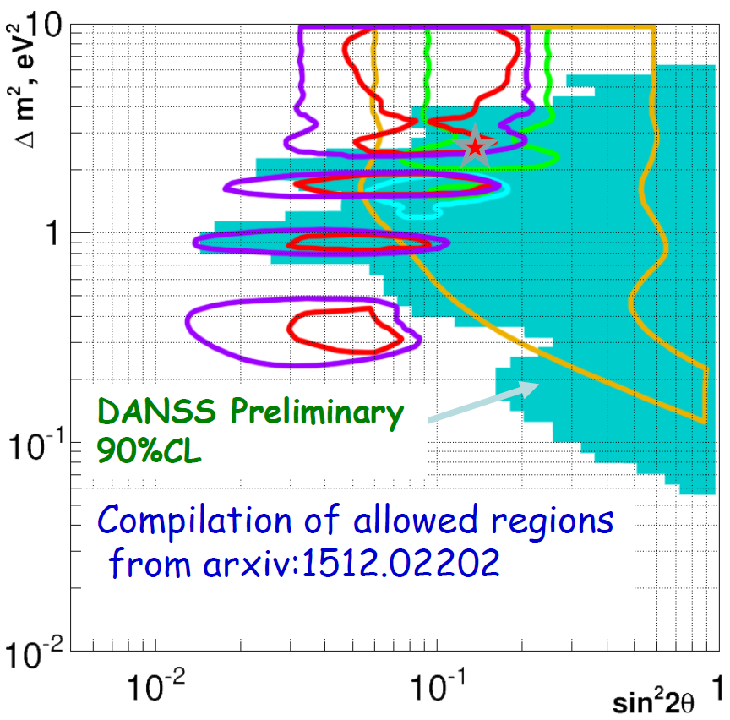
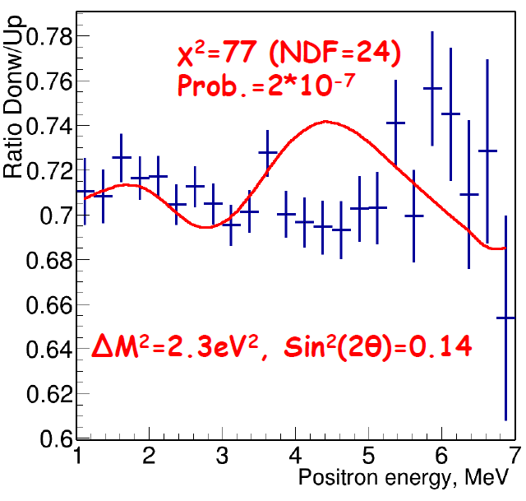
Exclusion region with current statistics
Based only on Up/Down spectrum ratio -- independent on detector efficiency
Theoretical curves for each Δm² and sin²(2θ) calculated based on:
  Model neutrino spectrum from Huber and Mueller
  Fuel burning profile from NPP
  Detector size
  Detector energy resolution
Exclusion region was calculated using Gaussian CLs method (arXiv:1407.5052)
Systematics studies include variations in:
  Reactor burning profile (small)
  Detector energy resolution
Most conservative variant is used
DANSS data already excludes a large fraction of allowed parameter region
3ν: χ²=28 / NDF=27

Slide 15
Summary
In experiment GEMMA I the best result in the world on the upper limit of the value of NMM was obtained.
Preparation of the experiment GEMMA II is in progress now.
DANSS now takes statistics at full speed of about 5000 antineutrino events per day with background < 1%. Plan to double statistics by the end of the year.
Preliminary analysis of the portion of data collected till May 2017 already excludes a large and most interesting fraction of available sterile neutrino parameter space, using only the ratio of positron spectrum at two distances (independent on neutrino spectrum and detector efficiency)
We took data during 40 days scheduled reactor shutdown this summer and hope for even better background estimates
In addition to collection of more data we plan:
  Improve MC for perfect reflection of detector energy response
  Continue systematic studies
  Elaborate more analysis methods for better sensitivity
More results are coming !
The work is partially supported by the State Corporation «RosAtom»
through the state contracts Н.4х.44.90.13.1119 and Н.4х.44.9Б.16.1006 and by Russian Science Foundation, grant 17-12-01145

Slide 16
Thank you !

Slide 17
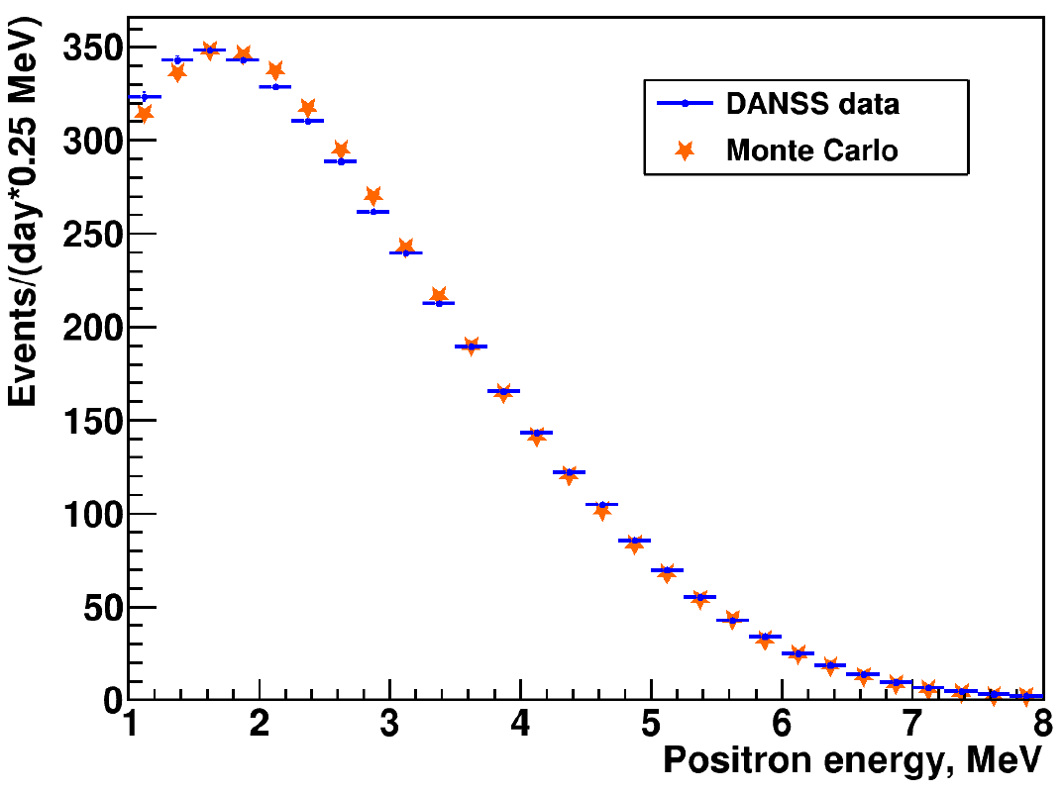
Positron spectrum - compare to the theory
MC simulated DANSS response use theoretical antineutrino spectrum by Huber and Mueller
Very preliminary – more work on calibration and simulations needed and planned
!!! Preliminary !!!

Slide 18
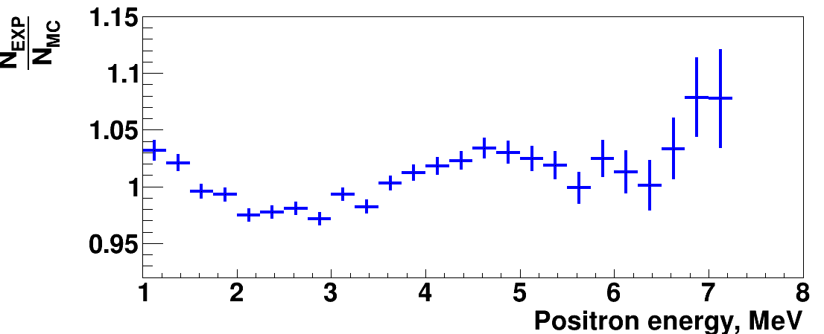
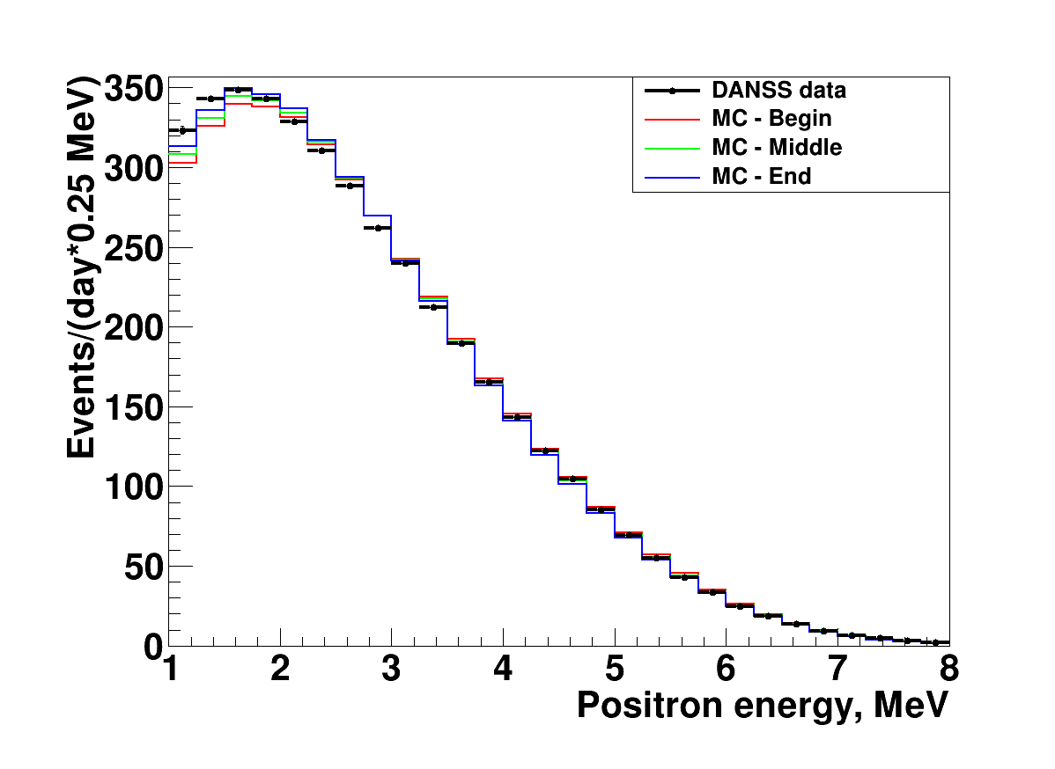
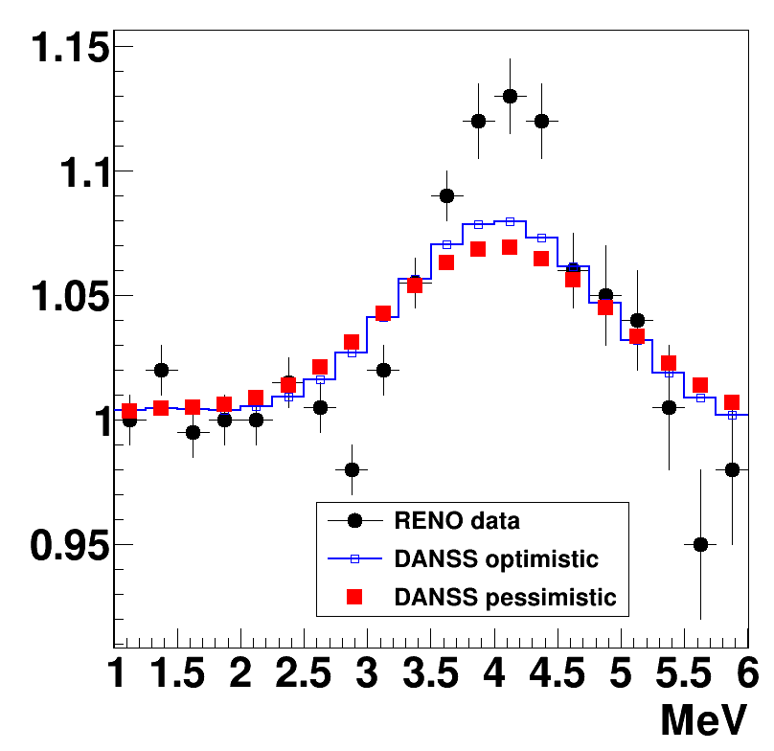
Reactor anomaly -- inconclusive
Experiment to MC ratio
Anomaly smearing with DANSS energy resolution
MC needs improvement

Slide 19
