Slide 1
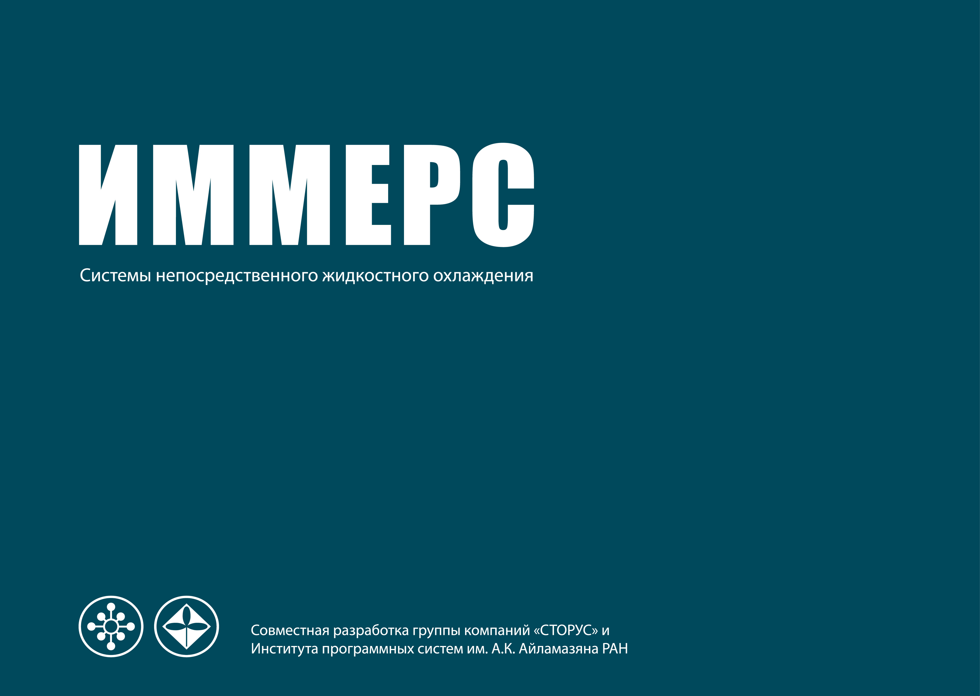
  DIRECT IMMERSION COOLED IMMERS HPC CLUSTERS BUILDING EXPERIENCE
  Leo Klyuev, General Manager, Immers Inc.
Notes:
IMMERS
Direct Immersion Cooling Systems
Codesigned by the STORUS Group and the Ailamazyan Program Systems Institute of the Russian Academy of Sciences

Slide 2
  Topics
  Technology Overview
  Project History
  Product Line
  Key Features
  MEPHI projects

Slide 3
  Technology Overview. Participants
Ailamazyan Program Systems Institute of the Russian Academy of Sciences established in 1983 lead the implementation of SKIF and SKIF-GRID State Programs
Storus group was founded in 2001. It specializes in storage systems and high performance computing

Slide 4
  Technology Overview. Participants
IMMERS is part of the Storus Group. The Company's primary focus is to develop, supply and maintain HPC systems for educational, academia/research institutions and data centers dedicated to industrial, engineering and oil-gas companies

Slide 5
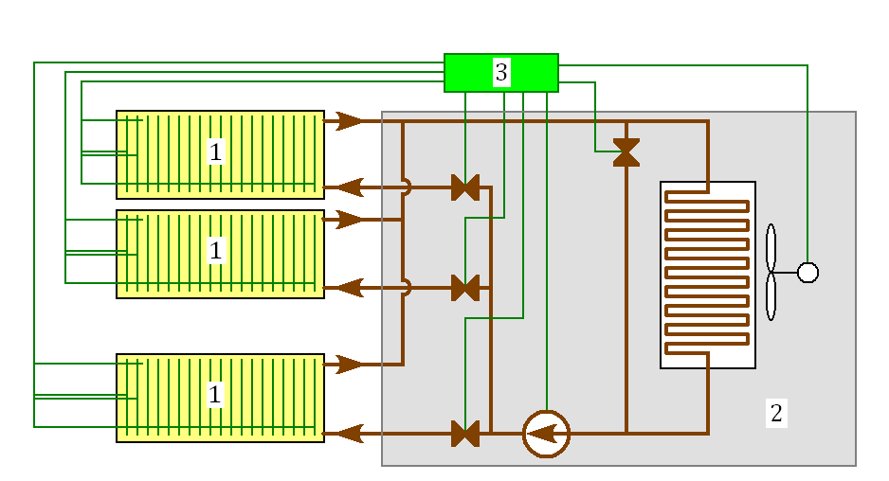
  Technology Overview
Server racks: immers cooling of computational nodes (motherboards, hard drives, and power supplies)
Heat exchange unit serves to absorb heat and transfer it to the outside (heating of water, heat rejection)
Control unit ensures optimum operation of the system.

Slide 6
  Project History
Server March 2011 – First experiments
September 2011 – IMMERS-01 first release readiness, start of survival testing
April 2012 – IMMERS-02 second release readiness
September 2012 – Successful completion of the first supply
July 2013 – IMMERS-03 third release readiness
January 2014 – IMMERS 660 start of supplies
May 2014 – IMMERS 880 availability
April 2015 – IMMERS 6 R4 availability
October 2016 – IMMERS 8 R6 availability .

Slide 7
  Product Line
IMMERS 6 R6. Up to 24 Intel/AMD CPUs. Ideal for building
HPC clusters with a 100 Tflops performance

Slide 8
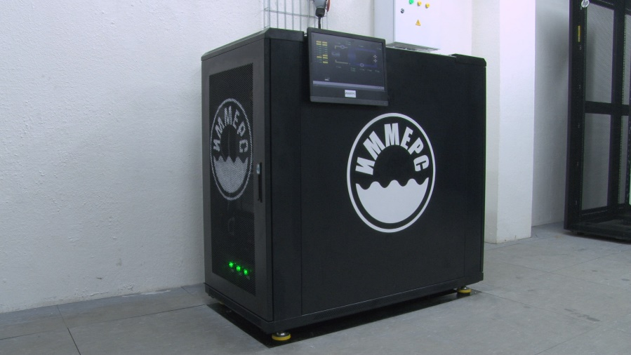
  Product Line
IMMERS 8 R6. Up to 78 Intel/AMD CPUs. Ideal for building
computing clusters with a 70 Tflops peak performance

Slide 9
  IMMERS 6 R6/8 R6 Computational Nodes
Homogeneous nodes. Up to 4 Intel/AMD CPUs motherboards
Heterogeneous nodes. 2x Intel Xeon E5 CPUs + 4x nVIDIA or Xeon Phi or AMD Radeon cards
Depending on the application, computational nodes can be combined

Slide 10
  Key Features. IMMERS allows to
Eliminate specific requirements for temperature, humidity, and air purity in data centers & server rooms
Significantly simplify the cooling system and increase its reliability
Provide comfortable conditions of work in data centers due to decrease of noise and increase of air temperature
Substantially reduce floor space by eliminating hot/cold aisles and inter-row air conditioning

Slide 11
  Key Features
The computing cluster operates at an industry-record PUE of 1.037
The noise level of the operating computing cluster does not exceed 48 dB -> cluster can be installed in research lab close to work places
The installation of equipment at the customer’s premises takes 1-2 working days

Slide 12
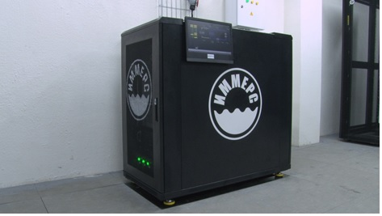
  MEPHI projects
HPC cluster Cherenkov installed in main data center
20 2xXeon E5-2630 v3 nodes
64 Gb DDR4 per node
IB FDR network
50 Tb external storage
Full onsite installation, tuning peak performance

Slide 13
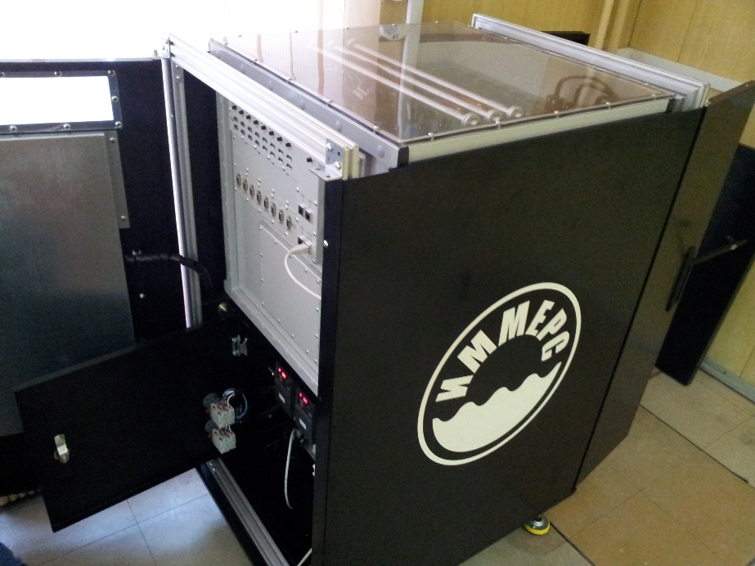
  MEPHI projects
HPC cluster installed in education college 1511
Three 2xXeon E5-2630 v4 nodes
128 Gb DDR4 per node
800 Gb SSD per node
IB FDR network
Tuning performance, dedicated parallel programming master classes

Slide 14
  Immers Services
System design and development, including computing and communication units, power system and cooling system
Software development
Installation and commissioning of equipment at the customer’s premises
Testing, configuration and software upgrades
Maintenance service
Staff training

Slide 15
  Got questions? Just ask.
If you have any questions, please contact IMMERS by phone or email
Tel/Fax: +7 (495) 631-56-43
l.klyuev@immers.ru

Slide 16


