Slide 1


NRC KI IHEP: recent results at the U-70 machine
NATIONAL RESEARCH CENTRE
«КURCHATOV INSTITUTE»
INSTITUTE FOR HIGH ENERGY PHYSICS
Russia 142281, Moscow region, Protvino, Nauki sq., 1
ICCPA’17
MEPhI, October 5
A.Zaitsev

Slide 2
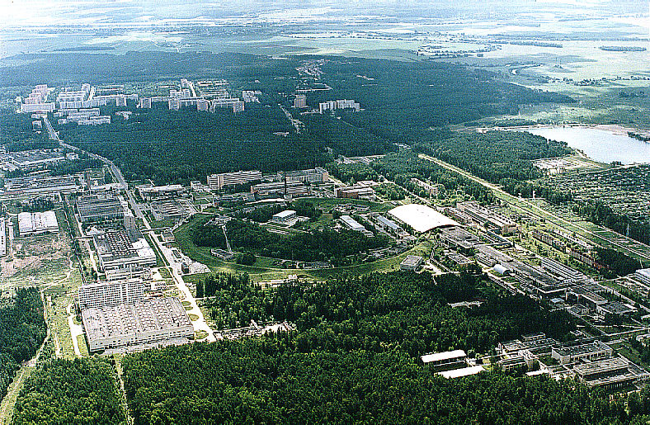
NRC «Kurchatov Institute» -
Institute for High Energy Physics
Protvino

Slide 3
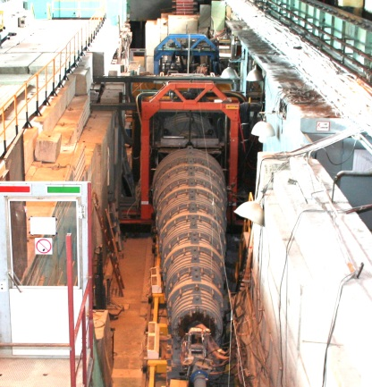
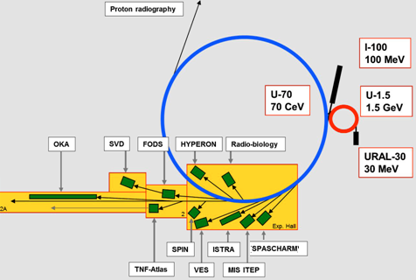
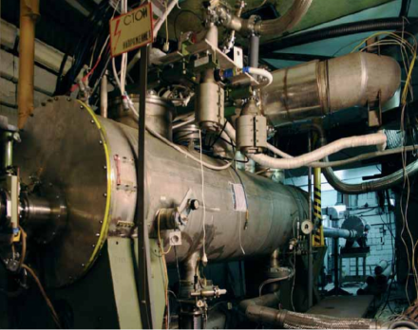
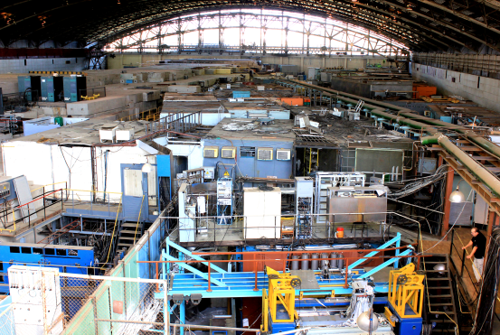
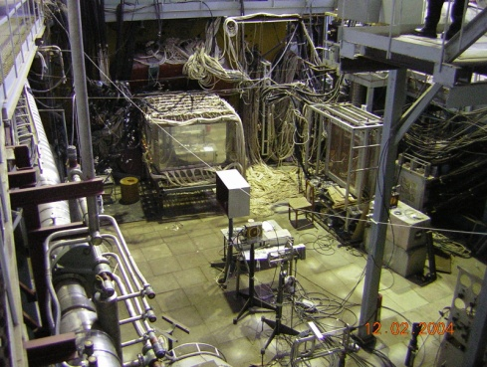
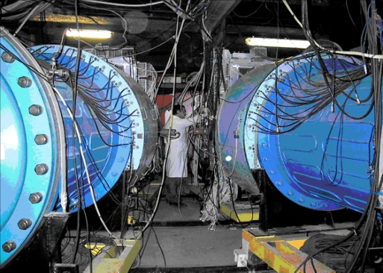
Layout of accelerators and research facilities
E=70 GeV, (50 GeV)
I=1.7·10¹³ppp(1.0·10¹³ppp)
Beams : π+-, K+-,p,p̄, e+-,¹²C
• Fast extraction
• Slow extraction
• Extraction by crystals
• Internal targets
Research directions:
hadron spectroscopy
rare kaon decays
spin asymmetries
baryon matter
nuclear physics
………
proton radiography
radiobiology
radiation hardness
beam optics with crystals
R&D on detectors
……….

Slide 4
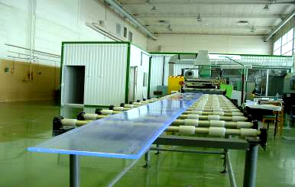
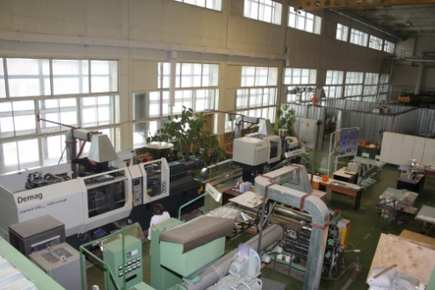
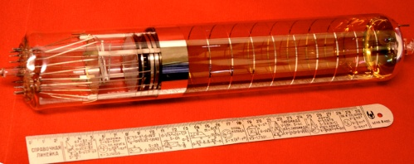
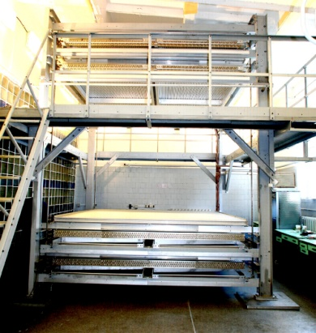
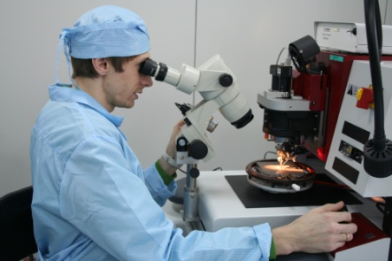
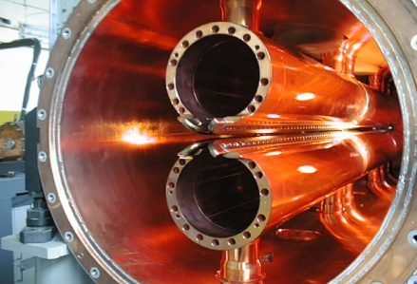
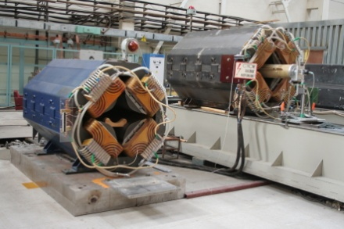
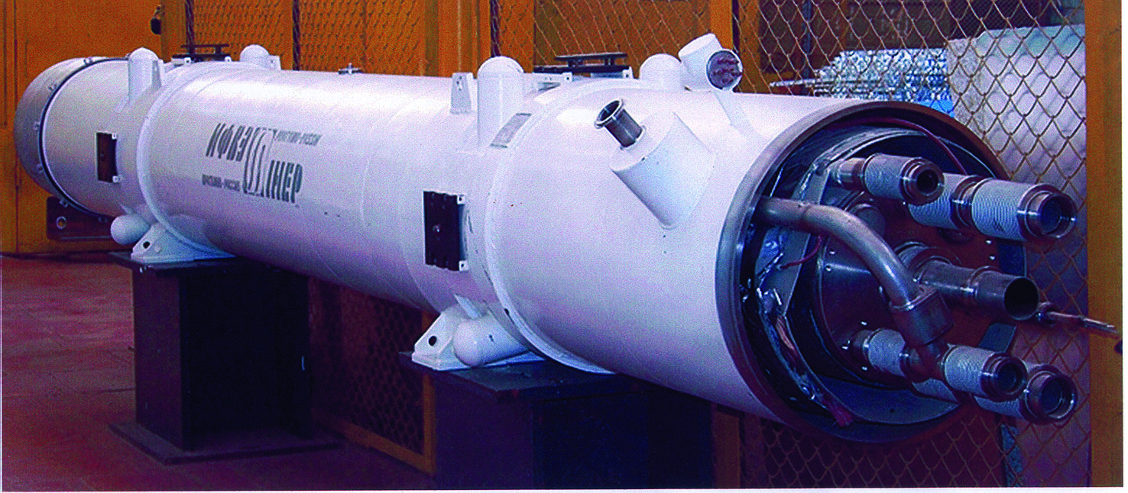
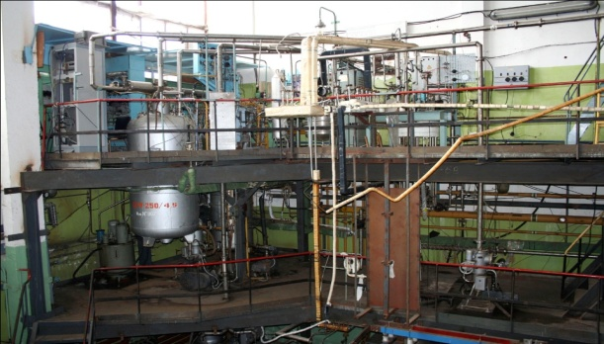
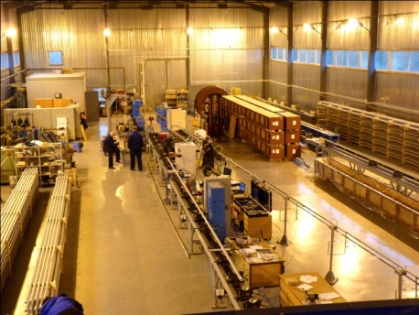
R@D
Scintillators
Photomultipliers
Muon tomography
GaAs detectors
RFQ development
Beam optics
Superconducting systems
…….

Slide 5
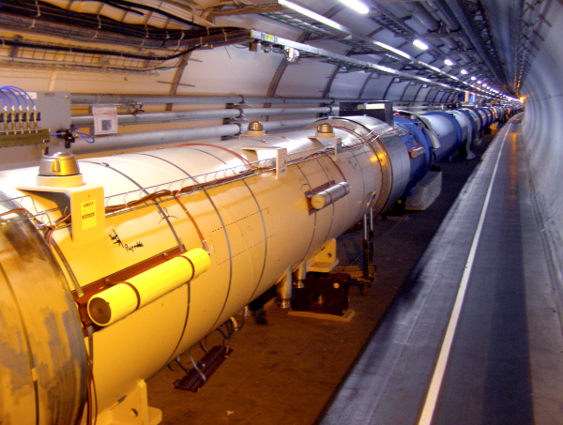
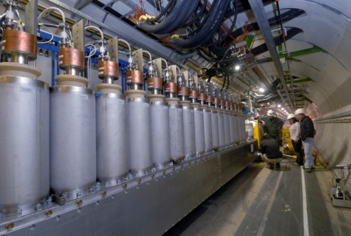
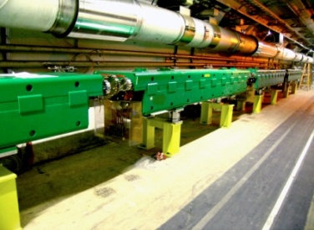
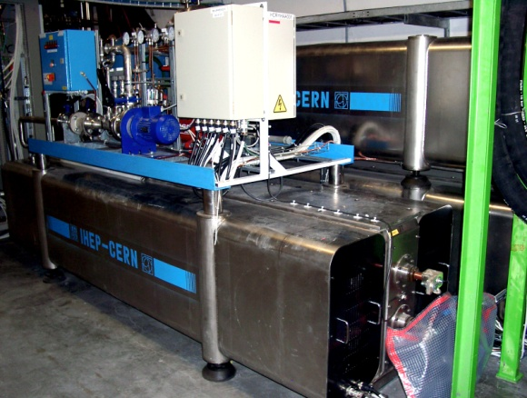
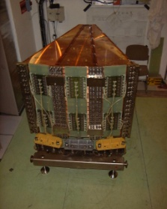
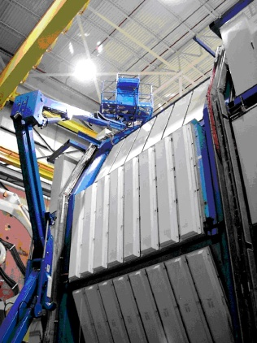
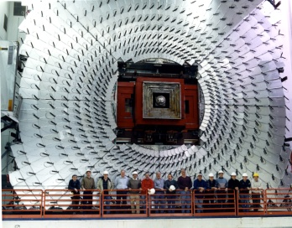
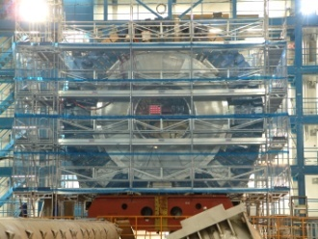
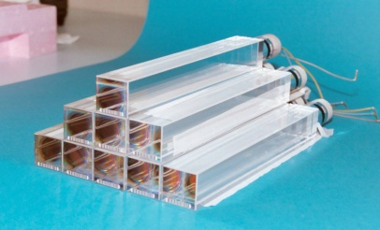
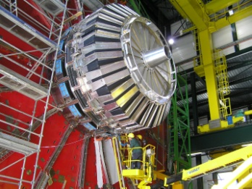
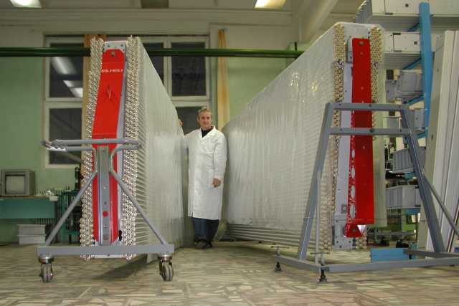
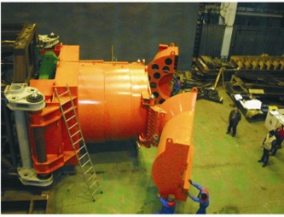
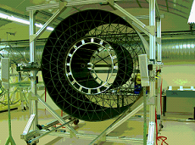
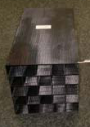
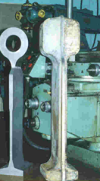
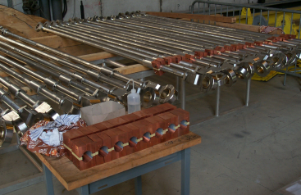
International collaborations
USA
  FNAL D0, MU2e
  BNL PHENIX, STAR
EUROPE
  DESI XFEL , HERMES
  FAIR PANDA
CERN
  LHC machine
  ATLAS
  CMS
  LHCb
  ALICE
  COMPASS
  DIRAC
  NA 62
  NA 64
JAPAN
  BELLE, BELLE II

Slide 6
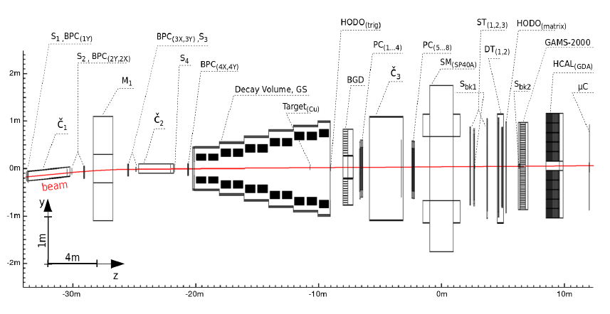
OKA Kaon decays
OKA
Separator (Panofsky scheme):
Frequency 2865 MHz
– The resonator length is 2.74 m
– The average deflection field ~ 1 (.6) MV / m
– Operating temperature 1.8 K
– The proton beam momentum 50 GeV
– Intensity ~ 7x10¹³ / spill
– Spill 2 sec, τ cycle = 9,7 s
– Secondary beam momentum 12.5 or 18 GeV
– Length of the channel ~ 200 m
– K⁺ intensity ~0.5x10⁶/spill
% K⁺ in the beam up to 20%
Analysis in progress:
1. Form factors of the decays: Ke3, Kμ3
2. Search for a heavy sterile neutrino in K⁺→μ+ν
3. Study of the decay Kμ3γ
4. Study of the coherent process K⁺ Z→ K⁺π⁰ Z
5. Exact measurement of BR Ke3
6. Study of the Ke3γ decay
7. Study of the decay Kμ2γ

Slide 7
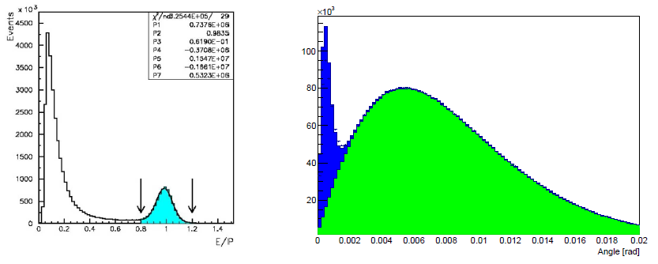
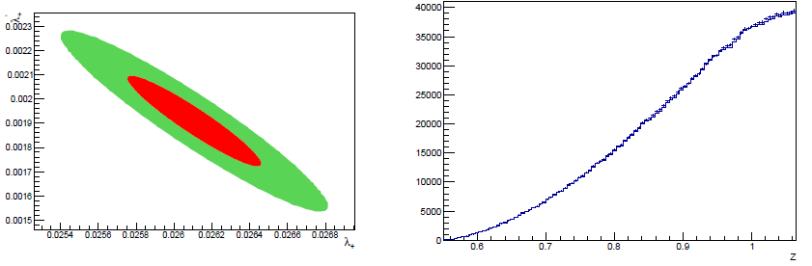
Ke3 decay studies
OKA
arXiv:1708.09587v1
E/P plot - the ratio of the energy of the associated ECAL cluster to the momentum of the charged track (left); α - the angle between and in the lab-system(right).
About 5.25M events are selected for the analysis. The linear and quadratic slopes for the decay
formfactor f+(t) are measured: λ′+ = (26.1±0.35±0.28)×10⁻³ , λ′′+ = (1.91±0.19±0.14)×10⁻³ .
The scalar and tensor contributions are compatible with zero.
λ′ − λ′′ correlation plot (left); Projection of the Dalitz-plot on z (right) axis

Slide 8
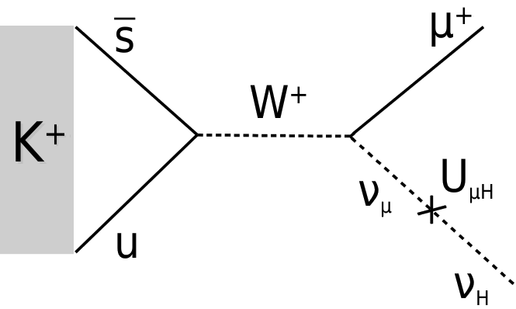
Search for heavy neutrino in K⁺ →μ⁺ ν_{H} decay
OKA
arXiv:1709.01473v1
A high statistics data sample of the K+ →μ+ν decay was accumulated by the OKA experiment in 2012. The missing mass analysis was performed to search for the K⁺ →μ⁺ ν_{H} channel with a hypothetic stable heavy neutrino in the final state. The obtained missing mass spectrum does not show peaks which could be attributed to existence of stable heavy neutrinos in the mass range (220 < m_{H} < 375) MeV/c².
As a result, we obtain upper limits on the branching ratio and on the value of the mixing element |U_{μH}|².
Production of a heavy sterile neutrino in the K+ decay

Slide 9
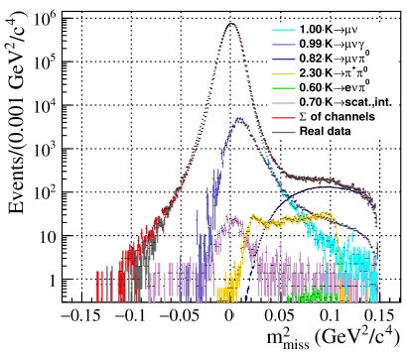
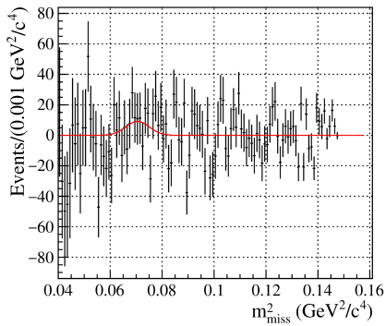
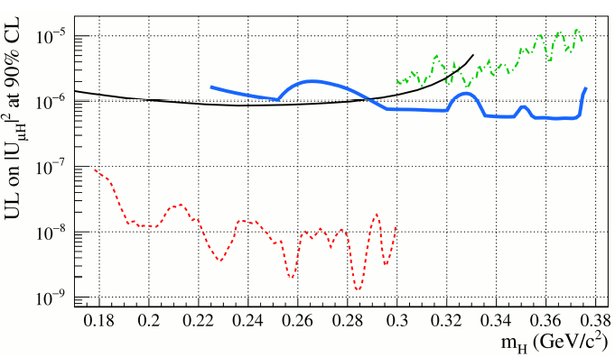
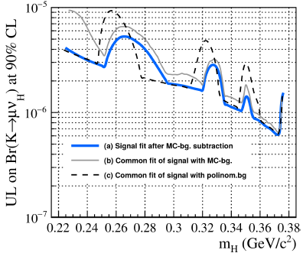
OKA
Missing mass distribution m²_{miss} for the data and MC events
The residual signal distribution after subtraction of the fitted background
The OKA upper limit on the mixing matrix element |U_{μH}|² at 90% CL is shown with solid blue curve, in comparison with preceding experiments
Upper limit for Br(K⁺ →μ⁺ ν_{H} )at 90% CL as a function of a heavy neutrino mass

Slide 10
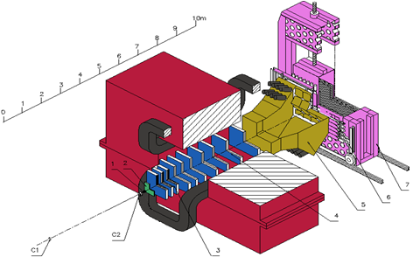
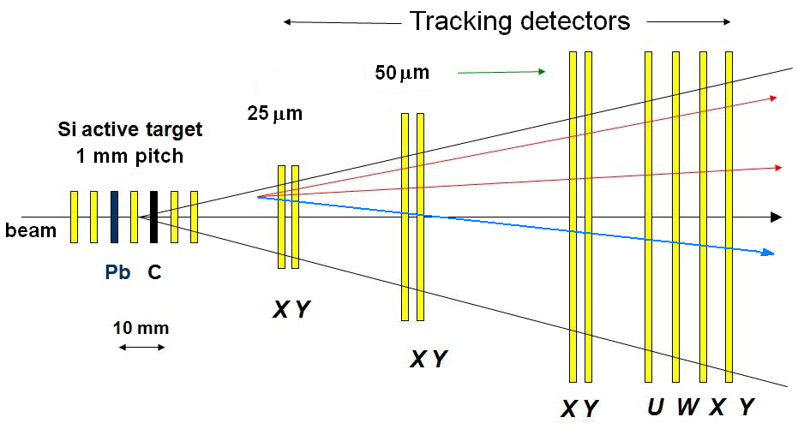
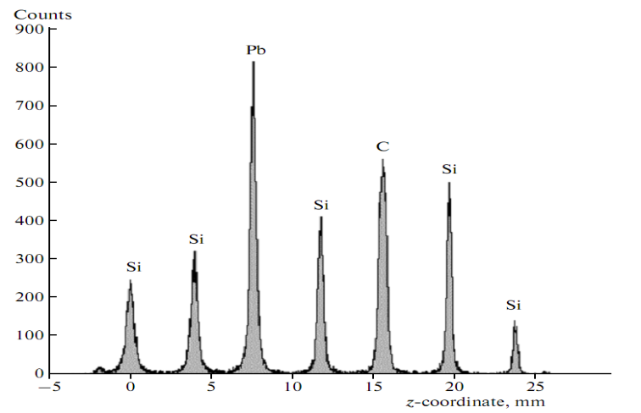
SVD Charmed particles production
SVD
Z-resolution:
  for the primary vertex : 70-120 μm
  for the secondary vertex : 250-300 μm
X,Y-resolution for primary vertex : 8-12 μm
Impact parameter resolution : ~ 12 μm
Effective mass resolution :K⁰ - 4.4 MeV, Λ⁰ - 1.6 MeV
С1, С2 – beam scintillation counters;
1 – Si active target (АT);
2 – microstrip vertex Si-detector (MSVD);
3, 4 – MWPC of magnetic spectrometer (МS);
5 – threshold Čerenkov counter (ČС);
6 – scintillation hodoscope (SC);
7 – detector of γ-quanta (DEGA)
The reconstructed Z-coordinates of the primary vertices in AT
This setup has been constructed for study of charmed particles production in pp- and pA-interactions by the SVD collaboration including NRC KI IHEP (Protvino), JINR (Dubna), NPI MSU (Moscow).

Slide 11
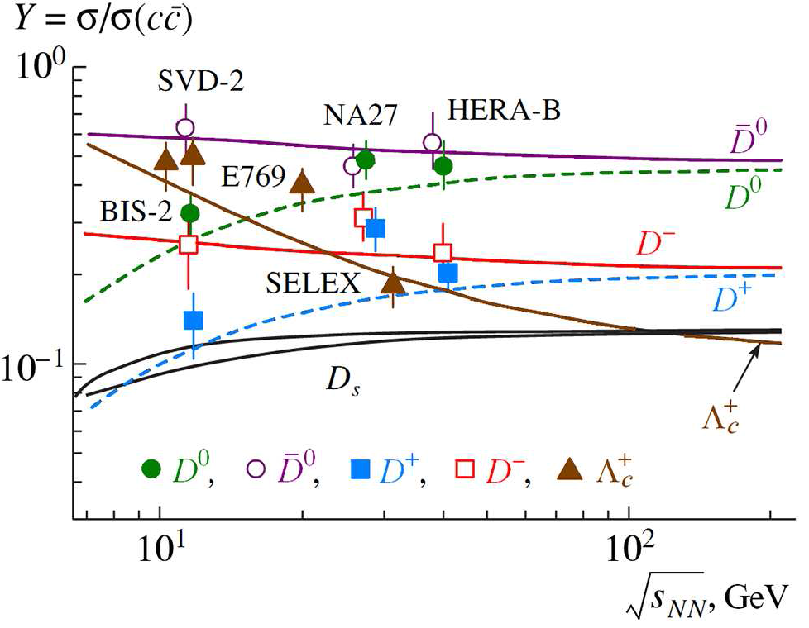
RATIOS OF CHARMED PARTICLES YIELDS
SVD
Relative yields of charmed particles. The theoretical curves (with designation of a particle) are taken from the predictions of the statistical hadronization model.
The results are compatible with the predictions of the statistical hadronization model

Slide 12
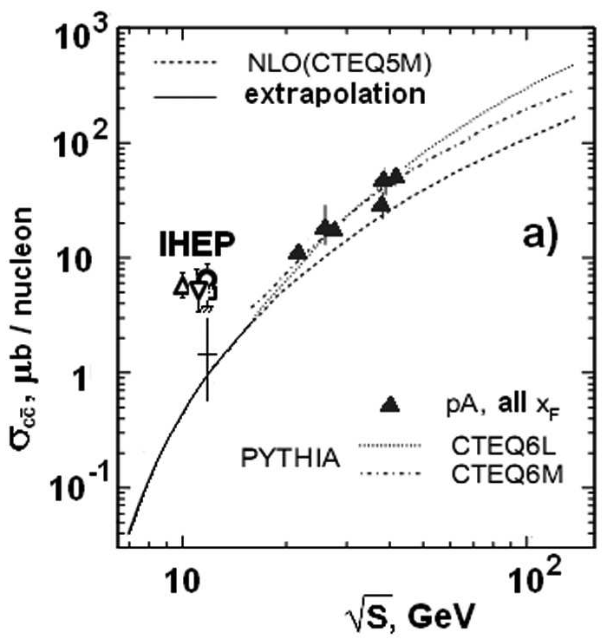
RESULTS:
SVD
The total cross section for charm production in pA-interactions from SVD-2 and other experiments: ○ – SVD-2, ∇ – beam-dump with muon absorber , □ – SCAT bubble chamber experiment and Δ – the experiment with BIS-2 spectrometer.
The total open charm production cross-section at √s = 11.8 GeV is well above QCD models predictions. Relative yields are close to the prediction of QGSM for D mesons and for Λ_{с}⁺ baryon at this energy.

Slide 13
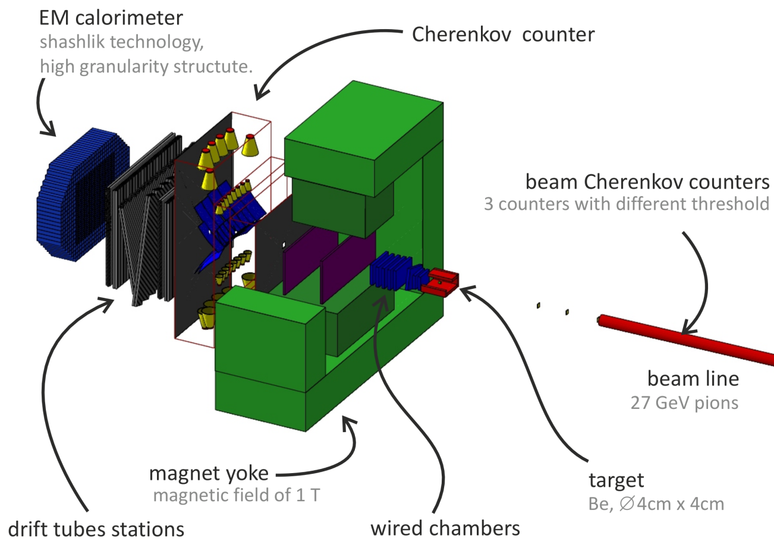
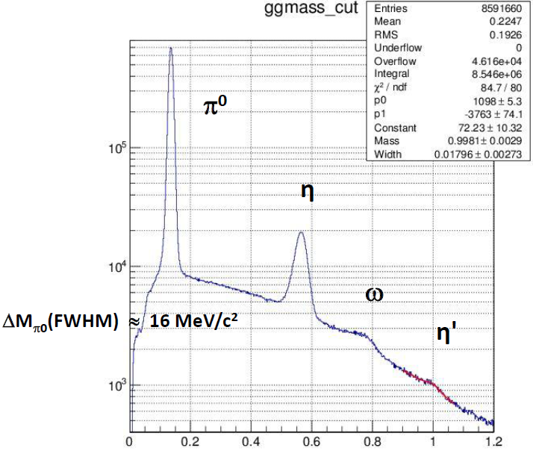

VES
VES Meson spectroscopy
Soft trigger
~ 10¹⁰ events
3 π
Exotics: JPC = 1-+ …..
Radial excitations: a1’, a2’ ….
Threshold effects: a1(1420)...
High spin a3(1880): a4(2040)...
ππ S-wave
ππ
Excitations: ρ’ …..
ηπ, η’π, ηηπ, ηππ, KKπ ….
Exotics, precision spectroscopy, isospin violation …..
π⁻ Υ*→X
X = 3 π
X = ππ
X = ηπ

Slide 14

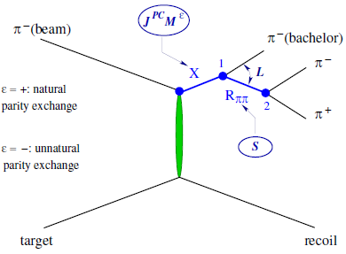
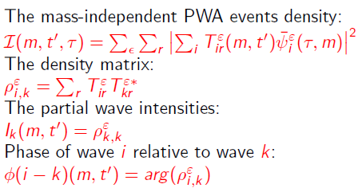

VES
VES Partial Wave Analysis
Data:
Statistics +-
Background +-
Precision +
Efficiency +
Systematics +-
Analysis (PWA)
This ansatz can be too simplistic and lead to erroneous results for weak waves and an uncontrolled systematic errors for large waves. A number of additional analyzes improve the reliability of the results:
- Variation of a set of waves
- Variation of the parameters of isobars
- Variation of the rank of the density matrix
- Mapping channels π⁻π⁻π⁺ and π⁻π⁰π⁰

Slide 15

VES
VES PWA example One wave out of a fifty

Slide 16

VES

Slide 17





SPIN Cumulative reactions
Main purpose of the SPIN experiment is to obtain information on the nuclear matter structure by studying the spectra and composition of cumulative particles emitted with large transverse momenta (p_{T}) in hard proton-nucleus and nucleus-nucleus interactions. Cumulative particles are those generated in the kinematic regions that are forbidden for scattering with the participation of free nucleons.
π,K,p,d,t
SPIN: a single-arm narrow-aperture spectrometer
proton beam
10¹²- 10¹³ /sec
or carbon ion beam ~10⁹ /sec
Models for cumulative processes:
Multiple scattering
Multi-nucleon (multiquark) configurations (dense baryon matter)
Short-range correlated (SRC) NN pairs
with large relative momentum
Notes:
17
17
17
17

Slide 18

V.V. Ammosov et al.,Physics of Atomic Nuclei, 2013, Vol. 76, No. 10, pp. 1213–1218
V.V.Ammosov et al. Yadernaya Fizika I Inzhiniring 4 (2013)773–778] , arXiv-1410.5582
pA→h± +X
Proton beam, 50 GeV/с
Intensity 5x10¹² /sec
Targets: C, Al, Cu, W
Angle of arm 35⁰ (lab.syst.)
Production of cumulative particles with large transverse momentum (p> 2.5 GeV/c) has been observed for the first time for both positive and negative particles
Differential production cross sections for (a) positively and (b) negatively charged
particles as functions of momentum. The upper horizontal axis shows the transverse momentum. Vertical dashed lines show the kinematic thresholds in interaction of free nucleons.
18

Slide 19


pA→h⁺ + X
Proton beam, 50 GeV/с
Intensity 5x10¹² /sec
Angle of arm 35⁰ (lab.syst.)
Absence of a strong dependence of the ratios p/π ─ and p/π⁺ on the nucleus mass at large p_{T} values serves as an indication of the local mechanism of the particle production with a weak contribution
from the intranuclear rescattering.
Strong dependence (α > 1 ) of inclusive
cross-section at high p_{T} on atomic mass is
typical for the cumulative processes.
α=ln(σ₁/σ₂ ) /ln(A₁ /A₂ )

Slide 20



N. N. Antonov et al., JETP Letters, 2015, Vol. 101, No. 10, pp. 670–673
N. N. Antonov et al., JETP Letters, 2016, Vol. 104, No. 10, pp. 662–665
N. N. Antonov et al., JETP Letters, 2015, Vol. 101, No. 10, pp. 670–673
p/π+
d/p
Fraction of π+ among all h+ at p_{T} >2.5 GeV/c is less than 5% for all targets.
Contributions of d and t increase rapidly
with increasing transverse momentum.
It indicates on the knockout mechanism.
t/p

Slide 21


FODS
FODS Nuclear-nuclear interactions
Acceleration of the carbon nuclei gave rise to a new direction of experimental research on the U-70. The first measurements of the production of hadrons and nuclear fragments at zero angle in nuclear-nuclear interactions were performed in 2016 on channel 22 of the IHEP accelerator. Accelerated carbon nuclei had a kinetic energy of 20 GeV per nucleon.
Nuclear targets were installed in the channel head. Optics of the channel made it possible to select positive or negative particles at given momentum. A large set up of detectors made it possible to determine the charge and mass of hadrons or nuclear fragments.
Ch 22
target
Beam direction
hcal
DT
DC
SCOCH
DC
Si-scintillation counters, C̆- Cherenkov counters, SCOCH – RICH detector, hcal - hadron calorimeter, DT – drift tubes, DC – drift chambers.

Slide 22


FODS
Fragments separation
The first results on studying forward nuclei production in collisions of beam carbon at energy 25 GeV/n with nuclear targets on accelerator U-70 at using beam line 22 as spectrometer published: M.Yu.Bogolyubsky et al., Physics of Atomic Nuclei, 2017, Vol. 80, N0 3, pp 455-460.
The following puctures show fragment yields of carbon target at beamline rigidity 47 (left) and 53 GeV/c (right) and beam energy 25 GeV/n.

Slide 23
Hadron yelds at p=20 GeV/n
FODS
preliminary
Yields versus the reduced lab momentum at zero angle for p, π⁺ , d, α(left picture) and p̄, π⁻, K⁻ (right picture) for C+C collisions at p=20 GeV/n.

Slide 24
Nuclear fragments
FODS
preliminary
Yields versus the lab momentum at zero angle for different nuclear fragments for C+C collisions. The curves are drawn to guide an eye.

Slide 25




Beam focusing by crystal devices
CRYSTAL
The focusing device on the basis of channeling in crystals of trapezoidal shape has been invented
Several crystals were tested in the mode of focusing of a parallel beam into a point in the U-70 experiments [AG Afonin, EV Baranov, GI Britvich et al. JETP Letters 105 (12), 763-765, 2017] The compression ratio of the beam, linearity, focus and deflection efficiency correspond to the expectations.
Reversed direction: the parallel beam formation from point-like source. [A. G. Afonin et al, JETP Lett. 104 12 (2016)] This first experiment with divergent beam of protons with an energy of 50 GeV was performed on the U-70 in Protvino. Proton beam with a divergence of about 1 mrad deflected by an angle of 1.8 mrad with an efficiency of about 15%.

Slide 26
New projects
Spin physics with polarized target (SPASCHARM) – commissioning
Elastic scattering with very high stastistics – LOI
Search for fluctons (second arm in SPIN) – LOI
Carbon-nuclear interaction at √s ≈ 7 GeV (FODS)
Low energy (in tens MeV) photons in carbon-nuclear interactions (SVD)
Baryon spectroscopy in exclusive πp reactions (VES)
.
.
.

Slide 27
Thanks to V.Obraztsov, A.Vorobiev, Yu.Khokhlov, V.Gapienko, A.Volkov and Yu.Chesnokov for providing materials
THANK YOU

Slide 28
SPARE

Slide 29


Slide 30


Slide 31



Slide 32






