Slide 1



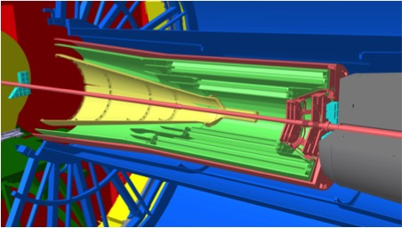
Upgraded Inner Tracking System for ALICE at the LHC: Status and Plans
3D view of the new ITS by Corrado Gargiulo
Grigory Feofilov (on behalf of the ALICE collaboration)
Saint-Petersburg State University
The 3rd International conference on particle physics and astrophysics (ICPPA-2017), Moscow, 2-5 October 2017, MEPhI, Moscow
Acknowledgement: This work was supported for the SPbSU participants in 2016 within the Program of Russian groups activities in the ALICE upgrade by the Ministry of Education and Science of Russian Federation, contract No14.610.21.0003, identification number RFMEFI61014X0003 (SPbSU identification number No. 11.19.1632.2014).

Slide 2
Outline
Motivation.
Upgrade of ALICE/ITS
  General design
  Detectors and readout
  General layout
  Production status
3) Plans and summary of new physics possibilities

Slide 3
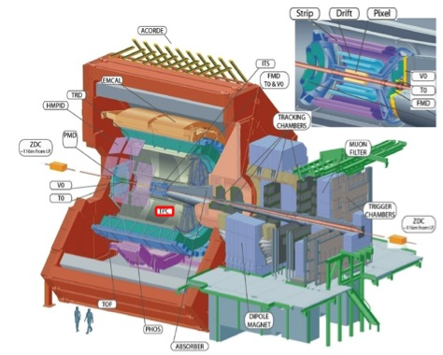
ALICE installation at the LHC
Central Detectors:
Inner Tracking System
(SPD,SDD,SSD – 6 layers
between 39 and 430 mm)
Time Projection Chamber
Time-of-Flight
Transition Radiation Detector
Spectrometers:
High Momentum PID (RICH)
Photon Multiplicity
Forward Multiplicity
Muon Spectrometer
Calorimeters:
EM Calorimeter
Photon Spectrometer (PHOS)
Zero Degree Calorimeter
Trigger:
Trigger Detectors
pp High-Level-Trigger

Slide 4
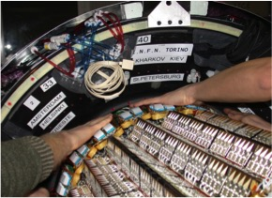
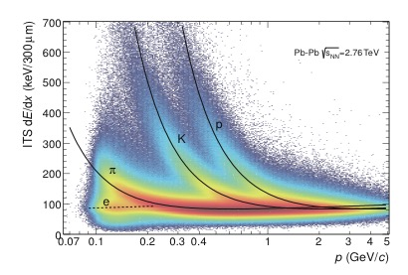
Current ITS performance
International Journal of Modern Physics A Vol. 29,
^{No. 24 (2014) 1430044}
International Journal of Modern Physics A Vol. 29,
^{No. 24 (2014) 1430044}
Distribution of the energy-loss signal in the ITS
^{as a function of momentum.}

Slide 5
Some physics results of Run-2:
D meson elliptic flow puzzle
PRL 111, 102301 (2013)
Elliptic flow for D-mesons?

Slide 6
Why heavy quarks as one of the main motivations?
Study the early stages
in heavy-ion collisions
Probe to study
thermalization
of Quark Gluon Plasma (QGP)
Microscopic insight into
transport properties of the medium
__
C
C
1] T. Matsui and H. Satz, Phys. Lett. B 178 (1986) 416.
[2] Helmut Satz, Calibrating the In-Medium Behavior of Quarkonia, arXiv: 1303.3493, 12 April 2013
[3] 2013 -- Berndt Müller, arXiv:1309.7616

Slide 7
  Design goals to be met in the upgrade:
CERN-LHCC-2012-013 (LHCC-P-005)
Coverage in transverse momentum to be as complete as possible,
in particular down to zero momentum
2. Very accurate identification of secondary vertices
from decaying charm or beauty (D, J/psi, , ).
Λ_{c}
Λ_{b}
Comparison of ALICE,ATLAS and CMS upgrade

Slide 8
  Identification of secondary vertices
CERN-PH-EP-2012-XXX March 6, 2012
Schematic view of the D0 decay
in the D0 → K−π+ channel.
Impact parameter ~100μm
D0 → K−π+
secondary
vertex position
resolutions vs. p_{T}:
for current and
upgrade scenarios:
x (left) and
z (right)
coordinates.

Slide 9
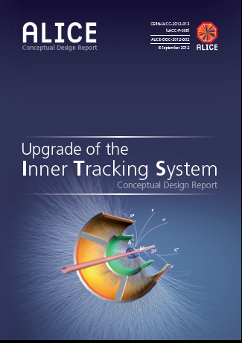
Challenges and requirements:
Improve impact parameter resolution factor of ~3 in r-φ (z) at 500 MeV/c)
First layer closer to interaction point: r0 = 39 mm → 22 mm
Smaller beam pipe radius: 29 mm → 18.2 mm
Smaller pixel size: 50 μm x 425 μm → 28 μm x 28 μm
Improve tracking efficiency and p_{T} resolution at low p_{T}
Increase the number of layers 6 →7
Easier maintenance
Fast readout : 1 kHz → 50 kHz in Pb-Pb, 200 kHz in pp
Low-material budget (< 0.3% Xo for 3 inner layers)
CDR: Endorsed by LHCC
in Sept. 2012
ITS Upgrade TDR:
in March 2014
  → New, high-resolution, low-material, fully-monolithic inner tracker based on CMOS sensors!

Slide 10
Upgraded ALICE ITS design
Based on high resistivity epitaxial layer
Monolithic Active Pixel Sensors (MAPS)

Slide 11
CMOS Pixel Sensor
J. Phys. G: Nucl. Part. Phys. 41 (2014) 087002
TowerJazz 0.18μm CMOS Imaging Process
Pixel pitch ~ 30 μm
High-resistivity (> 1kΩ cm) p-type
epitaxial layer (25μm) on p-type substrate
Small n-well diode (2 μm diameter),
=> low capacitance
Reverse bias voltage to substrate
(contact from the top) can be used
to increase depletion zone around NWELL collection diode
Deep PWELL shields NWELL of PMOS
Transistors
Very low power dissipation
(<300nW/pixel)
Schematic of MAPS pixel
in imaging CMOS TowerJazz 0.18 μm technology

Slide 12
PIXEL Chip – General Requirements and ALPIDE Specifications
Parameter | Inner Barrel (IB) | Outer Barrel (OB)
ALICE-TDR-017, Upgrade of the ALICE Inner Tracking System , CERN-LHCC-2013-024 02 December 2013
Notes:
(*) Colour code: ALPIDE specifica:ons if different from requirements
(**) 10 x radia:on load integrated over approved programme (~ 6 years of opera:on)

Slide 13
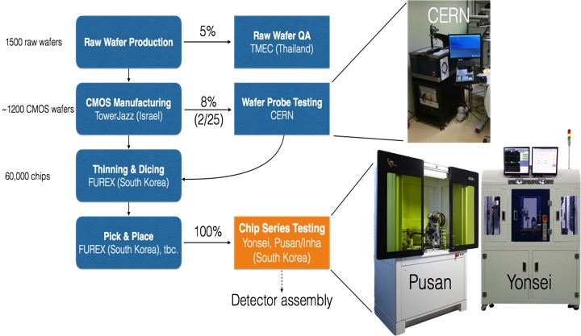
Chip Production – Overview

Slide 14
ALPIDE Chip

Slide 15

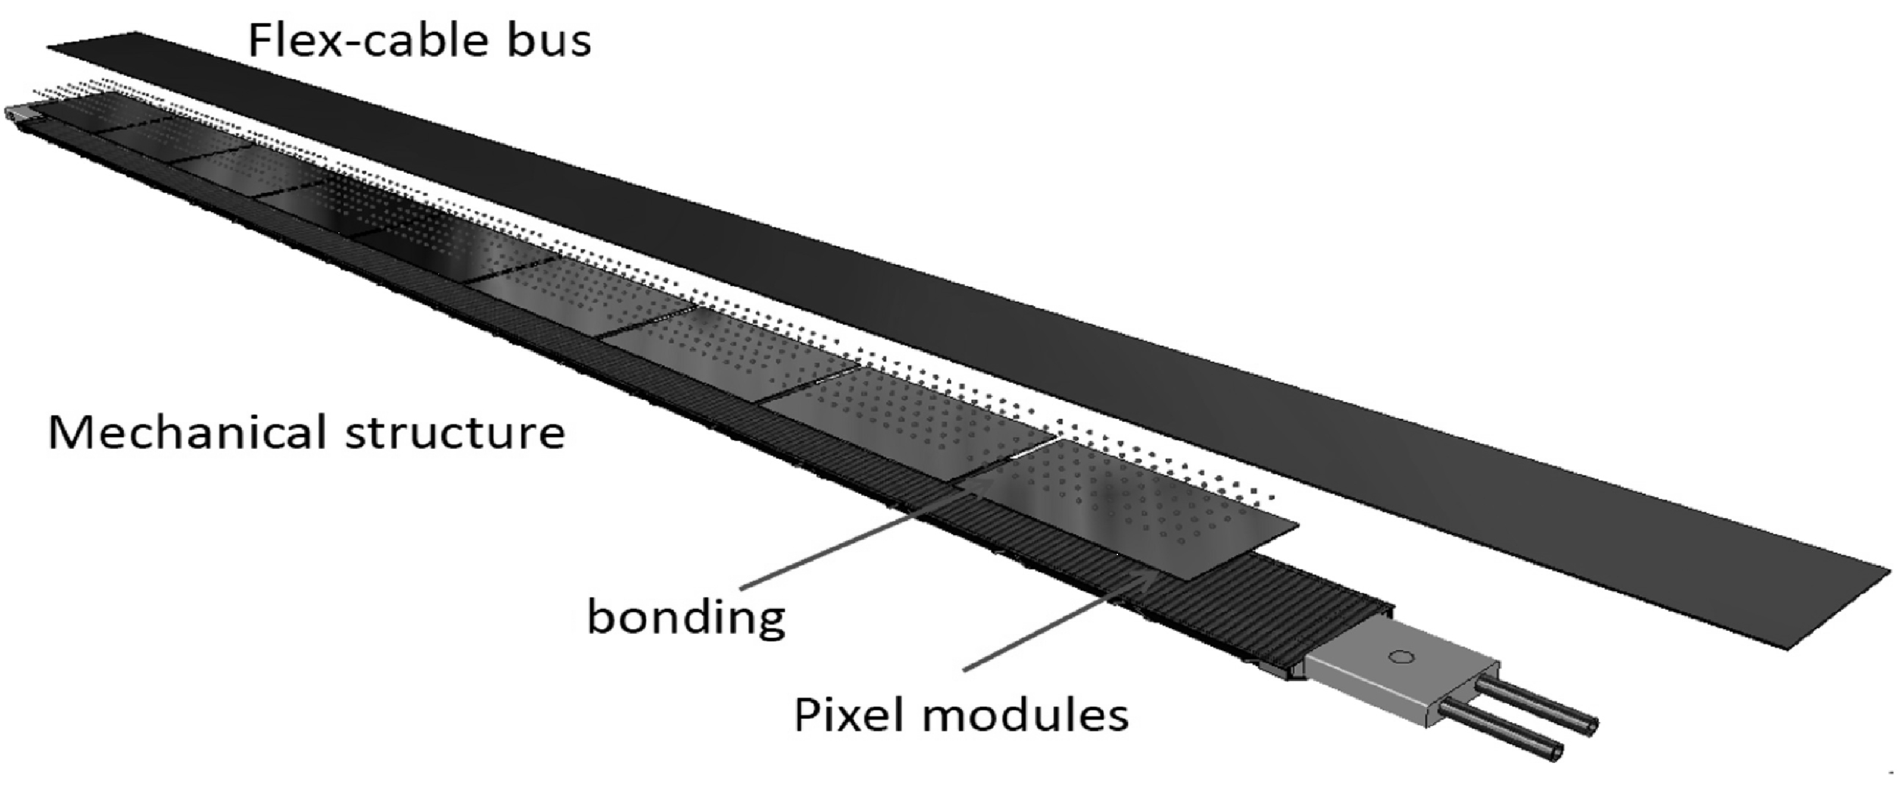
ALICE technology for IB staves:
JINST 9 P06005(2014)
Thickness of detector components in terms of fraction of radiation length X/Xo -
Material | Thickness (μm) | Xo (cm) | X/Xo (%)
Polyimide cooling pipe wall | 25 μm | 28.41 | 0.003
Carbon fleece | 40 μm | 106.8 | 0.004
Water | 1mm | 35.76 | 0.032
Carbon fiber plate K13D2U | 70 μm | 26.08 | 0.027
Graphite foil | 30μm | 26.56 | 0.011
Thermal greese (glue) | 100μm | 44.37 | 0.023
Si-sensor | 50μm | 9.36 | 0.064
Total (without FPC) |  |  | 0.154
Total |  |  | <0.3
ALPIDE chip
Record level of radiation transparency <0.3% Xo
24.09.17

Slide 16
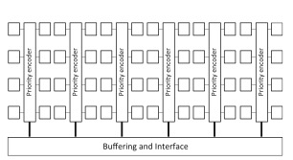
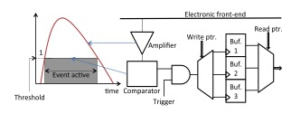
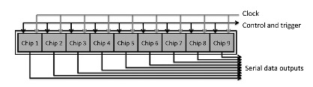
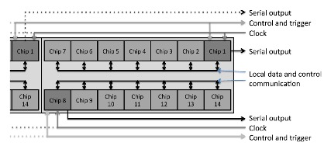
Readout of ALPIDE chips
NIMA 824 (2016) 465–469
ALPIDE pixel cell
Sketch of the ALPIDE architecture.
The Outer Barrel half-stave readout .
The Inner Barrel stave readout

Slide 17
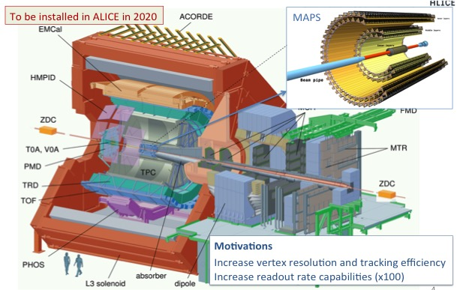
Upgrade of the ALICE Inner Tracking System
  → New, high-resolution, low-material, fully-monolithic inner tracker.

Slide 18
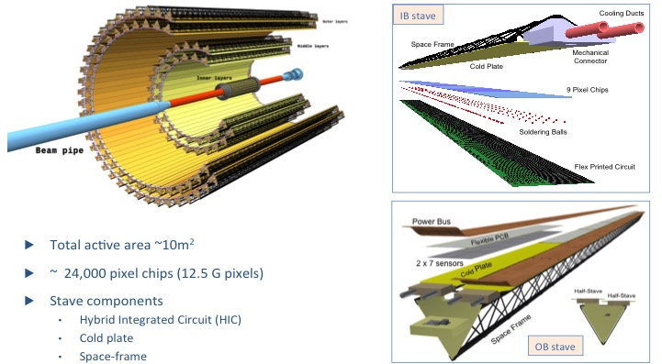
New ITS design

Slide 19
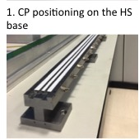
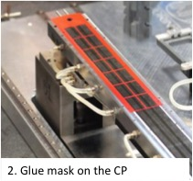
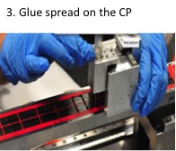

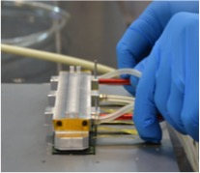
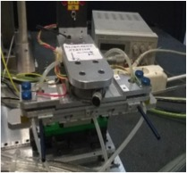
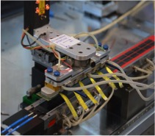
Hybrid Integrated Circuit (HIC) and Stave Production
3. Glue spread on the CP
4. HIC gripped by the HIC gripper
5. HIC gripper fixed to the Alignment station
6. HIC alignment

Slide 20
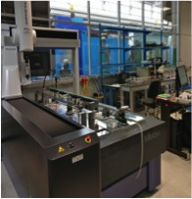
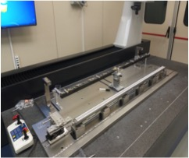
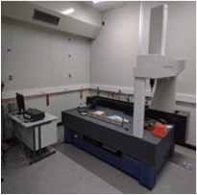
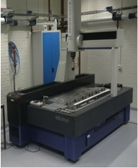
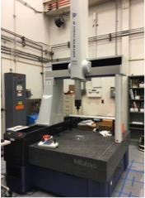
Stave Assembly – Production Sites
TORINO
FRASCATI
DARESBURY
READY
DONE
DONE
READY
DONE
DONE
READY
TO BE DONE
TO BE DONE
NIKHEF
BERKELEY
Readiness of laboratories:
Infrastructures and tooling
Training on assembly procedures
Training on test procedures
READY
DONE
TO BE DONE
READY
DONE
TO BE DONE

Slide 21
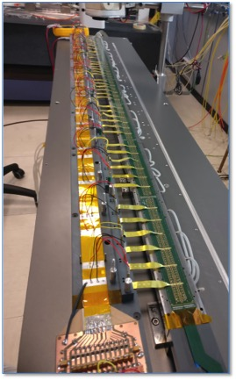
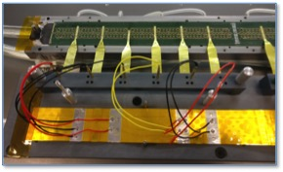
Stave prototypes
Assembly of Stave-0 completed using prototype HICs
Used to validate design and layout for production readiness review; characterisation results reproduced performance measured on single HICs
Assembly of Stave-1 ongoing; first half-stave completed, tests show all 98 chips fully functional

Slide 22
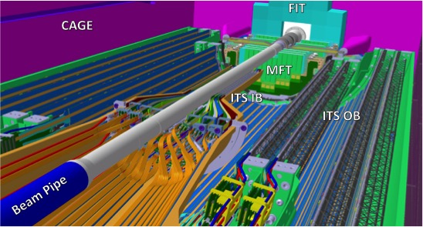
3D view of the new ITS layout
ITS IB
Inner Barrel (ITS IB)
Material thickness per detector layer: ~ 0.3% X/X₀ ₎

Slide 23
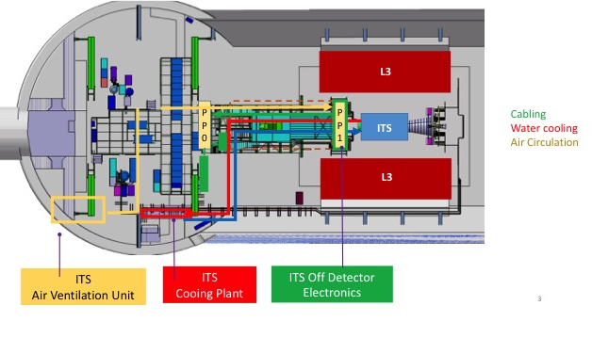
Services Layout in the ALICE Cavern

Slide 24
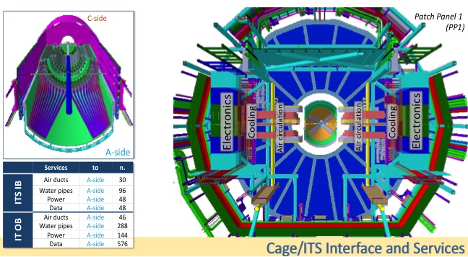
Services: Interface Cage of New ITS

Slide 25
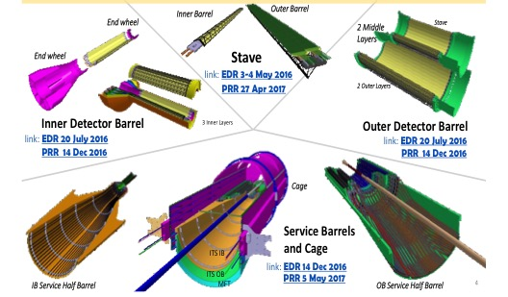
Services, Mechanics and Cooling Overview
IN PRODUCTION PHASE
Dry Assembly Test at the end of 2017

Slide 26
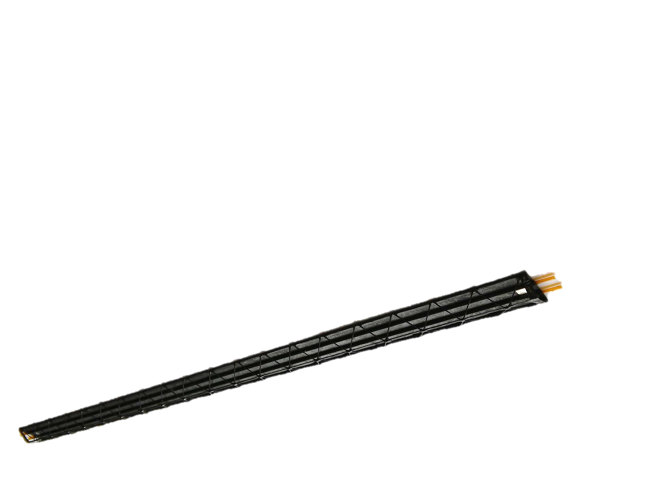
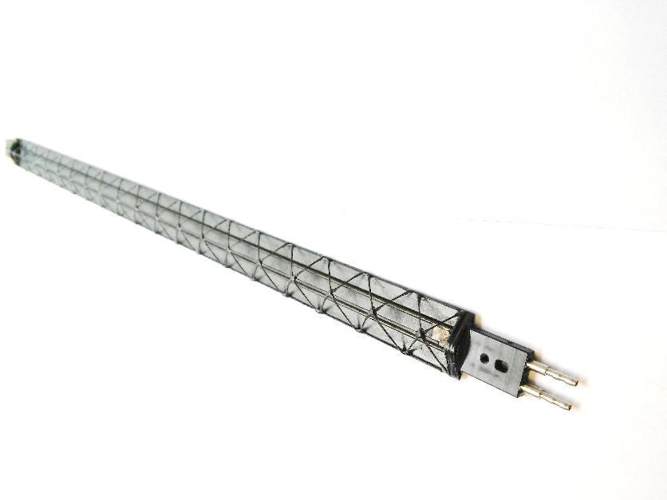
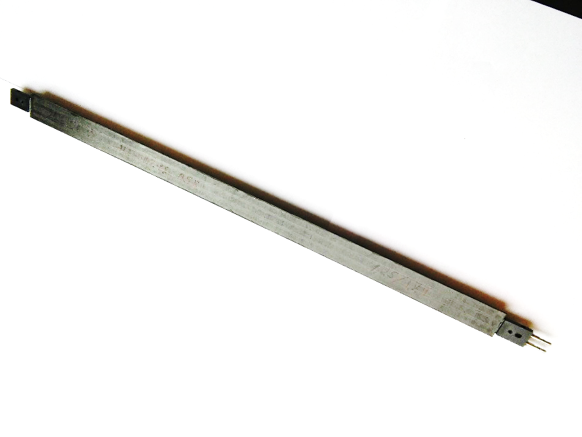


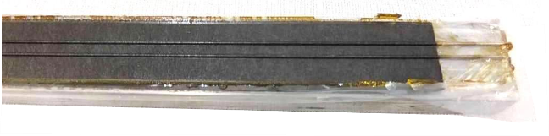
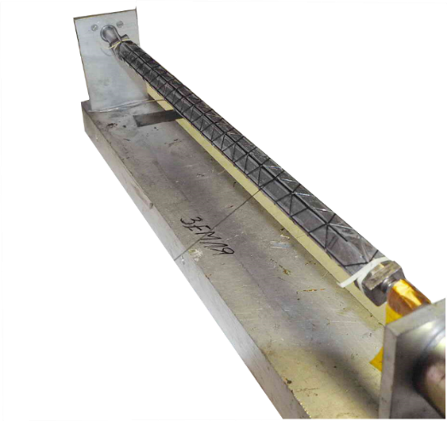
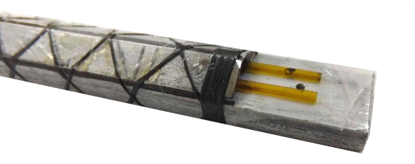
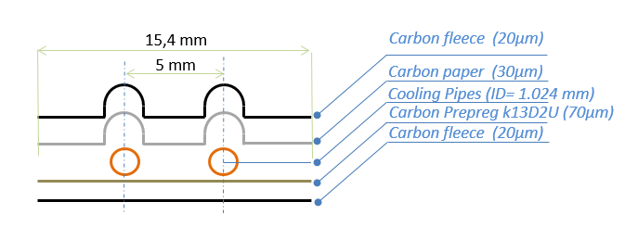
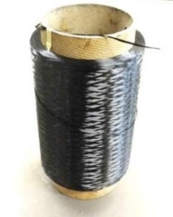
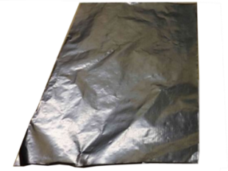
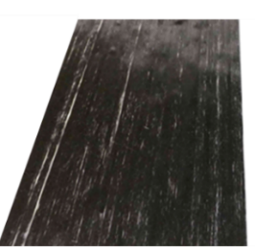
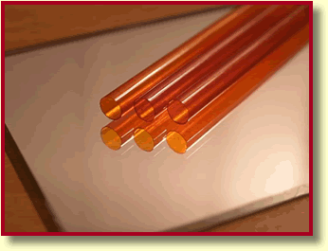
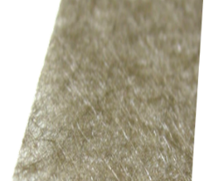
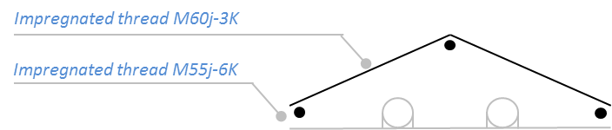
2017: Spaceframe production status: IB
PRR 27 April 2017
CARBON PARTS PRODUCTION FINISHED
Positioning
Cooling
Stiffness
0.3 m, 1.7gr
Light-stiff mechanical Space Frame
Light-high thermal conductive
Cold Plate
Stave Precise positioning
end pieces
Production at
Number of Space Frame produced to date for the ITS Inner Barrel are 170 out of 106 (40*)
Total number of structures needed IB Layer 0,1,2: 12+16+20pc = 48pc; spare 120%; total 106 SF
* with connectors and fittings
Cold Plate
Space Frame
Water leak-less cooling
(-- below atmospheric pressure).
Pipe Burst pressure at 51bar
Manual Layup
Filament winding
Embedded polyimide pipes Pyre M.L.®
Amec FGS_003
M60J
fleece
K13D 2U
ITS Plenary Meeting, 10 July 2017. Corrado Gargiulo

Slide 27
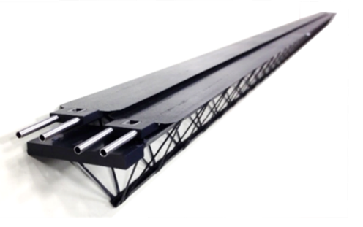
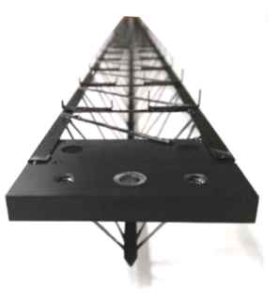
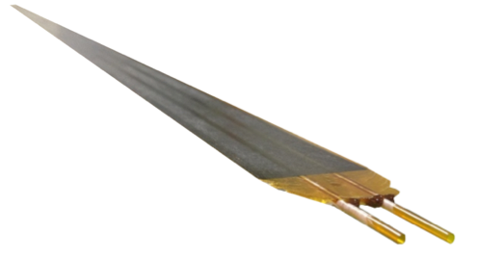

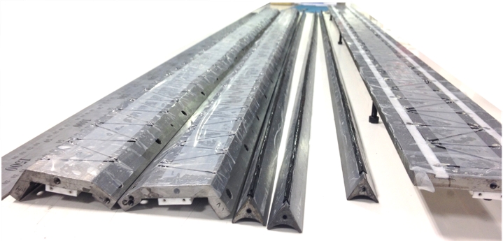
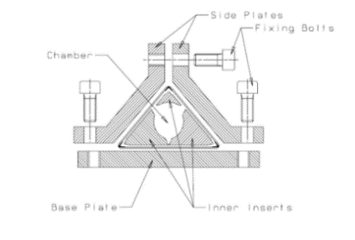
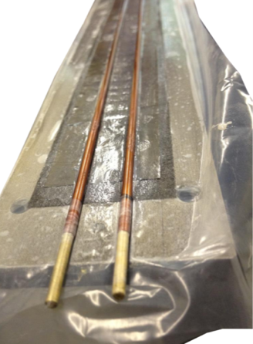
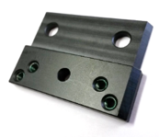

2017: OB Spaceframe Production
Spaceframe CARBON PARTS PRODUCTION FINISHED
Positioning
Stiffness
Cooling
1.5 m, 40 g
1.5m, 21g
Connection between
Space Frame and Cold Plate
Stave Precise positioning
End Pieces
Light-stiff mechanical Space Frame
Light - high thermal conductive
Cold Plate
-- for the Middle Layers: 82 SF out of 65 (9*), 140 CP out of 130
--for the Outer Layers: 140 SF out of 108 (12*), 230 CPout of 216 (75*)
Production
at
Number of Space Frames (SF) and
Cold Plates (CP) produced to date
* with connectors and fittings
A set of structures is ready for delivery to the integration centers
Total number of structures needed:
OB ML (layer 3,4): 24+30 pc = 54pc; spare 20%; total 65 SF (130 CP)
OB OL (layer 5,6): 42+48 pc = 90pc; 20%spare; total 108 SF (216 CP)
Polyimide pipes
Carbon peek machined part
M55j thread
Filament deposition
Carbon paper (FGA)
Carbon fleece
Manual layup
M55j prepreg
27

Slide 28
Inner Barrel (IB) mock-up and prototype
Composite parts production is well advanced

Slide 29






DETECTOR BARREL Mechanics production status: IB
PRR 27 Dec 2016
END WHEEL carbon parts
END WHEEL (EW) carbon assembly
EW with ruby pads
All assembly jig for ruby pads gluing produced
END WHEEL carbon parts produced to date 3x EW0, 3x EW1, 3x EW2
END WHEEL carbon assembly produced to date 1x EW1, 0.5x EW2
END WHEEL with ruby pads produced to date 0.5x EW2
Total number of structures needed
Nominal=1 EW0, 1 EW1, 1 EW2 + 1 CYSS; spare 120%; total 3 EW0, 3 EW2, 3 EW3, 3 CYSS
Production
at
Number of
CYSS
Cylindrical Structural Shell.
ITS Plenary Meeting, 10 July 2017. Corrado Gargiulo

Slide 30







DETECTOR BARREL Mechanics production status: OB
PRR 27 Dec 2016
END WHEEL with ruby pads
COSS
Conical Structural Shells
END WHEEL carbon parts
Prototype phase completed, tender closed, contract assigned LOSON, Carbon Material procured, Moulds produced
Number of:
END WHEEL (EW) carbon parts and
END WHEEL with ruby pads produced to date # end production foreseen
EW6 Jul, EW 4 Sept, EW3 5 October 2017
n. of COSS produced to date # end production foreseen Sept
Production at
Loson Compositi
Production at
Total number of structures needed
n.1 EW3, n.1 EW4, n.1 EW5,n.1 EW 6, n.1 COSS, n1 CYSS
Cylindrical Structural Shells (CYSS) produced to date # end production
was foreseen in July 2017 Conical Structural Shells (COSS)
Prototype phase completed, Carbon Material procured, use of existing mould
CYSS
Cylindrical Structural Shells
ITS Plenary Meeting, 10 July 2017. Corrado Gargiulo

Slide 31












Service Barrel Mechanics production status: IB and OB
PRR 5 May 2016
IB Service Barrel
Prototype phase completed, Carbon Material procured, Mould material procured, Mould machining done in May 2017.
Production at CERN EP DT Composite Lab
IB SERVICE BARREL production in progress
Total number of structures needed: 1 IB Service Barrel, 1 OB Service Barrel
Production at
OB SERVICE BARREL production in progress
Prototype phase completed, Carbon Material procured, Mould production next
OB Service Barrel

Slide 32

Outer Barrel Mechanics at LBNL
Fabrication of large composite structures is progressing well, expected to be completed by October 2017
Will be shipped to CERN
Dry assembly test will take place in Nov-Dec 2017

Slide 33

Service Barrel Patch Panels (PP)
Patch Panel (PP) at OB Service Barrel(SB)
cooling
4- Samtec cables
Power connectors OB-ML (D=22mm), OB-OL 106(D=37 mm)
Increase of connector size (D=24mm),(D=40mm) under study
Final assessment needs definition of Samtec Connector
The room available at the end of the OB service barrel is limited compared to the number of services and connectors
The patch panel needs to be displaced away from the end of the SB in order
to gain more room for the connectors. Samtec connectors to be decided.
PP layout under study

Slide 34
Production readiness reviews(PRRs)
2016
2017
2018
2019
2020
Development
PRR
Sensor Series Production
CMOS processing, thinning & dicing, test
Stave Develop
PRR
Stave Mechanics
HIC Production
Hic and Stave
Stave Production
Mechanical Support Structures
Dry Assembly Test
Development
Production
EDR
PRR
Readout Electronics
Global Assembly
Commissioning at Surface
Design & Prototyping
Design & Prototyping
Production & Test
Installation
EDR
PRR
Commiss.
10 months
Commissioning in ALICE
2016
2017
2018
2019
2020

Slide 35
Summary
The following results were provided by the ITS/ALICE collaboration for the upgrade preparation during the LS1:
the Research and Design was completed in 2012–2014;
the evaluation of technologies and prototypes, selection of technologies, engineering, design, TDR, final design - were finished in 2014 -- 2016 .
2017 – Production phase started to provide:
The extremely low material budget for the ITS (~ 0.3% Xo for 3 innermost layers).
Improvement of the impact parameter resolution by a factor of ~3;
Reconstruction of charged particles starting from a p_{T} of ~50 MeV/c, and measurements of charm and beauty mesons down to zero p_{T} ;
Increase of the rate of data taking in Pb–Pb collisions from 1 kHz to ~50 kHz.
The project is well on track to meet the very challenging and ambitious schedule of 2018-2019!
New physics studies in Pb-Pb at the LHC will be opened by ALICE after 2020!

Slide 36

New physics by ALICE at the LHC
With Pb beams of high luminosity L=7x10²⁷cm⁻²s⁻¹
Thermalization of partons in the QGP, with focus on the massive charm and beauty quarks.
In-medium parton energy loss mechanism
Quarkonium dissociation as a probe of deconfinement
Production of thermal photons and low-mass dileptons
Production of D mesons, including Ds, down to zero p_{T} will be accessible for the first time.
    Charm and beauty baryons and . .
    For the first time via the decay → Λ_{c} + X .
    Baryon/meson ratios for charm ( /D) and for beauty (Λ_{b}/B), will be accessible for the first time.
    The elliptic flow (v2) of charmed and beauty mesons and baryons down to low p_{T} will also be accessible for the first time.
    Measurement of beauty via displaced D0 → Kp which will be accessible for the first time.
    Measurement of beauty via displaced J/psi → ee, which will also be accessible for the first time.
Λ_{c}
Λ_{b}
Λ_{b}
Technical Design Report for the Upgrade of the ALICE Inner Tracking System
J. Phys. G: Nucl. Part. Phys. 41 (2014) 087002
Λ_{c}
Gain a factor of 100 in statistics
^{over original programme}
^{(Run1 + Run2)}

Slide 37
Back-up slides

Slide 38
Chip Production – Overview

Slide 39
ITS Collaboration
Czech Republic (Prague), Slovakia (Kosice),

