Slide 1
Light output distribution in scintillator strips with wave length shifting fibers of DANSS spectrometer
The 3rd international conference on particle physics and astrophysics
N. Pogorelov¹ for the DANSS collaboration:
ITEP (Moscow) + JINR (Dubna)
¹ ITEP (Alikhanov Institute for Theoretical and Experimental Physics)
2-5 October 2017

Slide 2
Plan
General info about DANSS
Scintillator strips
Test bench
Non-uniformity of light output – profile
Impact of the non-uniformity on energy response

Slide 3
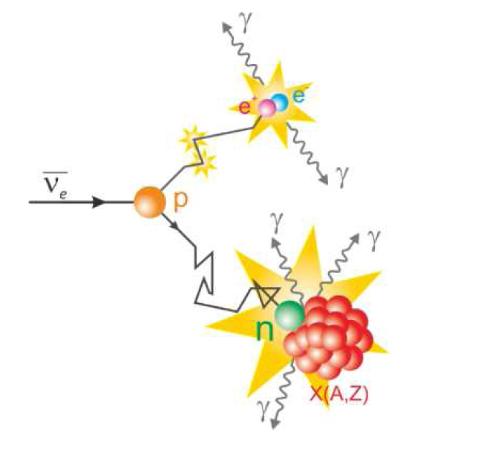
General info about DANSS
Spectrometer lies 10 m below the nuclear reactor
Reactor antineutrino is detected by inverse beta-decay. Energy outputs of positron annihilation and neutron capture are registered.
Search of sterile neutrino is the main task of the experiment.

Slide 4
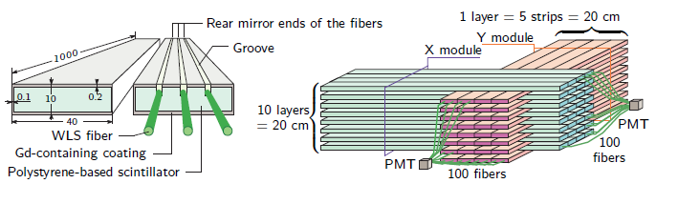
Scintillator strips
Spectrometer consists of 2500 strips, arranged in modules
Each strip has size 1х4х100 cm³
Each strip contains 3 wavelength shifting fibers, 2 side fibers go to РМТ, the central fiber goes to SiPM
Relative dependence between counts in SiPM/РМТ and position of energy release is very important for Monte-Carlo model of detector and data analysis.
Light in scintillator is divided between different fibers, so transverse profile of light collection must be taken into account. In order to address this problem, we constructed a test bench consisting of proportional chambers and scintillator strips

Slide 5
General outline of the test bench
PC – Proportional chamber (wires with step 1mm)
TS – Trigger strip
IS – Inner strip (similar to strips, used in DANSS)
PC`s give us coordinate resolution 0.3 mm. Sensitive area of chambers is 20х20cm², which cower only 20% of strip length. Measurements were done in three positions, so that center of the sensitive area lies in 20, 50 and 80 cm from the end, containing SiPMs. We study strips similar to strips, used in DANSS, but with all wave length shifting fibers connected to SiPMs.
Notes:
Указать точность 0.3 мм и шаг проволочек камер 1 мм. Расшифровать обозначения словами.

Slide 6
Building profile of light output
Dividing sensitive area along transverse coordinate with step 1 mm
Building spectrum in p.e./cm (length-normalized) in every slice for every SiPM
Finding median – vertical line, which bisects square below histogram
The error is defined as the root-mean-square deviation divided by the root of the number of events.
Dependence of the median on the coordinate is profile of the light output
A hit is included in spectrum, if…
… there are at least 5 р.е.
… slope of the track in the transverse plane is not more than 0.1
… the track is found in both projections (χ²≤6)
… the ratio median/error is at least 10

Slide 7
Examples of profile and spectrum
Three colors are correspondent to three fibers. Groves are in predictable places.
Notes:
Подписать профили.

Slide 8
Insensitive area at the borders of inner strips
Layer | Size of insensitive area at 50 cm – point, mm | Size of insensitive area at 20 cm – point, mm
Top | 0.66±0.08 | 0.54±0.14
Middle | 0.48±0.08 | 0.50±0.11
Bottom | 0.62±0.08 | 0.52±0.17
Measured size of gap is correspondent to predictable (gap + cover) in all positions.
Notes:
Написать, что оно соответствует предсказанному зазору + гадолинию. Слишком надолго остановился.

Slide 9
Non-uniformity impact on SiPM and PMT respond in DANSS
PMT
SiPM
Impact of the non-uniformity to energy resolution could be estimated by average dependence of the signal on coordinate in the strip in relative values. RMS is about 14.2% for SiPM and about 6.7% for PMT.
Notes:
Подписать профили

Slide 10
Non-uniformity impact on the respond of one strip in DANSS-spectrometer
PMT+SiPM
In the analysis of data from the DANSS we sum response of both types of the detectors. This procedure results in non-uniformity of about 7.8%.
Notes:
Складываем для фотостатистики именно с равными весами.

Slide 11
Conclusion
Non-unirotmity of light yield cause small (~8%) but accountable contribution to the energy resolution of the DANSS detector.
This result could be useful in construction of similar detectors.

Slide 12
Thanks for your attention

