Slide 1
STUDY OF COSMIC RAY SOURCES
USING DATA ON EXTRAGALACTIC DIFFUSE GAMMA-RAY EMISSION
A. Uryson
Lebedev Physical Institute RAS, Moscow

Slide 2
INTRODUCTION
UHECR data are obtained by Pierre Auger Observatory (PAO) and Telescope Array (TA):
CR energy spectrum; CR mass composition; CR arrival directions.
It is supposed that UHECRs are only weakly deflected in extragalactic magnetic fields.
Thus direct identification of sources is possible, using particle arrival directions.
Anisotropies in the arrival directions observed by PAO and TA are also examined.
No successful correlations of UHECRs with potential astrophysical sources
were found by these methods.
Data on CR mass composition obtained by PAO and TA are not in agreement.
Sources of ultrahigh energy cosmic rays (UHECR) are
presumably extragalactic objects – active galactic nuclei (AGN).
However they are not established and their acceleration mechanism is not clear.

Slide 3
ANOTHER METHOD TO STUDY UHECRs
(Berezinskii et al. 2016; Gavish, Eichler 2016; Uryson, 2016)
In space, UHECRs interact with cosmic microwave background and extragalactic background light.
It results in electromagnetic cascades initiating by UHECRs in extragalactic space.
Consequently UHECRs contribute to isotropic gamma-ray background.
Isotropic gamma-ray background (IGRB) is measured by Fermi LAT.
Therefore Fermi LAT data can be used for UHECR study:
1) different classes of AGN which are possible UHECR sources are considered
and UHECR spectra at the Earth are calculated;
2) gamma-ray emission I_{g} generated by UHECRs in extragalactic space is calculated;
3) the calculated gamma-ray intensity is compared with Fermi LAT IGRB,
and models of UHECR sources in which UHECR contribution in IGRB is
I_{g} > Fermi LAT IGRB are excluded.

Slide 4
Examined models of UHECR sources are:
AGNs with different evolution of density with redshift z,
AGNs with different values of index α in the generation spectrum E ^{-α}.
Here we analyze the class of AGNs in which supermassive black hole
is surrounded by a superstrong magnetic field of 10¹⁰ – 10¹¹ Gs
(in contrast to common value of 10⁴ Gs).
In this model an electric induction field can accelerate CRs
to extremely high energies, and CR protons escape the source at the energy of 10²¹ eV.
(Kardashev 1995-2001; Shatskii, Kardashev 2002; Kardashev et al. 2003).

Slide 5
THE MODEL
Due to acceleration mechanism we suppose the monoenergetic generation spectrum
in these AGNs.
Parameters of extragalactic background light: (Inoue et al. 2013).
3) Evolution of density with redshift z. Two cases:
3a) weak, similar to evolution of Blue Lacertae objects (BL Lacs) (Giachinti et al. 2015);
3b) similar to evolution of radio AGNs (Smolcic et al. 2017).
Computing: the public available code TransportCR (Kalashev, Kido 2015).

Slide 7
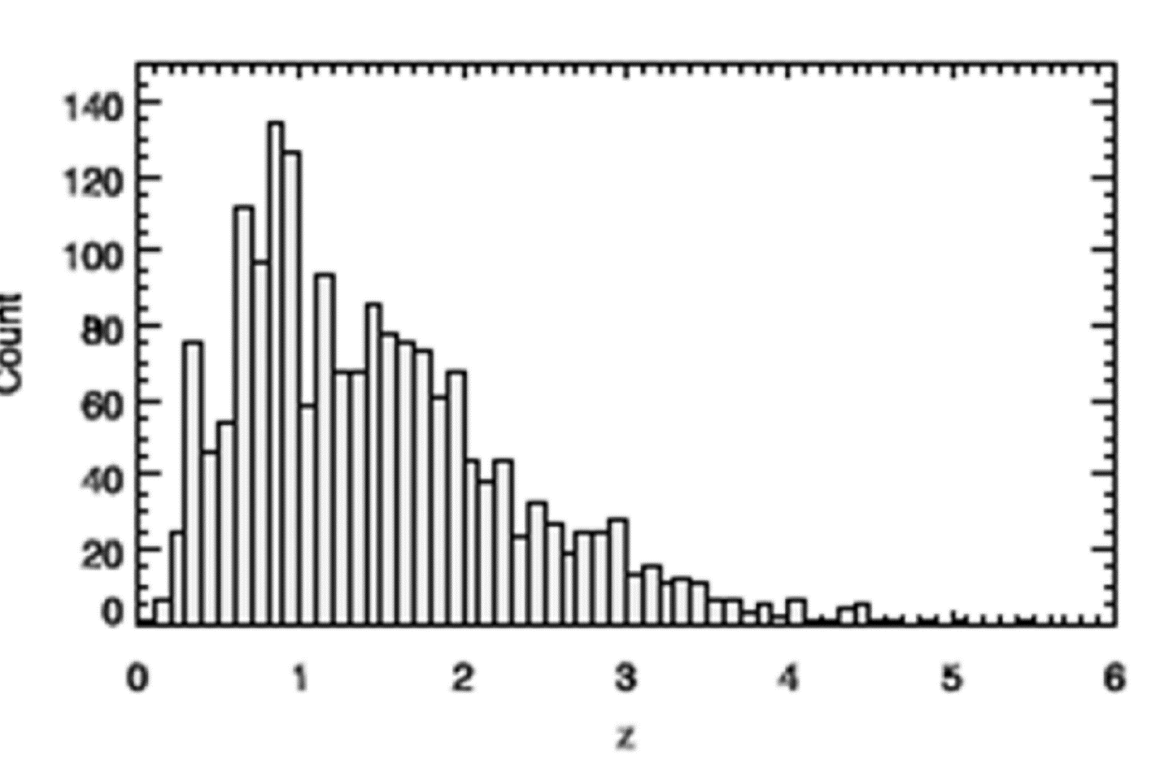

Slide 8
CR SPECTRA
In both cases of cosmic evolution CR energy spectra calculated are much lower than the PAO spectrum.
Thus the CR sources under consideration are only subdominant.
What is the UHECR contribution to the diffuse gamma-ray emission?

Slide 11
The FERMI LAT IGRB spectrum (Ackermann et al. 2014)

Slide 12
DIFFUSE GAMMA-RAY INTENSITY CALCULATED
Iγ (>50 GeV, z-dependence: BL Lac’s) = 7.80x10⁻¹⁰ (cm⁻² s⁻¹ sr⁻¹)
Iγ (>50 GeV, z-dependence: Smolcic 2017) = 1.28x10⁻⁹ (cm⁻² s⁻¹ sr⁻¹)
(Values are downshifted by 20% due to errors in UHECR flux.)

Slide 13
Fermi LAT IGRB (E>50 GeV)
IGRB = unresolved sources + CR in the Galaxy + extragalactic diffuse emission
Contribution of unresolved sources at E>50 GeV: 86 (+16, -14) % (Mauri 2016)
Then the minimal Fermi LAT IGRB (>50 GeV) = 0.28 Fermi LAT IGRB
CR in the Galaxy: foreground models (Ackermann et al. 2014)
Accounting for uncertainties (including systematic ones)
2.20x10⁻¹⁰ ≤ FERMI LAT IGRB (without unresolved sources) ≤ 5.40x10⁻⁹ (cm⁻² s⁻¹ sr⁻¹)

Slide 14
Contribution of subdominant UHECR sources to IGRB is:
Iγ (>50 GeV, z-dependence: BL Lac’s) / Fermi LAT IGRB = 0.14
Iγ (>50 GeV, z-dependence: Smolcic 2017) / Fermi LAT IGRB = 0.24

Slide 15
CONCLUSION
I consider AGNs with supermassive black holes surrounded by superstrong magnetic field
as possible UHECR sources.
It appears that these sources contribute negligibly to the CR flux at the Earth.
The contribution is irrespective of cosmic evolution model.
UHECRs from these objects contribute noticeably to IGRB: from 14 to 24 %.
Their contribution in IGRB should be taken into account
while investigating UHECR mass composition and dark matter decay with Fermi LAT data.

Slide 16
Thank you

