Slide 1
The PSD supermodule response study at proton beam energies 2-6 GeV at CERN test beams
Moscow, 2017

Slide 2
Outline
CBM@FAIR and MPD@NICA
Forward hadron calorimeters at CBM and MPD
Structure of calorimeters module
Supermodule of the PSD CBM
Facility for module response study at CERN
Preliminary test results
Summary and outlook

Slide 3
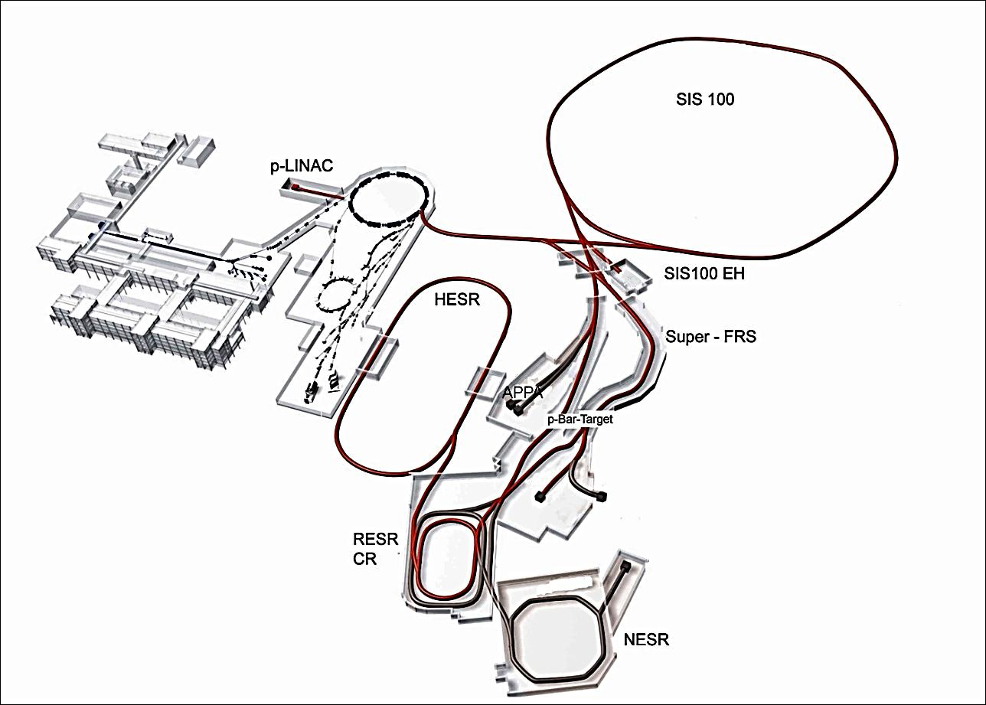
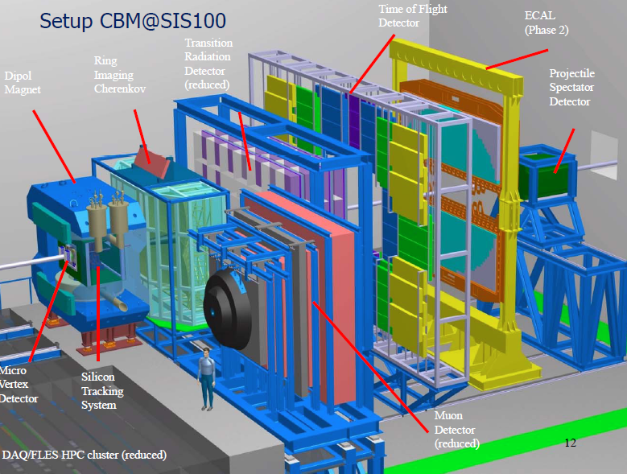
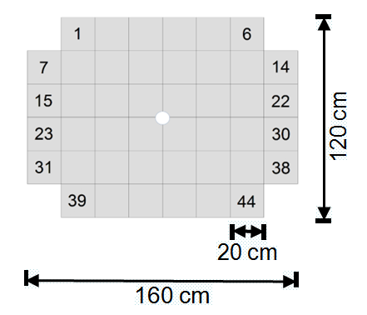
FAIR accelerator complex in Darmstadt
SIS100 is aimed to accelerate Au nuclei upto 11GeV/nucleon with intensity upto 10⁹ nuclei/sec.
CBM
СВМ experiment
APPA
PANDA
NUSTAR
CBM uses forward hadron calorimeter (Projectile Spectator Detector – PSD) to measure centrality and the reaction plane orientation.
Hadron calorimeter consists of 44 modules with transverse sizes
20х20см and 160см length.
Total weight - 22 tons.

Slide 4
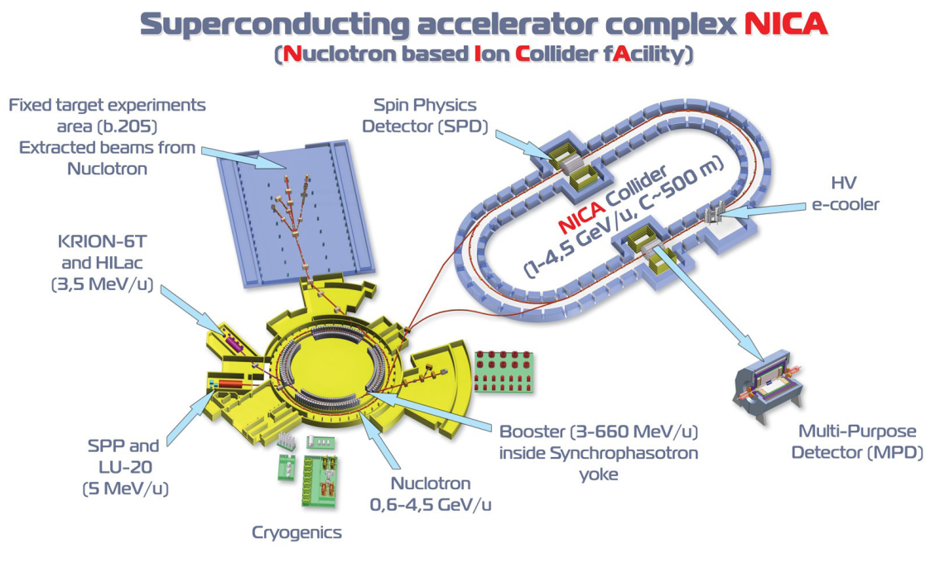
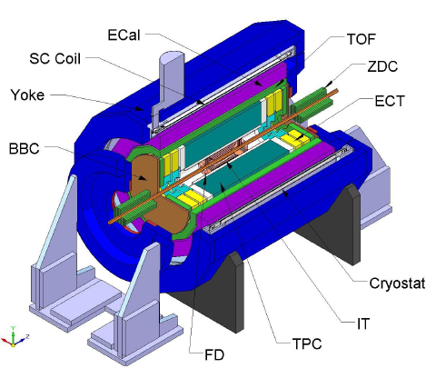
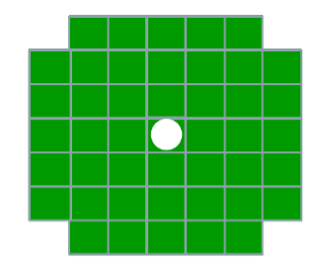
NICA accelerator complex in Dubna
Energies (c.m.s.) 4-10 GeV.
Beams – from protons to Au nuclei.
Luminosity – to 10²⁷ Au nuclei.
2 forward hadron calorimeters (FHCAL) are used in MPD to measure centrality and the reaction plane orientation.
MPD experiment
Each of hadron calorimeters consists of 44 modules with transverse sizes 15х15cm and 110cm length.

Slide 5
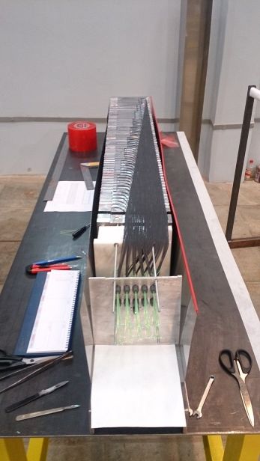
Hadron calorimeter module structure
MPPC& Preamplifires
60 lead-scintillator tiles
10 longitudinal sections
6 WLS/MPPC
10 MPPC/module
10 readout channels
All modules for the PSD and FHCAL are produced at INR

Slide 6
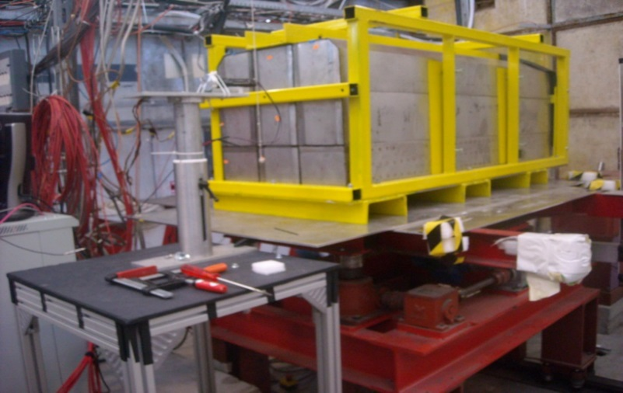
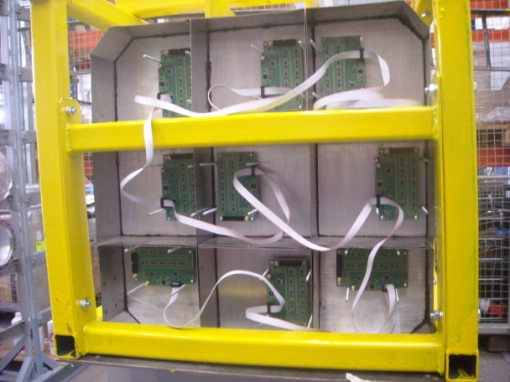
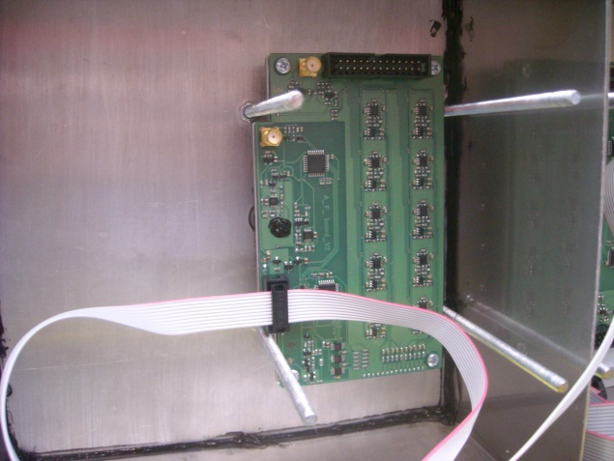
PSD supermodule
test on T10 at CERN (September 2017)
Supermodule – array of 3x3 modules.
Total size 600 x 600 x1650 mm³.
Total weight -5000 Kg.
PSD supermodule placed on
movable platform at T10 beam
Tasks:
PSD modules calibration with beam muons;
Study of PSD supermodule response at 2- 6 GeV/c (proton and pions) with Dubna FEE and readout electronics;

Slide 7
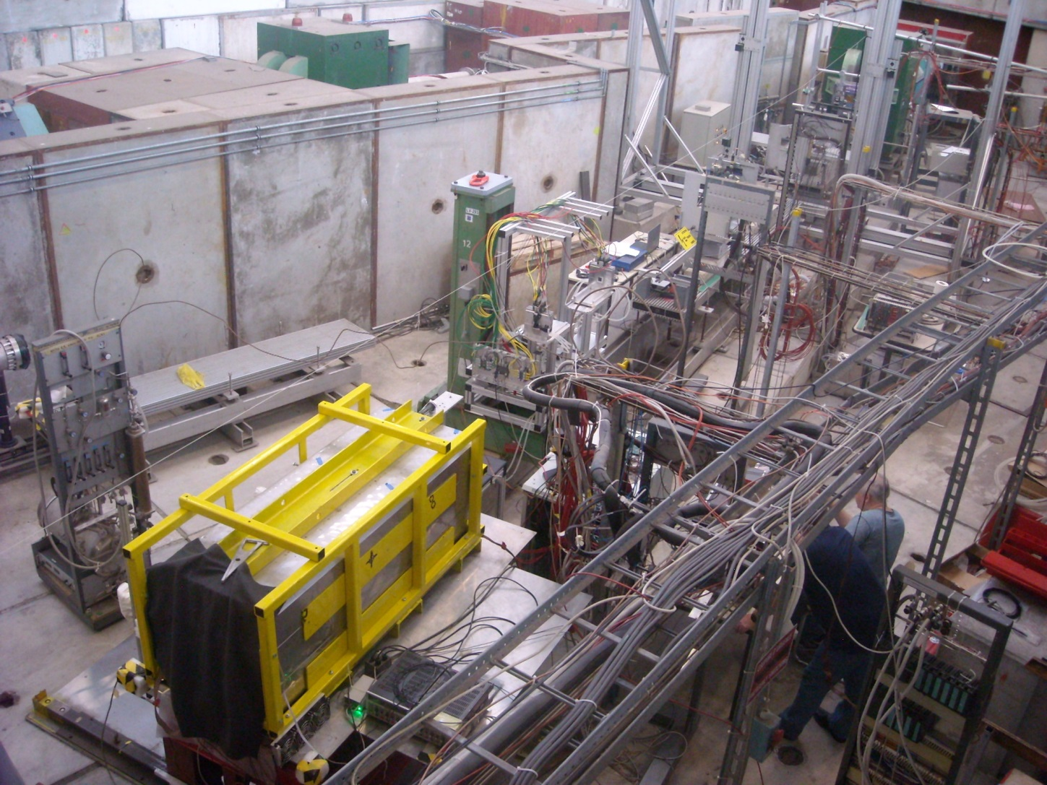
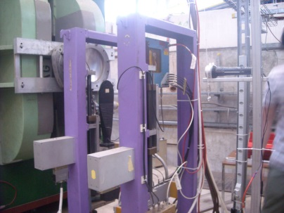
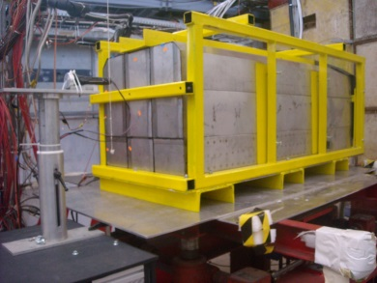
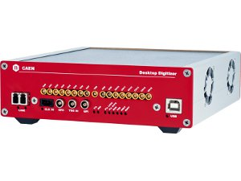
Test of PSD Supermodule on T10 beam at CERN
(6-20 September 2017)
2 quartz cherenkov detectors provided trigger and used
for beam particle
identification (σ_{t} ~ 60 psec)
ToF between 2 beam detectors has been measured by
CAEN DT5742 12 bit 5 GS/s
Switched Capacitor ADC

Slide 8
Scheme of measurements

Slide 9
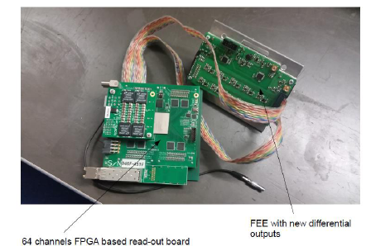
Dubna FEE and readout electronics for supermodule PSD
Hamamatsu MPPC:
size – 3x3 mm²;
pixel -10x10 µm²;
PDE~10%.
Gain 10⁵
Recov. time – 10 nsec
FEE
ADC64s
Integrator
ADC1
...
ADC64
Amp
MPPC
FPGA
Ethernet
1Gbit
τ ~ 50ns
τ ~ 1.2μs
FEE – 9 boards with 10 MPPCs
and amplifiers (Gain – about 10)
Readout: 2 x 64 channel
fast 12bit ADC64s board, 62.5MS/s
(AFI, JINR)

Slide 10
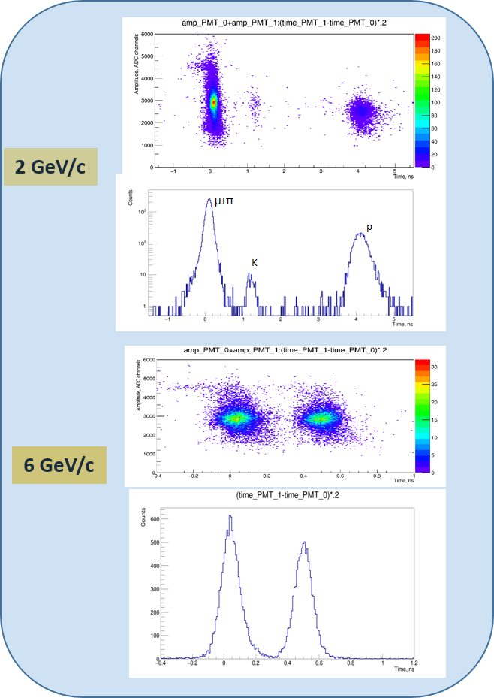
Beam particle identification on T10
Measured T10 beam composition
vs particle momentum
Beam composition
P(GeV/c)

Slide 11
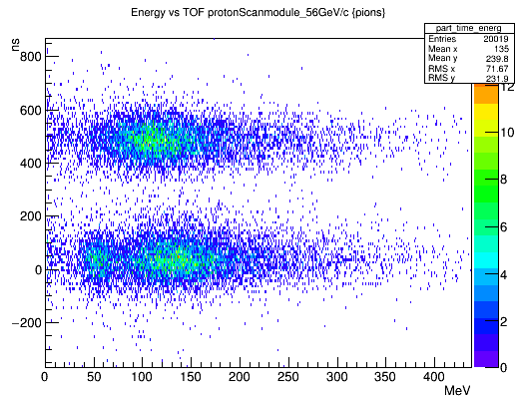
TOF vs Energy deposition in supermodule
for 6 Gev/c beam
P
TOF between beam counters,psec
π
μ
Energy deposition in supermodule, MeV

Slide 12
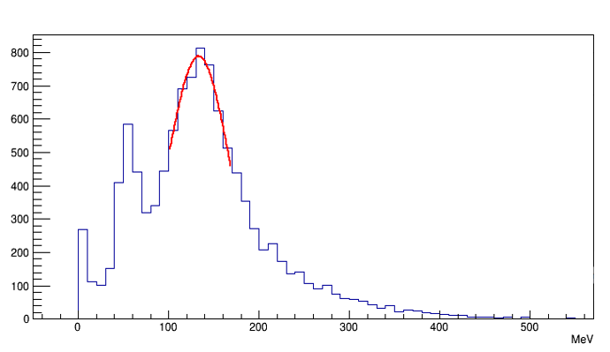
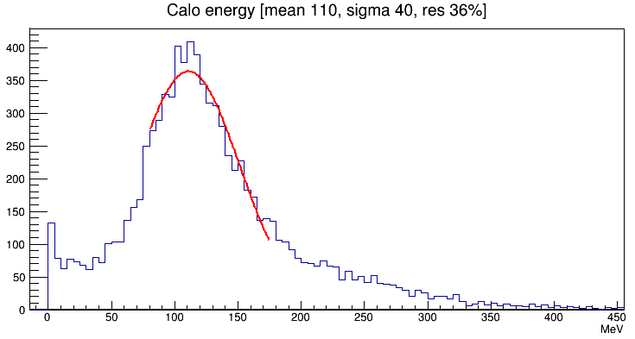
Reconstructed supermodule energy deposition
of pions and protons with momentum 6GeV/c
π
P
μ

Slide 13
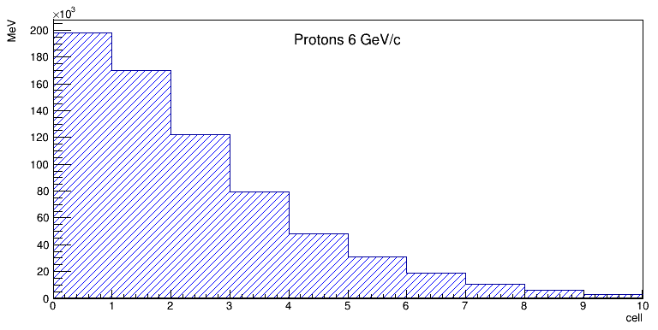
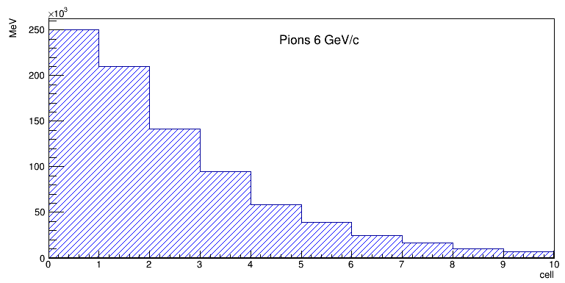
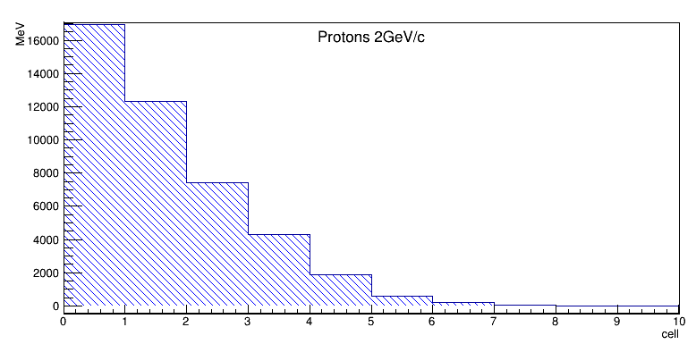
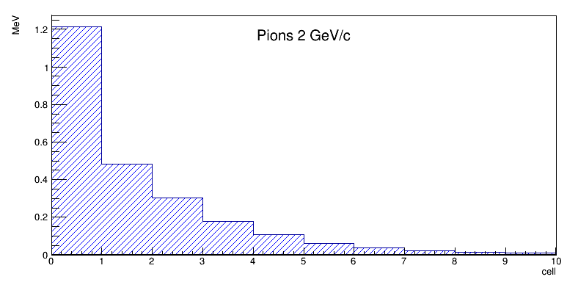
Energy deposition profile
for protons and pions in module 5
Protons 6 GeV/c
Pions 6 GeV/c
Mean E _{dep}, MeV
Mean E _{dep}, MeV
Cell number
Cell number
Protons 2 GeV/c
Pions 2 GeV/c
Mean E _{dep}, MeV
Mean E _{dep}, MeV
Cell number
Cell number

Slide 14
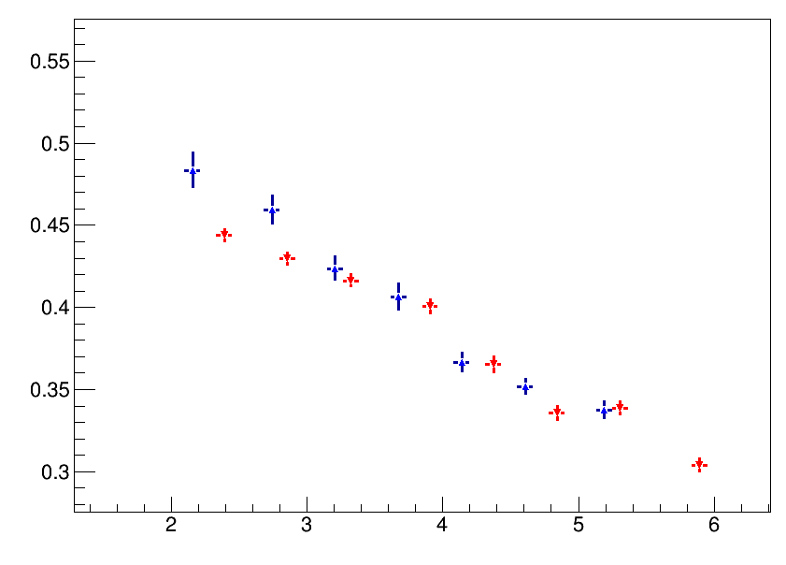
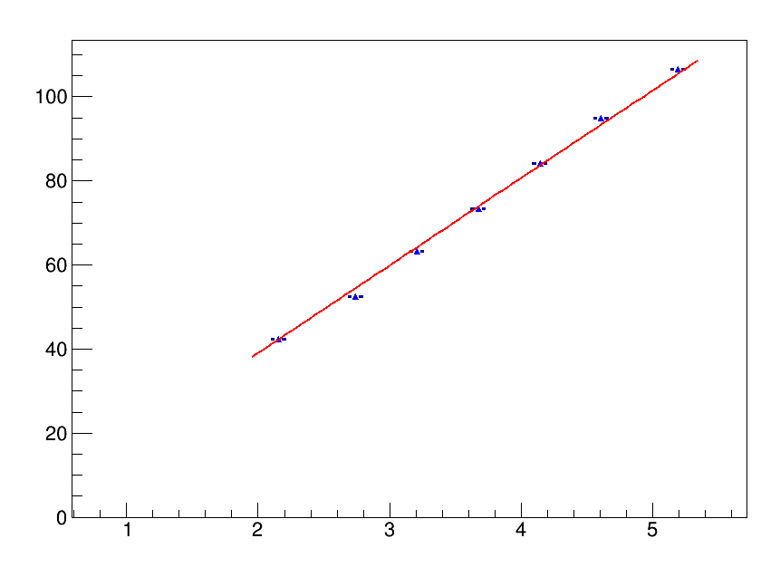
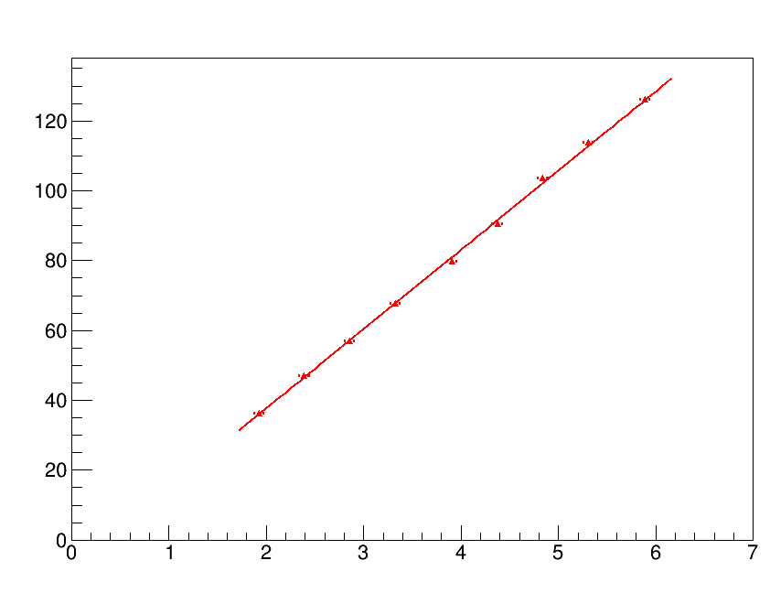
Supermodule energy resolution
and linearity for protons and pions
● protons
● pions
Energy resolution
E _{kin} , GeV
Mean energy deposition
Mean energy deposition
Proton beam energy, GeV
Pion beam energy, GeV

Slide 15
Summary and outlook
Response of the PSD CBM has been studied at very low hadron energies for the first time.
PSD modules have been calibrated by beam muons.
Energy resolution and linearity of supermodule were measured for low beam energies
Next test of supermodule at proton beam energies upto 10 GeV is planned to perform in November-December 2017.

Slide 16
Thanks for your attention

Slide 17
Backup slides

Slide 18
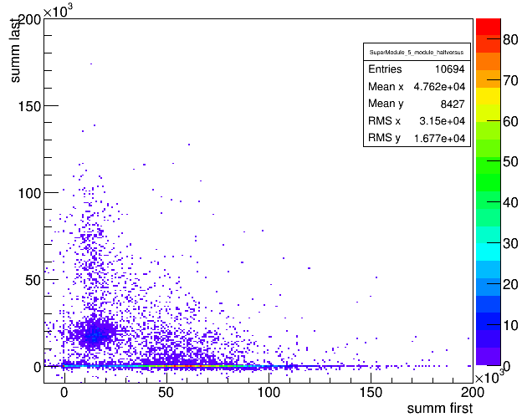
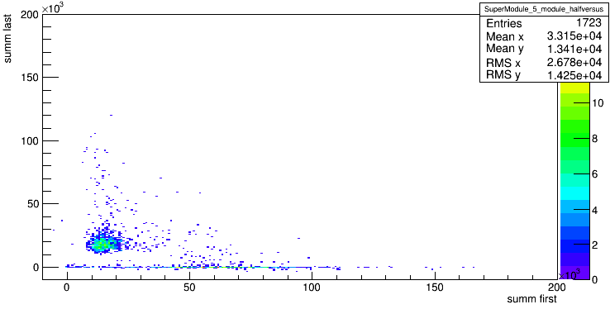
Muons selection by supermodule
Muons 6 GeV/c with beam dump
in T0 beam line
Muons / Pions separation 6 GeV/c beam
E _{dep} (chan.) for last five sections of module 5
E _{dep} (chan.) for last five sections of module 5
E _{dep} (chan.) for first five sections of module 5
E _{dep} (chan.) for first five sections of module 5

Slide 19
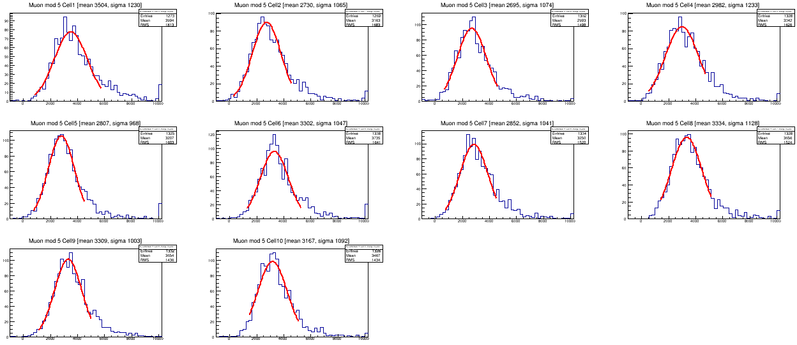
cell 1
cell 2
cell 3
cell 4
cell 5
cell 6
cell 7
cell 8
cell 9
cell 10
Muons energy deposition in 10 sections
of module 5 at beam momentum 6GeV/c

Slide 20
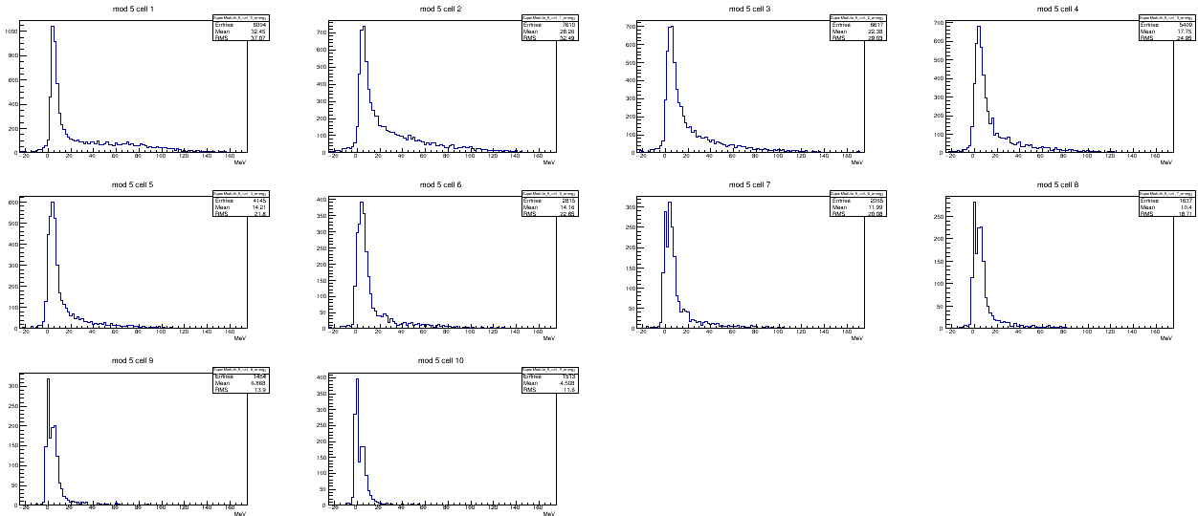
Pions, beam 6GeV/c module5
cell 1
cell 2
cell 3
cell 4
cell 5
cell 6
cell 7
cell 8
cell 9
cell 10

Slide 21
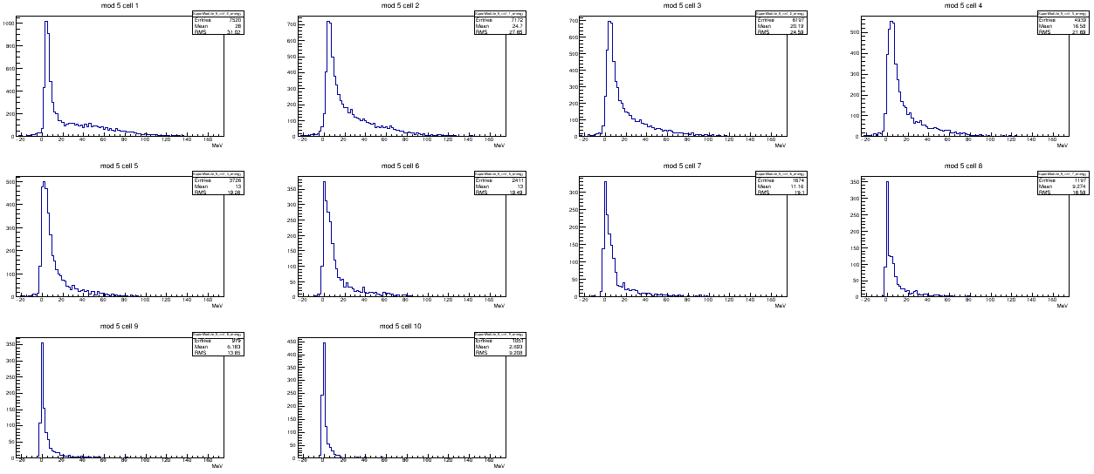
Protons, beam 6GeV/c module5
cell 1
cell 2
cell 3
cell 4
cell 5
cell 6
cell 7
cell 8
cell 9
cell 10

Slide 22
Определение центральности
PSD
$$C_{b1,b2}=\frac{σ_{b1,b2}}{σ_{tot}}$$
projectile spectators
b
STS+MVD
participants

Slide 23
Определение классов центральности по множественности треков
PSD1
CBM simulation, Au+Au, 10AGeV,
1.5M events, UrQMD
CBM simulation Au+Au, 10AGeV
1.5M events UrQMD
5% of events

Slide 24
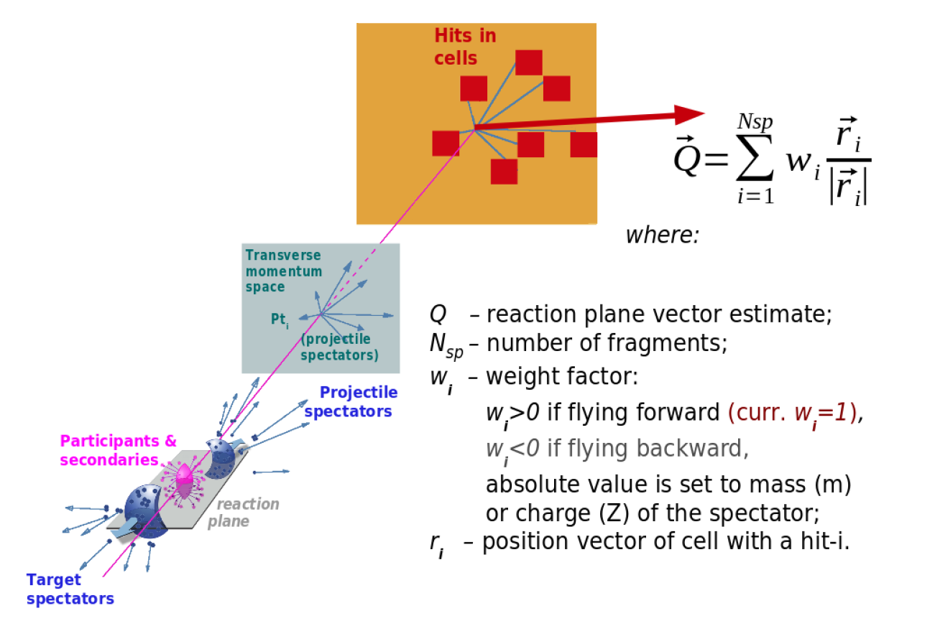
Определение плоскости реакции

Slide 25
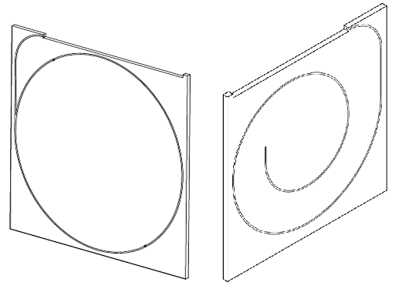
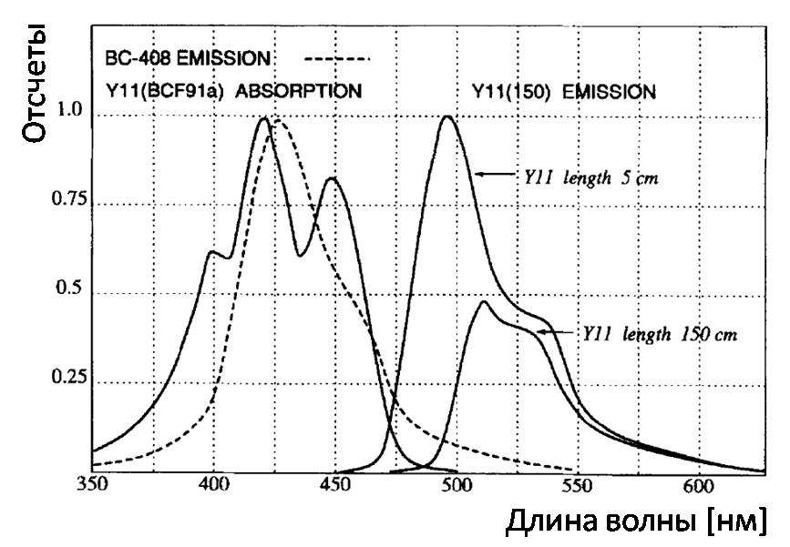
Сцинтилляционные пластины
Для съема света в обоих детекторах использовались переизлучающие оптоволокна фирмы Kuraray (Япония) типа Y11(200) S-type диаметром 1 мм.
Пластины для CBM 20х20х0.4 см³ (слева) и MPD 15х15х0.4 см³ (справа)
Спектры поглощения и излучения оптоволокна Y11

Slide 26
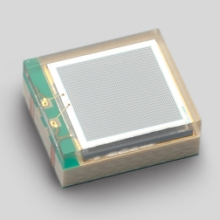
Фотодетектор – микропиксельный лавинный фотодиод
На конце оптоволокна установлен оптический разъем, к которому присоединен микропиксельный лавинный фотодиод.
Светочувствительная зона | 3 × 3 mm
Шаг пикселя | 10 μm
Количество пикселей | 90000
Спектральная чувствительность | от 320 до 900 nm
Пик чувствительности | 470 nm
Dark count (typ.) | 1000 kcps
Усиление | 1.35×10⁵
Эффективность регистрации фотонов | 10 %
HAMAMATSU MPPC S12572-010P

