Slide 1
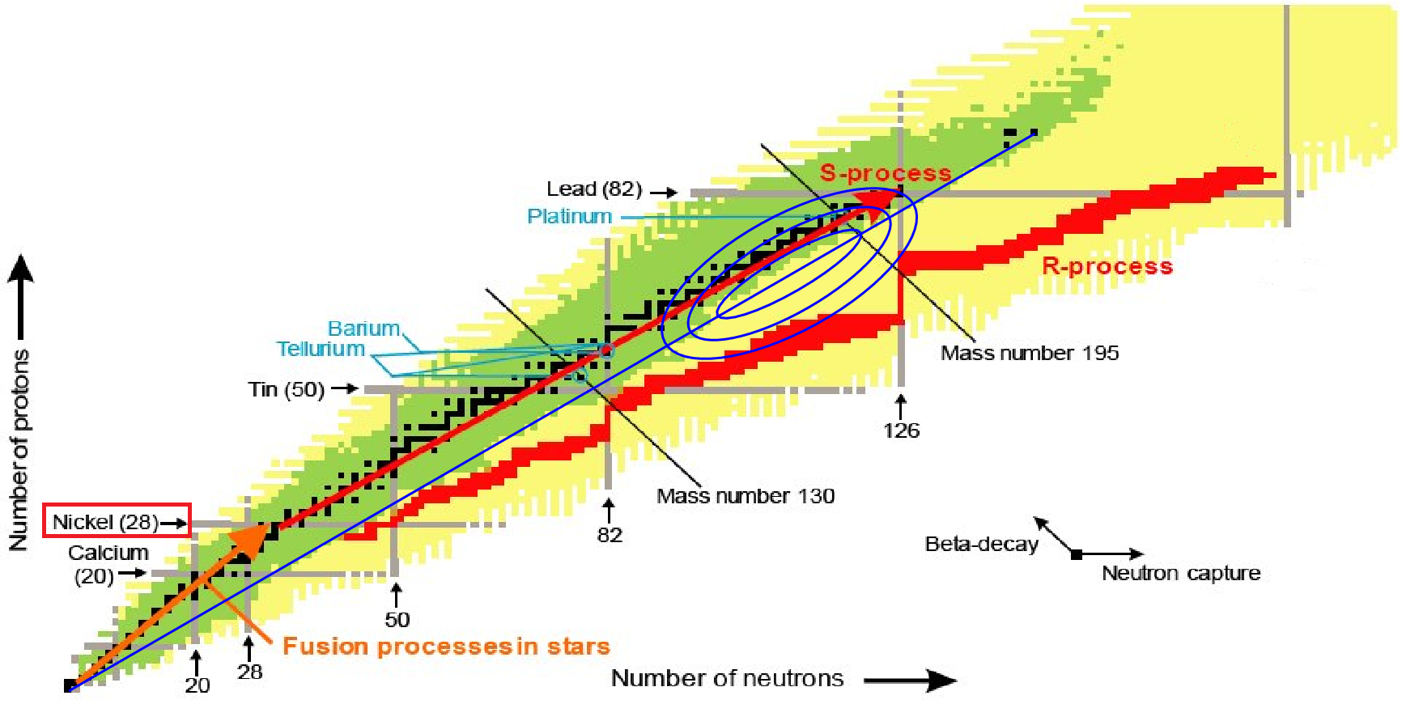
The impact of the tensor interaction on the β-delayed neutron emission of the neutron-rich Ni isotopes
E. O. Sushenok, A. P. Severyukhin, N. N. Arsenyev, I. N. Borzov
Bogoliubov Laboratory of Theoretical Physics, JINR

Slide 2
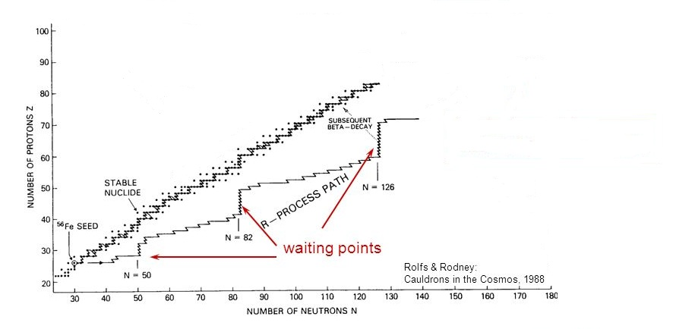
The β-decay properties of r-process “waiting-point nucleus” ⁷⁸Ni have attracted a lot of experimental efforts
The probabilities of the β-delayed neutron emission is a crucial quantity, that can provide insight into the microscopic structure of the nuclei involved in the β-decay process
M. Madurga et al., Phys. Rev. Lett. 117, 092502 (2016)

Slide 3
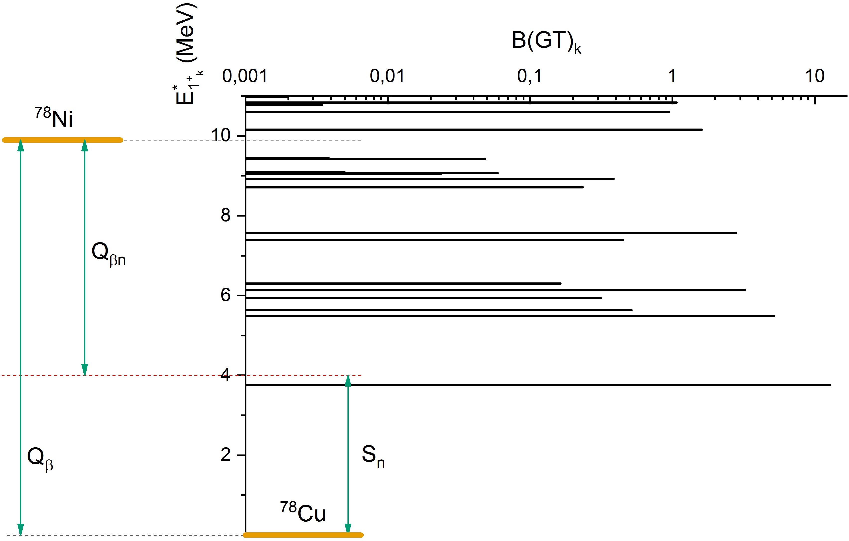
The β-decay of ⁷⁸Ni followed by the βn emission to the ground state of the product nucleus
$$Q_{β}=ΔM_{n−H}+B\left({}_{29}^{78}{Cu}\right)−B\left({}_{28}^{78}{Ni}\right)$$
$$S_{n}=B\left({}_{29}^{78}{Cu}\right)−B\left({}_{29}^{77}{Cu}\right)$$
$$Q_{βn}=Q_{β}−S_{n}$$

Slide 4
We use the Skyrme interaction, that consists of central, spin-orbit and tensor parts:
$$v^{c}\left(R,r\right)=t_{0}\left(1+x_{0}{\hat{P}}_{σ}\right)δ\left(r\right)+\frac{1}{6}t_{3}\left(1+x_{3}{\hat{P}}_{σ}\right)ρ^{α}\left(R\right)δ\left(r\right)+\frac{1}{6}t_{1}\left(1+x_{1}{\hat{P}}_{σ}\right)\left[{k′}^{2}+k^{2}\right]δ\left(r\right)+t_{2}\left(1+x_{2}{\hat{P}}_{σ}\right)k^{′}∙δ\left(r\right)k+iW_{0}\left(σ_{1}+σ_{2}\right)\left[k′×δ\left(r\right)k\right]$$
$$v^{t}\left(r\right)=\frac{3}{2}T\left\{\left[3\left(σ_{1}∙k′\right)\left(σ_{2}∙k′\right)−\left(σ_{1}∙σ_{2}\right){k′}^{2}\right]δ\left(r\right)+δ\left(r\right)\left[3\left(σ_{1}∙k\right)\left(σ_{2}∙k\right)−\left(σ_{1}∙σ_{2}\right)k^{2}\right]\right\}+3U\left[3\left(σ_{1}∙k′\right)δ\left(r\right)\left(σ_{2}∙k\right)−\left(σ_{1}∙σ_{2}\right)k∙δ\left(r\right)k′\right]$$
$r=r_{1}−r_{2}$; $R=\frac{1}{2}\left(r_{1}+r_{2}\right)$; $k=−\frac{i}{2}\left(∇_{1}−∇_{2}\right)$ acts on the right; $k′=\frac{i}{2}\left(∇_{1}−∇_{2}\right)$ acts on the left

Slide 5
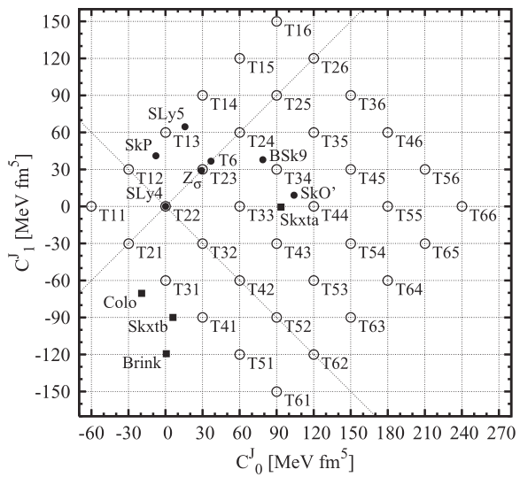
TIJ parametrizations
$$−\frac{ℏ^{2}}{2m_{q}^{∗}}∇^{2}φ_{i}−\left(∇\frac{ℏ^{2}}{2m_{q}^{∗}}\right)∇φ_{i}+\left(U_{q}+W_{q}\left(l∙s\right)\right)φ_{i}=ε_{i}φ_{i}$$
HF equations:
The inclusion of tensor terms modificates the spin-orbit potential in coordinate space:
$$W_{q}=\frac{W_{0}}{2r}\left(2\frac{dρ_{q}}{dr}+\frac{dρ_{q′}}{dr}\right)+\left(α\frac{J_{q}}{r}+β\frac{J_{q′}}{r}\right)$$
where $q=n,p$; $ρ_{q}$ and $J_{q}$ – nucleon and spin densities.
The indexes I and J denotes the contribution of the tensor terms:
$α=60\left(J−2\right)$ MeV·fm⁵
$β=60\left(I−2\right)$ MeV·fm⁵
The parameter sets T43 and T45 contain strong and weak neutron-proton tensor terms (with respect to like-particle tensor interaction).
$$C_{1}^{J}=\frac{1}{2}\left(α−β\right)$$
Tensor force
 | T43 | T45
$$β/α$$ | 2.0 | 0.7
$$C_{0}^{J}=\frac{1}{2}\left(α+β\right)$$
T. Lesinski, M. Bender, K. Bennaceur, T. Duguet, and J. Meyer, Phys. Rev. C 76, 014312 (2007)

Slide 6
HF-BCS
The quasiparticle representation defined by the canonical Bogoliubov’s transformation:
$$a_{jm}^{†}=u_{j}α_{jm}^{†}+{\left(−\right)}^{j−m}v_{j}α_{j−m}$$
The pairing correlations are generated by the zero-range force
$$V_{T=1}^{\left(pp\right)}\left(r_{1},r_{2}\right)=V_{0}\left(\frac{1−P_{σ}}{2}\right)δ\left(r_{1}−r_{2}\right)$$
$$V_{T=0}^{\left(pp\right)}\left(r_{1},r_{2}\right)={fV}_{0}\left(\frac{1+P_{σ}}{2}\right)δ\left(r_{1}−r_{2}\right)$$
The value of $V_{0}=−270$ MeV·fm³ is fixed to reproduce the odd-even mass difference of the studied nuclei. The parameter $f=1$ determines the ratio of $T=1$ and $T=0$ interactions in the pp-channel.
The pairing is taken into account in the BCS approximation. To calculate binding energies of the daughter nucleus $B\left(N−1,Z+1\right)$ and the final nucleus $B\left(N−1−X,Z+1\right)$, the blocking of the BCS ground states is taken into account. For ^{74,76,78}Cu the neutron quasiparticle blocking is based on filling the $1g_{9/2}$ subshell and the $2d_{5/2}$ subshell should be blocked for ⁸⁰Cu. The proton $2p_{3/2}$ and $1f_{5/2}$ subshells are chosen to be blocked in the cases of ^{74,76}Cu and ^{78,80}Cu, respectively.
V. G. Soloviev, Kgl. Dan. Vid. Selsk. Mat. Fys. Skr. 1, 238 (1961)
V.G. Soloviev, Theory of Complex Nuclei (Nauka, Moskow, 1971)

Slide 7
QRPA
$$Q_{ν}^{†}=\sum_{aα}{X_{aα}^{ν}A^{†}\left(JM\right)−{\left(−\right)}^{J−M}Y_{aα}^{ν}A\left(J−M\right)}$$
The phonon creation operator:
$$A^{†}\left(JM\right)=\sum_{m_{a}m_{α}}{C_{j_{a}m_{a}j_{α}m_{α}}^{JM}α_{j_{a}m_{a}}^{†}α_{j_{α}m_{α}}^{†}}$$
Making use of the linearized equation-of-motion approach one can get the QRPA equations
$$\left(\begin{matrix}A & B \\ −B & −A\end{matrix}\right)\left(\begin{matrix}X \\ Y\end{matrix}\right)=E_{k}\left(\begin{matrix}X \\ Y\end{matrix}\right)$$
$$A_{aα,bβ}=\left(u_{a}v_{α}u_{b}v_{β}+v_{a}u_{α}v_{b}u_{β}\right)V_{aαbβ}^{\left(ph\right)}+\left(u_{a}u_{α}u_{b}u_{β}+v_{a}v_{α}v_{b}v_{β}\right)V_{aαbβ}^{\left(pp\right)}+ε_{aα}δ_{aα}δ_{bβ}$$
$$B_{aα,bβ}=\left(u_{a}v_{α}v_{b}u_{β}+v_{a}u_{α}u_{b}v_{β}\right)V_{aαbβ}^{\left(ph\right)}−\left(u_{a}u_{α}v_{b}v_{β}+v_{a}v_{α}u_{b}u_{β}\right)V_{aαbβ}^{\left(pp\right)}$$
where the p-h matrix elements $V_{aαbβ}^{\left(ph\right)}$ and the p-p matrix elements $V_{aαbβ}^{\left(pp\right)}$ written in the separable form as a sum of $N$ terms. Making use of the finite rank separable approximation for the residual
interaction enables one to perform the calculations in very large configuration spaces. The eigenvalues of the QRPA equations are found numerically as the roots of the FRSA secular equation. The cutoff of the discretized continuous part of the single-particle spectra is performed at the energy of 100 MeV. This is sufficient for exhausting the Ikeda sum rule $S_{−}−S_{+}=3\left(N−Z\right)$.
Nguyen Van Giai, Ch. Stoyanov, and V. V. Voronov, Phys. Rev. C 57, 1204 (1998)
A.P. Severyukhin, V.V. Voronov, and Nguyen Van Giai, Prog. Theor. Phys. 128, 489 (2012)
A.P. Severyukhin and H. Sagawa, Prog. Theor. Exp. Phys. 2013, 103D03 (2013)
E.O. Sushenok, A.P. Severyukhin, N.N. Arenyev, I.N. Borzov, preprint JINR Р4-2016-77 (2016)

Slide 8
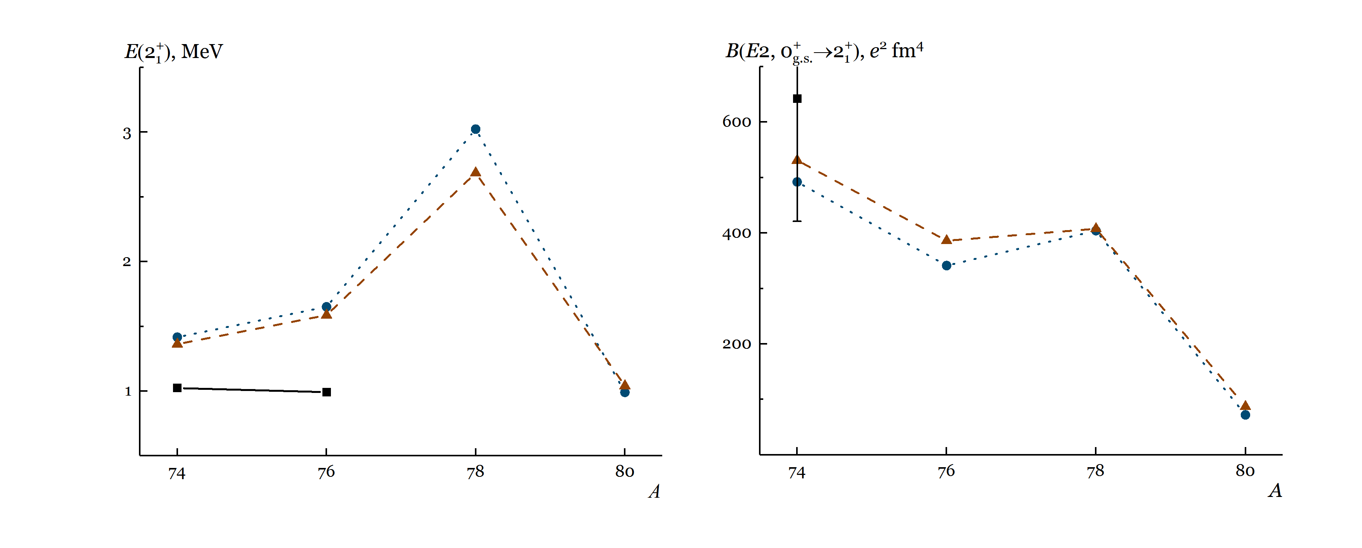
We construct the wave functions from a linear combination of one-phonon and two-phonon configurations
$$Ψ_{ν}\left(JM\right)=\left(\sum_{i}{R_{i}\left(Jν\right)Q_{JMi}^{†}}+\sum_{λ_{1}i_{1}λ_{2}i_{2}}{P_{λ_{2}i_{2}}^{λ_{1}i_{1}}\left(Jν\right){\left[Q_{λ_{1}μ_{1}i_{1}}^{†}{\overline{Q}}_{λ_{1}μ_{1}i_{1}}^{†}\right]}_{JM}}\right)\left|\left.0\right\rangle \right.$$
The normalization condition for the wave functions is
$$\sum_{i}{R_{i}^{2}\left(Jν\right)}+\sum_{λ_{1}i_{1}λ_{2}i_{2}}{{\left(P_{λ_{2}i_{2}}^{λ_{1}i_{1}}\left(Jν\right)\right)}^{2}}=1$$
The wave functions $Q_{λμi}^{+}\left|\left.0\right\rangle \right.$ of the one-phonon Gamow-Teller states of the daughter $\left(N−1,Z+1\right)$ nucleus are described as a linear combinations of 2QP configurations; ${\overline{Q}}_{λμi}^{+}\left|\left.0\right\rangle \right.$ is a one-phonon 2⁺ excitation of the parent $\left(N,Z\right)$ nucleus.
All one- and two-phonon configurations with the excitation energy of the daughter nucleus $E_{1_{k}^{+}}$ up to 16 MeV are included.
A. P. Severyukhin, V. V. Voronov, I. N. Borzov, N. N. Arsenyev, and Nguyen Van Giai,
Phys. Rev. C 90, 044320 (2014)

Slide 9
In the allowed GT approximation, the β-decay rate is expressed by summing up the probabilities (in units of ${G_{A}}/{4π}$) of the energetically allowed transitions ($E_{k}^{GT}≤Q_{β}$) weighted with the integrated Fermi function
$$T_{1/2}^{−1}=D^{−1}{\left(\frac{G_{A}}{G_{V}}\right)}^{2}\sum_{k}{f_{0}\left(Z+1,A,E_{k}^{GT}\right)B{\left(GT\right)}_{k}}$$
$$E_{k}^{GT}=Q_{β}−E_{1_{k}^{+}}$$
where ${G_{A}}/{G_{V}}=1.25$ and $D=6147$ s. $E_{1_{k}^{+}}$ denotes the excitation energy of the daughter nucleus, $E_{1_{k}^{+}}≈E_{k}−E_{2QP,lowest}$. $E_{k}$ are the $1_{k}^{+}$ eigenvalues of the QRPA equations with taking into account the two-phonon configurations, and $E_{2QP,lowest}$ corresponds the lowest 2QP energy.
The difference in the characteristic time scales of the β-decay and subsequent neutron emission processes justifies an assumption of their statistical independence. the $P_{xn}$ probability of the βxn emission accompanying the β-decay to the excited states in the daughter nucleus can be expressed as
$${P_{xn}=T}_{1/2}^{}D^{−1}{\left(\frac{G_{A}}{G_{V}}\right)}^{2}\sum_{k^{′}}{f_{0}\left(Z+1,A,E_{k^{′}}^{GT}\right)B{\left(GT\right)}_{k^{′}}}$$
where the GT transition energy ($E_{k^{′}}^{GT}$) is located within the neutron emission window $Q_{βxn}≡Q_{β}−S_{xn}$
A. P. Severyukhin, N. N. Arsenyev, I. N. Borzov, and E. O. Sushenok, Phys. Rev. C 95, 034314 (2017)

Slide 10
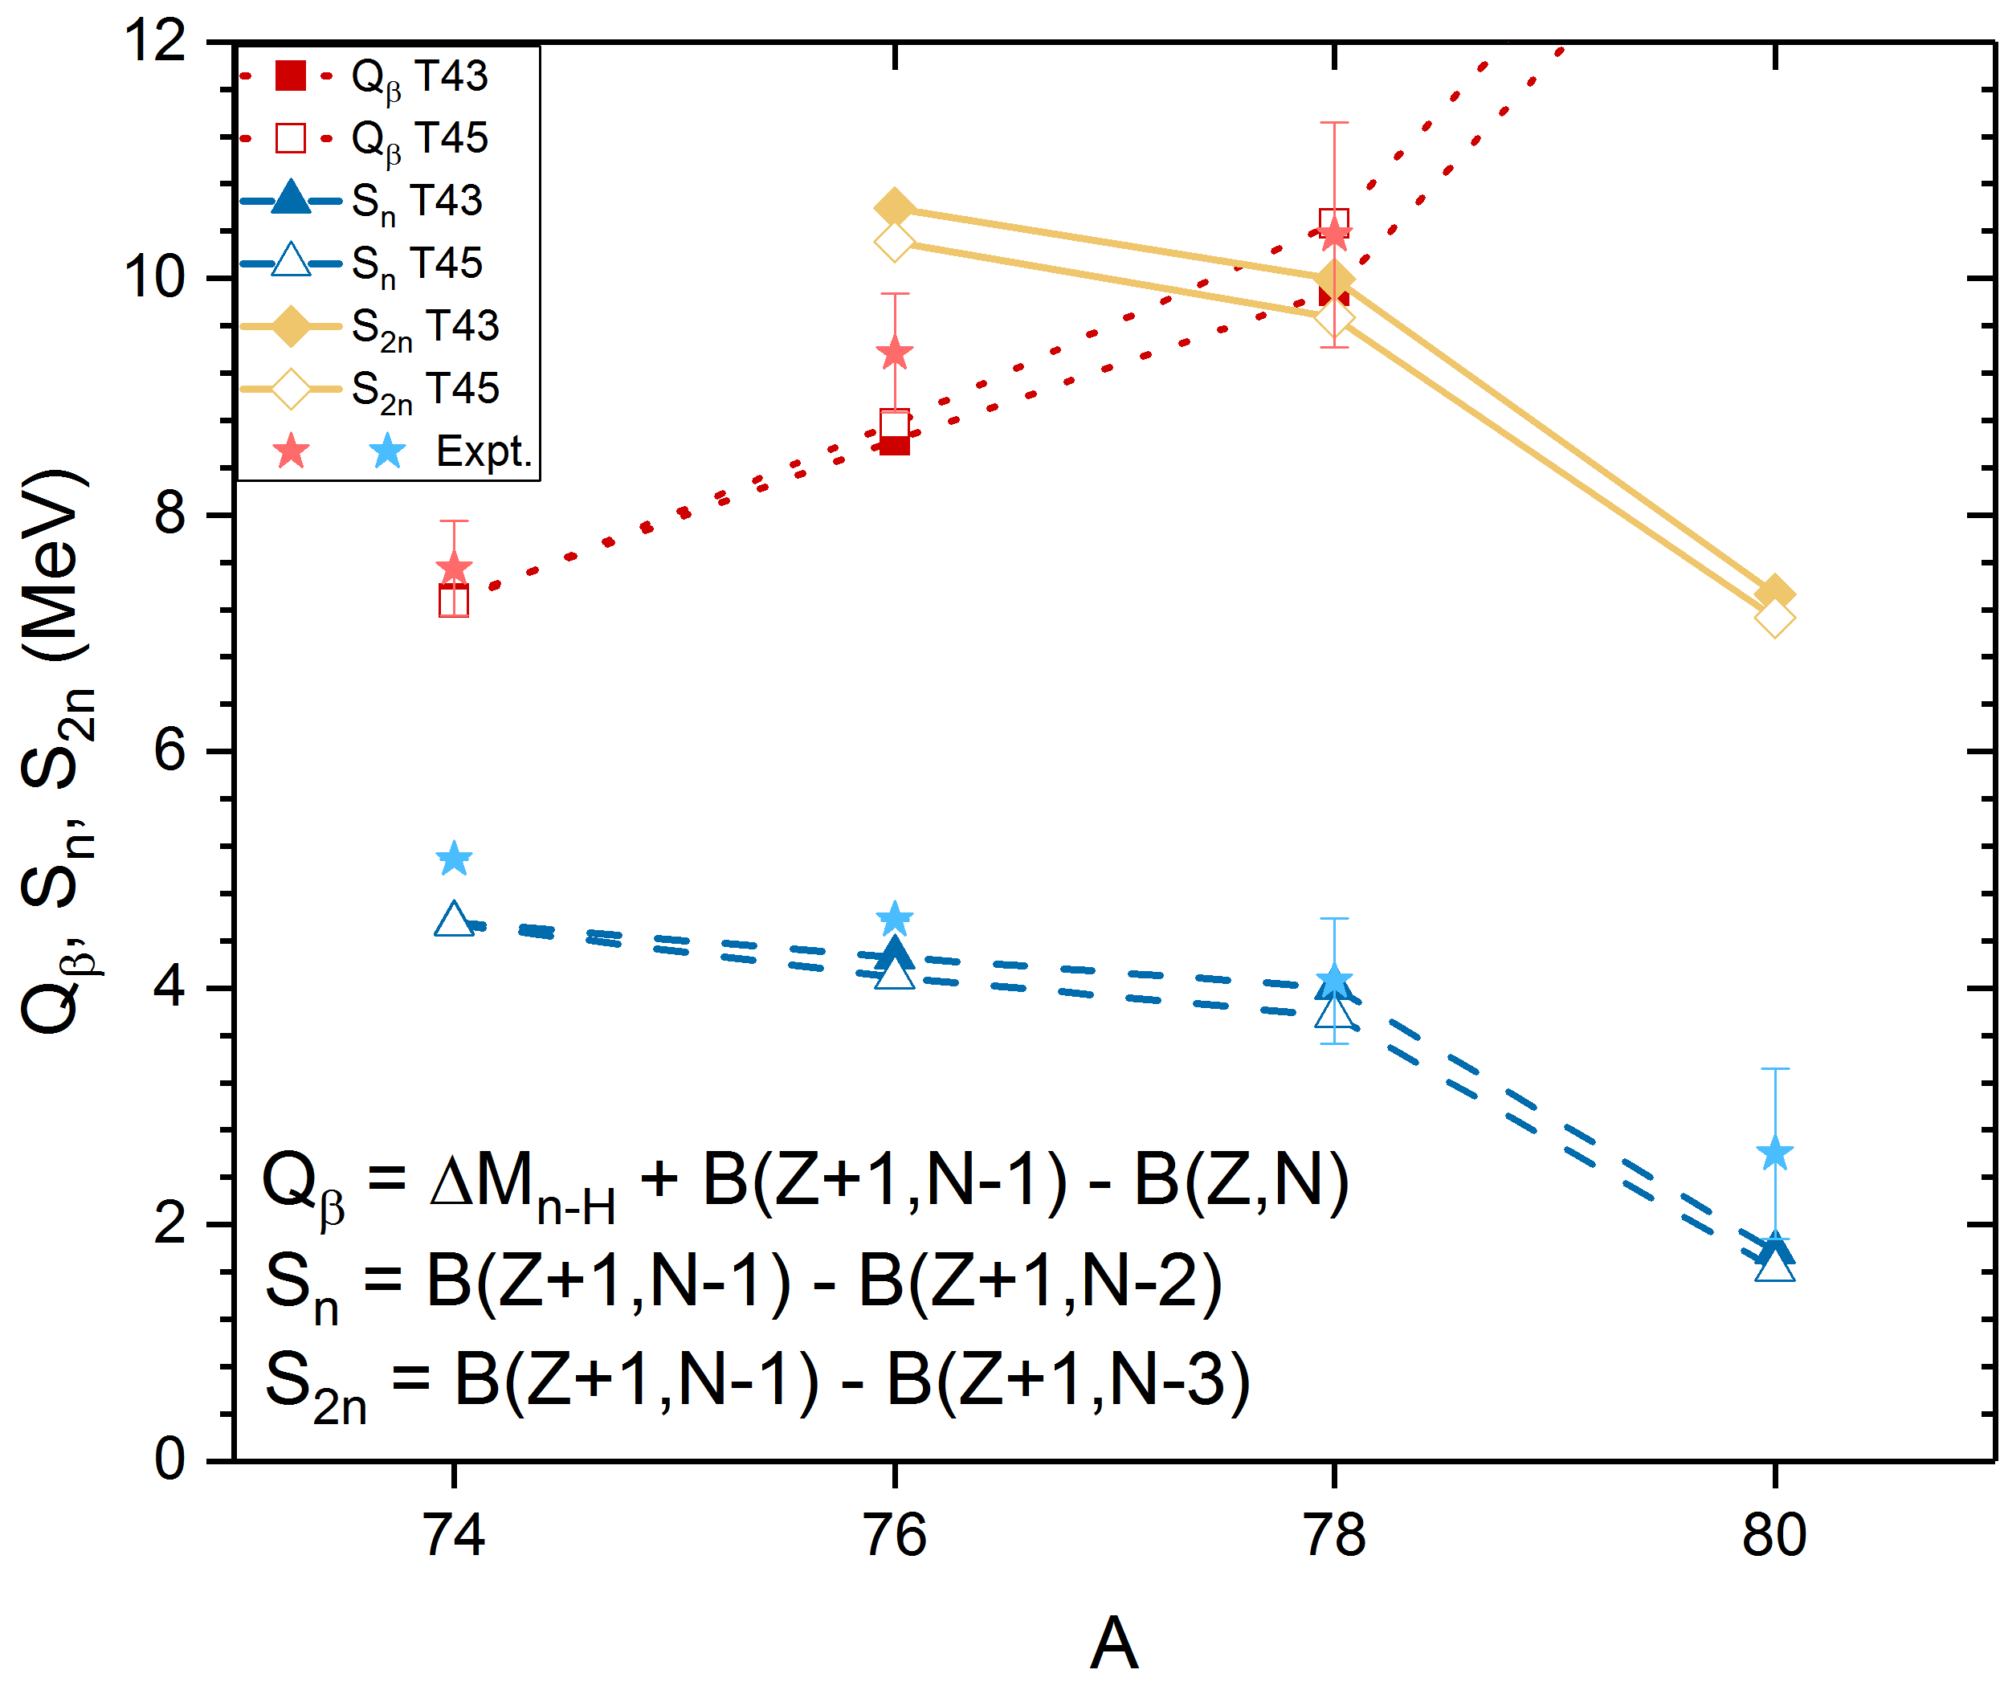
The $Q_{β}$-values of ^{74,76,78,80}Ni, $S_{n}$ and $S_{2n}$ of ^{74,76,78,80}Cu in cases of T43 and T45 Skyrme forces

Slide 11
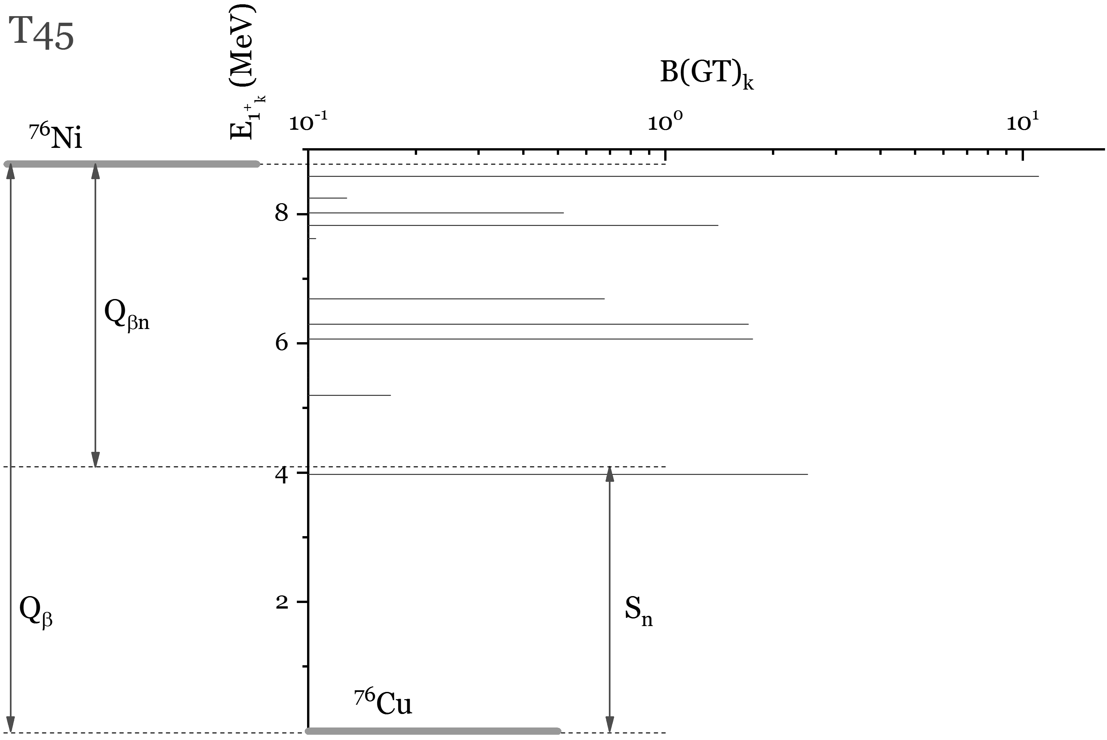
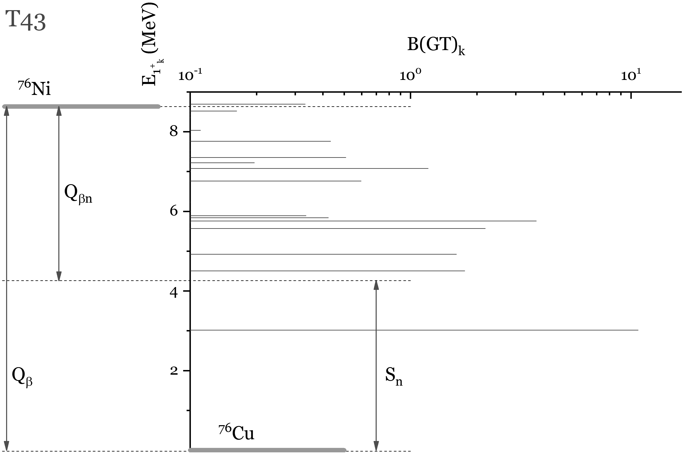
The β-decay of ⁷⁶Ni
$$Q_{β}=ΔM_{n−H}+B\left(N−1,Z+1\right)−B\left(N,Z\right)$$
$$S_{xn}=B\left(N−1,Z+1\right)−B\left(N−1−X,Z+1\right)$$
$$Q_{βxn}=Q_{β}−S_{xn}$$
In case of T45 Skyrme force, there is an increase of the GT excitations with the β-decay rates $λ<{10}^{−3}$ s⁻¹.
Tensor force
 | T43 | T45
$$β/α$$ | 2.0 | 0.7
Tensor part of the energy density functional
$$ℋ^{t}=\frac{1}{2}α\left(J_{n}^{2}+J_{p}^{2}\right)+βJ_{n}J_{p}$$

Slide 12
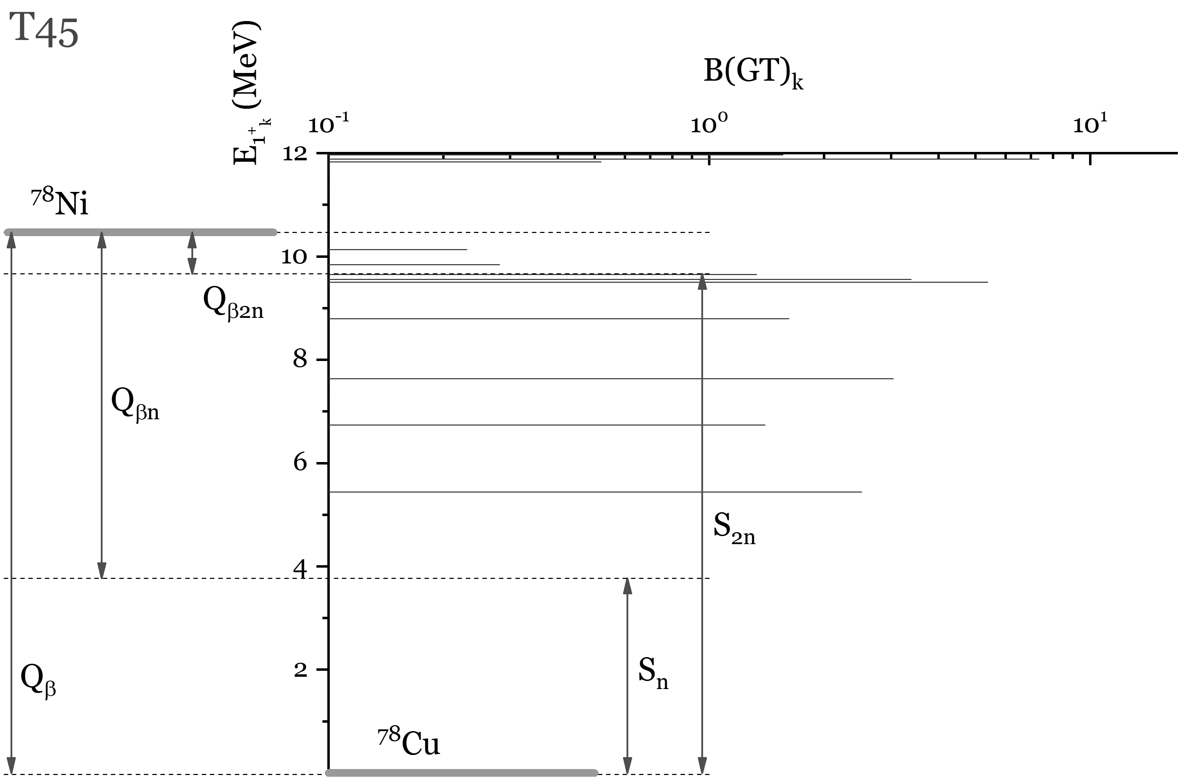
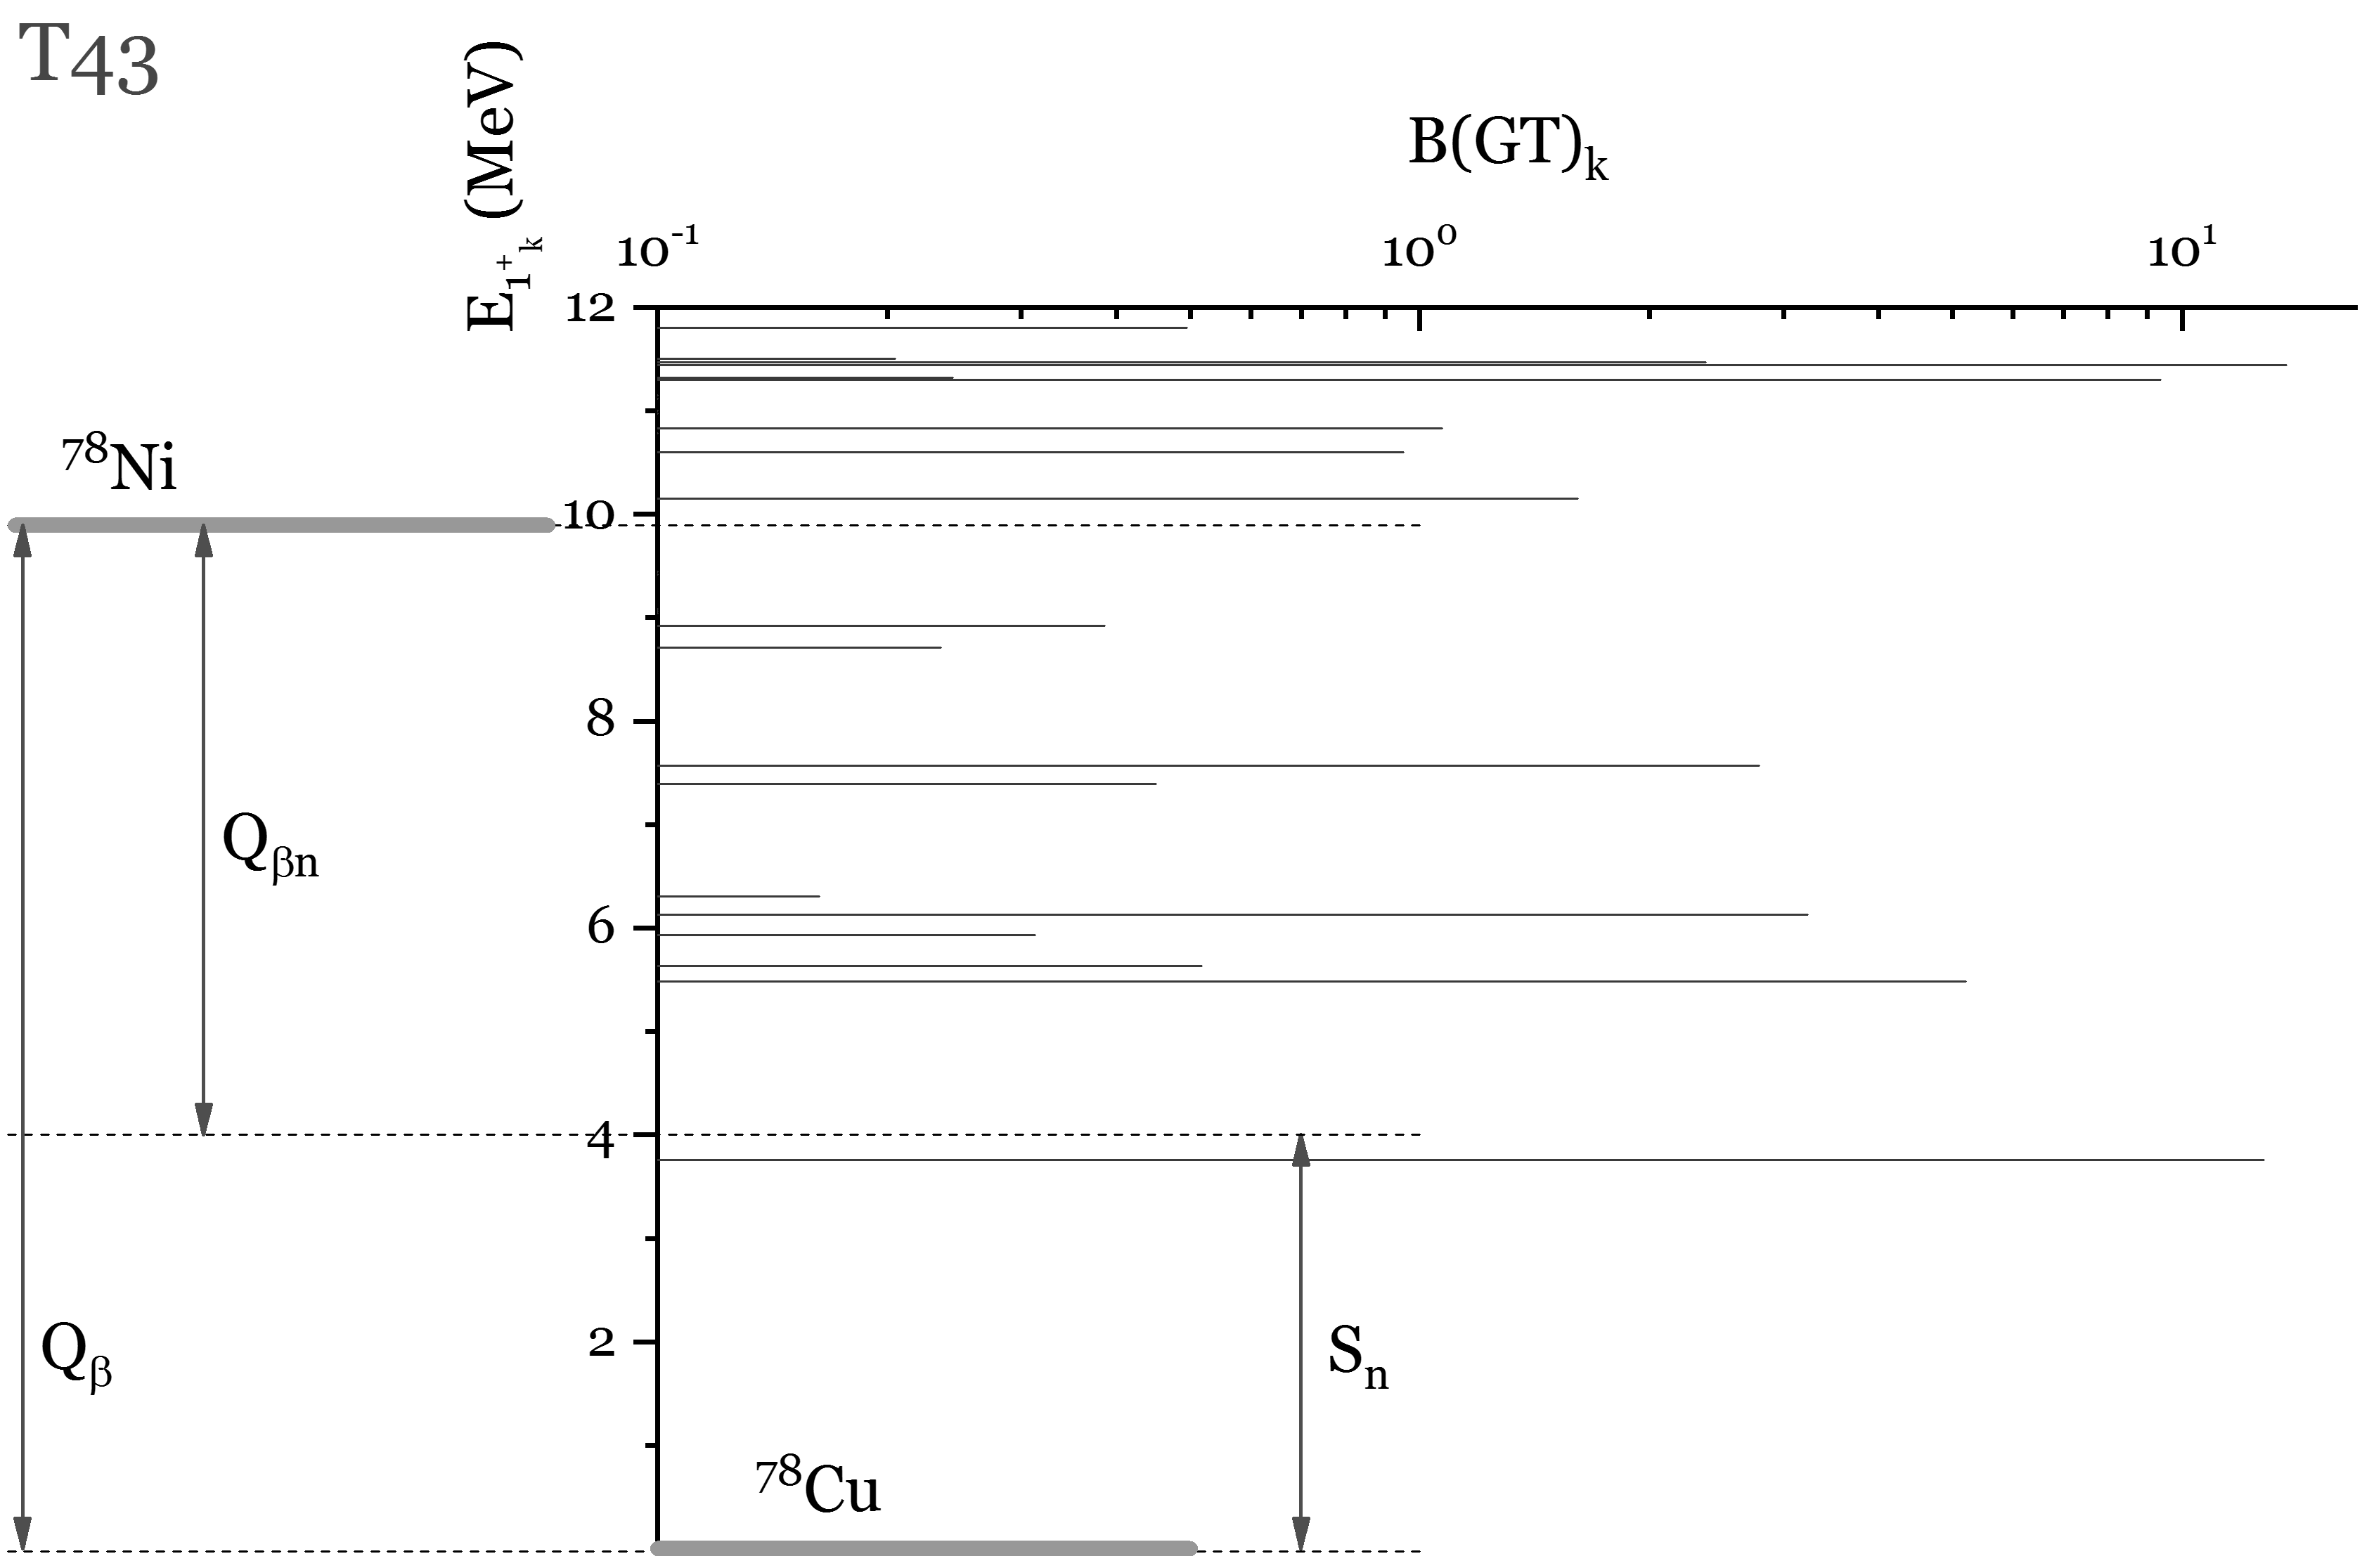
The β-decay of ⁷⁸Ni
$$Q_{β}=ΔM_{n−H}+B\left(N−1,Z+1\right)−B\left(N,Z\right)$$
$$S_{xn}=B\left(N−1,Z+1\right)−B\left(N−1−X,Z+1\right)$$
$$Q_{βxn}=Q_{β}−S_{xn}$$
In case of T45 Skyrme force, there is an increase of the GT excitations with the β-decay rates $λ<{10}^{−3}$ s⁻¹.
Tensor force
 | T43 | T45
$$β/α$$ | 2.0 | 0.7
Tensor part of the energy density functional
$$ℋ^{t}=\frac{1}{2}α\left(J_{n}^{2}+J_{p}^{2}\right)+βJ_{n}J_{p}$$

Slide 13
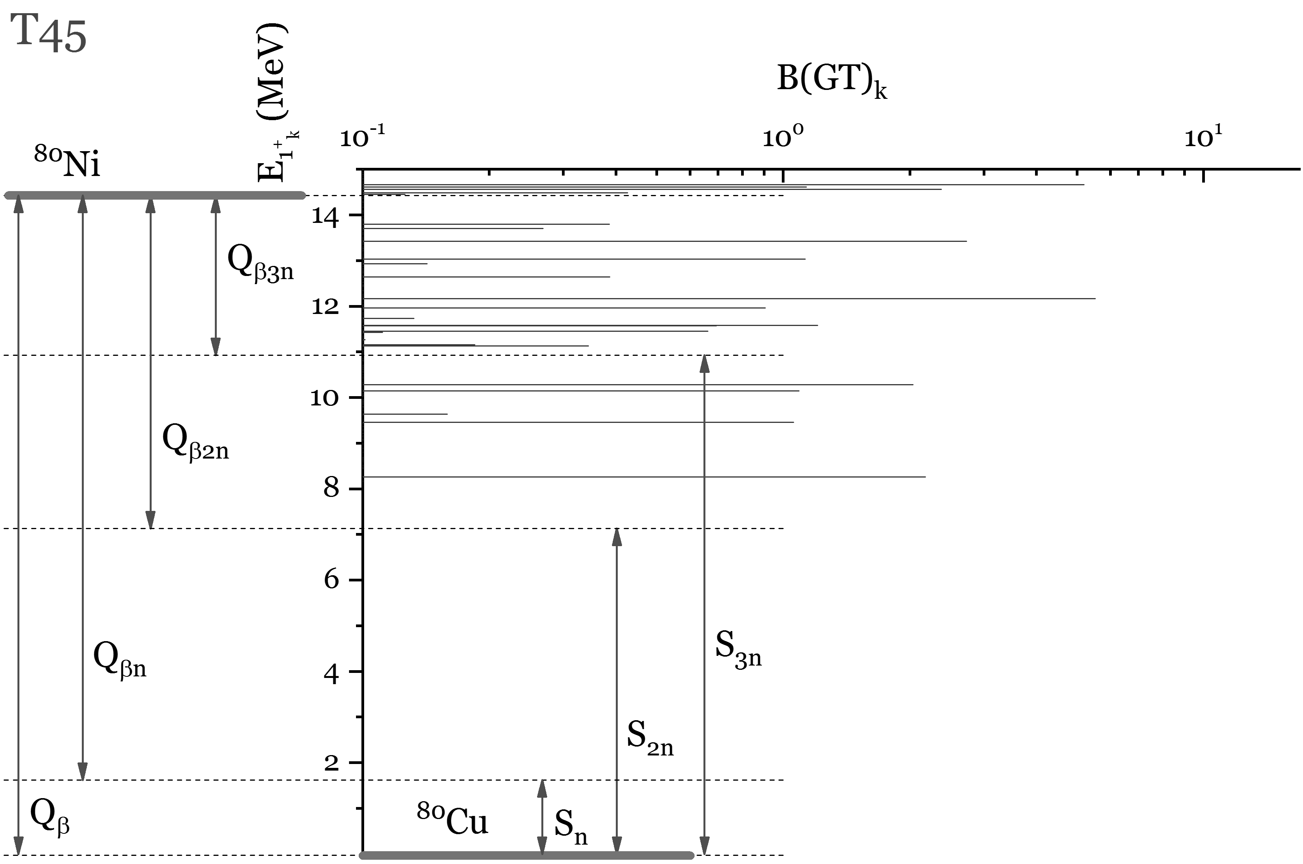
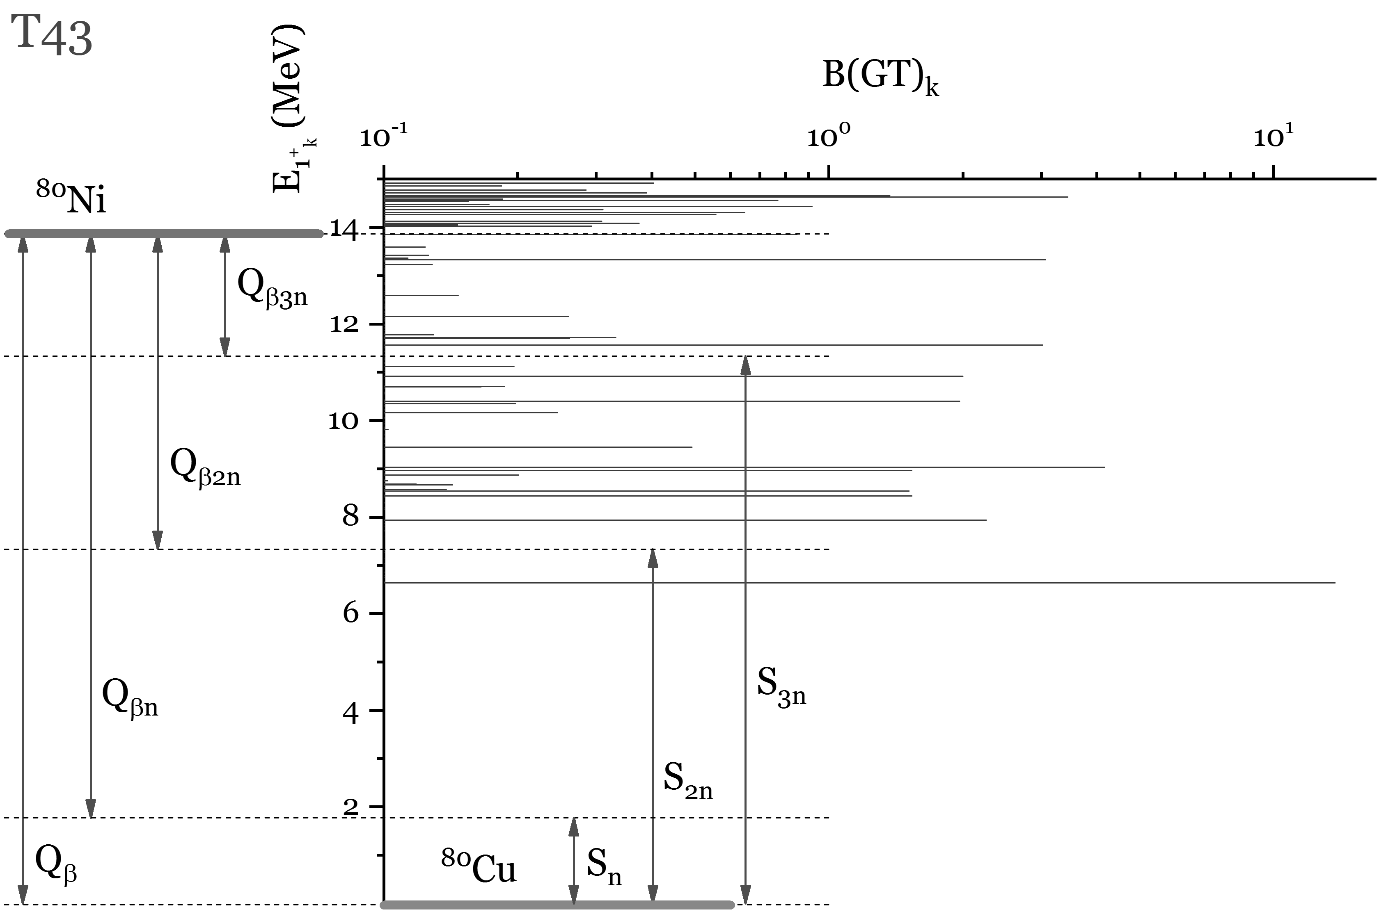
The β-decay of ⁸⁰Ni
$$Q_{β}=ΔM_{n−H}+B\left(N−1,Z+1\right)−B\left(N,Z\right)$$
$$S_{xn}=B\left(N−1,Z+1\right)−B\left(N−1−X,Z+1\right)$$
$$Q_{βxn}=Q_{β}−S_{xn}$$
In case of T45 Skyrme force, there is an increase of the GT excitations with the β-decay rates $λ<{10}^{−3}$ s⁻¹.
Tensor force
 | T43 | T45
$$β/α$$ | 2.0 | 0.7
Tensor part of the energy density functional
$$ℋ^{t}=\frac{1}{2}α\left(J_{n}^{2}+J_{p}^{2}\right)+βJ_{n}J_{p}$$

Slide 14
RESULTS
 | T43 |  |  | T45 |  |  | Expt.
A | $T_{1/2}$,ms | $P_{1n}$,% | $P_{2n}$,% | $T_{1/2}$,ms | $P_{1n}$,% | $P_{2n}$,% | $T_{1/2}$,ms | $P_{1n}$,% | $P_{2n}$,%
74 | 40 | 1 | 0 | 281 | 3 | 0 | 507.7±46 | -- | --
76 | 19 | 9 | 0 | 162 | 11 | 0 | 234.6±27 | 14±3.6 | --
78 | 10 | 12 | 0 | 115 | 100 | 0 | 122.2±51 | -- | --
80 | 4 | 80 | 19 | 40 | 0 | 94 | 24±21 | -- | --
E.O. Sushenok, A.P. Severyukhin, N.N. Arenyev, I.N. Borzov, in preparation

Slide 15
SUMMARY
The neutron emission of the β-decay of ^{74,76,78,80}Ni are studied with the Skyrme interaction taking into account the tensor terms. Calculations are performed within the quasiparticle random phase approximation. The coupling between one- and two-phonon terms in the wave functions of the low-energy 1⁺ states of the daughter nuclei is taken into account.
It is shown that the reduction of the neutron-proton tensor interaction leads to the substantial increase of the half-life and the neutron-emission probability. The results of calculations with the Skyrme interaction T45 are in a reasonable agreement with available experimental data.
E.O. Sushenok, A.P. Severyukhin, N.N. Arenyev, I.N. Borzov, in preparation

