Slide 1


High-energy ν astronomy
Where do we stand, where do we go ?
ICPPA, Moscow
Oct. 6, 2015
Christian Spiering, DESY Zeuthen

Slide 2
Detection principles

Slide 3
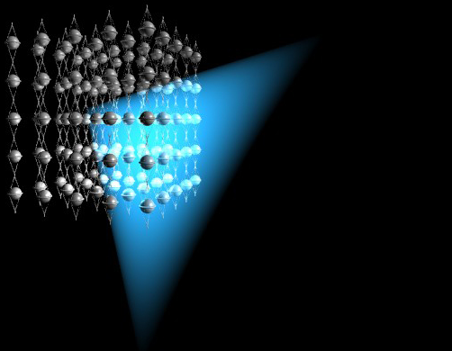
How to detect high energy neutrinos
The
traditional
method:
ν_{μ} charged current
μ
ν_{μ}

Slide 4
Detection Modes
Muon track from CC muon neutrino interactions
  Angular resolution 0.1° - 0.5°
  Energy resolution from dE/dx: factor 2-3
Cascade from CC electron and NC all flavor interactions
  Angular resolution 2° - 15 °
  Energy resolution ~ 15%

Slide 5
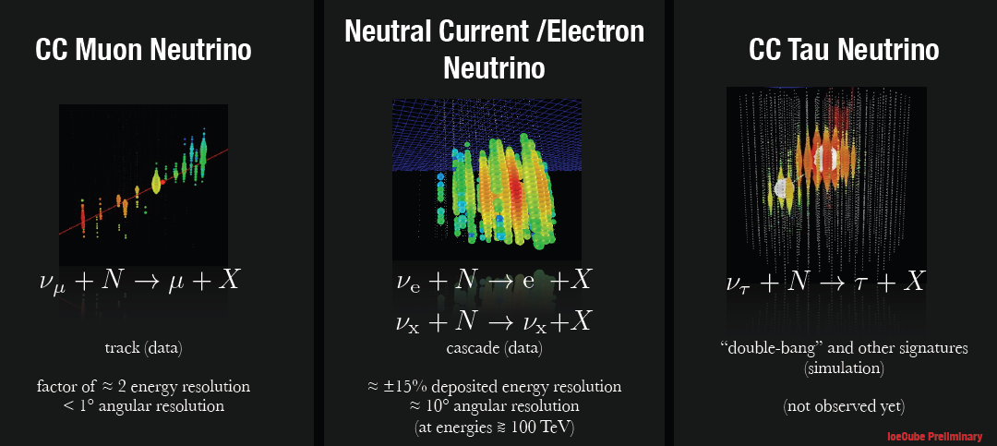
Detection Modes
Muon track from CC muon neutrino interactions
  Angular resolution 0.1° - 0.5°
  Energy resolution from dE/dx: factor 2-3
Cascade from CC electron and NC all flavor interactions
  Angular resolution 2° - 15 °
  Energy resolution ~ 15%

Slide 6
The detectors

Slide 7

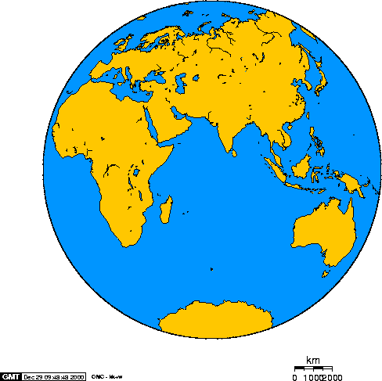
The devices
Baikal
Antares
AMANDA
IceCube

Slide 8
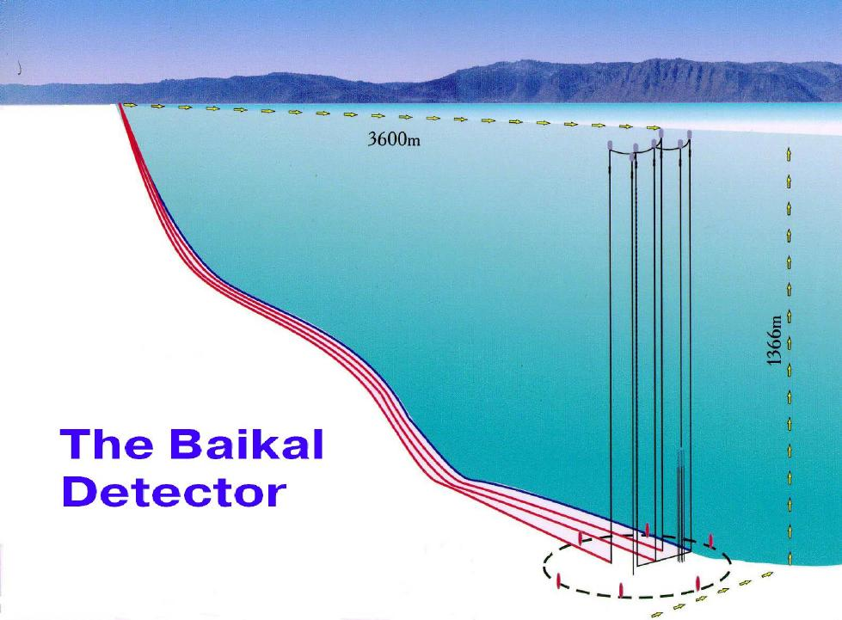
The pioneer: NT200 in Lake Baikal
3600 m
1366 m
8 strings
192 PMTs
Height 72 m
Diameter 42 m

Slide 9
A textbook underwater neutrino event
1996
3600 m
1366 m

Slide 10
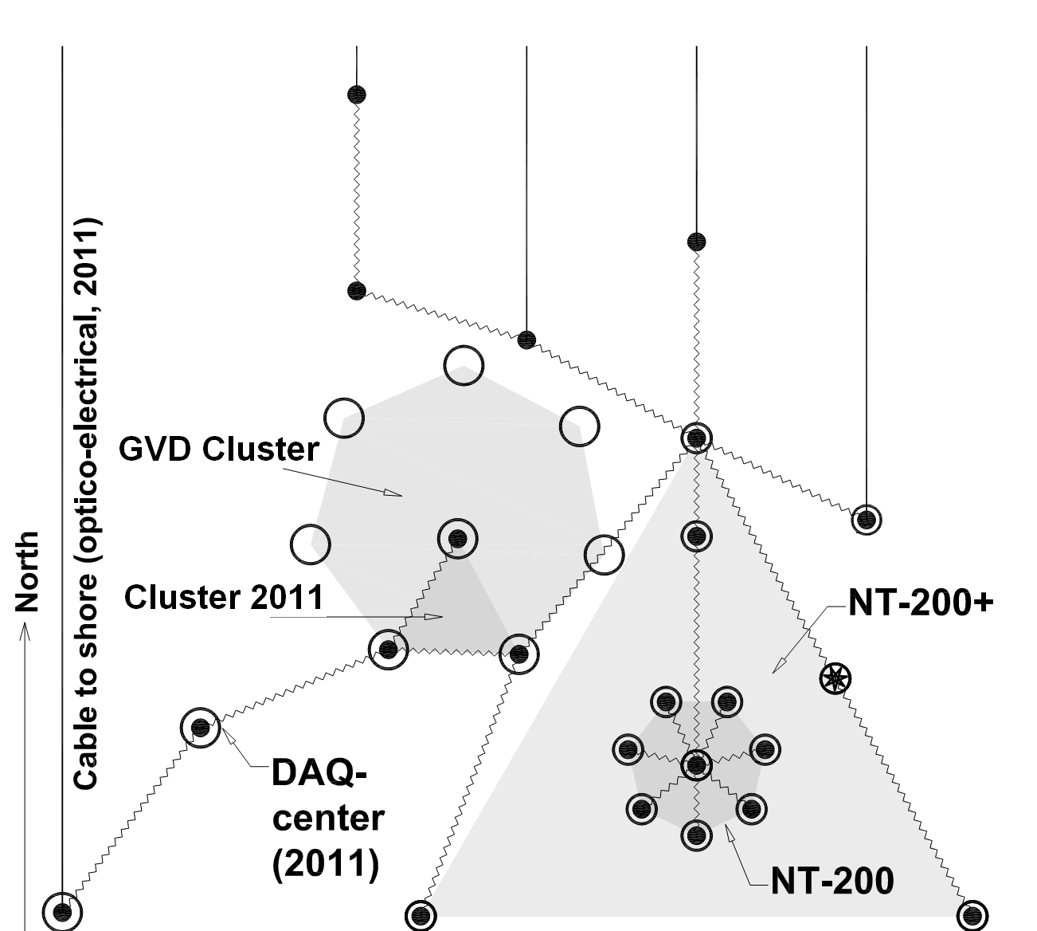
2015: First cluster of GVD versus NT200

Slide 11
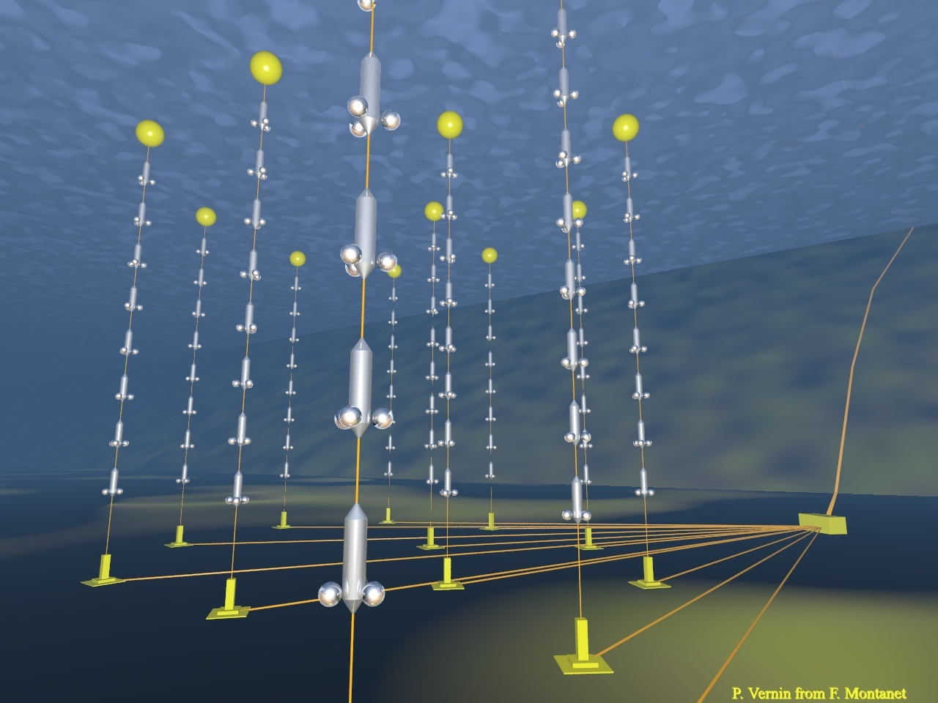
ANTARES
2500m
885 PMTs
12 strings
Operating in final
configuration
since 2008
450 m
70 m

Slide 12
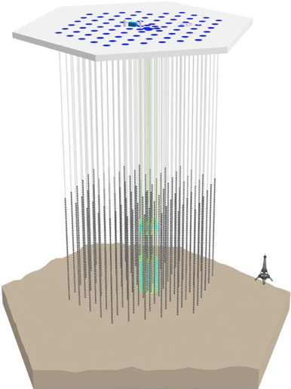
IceCube Neutrino Observatory
IceTop air shower detector
81 pairs of water Cherenkov tanks
IceCube
86 strings including 8 Deep Core strings
60 PMT per string
DeepCore
8 closely spaced strings
Operating in final configuration (IC86) since Dec. 2010
2008 2009 2010 >2010
IC1 → IC9 → IC22 → IC40 → IC59 → IC-79 → IC86
1450m
~220 ν/day
Threshold
- IceCube ~ 100 GeV
- DeepCore ~10 GeV
2450m
2820m

Slide 13
Atmospheric neutrinos

Slide 14
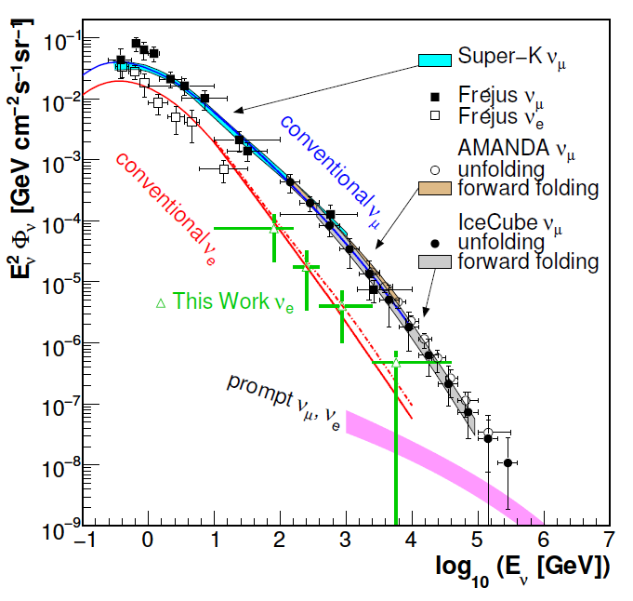
Atmospheric neutrinos in IceCube (2 years)
proton
c,(b)
prompt
e,μ
νe,μ
π
μ
νμ
e
νμ
νe
conventional

Slide 15
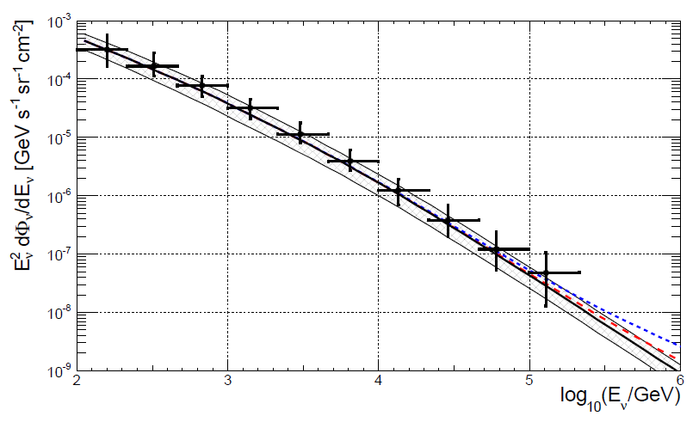
Atmospheric neutrinos in IceCube (2 years)
.. and ANTARES
arXiv:1308.1599

Slide 16
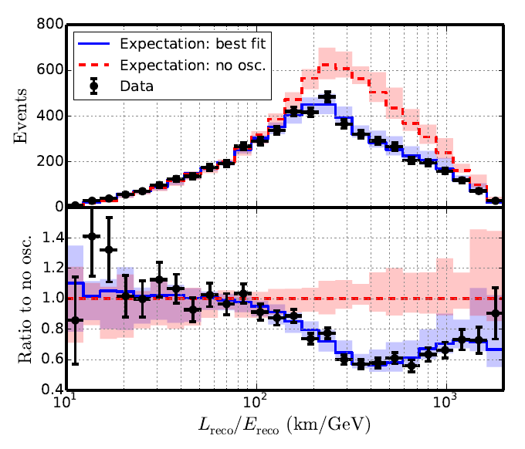
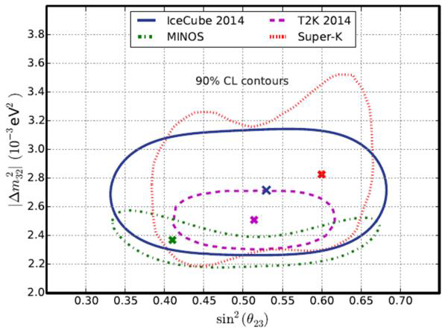
DeepCore: Oscillations for atmopheric neutrinos (E < 30-40 GeV)
arXiv:1410.7227
Phys. Rev. D91, 072004 (2015)

Slide 17
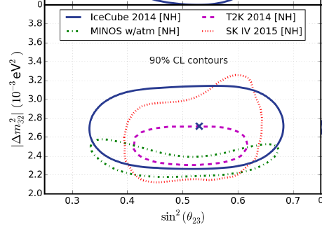
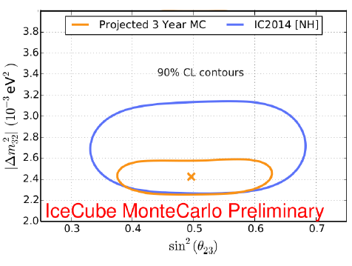
DeepCore: Oscillations for atmopheric neutrinos (E < 30-40 GeV)
arXiv:1410.7227
Phys. Rev. D91, 072004 (2015)
Super-K, new
DeepCore potentially

Slide 18
The discovery of a
Diffuse cosmic
Neutrino flux

Slide 19
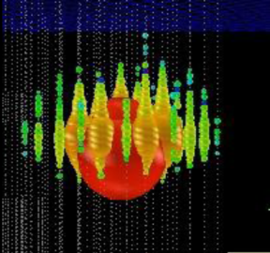
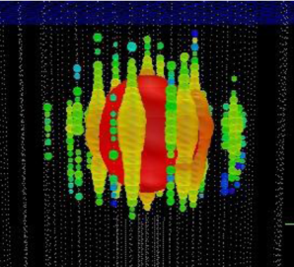
Special search for neutrinos with E_{ν} > 500 TeV
IC79/IC86 2.8 σ
Ernie Bert
~1.04 PeV ~ 1.14 PeV

Slide 20
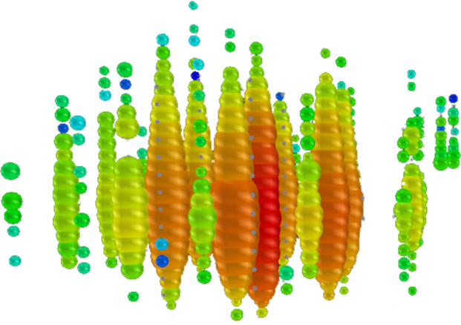
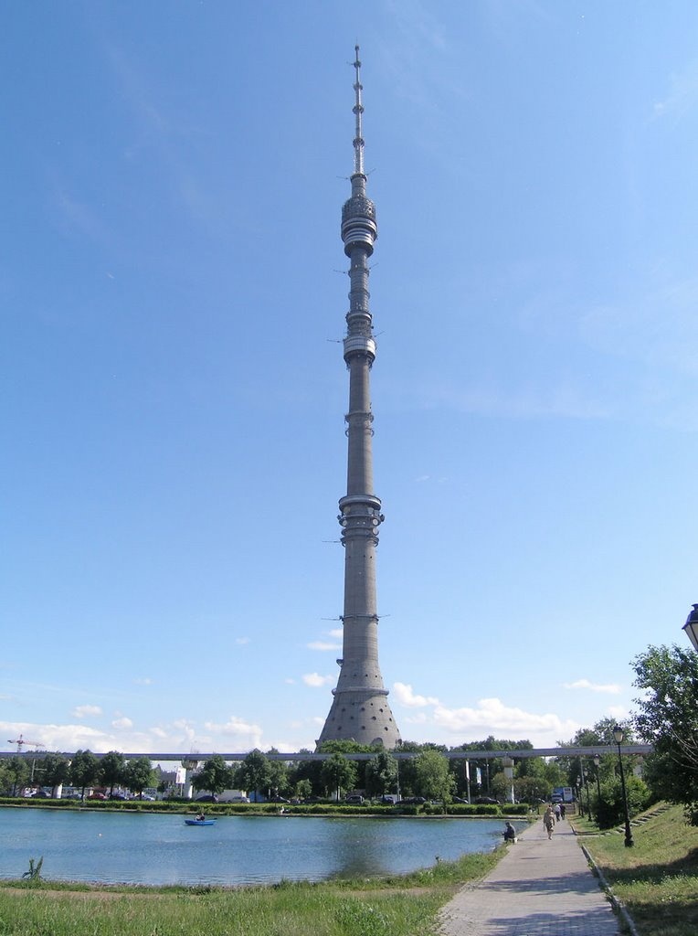

Slide 21
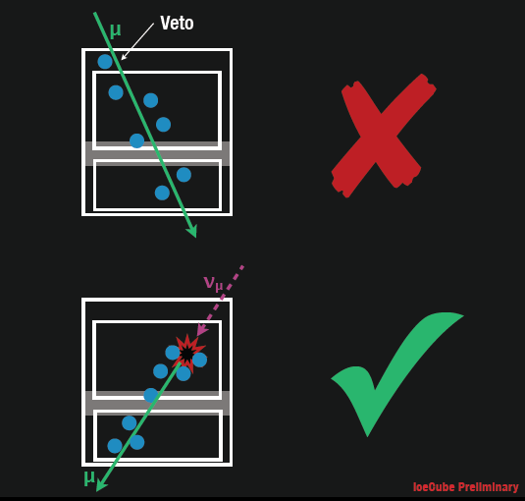
Follow-up Analysis: HESE (High Energy Starting Event)
Muon Veto
Q_{tot} > 6000 photoelectrons
→ 400 Mton eff.
Volume

Slide 22
Follow-up Analysis: HESE (High Energy Starting Event)
Muon Veto
Q_{tot} > 6000 photoelectrons
→ 400 Mton eff.
Volume
µ
Veto is also good for rejecting large part of atmospheric ν !!

Slide 23
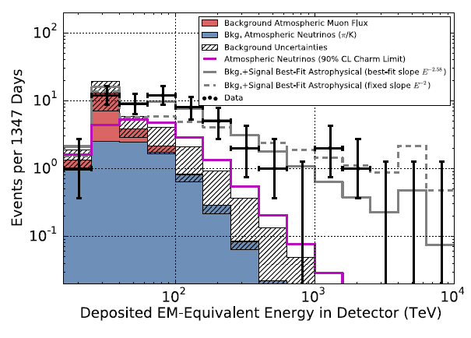
Follow-up Analysis: HESE (High Energy Starting Event)
First evidence for an extra-terrestrial h.e. neutrino flux
2 yrs data, 28 evts 4.1σ
Science 342 (2013)
3 yrs data, 37 evts 5.9σ
Phys.Rev.Lett. 113:101101 (2014)
4 yrs data, 54 evts ~ 7σ

Slide 24
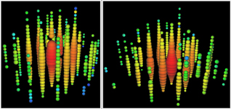
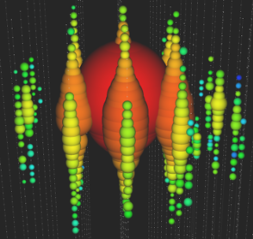


Follow-up Analysis: HESE (High Energy Starting Event)
First evidence for an extra-terrestrial h.e. neutrino flux
2 yrs data, 28 evts 4.1σ
Science 342 (2013)
3 yrs data, 37 evts 5.9σ
Phys.Rev.Lett. 113:101101 (2014)
4 yrs data, 54 evts ~ 7σ
”Bert”
1.04 PeV
Aug. 2011
”Ernie”
1.14 PeV
Jan. 2012
”Big Bird”
2 PeV
Dec. 2012

Slide 25
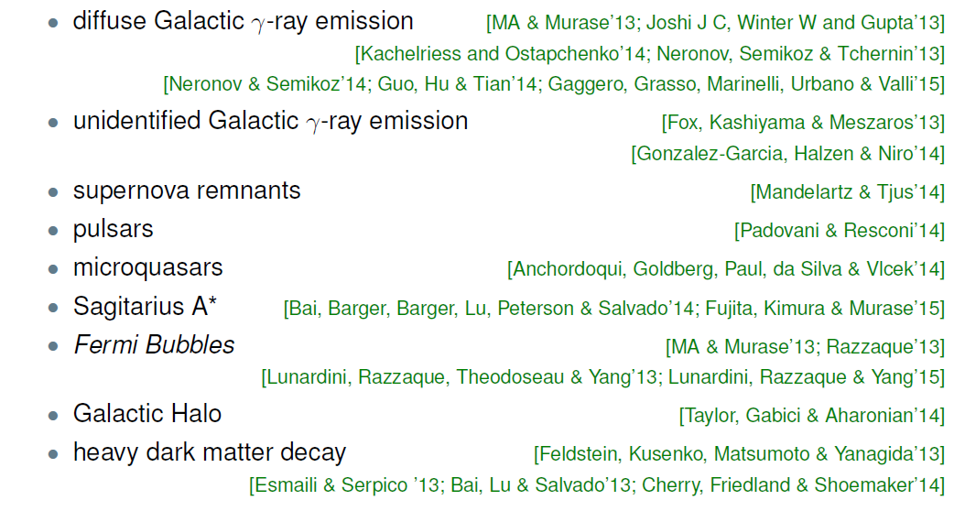
What are the sources? 1) Galactic
Taken from Markus Ahlers, VLVNT 2015

Slide 26
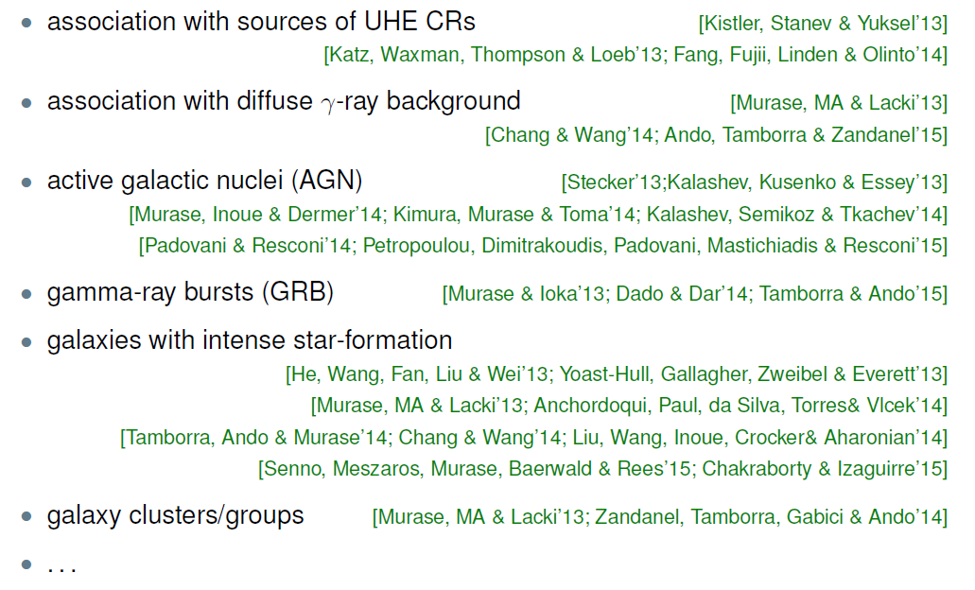
What are the sources? 2) Extragalactic
Taken from Markus Ahlers, VLVNT 2015

Slide 27
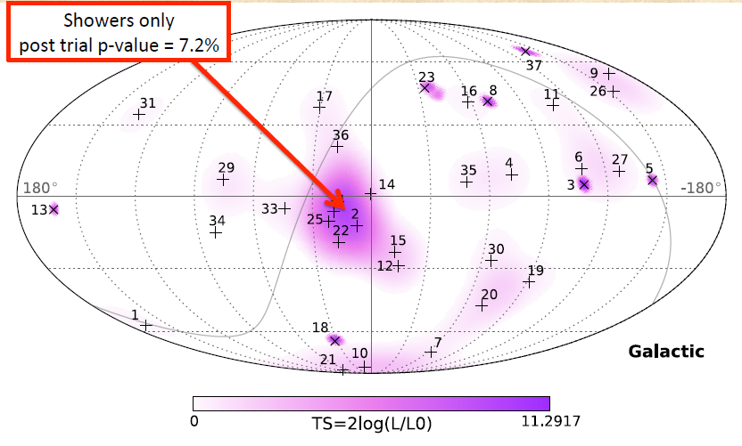
HESE skyplot, 3 years

Slide 28
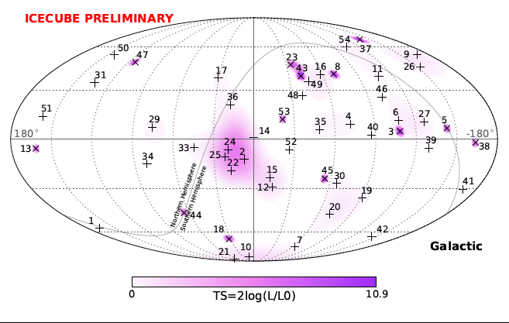

HESE skyplot, 4 years
18 %

Slide 29
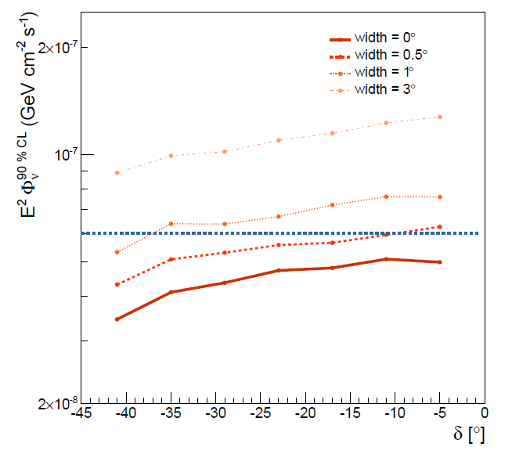
IceCube hot spot and ANTARES constraints
90% C.L. upper limits for different source widths vs. declination.
Blue line: flux from IceCube hot spot
Single source with
E²·Φ = 8 × 10⁻⁸ GeV/(cm²s)
and < 0.5° width
is discarded as reason for IceCube‘s „hot spot“.
Antares coll., ApJ 2014, arXiv1402.6182

Slide 30
HESE skyplot 4 years: Galactic Plane ?

Slide 31
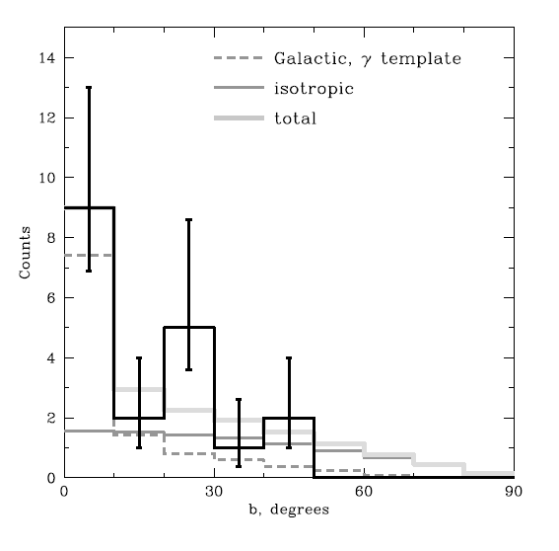
HESE skyplot 4 years: Galactic Plane?
Neronov & Semikoz, arXiv:1509.03522
Chance probability for excess at |b| < 10° plus a deficit at |b| > 50° for isotropic flux is about 7×10⁻⁵
Best description by a 50:50 combination of galactic and extragalactic component.
IceCube analysis (preliminary): post-trial chance probability for being due
to an isotropic distribution ~2.5%. Interesting but not compelling.

Slide 32
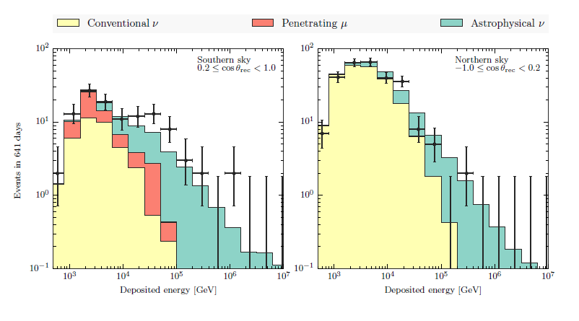
MESE (Medium Energy Starting Events)
Reduce threshold by further cuts down to ~ 1 TeV
Phys.Rev. D91, 022001 (2015) & arXiv:1410.1749
?

Slide 33
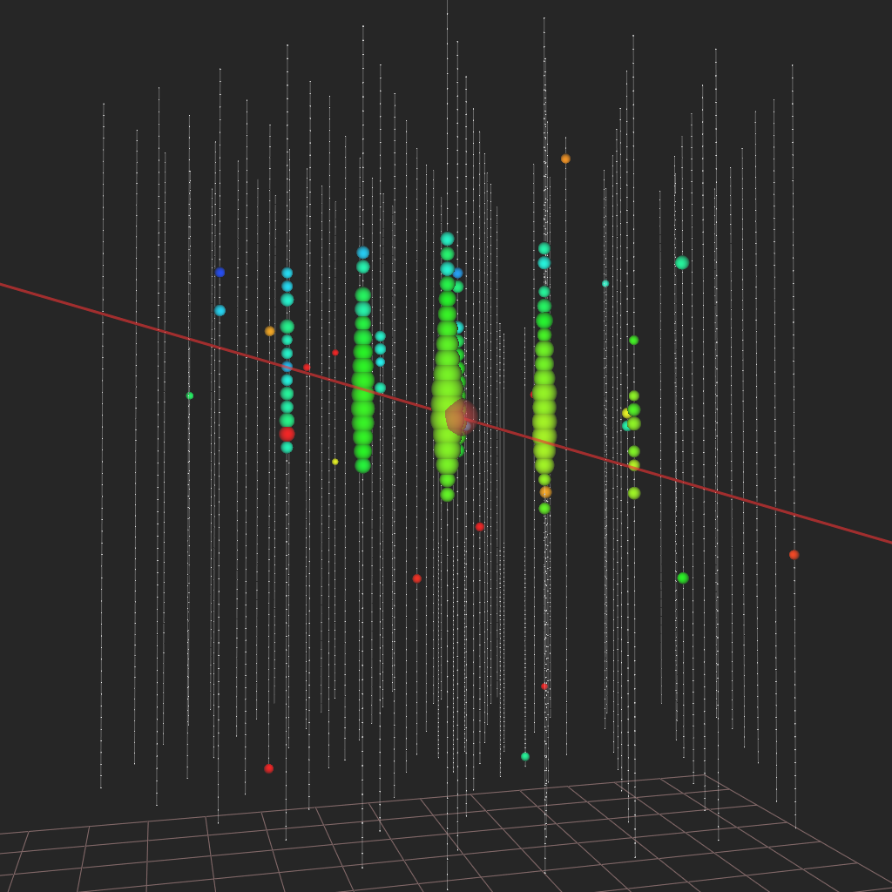
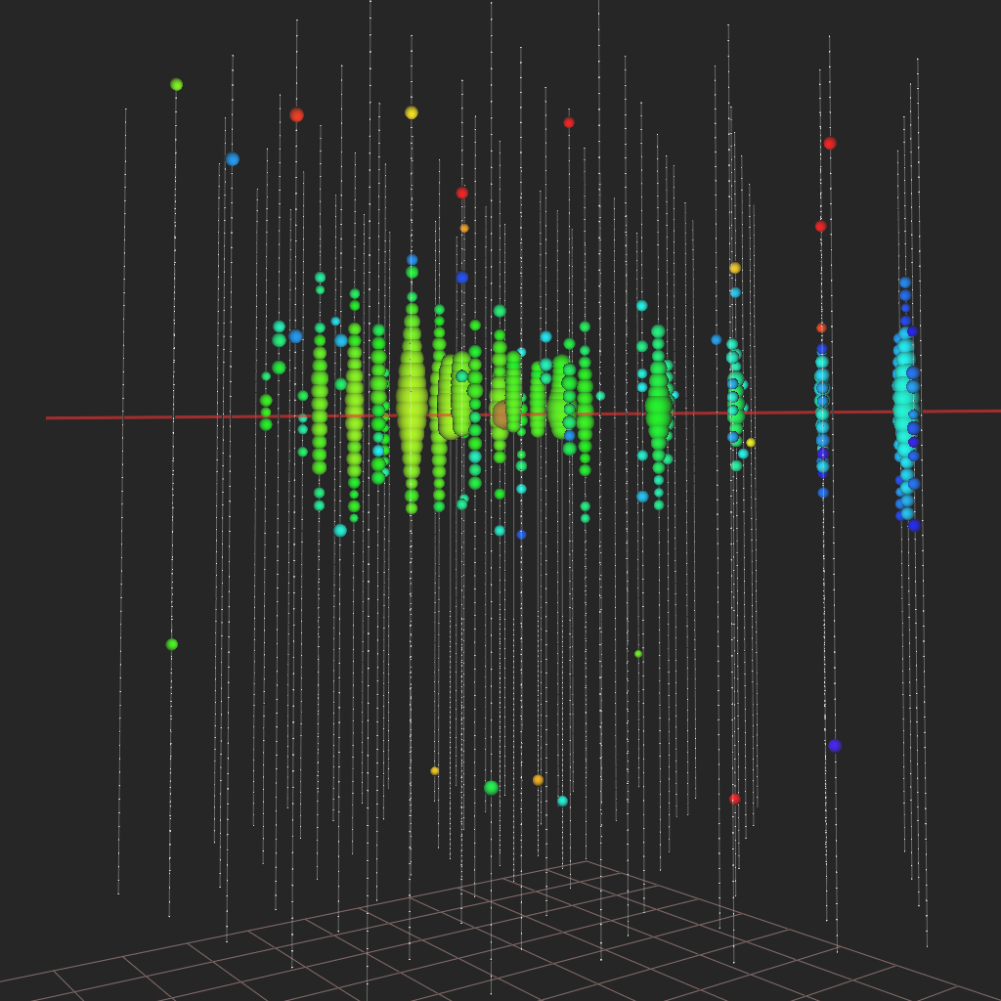
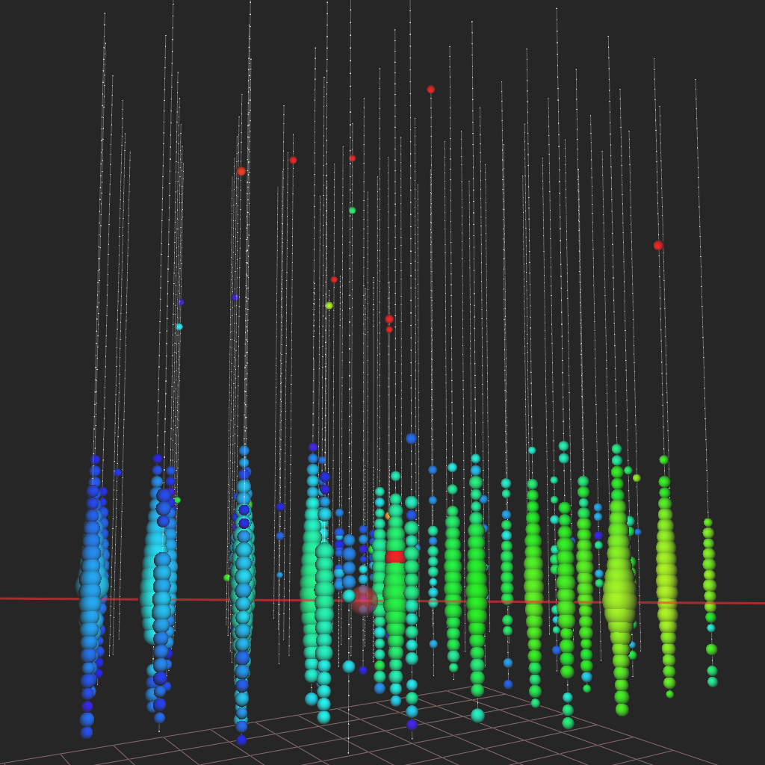
Throughgoing muons, IC-79/86
0.5 PeV
muon
~1 PeV
neutrino
Examples of muons found in IC79/86 upgoing diffuse analysis

Slide 34
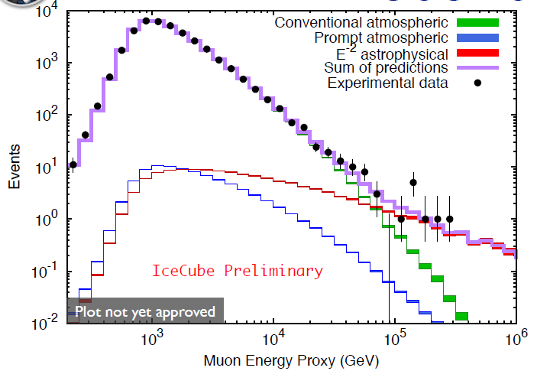
Through-going muons, IC-79/86
3.9σ

Slide 35
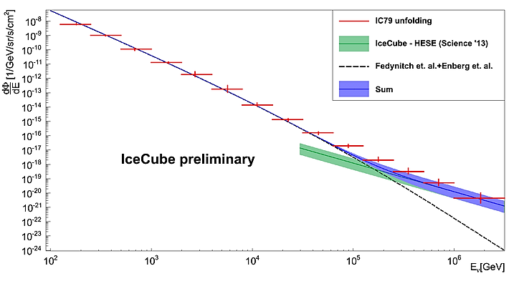


Putting all together
Global fit
Flux:
at 100 TeV
Spectral index:

Slide 36
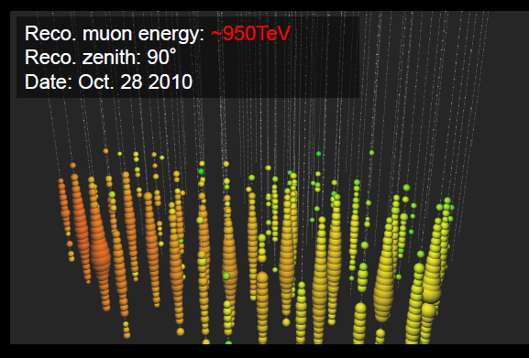
3 years through-going muons
The highest energy muon in 2009-12
(IC 59+79+86)
4.3σ

Slide 37
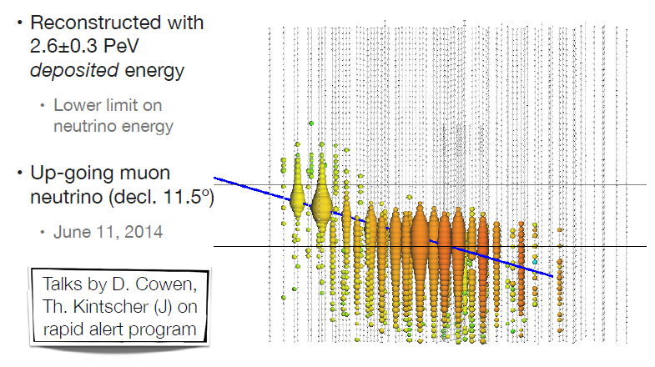
New: The highest energy of all !

Slide 38
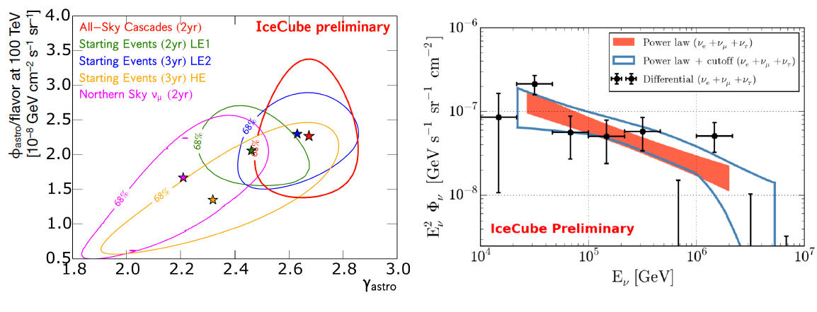
Energy spectrum
Different analyses find different (but statistically compatible) spectral indices
→ need more statistics
→ need independent measurement with different systematics
→ need GVD and KM3NeT!

Slide 39
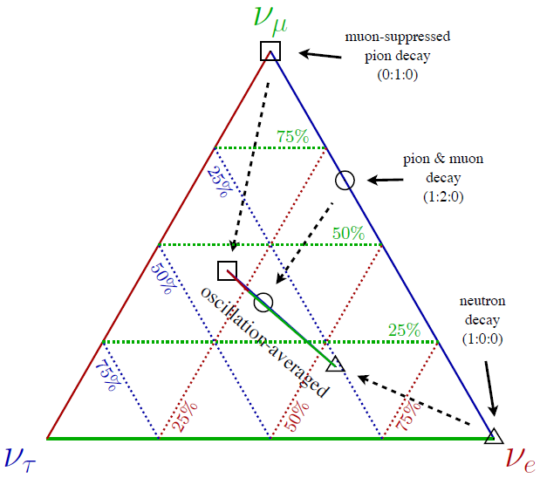
Flavor composition: what do we expect?

Slide 40
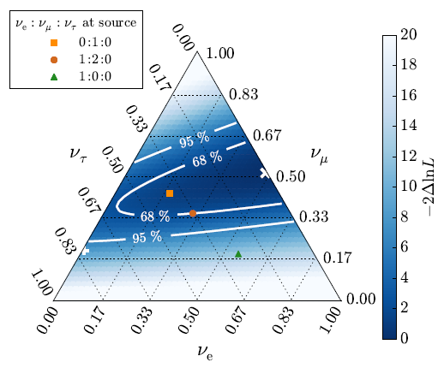
Flavor composition: what do we measure?
preliminary
the best fit flavor composition disfavors 1:0:0 at source at 3.6 σ

Slide 41
Individual sources
Or Source classes?

Slide 42
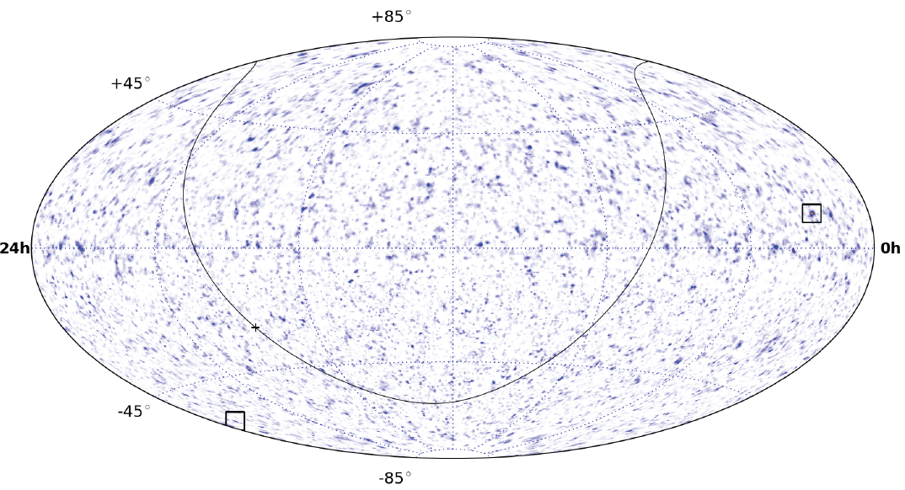
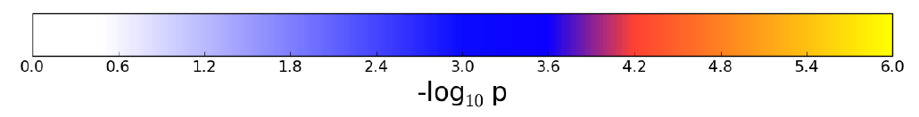
Pre-trial significance skymap, IC40+59+79+86 (4 years)
North
South
178 000 upward μ from ν interaction
216 000 downward µ from CR showers

Slide 43
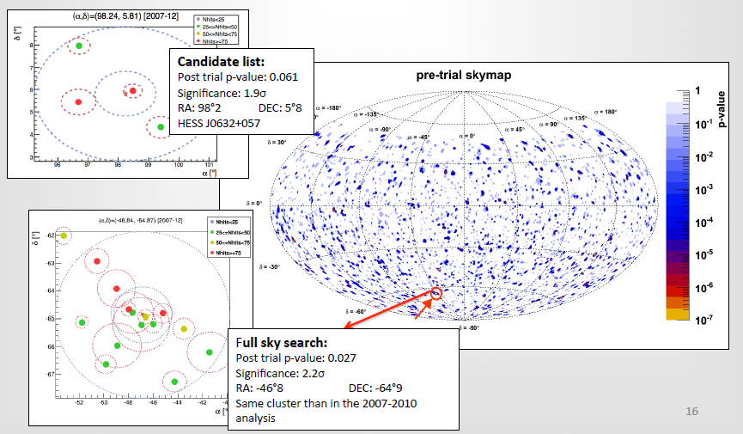
ANTARES point source search

Slide 44
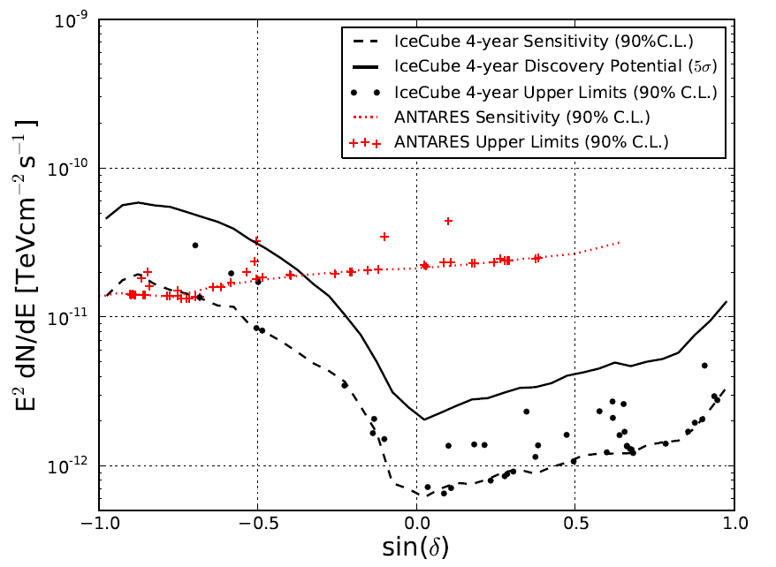
Upper limits and 5σ discovery potential
100 TeV cut-off

Slide 45
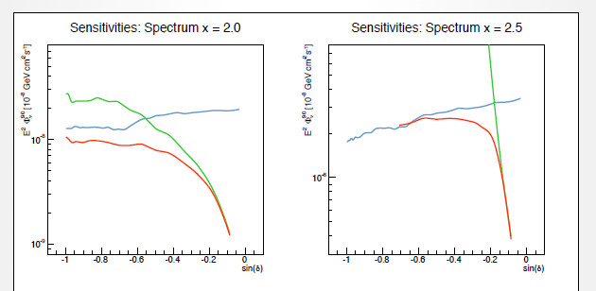
Combining ANTARES + IC 40/59/79
Icecube
ANTARES
Combined
Preliminary. Paper to be submitted in ~ 1 month

Slide 46
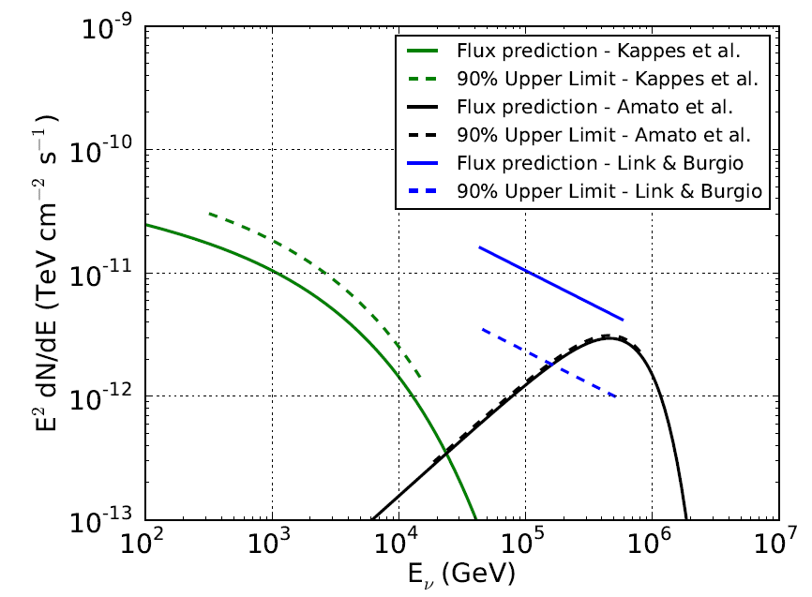
IceCube 4 years: upper limits and predictions
Crab Nebula
model excluded
The most realistic model:
can be tested with 2 x
present sensitivity (2016)
model
almost
excluded

Slide 47
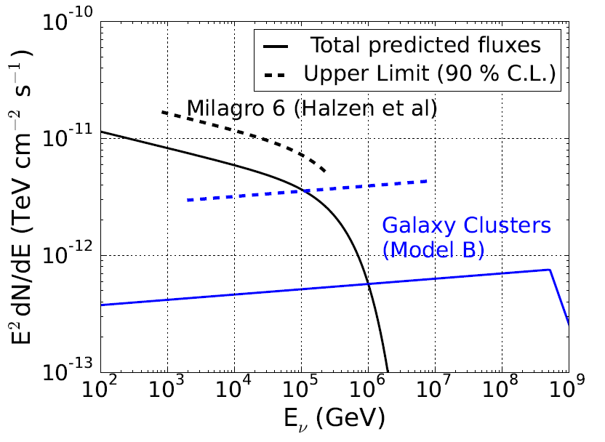
2 examples for stacked-source limits

Slide 48
Search for neutrinos from
Gamma Ray Bursts

Slide 49
Neutrinos from GRB
Flux
ε_{b}
t ~ t90 → ?
t ~
-10 →-100s
t ~ 0 → t90
Energy →
Energy

Slide 50
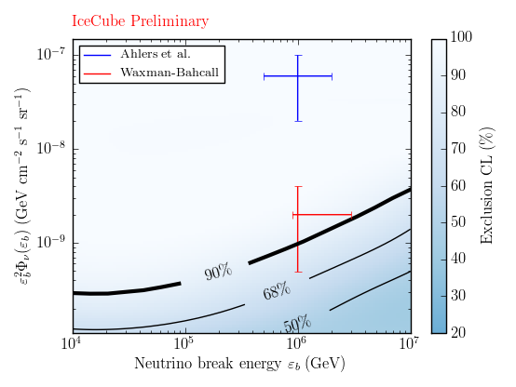
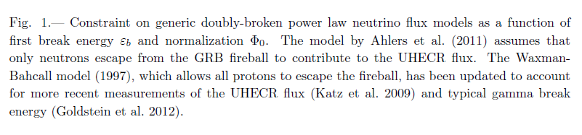
Neutrinos from GRB Astrophys. J. 805, L5 (2015) & arXiv:1412:6510
506 GRB
One single low-significance coincidence, consistent with atmospheric background
IceCube has ruled out neutron escape models
ε_{b}
γ, ν
distant GRB
Energy →

Slide 51
Remaining source candidates
To explain the hESE flux

Slide 52
Resolving the sources of the diffuse flux
Marek Kowalski
arXiv:1411.4385
Φ_{diffuse}∝ L・ρ
1%

Slide 53
Resolving the sources of the diffuse flux
Galaxy Clusters

Slide 54
Summary of where we stand:
Cosmic high-energy ν discovered
Opened new window, but landscape not yet charted: no point sources identified up to now
Also: remaining uncertainties on spectrum and flavor composition.
Some individual sources in reach!
Excluded GRB, Blazars, …. as sole source of HESE events

Slide 55
Where do we go?

Slide 56
Baikal, Mediterranean Sea, South Pole
GVD
KM3NeT
(ARCA + ORCA)
GNN
IceCube Gen2
HEA +PINGU + ….

Slide 57
Gigaton Volume Detector
Baikal GVD

Slide 58
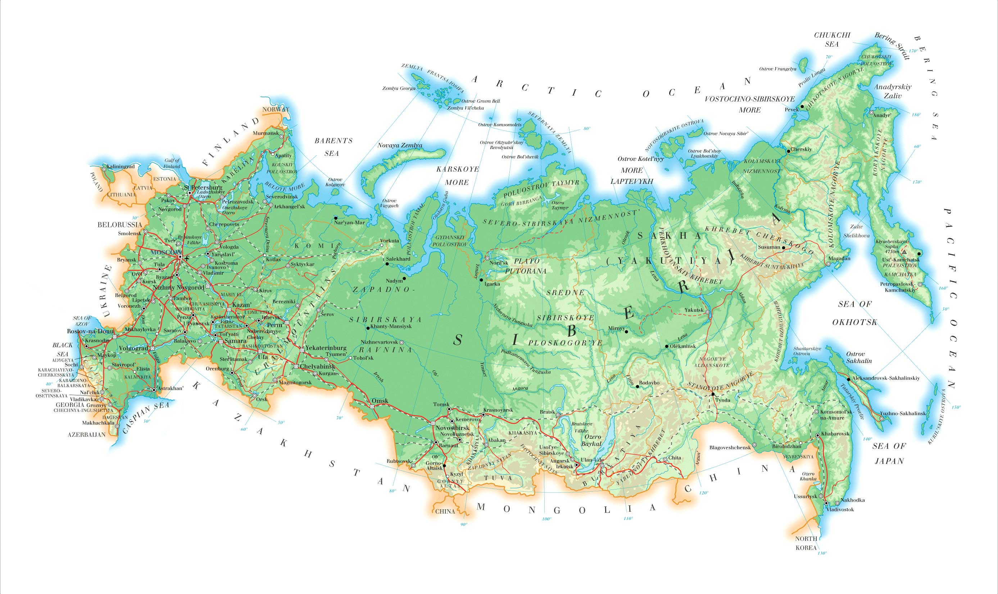
Gigaton Volume Detector: Baikal GVD
~ 50 authors, 6 +3 institutions
State Marine U. Petersburg
JINR Dubna INR, MSU Moscow
Techn State U. Nizhni Novgorod
Irkutsk State University
Plus:
EvoLogics Gmb., Berlin, Germany
Czech Technical University, Prague, Czech Republic
Comenius University, Bratislava, Slovakia

Slide 59
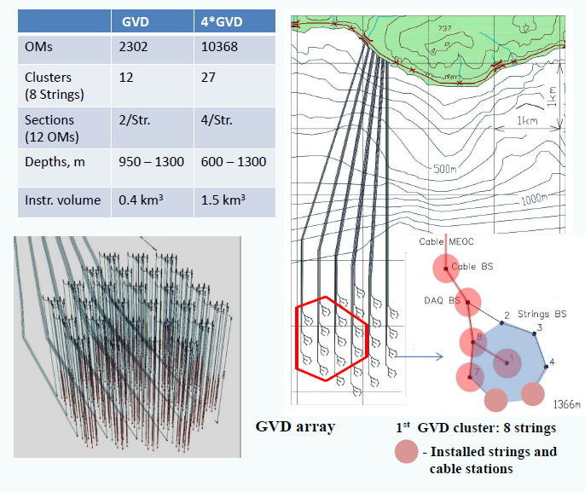
GVD: Phase 1 (2020) and Phase 2 (~2025)
3
3-
GVD-1
  12 clusters with 8 strings each
  Cluster diameter 120 m
  Height 520 m
  Volume ~ 0.4 km³
  36 OMs per string
  Ang. resol. for muons ~ 0.25°
  Ang. resol. for cascades 3-4°

Slide 60
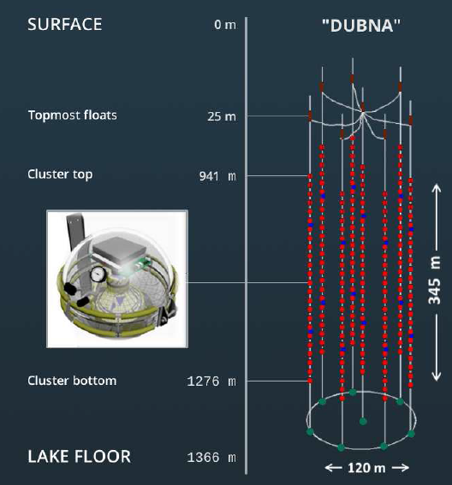
Since April 2015: Lake Baikal, first cluster of GVD
Old NT200:
volume ~ 0.0001 km³
DUBNA cluster:
0.004 km³
(Antares 0.015 km³)

Slide 61
KM3NeT

Slide 62

KM3NeT

Slide 63

Original idea: 6 blocks at 3 locations: 6 x 0.6 km³
115 strings per block
18 DOMs per string
31 PMTs per DOM
France
Italy
Greece

Slide 64

Phase 1 (2017):
France
7 strings, small spacing
- Feasibility test for ORCA
Italy
24 strings, 124 m spacing
Demonstrate principle
- Physics on the 3-4 times Antares scale

Slide 65
Phase 1 (2017):
France
7 strings, small spacing
- Feasibility test for ORCA
Italy
24 strings, 124 m spacing
Demonstrate principle
- Physics on the 3-4 times Antares scale

Slide 66

Phase 2: ORCA and ARCA (2020?)
France
ORCA
ARCA
Italy
ORCA: determination of the Neutrino Mass Hierarchy (NMH)
ARCA: IceCube physics, but with better angular resolution and
from the Northern hemisphere

Slide 67


KM3NeT:
the mDOM
31 3-inch PMTs
→3 times higher photocathode area per DOM
→ sensitive to angle
→ easy background supression

Slide 68

KM3NeT Phase 2: diffuse fluxes
Sensitivity to IceCube HESE signal

Slide 69

KM3NeT Phase 2: point source sensitivity
2,
2,
  For specific flux assumptions for
  Supernova Remnants
  (modeled using γ-ray results) Kelner et al., Phys.Rev. D74 (2006) 034018
  → 3σ detection in ~5 years
IceCube sensitivity
at the time KM3NeT-2
has operated 3 years

Slide 70
IceCube Gen2

Slide 71


Slide 72
The IceCube Gen2 facility: conceptual drawing
  PINGU : low energy, mass hierarchy
  High Energy Array (HEA) - PeV scale neutrinos - optical sensors
  Cosmic Ray Array (CRA) - - veto array for HEA - cosmic ray physics
  Radio Array (RA) - > 100 PeV - BZ (GZK) neutrinos

Slide 73

The IceCube Gen2 facility: conceptual drawing
  PINGU : low energy, mass hierarchy
  High Energy Array (HEA) - PeV scale neutrinos - optical sensors
  Cosmic Ray Array (CRA) - - veto array for HEA - cosmic ray physics
  Radio Array (RA) - > 100 PeV - BZ (GZK) neutrinos

Slide 74

Gen2/HEA
Gen2/HEA Parameters
# Strings | 120
DOMs / String | 80
String Length | 1.3 km
Studies have focused on “sunflower” design.
Simulation of baseline string spacing of 240 m
indicate no loss of well-reconstructed PeV events

Slide 75
Global timeline
2014 2015 2016 2017 2018 2019 2020 2021 2022 2023 2024
KM3NeT-1 constr.
KM3-ARCA construction
Relevant physics
ORCA
2 (1) x 0.6 km³
+ 1 x 0.4 km³
GVD 1.cluster
GVD-1 construction
Relevant physics
IceCube: more and better data.Relevant physics all the time
5-10 km³
Gen2 construction (finish 2028)
Gen2: R&D + preparatory phase
PINGU
Relevant physics

Slide 76
Global timeline
2014 2015 2016 2017 2018 2019 2020 2021 2022 2023 2024
towards full
KM3NeT/ARCA
(3-4 km³)
towards GVD-2
(1.5 km³)
KM3NeT-1 constr.
KM3-ARCA construction
Relevant physics
ORCA
5 km³
GVD 1.cluster
GVD-1 construction
Relevant physics
IceCube: more and better data.Relevant physics all the time
5-10 km³
Gen2 construction (finish 2028)
Gen2: R&D + preparatory phase
PINGU
Relevant physics

Slide 77
Conclusions
Cosmic high-energy ν discovered
Opened new window, but landscape not yet charted: no point sources identified up to now
Also: remaining uncertainties on spectrum and flavor composition.
Point sources in reach!
Need larger detectors, also with different systematics and at the Northern hemisphere.
GNN: KM3NeT-GVD-IceCube-Gen2 will do it!

Slide 78
end

Slide 79
Content
Detection principles and detectors
Atmospheric neutrinos
Discovery and nature of cosmic neutrinos
Search for individual sources
Detectors of the next generation

Slide 80
GVD-1 timeline
-pro
Cumulative number of clusters vs. year
Year | 2015 | 2016 | 2017 | 2018 | 2019 | 2020
Cluster 192 OM | 1 192 | 1 192 | 3 576 | 5 960 | 7 1344 | 10 1920
Cluster- 288 OM | 2/3 192 | 1 288 | 2 576 | 4 1152 | 6 1728 | 8 2304
Cost of 8 additional clusters ~27M$

Slide 81


Oscillations of atmospheric neutrinos
Muon neutrino survival probability
Vertically upward
Oscillations
to sterile ν
Non-standard
oscillations due
to VLI
ANTARES/DeepCore
δc/c = 10⁻²⁷
Standard
oscillations
VLI
AMANDA
90%, 95%, 99%
SK + K2K
90%
Horizontal
IceCube
10y, 90%

Slide 82

Rejection of atmospheric μ and ν by „selfveto“
Dotted lines: without self-veto
Full lines: with self-veto
proton
c,(b)
charm
e,μ
νe,μ
π K
μ
νμ
e
νμ
νe
conventional

Slide 83
Rejection of atmospheric μ and ν by „selfveto“
proton
c,(b)
atm.μ
charm
e,μ
νe,μ
π K
μ
νμ
e
νμ
νe
conventional

Slide 84


Putting (all) together: Global fit
T1 = tracks (IC59) T2 = tracks (IC79), S1 = showers (IC40), S2 = showers (IC59)
H1 = HESE (IC79/86/86) H2 = MESE (IC79/86)

Slide 85

Putting all together
T3

Slide 86


Follow-up observations all-sky devices → pointing devices
ANTARES
IceCube

Slide 87

Putting all together
Global fit
Flux:
at 100 TeV
Spectral index:

Slide 88

Galactic plane
IC40+59, preliminary

Slide 89

A surface veto
R&D under way
up to ~120 km² and 1000 modules
~1m
>100 TeV: Earth opaque
Expect most of the signal from above
Veto could give 50-75% more events above 100 TeV (averaged over 4 π)
Galactic center !
CR physics one a scale just midway between 1 km² and 3000 km²
Albrecht Karle, Arlington Meeting April 24, 2014

Slide 90

…and once more the spectrum
6 different data samples based on data from 2008 – 2012
different strategies to suppress the atm. muon background
Large samples of track-like and cascade-like events
preliminary
assume isotropic astrophysical flux and ν_{e} : ν_{µ} : ν_{τ} = 1:1:1 at Earth , then
  can fit with unbroken power-law between 25 TeV and 2.8 PeV
  spectral index – 2.5 ± 0.09 (-2.0 disfavoured at 3.8σ)
  flux at 100 TeV (6.7 ± 1.2)x10⁻¹⁸ (GeV ⋅ cm² ⋅ s ⋅ sr)⁻¹
Notes:
We have also performed a measurement of the flavor composition, illustrated in the figure on the right.
Muon damped, pion decay, neutron beam

Slide 91

HESE analysis
Effective target mass for various interactions
100 TeV 1 PeV

Slide 92
Oscillations of atmospheric neutrinos
Muon neutrino survival probability
Vertically upward
cosmic
ray
ANTARES/DeepCore
ν
Earth
L
θ
Horizontal

