Slide 1
The DarkSide-20 tonnes
Experiment
Future plans
ICPPA-2015
Moscow
October 8, 2015
(An. Ianni, Princeton Un.)

Slide 2
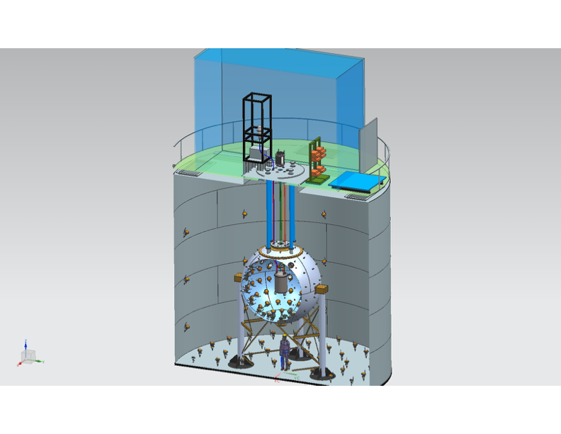
Actual Experiment
DarkSide-50
Liquid Ar TPC
153kg 39Ar-Depleted
Underground Argon
Target
4m Diameter
30 Tonnes
Liquid Scintillator
Neutron Veto
10m Height
11m Diameter
1,000 Tonnes
Water Cherenkov
Muon Veto

Slide 3
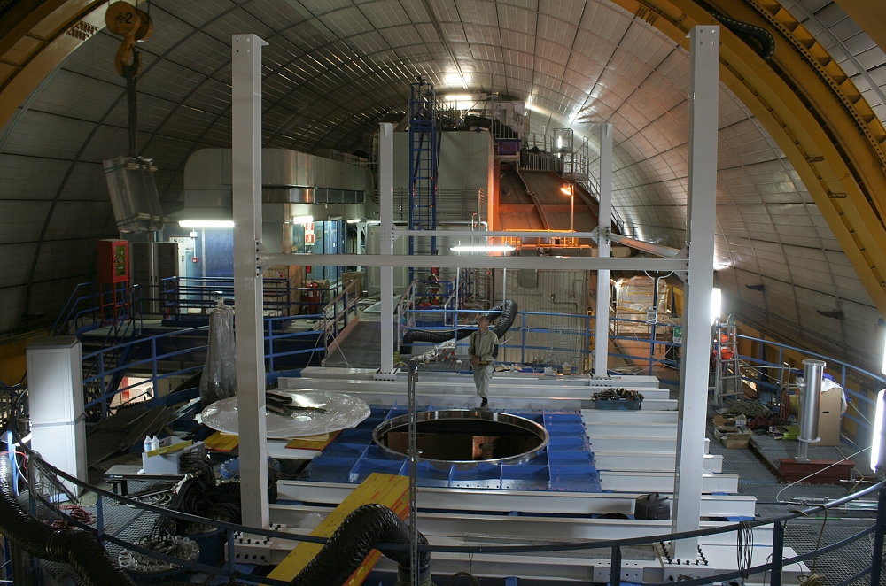
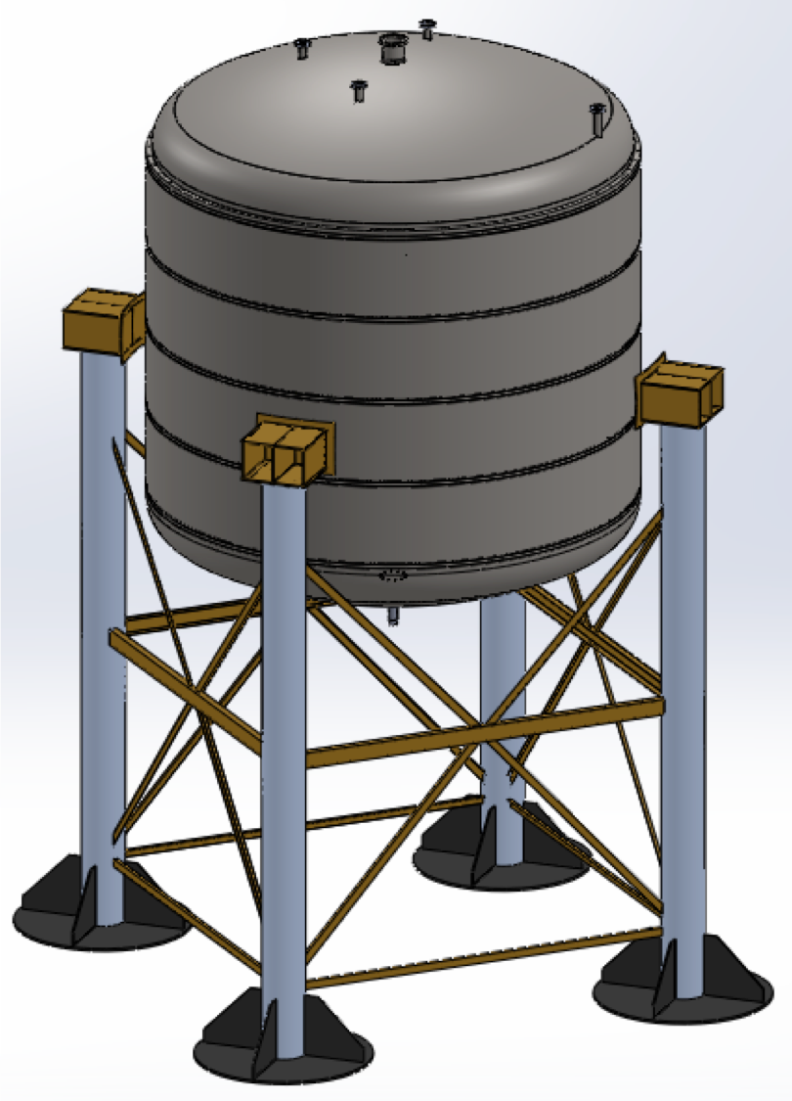
DS-20K
Actual bigger
flange to enter
the CTF
30 Tonnes
(23 fiducial)
Cryostat
Structured legs
the same of LSV

Slide 4
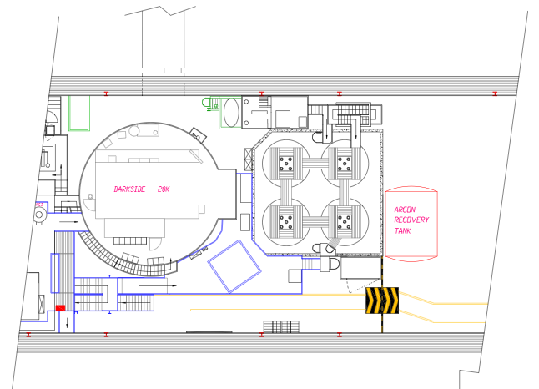
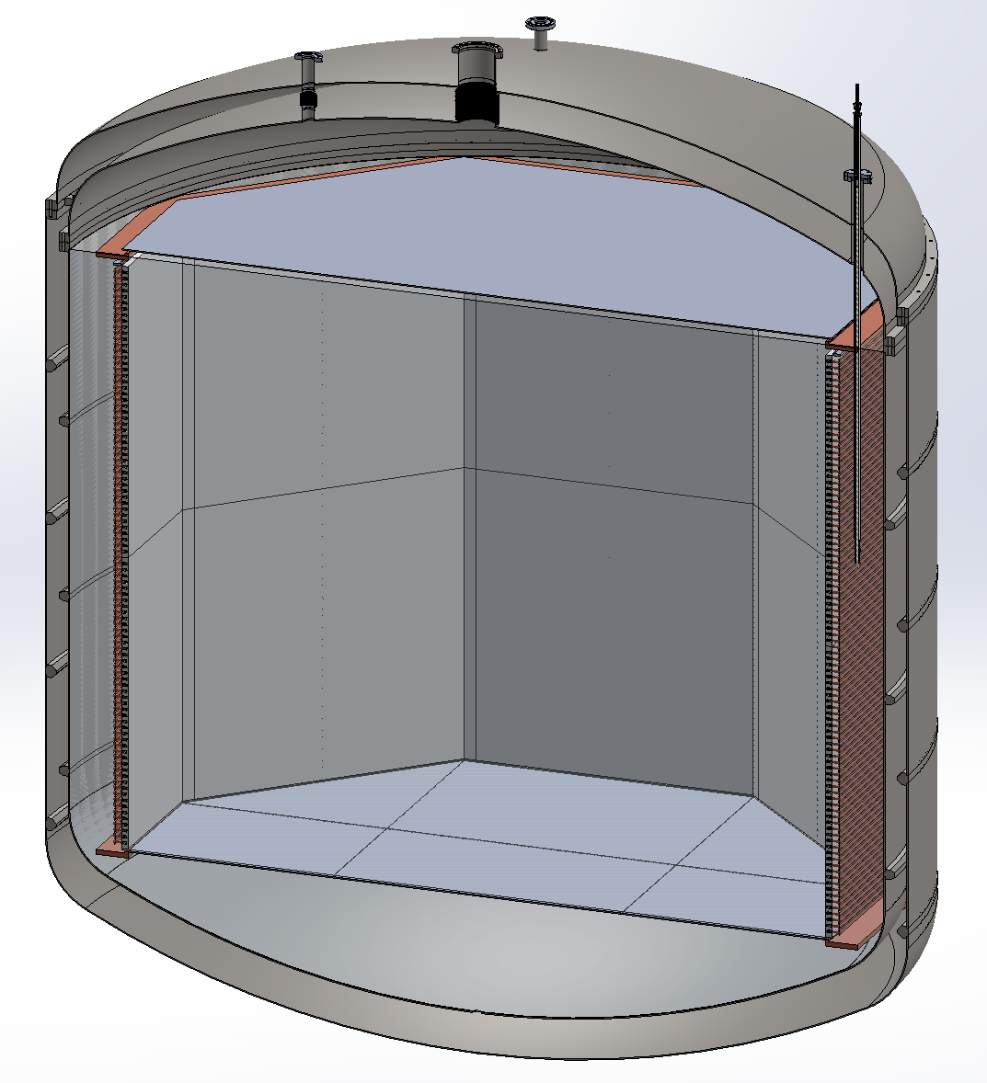
Future Plan
Main Tasks:
CTF Modification and local Area (to be agreed to Borexino)
Allocation of the Recovery Tank for the UAr
Possible use of Gadolinium and modification of the Water Plant for such a possibility
Zoom View
Cryostat:
Intention to use Pure Titanium
Russia has a crucial role to find pure Ti with low radio-contamination
Classification of material, weldings, engineering very fundamental
SiPM tiles (15m² total surface)

Slide 5
Future Plan
SiPM development
Test on 10cm² tile at 80K
All channels connected together on one front-end.
Tile illuminated with laser. Integration time = 6us.
Measurement performed by
Razeto (LNGS) and Korga (Houston) @ LNGS
Single-photon spectrum visible!!
low noise
very uniform behavior of the SiPMs!!

Slide 6
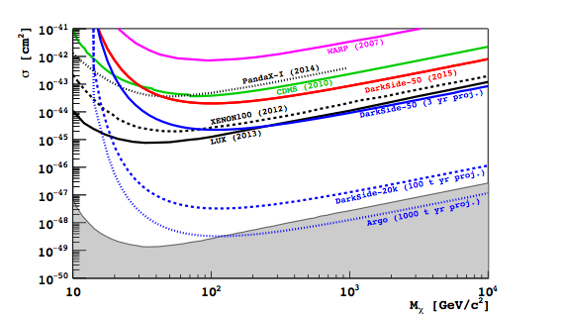
Notes:
Expected spin-independent WIMP-nucleon cross section sensitivity (90% C.L.) of DarkSide-50 after three years of UAr running (solid blue), DarkSide-20k (dashed blue) and Argo (dotted blue). Also shown are the 90% C.L. exclusion plots for DarkSide-50 [1] (solid red), LUX [21] (solid black), XENON100 [22] (dashed black), CDMS [23] (solid green), PandaX-I [24] (dotted black), and WARP [25] (magenta).

Slide 7
DarkSide-20k
20-tonnes fiducial dark matter detector
start of operations at LNGS within 2020
100 tonne×year background-free search for dark matter
20- | 15 | 16 | 17 | 18 | 19 | 20 | 21 | 22 | 23 | 24 | 25 | 26 | 27 | 28 | 29 | 30 | 31 | 32 | 33 | 34
DS-20k
ARGO
Argo
300-tonnes depleted argon detector
start of operations at LNGS within 2025
1,000 tonne×year background-free search for dark matter
precision measurement of solar neutrinos
Notes:
Schedule and target mass for the two depleted argon TPC dark matter searches proposed by the DarkSide Collaboration: DarkSide-20k and Argo.

Slide 8
DarkSide-20k and Argo LoI Signatories
D. Franco, A Tonazzo (APC Paris)
D. Alton (Augustana)
A. Kubankin (Belgorod)
K. Keeter, B. Mount (BHSU)
A. Devoto, M. Lissia, M. Mascia, S. Palmas (Cagliari)
A. Machado, E. Segreto (Campinas)
M. Leal, L. Romero, R. Santorelli (CIEMAT)
S. Horikawa, K. Nikolics, C. Regenfus,
A. Rubbia (ETH)
S. Pordes (Fermilab)
A. Gola, C. Piemonte (FBK & TIFPA)
M. Pallavicini, G. Testera, S. Zavatarelli (Genova)
S. Davini (GSSI)
E. Hungerford, A. Renshaw (Houston)
M. Guan, J. Liu, Y. Ma, C. Yang, W. Zhong (IHEP)
M. Misziazek, K. Pelczar, M. Woicik, G. Zuzel (Jagiellonian)
K. Fomenko, A. Sotnikov, O. Smirnov (JINR)
M. Skorokhvatov (Kurchatov)
N. Canci, F. Gabriele, G. Bonfini, A. Razeto,
N. Rossi, F. Villante (LNGS)
S. De Cecco, C. Giganti (LPNHE Paris)
D. D’Angelo, G. Ranucci (Milano)
A. Chepurnov, G. Girenok, I. Gribov,
M. Gromov, I. Zilcov (MSU)
H. Back (PNNL)
M. Ghioni, A. Gulinatti, L. Pellegrini, I. Rech,
A. Tosi, F. Zappa (PoliMi)
C. Galbiati, A. Goretti, A. Ianni,
P. Meyers, M. Wada (Princeton)
C. Dionisi, S. Giagu, M. Rescigno (Roma 1)
S. Bussino, S. Mari (Roma 3)
A. Derbin, V. Muratova, D. Semenov,
E. Unzhakov (St. Petersburg)
C. Jollet, A. Meregaglia (Strasbourg)
C.J. Martoff, J. Napolitano, J. Wilhelmi (Temple)
E. Pantic (UC Davis)
Y. Suvorov, H. Wang (UCLA)
A. Pocar (UMass Amherst)
F. Ortica, A. Romani (Perugia)
S. Catalanotti, A. Cocco, G. Covone,
G. Fiorillo, B. Rossi (Napoli)
J. Maricic, R. Milincic, B. Reinhold (Hawaii)
P. Cavalcante (Virginia Tech)
Notes:
List of senior signatories for the Letter of Intent for DarkSide-20k and Argo.
The list includes 92 senior members from 35 institutions.

