Slide 1
Pyroelectric X-ray and neutron generator for low background detectors calibration
A.S. Chepurnov ª, V.Y. Ionidi ª, O.O. Ivashchuk ^{b}, A.S. Kubankin ^{b,c}, A.N. Oleinik ^{b},
A.V. Shchagin ^{b,d}
ª Skobeltsyn Institute of Nuclear Physics, Lomonosov Moscow State University, Moscow, Russia
^{b} Radiation Physics Laboratory, Belgorod State University, Belgorod, Russia
^{C} Lebedev Physical Institute, Moscow, Russia
^{d} Kharkov Institute of Physics and Technology, Kharkov, Ukraine
International Conference on Particle Physics and Astrophysics (ICPPA 2015)
2015 October 8, Moscow

Slide 2
Calibration neutrino and dark matter detectors using neutrons
Primary recoil nucleus required for detector calibration can be produced by neutrons. Recoils is produced by elastic scattering on neutrons.
A source of neutrons with constant energy and low divergence is required.
Scattered
neutrons
Liquid
argon
Elastic scattering:
n+Ar→n+Ar_{rec}
Neutron
source
θ
Inelastic scattering:
n+Ar→n+Ar*→n+Ar_{rec}+γ(1.46 MeV)
Scattering event
taken by A. E. Bondar, A. F. Buzulutskov, et al., Proposal for neutron scattering systems for calibration of dark matter search and low-energy neutrino detectors, Vestnik of NSU: Physics Series, pp. 27-38, vol. 8, n. 3, (2013) (at Russian)
James R. Verbus, Brown University, Measurement of Ultra-low Energy Nuclear Recoils in the LUX Detector Using a D-D Neutron Generator, report at workshop “Calibration of low energy particle detectors”, September 23-25, 2015, Chicago.
Possible calibration geometry, if generator is compact
Scattered
neutrons
Neutron
source
Liquid
argon
θ
Scattering event

Slide 3
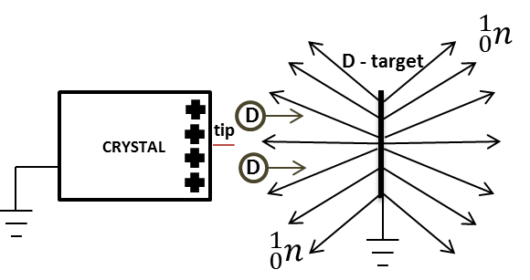
Mechanisms of X-Ray and neutrons generation by pyroelectric crystals
X-Ray radiation generation
Neutrons (2.45 MeV) generation
Positively charged only
Notes:
A
Polarity - charge
As known, pyroelectric crystals, as tantalate lithium or niobate lithium can produce high electric field up several hundred kV per cm. Necessary conditions for this: pressure of residual gases about 1 mTorr, temperature of crystal is changing. Crystal has negative or positive polarity, depending on phase of change temperature (cooling or heating) and orientation of Z-axis.
If grounded target is located in front of the charged surface of the crystal, it becomes possible generation of X-Ray radiation from this system. . If the crystal has a positive charge polarity the electrons from polarized molecules are accelerated towards the crystal surface producing bremsstrahlung and characteristic radiation from the crystal surface. When crystal surface has a negative polarity, then electrons from polarized molecules and the crystal surface are accelerated to the grounded target producing bremsstrahlung and characteristic radiation from the target.
Also known, if residual gas – deuterium, then charge surface of pyroelectric crystal can polarized molecules of deuterium. If tungsten probe with tip radius about several hundred nanometers mounted on crystal surface, nearby to him strong electric field appears and when crystal has positive polarity, d-ions accelerated from this small value to deuterium target. Energy of D-ions is enough for D-D fusion reaction. According to estimate, pyroelectric neutron production can consist until 10^4 neutrons per cycle, energy of neutrons – 2.45 MeV.
Specifically, in this scheme, neutron production is possible only one polarity. However there are other geometry, this disadvantage can be easily corrected.

Slide 4
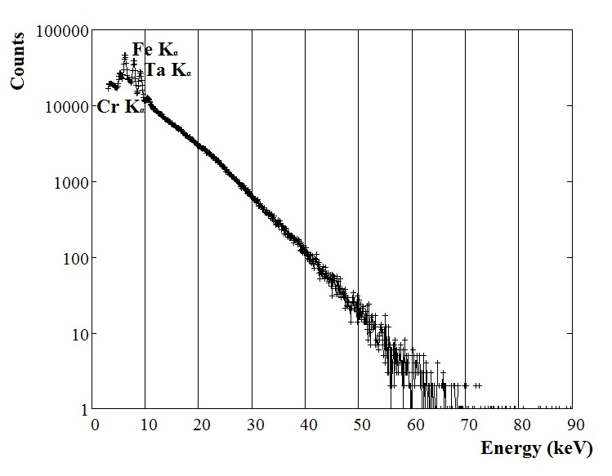
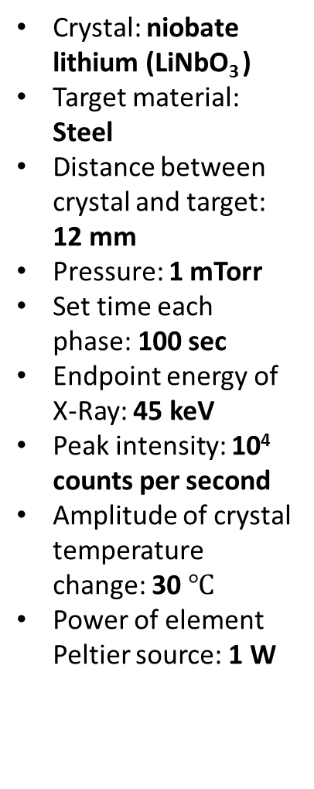
X-Ray emission is indication of proper condition of neutron generation
Crystal: niobate lithium (LiNbO₃ )
Target material: Steel
Distance between crystal and target: 12 mm
Pressure: 1 mTorr
Set time each phase: 100 sec
Endpoint energy of X-Ray: 45 keV
Peak intensity: 10⁴ counts per second
Amplitude of crystal temperature change: 30$℃$
Power of element Peltier source: 1 W
Data are summarized for three thermal cycles
Typical X-Ray spectrum from pyroelectric source
Notes:
There are presented typical spectrum of X-Ray radiation from pyroelectric source. Data are summarized for three thermal cycles. Left shown several characteristics of measurement. Input window of detector was in vacuum chamber, at an angle of 90 degrees to the axis connecting the crystal and the target. How you see, pyroelectric X-ray source can be used for practical purposes and energy of produced radiation is not high.
However, neutron source is more convenient for calibration detectors and next step is investigation pyroelectric neutron source.

Slide 5
Advantages of pyroelectric neutron generator for low background detectors calibration
Such sources will have a typical size of several cubic centimeters.
Pyroelectric source do not contain any radioactive substances and could be manufactured low background.
Pyroelectric source don’t need external high voltage power supply.
When the pyroelectric source is tuned off, it does not produce any radiation and does not disturbed operation of the detector
Fixed neutron energy (2.45 MeV), controllable time-stamp of neutron flux.
The source can be tuned on by connecting of a low voltage power supply that should provide variation of the temperature of the pyroelectric crystal.
Notes:
Pyroelectric generator has certain advantages over the other X-Ray and neutron source.
First of all, it is size - pyroelectric crystals usually have ranged from 0.025 cm^3 to 7 cm^3, low voltage source – for changing crystal temperature using element Peltier enough 9V battery, safety pyroelectric sources can be turned on and off and he hasn’t and doesn’t need in radioactive materials.
It all makes pyroelectric source very interesting and advantage device in application, where not required high intensity of radiation and needed in compactness and fast tuning On/Off mode. One of possible application – calibration low background detectors for search neutrino or dark matter. The pyroelectric neutron source can be installed stationary into a neutrino or dark matter detector. When the source is tuned off, it does not produce any radiation and does not hamper operation of the detector. The source can be tuned on by connecting of a low voltage power supply that should provide variation of the temperature of the pyroelectric crystal. The tuned on source produces 2.45 MeV neutrons. The scattering of the neutrons on atomic nuclei of the detector produces recoil nuclei that can be used for calibration of the detector. Besides of neutrons, the source can produce X-rays that can hamper the calibration. The X-rays should be absorbed by walls of the chamber of the source.

Slide 6
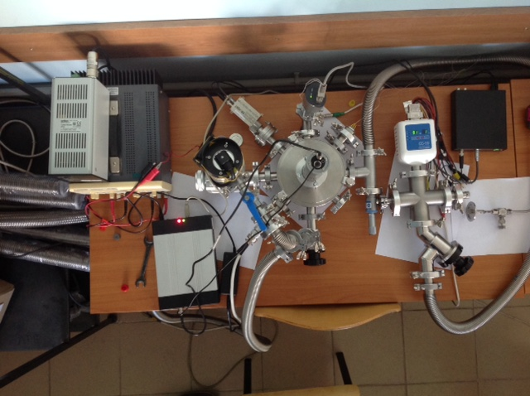
Experimental setup (Radiation Physics Laboratory, Belgorod)
vacuum gauge
needle valve
X-Ray detector
vacuum chamber
high vacuum pump
forvacuum pump
D₂ buster
volume
γn - detector
Notes:
Now, properties and possibilities of improving pyroelectric source actively investigated in Radiation Physics Laboratory, in Belgorod. On slide presented part of our experimental setup. He included vacuum system, with possibility receiving and monitoring vacuum up to 10^-6 Torr, X-Ray spectroscopic system using semiconductor detector, neutron spectroscopic system, system of fine adjustment of the gas, tuning source for element Peltier and temperature monitoring system.
Primarily, we investigate generation of X-Ray radiation from pyroelectric source.

Slide 7
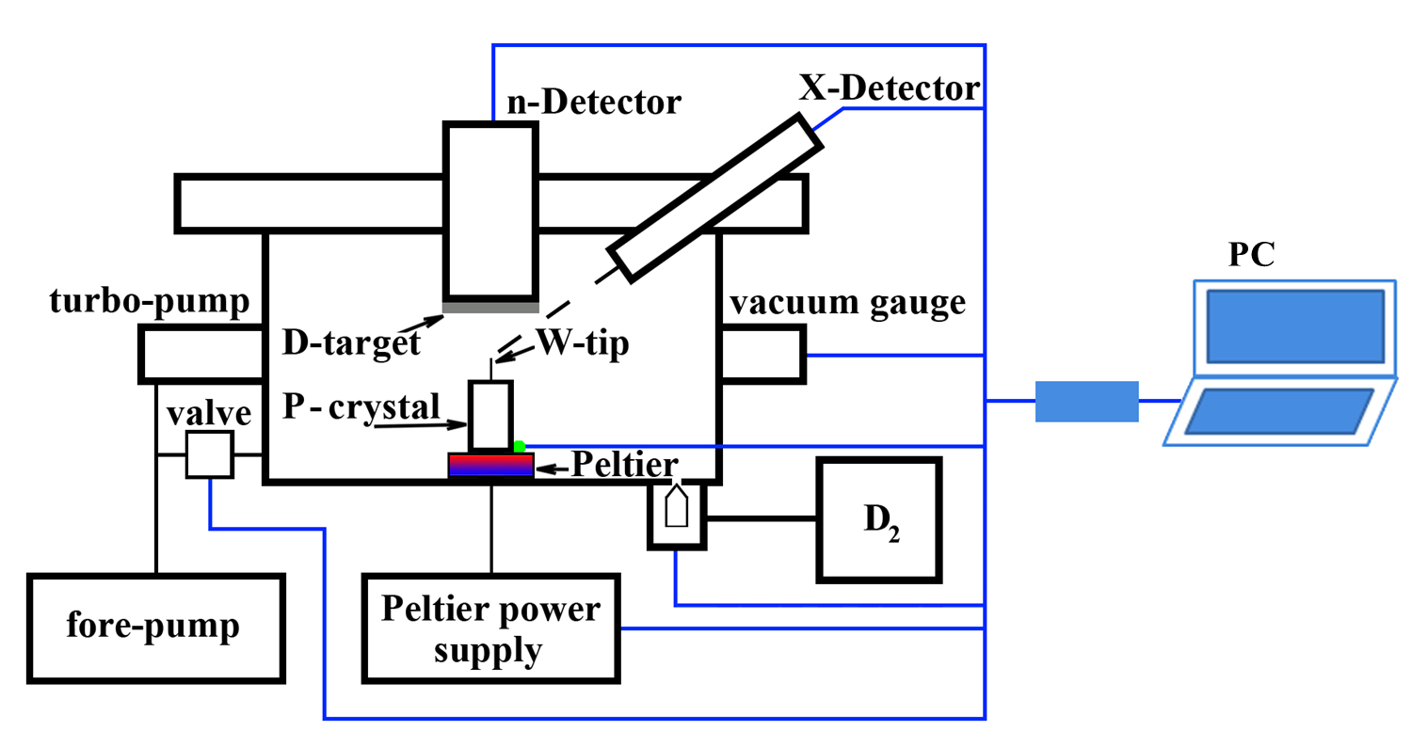
Scheme of experimental setup for neutron
generation
Energy of produced neutrons – 2.45 MeV.
The neutrons source should has intensity of several hundred neutrons per thermal cycle.
Notes:
There are presented scheme of experimental setup for neutron generation. At the moment all components of this scheme is ready and built in one experimental setup.

Slide 8
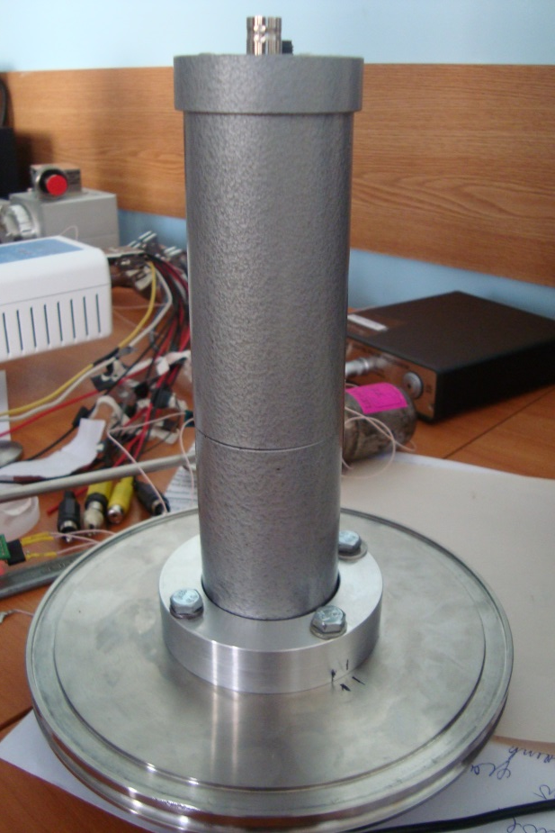
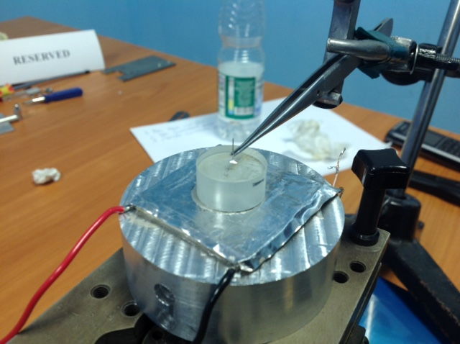
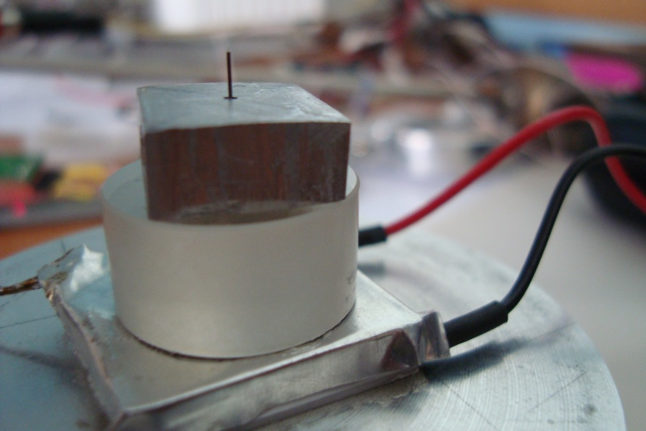
Current state of the project
Production tungsten tip and deuterium target
Construction experimental setup for neutron generation
First experiment of neutron generation – no success yet
Neutron detector
SDMF-1206
Development in progress….
tungsten tip
aluminum pad
LiTaO₃
Notes:
There shown some photo of experimental setup: mounting neutron detector, pyroelectric crystal tantalate lithium with mounting tungsten tip.
Now, first experiment for neutron generation show some difficulty in neutrons production. While, we could not get necessary yield of neutrons for calibration.
There are several reasons: at beginning choose non-optimal parameters mounting tip on the crystal, necessary optimization of geometry measurement and monitoring temperature.

Slide 9
Next steps
Search of optimal condition for neutrons generation from pyroelectric source (thermal conditions, pressure, geometry of source, W-tip characteristics, D-target characteristics).
Selection materials with ultra low level of radioactivity for pyroelectric neutron source device.
Design and construction of the compact neutron generator for low background detectors calibration
Acknowledgement
Authors are thankful to S.I. Bashko and his team from ISSP RAS for production of tungsten tips.
This study was supported financially by the Russian Foundation for Basic Research, projects 14-22-0301 ofi_m and the Ministry of Education and Science of the Russian Federation, project 3.2009.2014/K.
Notes:
Because, our next steps is search of optimal condition for neutrons generation from pyroelectric source and later, design compact neutron generator for low background detectors calibration.

Slide 10
Thank you for attention!

Slide 11
taken by A. E. Bondar, A. F. Buzulutskov, et al., Proposal for neutron scattering systems for calibration of dark matter search and low-energy neutrino detectors, Vestnik of NSU: Physics Series, pp. 27-38, vol. 8, n. 3, (2013) (at Russian)
elastic scattering
nonelastic scattering
Energy of Ar recoils
Cross-section of scattering
Recoil energy, keV
Cross-section, barn
Scattering angle, deg.
Scattering angle, deg.

Slide 12
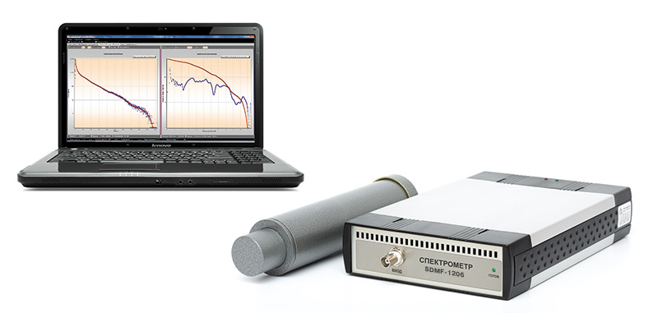
Detector
SDMF-1206 (made in Russia)
Energy scale for n 350 keV – 12 (14) МeV
Energy scale for gamma 100 keV – 6 MeV
Power of equivalent doze for
mixed n/gamma fields 0.1-1000 mkSv/s
Principle – FADC (PSD) p-recoil /gamma discrimination,
p-Terphenyl/Stilben crystal 2 – 4 sm³ + PMT

Slide 13
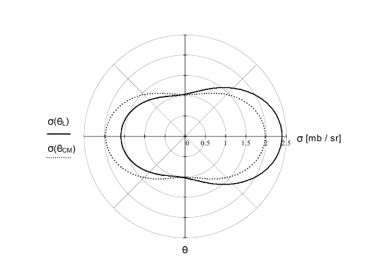
Angular dependence of neutron emission cross section [mb / sr], given in terms of the
emitted neutron angle relative to the angle of the incident deuteron. Shown for center-of-mass system (dashed line) and laboratory system (solid line).
Taken by Y. Danon “A novel compact neutron and X-Ray source”, technical report (2007)
Data for incident deuterons with energy 100 keV.
If energy of incident deuterons increase, then anisotropy of neutron emission is more.

