Slide 1
Development of the Readout ASIC for Muon Chambers
E. Atkin, I. Bulbalkov, A. Voronin, V. Ivanov, P. Ivanov, E. Malankin, D. Normanov, V. Samsonov, V. Shumikhin,
A. Gusev, S. Vinogradov, O. Shumkin, I. Sagdiev
ASIC Laboratory @MEPhI

Slide 2
Plan
Muon chambers
GEM features
Specifications
Prototype ASIC
Functionality tests
Tests with detector prototypes
Plans
International Conference on Particle Physics and Astrophysics, October,2015 (Moscow)

Slide 3
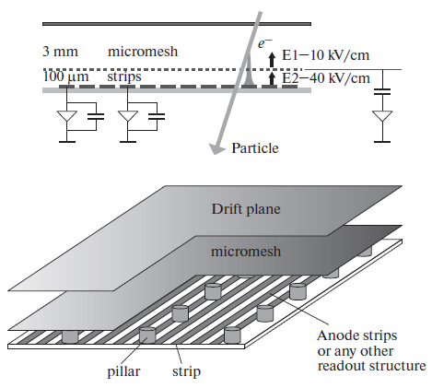
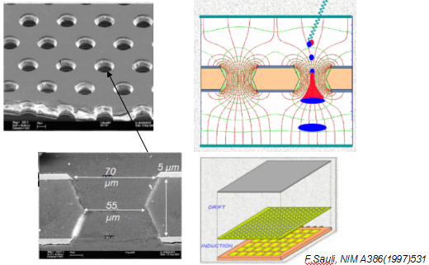
Muon Chambers
GEM & ThickGEM
Giomataris Y et al. NIM ( 1996) 376
Micromegas
International Conference on Particle Physics and Astrophysics, October,2015 (Moscow)

Slide 4
Features
Slow charge collection (e.g. vs Silicon Strips)
High Voltage applies to the foils
Sparkling probability
High output capacitance (10 and 100 pF)
High spatial resolution
International Conference on Particle Physics and Astrophysics, October,2015 (Moscow)

Slide 5
Design Approach
high input count rate range up to 10⁷ c.p.s/c in the middle of detector ->
- S/N maximization at the periphery
- hit rate optimization at the central pads
Detector capacitance range: C_{D} ~ (10-50) pF.
Up to 1,5 mln chs. -> area efficiency & low power consumption
Data-driven & Self-triggered readout -> timestamp
International Conference on Particle Physics and Astrophysics, October,2015 (Moscow)

Slide 6
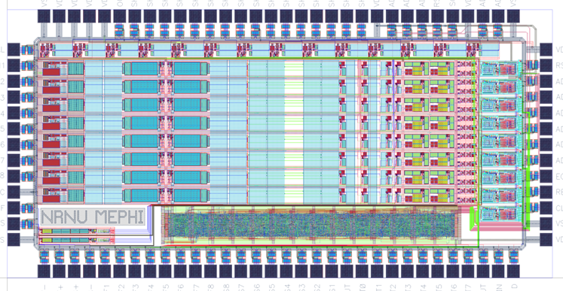
Prototype ASIC for Muon Chambers
8 Analog Channels
Discriminators
Threshold DACs
8 x SAR ADCs
ESD protection
Output Buffers (50 Ω)
Calibration Capacitance (1 pF)
Die Size 3240 x 1525 μm²
Package CPGA120
Process UMC 180 MMRF
Europractice double miniASIC Run
International Conference on Particle Physics and Astrophysics, October,2015 (Moscow)

Slide 7
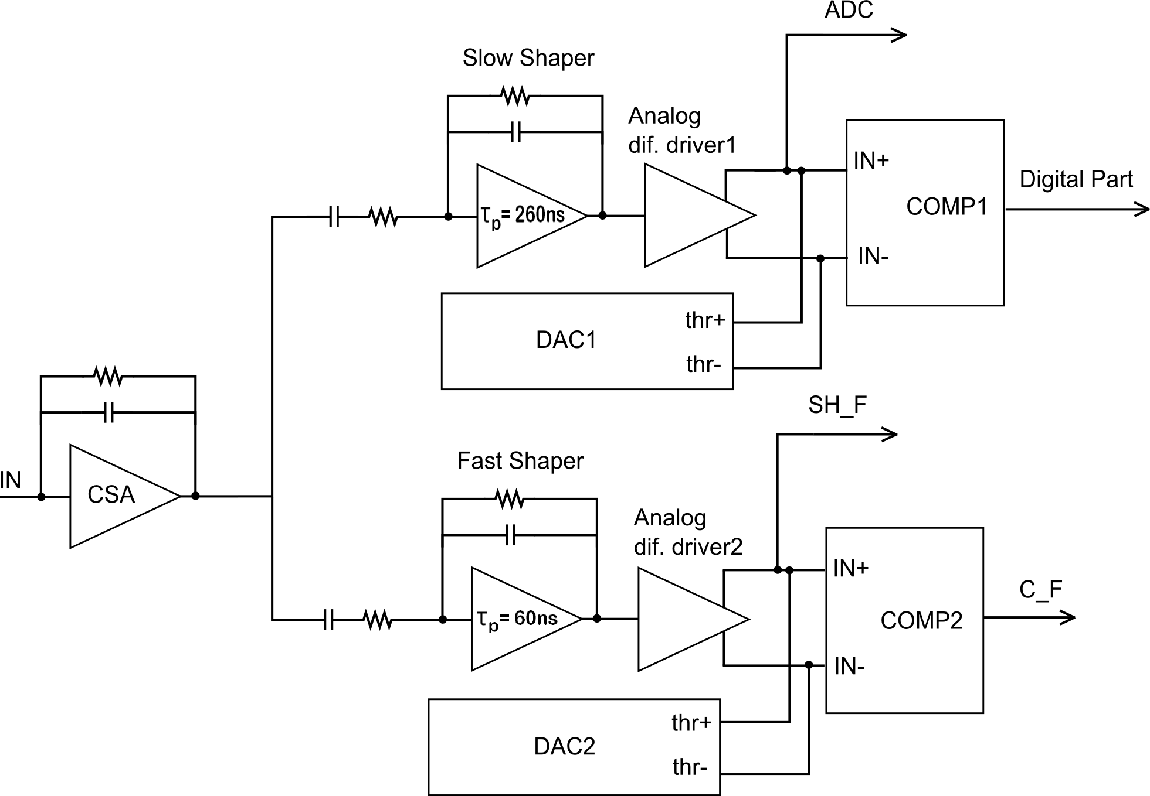
Analog Channel Architecture
Slow Channel:
Slow shaper (τ_{p} = 260 ns)
Analog differential driver1
DAC1
Comparator1
Fast Channel:
Fast shaper (τ_{p} = 60 ns)
Analog differential driver2
DAC2
Comparator2
International Conference on Particle Physics and Astrophysics, October,2015 (Moscow)

Slide 8
MUCH ASIC layout
3240
1525
Die Size 3240 x 1525 μm²
UMC CMOS MMRF 180
CPGA 120 Package
6 Metal Layers
90 PADs
PADs ESD
International Conference on Particle Physics and Astrophysics, October,2015 (Moscow)

Slide 9
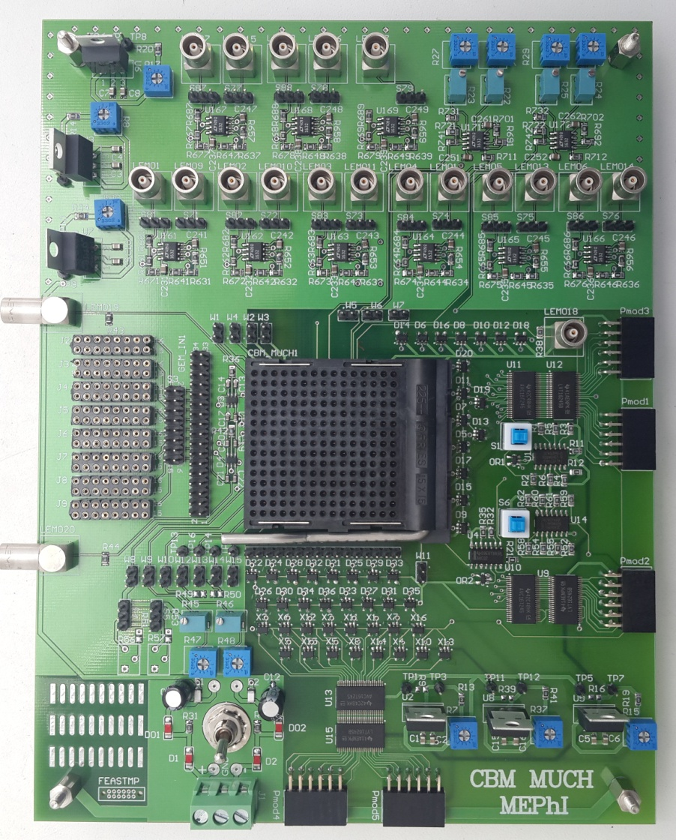
Test bench
Functionality:
Electrical tests ( input signal source – pulse generator)
MUCHv2 tests with GEM detector (detector prototype for the muon system of the CBM experiment), electrical check and measurements with the radioactive source ⁵⁵Fe.
International Conference on Particle Physics and Astrophysics, October,2015 (Moscow)

Slide 10
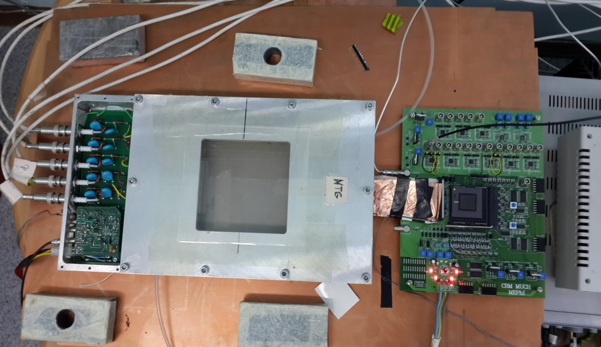
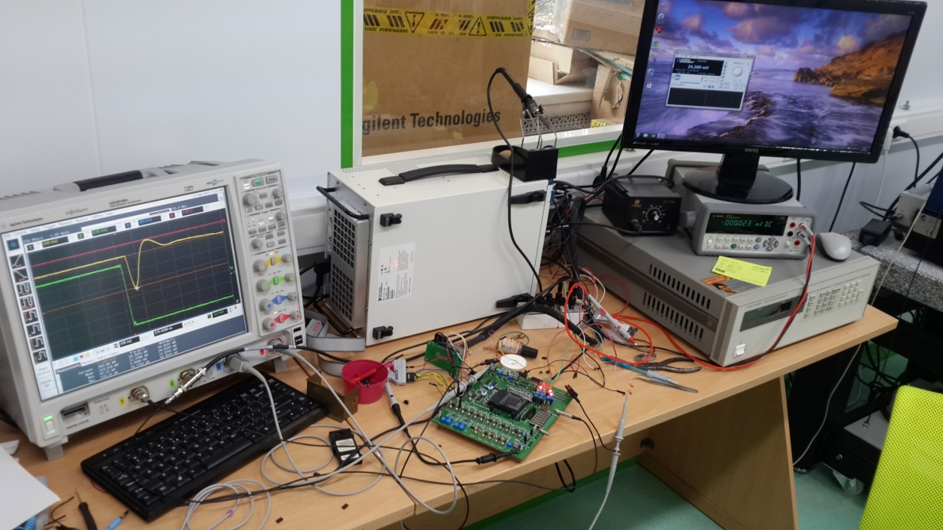
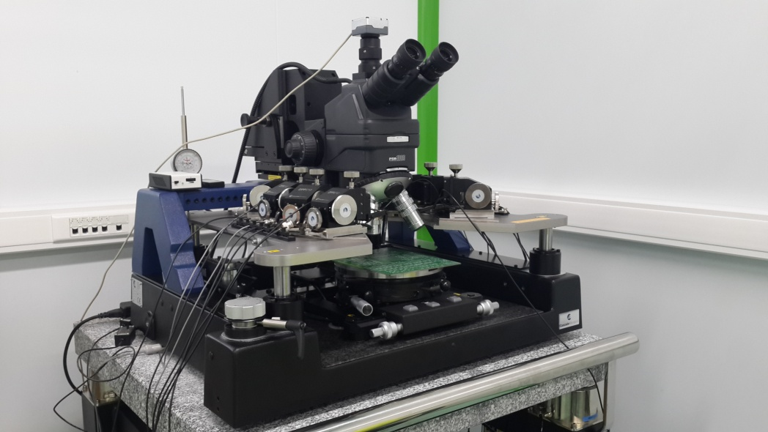
Test bench
International Conference on Particle Physics and Astrophysics, October,2015 (Moscow)

Slide 11
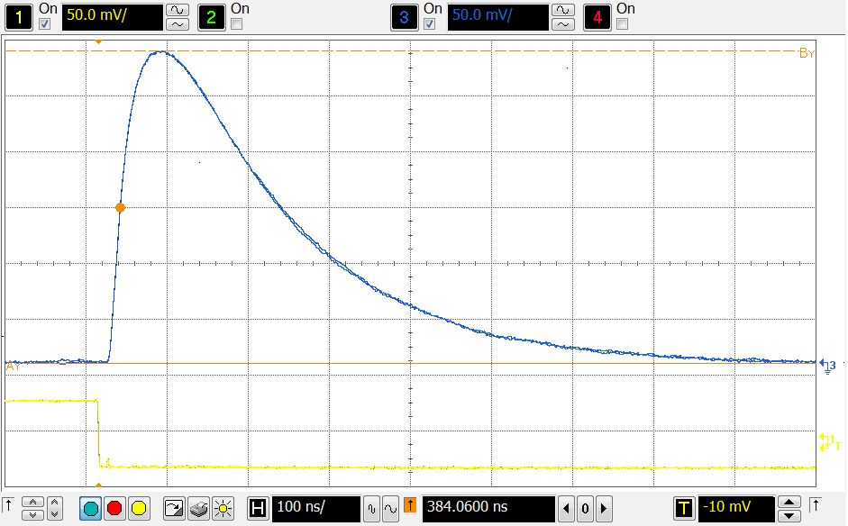
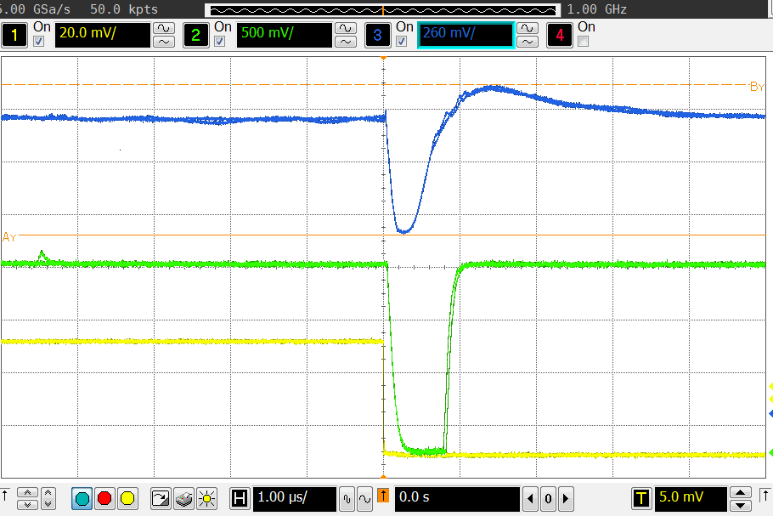
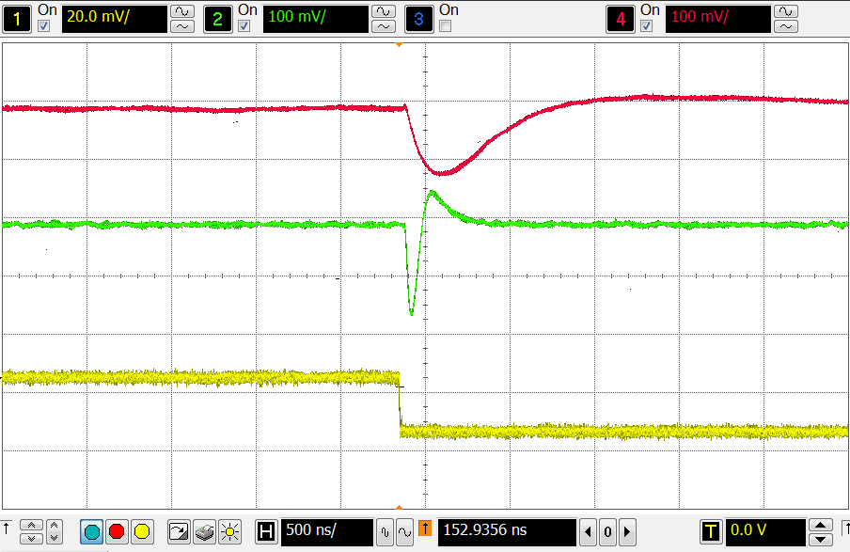
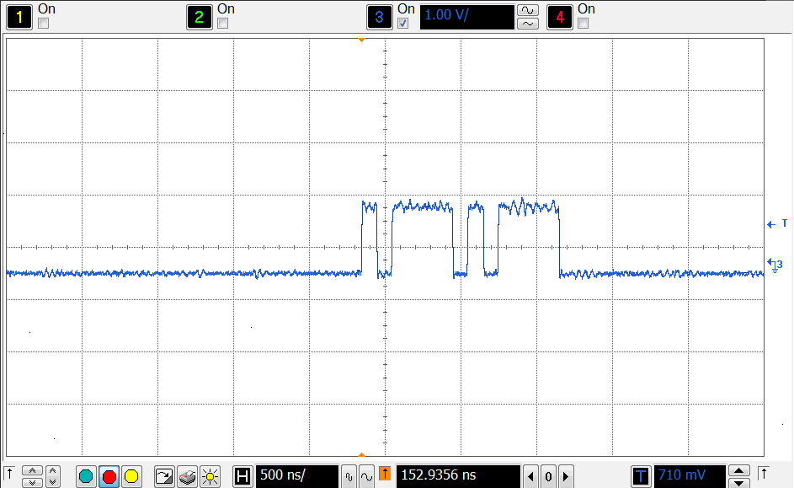
Lab study (Electrical tests)
CSA
COMPARATOR
SHAPERS
DAC REGISTER
International Conference on Particle Physics and Astrophysics, October,2015 (Moscow)

Slide 12
Lab study (Dynamic Range)
International Conference on Particle Physics and Astrophysics, October,2015 (Moscow)

Slide 13
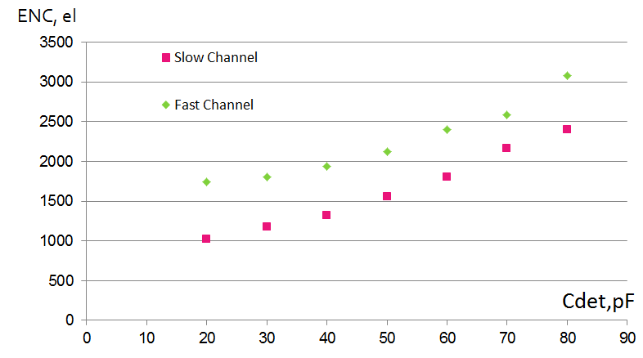
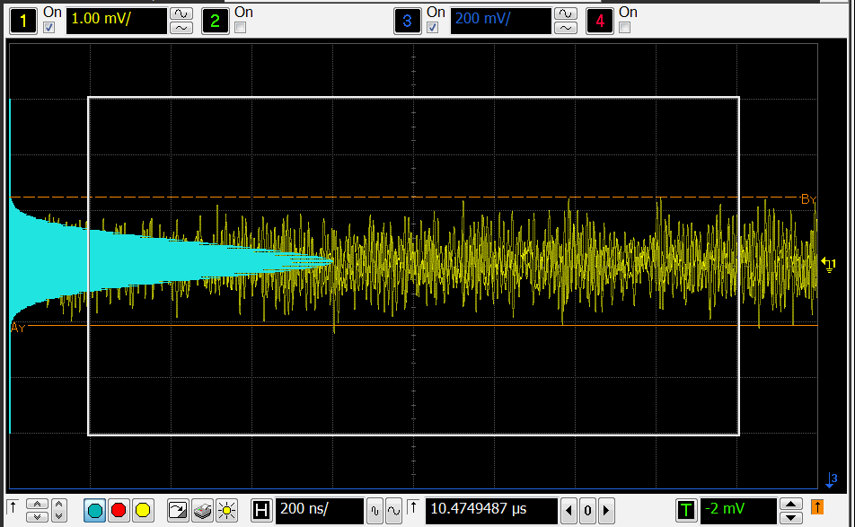
Lab study (Noise estimation)
Slow channel:
1000 el @ Cdet = 20pF
1500 el @ Cdet = 50 pF
Fast channel:
1800 el @ Cdet = 20pF
2100 el @ Cdet = 50 pF
International Conference on Particle Physics and Astrophysics, October,2015 (Moscow)

Slide 14
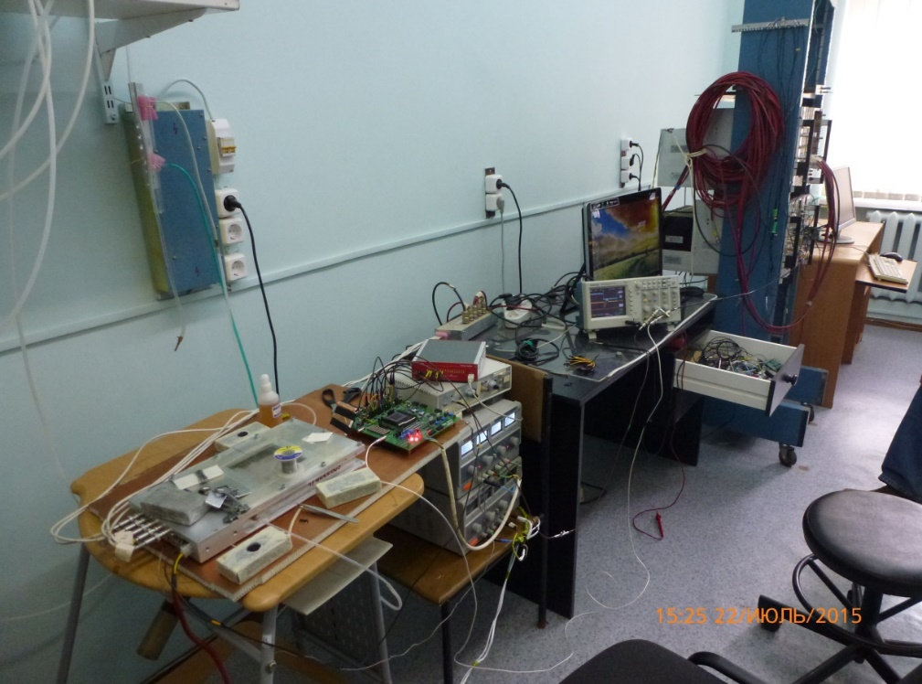
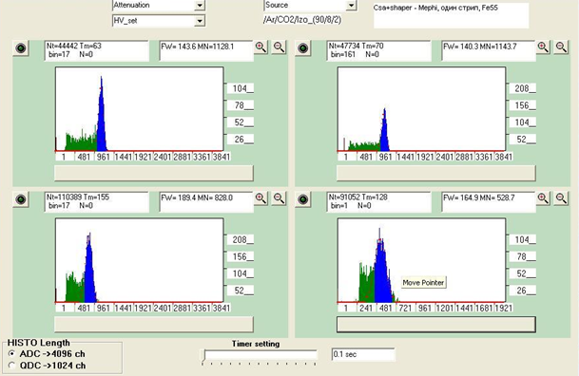
Lab study with GEM prototypes at PNPI
Test bench with the gas-filled detector based on the GEM and TGEM technologies, gas and high voltage (HV) system and the front-end electronic prototype
The measurements were carried with the Ar/CO2 gas mixture and the ⁵⁵Fe source
International Conference on Particle Physics and Astrophysics, October,2015 (Moscow)

Slide 15
Measured parameters
№ | Parameter | Simulation | Measurements
1 | Dynamic range | 1 – 100 fC | 1 – 100 fC
2 | Detector capacitance | up to 100 pF | up to 80 pF
3 | CSA rise time | 50 ns | 30 ns
4 | Shaping times (fast and slow) | 60 and 260 ns | 50 and 250 ns
5 | Slow channel gain | 5 mV/fC | 4.4 mV/fC
6 | Fast channel gain | 5.5 mV/fC | 5 mV/fC
9 | Slow channel ENC @ 50 pF Cdet | 800 el | 1500 el
11 | Fast channel ENC @ 50 pF Cdet | 1200el | 2000 el
10 | Power consumption (per channel) | 10 mW | 13 mW
International Conference on Particle Physics and Astrophysics, October,2015 (Moscow)

Slide 16
Summary
8 channel prototype ASIC for muon chambers was designed and prototyped in UMC 180 nm process
Functionality was tested with the pulse generator
Measurement of ⁵⁵Fe spectrum was provided with GEM detector and the ASIC
Development of the 64 channels ASIC for muon chambers is proceeded.
International Conference on Particle Physics and Astrophysics, October,2015 (Moscow)

Slide 17
Thank you for Your attention!

