Slide 1

The International Conference
on Particle Physics and Astrophysics (ICPPA-2015), Moscow,
October 5 -10, 2015
PAMELA mission for
solar-terrestrial physics
(Solar cosmic rays)
G.A, Bazilevskaya
Lebedev Physical Institute, RAS

Slide 2
Outline
What are Solar Energetic Particles (Solar Cosmic Rays).
Fundamental importance
Practical Importance
Why is PAMELA important for Solar Cosmic Rays
What is PAMELA contribution.
Conclusion: PAMELA results should be integrated into the world data bases.

Slide 3
Observational features of SEP:
elemental, isotope and charge composition vs. energy/rigidity,
intensity-time history vs. particle type,
intensity size distribution,
dynamics of the energy spectra,
dependence of (1), (2) and (3) on the source on the Sun, on the interplanetary conditions, on the point of observation in the heliosphere,
cosmogenic isotopes generated by solar particles in the past.

Slide 4
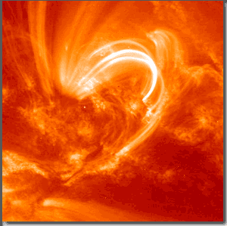
Flares are the sudden release of energy, leading to increased emission in most wavelength ranges lasting for minutes to hours.
A typical solar flare emits about 10³² ergs in total.
flare seen in ultraviolet radiation with the TRACE satellite.
www.suntrek.org/images/spaghettibig.gif

Slide 5
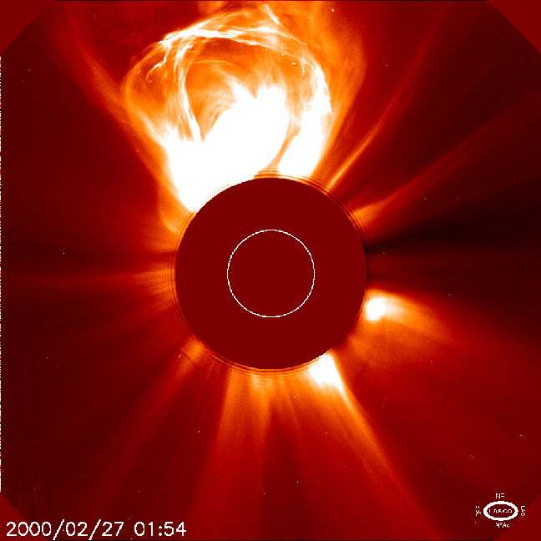
Coronal mass ejections (or CMEs) are huge ejections of mass from the Sun threaded with magnetic field lines.
They can involve 10^16 g of gas that is suddenly ejected at speeds up to 2000 km/s with a kinetic energy of >10^32 ergs.
CME-driven shocks can accelerate particles in the corona and interplanetary space.
rashomon.blogspot.com/2003_10_01_archive.html
Concerning the powerful SEP events
(GLEs), fast CMEs and flares always occur together,
which makes it difficult to directly identify the actual
source of SEP events detected near Earth orbit..

Slide 6
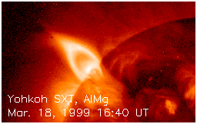
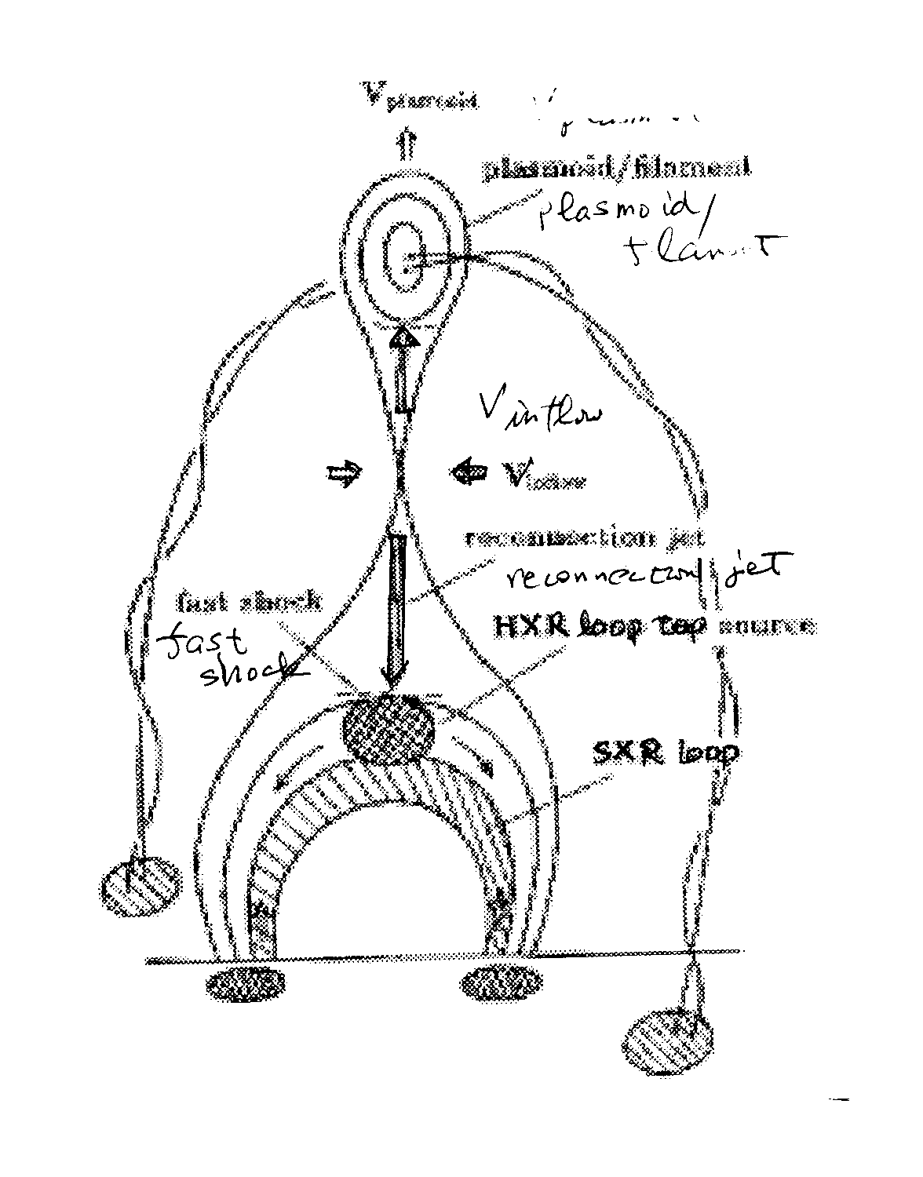
Possible
Acceleration Site 1
Magnetic Reconnection @ flare
Upward going plasma
(plasmoid)
brems X by
accelerated
electrons
2
4
Reconnection point
thermal X by
evaporated
electrons
1
2
Downward going plasma
(reconnection jet)
5
3
Shock between jet &
solar atmosphere
5
photosphere
4
4
From T.Sako, 2007

Slide 7
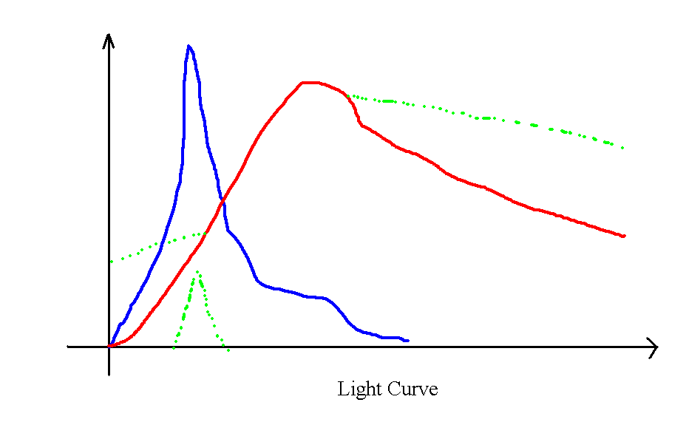
Energy Release
(Reconnection)
Acceleration
Heating
Turbulence
Turbulence?
Heating
Acceleration
Radiation
(non-thermal)
Heating
Heating
Radiation
(non-thermal)
RADIATION
(thermal)
IMPULSIVE
IMPULSIVE
GRADUAL
Vahe' Petrosian, SEE-2005, Nor-Ambert

Slide 8
NASA/TM-2006-214137. Solar Sentinels: Report of the Science and Technology Definition Team, 2006. http://www.fp7-spacecast.eu/help/bg_sp.pdf

Slide 9
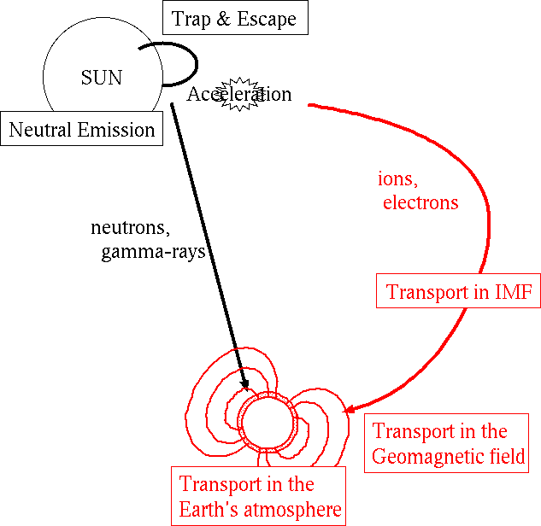
Charged particles
From T.Sako, 2007

Slide 10
Why is it a difficult problem? Too many factors involved; too many concomitant phenomena
On the Sun: acceleration in the flare region or in the corona, propagation and acceleration in the corona, lasing or multiple escape, etc.
In the interplanetary space: scatter-free propagation, diffusion, convection, adiabatic cooling, adiabatic focusing, wave generation, wave-particle iteraction, acceleration on the CME-driven shock, drift, etc.
Notes:
(3 main mechanisms of acceleration: DC from E-fields ~ 10³ Vm⁻¹ during reconnection; diffusive shocks, and stochastic acceleration, due to highly turbulent environment);

Slide 11
Fundamental problems:
energy conversion and charged particle acceleration
wave-particle interaction
solar activity dynamics and its transfer to the heliosphere
Scatter-free and diffusion propagation in space
geomagnetic disturbances

Slide 12
Practical issues
radiation danger for human beings
damage of orbital instruments and ground-based networks
violation of radio wave propagation due to increase of ionization
influence on the weather and climate via generation of minor chemical constituents in the atmosphere leading finally to the ozone depletion

Slide 13
Why PAMELA is so important?

Slide 14
Notes:
d:\PAMELA\PAMSPEC.XLS, sheet 3

Slide 15
Notes:
d:\PAM_SOLAR\GLE70\NM\Ap_GOES__Dec_09.xls

Slide 16
Notes:
d:\PAM_SOLAR\GLE70\GLE70_int_spec.xlsx

Slide 26
Tasks of the PAMELA SEP study (open for add)
Sources
  Relation to particles trapped on the Sun (De Nolfo)
Spectrum
GLE - special class of events?
He. Why P/He is so variable?
  3He
SEP in the magnetosphere – new direction in research, to be compared with ACE (Bruno, De Nolfo)
Peculiarities of the solar cycle 24

Slide 27
SEP’s statistic, collected by PAMELA
№ | Date, X start* | X ray burst | Active reg. | Lat., deg. | Lon., deg. | CME date | CME velocity, km/s
2006
1 | 13.12.06 / 02:14 | Х3.4 | 10930 | -5 | 23 | 13.12.06 / 02:54 | 1774
2 | 14.12.06 / 21:07 | Х1.5 | 10930 | -5 | 31 | 14.12.06 / 22:30 | 1042
2011
1 | 21.03.11 / - | - | - | - | 90 | 21.03.11 / 02:24 | 1341
2 | 07.06.11 / 06:16 | М2.5 | 11226 | -21 | 54 | 07.06.11 / 06:49 | 1255
3 | 06.09.11 / 01:35 | М5.3 | 11263 | 14 | 7 | 06.09.11 / 02:24 | 782 Fast SEP
4 | 06.09.11 / 22:12 | X2.1 | 11283 | 14 | 18 | 06.09.11/21:24 | 499
5 | 04.11.11 / 00:26 | С5.4 | 11339 | 19 | -61 | 03.11.11 / 23:30 | 991 Late flare
2012
1 | 23.01.12 / 03:38 | М8.7 | 11402 | 28 | 21 | 23.01.12 / 04:00 | 2175 Late SEP
2 | 27.01.12 / 17:37 | Х1.7 | 11402 | 27 | 71 | 27.01.12 / 18:27 | 2508
3 | 07.03.12 / 01:14 | Х1.3 | 11430 | 22 | -12 | 07.03.12 / 01:30 | 1825
4 | 13.03.12 / 17:12 | М7.9 | 11429 | ~17 | ~60 | 13.03.12 / 17:36 | 1884 Far side?
5 | 17.05.12 / 01:25 | M5.1 | 11476 | 11 | 76 | 17.05.12 / 01:48 | 1582
6 | 06.07.12 / 23:01 | Х1.1 | 11515 | -17 | 51 | 06.07.12 / 23:24 | 1828 Fast SEP
7 | 08.07.12 / 14:35 | C6.7 | 11515 | -16 | 74 | 08.07.12 / 14:36 | 796
8 | 19.07.12 / 04:17 | М7.7 | 11520 | -28 | 65 | 19.07.12 / 05:24 | 1631
9 | 23.07.12 | - | 11520 | Far side | - | 23.07.12/02:36 | 2003
Revised 20150925

Slide 28
SEP’s statistic, collected by PAMELA
№ | Date | X ray burst | Active reg. | Lat., deg. | Lon., deg. | CME date | CME velocity, km/s
2013
1 | 11.04.13 / 06:55 | М6.5 | 11719 | 9 | -12 | 11.04.13 / 07:24 | 861Far side?
2 | 24.04.13 / 16:50 ? | C2.5 | 11726 | ~13 | ~60 | 24.04.13 / 19:48 | 194 Wrong flare!
3 | 22.05.13 / 13:08 | М5.0 | 11745 | ~-19 | ~-24- | 22.05.13/13:25 | 1466
4 | 28.10.13 / 15:07 | M4.4 | 11882 | ~-12 | ~-28 | 28.10.13 / 15:36 | 812
5 | 02.11.13 / 04:46 | С8.2 | 11885 | -23 | 4 | 02.11.13 / 04:48 | 828
2014
1 | 06.01.14 / |  | 11936 | Far side | 115 | 06.01.14/08:00 | 1402
2 | 07.01.14 / 18:04 | Х1.2 | 11943 | -15 | 11 | 07.01.14 / 18:24 | 1830
3 | 25.02.14 / 00:39 | Х4.9 | 11990 | -12 | -82 | 25.02.14 / 01:25 | 2147
4 | 18.04.14 / 08:03 | C4.8 | 12036 | -18 | 31 | 18.04.14 /09:24 | 926
5 | 01.09.14/15:27 | C1.7 | 12152 | -13 | -5 | 01.09.14/16:00 | 846
6 | 10.09.14/17:21 | X1.6 | 12158 | 14 | -2 | 10.09.14/16:00 | 702
*Time of X-burst start to be checked up!
25 of 41 solar energetic particle events with >100 MeV protons spectra were recorded by PAMELA during the solar cycle 24
Revised 20150925

Slide 29
Spectrum – signatures of the acceleration mechanisms an propagation environment
Types of analysis
Fitting form,
upper E/P limit,
dependence on energy interval, time profile, size of the event, the source position, IMF, magnetosphere conditions

Slide 30
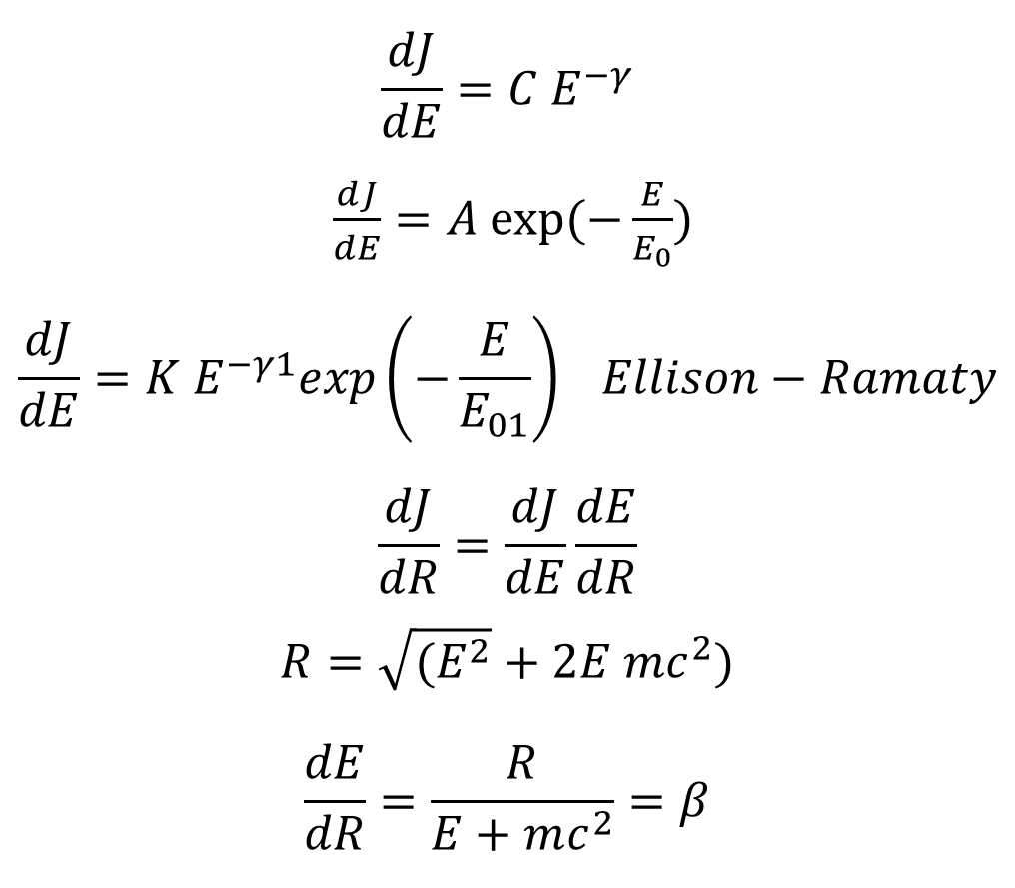
$$\frac{dJ}{dE}=C E^{−γ}$$
$\frac{dJ}{dE}=A exp⁡(−\frac{E}{E_{0}})$
$$\frac{dJ}{dE}=K E^{−γ1}exp\left(−\frac{E}{E_{01}}\right) Ellison−Ramaty$$
$$\frac{dJ}{dR}=\frac{dJ}{dE}\frac{dE}{dR}$$
$$R=\sqrt{(E^{2}}+2E mc^{2})$$
$$\frac{dE}{dR}=\frac{R}{E+mc^{2}}=β$$
PGI model: J(R) = J₀R^{-γ*} ; γ* = γ + Δγ ∙ (R-1); γ is a power-law spectral exponent at R = 1 GV, Δγ is a rate of γ increase per 1 GV.
(www.NMDB.eu)
Notes:
d:\PAM_SOLAR\PAM_24_14\Formulae.docx

Slide 33
23 January 2012 fitting, χ2 values
 | 20120123 | 0534-1134
 | Energy |  |  |  | Rigidity
 | E, GeV | Power Law | Exp | El-Ram | R, GV | Power Law | Exp | El-Ram
PAMELA | 0.13-2.67 | 0.9 | 1.9 | 0.6 | 0.51-3.48 | 0.4 | 0.3 | 0.3
PAMELA+GOES | 0.03-2.67 | 8.30E+04 | 4600 | 3642 | 0.23-3.48 | 1459 | 388 | 359
Spectrum of weak and moderate events can be fitted well by all laws if only PAMELA data are considered.
As far as low energy data are added, no law is satisfactory.
Fitting by rigidity is always better than by energy.

Slide 34
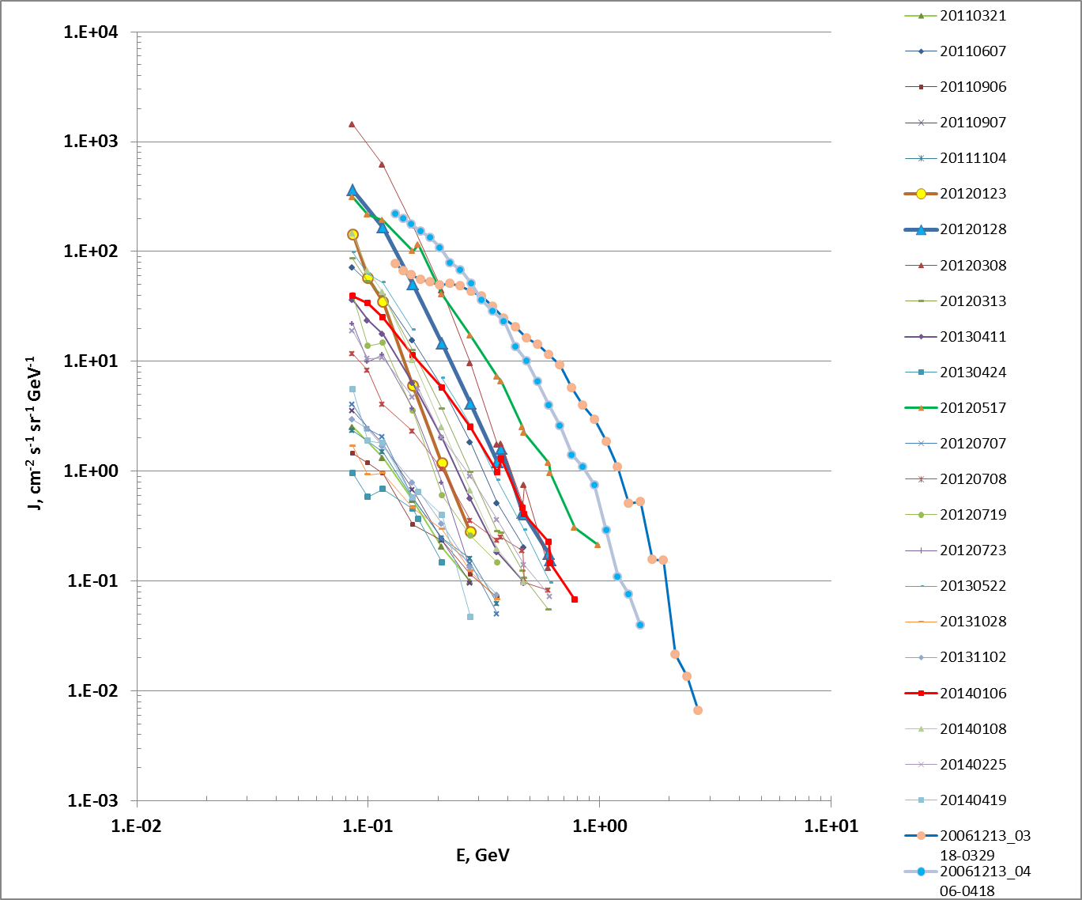
Energy spectra of PAMELA, Dec.2006- Apr.2014.
Notes:
d:\PAM_SOLAR\PAM_24_14\All_spectra.xlsx

Slide 35
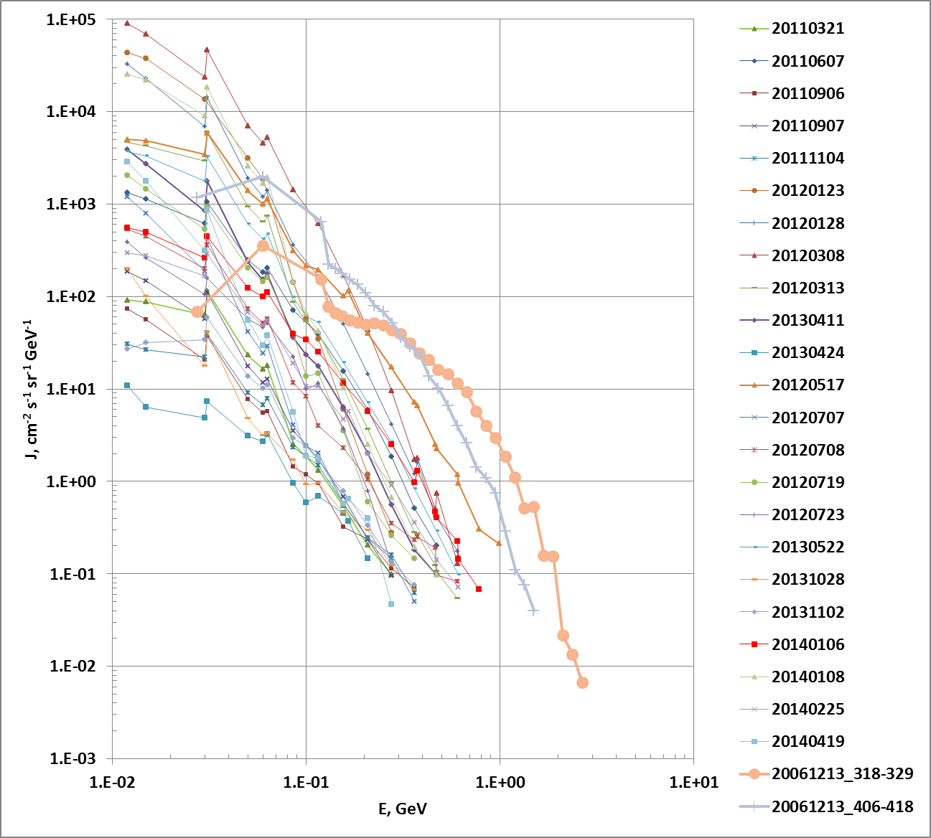
Energy spectra of PAMELA +GOES, Dec.2006- Apr.2014.
Notes:
d:\PAM_SOLAR\PAM_24_14\All_spectra.xlsx

Slide 36
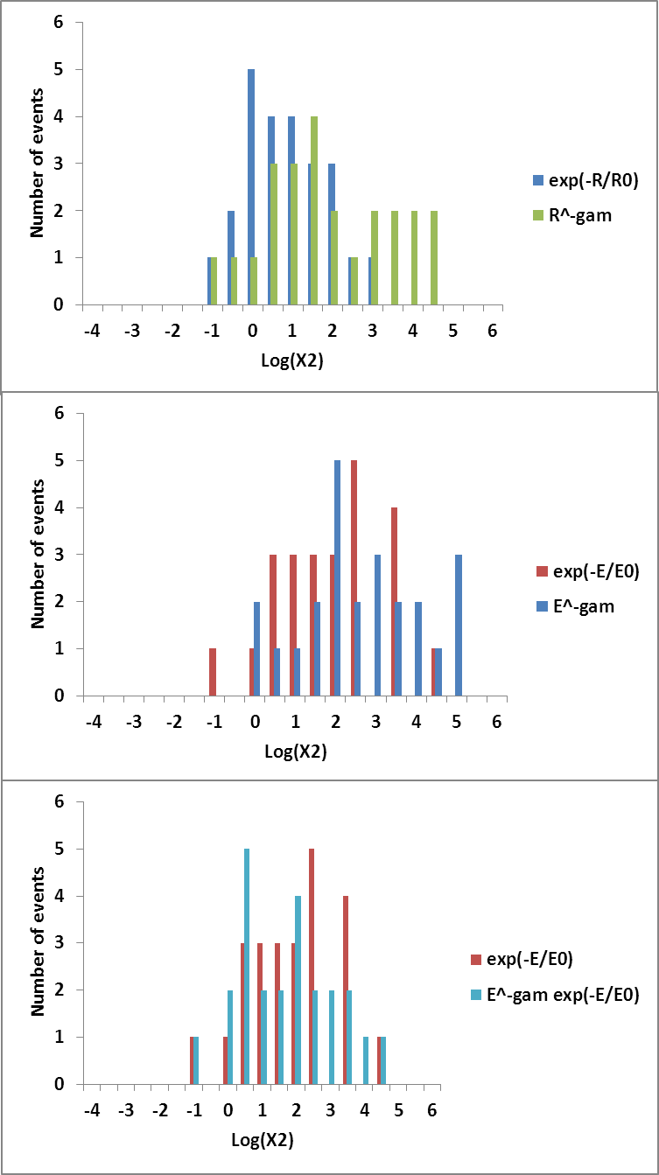
χ2 distribution of PAMELA+GOES fitting
χ2 distribution of PAMELA spectra fitting

Slide 37
Average χ2
 | Exponential |  | Power Law |  | Ellison-Ramaty
Average χ2 | Rigidity | Energy | Rigidity | Energy | Rigidity | Energy
PAMELA | 1.2 | 6.6 | 2.3 | 5.2
PAMELA+GOES | 103 | 2702 | 5163 | 31928 | 203 | 2905
Fitting by rigidity is always better than by energy. Energy/Rigidity SCR spectrum in the range of 10 – n100 MeV cannot be fitted by a single law: different mechanisms may be involved in the particle acceleration in ~10n MeV and ~100n MeV intervals.

Slide 38
Longitude distribution

Slide 39
Parameters of fitting strongly depend on the chosen energy range. Taking only PAMELA spectra power-law and exponential differ not much. Rigidity spectra fit is better than energy spectra fit.
Increasing of energy range leads to deterioration of fit. This may be indicative of contribution of different factors to proton fluxes of different energies. Rigidity spectra fit better to all analytical forms at all energy ranges.
No dependence on the source position is found as yet.
It is relevant to use the early phase of an event till the time of maximum (TOM) to try to retrieve the acceleration parameters. It is relevant to use fluence to build a model for the space weather or dosage purposes.

Slide 40
GLE
13 Dec. 2006
17 May 2012

Slide 42
20061213 0318-0329
PAMELA+GOES+NM
R₀=-0.39
γ₁=-0.8±0.33?
R₀₁=-0.45±0.04

Slide 43
20120517, 0335-0359 PAMELA+GOES+NM (0310)

Slide 44
20120517, 0335-0359 PAMELA+GOES+NM (0310)

Slide 45

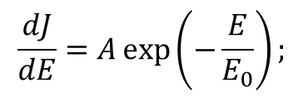

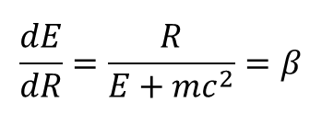
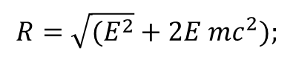

Approximation of solar proton energy spectra: χ2 values
GLE 70 |  | 20061213 | 0318-0329
 |  | Energy |  |  | Rigidity
 | E, GeV | Power Law | Exp | El-Ram | R, GV | Power Law | Exp | El-Ram
PAMELA | 0.13-2.67 | 38 | 1.7 |  | 0.51-3.48 | 19 | 1.8
PAM+GOES | 0.03-2.67 | 6145 | 8.9 |  | 0.23-3.48 | 1459 | 20.9
PAM+G+NM | 0.03-5.5 | 1.16E+05 | 10 | 88 | 0.23-4.64 | 2.78E+04 | 5.7 | 26
PAM+NM | 0.13-5.5 | 169 | 5.4 | 4.8 | 0.51-4.64 | 83.4 | 1.1 | 3
GLE71 |  | 20120517 | 0335-0359
 |  | Energy |  |  | Rigidity
 | E, GeV | Power Law | Exp | El-Ram | R, GV | Power Law | Exp | El-Ram
PAMELA | 0.086-1.56 | 15.2 | 16.9 |  | 0.41-2.31 | 6.4 | 1.7
PAM+GOES | 0.012-1.56 | 9495 | 698 | 903 | 0.15-2.31 | 1555 | 50 | 114
PAM+G+NM | 0.012-4.0 | 1.75E+07 | 512 | 145 | 0.15-3.17 | 2.82E+06 | 56 | 28
PAM+NM | 0.086-4.0 | 20327 | 18.5 | 5.3 | 0.41-3.17 | 8349 | 2.1 | 2.7
$\frac{dJ}{dE}=C E^{−γ}$;
$$\frac{dJ}{dE}=A\exp\left(−\frac{E}{E_{0}}\right);$$
$\frac{dJ}{dE}=K E^{−γ1}exp(−\frac{E}{E_{01}})$;
$\frac{dJ}{dR}=\frac{dJ}{dE}\frac{dE}{dR}$;
$$R=\sqrt{(E^{2}}+2E mc^{2});$$
$$\frac{dE}{dR}=\frac{R}{E+mc^{2}}=β$$
Notes:
d:\PAM_SOLAR\PAM_24_14\Fitting\fit\Xsq_spec.xlsx

Slide 46
Energy spectra of PAMELA, Dec.2006- Apr.2014.
Notes:
d:\PAM_SOLAR\PAM_24_14\All_spectra.xlsx

Slide 49
Dependence on the source position: Longitude distribution
Notes:
d:\27_day\SPE\New_Catalogue\Comparison 23 and 24\J10024_vs_Long.xlsx

Slide 50
28 Feb. 1942 | 600%
7 Marc 1942 | 750%
25 Jul. 1946 | 1100%
19 Nov.1949. | 2000%
23 Feb. 1956 | 4554%
Giant GLEs are a puzzle!

Slide 51
Carrington 1859
GCR/y@solar min
GCR/y@solar Max
Dangerous range
Al=
1mm
Al=
2mm
Al=
3mm
Al=
5mm
Al=
7mm
Fluence vs proton energy of the most intense SPEs of last 5 decades
Courtesy of Piero Spillantini

Slide 52
CONCLUSIONS
PAMELA SEP data bridge the gap between the energy ranges of spacecraft and neutron monitors.
25 SEP events were recorded by PAMELA during Dec 2006- Sep. 2015. At least 7 of them need more reliable source identification.
Energy/Rigidity SCR spectrum in the range of 10 – n100 MeV cannot be fitted by a single law: different mechanisms may be involved in the particle acceleration in ~10n MeV and ~100n MeV intervals. Fitting by rigidity is always better than by energy.
GLE seems to be a special class of events concerning spectrum (flat in the low-energy range, possible steepening above 500 MeV), longitudinal distribution of the parent flares, … ?
Giant GLEs are a puzzle.
SEPs are important for the space weather.
To search for physical mechanisms related to SEPs and to contribute into the Space Weather forecast PAMELA results should be integrated into the world data bases.

Slide 53
Thank you!

Slide 54
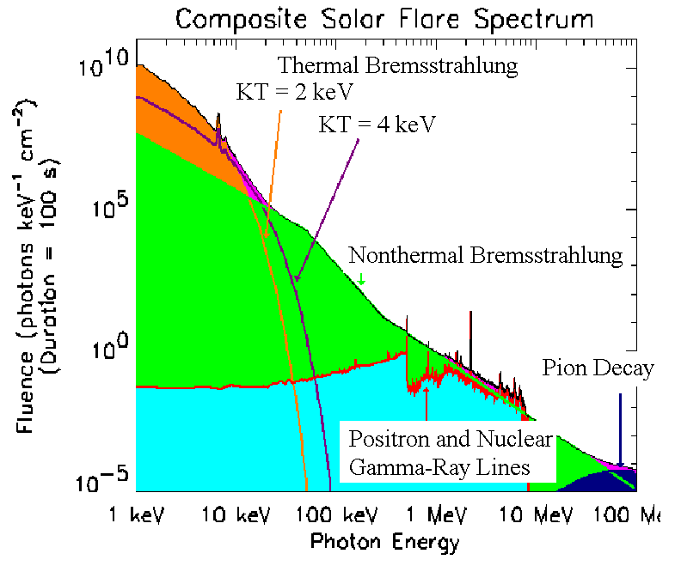

Slide 55
P+16O→P+16O*+γ 6.14 MeV
P+12C→P+12C*+γ 4.43 MeV
n+P→d+γ 2.223 MeV
e+ +e-→2γ 0.511 MeV
Neutrons:
P+P→P+nπ Eth=292.3 MeV
4He +P ….→ n Eth=25.9 MeV, 32.8 MeV, 35.6 MeV
12C+P …→ n Eth=19.8 MeV
14N+P…→ n Eth=6.3 MeV
16O+P…→n Eth=16.5 Me V

Slide 56
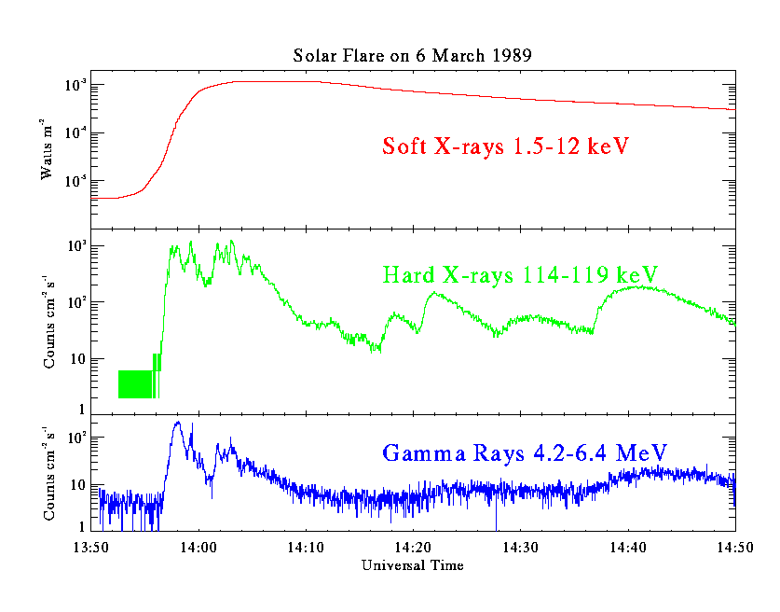

Slide 57
