Slide 1
International conference on particle physics and astrophysics
Center of Basic Research and Particle Physics of National Research Nuclear University “MEPhI”
(October 6-10, 2015)
Baryonic B Decays
Ruslan Chistov (ITEP and MEPhI)
OUTLINE:
(1) Introduction
(2) New effects in baryonic B decays
discovered by Belle
(3) Summary
1

Slide 2
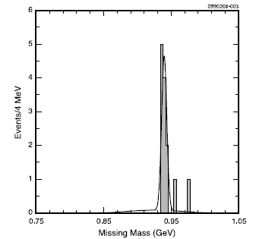
Introduction
In the Standard Model baryons should be produced in pairs.
Since M(p) + M(anti-p) > M(D⁰) and M(p) + M(anti-n) > M(D+),
there are no baryonic decays for D⁰ or D+ mesons.
The only possible decay is D_{s}⁺ → p anti-n
and it was observed by CLEO-c.
The br.fr. was measured to be
Br(D_{s}⁺ → p anti-n )=(1.30 ± 0.36 ^{+0.12}_{-0.16})x10⁻³
This interesting result was obtained by
CLEO-c using e+e- → Ds*+ Ds- data at E_{cms} =4170 MeV
CLEO-c
Phys.Rev.Lett. 100 (2008) 181802
But the B-mesons are massive and their baryonic decays are possible !

Slide 3
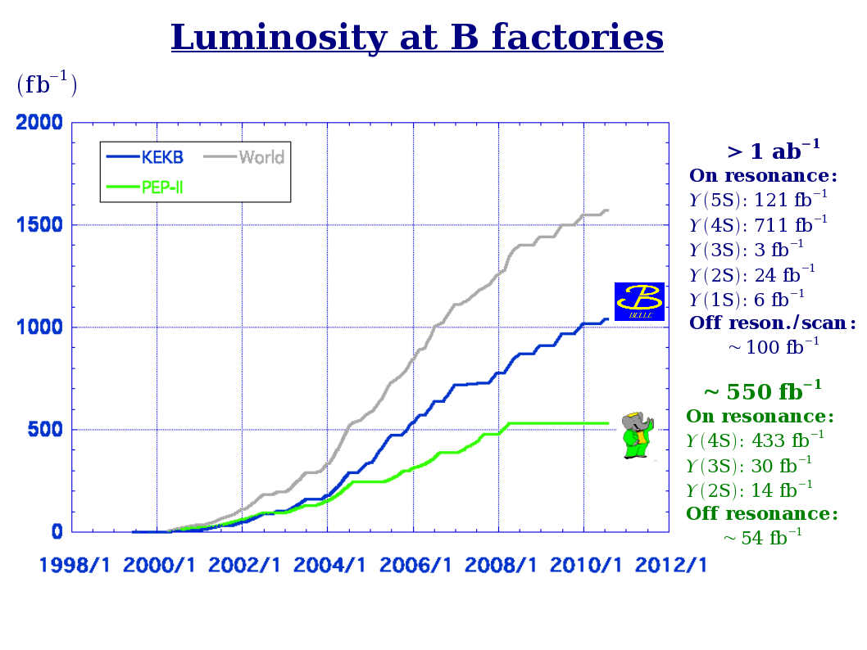
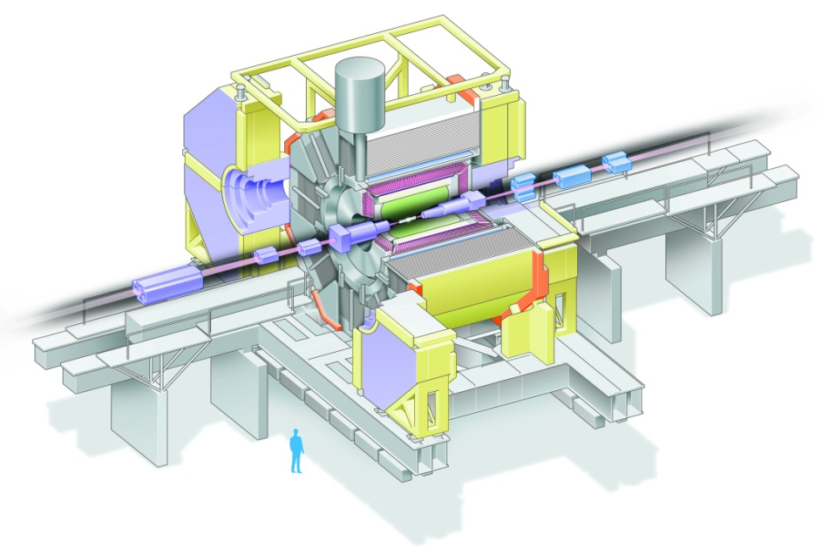
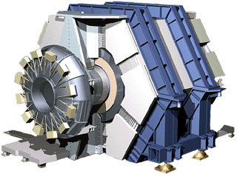
In sum L >1552 fb⁻¹
For 10 years thanks to the successful operation of B-factories and world largest accumulated statistics, Belle and BaBar have observed many new baryonic B decays and connected with them new effects.
3

Slide 4
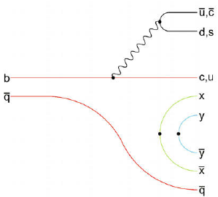
Production of charm baryons at B-factories
B-factories Belle and BaBar
over past decade dominate in the field of charmed baryons.
They provide new knowledge about the spectroscopy,
decay modes and production mechanism of charmed baryons.
Charmed baryons
in e+e-→ cc continuum
Baryonic B decays
c
u
d
π⁻/К⁻
W-
∗
d
u
∗
B⁻
Λ_{c}⁺
c
u
u
p
e+e- →Λ_{c}⁺ p D⁰
B⁻→Λ_{c}⁺ pπ⁻
4

Slide 5
Decays of beauty mesons into baryons
Before B-factories it was known that B mesons can decay into baryons, including charm baryons (ARGUS, CLEO).
But only few exclusive modes were measured with moderate accuracy (CLEO).
B-factories with their large statistics become active players in this field. BaBar и Belle performed significantly improved the accuracy for previously measured modes, observed new modes and connected with them new effects.

Slide 6
Baryonic B decays: new effects
6

Slide 7
Baryonic B decays: threshold enhansement
7

Slide 8
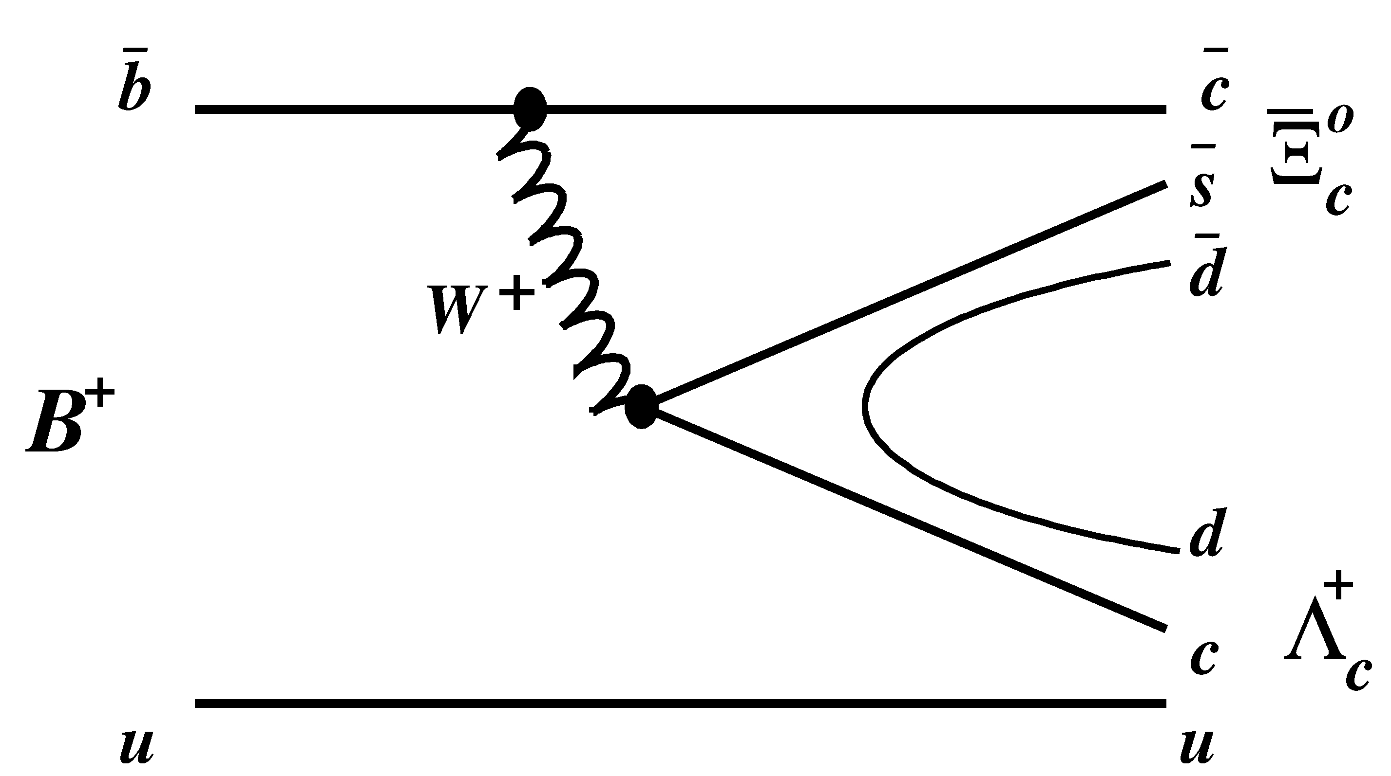
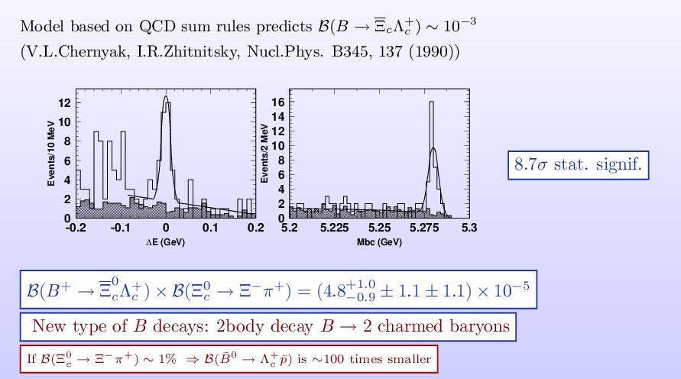
New Type of Baryonic B decays → else one new effect
B⁰ → Λ_{c}⁻ p
B⁺ → Ξ⁰_{c} Λ_{c}⁺
Br=(2.19+0.56-0.49+-0.32+-0.57)x 10⁻⁵
One can expect Br ~ 10⁻⁵
But unexpectedly….
Ruslan Chistov (ITEP, Moscow)
One needs abs. Br’s !
8

Slide 9
В⁰→Ξ_{c}⁻ Λ_{c}⁺
PRD(RC) 74, 111105

Slide 10
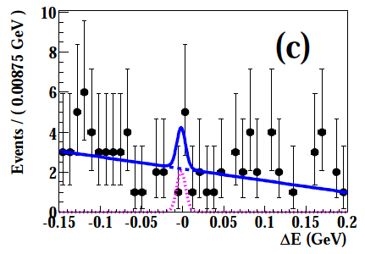
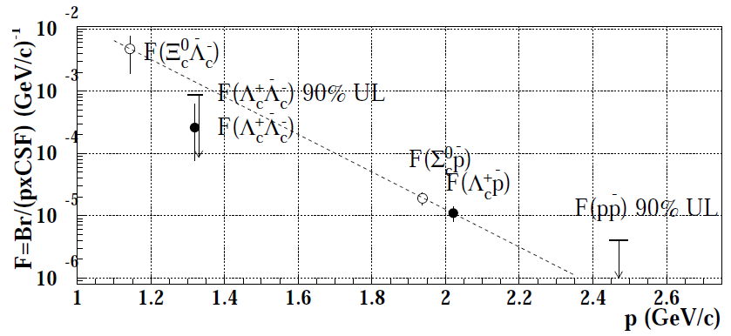
Search for В→Λ_{c}⁺ Λ_{c}⁻

Slide 11
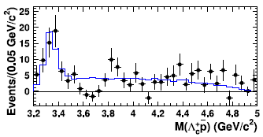
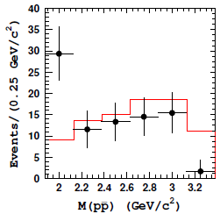
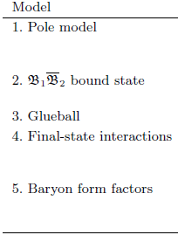
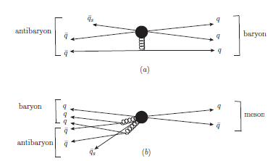
3-body baryonic B decays
Threshold effect
Different theoretical
Models were proposed
Threshold enhancement was qualitatively
predicted before it was observed by Belle
W.-S. Hou, A. Soni, Phys.Rev.Lett. 86 (2001) 4247-4250

Slide 12
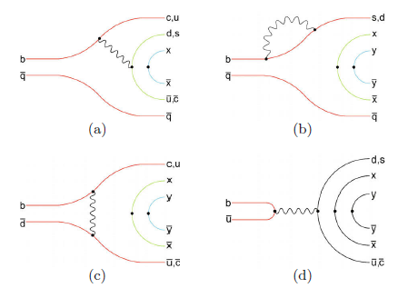
2-body baryonic B decays
Theory predicted:
B-factories have observed:
Phenomenological explanation:
The whole picture is that the
uniform baryonic form-factor acts:
F ~ (M₁₂²-(m₁+m₂)² )⁻¹
Unsuppressed
Suppressed by
The closer invariant mass of
2 baryons to its threshold
the larger probability
for the corresponding process

Slide 13
Summary
Menu for the future:
Progress in theoretical calculations for the baryonic B decays;
Observation of rare charmless two-body baryonic B decays;
More experimental data on baryonic B decays: (e.g. Bs, Bc decays);
Development of the universal model for the description of
baryon production in different processes at different energies

Slide 14
Backup slides

Slide 15
Decays of beauty mesons into charm baryons
B→ baryon + anti-baryon
B→ baryon + anti-baryon + meson(s)
Before B-factories it was known that B mesons can decay into baryons, including charm baryons (ARGUS, CLEO).
But only few exclusive modes were measured with moderate accuracy (CLEO). B-factories with their large statistics become active players in this field. BaBar и Belle performed significantly improved the accuracy for previously measured modes, observed new modes and connected with them new effects.

Slide 16
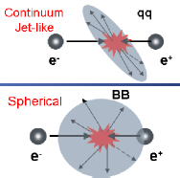
Метод восстановления очарованных барионов,
рожденных в e+e- → cc
• Восстановление заряженных стабильных адронов, π-K-p разделение,
используя dE/dx в CDC, Aerogel Cherenkov counters, TOF.
• K0s→ππ, Λ→πp, Ξ-→Λπ-, Ω- →ΛK- по топологии отдаленной от точки е+е-
взаимодействия вершины распада.
• Финальное подавление фона – требование большого импульса
для очарованного бариона, собранного из дочерних частиц.
(фон пикуется в мягкой части импульсного спектра)
Метод восстановления распада В мезона в конечное состояние с очарованными барионами
Сигнальные переменные + подавление не-ϒ(4S)
событий

Slide 17
Обнаружение В⁺→Ξ_{c}⁰ Λ_{c}⁺
PRD(RC) 74, 111105
Но эта же модель
предсказывала такую
же вероятность и для
В⁰→ Λ_{c}⁻ p

Slide 18
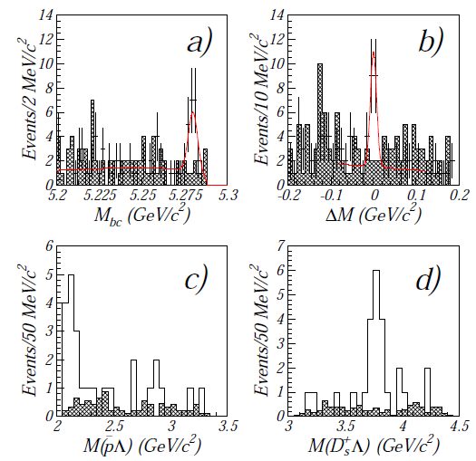
Обнаружение распада В⁰→D_{s}⁺ Λ p
PRD 76, 051102 (2007)
Распад относится к категории распадов с подхватом ss пары.
Другие подобные распады были позже обнаружены Belle и BaBar.
• Может в будущем при большой
статистике использоваться для
CPV в барионных распадах В мезонов
Другой механизм – перерассеяние
в конечном состоянии (моды )

Slide 19
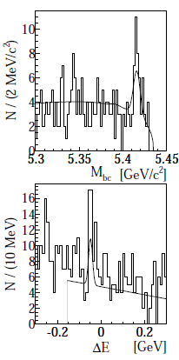
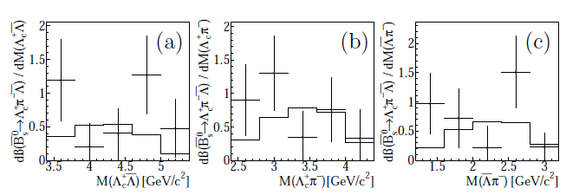
Экспериментальное свидетельство о первом барионном распаде B_{s}⁰ мезона : B_{s}⁰ → Λ_{с}⁺Λπ-
PLB 726, 206-210, (2013)

Slide 20
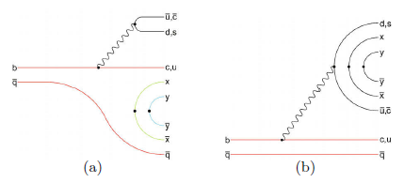
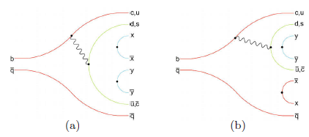
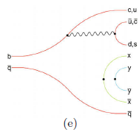
3-body baryonic B decays
Color suppression is responsible for the difference in Br for
Theoretical models
Threshold effect
Threshold enhancement was qualitatively
predicted before it was observed by Belle
W.-S. Hou, A. Soni, Phys.Rev.Lett. 86 (2001) 4247-4250
Отсюда понятна иерархия
2-х частичных Br: M(B) ближе или дальше от соотв. порогов

