Slide 1
Thermosyphon cryogenic system for RED-100 detector
A. V. Shakirov (MEPhI)
Moscow
International conference on particle physics and astrophysics
National Research Nuclear University MEPhI
5-10 October 2015

Slide 2
The challenges for the cryostatting system
1. The detector should be placed inside a massive shield for providing low-background experiment
2. System should provide condensing of 200 kg of xenon and maintaining a stable temperature of the liquid with an accuracy of about 1K in the range of 160-170K during long time required for the experiment
The goal is to develop a powerful cryostatting system with most of the mass located at a distance and with the possibility of precise temperature control
The thermosyphon technology meets the requirements
Thermosyphon cryogenic system for RED-100 detector
2/9
07.10.2015

Slide 3
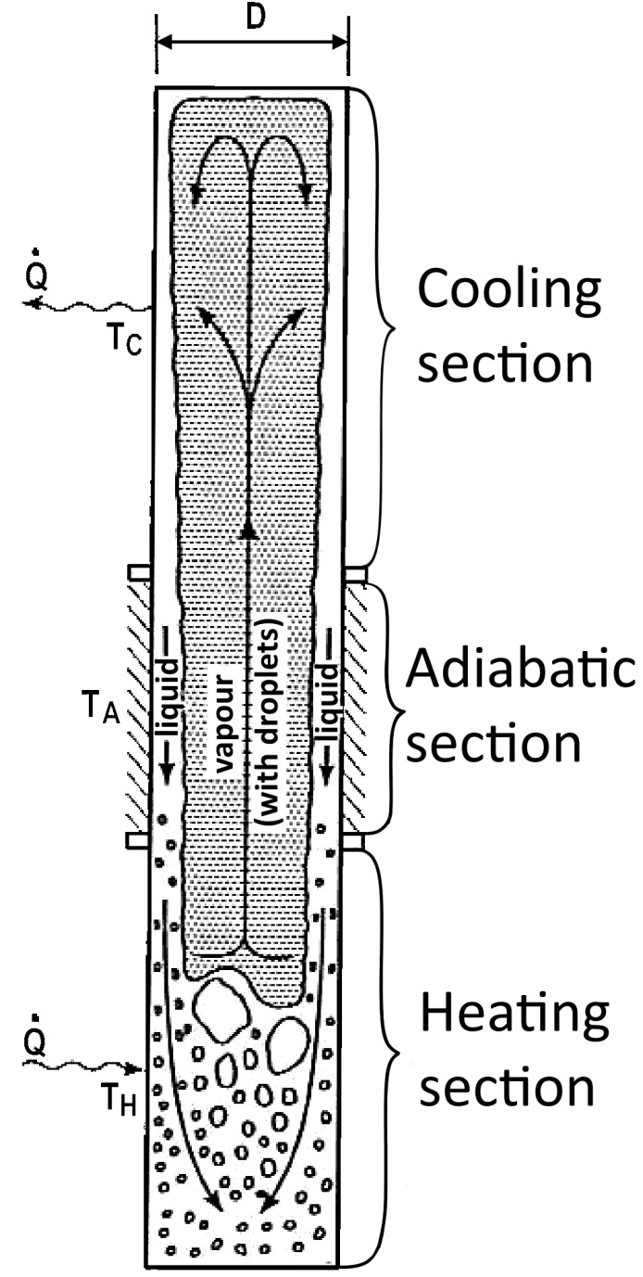
The principle of thermosyphon operation
A two-phase closed tubular thermosyphon is a device developed for transfer the large heat energies
A heat exchange takes place along heat pipe by condensation and evaporation of N₂ in the top and bottom parts of pipe
The gravity division of the working substance in liquid and gaseous states is possible.
A thermosyphon or a gravity-assisted heat pipe consists of three basic sections:
A cooling section (condenser)
A passive adiabatic section connecting the two active sections
A heating section (evaporator)
Thermosyphon cryogenic system for RED-100 detector
3/9
07.10.2015

Slide 4
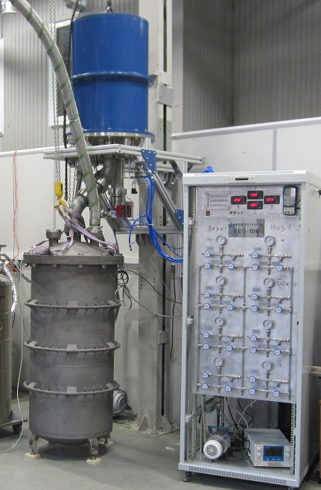
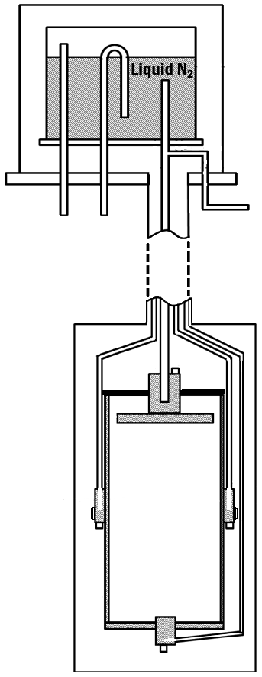
The cryostatting system
Dewar with liquid N₂
Thermosyphon in metal hose
Control system
Titanium cryostat
Thermosyphon cryogenic system for RED-100 detector
4/9
07.10.2015

Slide 5
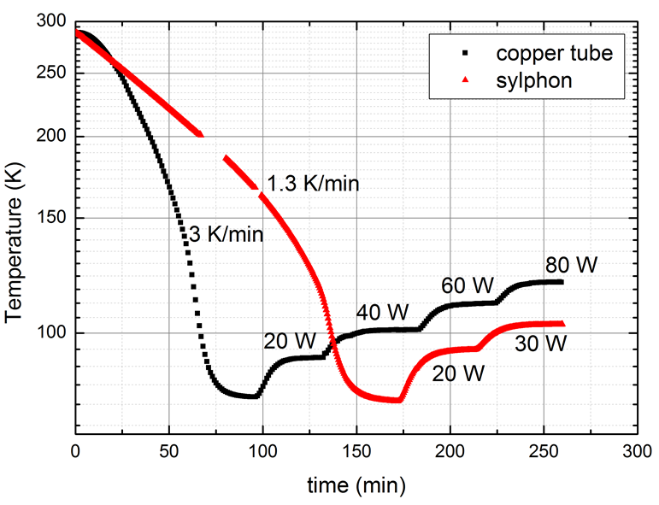
Thermosyphon types and characteristics
Bellow flex hose thermosyphon
Tubular thermosyphon made of copper pipe
The comparison of the two types of thermosyphon
 | Copper pipe | Sylphon
Cooling rate | 3 K/min | 1.3 K/min
The heat transfer limit | 100W | 60W
Thermosyphon based on copper pipe is more powerful and should be used in experiment
Thermosyphon cryogenic system for RED-100 detector
5/9
07.10.2015

Slide 6
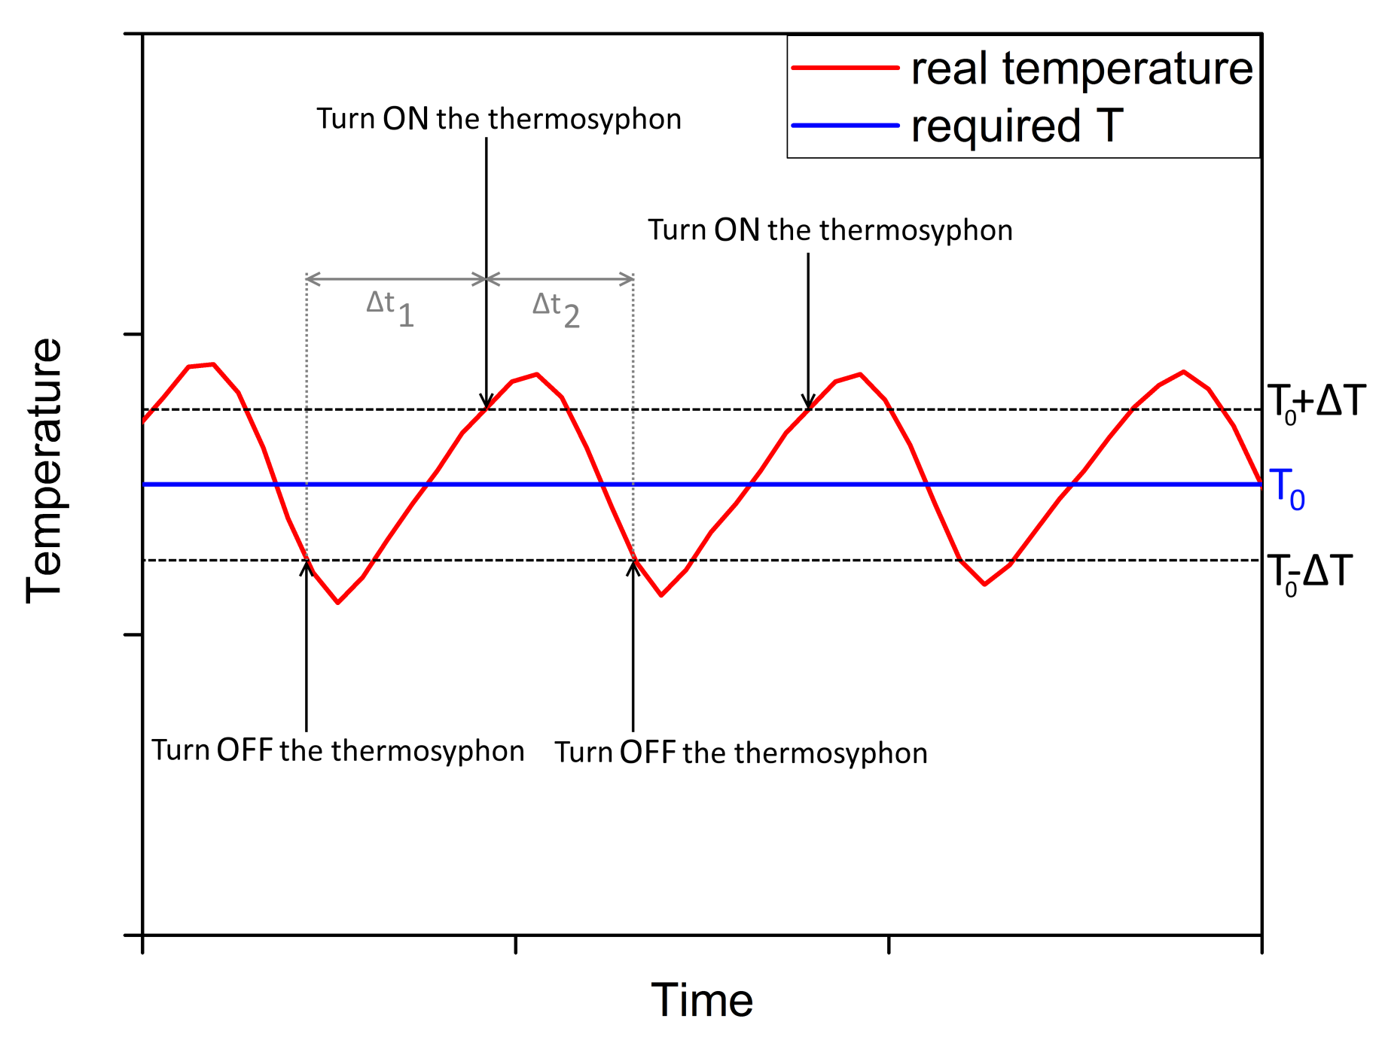
Thermal stabilizing control system
Thermosyphon cryogenic system for RED-100 detector
6/9
07.10.2015

Slide 7
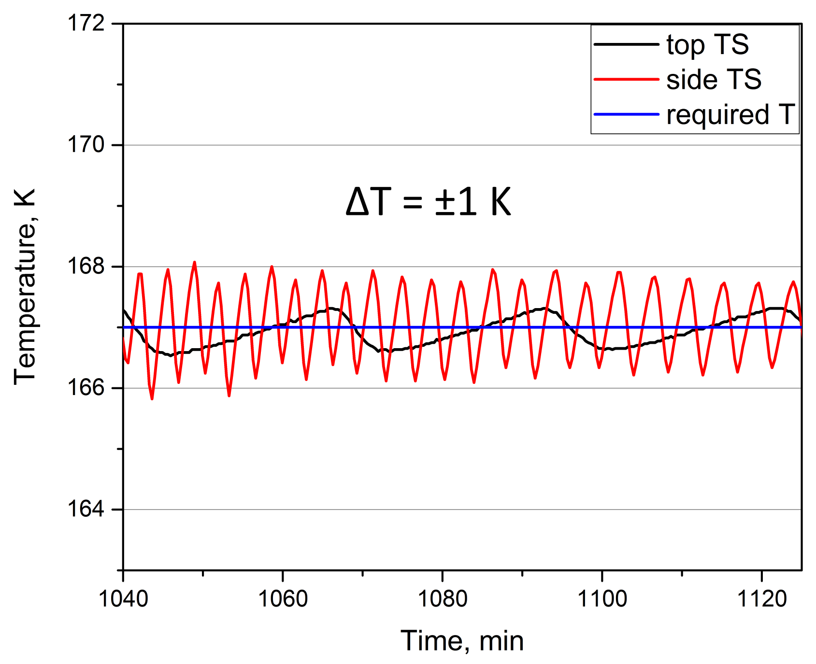
Thermal stabilization results
Thermosyphon cryogenic system for RED-100 detector
7/9
07.10.2015

Slide 8
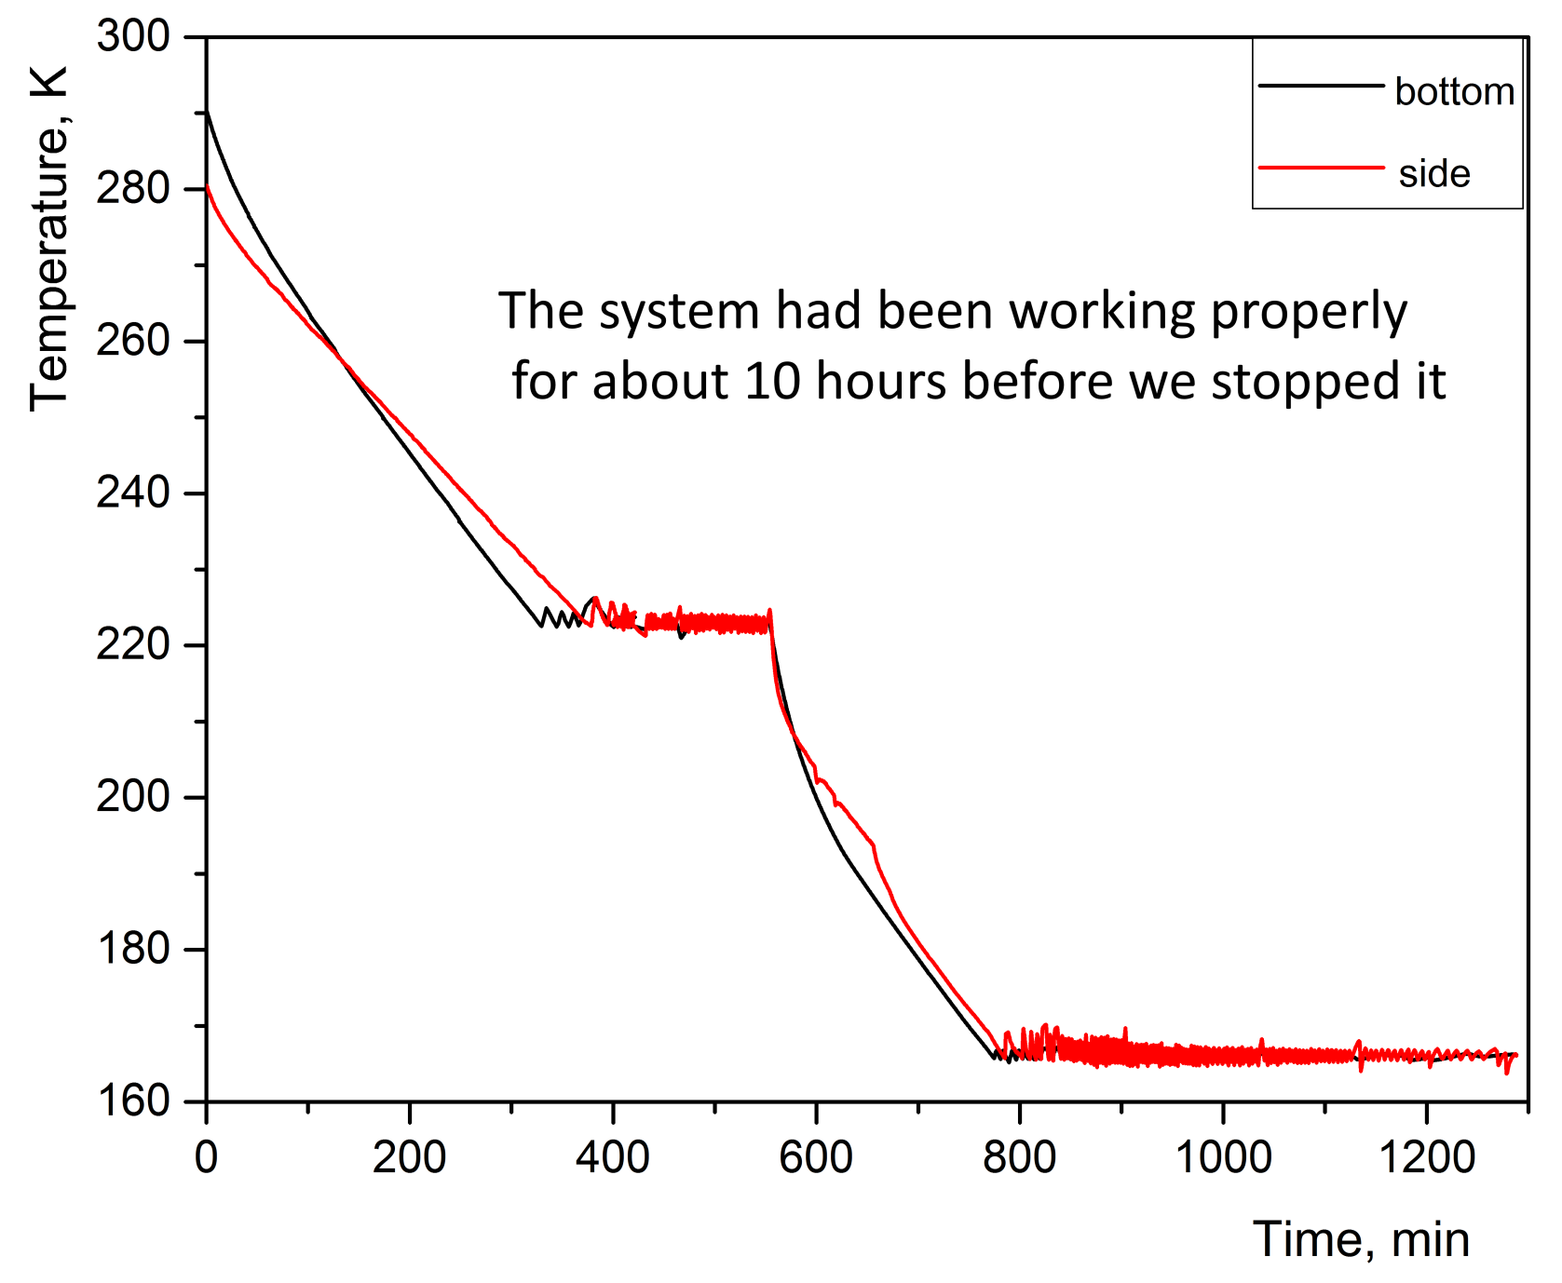
Summary cooling and stabilization results
Thermosyphon cryogenic system for RED-100 detector
8/9
07.10.2015

Slide 9
Conclusions
The cryogenic system based on closed two-phase thermosyphon using nitrogen as an active medium was developed
This system provide thermal stabilization of the emission detector based on a liquid xenon at required temperature with an accuracy of 1K .
Such a system may be used in the RED100 detector
Thermosyphon cryogenic system for RED-100 detector
9/9
07.10.2015

