Slide 1
Trapped positrons and electrons observed by PAMELA
ICPPA 2015, PAMELA workshop, 9 October 2015
Vladimir Mikhailov
NRNU MEPHI , Moscow, Russia
For PAMELA collaboration

Slide 2
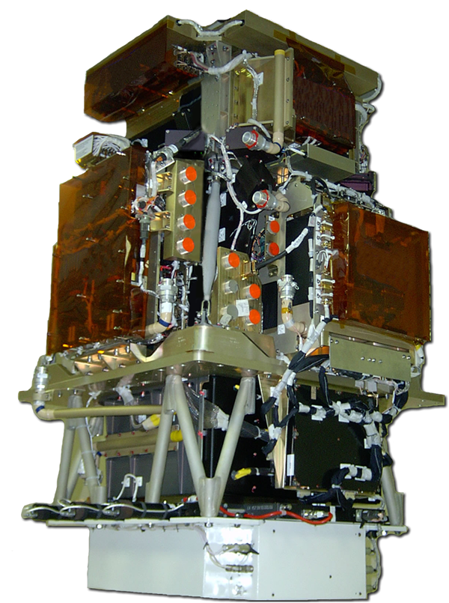
PAMELA detectors
Main requirements → high-sensitivity antiparticle identification and precise momentum measure
+ -
Time-Of-Flight
plastic scintillators + PMT:
Trigger
Albedo rejection;
Mass identification up to 1 GeV;
- Charge identification from dE/dX.
Electromagnetic calorimeter
W/Si sampling (16.3 X₀, 0.6 λI)
Discrimination e+ / p, anti-p / e⁻
(shower topology)
Direct E measurement for e⁻
Neutron detector
³He tubes + polyethylene moderator:
High-energy e/h discrimination
GF: 21.5 cm² sr Mass: 470 kg
Size: 130x70x70 cm³
Power Budget: 360W
Spectrometer
microstrip silicon tracking system + permanent magnet
It provides:
- Magnetic rigidity → R = pc/Ze
Charge sign
Charge value from dE/dx
Notes:
Overview of the apparatus

Slide 3
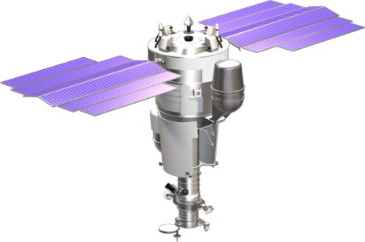
The PAMELA Experiment
Resurs DK satellite built by
the Space factory «TsSKB Progress»
in Samara (Russia)
PAMELA is here
Satellite was launched 15.06.2006 on elliptical polar orbit with inclination 70⁰,
altitude 350-610km. Circular orbit with altitude ~570km from September 2010
Mass: 6.7 tons
Height: 7.4 m
Solar array area: 36 m²
Trigger rate ~25Hz (outside radiation belts)
Event size (compressed mode) ~ 5kB
25 Hz x 5 kB/ev → ~ 10 GB/day
Since July 2006 till June 2015:
~3000 days of data taking (~90% )
~50 TByte of raw data downlinked
~8•10⁹ triggers recorded and analyzed

Slide 4
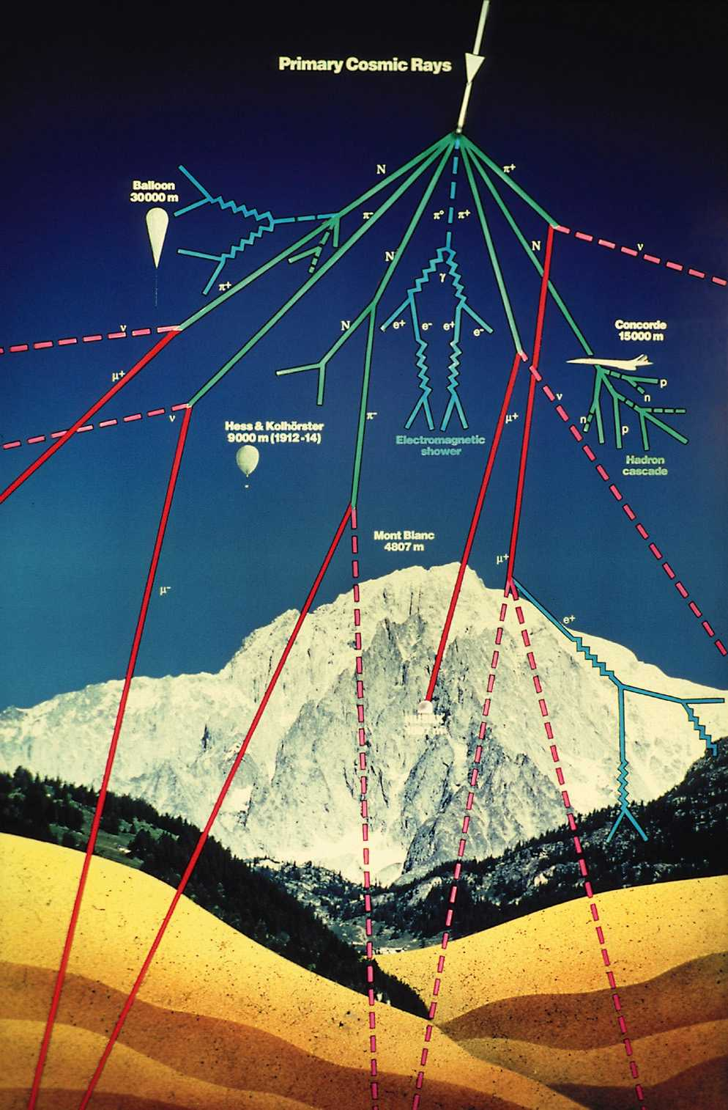
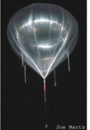
~500 km
Primary cosmic ray
Smaller detectors but long duration. PAMELA!
geomagnetic field !
~40 km
Top of atmosphere
Large detectors but short duration. Atmospheric overburden ~5 g/cm². Almost all data on cosmic antiparticles from here.
~5 km
Ground
0 m

Slide 5
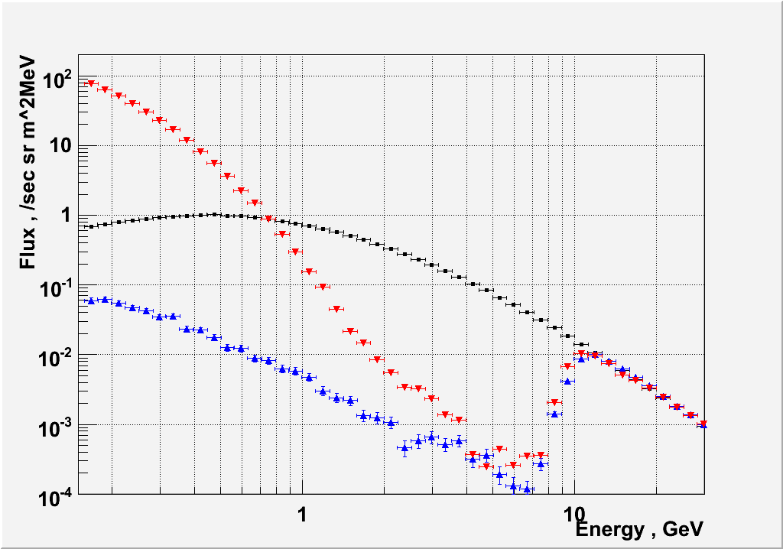
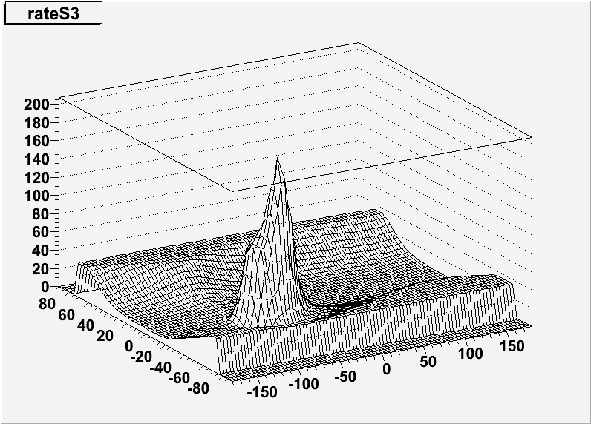
Spectra in different parts of magnetosphere
Analyzed data July 2006 – June 2015 (~2900 days)
Identified ~ 4× 10⁶ electrons and ~ 5× 10⁵ positrons between 50 MeV and 100 GeV
Trapped protons in SAA.
Magnetic polar cups
(→ galactic protons)
S3 count rate, au
Secondary re-entrant-albedo protons
Latutude, deg
Longitude, deg
Geomagnetic cutoff

Slide 6
East-west effect
Excess of quasitrapped positrons
Ratio e+/e- up to 5

Slide 7
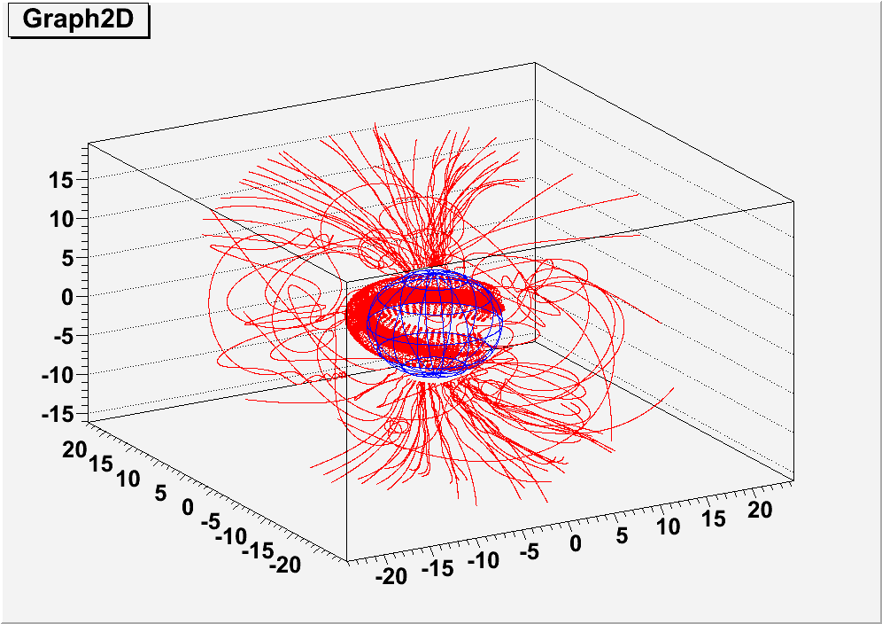
Data analysis
Spectra and ratios of positrons and electrons were published in Adriani et. al “Measurements of quasi-trapped electron and positron fluxes with PAMELA” JRG, 2009
doi:10.1029/2009JA014660
Analysis for protons based on particle tracing was published : O.Adriani et al ApJ,799, 1, L4 (2015) and arXiv:1504.06253 (submitted to JGR)
Here trajectories of positrons and electrons were reconstructed in the Earth's magnetosphere by a program based on Runge-Kutta numerical integration method. IGRF field model was used
(http: //nssdcftp.gsfc.nasa.gov)
Boundary of magnetosphere was chosen as
Hmin=30 km, Hmax=20000 km
Time of tracing up to 30 second
(time of drift around the Earth for particles with energy E>0.1 GeV)
The method of tracing was used previously in AMS-01 experiment
Z, 1000км
Y, 1000км
X, 1000км
Reconstructed trajectories of electrons and positrons detected by PAMELA during several orbits

Slide 8
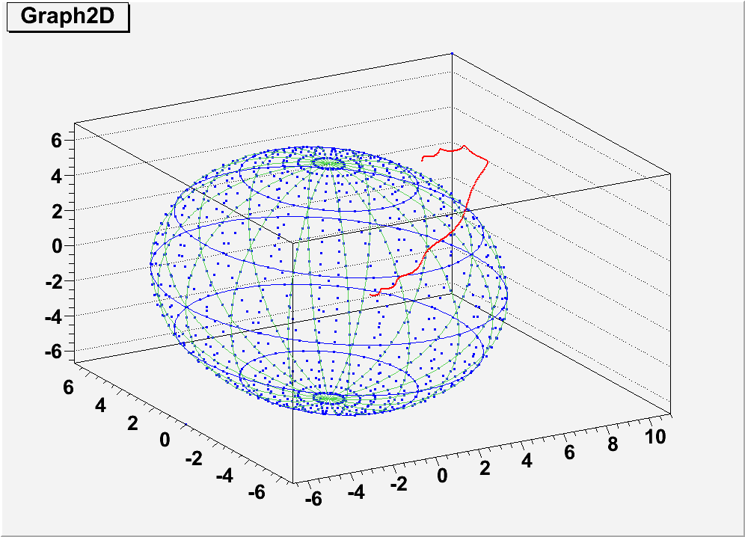
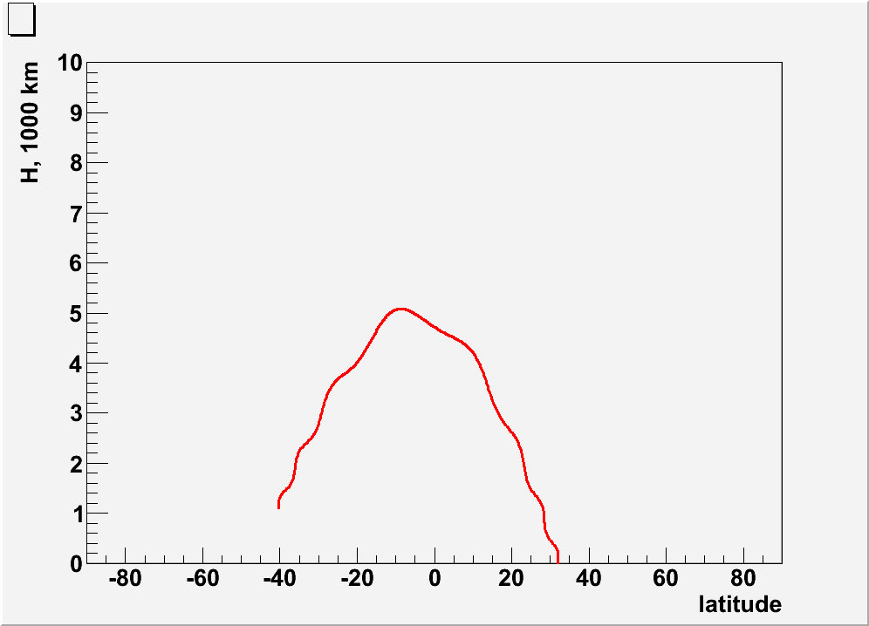
Samples of particles trajectories:
Simple reentrant albedo:
Altitude vs latitude
Z, 1000км
У, 1000км
Х, 1000км
Trajectory of albedo positrons with rigidity R=1.24 GV, detected on altitude ~1000 km

Slide 9
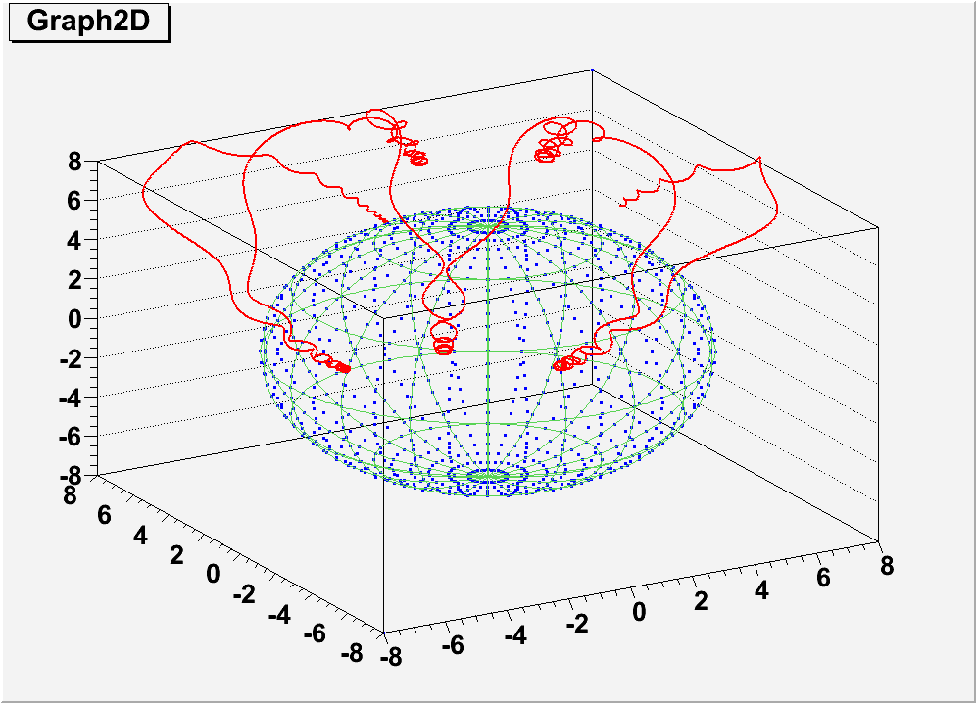
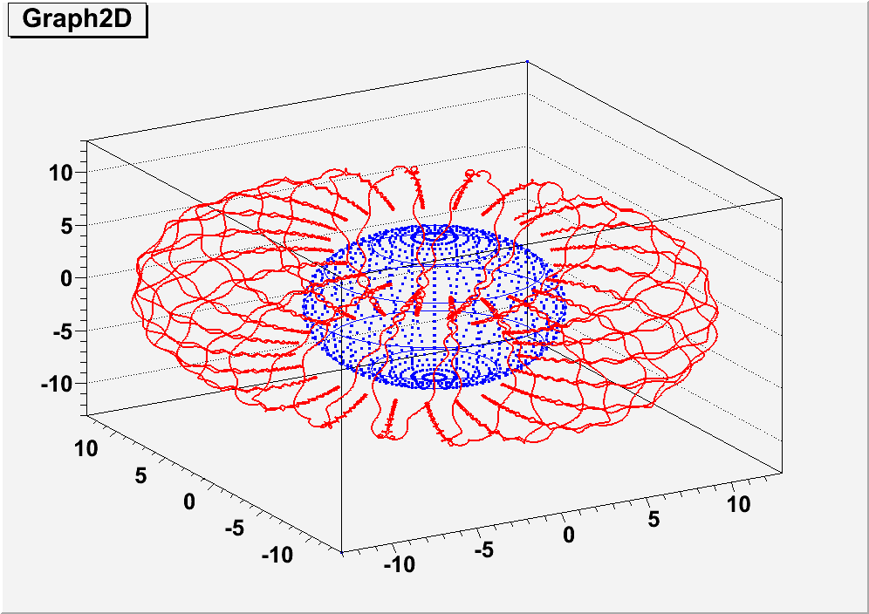
Quasi-trapped particles:
Z, 1000км
Y, 1000км
X, 1000км
Positron trajectory with rigidity R=1.24 GV, detected on altitude 1062 km with pitch-angle 68 °.
Positron trajectory with rigidity R=0.5 GV, detected on altitude 1062 km.

Slide 10
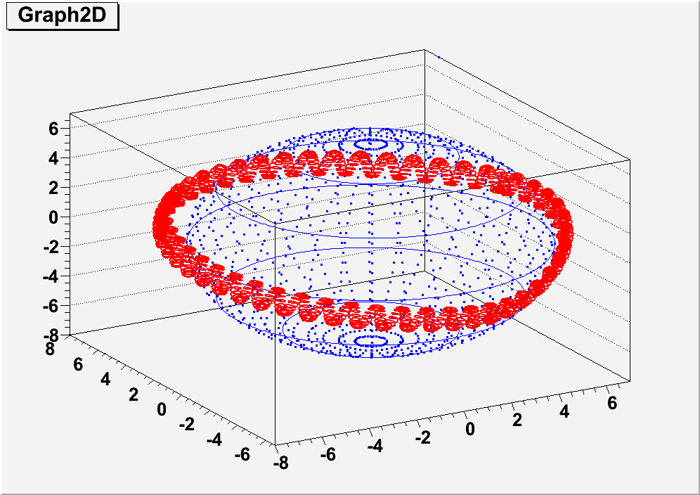
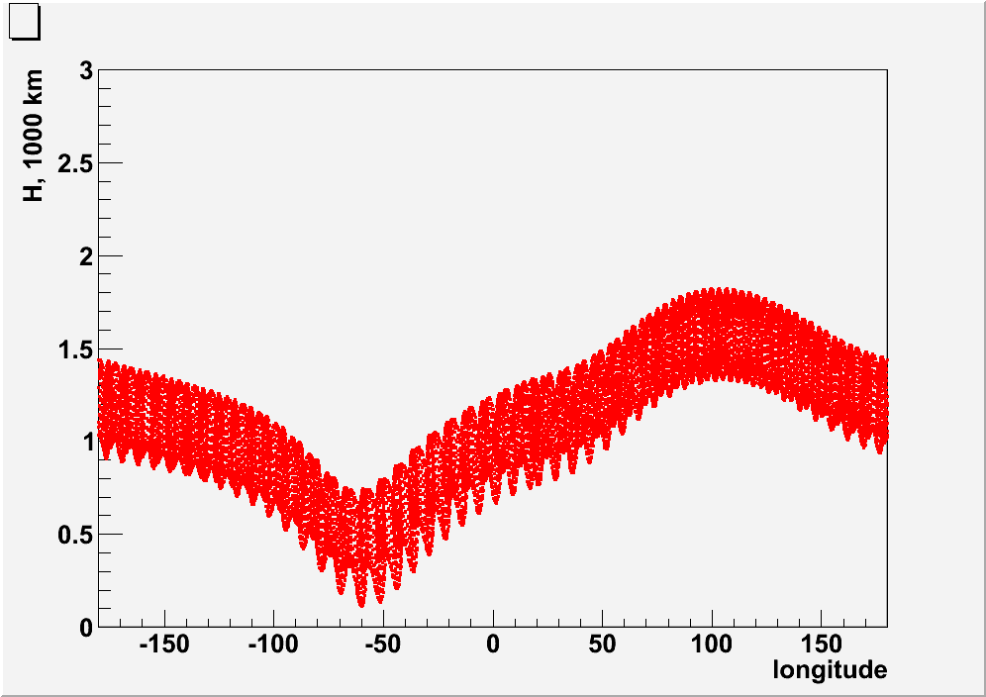
Trapped positron
Z, 1000км
У, 1000км
Х, 1000км
Altitude vs longitude. Minimal trajectory altitude is in South Atlantic Anomaly region.
Positron trajectory with rigidity R=1.24 GV, detected on altitude 1062 km with pitch-angle about 90 °.

Slide 11
Quasi-trapped particle near geomagnetic cut-off
Positron trajectory with rigidity R=2.24 GV, detected on altitude 1062 km with small pitch-angle .

Slide 12
Cosmic ray trajectory near geomagnetic cut-off
Chaotic trajectory of non-adiabatic type .
Only particles with rigidity R < 10 / L³ GV were considered to exclude chaotic trajectories

Slide 13
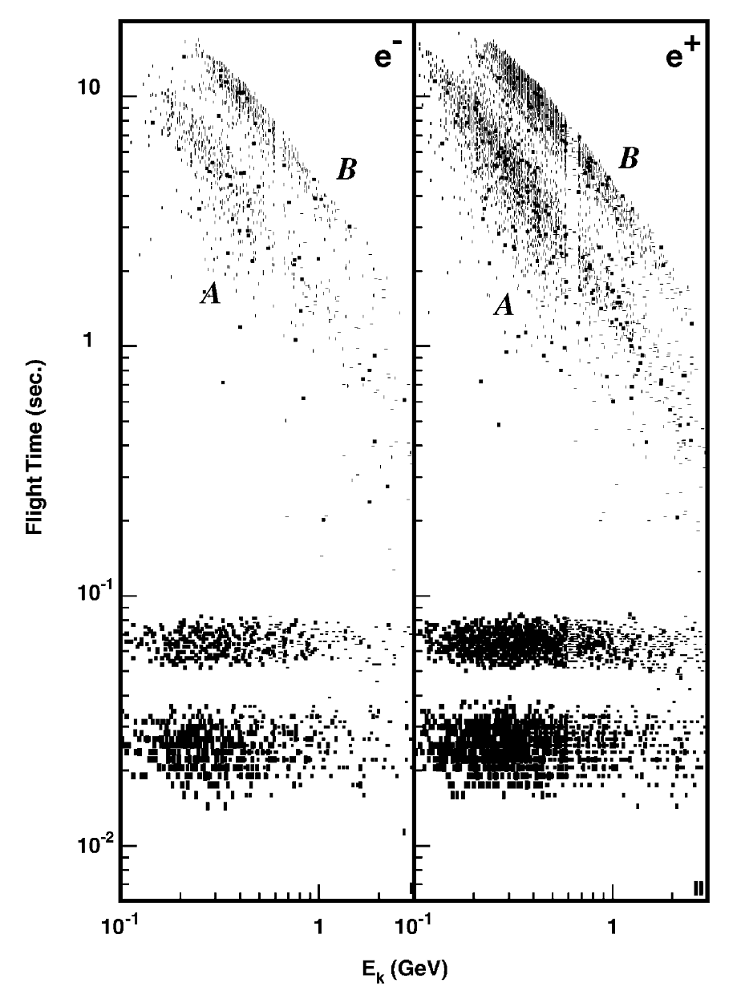
Tracing of events in AMS-01
The flight time versus energy from the tracing of leptons
The geographical origin of long-lived (a) electrons and (b) positrons.
M. Aguilar et al. / Physics Reports 366 (2002) 331– 405

Slide 14
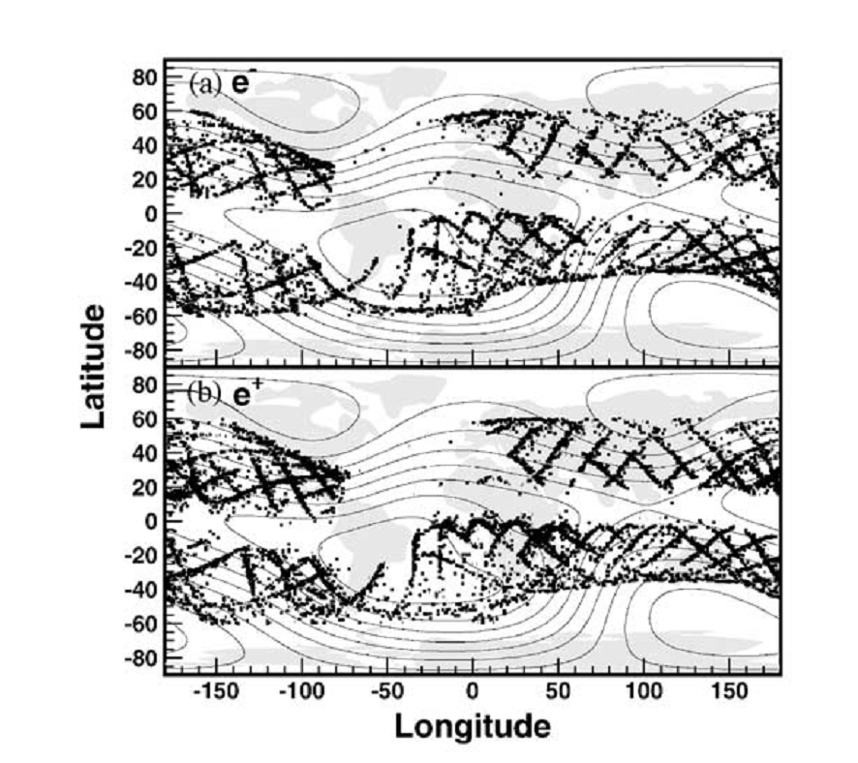
Tracing of events in AMS-01
The geographical origin of short-lived (a) electrons and (b) positrons.
M. Aguilar et al. / Physics Reports 366 (2002) 331– 405

Slide 15
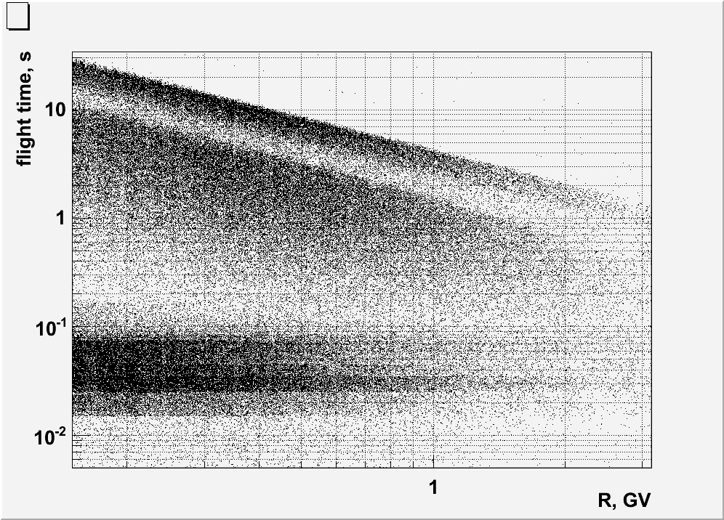
PAMELA: electron and positron flight time in magnetosphere
Cosmic ray (CR) selected
by Hmax>20000 km
The flight time versus energy from the tracing of leptons.
Difference with AMS-01: More wide interval of altitudes (350-600 km), possibility to work in SAA. There is trapped component with very long flight time

Slide 16
Re-entrant albedo: point of origin
PAMELA
electrons
AMS-01
positrons

Slide 17
Quasi-trapped albedo: points of detection
positrons
electrons

Slide 18
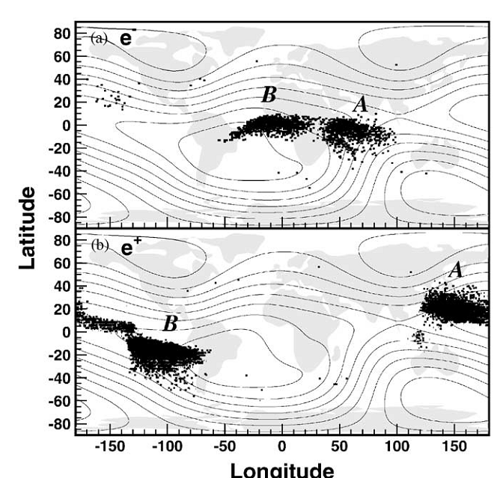
Quasi-trapped albedo: points of origin
AMS-01
PAMELA
electrons
positrons

Slide 19
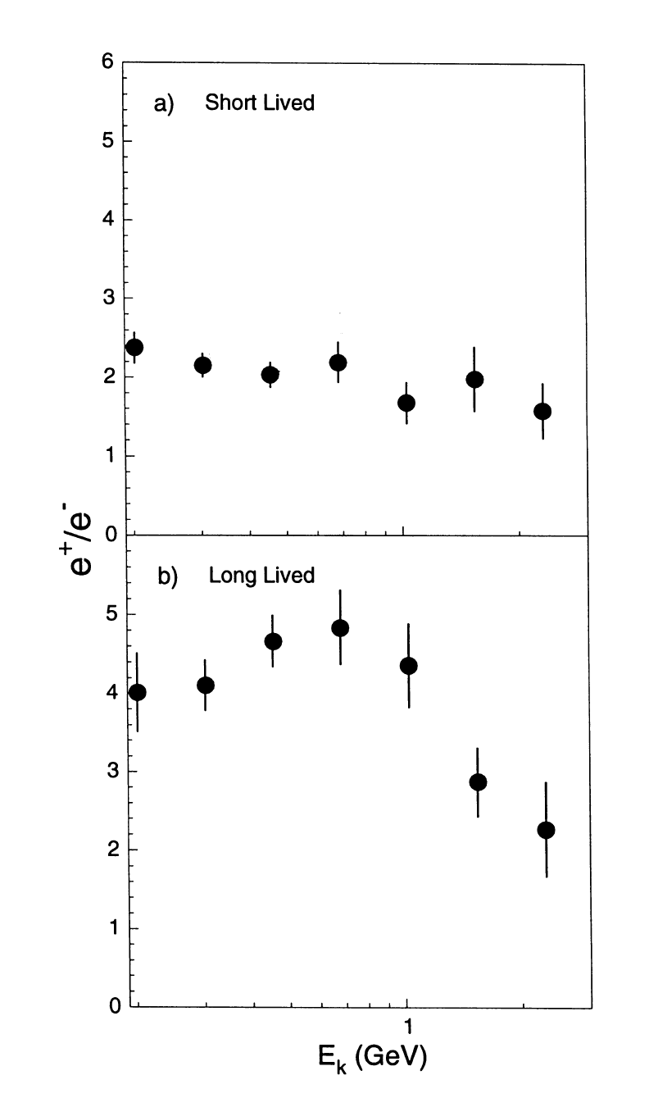
Positron to electron ratio vs energy

Slide 20
Positron to electron ratio vs longitude
Albedo (shortlived)
Quasitrapped (longlived)

Slide 21
Trapped albedo: points of detection
positrons
electrons

Slide 22
Space distribution of trapped particles
positrons
electrons

Slide 23
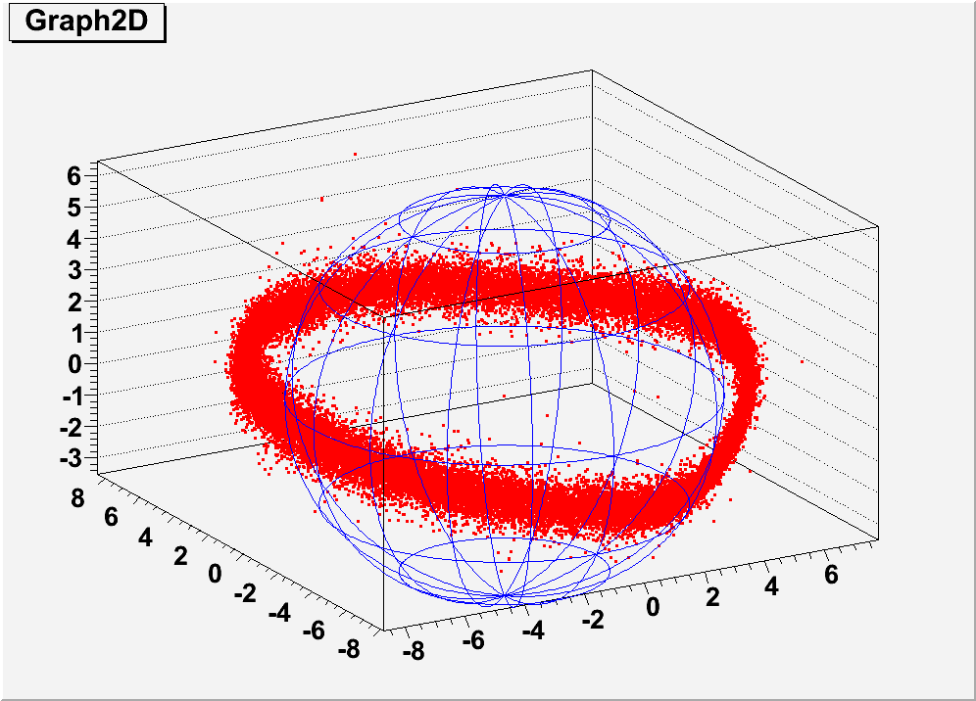
Space distribution of trapped particles

Slide 24
Geomagnetic coordinates of detected trapped particles

Slide 25
Trapped ratio e-/e+

Slide 26
Positron to electron ratio

Slide 27
Conclusion
From tracing of particles :
1. By flight time selection in geomagnetic field electrons and positrons have five distinct components:
- cosmic rays
- cosmic rays with chaotic trajectories
- albedo
- quasitrapped
- trapped
2. For first time PAMELA observed high energy trapped electrons and positrons with energy ~>100 MeV
3. Origin (production mechanism) of trapped lepton component differs from re-entrant and quasitrapped components.

Slide 28
Spare slides

Slide 29
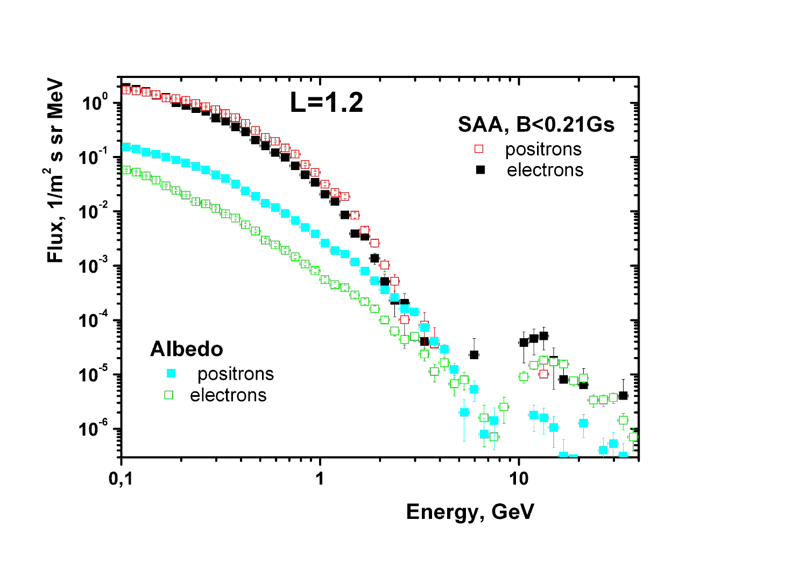
East-west effect

Slide 30
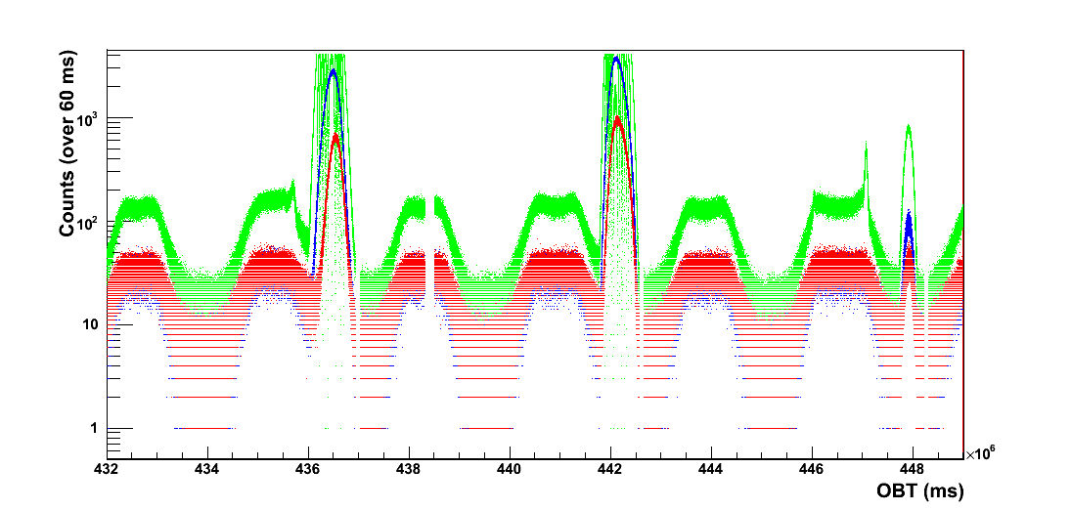
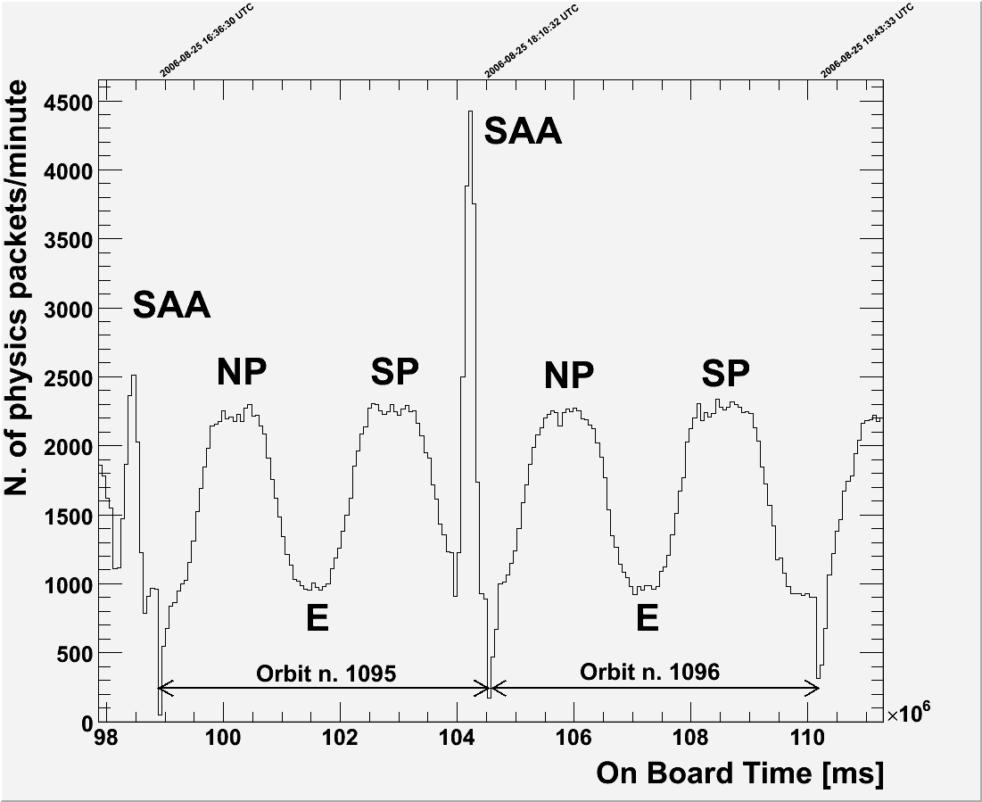
Download @orbit 3754 – 15/02/2007 07:35:00 MWT
Outer radiation belt
NP SP
EQ EQ
S1
S2
S3
Inner radiation belt
(SSA)‏
95 min
orbit 3751
orbit 3752
orbit 3753
Notes:
Outer rb = elettroni. Piu` vicina alla terra. Si attraversa al polo sud perche` il satellite e` piu` lontano. 600km a sud 350km nord.
La SSA e` un’estenzione della fascia interna. Causata dal fatto che in centro del dipolo magnetico e` spostato rispetto al cetro della terra.
Counting rates along the orbit. Comparison between different detectors (tof scintillators, neutron detector, anticounters) allows to check detector behavior in the space environment.
Conclusion: counting rates are consistent with satellite position along the orbit
Rate on S1, S2 S3:
- Duration of a orbit
- Environment: passage @ poles, equators and SSA

Slide 31
Positron to electron ratio vs energy

Slide 32
Quasi-trapped albedo: point of origin
positrons
electrons

