Slide 1
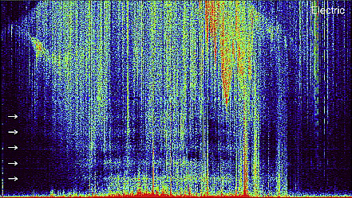
Observation of global electromagnetic resonances by low-orbiting satellites
Surkov V. V.
National Research Nuclear University MEPhI

Slide 2
1. Introduction
z
M(t)
EMW
The characteristic feature of the Earth's atmospheric electromagnetic activity is the world-wide occurrence of Schumann resonances; that is, narrow-band electromagnetic noise at certain frequencies in the ELF range of 8–50 Hz. Schumann resonances are formed due to the natural spherical resonance cavity between the ground and lower ionosphere. This Earth – ionosphere resonator are permanently excited by the global thunderstorm activity.
B_{φ}
E_{r}
d
R_{e}
E_{θ}
R_{i}
θ
r
Earth
Fig. 1. The resonator is arranged between two conducting “spheres”, i.e. the ionosphere and the Earth.

Slide 3
The IAR resonance cavity occupies a space bounded from below by E layer and from above by a zone located at altitude about 500–1000 km, where the plasma density and Alfvén velocity changes abruptly. The IAR resonance frequencies are in ULF range (0.5−5 Hz). Hall conductivity of the E-layer leads to the coupling between shear Alfvén and FMS waves. As a result of such coupling the energy of trapped Alfvén oscilla-tions partially leaks from the resonator into the atmosphere.
MAR
L
IAR
shear Alfven
waves
Earth
"reflection"
points
Atmosphere
F-layer
Fig. 2. The IAR arises due to Alfvén wave reflection from the E-layer of the ionosphere and from the plasma density gradient at a few hundreds of kilometers from the Earth's surface.
Schumann resonances and IAR spectrum were observed on the ground at low, middle, and even high latitudes irrespective of season.

Slide 4
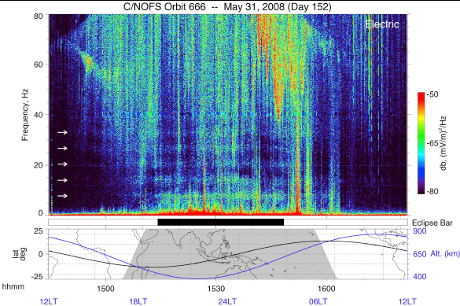
Fig. 3. Recently both the Schumann resonances and IAR signature have been discovered in the space [Simões et al., 2011; 2012]. The ELF electric field measurements onboard low-orbiting C/NOFS satellite revealed a distinct picture of the first five SR
.

Slide 5
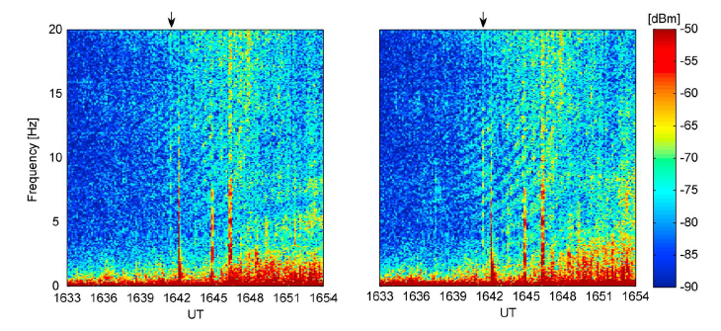
Fig. 4. Moreover several spectrograms of the electric field meridional and zonal components with "fingerprint" pattern manifest itself similar to typical IAR SRS, although these spectral peaks lie in the frequency band
Hz [Simões et al., 2012]. These abnormal spectra were detected by the C/NOFS satellite in the near-equatorial region near the terminator.

Slide 6
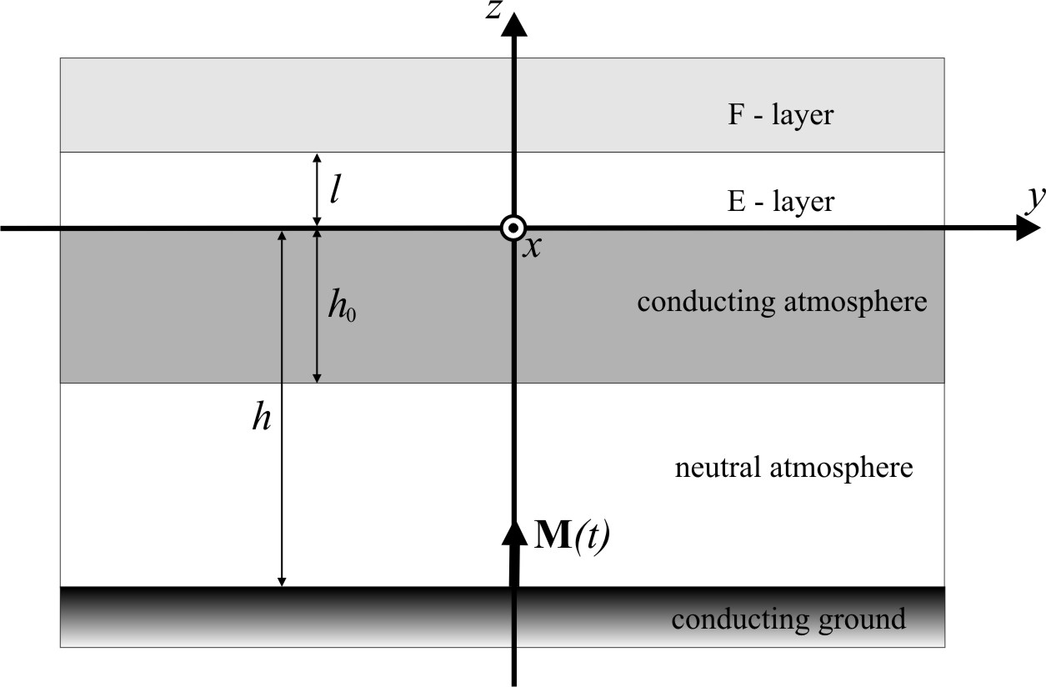
2. Estimates of Schumann resonance amplitudes in the ionosphere
In order to compare the magnitudes of SR at the ionospheric altitudes and on the Earth surface, we use the simplified plane stratified model which consist of the infinitely conductive ground , neutral atmosphere , conducting atmosphere , conducting gyrotropic E-layer of the ionosphere and the F-layer .
Fig. 5. A schematic illustration of the model. The origin of coordinate system is situated at the interface between the ionospheric E-layer and conducting atmosphere. The bold arrow represents the lightning current moment M(t).

Slide 7
To treat the electric and magnetic fields in the E-layer, Maxwell's equations are needed, which, in their full form, are given by
(1)
(2)
Here B₀ is the unperturbed geomagnetic field; and denote components of electric field parallel and transverse to B₀, respectively;
ω is frequency, , , and are parallel, Pedersen, and Hall conductivities of the ionospheric plasma, respectively.
In the F-layer, instead of equation (1) we have to use the following:
(3)
where and are components of the ionospheric plasma permittivity tensor; is Alfvén wave velocity.

Slide 8
Analysis of this problem have shown that the ratio of azimuthal magnetic perturbations in ionosphere and on the ground can be roughly estimated through the height-integrated Pedersen Σ_{P} and Hall Σ_{H} conductivities as follows
(4)
where is the Alfvén wave conductance, Σ_{a} is the height-integrated atmospheric conductivity and denotes the Alfvén wave number. Here we have used the following night-time/daytime parameters: S, S,
S, and km. Similarly
(5)
Our estimates of Schumann resonance amplitudes in the ionosphere are in a good agreement with the C/NOFS satellite observations.

Slide 9
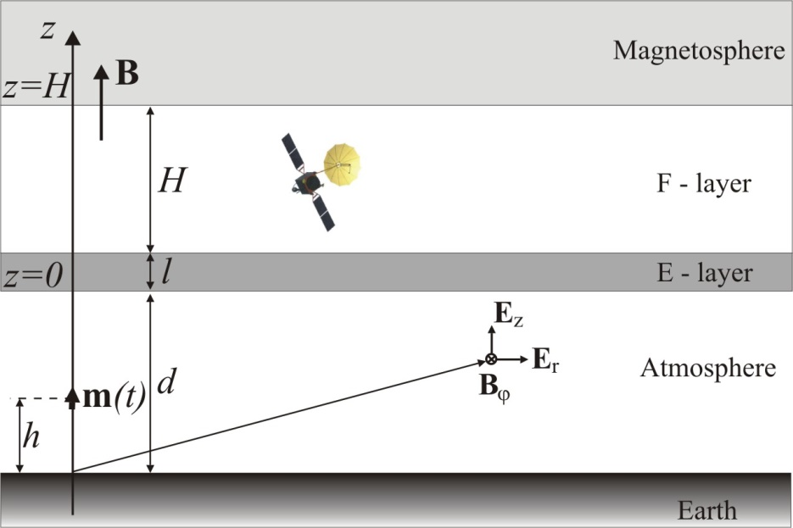
3. Analysis of IAR spectra observed
by low-orbiting satellite
A simplified plane-stratified model of IAR has been used to study electromagnetic perturbation inside the IAR. This model is different from that used above by incorporating upper IAR boundary at height about 10³ km. To model the increase in Alfvén wave velocity with height, we assume that the Alfvén velocity has a jump across the upper IAR boundary.
The major source for IAR excitation is supposed to be either a separate intense lightning stroke or stochastic global thunderstorm activity.
Fig. 6. A schematic illustration of a plane stratified medium model.

Slide 10
In the framework of the above model the ratio between the magnetic disturbance inside IAR and on the ground can be roughly estimated as
(6)
where and are Alfvén wave velocities in the IAR and the magnetosphere, respectively. According to this estimate the peak disturbance inside the IAR can be an order of magnitude larger than that in the atmosphere.
The spectral amplitudes of electric power spectra are estimated as
μV/m∙Hz^{1/2}.
The electric field power spectra detected by C/NOFS satellite at the altitude range of km were μV/m∙Hz^{1/2} [3].
The calculated value is thus consistent with the observations.

Slide 11
However the dynamic spectra recently observed by the C/NOFS satellite can hardly be interpreted on the basis of standard IAR theory because these spectra were shifted to higher frequencies (up to 15 Hz) as compared with typical SRS on the ground [Simões et al., 2012].
Fig. 7
To study this effect in more detail, we develop a simple one-dimensional model of the field-aligned Alfvén wave propagation inside the IAR.

Slide 12
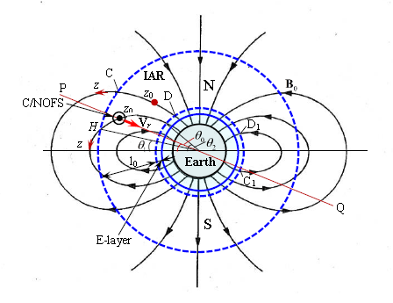
Analysis of this problem has shown that interference between the primary Alfvén wave and the waves reflected from IAR boundaries can greatly affect the power spectra of electromagnetic perturbations detected by satellite.
Fig. 8. A schematic plot of IAR model. The geomagnetic field B₀ is shown in dipole approximation. The IAR cavity is bounded from below and above by two circular dotted lines. The coordinate z is measured along the field line piece CD bounded by the resonator boundaries. The observation point is labeled by z₀. The location of C/NOFS satellite is schematically shown with a circle and dot in its center. The line PQ shows the plane of satellite orbit while the arrow indicates the direction of meridional/radial C/NOFS satellite velocity V_{r} .

Slide 13
IAR boundaries
H
magnetic field line
z
Alfvén wave
E layer of the ionosphere
satellite position
Fig. 9.
Let H be the length of field line piece bounded by the resonator boundaries and z be the satellite coordinate measured along the field line. The interference effect results in “modulation” of power spectra in such a way that the spectra have a quasi-oscillatory shape with “period”
(or ) depending on the satellite coordinate and the direction of the primary Alfvén wave propagation.
To explain the increase of the spectral peak frequencies detected by C/NOFS satellite when the satellite descended from 650 to 450 km altitude [3], we suppose that the distance (measured along the field line) between the satellite and the ionospheric E-layer; that is the IAR lower boundary, decreased with time thereby producing both the increase in and the shift of spectral peaks to the higher frequencies.

Slide 14
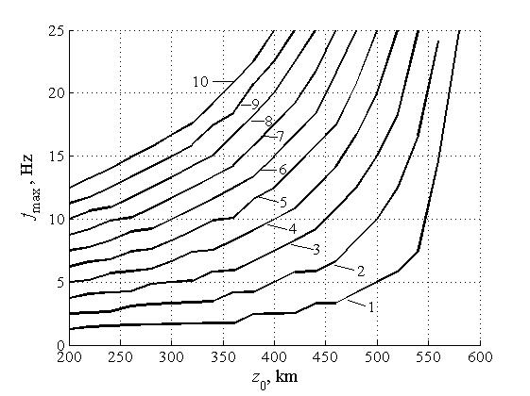
Theory
Experiment
Fig. 9. The frequencies corresponding to maxima (indicated by numbers) of power spectrum envelope as functions of time or the coordinate z₀ taken on the geomagnetic field line inside the IAR.
Model simulations have demonstrated that the interference effect can mask the spectral peaks due to excitation of the IAR eigenoscillations.

Slide 15
4. Conclusion
The above theoretical analysis is indicative of the feasibility of detection of both Schumann resonances and IAR signatures in space by modern magnetometers and electric field sensors onboard low-orbiting satellites.
However it seems likely that the observed "fingerprint" spectrograms resembling SRS are not typical for IAR eigenmodes because these spectrograms are subjected to the interference effects between primary and reflected Alfvén waves propagating in IAR.
The observation onboard low-orbiting satellite can thus provide us with additional information about ULF/ELF electromagnetic fields and noises at the ionospheric altitudes.

Slide 16
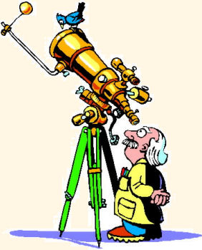
Thank you for attention!

Slide 17
Simões F A, Pfaff R F, and Freudenreich H T 2011 Satellite observations of Schumann resonances in the Earth's ionosphere Geophys. Res. Lett., 38, No 22, doi:10.1029/2011GL049668.

Slide 18
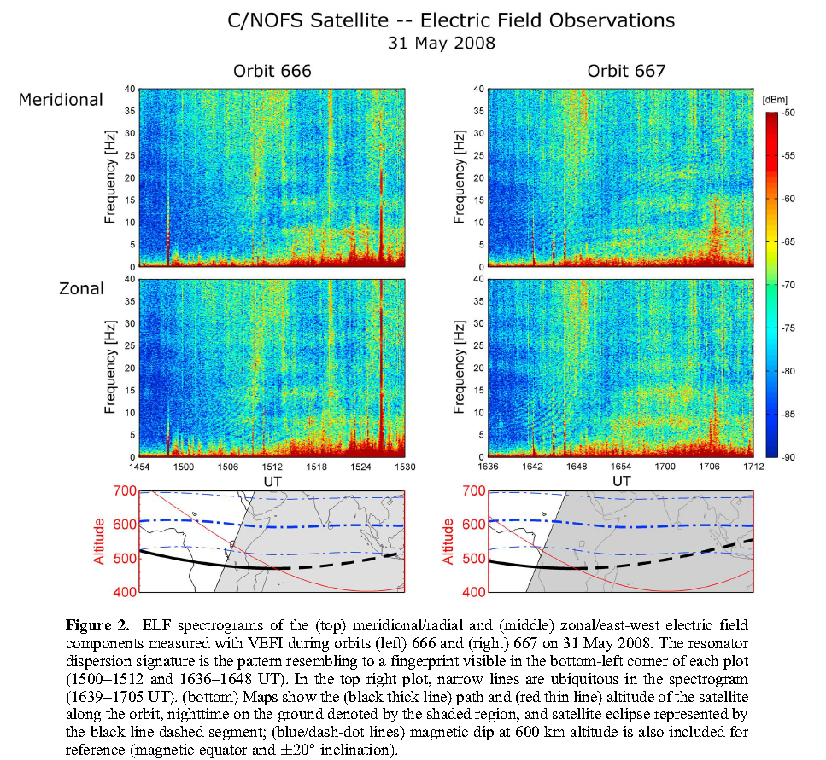

Slide 19
