Slide 1


Status of the LHC and plans
HL-LHC project
CLIC and FCC studies
Frédérick Bordry

Slide 2

LHC (Large Hadron Collider)
14 TeV proton-proton accelerator-collider built in the LEP tunnel
Lead-Lead (Lead-proton) collisions
1983 First studies for the LHC project
1988 First magnet model (feasibility)
1994 Approval of the LHC by the CERN Council
1996-1999 Series production industrialisation
1998 Declaration of Public Utility & Start of civil engineering
1998-2000 Placement of the main production contracts
2004 Start of the LHC installation
2005-2007 Magnets Installation in the tunnel
2006-2008 Hardware commissioning
2008-2009 Beam commissioning and repair
2010-2035… Physics exploitation
2010 – 2012 Run 1 ;7 and 8 TeV
2015 – 2018 Run 2 ; 13 TeV
2021 – 2023 Run 3 (14 TeV)
2024 – 2025 HL-LHC installation
2026 – 2035… HL-LHC operation
A 27 km circumference collider…

Slide 3
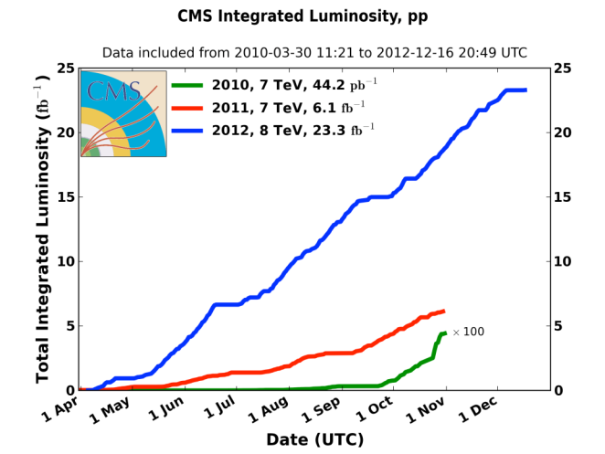

LHC 2010-2012: a rich harvest of collisions
Σ ∼30 fb⁻¹
∼ 2 10¹⁵ collisions
2010: 0.04 fb⁻¹
  7 TeV CoM
  Commissioning
  2011: 6.1 fb⁻¹
  7 TeV CoM
  … exploring limits
2012: 23.3 fb⁻¹
  8 TeV CoM
  … production
BEH boson announcement
7 TeV and 8 TeV in 2012
Up to 1380 bunches
with1.5 10¹¹ protons
Notes:
70 millions de millions de collisions = 1 femtobarn⁻¹

Slide 4
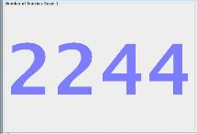
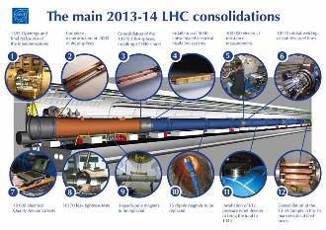
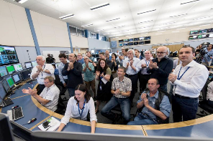
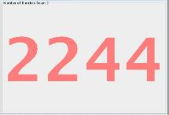

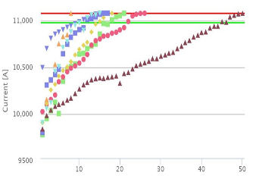
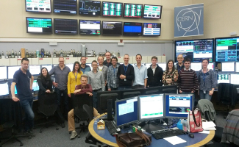

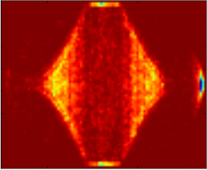
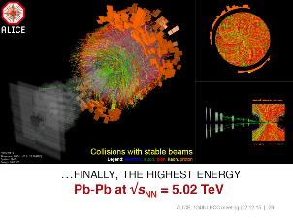

2013 - 2015
28th October
Physics with record number of bunches
Peak luminosity 5 x 10³³ cm⁻²s⁻¹
April ‘13 to Sep. ‘14
3rd June
First Stable Beams
13 TeV
5th April
1st B E A M
13-14
Aug 14-Apr 15
2015
Struggle
IONS
10th April
Beam at 6.5 TeV
Dipole training campaign

Slide 5
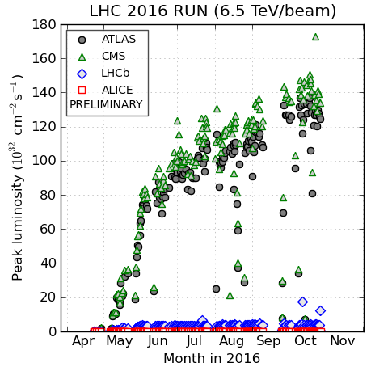
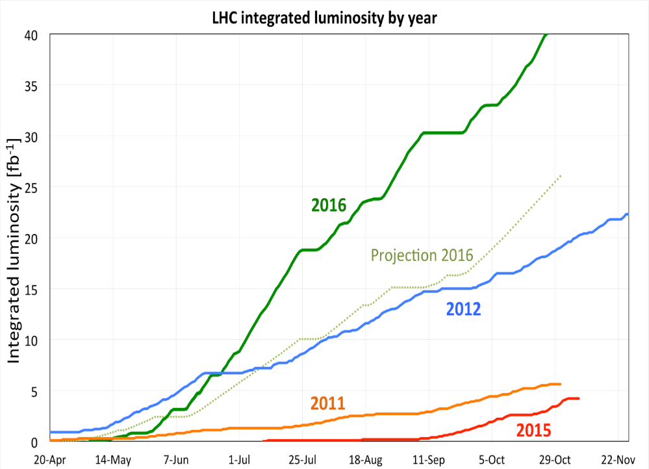
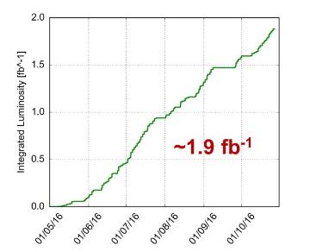
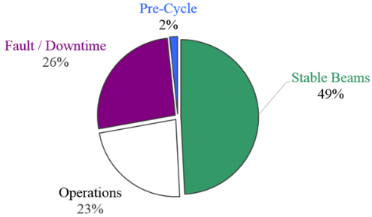
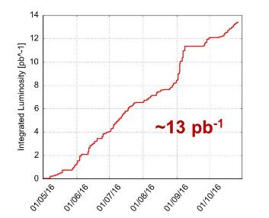
2016 LHC
Peak luminosity > 1.4 x 10³⁴ cm⁻²s⁻¹
OVER 25 fb⁻¹ in both ATLAS and CMS ☺
LHCb
ALICE

Slide 6
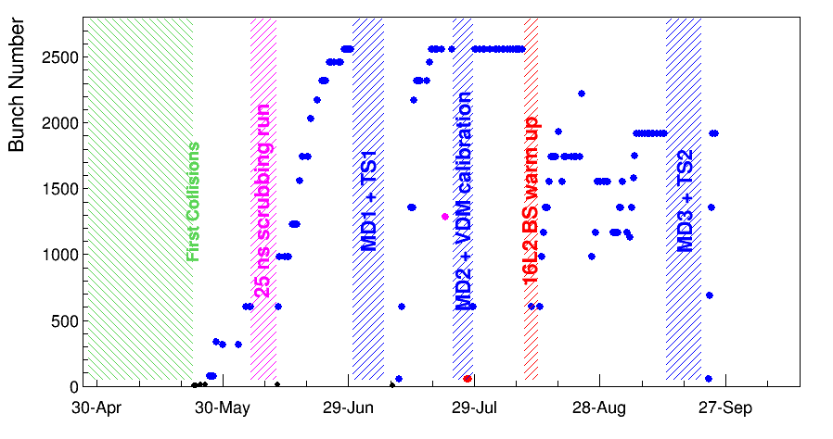
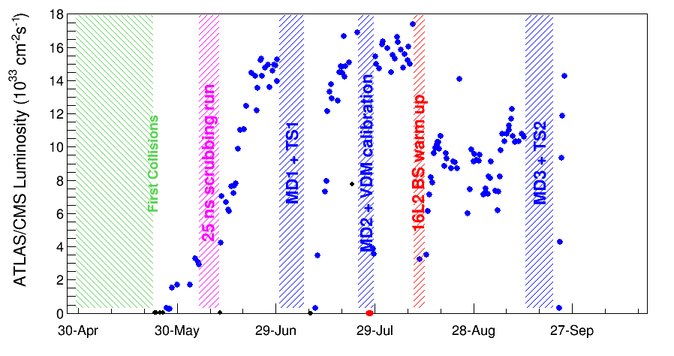
LHC Physics Run 2017 up to TS2: It was not all plain sailing !
Max 2556 bunches
Initial turn on and scrubbing very successful
After TS1 started to suffer from fast losses in the cell 16L2 (sector 1-2) leading to beam instabilities and beam dumps
  Not understood and limiting luminosity production, but mitigation strategy found
In order to try to understand the problem further it was decided to warm-up the beam screen in 16L2 to 80K in order to flush any contamination to the cold-bore
  Established procedure, used before
During this procedure: much larger pressure rise than expected
  10⁻³ mbar compared to 10⁻⁷mbar
Following this, 16L2 problems much worse
  Mitigation strategy no longer found to work and luminosity production much reduced
  Task force led by Jose Miguel Jimenez
A different bunch configuration reducing the problems found: 8b4e
  8 consecutive 25ns slots filled with proton bunches, followed by 4 slots with no bunches
  peak luminosity is ~1.1e34cm⁻²s⁻¹ (PU~40)
  Shorter TS2 (3 days) and very fast restart
    Beta * = 30cm
  Luminosity record: 1.75x10³⁴ cm⁻²s⁻¹

Slide 7
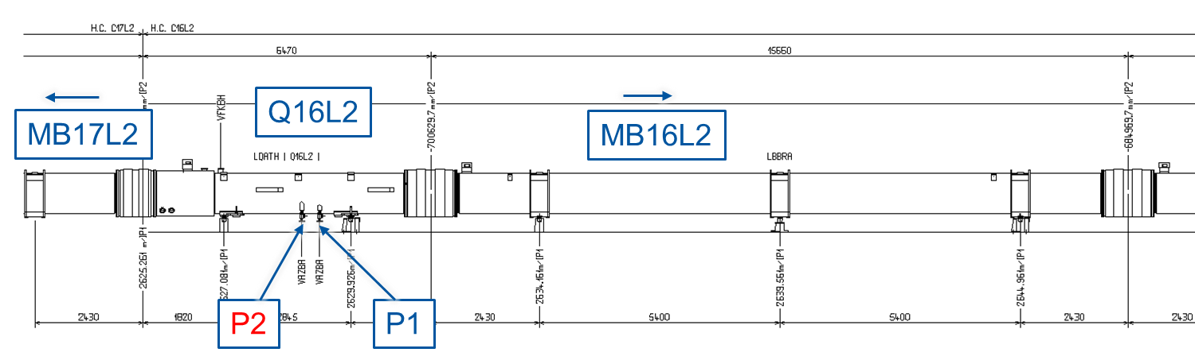
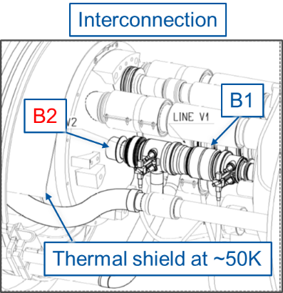
LHC “16L2”: Air inlet as “most probable” cause
Air inlet through both pumping ports while magnet cold masses, beam screens and thermal shields already at operating cryogenic temperature.
To be noted that gasses have a reduced mobility at those temperatures, explain why was not immediately identified.
Courtesy of “16L2” Task Force

Slide 8
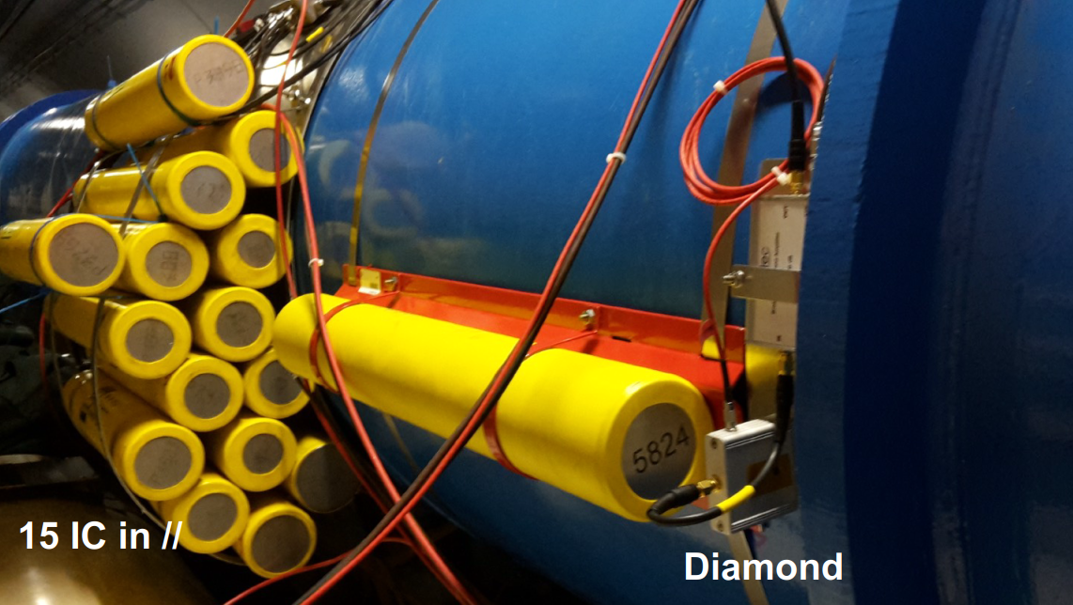
16L2 interconnect : more and more diagnostics

Slide 9



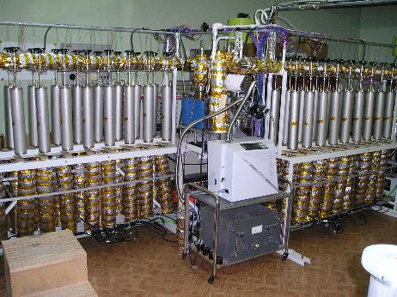
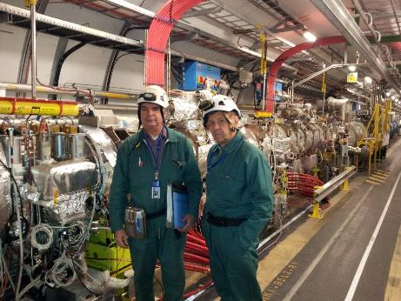
Russia and CERN
LHC beam loss monitors:
production, test and installation
Collaboration with the State Research Center of the Russian Federation, Institute for High Energy Physics (IHEP) of the Kurchatov Institute (NRC), Protvino
    Production, test and installation:
    4250 Ionisation chamber beam loss monitors
    378 Secondary emission beam loss monitors
    300 Little ionisation chamber beam loss monitors
Beam Loss Monitor Test Stand at IHEP
IHEP Team in the LHC

Slide 10
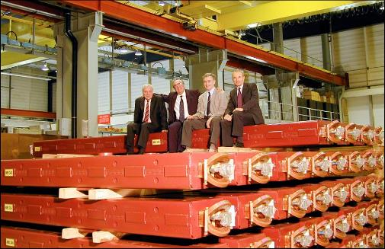
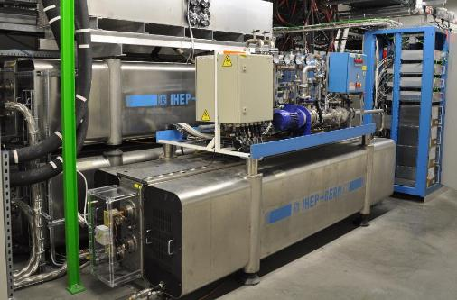
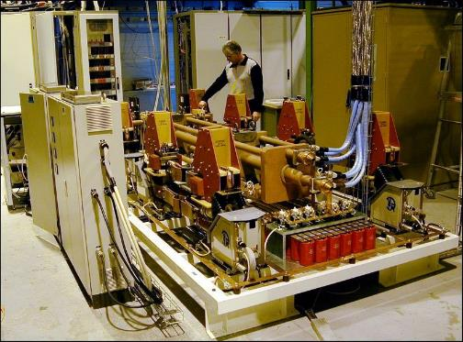
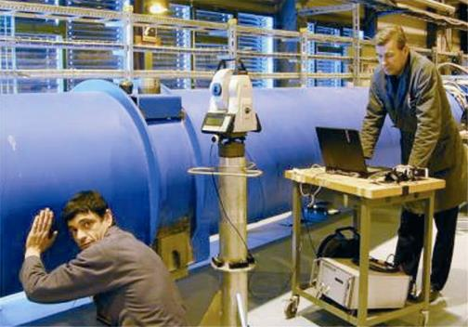
Russia and CERN
Strong involvement in the LHC accelerator and injectors, examples…
400 Magnets for the LHC transfer line (BINP)
24 main electrical systems for LHC superconducting magnet circuit protection (IHEP)
256 extraction switches for the LHC dipole and quadrupole chains (Plant Uralelectro - Yekaterinburg)
Development of survey equipment for the LHC Plants: TMZ (Tula) + “MIG” (Moscow)
Notes:
10
10

Slide 11
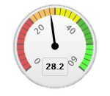
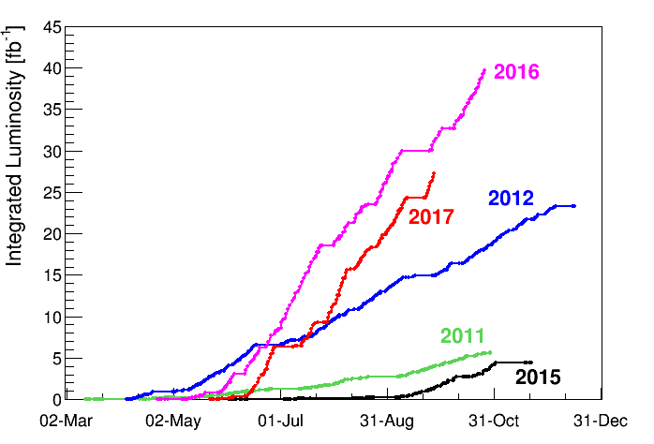
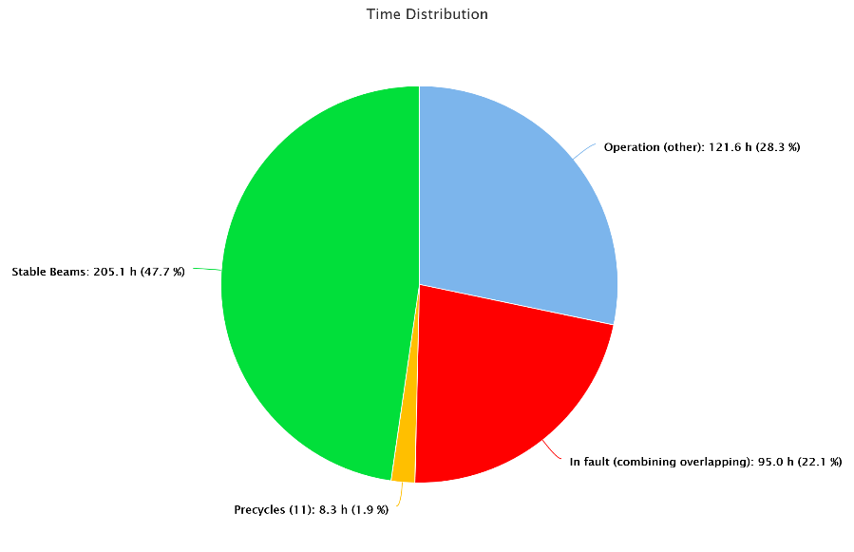
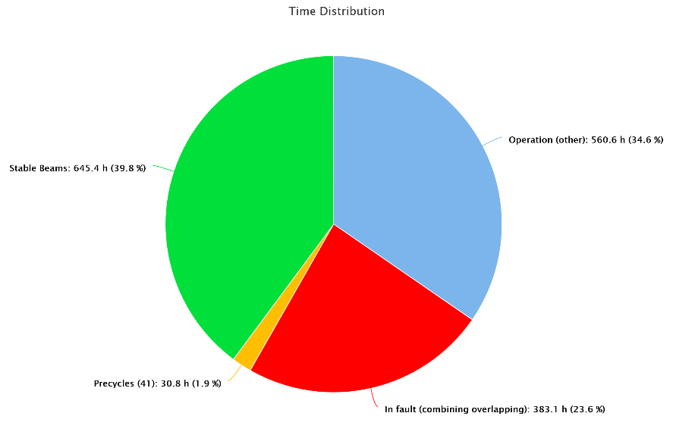
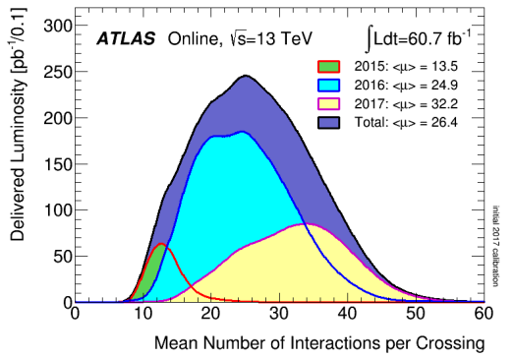
LHC 2017 : Integrated Performance (up to TS2)
2017 integrated luminosity: ∼29 fb⁻¹.
Time in collision
Before Tech. Stop 1
48%
Tech. Stop 1 – Tech Stop 2
40%

Slide 12
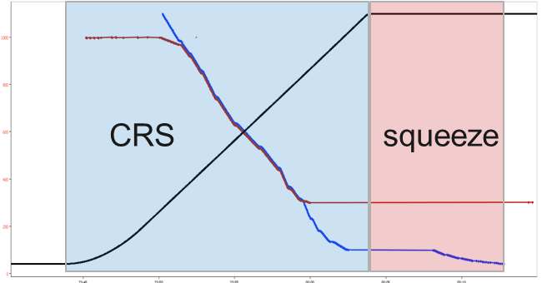
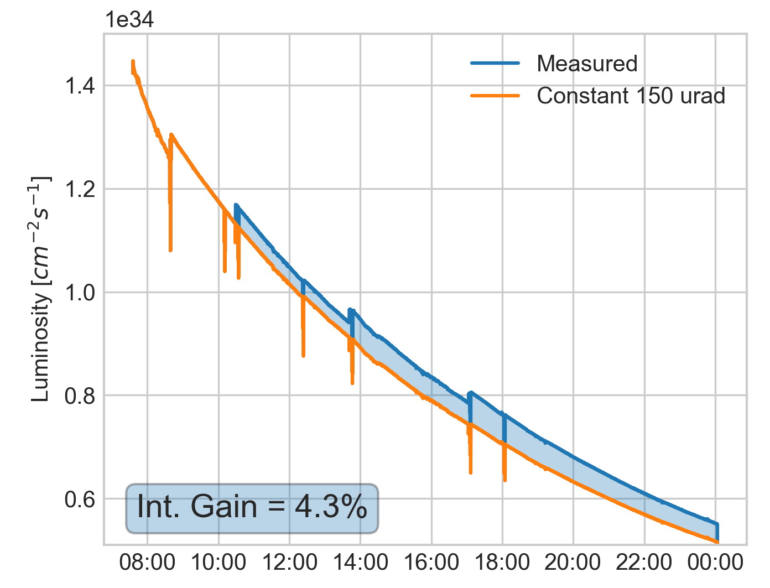
LHC 2017 : new achievements to optimise the integrated luminosity
Energy vs β* in IP1/5/8
Enhanced Combined Ramp & Squeeze (CRS) to reach 1 m β* (IP1/IP5) at the end of the ramp, followed by a squeeze to 40 cm
Crossing angle anti-levelling operational
  Observed luminosity gain of 3-4 %
  Steps of -10 μrad at stable beams
  after 2h, 4h, 8h
  150 → 140 → 130 → 120 μrad
Fill 5872
ATLAS Luminosity

Slide 13
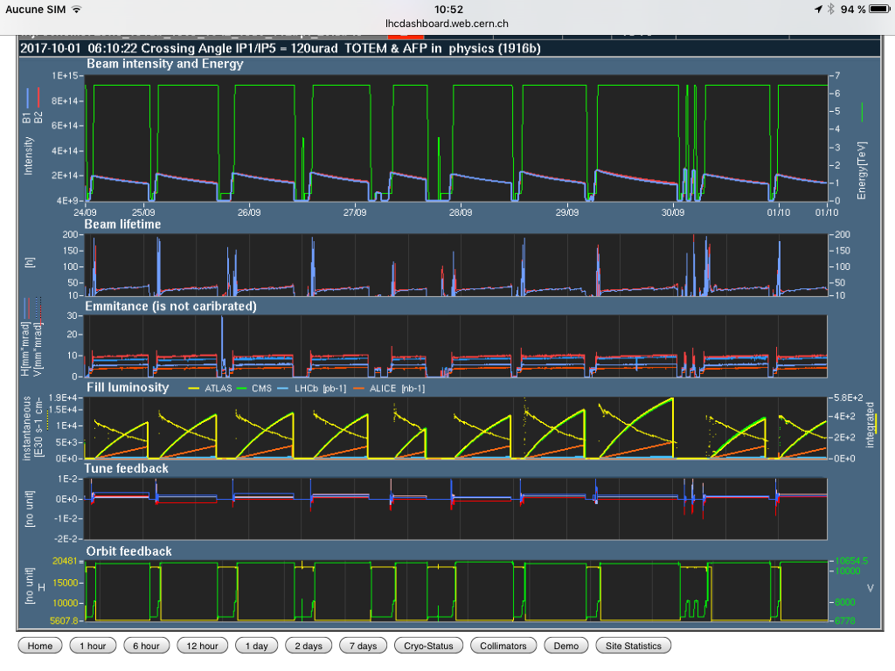
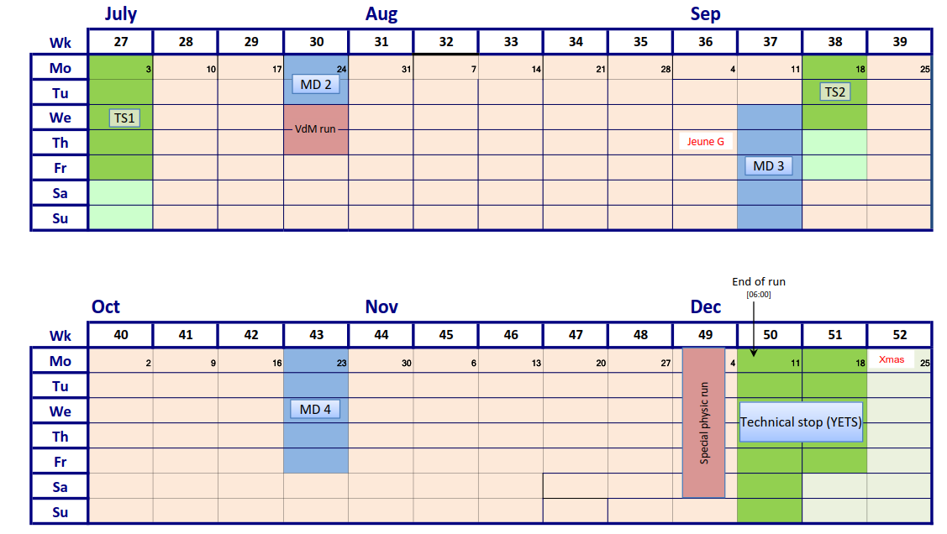
2017 LHC plans
- p-p runs with Beta * = 30 cm (ATLAS and CMS), crossing angle reduction during the fill
- Luminosity limited by 16L2 beam instabilities, but luminosity ∼ 1.4 10³⁴ cm⁻² s⁻¹ with 8b+4e
- Special runs (following LHCC recommendations: ∼17 days): 8 weeks “physics p-p” after TS2
- Preparing intervention (sector 1-2 warm-up) during the YETS (18 weeks “physics” to “physics”)

Slide 14
YETS 2017-2018: impact of warm up sector 1-2 @ T amb
Goal to keep 18 weeks “physics to physics”

Slide 15
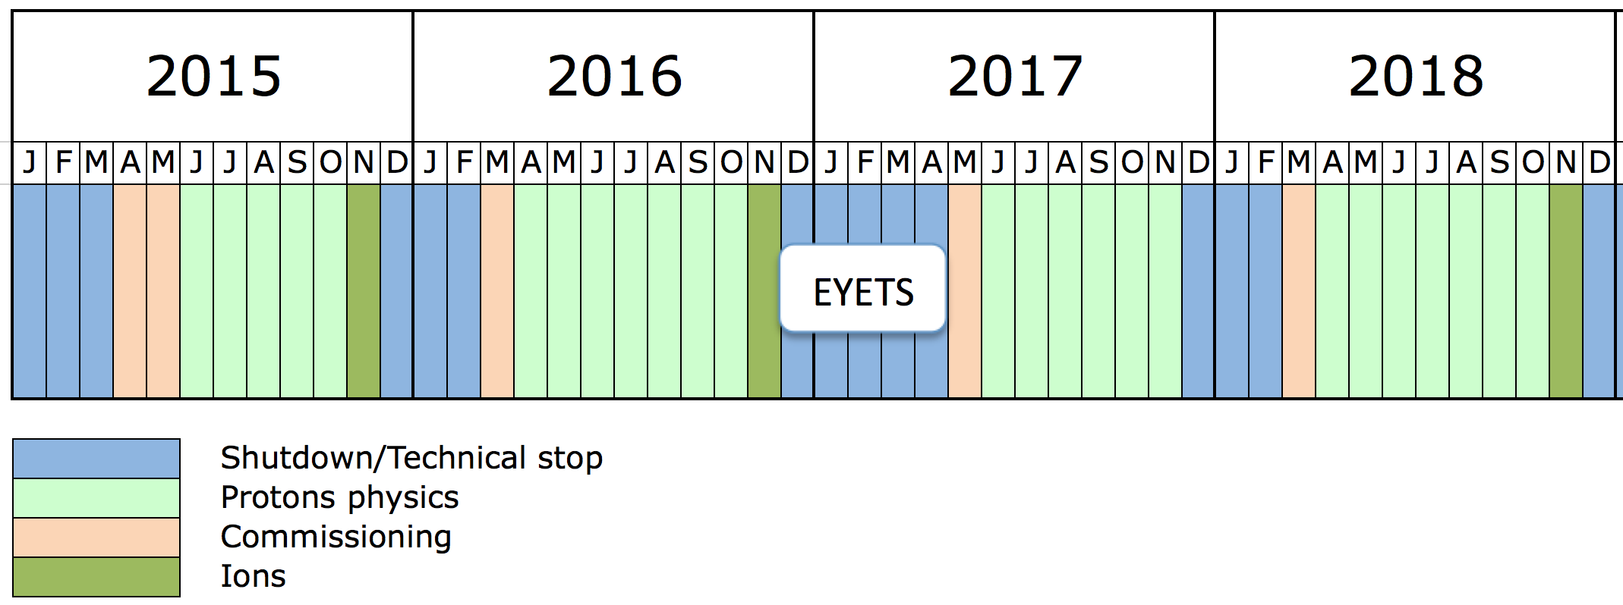
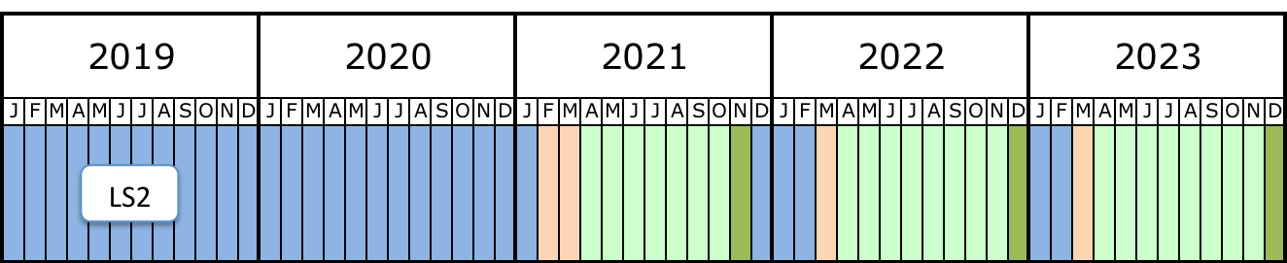
Run 2 and Run 3
Run 2
4 fb⁻¹
40 fb⁻¹
90 fb⁻¹
>130 fb⁻¹ (13 TeV)
Σ 300 fb⁻¹ (14 TeV)
140 fb⁻¹

Slide 16

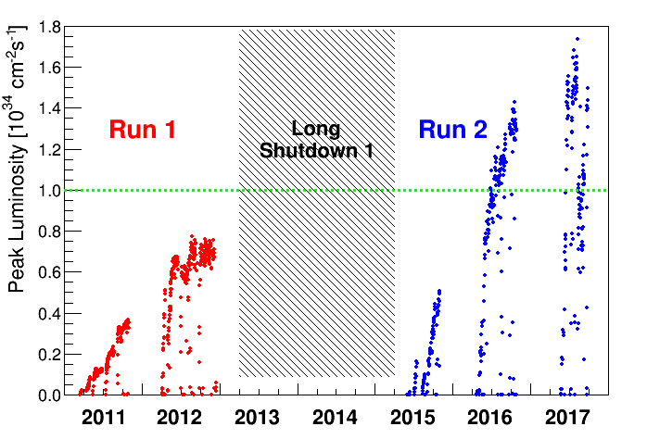
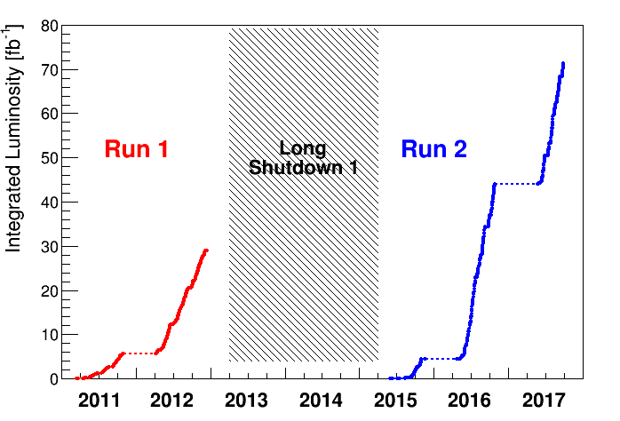
LHC is not a walk in the park !
Thanks to a collective effort, an effective taskforce, numerous ideas and innovations (to be channelled !):
- Operation > nominal luminosity; now ∼1.4 10³⁴ cm⁻² s⁻¹
Integrated luminosity > 28 fb⁻¹
90 fb⁻¹ goal maintained for 2017+2018
Run 1 + Run 2 : close to 100 fb⁻¹

Slide 17

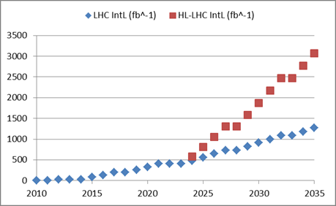
Why High-Luminosity LHC ? (LS3)
By implementing HL-LHC
Almost a factor 3
By continuous performance improvement and consolidation
Around 300 fb⁻¹ the present Inner Triplet magnets reach the end of their useful life (due to radiation damage)
and must be replaced.
Goal of HL-LHC project:
  250 – 300 fb⁻¹ per year
  3000 fb⁻¹ in about 10 years

Slide 18

The European Strategy for Particle Physics
Update 2013
Europe’s top priority should be the exploitation of the full potential of the LHC, including the high-luminosity upgrade of the machine and detectors with a view to collecting ten times more data than in the initial design, by around 2030. This upgrade programme will also provide further exciting opportunities for the study of flavour physics and the quark-gluon plasma.
HL-LHC from a study to a PROJECT
300 fb⁻¹ → 3000 fb⁻¹
including LHC injectors upgrade LIU (Linac 4, Booster 2GeV, PS and SPS upgrade)

Slide 19
LHC Upgrade Goals: Performance optimization
Luminosity recipe :
  1) maximize bunch intensities
  2) minimize the beam emittance
3) minimize beam size (constant beam power);
4) maximize number of bunches (beam power);
5) compensate for ‘F’;
6) Improve machine ‘Efficiency’
Injector complex
LIU ⬄ IBS
  triplet aperture
    25ns
Crab Cavities
minimize number of unscheduled beam aborts

Slide 20


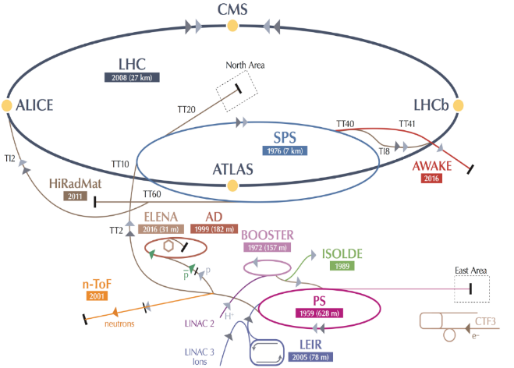
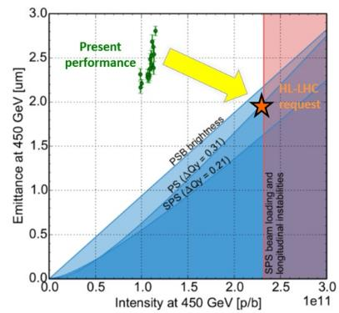
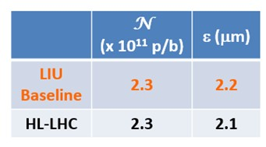
Goals and means of the LHC Injectors Upgrade: LIU project
Increase injector reliability and lifetime to cover HL-LHC run (until ~2040) closely related to consolidation program
Upgrade/replace ageing equipment (power supplies, magnets, RF…)
Improve radioprotection measures (shielding, ventilation…)
Increase intensity/brightness in the injectors to match
HL-LHC requirements
Enable Linac4/PSB/PS/SPS to accelerate and manipulate higher intensity beams (efficient production, space charge & electron cloud mitigation, impedance reduction, feedbacks, etc.)
Upgrade the injectors of the ion chain (Linac3, LEIR, PS, SPS) to produce beam parameters at the LHC injection that can meet the luminosity goal

Slide 21
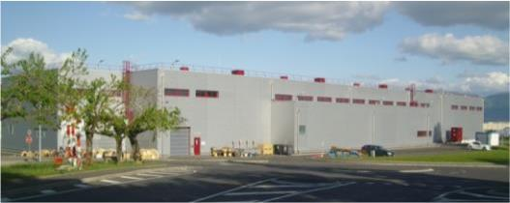
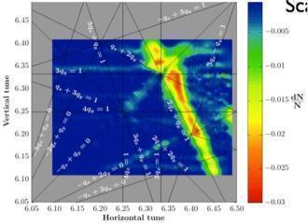
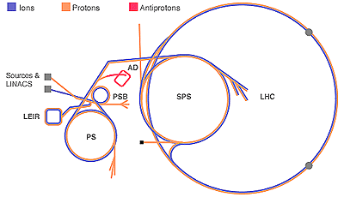
LS2 : (2019-2020), LHC Injector Upgrades (LIU)
LINAC4 – PS Booster:
  H⁻ injection and increase of PSB injection energy from 50 MeV to 160 MeV, to increase PSB space charge threshold
  New RF cavity system, new main power converters
  Increase of extraction energy from 1.4 GeV to 2 GeV
PS:
  Increase of injection energy from 1.4 GeV to 2 GeV to increase PS space charge threshold
  Transverse resonance compensation
  New RF Longitudinal feedback system
  New RF beam manipulation scheme to increase beam brightness
SPS
  Electron Cloud mitigation – strong feedback system, or coating of the vacuum system
  Impedance reduction, improved feedbacks
  Large-scale modification to the main RF system
These are only the main modifications and this list is far from exhaustive

Slide 22

The HL-LHC Project: 300 fb⁻¹ → 3000 fb⁻¹
New IR-quads Nb₃Sn
(inner triplets)
  New 11 T Nb₃Sn
  (5.5 m dipoles)
  Crab Cavities
  Collimation upgrade
  Cryogenics upgrade
  Cold powering
  Machine protection
  …
Major intervention on more than 1.2 km of the LHC

Slide 23
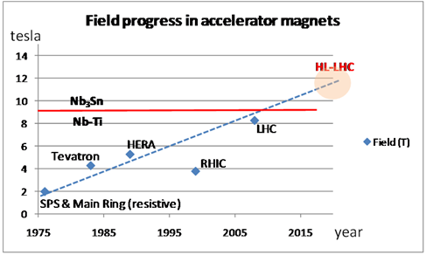
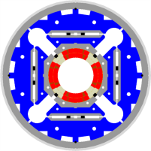
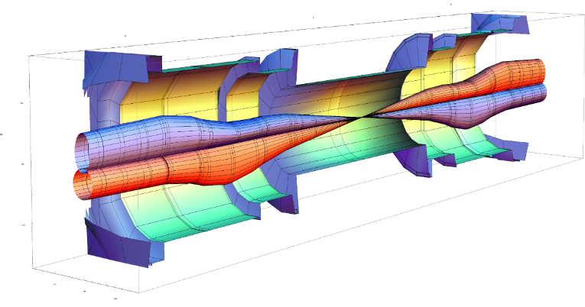
Squeezing the beams: High Field SC Magnets
Quads for the inner triplet
Decision 2012 for low-β quads
Aperture ∅ 150 mm – 140 T/m
(B_{peak} ≈12.3 T)
operational field, designed for 13.5 T => Nb₃Sn technology
(LHC: 8 T, 70 mm )
 | β_{triplet} | Sigma triplet | β* | Sigma*
Nominal | ~4.5 km | 1.5 mm | 55 cm | 17 um
HL-LHC | ~20 km | 2.6 mm | 15 cm | 7 um

Slide 24
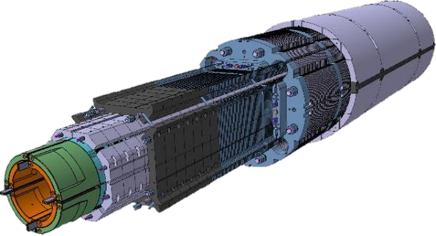
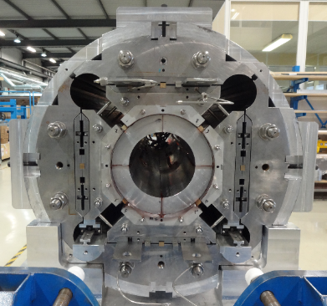

Nb₃Sn quadrupole: complexity increase vs Nb-Ti
Development of Nb3Sn Conductor
with Jc almost 3 times of ITER
Laminated structure for series production
Section of MQXF mechanical model
Second long (4 m) Nb3Sn coil

Slide 25



HL-LHC: Nb₃SN achievements
The 11 T dipole 2 m long model reached a B_{max} of 12.5 T
Test of the first full cross-section (150 mm aperture) Triplet Quadrupole, 1.5 m long, half CERN, half USA: it went beyond ultimate (B_{max eq.} of 12.5 T)
Test results of the Inner Triplet first 1.5 m long Quad

Slide 26


Crab Cavity: Proton machine (HL-LHC)
LHC Luminosity upgrade requires larger bunch charge and smaller $β^{∗}$.
To prevent parasitic bunch crossings, a larger crossing angle is needed.
This leads to geometric luminosity loss
at small $β^{∗}$.
A crab cavity is a deflecting cavity that
kicks the head of each bunch one way,
the tail the opposite way, such that the
crossing angle is compensated for the
bunch overlap in the collision point.
Luminosity vs. $β^{∗}$ for a non-zero crossing angle (lower curve) and possible luminosity for complete bunch overlap (upper curve)
Two bunches colliding with a non-zero crossing angle. Left: without crab cavity, right: with crab cavity

Slide 27






Superconducting RF Crab Cavity first prototypes
Operating point
Operating point
US-LARP DQW
CERN DQW
February 2017 three (naked) Crab Cavities were tested: all went well beyond the operating voltage of 3.4 MV
- One US-LARP DQW (tested at JLab) went up to 5.4 MV
- One US-LARP RFD (tested at Jlab) reached 4.03 MV.
- One CERN DQW (test at SM18) went up to 5.04 MV
Good results for the CC testing in the SPS in 2018

Slide 28


today
Run I
Run II
Run III
Run IV, V…
FAV = Fabrication, Assembly and Verification

Slide 29









In-kind contributions and collaborations
for design, prototypes, production and tests
Discussions are ongoing with other countries, e.g India, Canada, Russia, China,…
ATLAS
CMS
Q1-Q3 : R&D, Design, Prototypes and in-kind USA
D1 : R&D, Design, Prototypes and in-kind JP
MCBX : Design and Prototype ES
HO Correctors: Design and Prototypes IT
Q4 : Design and Prototype FR
CC : R&D, Design and in-kind USA
CC : R&D and Design UK

Slide 30


“to propose an ambitious post-LHC accelerator project at CERN by the time of the next Strategy update”
CERN should undertake design studies for accelerator projects in a global context,
d) CERN should undertake design studies for accelerator projects in a global context,
with emphasis on proton-proton and electron-positron high-energy frontier machines. These design studies should be coupled to a vigorous accelerator R&D programme, including high-field magnets and high-gradient accelerating structures, in collaboration with national institutes, laboratories and universities worldwide.
HFM
HGA

Slide 31




CLIC Multi-TeV Linear Collider
Tunnel implementations (laser straight)
Central MDI & Interaction Region
Notes:
Main points:
After the work done for the CDR there are several key points that need to be addressed or improved in the coming years (mention the five points on the fly in)
Several of them, for example costing-power-physics-some technical developments, can and will be done in collaboration with similar work for the large ring

Slide 32



Compact Linear Collider (CLIC)
Linear e⁺e⁻ collider √s up to 3 TeV
100 MV/m accelerating gradient
needed for compact (~50 km) machine
based on normal-conducting
accelerating structures and a
two-beam acceleration scheme
Direct discovery potential and
precise measurements of new
particles (couplings to Z/γ*) up
to m~ 1.5 TeV
Indirect sensitivity to E scales
Λ ~ O(100) TeV
Measurements of “heavy” Higgs
couplings: ttH to ~ 4%, HH ~ 10%
Parameter | Unit | 380 GeV | 3 TeV
Centre-of-mass energy | TeV | 0.38 | 3
Total luminosity | 10³⁴cm⁻²s⁻¹ | 1.5 | 5.9
Luminosity above 99% of √s | 10³⁴cm⁻²s⁻¹ | 0.9 | 2.0
Repetition frequency | Hz | 50 | 50
Number of bunches per train |  | 352 | 312
Bunch separation | ns | 0.5 | 0.5
Acceleration gradient | MV/m | 72 | 100
Most recent operating scenario: start
at √s=380 GeV for H and top physics

Slide 33
“to propose an ambitious post-LHC accelerator project at CERN by the time of the next Strategy update”
CERN should undertake design studies for accelerator projects in a global context,
d) CERN should undertake design studies for accelerator projects in a global context,
with emphasis on proton-proton and electron-positron high-energy frontier machines. These design studies should be coupled to a vigorous accelerator R&D programme, including high-field magnets and high-gradient accelerating structures, in collaboration with national institutes, laboratories and universities worldwide.
HFM
HGA

Slide 34



Malta Workshop: HE-LHC @ 33 TeV c.o.m.
14-16 October 2010
Magnet design (20 T):
very challenging but not impossible.
300 mm inter-beam
Multiple powering in the same magnet (and more sectioning for energy)
Work for 4 years to assess HTS for 2X20T to open the way to 16.5 T/beam .
Otherwise limit field to 15.5 T for 2x13 TeV
Higher INJ energy is desirable (2xSPS)
The synchrotron light is not a stopper by operating the beam screen at 60 K.
The beam stability looks « easier » than LHC thanks to dumping time.
Collimation is possibly not more difficult than HL-LHC. Reaching 2x10³⁴ appears reasonable.
The big challenge, after main magnet technology, is beam handling for INJ & beam dump: new kicker technology is needed since we cannot make twice more room for LHC kickers.

Slide 35

Future Circular Collider Study
Goal: CDR for European Strategy Update 2018
International FCC collaboration (CERN as host lab) to study:
pp-collider (FCC-hh) → main emphasis, defining infrastructure requirements
80-100 km tunnel infrastructure in Geneva area, site specific
e⁺e⁻ collider (FCC-ee), as potential first step
p-e (FCC-he) option, integration one IP, FCC-hh & ERL
HE-LHC with FCC-hh technology
~16 T ⇒ 100 TeV pp in 100 km

Slide 36


FCC-pp collider parameters
parameter | FCC-hh |  |  | HE-LHC | HL-LHC | LHC
collision energy cms [TeV] | 100 |  |  | 27 | 14 | 14
dipole field [T] | 16 |  |  | 16 | 8.33 | 8.33
circumference [km] | 97.75 |  |  | 26.7 | 26.7 | 26.7
beam current [A] | 0.5 |  |  | 1.12 | 1.12 | 0.58
bunch intensity [10¹¹] | 1 |  | 1 (0.2) | 2.2 (0.44) | 2.2 | 1.15
bunch spacing [ns] | 25 |  | 25 (5) | 25 (5) | 25 | 25
synchr. rad. power / ring [kW] | 2400 |  |  | 101 | 7.3 | 3.6
SR power / length [W/m/ap.] | 28.4 |  |  | 4.6 | 0.33 | 0.17
long. emit. damping time [h] | 0.54 |  |  | 1.8 | 12.9 | 12.9
beta* [m] | 1.1 | 0.3 |  | 0.25 | 0.20 | 0.55
normalized emittance [μm] | 2.2 (0.4) |  |  | 2.5 (0.5) | 2.5 | 3.75
peak luminosity [10³⁴ cm⁻²s⁻¹] | 5 |  | 30 | 25 | 5 | 1
events/bunch crossing | 170 |  | 1k (200) | ~800 (160) | 135 | 27
stored energy/beam [GJ] | 8.4 |  |  | 1.3 | 0.7 | 0.36

Slide 37








16 T dipole design activities and options
Swiss contribution
H2020
Cos-theta
Common coils
Canted
Cos-theta
Blocks
INFN
CIEMAT
LBNL
CEA
PSI
FNAL
Short model magnets (1.5 m lengths) will be built from 2017 - 2021

Slide 38

Implementation - footprint baseline
Optimisation in view of accessibility surface points, tunneling rock type, shaft depth, etc.
Tunneling
Molasse 90%, Limestone 5%, Moraines 5%
Shallow implementation
~ 30 m below lakebed
Reduction of shaft length and technical installations
One very deep shaft F (RF or collimation), alternatives being studied, e.g. inclined access

Slide 39

common layouts for hh & ee
11.9 m
IP
30 mrad
FCC-hh/
ee Booster
9.4 m
0.6 m
Lepton beams must cross over through the common RF to enter the IP from inside.
Only a half of each ring is filled with bunches.
Common
RF (tt)
Common
RF (tt)
Max. separation of 3(4) rings is about 12 m:
wider tunnel or two tunnels are necessary around the IPs, for ±1.2 km.
IP
2 main IPs in A, G for both machines
Notes:
Check with Katsunobu to have latest layout.
Check with detector people if 9 m offset is acceptable for ee detector

Slide 40

collaboration & industry relations
113
Institutes
25
Companies
32
Countries
EC
H2020

Slide 41


FCC WEEK 2018
Amsterdam
9-13 April 2018
  Consolidated parameter sets for FCC-hh, FCC-ee, HE-LHC and FCC-he as solid basis for the conceptual design report end 2018
  Superconducting magnets and SRF are key enabling technologies for Future Colliders at the energy frontier; international R&D programs established
  International FCC collaboration is growing steadily, addressing all the challenging subjects and research lines
  2018 FCC Physics WS: 15-19 Jan. 2018, CERN
  2018 FCC Week: 9-13 April 2018, Amsterdam
CDR by end of 2018

Slide 42
Conclusions
Run 2 : LHC operates at 13 TeV with record performance
  2016 : 1st production year with 40 fb⁻¹ and high availability ∼ 50%
  2017 : 29 fb⁻¹ in spite of vacuum problem;
    record peak luminosity 1.75 10³⁴ cm⁻² s⁻¹ with 2556 bunches
  2017 + 2018 : goal 90 fb⁻¹
LS2 preparation well advanced: mainly LIU, HL-LHC Civil Engineering
and preparing to run at 14 TeV during Run 3
- (Run 1 + Run 2 + Run 3) => Goal 300 fb⁻¹
The HL-LHC project is well established in terms of: beam parameters, technical requirements, needed technological developments.
R&D work is well advanced and construction of some components started.
=> Goal of 3’000 fb⁻¹
Depending on the physics findings of the LHC “precision” e+e- linear colliders might be built in Japan (ILC) or at CERN (CLIC: 380 GeV,…, 3 TeV)
CERN is hosting a study performed in international collaboration for a Future Circular Colliders in the Geneva area with a circumference of  100km:
hh-collider (FCC-hh) defining the infrastructure requirements
- e+e- collider (FCC-ee) as potential intermediate step
- e-h (FCC-eh) option
- HE-LHC is also a possible option (staged approach): 16T-20T High Field Magnets in the present LHC tunnel

Slide 43

Final Conclusion: CERN Technology Roadmap
HEP
Accelerator
Technologies
OPERATION
PROJECTS
STUDIES
Important milestone: 2019-2020
Update of the European Strategy for Particle Physics
PS
AD
LHC
CLEAR
Elena
FCC-ee
PSB
EA
HIE-Isolde
HL-LHC
AWAKE
CLIC
Linac 2 &3
nTof
SPS
FT-NA
Linac 4
LIU
HE-LHC
FCC-hh
FCC-eh
Isolde

Slide 44

Спасибо!
"The task of the mind is to produce future"
Paul Valéry

