Slide 1
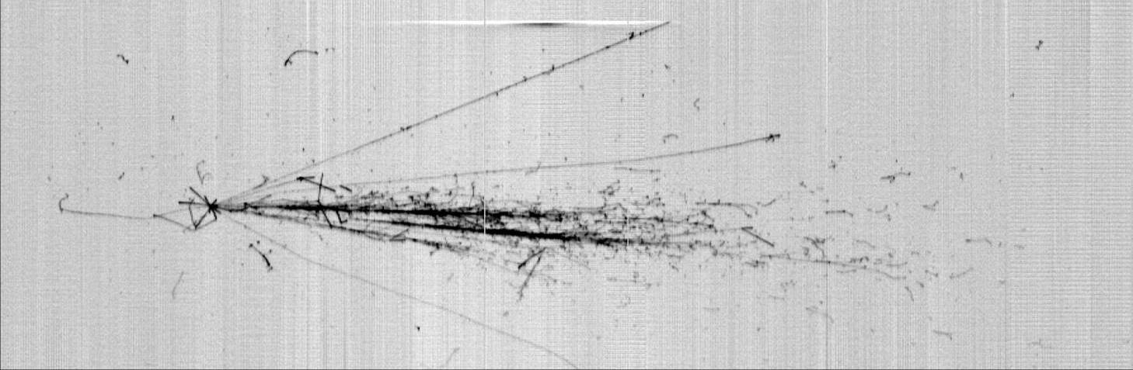

ICARUS: from CNGS to Booster beam
Daniele Gibin
INFN Padova
on behalf of the ICARUS Collaboration

Slide 2
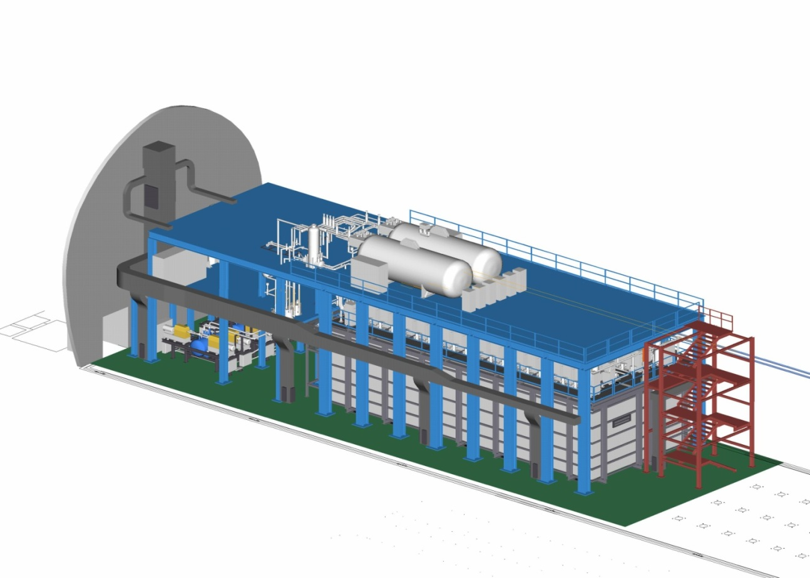
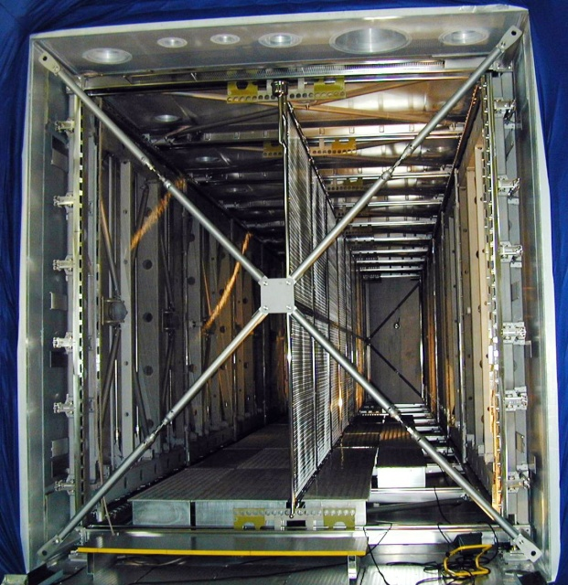
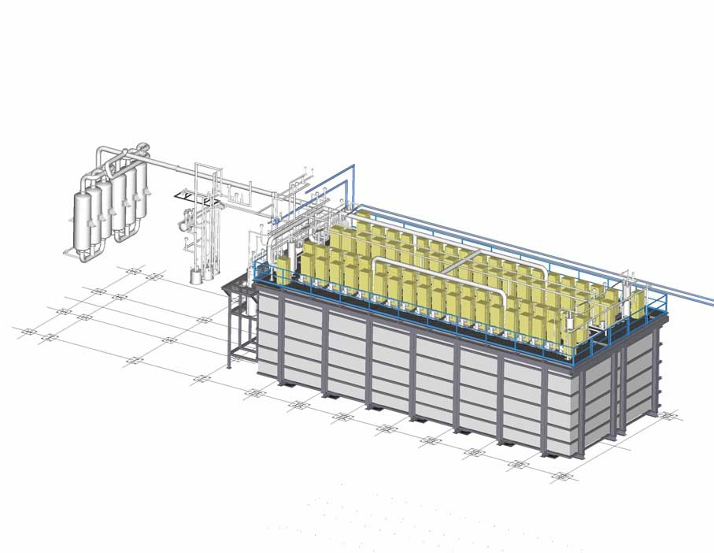
ICARUS-T600 @ LNGS Hall B: 0.77 kton LAr-TPC
N2 Phase separator
30 m³ Vessels for LN2 cooling circuit
Cathode: ED = 0.5 kV/cm
1.5m drift
E
E
PMT array
PMT array
N2 liquefiers: 48 kW total cryo-power
3 readout wire arrays
0, +/- 60⁰, 3mm pitch
54000 electronic chs, low noise charge amplifiers + digitizers
Two identical modules: 476 t active mass:
2 TPCs per module, common central cathode: ED= 0.5 kV/cm, vD=1.55 mm/μs, 1.5 m drift length;
3 ‘’non-destructive’’ readout wire planes per TPC, ≈54000 wires at 0, ±60° wrt horizontal: Induct.1, Induct. 2 and Collect. views;
Continuous TPC read-out, 0.4 μs sampling time;
8” PMTs +TPB wls arrays, sensitive at 128 nm, for t0 signal, timing and triggering of the event.
LAr purification systems
GAr purification systems

Slide 3
The LAr-TPC technology and ICARUS-T600
    Exposed to CNGS ν beam ICARUS concluded in 2013 a very successful-3 years long run, collecting 8.6 x 10¹⁹ pot event statistics with detector live time > 93% recording also c-rays to study atmospheric νs (0.73 kt y exposure) .
    Several physics/technical results has been achieved during the run at LNGS:
  An exceptionally low level ~20 p.p.t. [O2] eq. of e-negative impurities in LAr; the measured e- lifetime τele >15 ms ensured few m long drift path of ionization e- signal without attenuation;
  Demonstrated the detector performance, especially in νe identification and πº background rejection in νμ−νe study to unprecedented level;
  Performed a sensitive search for LSND-like anomaly with CNGS beam, constraining the LSND window to a narrow region at Δm² < 1 eV².
    These results have marked a milestone for the LAr-TPC technology with a large impact on the future neutrino and astro-particle physics projects, like the current SBN short base-line neutrino program at FNAL with three LAr-TPCs (SBND, MicroBooNE and ICARUS) and the multi-kt DUNE LAr-TPC detector.
    T600 detector underwent an overhauling at CERN before being exposed to ~0.8 GeV Booster ν beam at 600 m from target to definitely test the LSND claim searching for νμ−νe oscillations in the framework of SBN program.

Slide 4
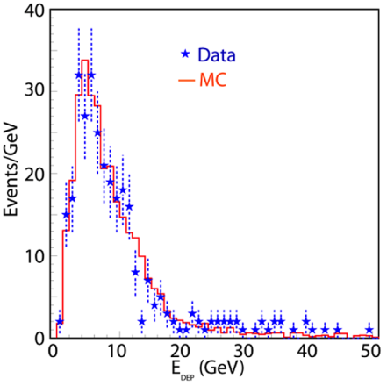
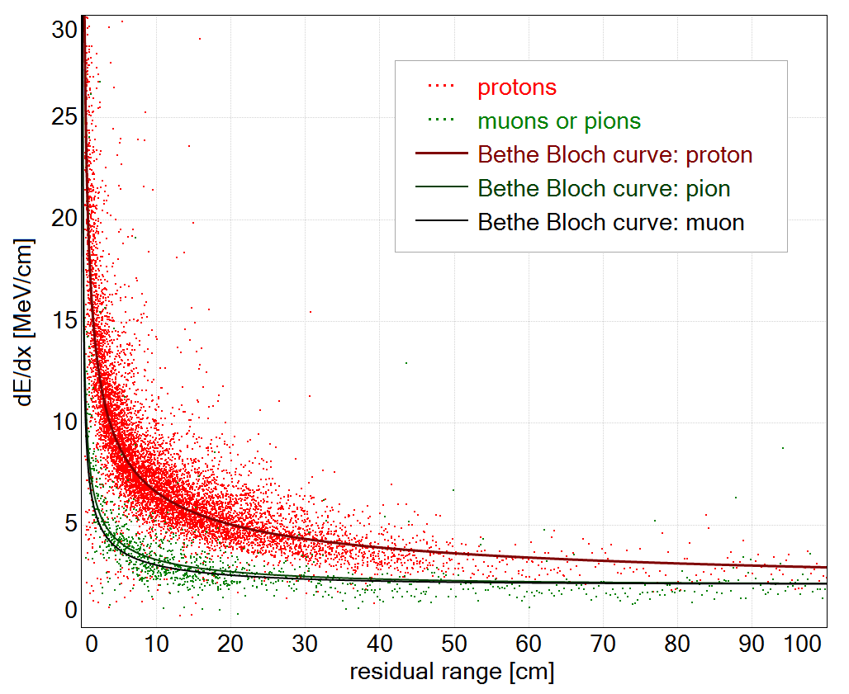
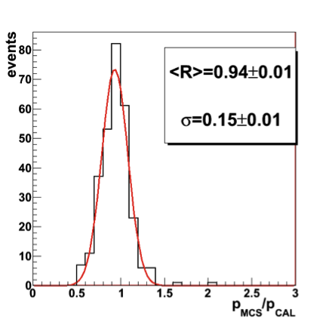
ICARUS LAr-TPC performance (CNGS ν’s and cosmics)
      Tracking device: precise 3D event topology with ~1 mm³ resolution for any ionizing particle;
      Global calorimeter: full sampling homogeneous calorimeter; total energy reconstructed by charge integration with excellent accuracy for contained events;
      momentum of non contained muons by Multiple Coulomb Scattering (MCS) with Δp/p ~15%.
      Measurement of local energy deposition dE/dx: remarkable e/γ separation (0.02 X0 sampling, X0=14 cm, and a powerful particle identification by dE/dx vs range):
EDEP distribution for νμ CC events
dE/dx (MeV/cm) vs. residual range (cm) for p,π,μ compared to Bethe-Bloch curves
L=4m
Low energy electrons:
σ(E)/E = 11%/√ E(MeV)+2%
Electromagnetic showers:
σ(E)/E = 3%/√ E(GeV)
Hadron showers:
σ(E)/E ≈ 30%/√ E(GeV)
Ratio
MCS/calorimetry
p
π
μ
ICPPA-2017, 2-5 October 2017
Slide# : 4

Slide 5
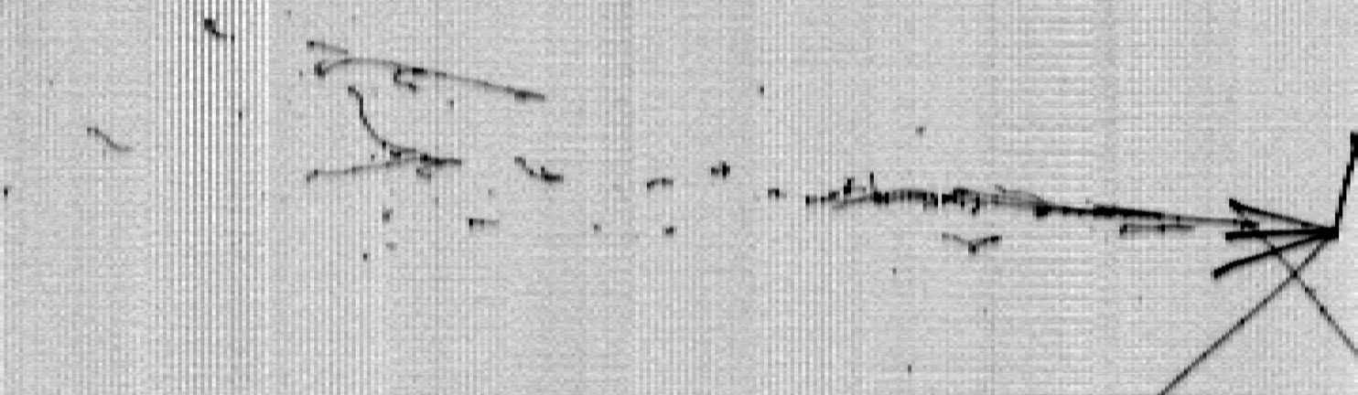
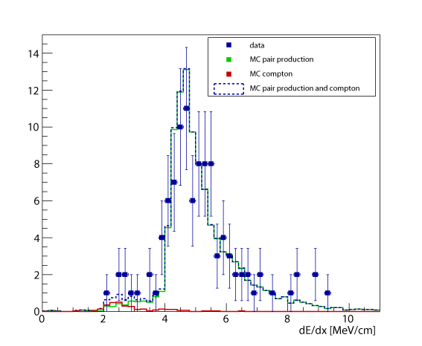
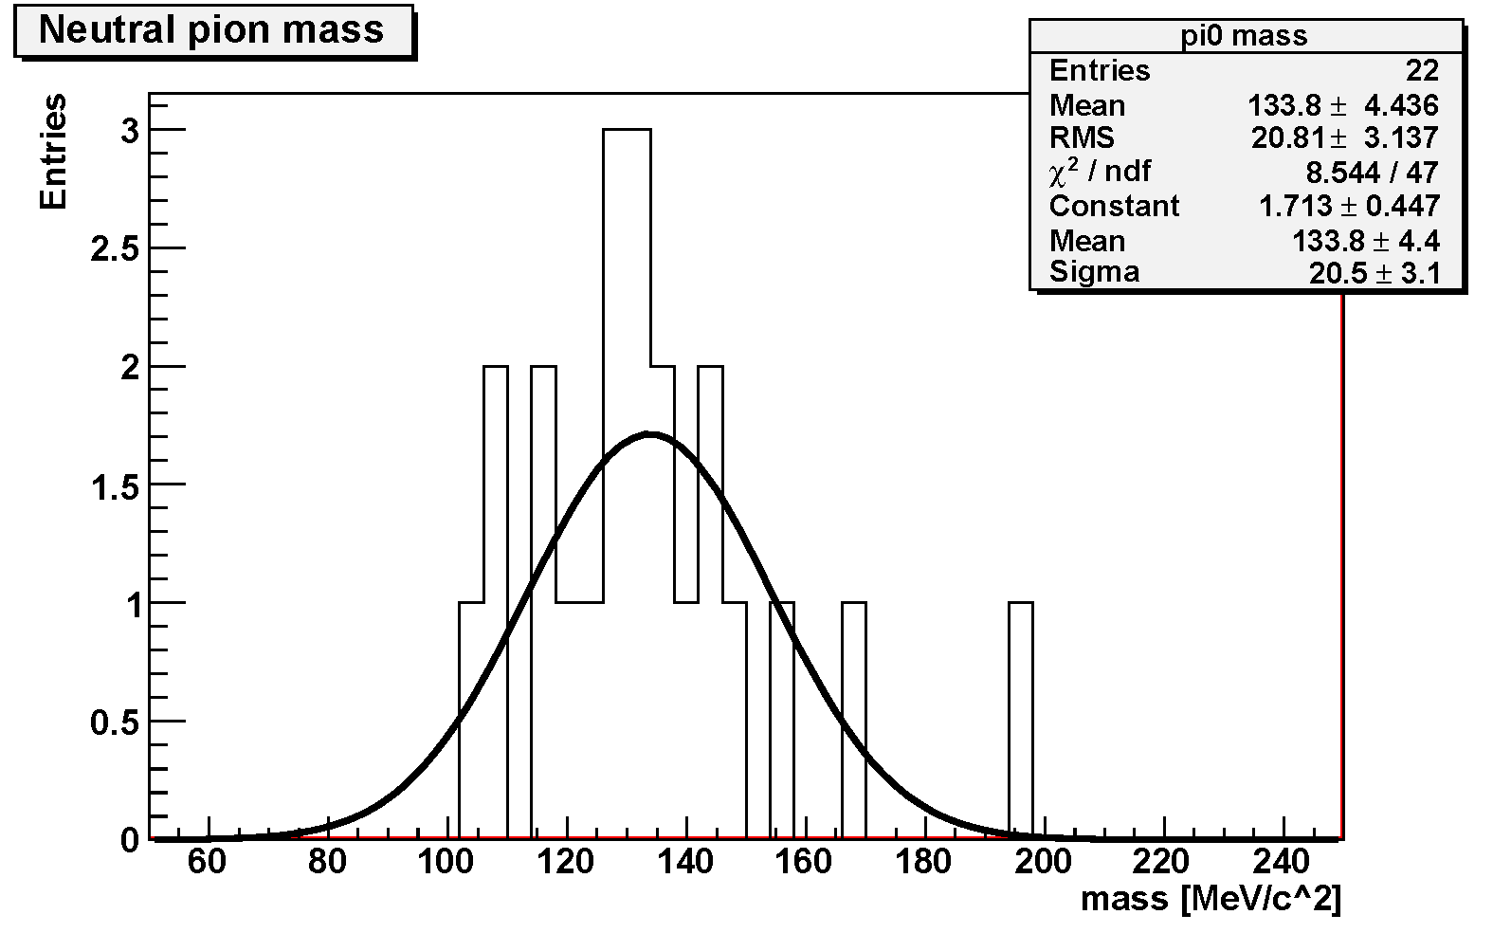
Unique feature of ICARUS: e/γ separation, π⁰ reconstruction
π⁰ reconstruction:
Ek = 102 ± 10 MeV
pπº = 912 ± 26 MeV/c
mπº = 127 ± 19 MeV/c²
θ
θ = 28.0 ± 2.5º
Three “handles” to separate e/γ :
invariant mass of π⁰
dE/dx: single vs. double m.i.p.
photon conversion separated from primary vertex
Ek = 685 ± 25 MeV
Collection
Mγγ: 133.8±4.4±4 MeV/c²
2 m.i.p.
1 m.i.p.
Collection
Induction2
π⁰
Crucial for NC rejection
in νe-physics
Conversion distances:
6.9 cm, 2.3 cm

Slide 6
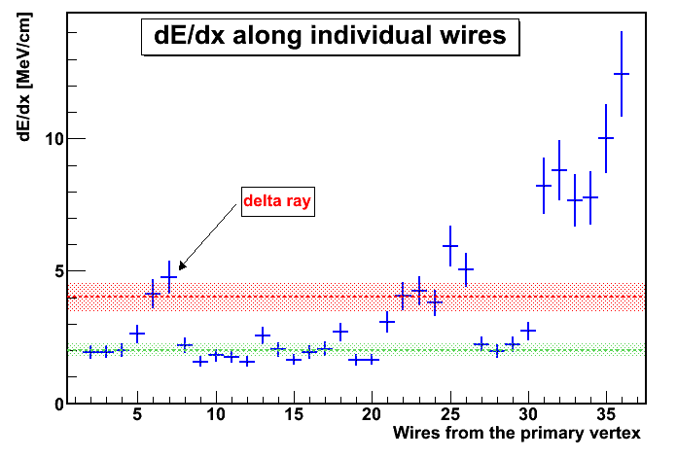
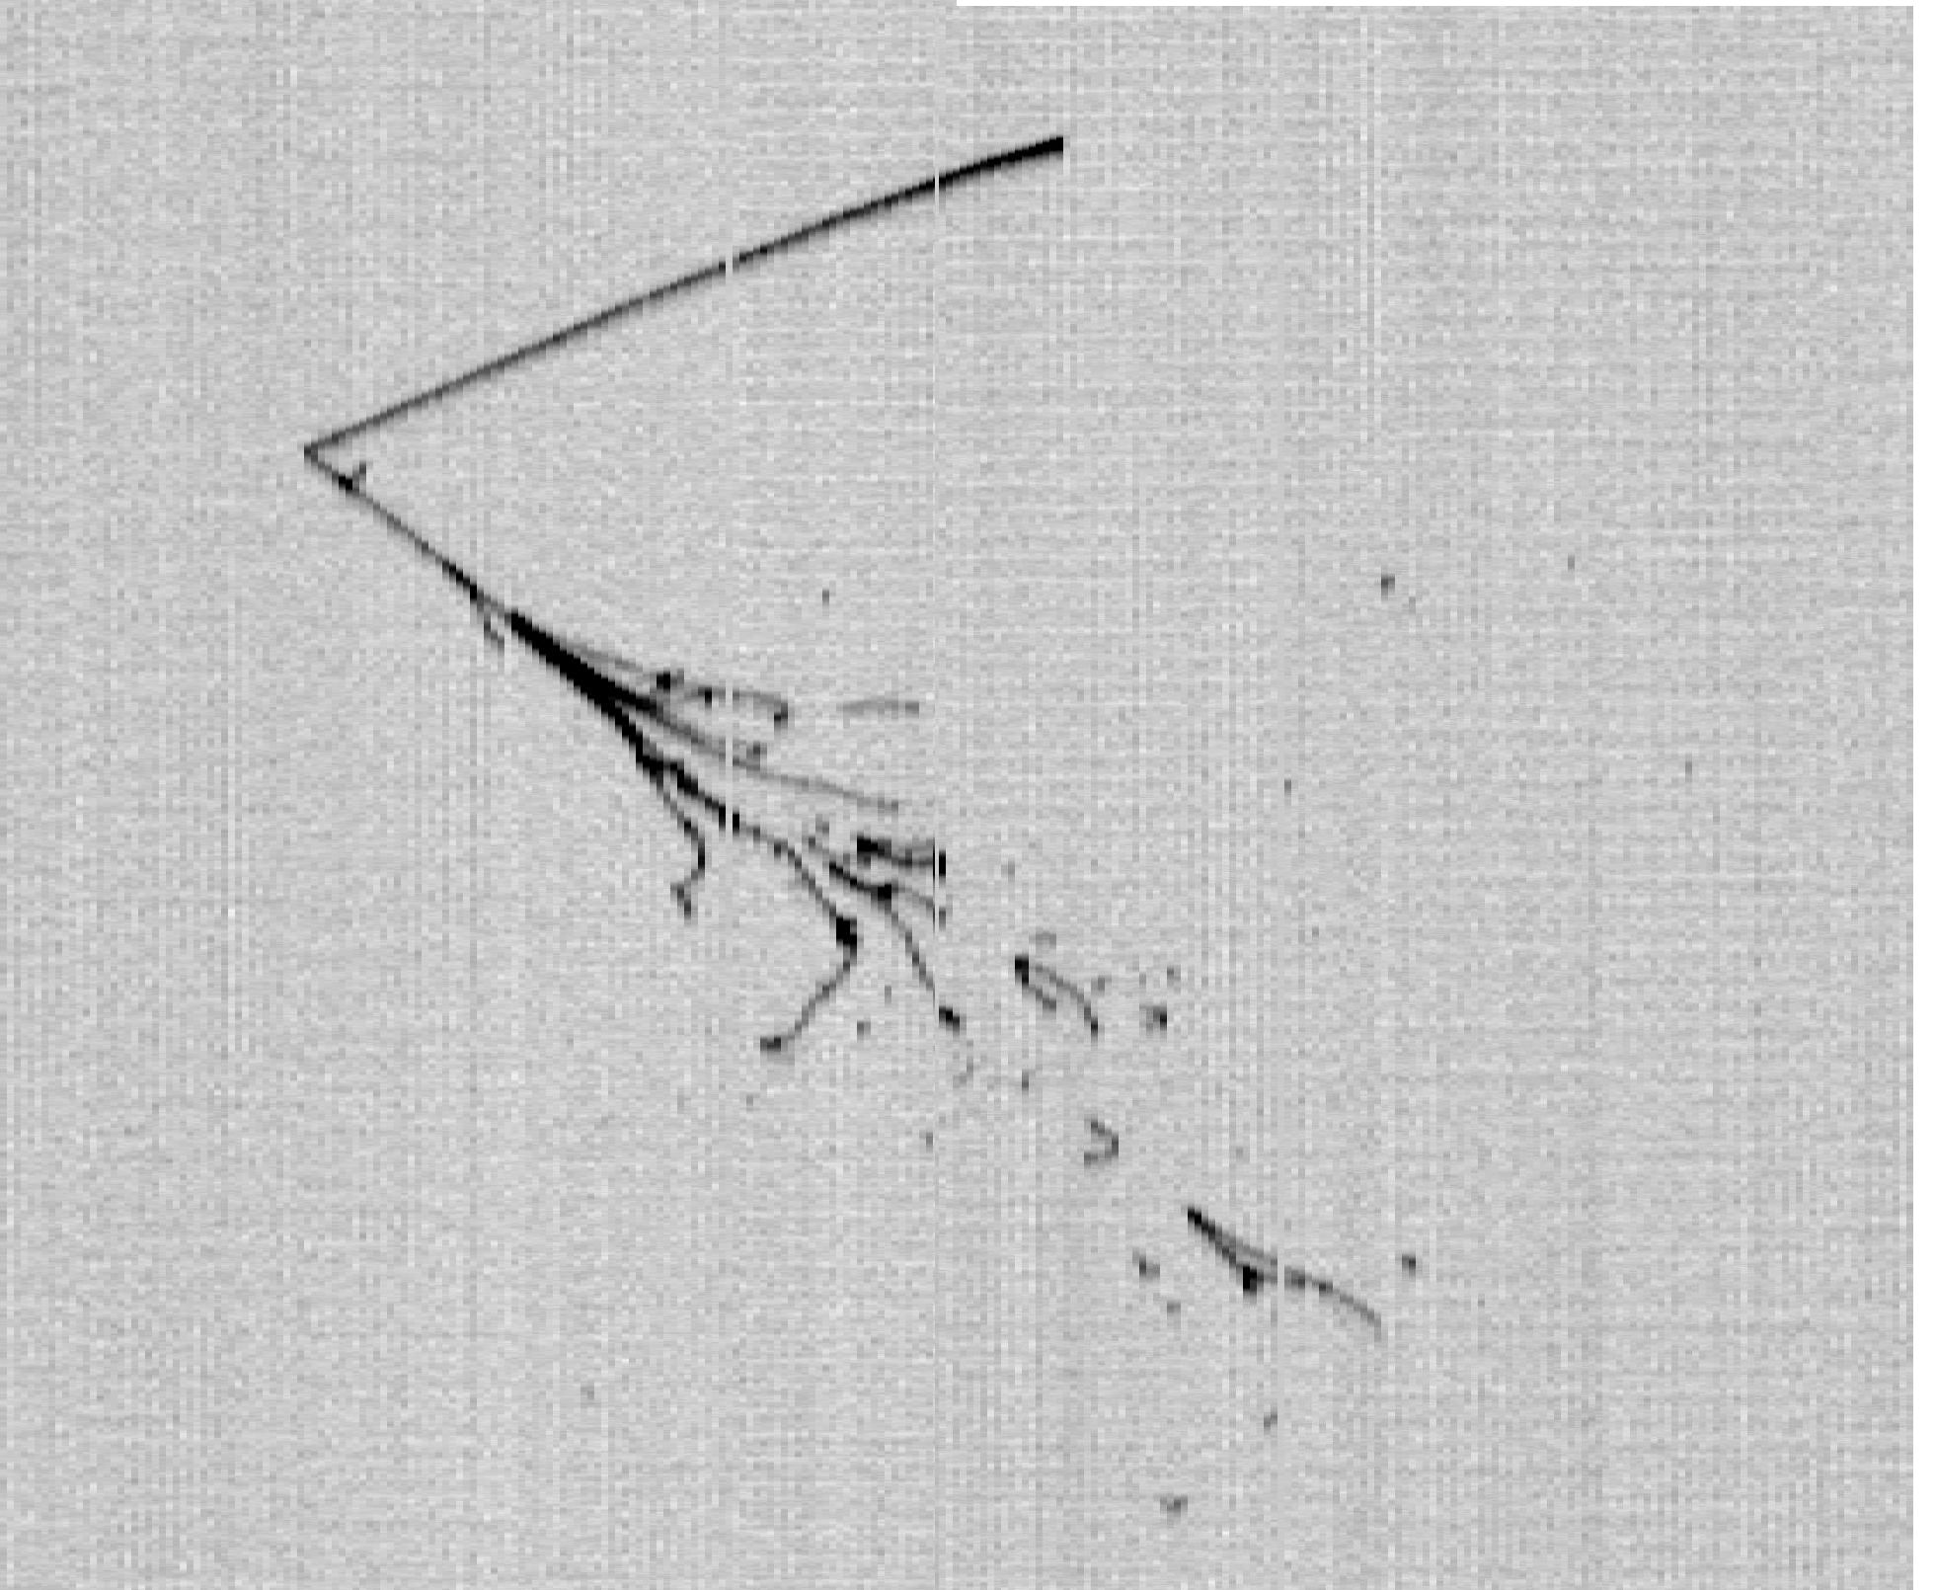
Towards automatic neutrino search: atmospheric ν
    Cosmic ray events recorded in ~0.48 kton y exposure (2012-2013 run), are being analyzed to identify and study atmospheric ν events, of interest since they cover the energy range expected for the SBN experiment at FNAL.
      Incoming c-rays are rejected by factor ~100 and ν candidates pre-selected automatically (~70% efficiency for νe), then validated by visual scanning;
      About 50% of exposure analyzed so far: 7 νμCC and 8 νeCC atmospheric neutrino events have been identified
    Can also address a sensitive search for nucleon decay in channels involving kaons, a single event search with zero background - competitive with present limit for n -> K⁺ e⁻. Preliminary selection/id. event efficiency: ~80%.
1 m
    Quasi-elastic νeCC, EDEP=0.9 GeV
      Proton identified by dE/dx;
      Electron identified by the single m.i.p. energy deposition before showering.
Proton
Electron
1 m.i.p.
80 cm

Slide 7
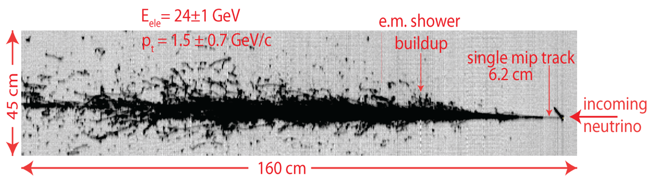
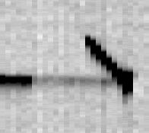
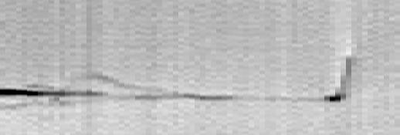
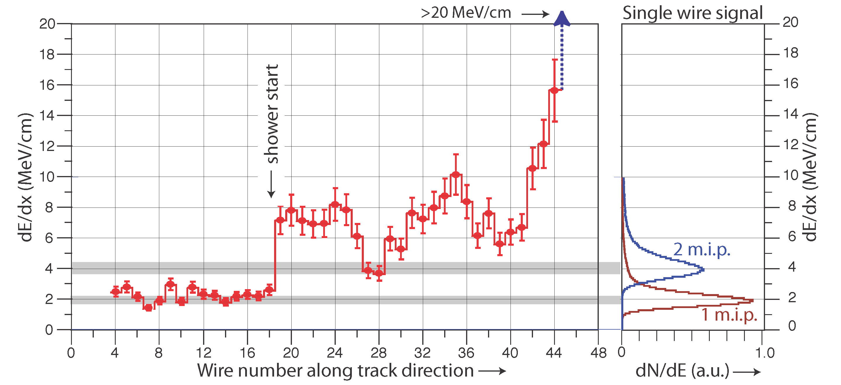
νe CC identification in CNGS beam
  The unique detection properties of the LAr-TPC allow to identify unambiguously individual e-events with high efficiency in Collection and Induction2
Collection
Induction2
Single electron at interaction vertex well identified also in Induction view
11 cm
25 cm
Evolution in Collection view from single m.i.p. to e.m. shower evident from dE/dx on individual wires.
Single M.I.P.

Slide 8
ICARUS search for an LSND-like effect with CNGS beam
    ICARUS searched for a νe-excess related to a LSND-like anomaly with the CNGS ν beam (~ 1% intrinsic νe contamination) despite the larger L/Eν ~36.5 m/MeV when compared to L/Eν ~ 1 m/MeV for LSND/ MiniBooNE:
      LSND-like oscillation signal would average to sin²(1.27Δm² L /E) ~1/2; compared to MINOS and T2K, ICARUS operated in a L/Eν range where contributions from standard oscillations are not yet too relevant.
    No excess observed in 7.93 x 10¹⁹ pot sample: 7 νe CC events compared to 8.5±1.1 expected in absence of effect, providing the limits:
P(νμ→νe) ≤ 3.85 x 10⁻³ (90% C.L.)
P(νμ→νe) ≤ 7.60 x 10⁻³ (99% C.L.)
    ICARUS has restricted the allowed LSND parameters to a narrow region Δm² < 1 eV², sin²2θ~ 0.005 where all positive/negative experimental results can be coherently accommodated at 90% C.L.
Confirmed by OPERA

Slide 9
Sterile neutrinos?
    Anomalies have been collected in last years in neutrino sector despite the well-established 3-flavour mixing picture within Standard Model:
      appearance of νe from νμ beams in accelerator experiments (LSND + MiniBooNE, combined evidence > 3σ);
      disappearance of anti-νe, hinted by near-by nuclear reactor experiments (ratio observed/predicted event rates R = 0.9384± 0.024);
      disappearance of νe, hinted by solar ν experiments during their calibration with Mega-Curie k-capture ν sources (SAGE, GALLEX, R = 0.84 ± 0.05).
Results hint to a new “sterile” flavor, described by Δm²~ eV² and small mixing angle, driving oscillations at short distance:
      ICARUS constrained Δm²new < 1 eV² with a small mixing;
      Planck data and Big Bang cosmology point to at most one further flavor with mnew < 0.27 eV;
      No evidence of νμ disappearance in IceCube in 0.32-20 TeV
      Recent reactor data (especially NEOS) are intriguing but inconclusive… New results are expected from ongoing/new experiments at reactor/radioactive source,…SOX at LNGS
THE EXPERIMENTAL SCENARIO CALLS FOR A DEFINITIVE CLARIFICATION!

Slide 10
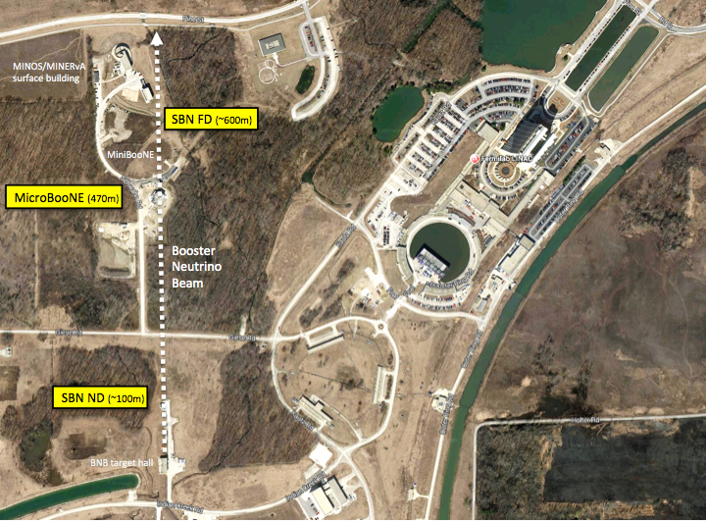
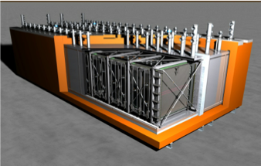
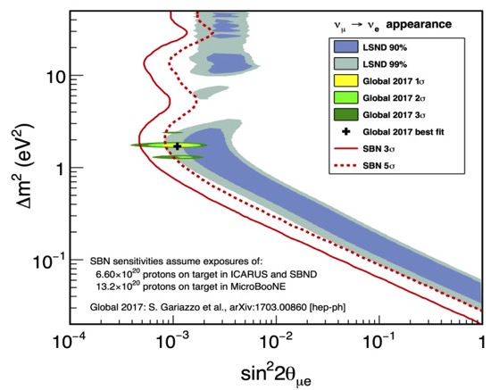
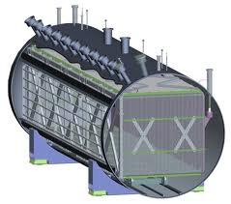
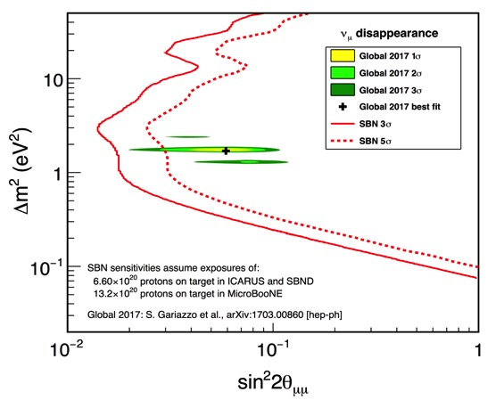
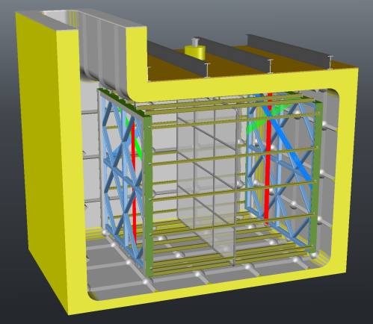
SBN 0.8 GeV ν FNAL Booster: 3 shallow-depth LAr-TPCs as definitive answer to sterileν puzzle
νe appearance: LSND 99% CL region covered at 5 σ level
ICARUS T600
476 t act. mass
MicroBooNE
89 t act. mass
νμ disappearance SBN sensitivity at 3σ-5σ level
NuMi
Line
SBND
82 t act. mass
    ICARUS will collect also ~2 GeV νe NuMI Off-Axis: an asset for next LBL LBNF-DUNE (ν cross-section in LAr)

Slide 11
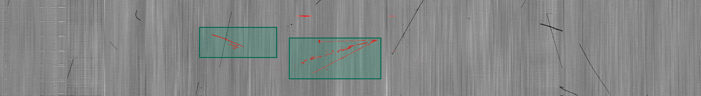
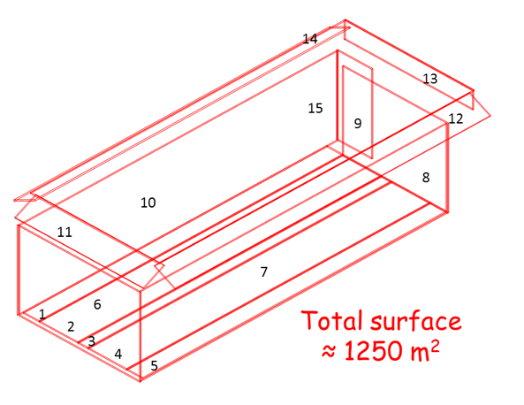
Taking data at shallow depth: Cosmic Ray Tagger is mandatory
ICARUS at FNAL will face a more challenging experimental condition than at LNGS, requiring the recognition of ν interactions amongst 11 KHz of cosmic’s.
A 3 m concrete overburden will remove contribution from charged hadrons/ γ’s.
~11 μ tracks will randomly overlap each event during the 1 ms drift readout: the associated γ’s represent a serious background source for νe search since e ’s produced via Compton scatt./ pair prod. can mimic a genuine νe CC.
Cosmic rays (Pavia test) + low energy CNGS neutrino events
Rejecting cosmic background, i.e. reconstructing the triggering event, would require to precisely know the timing of each track in the TPC image, exploiting:
  A much improved light detection system, high granularity /~1ns time resolution;
  An external cosmic ray tagger (CRT) to detect incoming particles and their direction of propagation by time-of-flight measurements:
Mandatory !
Detector
access
Scintillating bars surrounding T600 (aim: 98% coverage) equipped with optical fibers to convey light to SiPM arrays.
Top coverage under INFN/ CERN responsibility. FNAL is recovering modules by MINOS/Double Chooz for side/bottom.

Slide 12
ICARUS T600 Overhauling at CERN (WA104/NP01)
    To face the new experimental situation at FNAL the ICARUS T600 detector underwent an intensive overhauling at CERN in the framework of CERN Neutrino Platform (WA104/NP01 project) before being shipped to FNAL.
    In 2015, T600 detector was moved from LNGS to CERN to introduce some technology developments while maintaining the already achieved performance:
    New cold vessels with a purely passive insulation;
    renovated cryogenic/ LAr purification equipment;
    Flattening of TPC cathode: the punched stainless-steel panels, 58% transparency, underwent a thermal treatment improving planarity to few mm;
    Upgrade of light collection system with high granularity/sensitivity, ~1 ns time resolution;
    New higher performance read-out electronics
Cathode
PMT array
3 Wire Planes: Induction1, Induction2 and Collection

Slide 13
The ICARUS/WA104 Collaboration*
Argonne National Laboratory (ANL), USA
Brookhaven National Laboratory (BNL), USA
CERN, Geneva, Switzerland
Colorado State University, USA
Fermi National Laboratory (FNAL), USA
INFN Sez. di Catania and University, Catania, Italy
INFN GSSI, L’Aquila, Italy
INFN LNGS, Assergi (AQ), Italy
INFN Sez. di Milano Bicocca, Milano, Italy
INFN Sez. di Napoli, Napoli, Italy
INFN Sez. di Padova and University, Padova, Italy
INFN Sez. di Pavia and University, Pavia, Italy
Los Alamos National Laboratory (LANL), USA
Pittsburgh University, USA
SLAC, Stanford, CA, USA
Texas University, Arlington, USA
*Spokesman: C. Rubbia , GSSI

Slide 14
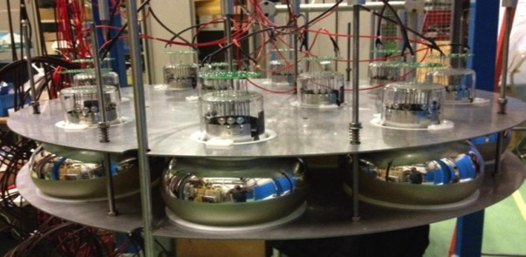
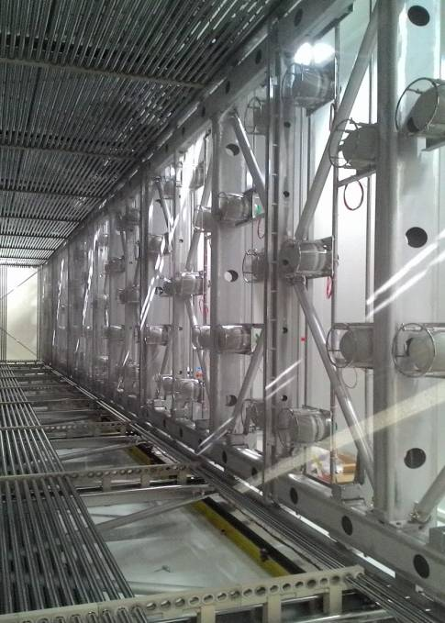
Upgrade of the light collection system
New scintillation light collection system consists of 90 PMT 8‘’ HAMAMATSU R5912-MOD installed behind TPC wires (360 PMT in whole T600) for a 5% total coverage of TPC wire planes.
All PMTs have been characterized at room and LAr temperatures. PMTs were coated by Tetra-Phenyl-Butadiene (~200μg/cm²) wavelength shifter to detect the 128 nm scintillation light in LAr;
Each PMT is enclosed in a wire screening cage to prevent induction of PMT pulses on the facing TPC wires. PMT timing/calibration will be provided by LASER light system.
Set-up for LAr test of 10 PMTs.
The scintillation light collection system will allow for < 0.5 m event localization and an initial classification of different topologies (μ-tracks vs. e.m. showers) exploiting arrival time of prompt photons and light intensity.
P
M
T
A clear cosmic μ ‘s identification will be provided by the combined use of different Neural Nets
(~2% expected residual misidentification).
ICPPA-2017, 2-5 October 2017
Slide# : 14

Slide 15
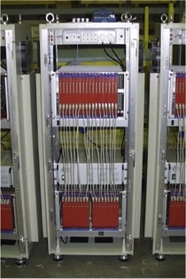
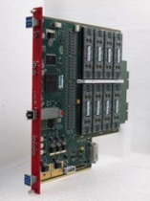
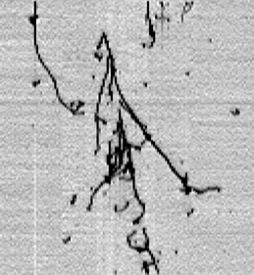
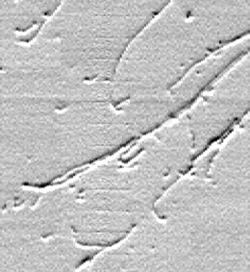
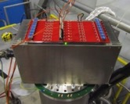
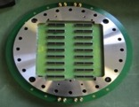
LNGS electronics: S/N ~8 (Collection view), ~0.7 mm single hit resolution, allowing precise spatial reconstruction and μ momentum measurement by MCS.
FNAL electronics improvements: Serial 12bits ADC, one per ch, 400 ns sampling synchronous on the whole detector. Serial bus architecture with Gbit/s optical links to increase the bandwidth (10 Hz). New compact design to host both analogue/digital electronics on ad-hoc signal feed-through flanges.
from 595 to 10 liters
Digital crate
300 µs (465 mm)
Drift velocity 1.55mm/µs
Analogue crate
128 Coll. wires (325 mm)
128 Induc. wires (325 mm)
  New analogue front-end with faster shaping time ~1.5 μs and S/N > 10, identical for collection and induction views.
  No signal undershoot even for large signals and very stable baseline.
  Unprecedented image sharpness also for complex shower events and better hit position separation due to faster shaping peak time.
  Calorimetric measurement in Induction views → improvement by 10% the νe identification efficiency at Booster neutrino energies
ICPPA-2017, 2-5 October 2017
Slide# : 15

Slide 16
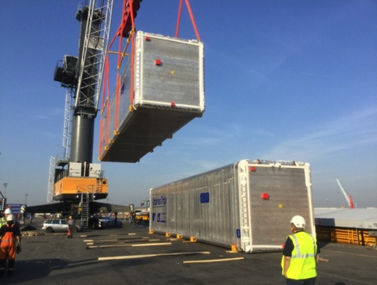
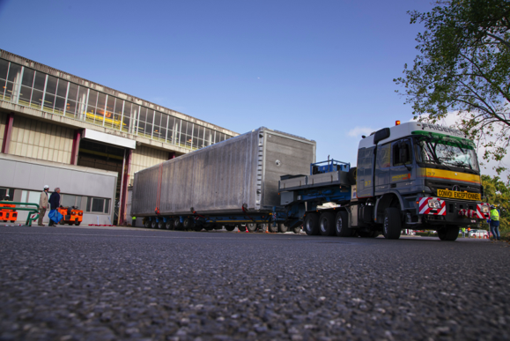
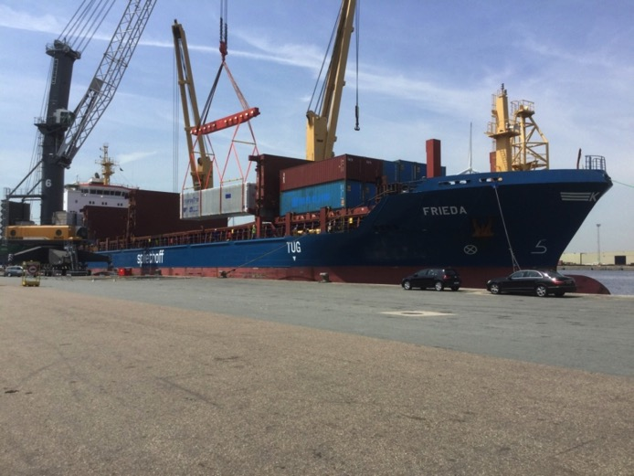
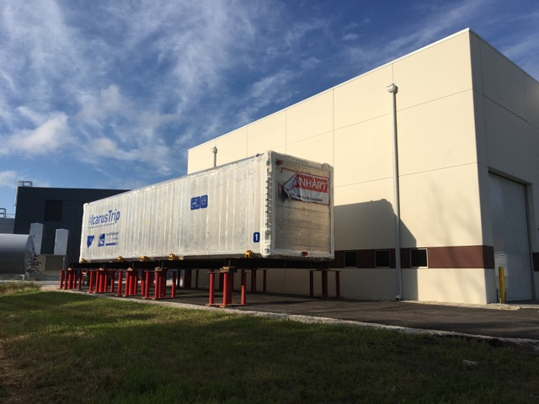
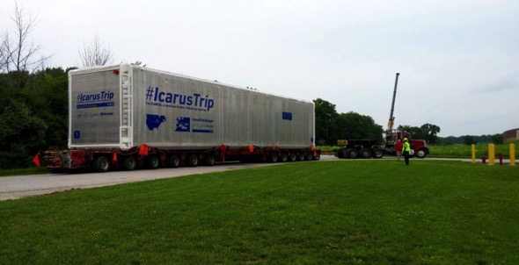
  T600 leaving from CERN June 12th
  T600 in Antwerp June21st: unloading from the barge from Basel and loading into ship to Burns Arbors, in the Michigan lake
Thank you !
http://icarustrip.fnal.gov/
  T600 arriving at SBN Far site building at FermiLab, July 26th

