Slide 1
ICPPA 2018
Oct 22-26 ,2018
Photo-sensors and Front-End Electronics for the Fast Interaction Trigger detector of the ALICE experiment at CERN
D. Serebryakov
for the ALICE Collaboration
Institute for Nuclear Research of the Russian Academy of Sciences

Slide 2
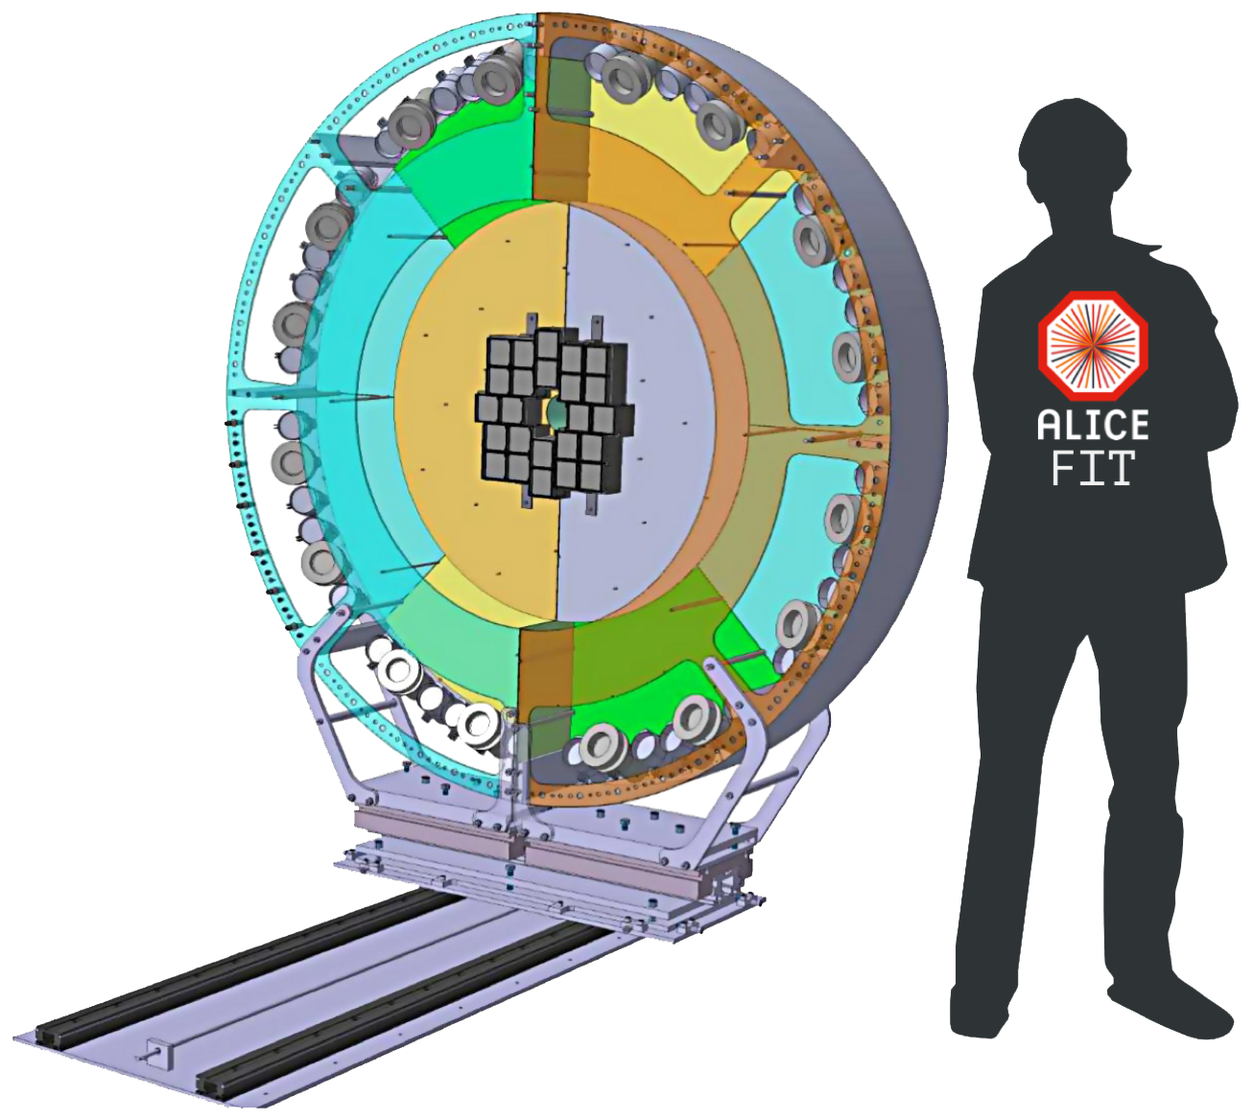
Outline
ALICE during Run1 and Run2
ALICE Fast Interaction Trigger (FIT) detector for Run3 and Run4
FIT photo-sensors and electronics

Slide 3
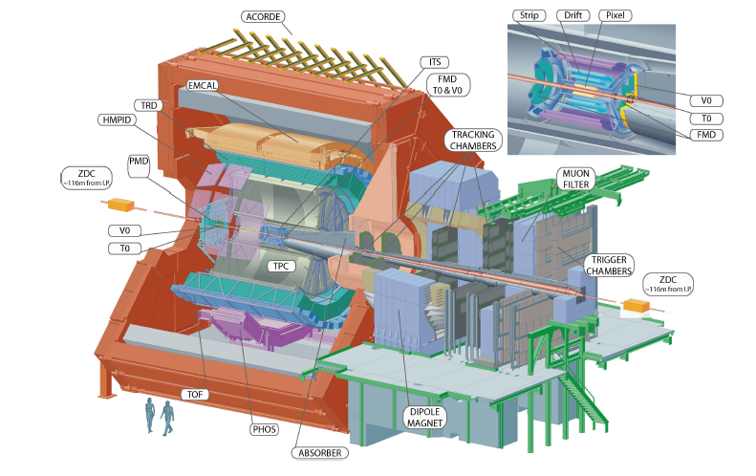
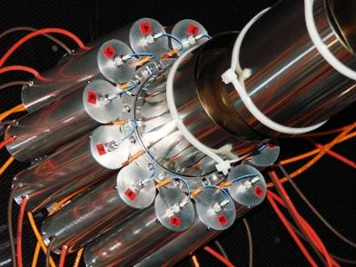
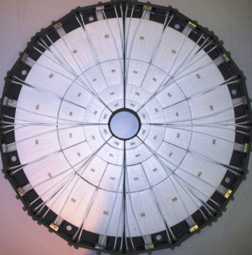
The ALICE detector
V0-C
T0-C
T0
V0-A
T0-A
T0 consists of two arrays, placed
on the opposite sides of the IP
Cherenkov radiators, each
coupled to PMTs (12 per module)
-5 < η < -4.5, 2.9 < η < 3.3
Time resolution of ~ 40ps for protons and ~25ps for Pb-Pb collisions
V0
V0 consists of two arrays of 32 scintillating counters
Installed on opposite sides of IP
Scintillators coupled to PMTs by clear fibers on C side and by wavelength-shifted fibers on A side.
−3.7< η < −1.7 , 2.8< η < 5.1
Time resolutions 450 ps and 350 ps
for V0-A and V0-C, respectively
V0 & T0 Provide LM triggers (425 ns delay), luminosity monitoring, background reduction, collision time (for PID), centrality, and event-plane determinations

Slide 4
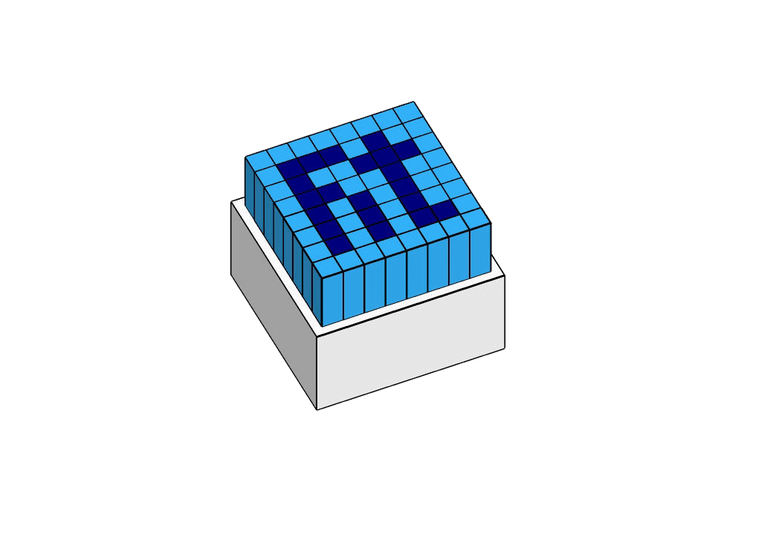
Fast Interaction Trigger: requirements
Online
Luminosity monitoring and feedback to LHC
Trigger signals
Online Vertex determination
Minimum Bias and centrality selection
Rejection of beam/gas events
Veto for Ultra Peripheral Collisions
LM trigger latency <= 425 ns (Time of flight + detectors + cables ~200 ns)
Offline :
Collision time for Time-Of-Flight for particle ID
Multiplicity, Centrality and Event Plane
4

Slide 5
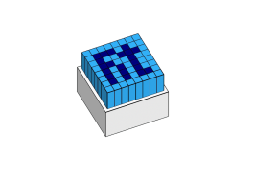
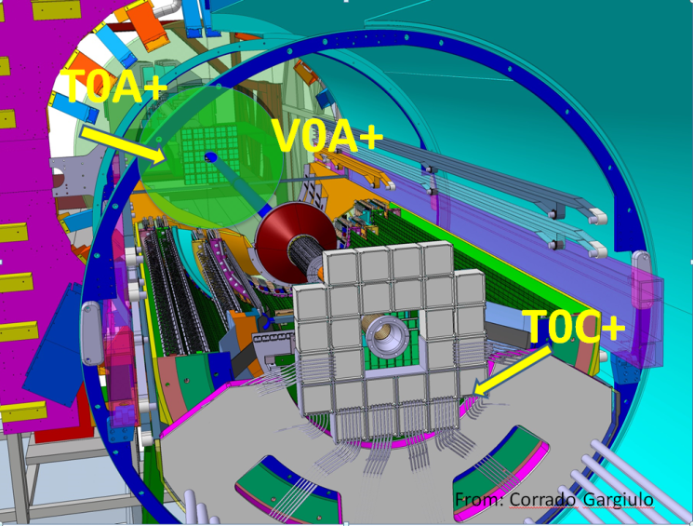
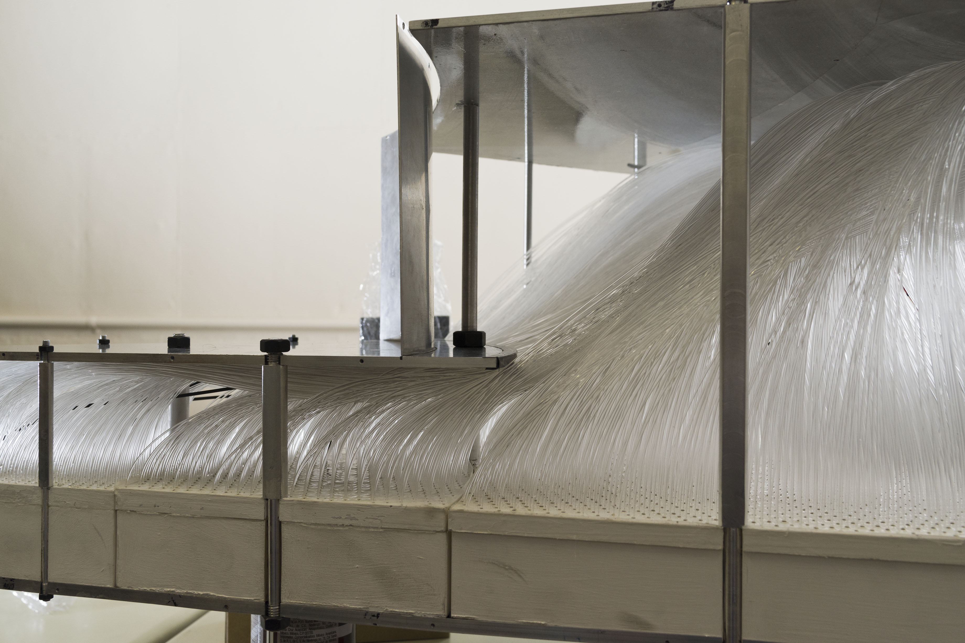
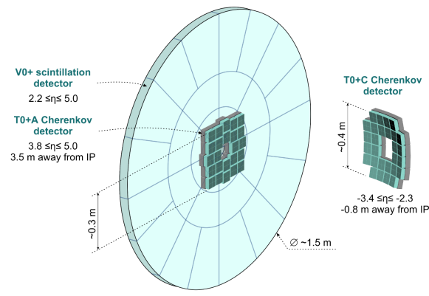
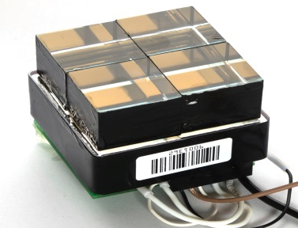
FIT detector
T0+ uses 26.5x26.5x20 mm Cherenkov quartz radiators with mirrors and modified MCP-PMTs Photonis XP85012-A1/Q-FIT as photo-sensors. Each photo-sensor has 4 radiators and 4 output signals
40 V0+ elements are built from
EJ-204 plastic scintillator
clear Asahi fibers with recessed ends (less effective light collection, but better timing resolution)
48 2” Hamamatsu R5924-70 fine-mesh PMTs. (Two per sector for outer ring)

Slide 6
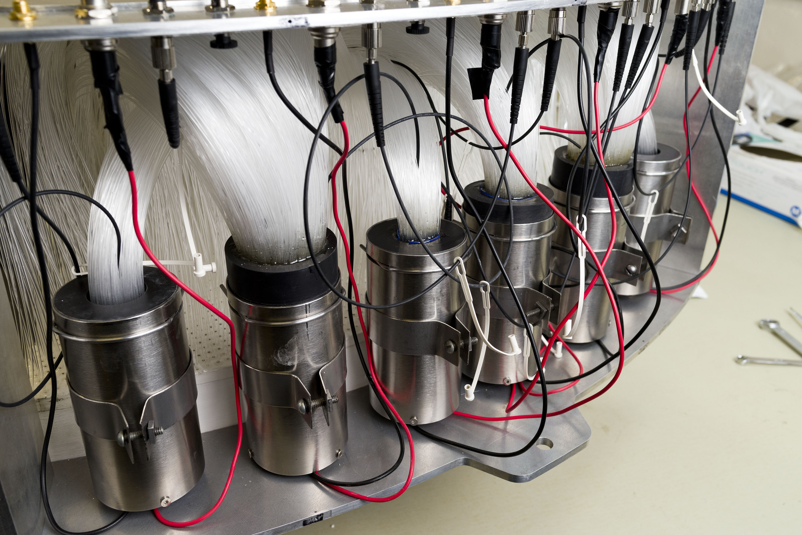
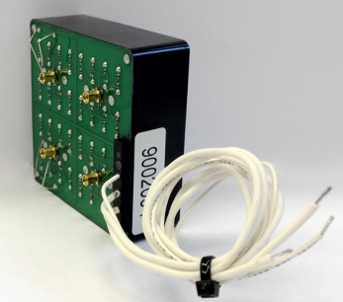
FIT Photo-sensors
T0+ (Cherenkov) part: 4- channel modified Photonis XP85012-A1/Q-FIT MCP - PMT
290 p.e./mip (minimum interacting particle)
Gain 1.5x10⁴
10 mV/mip pulse amplitude at PMT output
Dynamic range up to 280 mip/quadrant (limited by MCP conductivity)
Can operate in 0.5 T magnetic field, if correctly oriented (normal to photocathode plane)
Estimated lifetime ~2-3 C/cm² (0.6 C/cm² total charge load is expected for basic LHC working scenario for 2020 – 2029 years)
Signal rise time after cabling system 1.4 ns
Detector time resolution <50 ps
V0+ (Scintillator) part: 2” Hamamatsu R5924-70 fine-mesh PMT
~100 p.e./mip(varies for different rings)
Gain 4-8x10⁴ (varies for different rings)
15 mV/mip pulse amplitude at PMT output
Dynamic range up to 600 mip/sector (limited by photocathode linearity)
Can operate in 0.5 T magnetic field, if correctly oriented (normal to photocathode plane)
No problems with lifetime expected
Signal rise time after cabling system 5 ns
Detector time resolution <250 ps

Slide 7
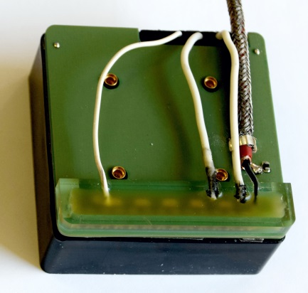
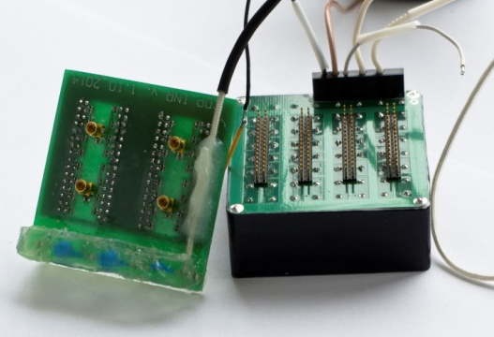
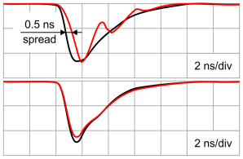
FIT solution for PLANACON® XP85012
New PCBs for XP85012 with FIT modifications was designed and manufactured in the Institute of Nuclear Research RAS (Moscow) and assembled with new PLANACONs by Photonis.
“Positive cross-talk” was eliminated, rising edge is never distorted;
Improved time resolution and signal-shape stability with wide spot (13 – 22 ps);
Reduced unit thickness;
smaller cross-talks between anodes, higher amplitude-to-charge ratio (up to 2x compared to standard Planacon);
FIT design with base
Standard design
Standard
FIT design

Slide 8
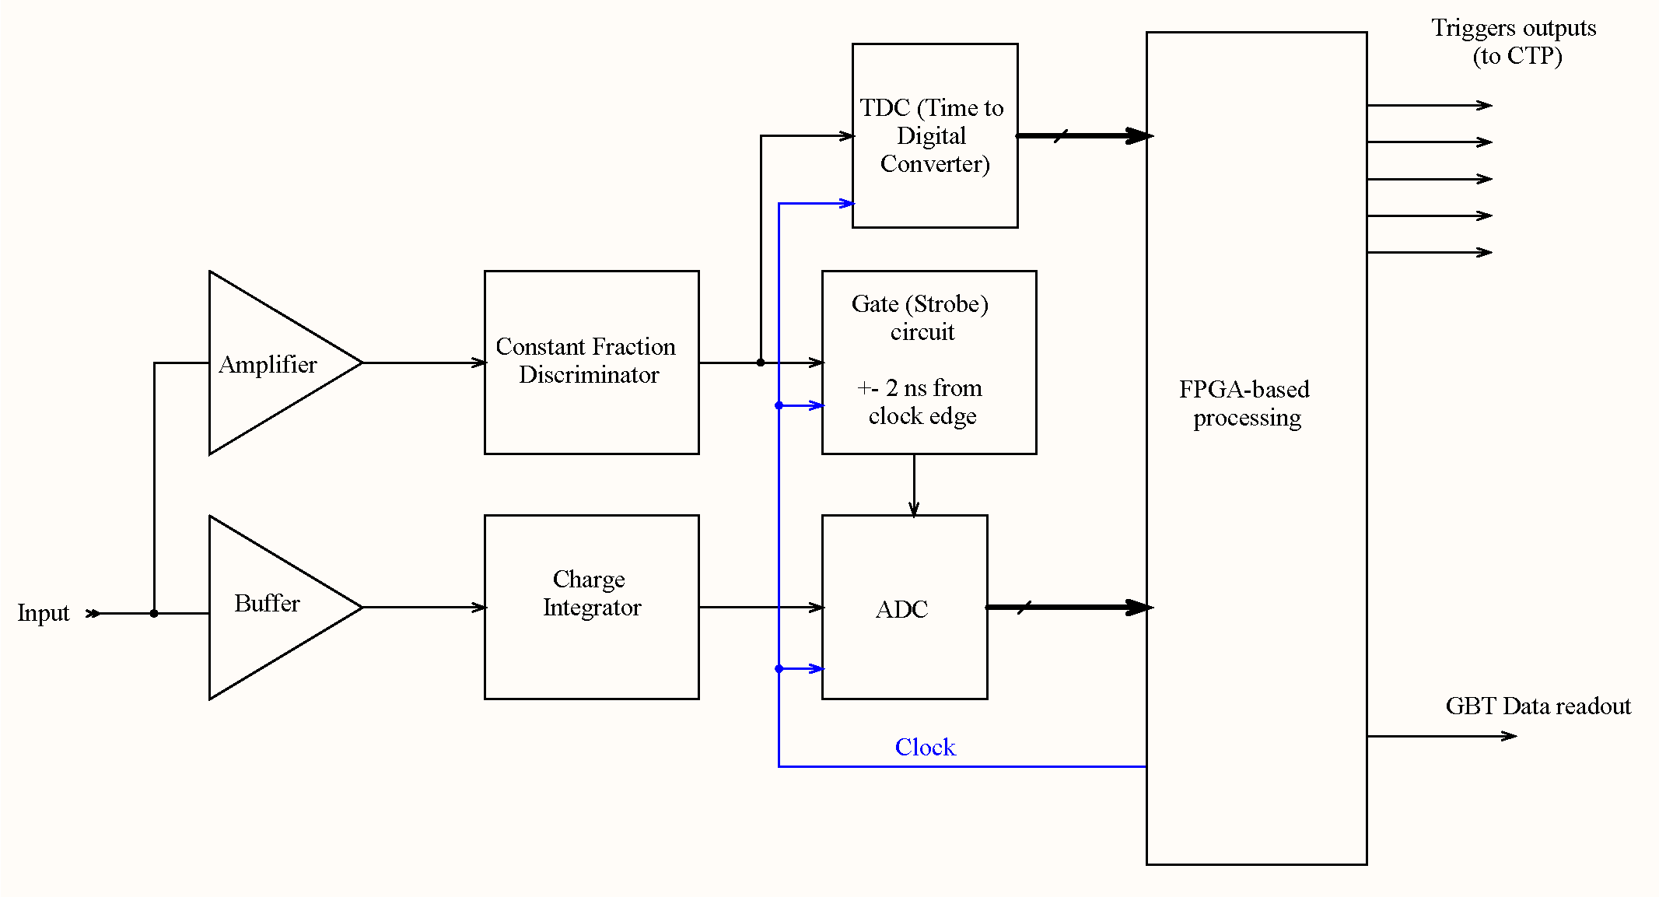
FIT electronics concept
Time and charge are evaluated by Constant Fraction Discriminator and Integrator, then digitized by ADC and TDC. Digital data from each channel are used for calculating trigger decisions in FPGA-based processors. Data readout is based on CERN optical 4.8 GBt/s GBT data transmission protocol.
8

Slide 9
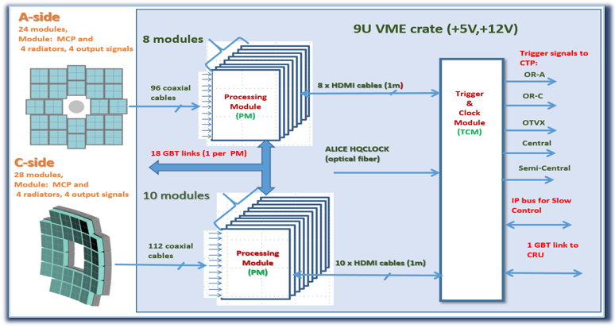
FIT electronics
FIT electronics will be built from
only two types of modules –
Processing Module (PM) – one per 12 analog inputs
Trigger and Clock Module (TCM) – one for T0+ and one for V0+ parts of the detector.
PM and TCM is connected by 1 meter standard HDMI cable.
PM processes the input signals, converts them to digits, packs the data for readout (in continuous or triggered mode), and makes the first stage calculations for trigger decision.
TCM collects trigger data from PMs (4 LVDS links at 320 Mbits/s for each PM) and makes a final decision. Also the TCM provides accurate clocks and slow control for all PMs.
All FIT electronics will be placed in 3 9U crates in one standard ALICE rack.

Slide 10
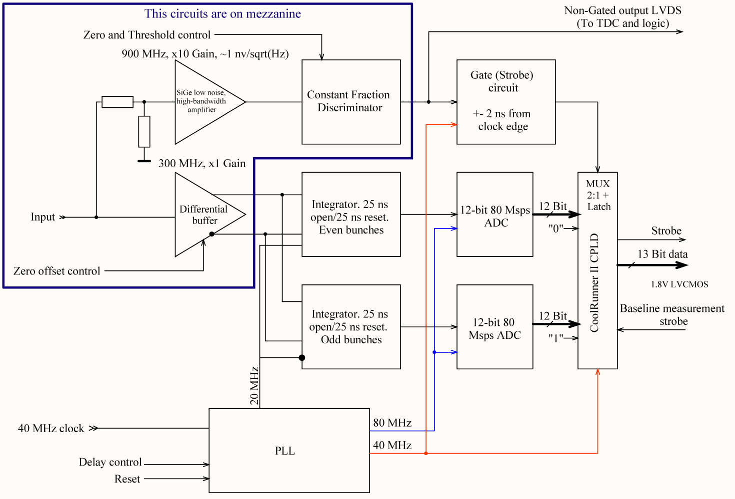
FEE detailed structure

Slide 11
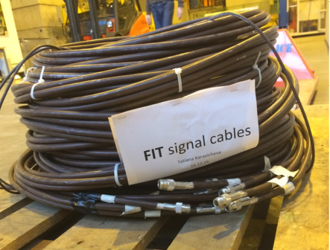
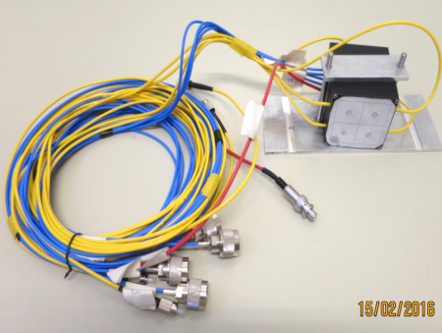
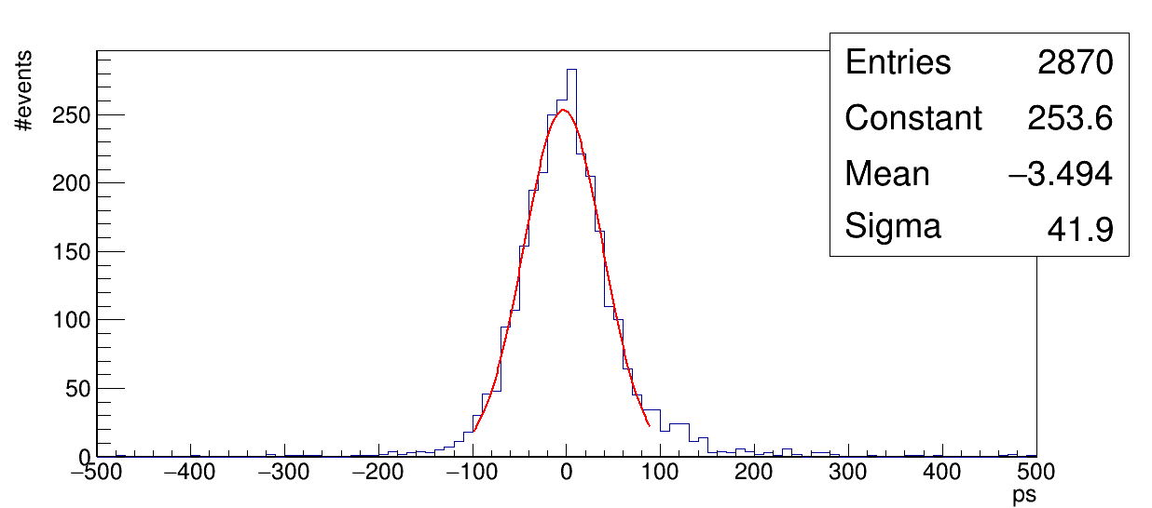
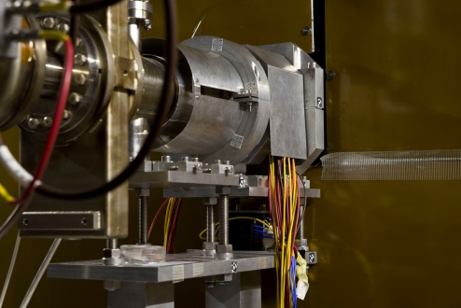
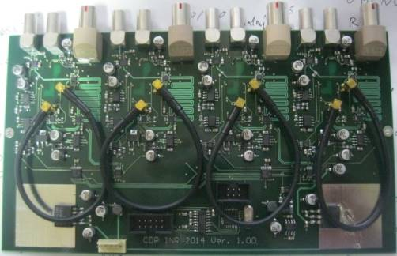
FIT module and FEE prototype installed in ALICE
T0_FIT resolution, ps (FIT_CFD1–T0C)/2
Cavern (rack C33)
40 m
T0 Readout
OTVX signal as Trigger
HV cable from CR4

Slide 12
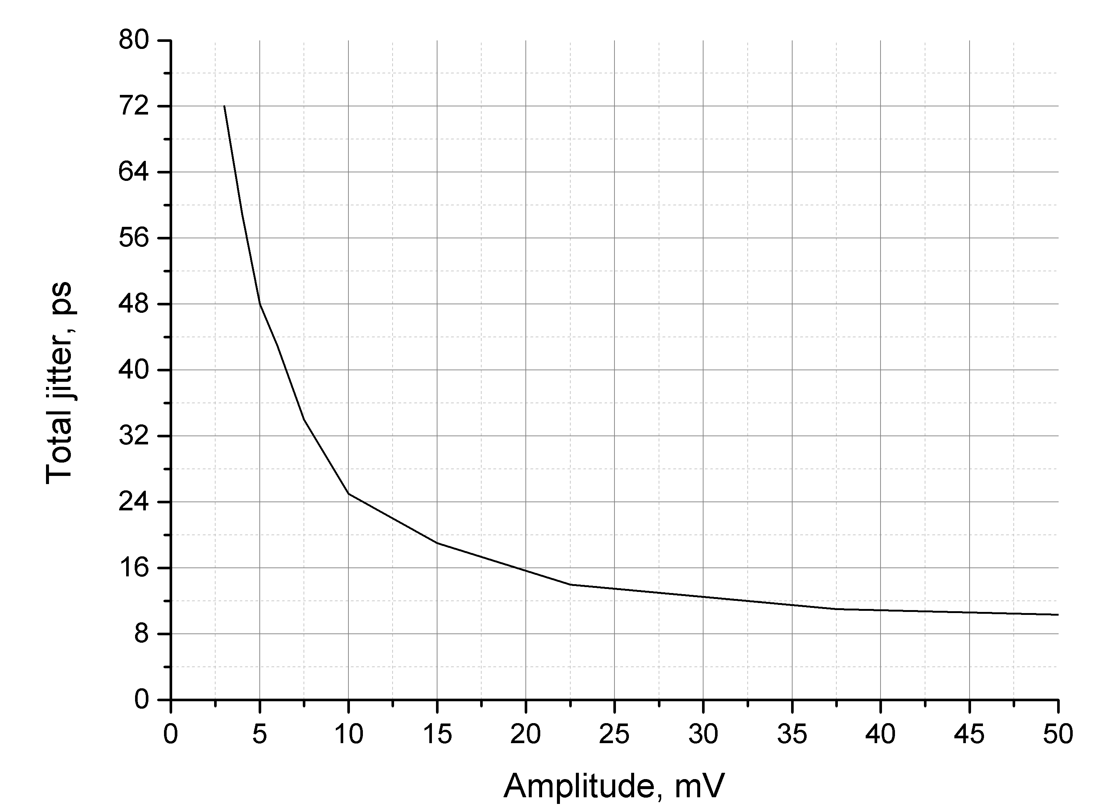
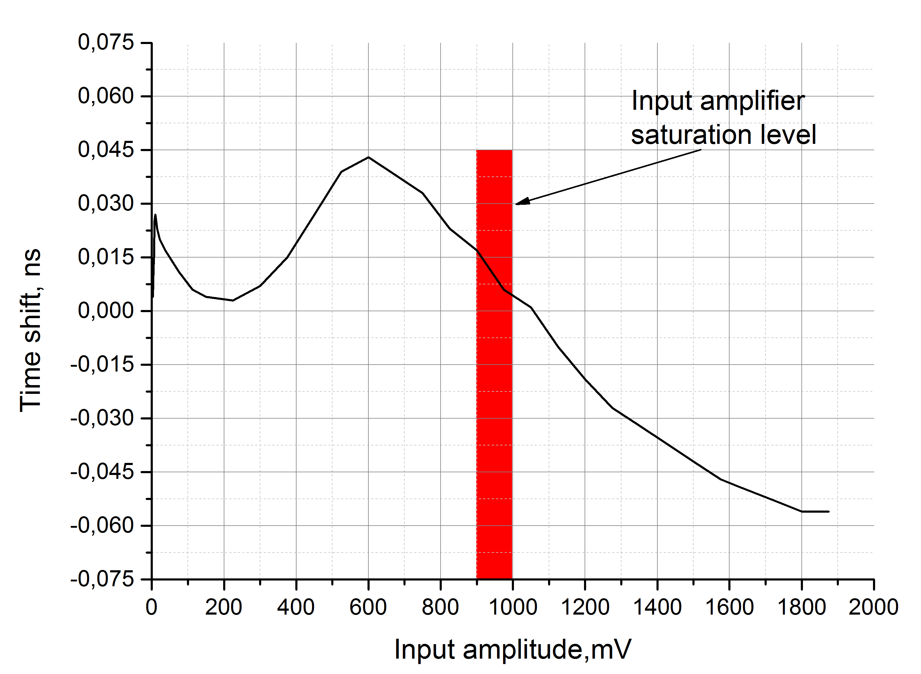
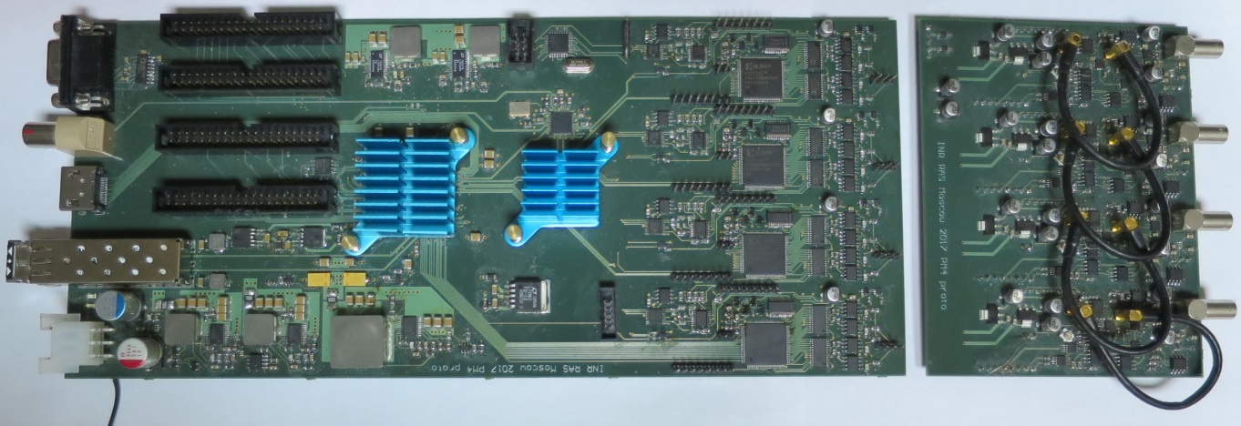
4-channel PM prototype FEE performance
(laser optical source, detector prototype, cables)
For lower thresholds, jitter is defined by the thermal noise of the input amplifier.
7.5 mV – 1 mip signal amplitude.
0.9 - 1 V – CFD amplifier saturation point,
1.9 V (250 mip)– end of the ADC linear dynamic range (for T0+)
ADC noise is 3 LSB (one sigma), 1 mip ~16 ADC LSB
(1 bin = 1 LSB)

Slide 13
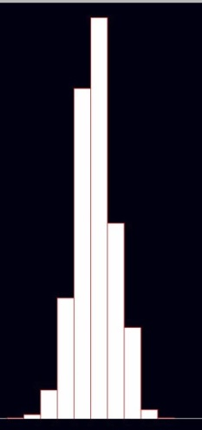
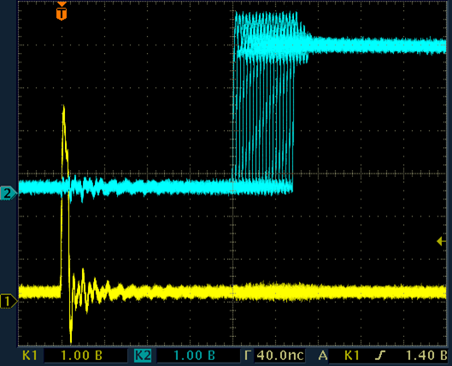
TDC for FIT
It is very accurate – this is the time distribution for the 4 mip amplitude signal (1 bin = 13.02 ps)
Texas Instruments TDC THS788 was selected
for FIT as it has 4 independent channels,
13 ps resolution and fast (300 MHz) readout.
But the output data delay is ~100 ns higher, than declared in chip documentation. This exceeds the limit for FIT.

Slide 14
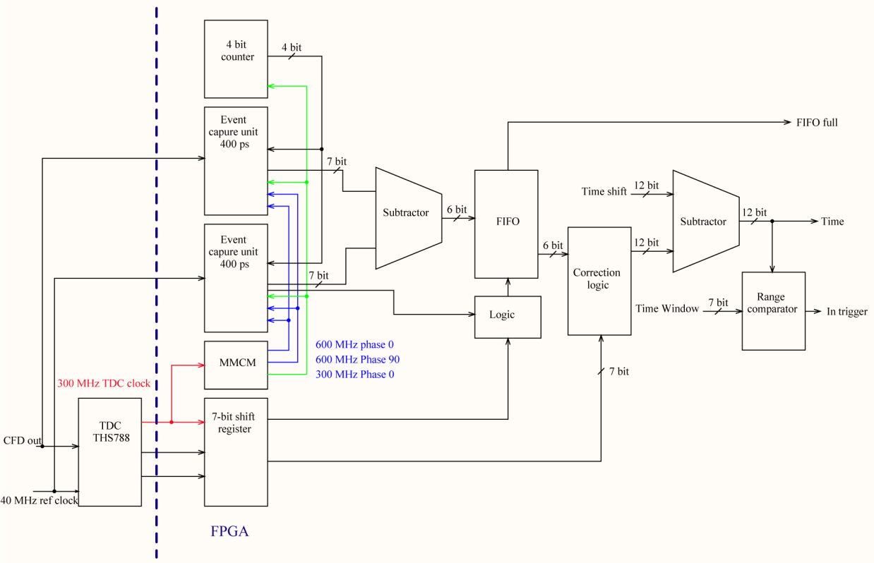
Solution to reduce THS788 Latency
As THS788 data delay is proportional to the result data word length, one can decrease this delay by reducing the word length from 16 to 8 bits. This decreases delay by 100 ns, but the result will contain only 7 least significant bits out of 11 needed to measure 25 ns interval. To solve the problem, the 400 ps resolution TDC was built in the readout FPGA, and the results of both measurement are combined to build up the correct result.

Slide 15
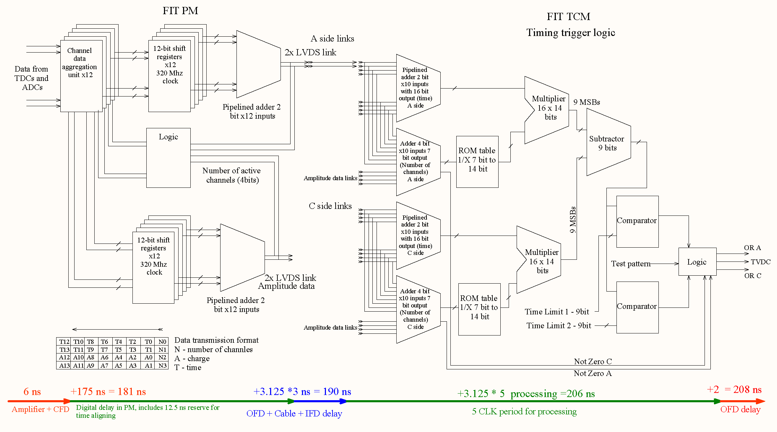
Total processing latency in FIT electronics

Slide 16
Thank you for the attention !
Acknowledgements. This work was supported for the INR RAS and MEPhI participants within the Program of activities of the Russian groups in the ALICE upgrade by the Ministry of Education and Science of Russian Federation, contract No14.610.21.0003

