Slide 1
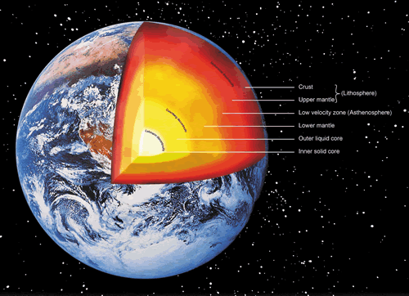
Earth thermal flux in the light of geoneutrinos
V. V. Sinev (INR, Moscow)
in collaboration with
L.B.Bezrukov, I. S. Karpikov, A.S. Kurlovich,
B. K. Lubsandorzhiev, A. K. Mezokh, V. P. Zavarzina (INR, Moscow)
and V. P. Morgaluk (A. N. Nesmeyanov Institute of Organoelement Compounds of Russian Academy of Sciences, Moscow)
ICPPA 2018 October, 22-26

Slide 2
Plan of the talk
Introduction. Earth heat flux (origin and transfer to the surface)
Geoneutrinos (how do they link to heat flux)
Solar neutrinos (Borexino data). CNO cycle could be depressed according to new knowledge.
Conclusion

Slide 3
Introduction
The origin of the Earth thermal flux is not understood completely up today.
The value of the heat flux from Earth interior also could be revised. Modern Earth model regards radiogenic heat as about a half of total measured one. Detection of ²³⁸U and ²³²Th neutrinos by detectors do not contradict to larger amounts of these isotopes in factor two.
Registering of antineutrinos on the Earth surface can help to understand if the most part of the heat flux is due to radioactivity or not.
Also there is possibility to analyze reservoirs of heat sources from radioactivity inside the Earth.
ICPPA 2018 October, 22-26

Slide 4
Modern value of Earth heat flux

Slide 5
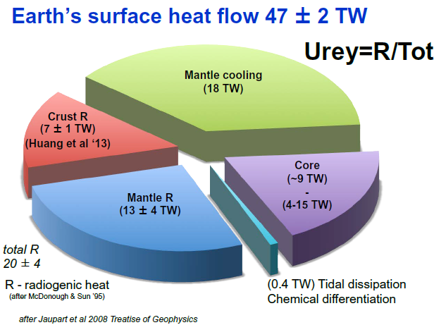

Slide 6
Evidence for larger value of Earth heat flux

Slide 7
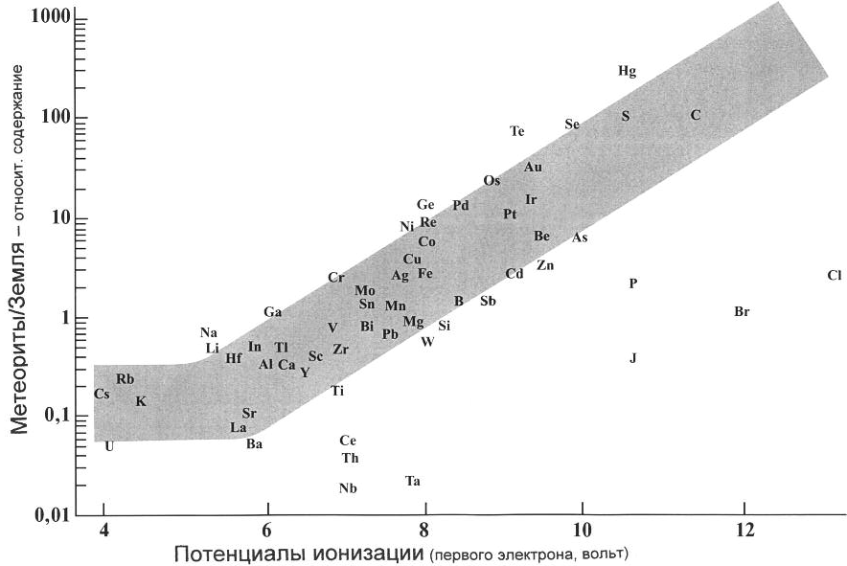
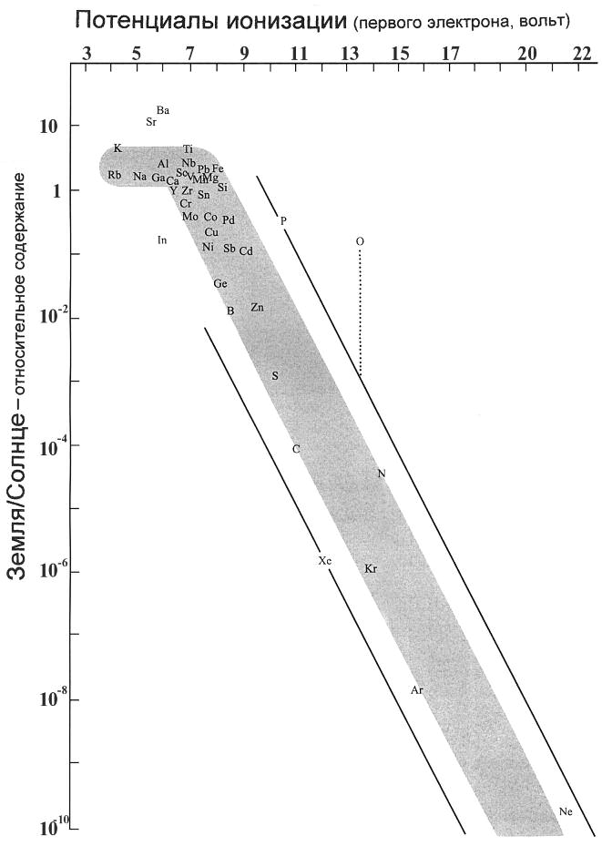
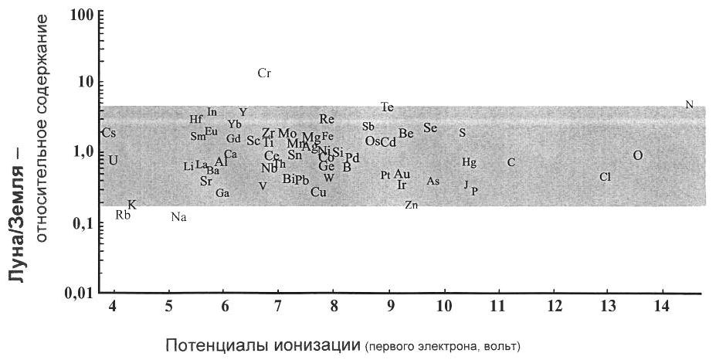
Abundances ratios in solar system
Meteorites/Earth
Earth/Sun
Moon/Earth

Slide 8
Summary of thermal Earth flux values
Earth
Bore-hole temperature gradient 47±2 TW
ARGO Earth’s energy imbalance 280±70 TW Moon recalculated to Earth heat flux
Apollo 15, 17 drilling 49-65 TW
Russian radio emission exp. 168 TW
LRO temperature map 254 TW
We consider the value of 200-250 TW as the most favorable to explain the all experimental data.

Slide 9
Heat transfer ways
Modern value
47 TW
H = H(ΔT) + H(ΔF) + H(Ch)
Thermo-conductivity, H(ΔT)
Hot gases flows,
Η(ΔF)
Chemical potential,
H(Ch)

Slide 10
Main heat transfer way is hot gases, not thermo conduction

Slide 11
To understand real value of Earth heat flux is possible to detect accurately all neutrino fluxes from terrestrial radioactive isotopes: ²³⁸U, ²³²Th and ⁴⁰K. First two surely can be detected through IBD reaction, but third one only through antineutrino-electron scattering.

Slide 12
Geoneutrino measurements by modern detectors

Slide 13
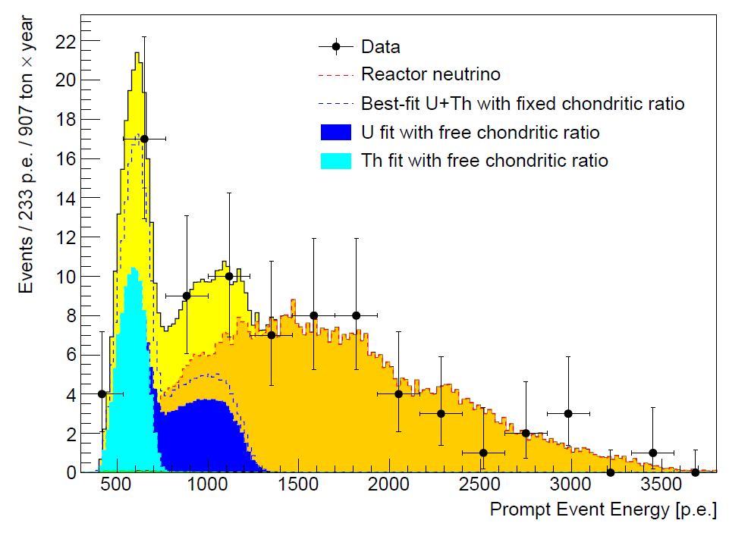
Borexino
M. Agostini et al. Phys. Rev. D 92, 031101 (2015).
Tmeas = 2056 days (5.6 years)
Np = (0.977±0.05)×10³¹ protons on target
Exposure (5.5±0.3) ×10³¹ proton years
23.7 ^{+6.5(st)+0.8} _{-5.7(st)-0.6} geo-nu events
43.5 TNU

Slide 14
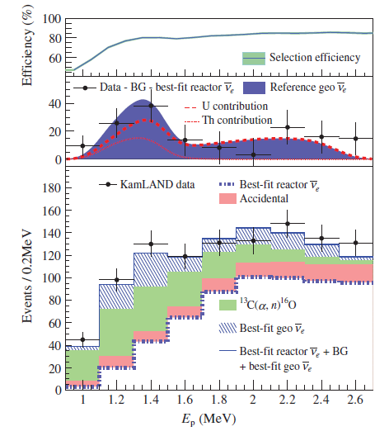
KamLAND
A. Gando et al. Phys. Rev. D 88, 033001 (2013).
Tmeas = 2991 days (8.2 years)
Np = (5.98±0.13)×10³¹ protons on target
Exposure (4.9±0.1) ×10³² proton years
116 ⁺²⁸ ₋₂₇ geo-nu events
23.67 TNU

Slide 15
It is easily possible to increase amount of ²³⁸U and ²³²Th inside the Earth in factor “2” and counting rate of Borexino and KamLAND do not change dramatically.

Slide 16
Bezrukov-Sinev Model
M(U) = 1.7×10¹⁷ kg, M(Th) = 6.7×10¹⁷ kg
In the Crust they distributed according BSE (Reference Model)
In the Mantle and Core they were chosen in abundances not to break observed counting rates (Borexino and KamLAND)
 | Experimental counting rate, TNU | Calculated counting rate, TNU
Borexino | 43.5 ± 12.5 | 38.1
KamLAND | 23.67 ± 5.61 | 31.8

Slide 17
Potassium (⁴⁰K) Geoneutrino

Slide 18
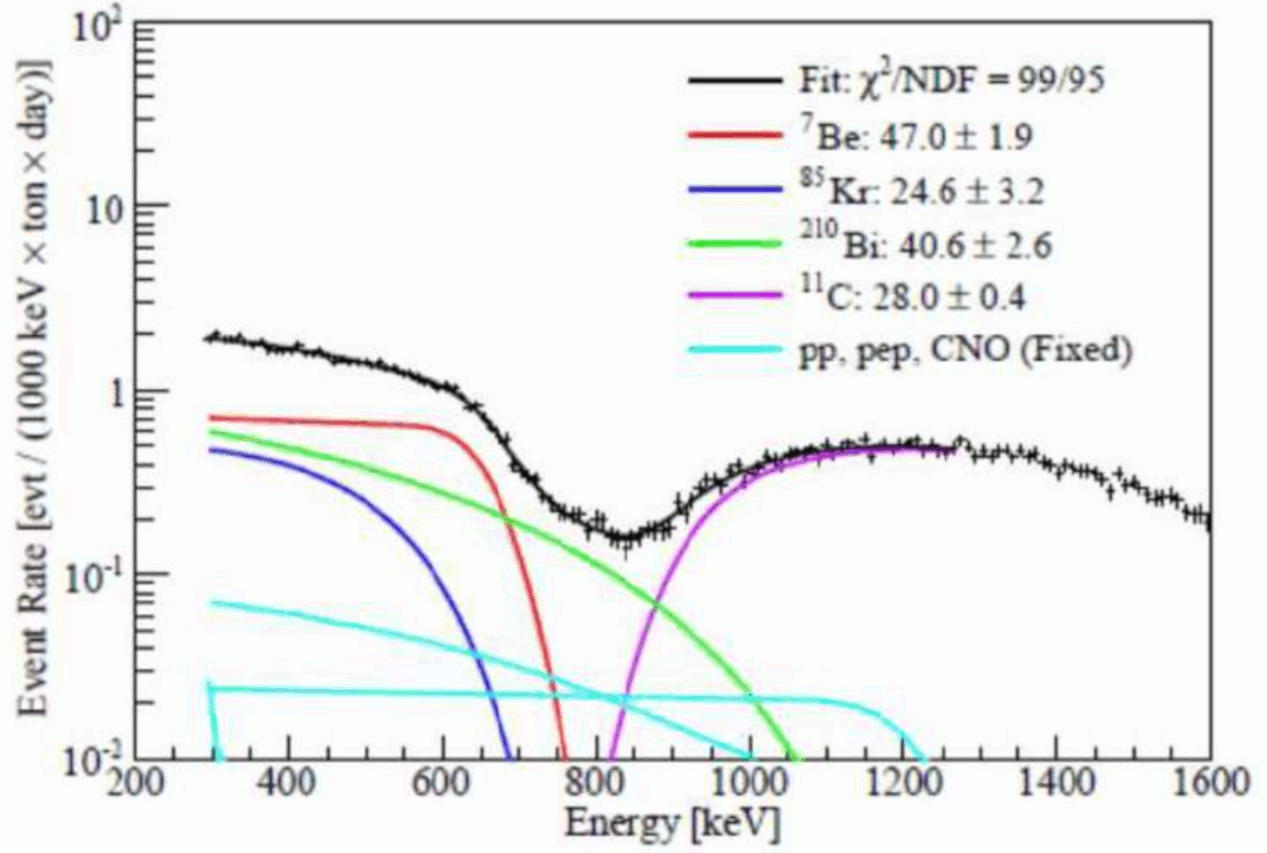
What does Borexino measure?
1605.06795 [hep-ex]

Slide 19
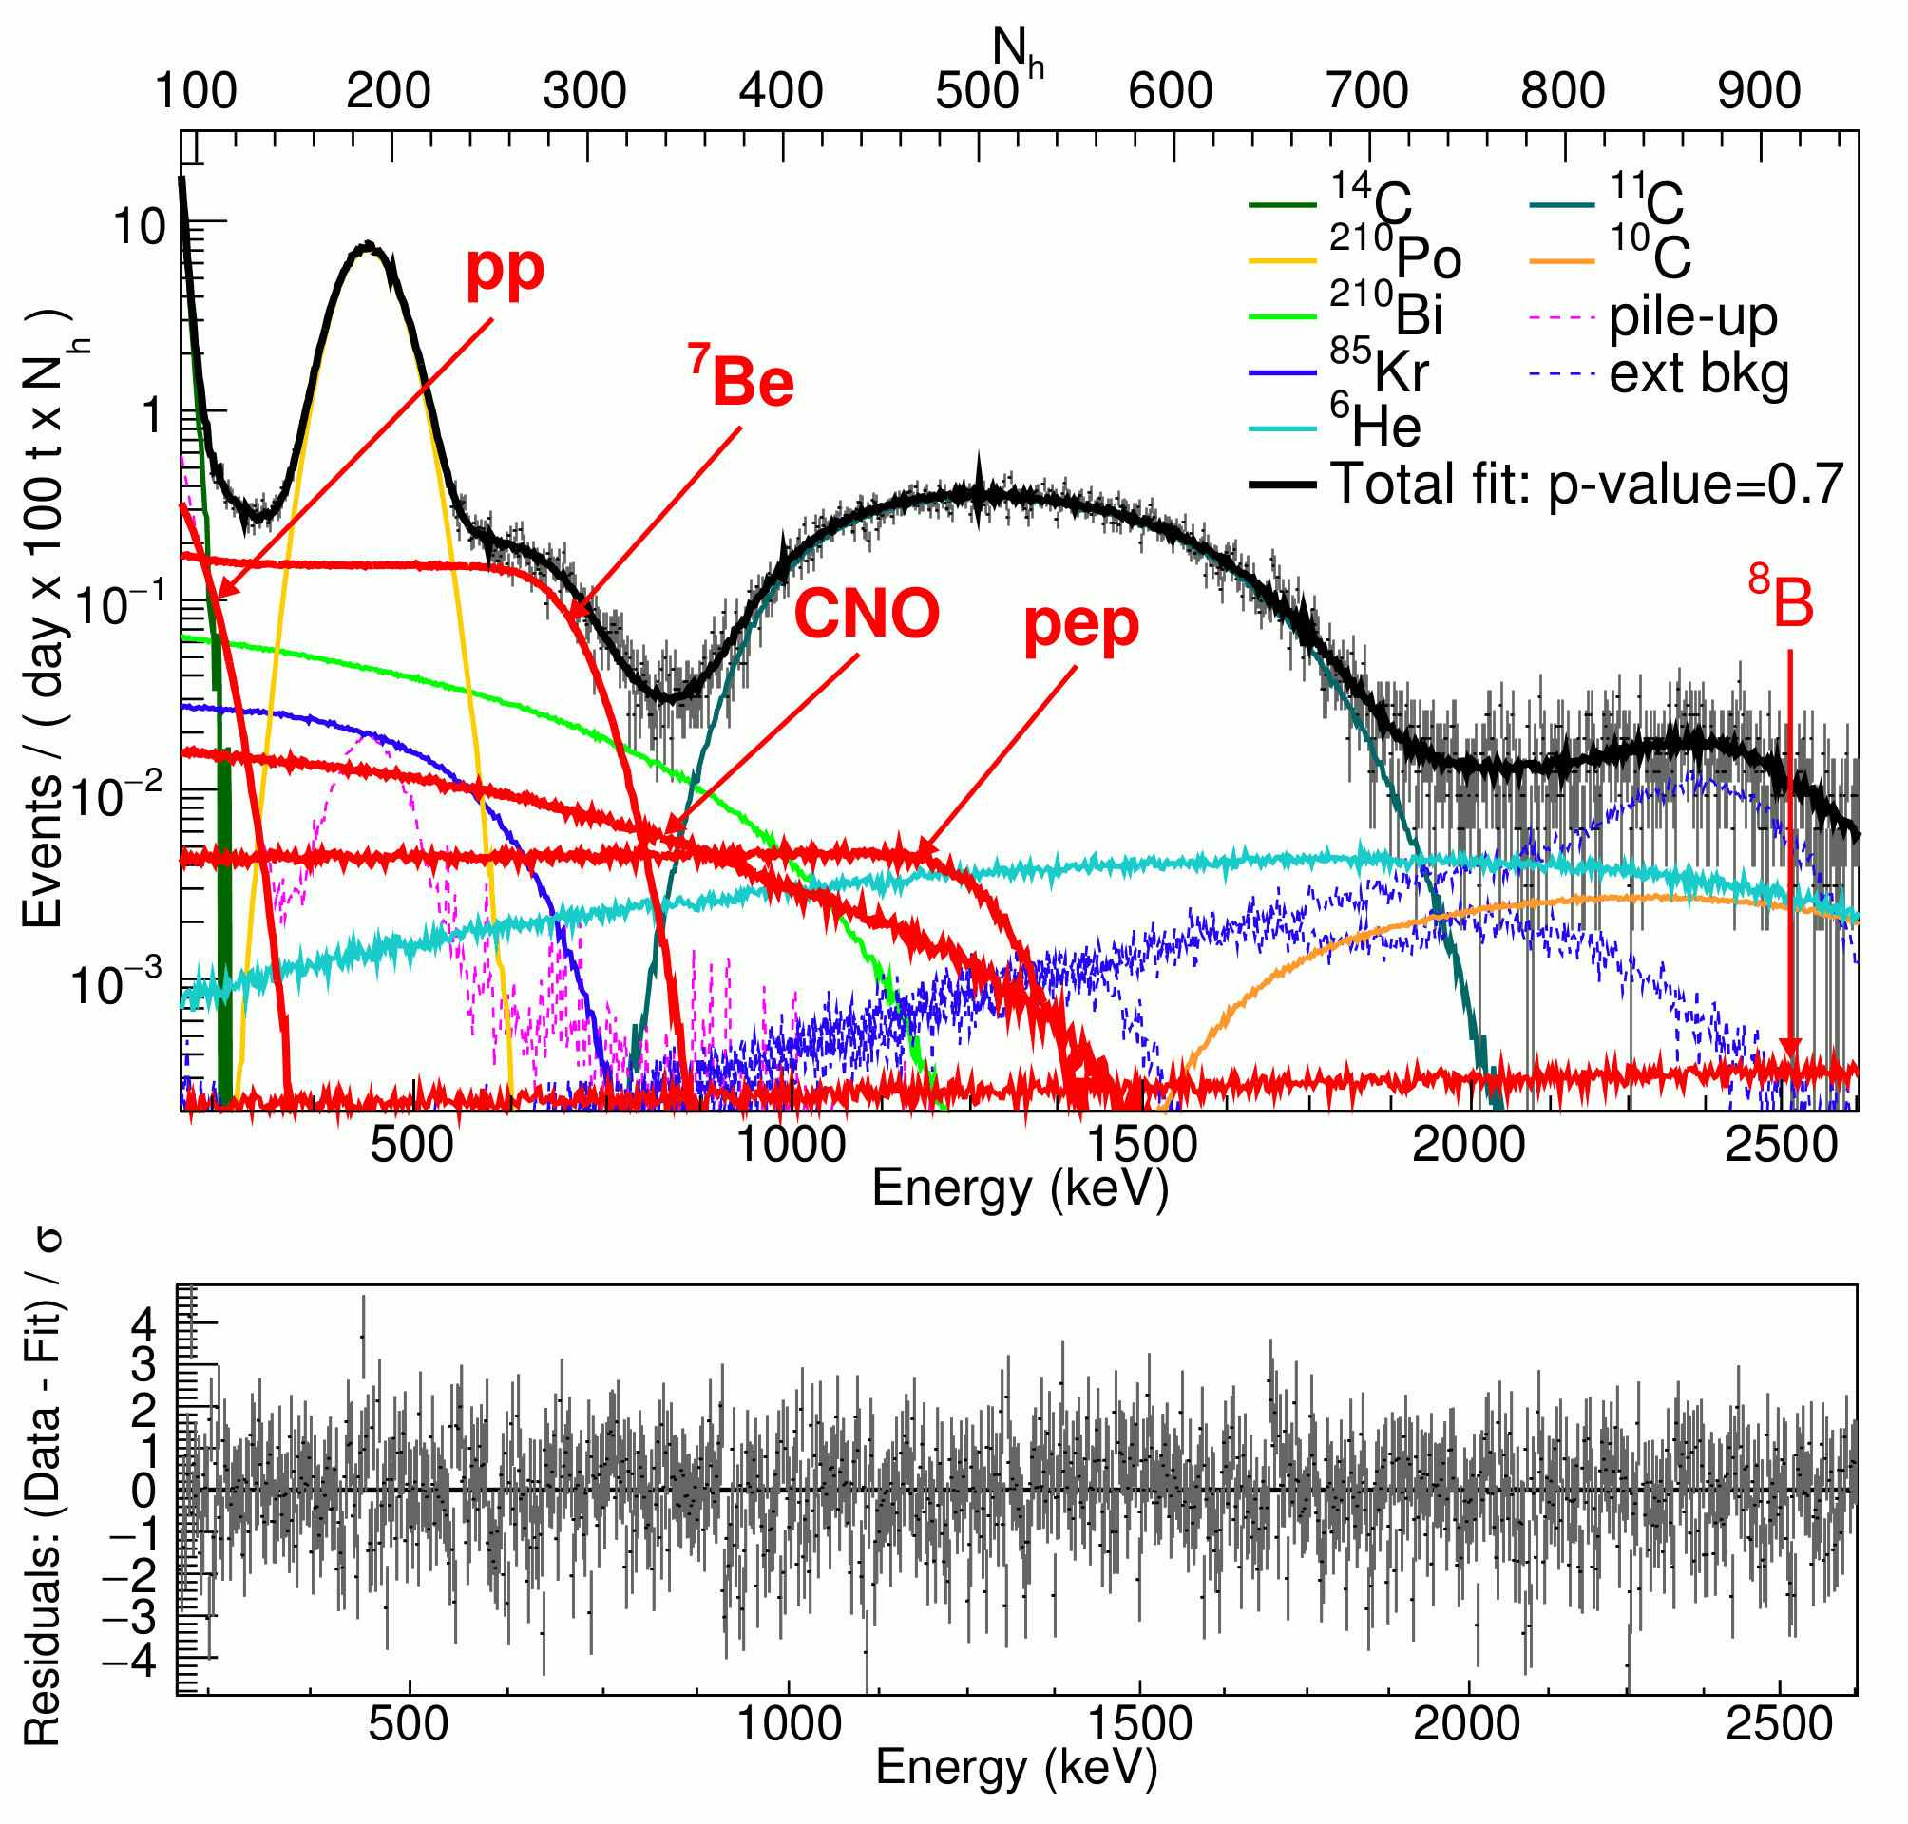
1707.09279 [hep-ex]

Slide 20
Recoil electrons spectrum from ⁴⁰К in BOREXINO ν_{e} + e → ν_{e} + e

Slide 21
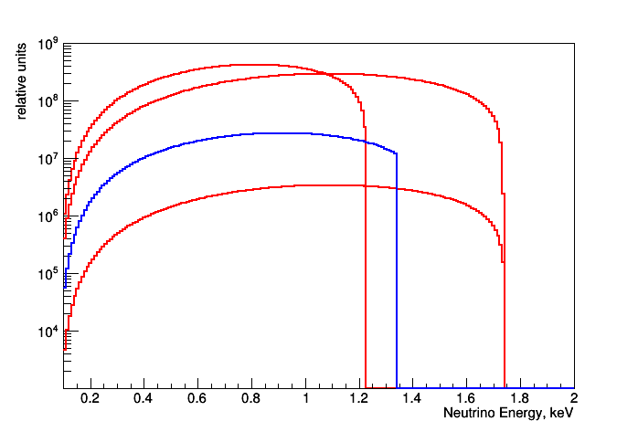
Neutrino CNO and antineutrino ⁴⁰K spectra
¹³N
¹⁵O
⁴⁰K
¹⁷F

Slide 22
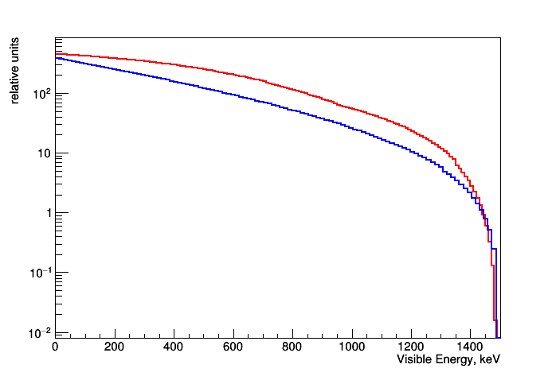
Spectra from CNO cycle neutrinos and ⁴⁰K antineutrinos in a detector as recoil electrons
CNO
⁴⁰K

Slide 23
Recently there appeared doubts about existence of CNO cycle in the Sun

Slide 24
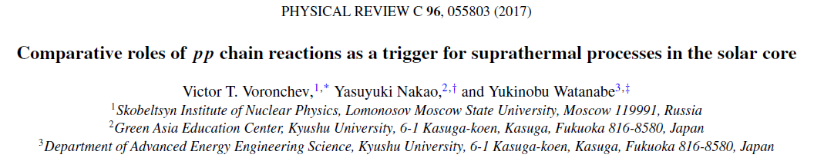
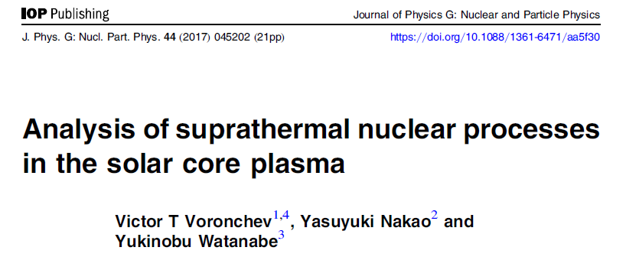
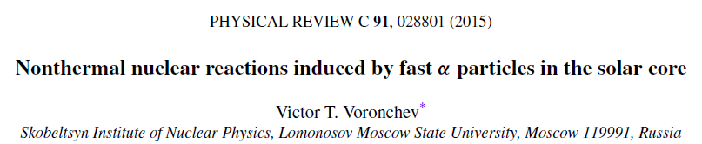
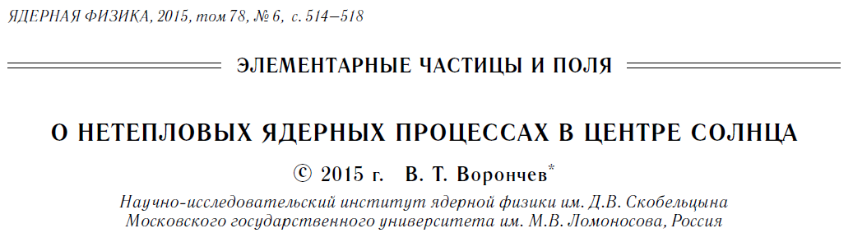

Slide 25
“Резервы” для усиления надтепловых эффектов в CNO
4) Дополнительные реакции Y(α,p)X и нейтрино
Decreasing of ¹³N- and ¹⁵O- neutrino fluxes ?

Slide 26
Comparison of direct (p,α)- and inverse (α,p)-reactions:
2) including α-particles

Slide 27
Conclusion and outlook
CNO cycle in the Sun could be sufficiently depressed due to suprathermal processes.
In this case instead of neutrinos from CNO cycle Borexino could detect ⁴⁰K antineutrinos.
Several events per day counting rate for ⁴⁰K antineutrinos in 100 t of Borexino target means potassium abundance in the Earth at the level more than 1% by mass.
We know that 1% of potassium in the Earth produces about 200 TW of heat.
To solve the problem of ⁴⁰K we need to have independent measurement of CNO cycle neutrinos from the Sun.

Slide 28
Thank you for attention

