Slide 1
Measurement of variations
in the flux of atmospheric muons
using underground LVD detector
Natalia Agafonova (INR RAS)
on behalf of the LVD Collaboration
IV International Conference on Particle Physics and Astrophysics
ICPPA – 2018, 22-26 October

Slide 2
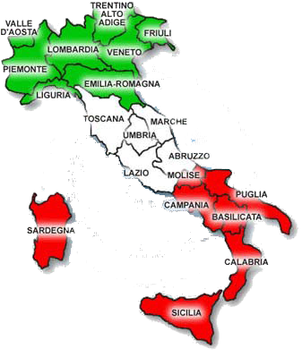
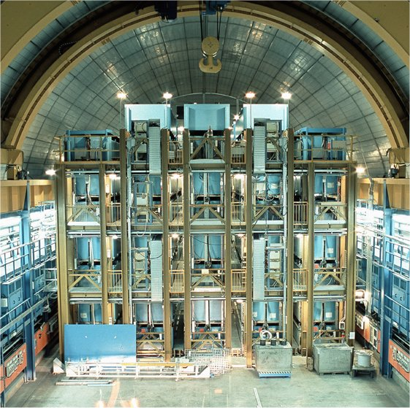
LVD – Large Volume Detector
at LNGS, Italy, Gran Sasso
The coordinates of the LNGS:
13.5333 E, 42.4275 N.
Length ×Width ×Height | 22.7×13.2×10 m
Iron mass | 1020 t
Scintillator mass | 1008 t
Amount of scintillation counters | 840
Average depth minimal | 3650 m w.e. 3000 m w.e.
Mean muon energy | 280 GeV
Е_{µ} on see level (min.) | 1.3 TeV
Muon rate (on 1 tower) | ~ 120 h⁻¹
Threshold ε_{th} | 5 MeV
The main goal of LVD is searching for neutrino radiation from stellar core collapse.
Notes:
The Large Volume detected is located in central Italy at Gran Sasso Laboratory at the depth 3650 m w.e. (three thousand six hundred and fifty meters of water equivalent). The main goal is …. The mass of iron and scintillator is by about one thousand tons. Mean muon energy is 280 GeV.

Slide 3
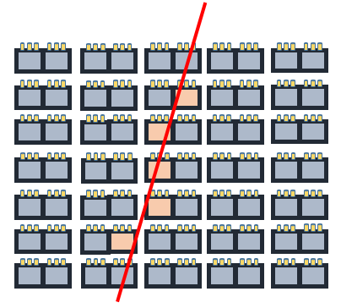
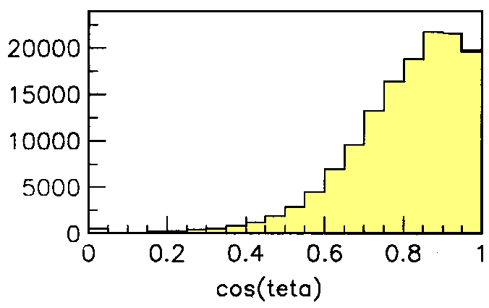
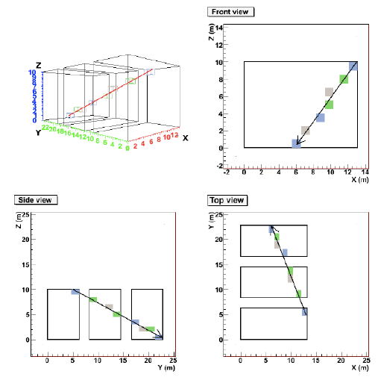
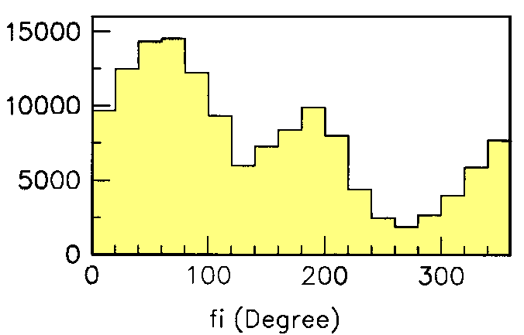
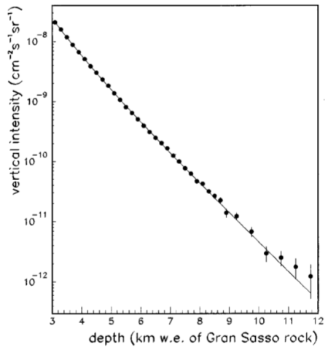
atmospheric muon
µ
Muon events in LVD
L=7
L=6
L=5
L=4
L=3
L=2
L=1
The LVD consists of three towers. It has 7 levels and 5 columns in each tower.
n
n
С=1 С=2 С=3 С=4 С=5
R_{μ}(LVD) = 0.097 ± 0.010 s⁻¹
Maximum depth for μ
Depth-intensity curve
Notes:
Muons cross our detector at different angles. The maximum intensity angle is 28 degrees.
The maximum depth from which atmospheric muons can be detected is twelve kilometers of water equivalent. This is depth-intensity curve measured with LVD

Slide 4
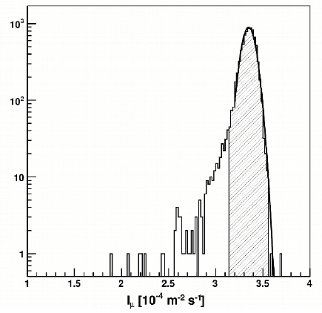
PoS(ICRC2017)291
Muon rate (event per day)
$\frac{{δI}_{μ}}{I_{μ}^{0}}$ = 1.5%
Daily muon flux distribution with, superimposed, the Gaussian fit. The average muon rate is I₀ = 3.3475 ± 0.0005stat ± 0.03sys ± 10⁻⁴ m⁻² s⁻¹. The dashed region represents the 3 σ band.
LVD exposure (m² s)
Muon intensity m⁻² s⁻¹
Time since 1.1.1992 [days]
Notes:
The top graph shows the counting rate of muons in the detector during 25 years. In the beginning, it is clear that only one detector tower was operated. Then two towers worked and since 2001 all three towers are working.
The picture in the middle shows the exposure of the detector. When we divide the counting rate by the exposure, we get the muon intensity. The average muon intensity is here.

Slide 5
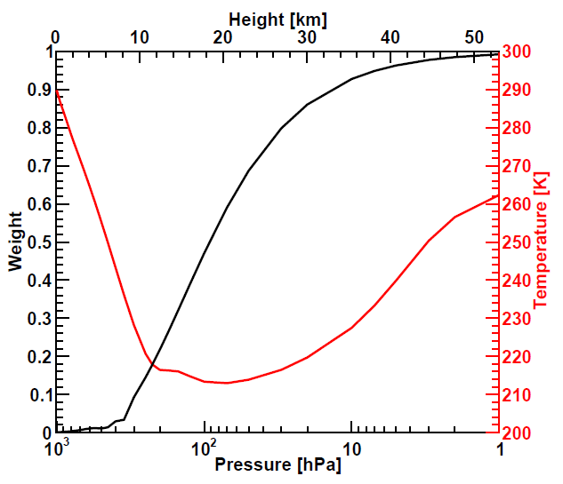
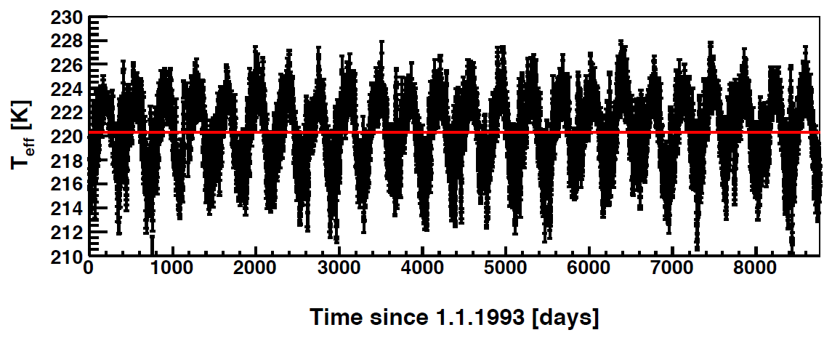
«Effective» temperature
The upper-air temperature data set obtained from the European Center for Medium-range Weather Forecasts
the effective temperature is a weighted average over several altitudes
The model provides atmospheric temperatures at N=37 discrete pressure levels in the 1-1000 hPa range, four times a day at 0, 6, 12,18 hour UTC.
Notes:
We use in this work the upper-air temperature data set obtained from the European Center for Medium-range Weather Forecasts.
The effective temperature is a weighted average over several altitudes.
This is plot of effective temperature during twenty five years.

Slide 6
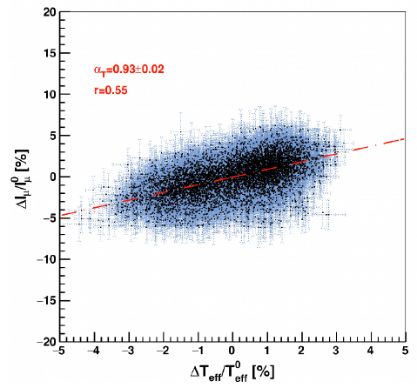
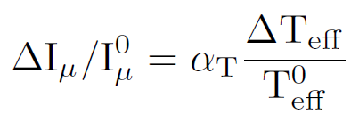
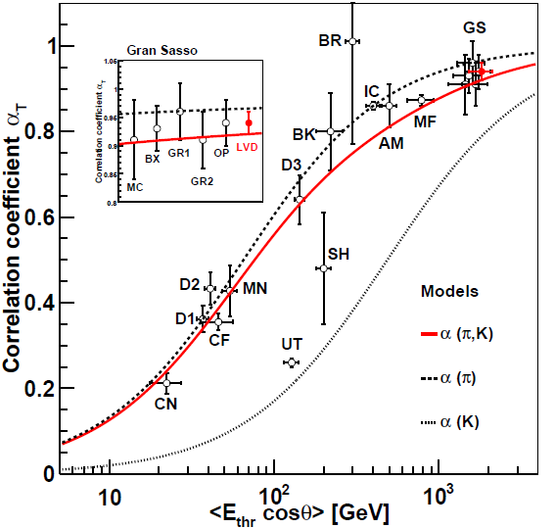
Dependence of temperature coefficient α_{T}
0.93 ± 0.02
correlation between muon flux and temperature variations
Experiment |  | E_{thr} cosθ, GeV | α_{T}
DoubleCHOOZ | CF | 22.3 | 0.212 ± 0.021
Daya Bay | D1 | 37 | 0.362 ± 0.031
Daya Bay | D2 | 41 | 0.433 ± 0.038
DoubleCHOOZ | CN | 46 | 0.355 ± 0.019
UTAH | UT | 128 | 0.26 ± 0.01
Daya Bay | D3 | 143 | 0.641 ± 0.057
SHERMAN | SH | 200 | 0.48 ± 0.13
BAKSAN | BK | 220 | 0.8 ± 0.09
BARRETT | BR | 300 | 1.01 ± 0.24
Ice Cube | IC | 400 | 0.86 ± 0.01
AMANDA | AM | 500 | 0.86 ± 0.05
MINOS | MF | 785 | 0.873 ± 0.013
MACRO | MC | 1600-150 | 0.91 ± 0.07
BOREXINO | BX | 1600-75 | 0.93 ± 0.04
GERDA | G1 | 1600 | 0.96 ± 0.05
GERDA | G2 | 1600+75 | 0.91 ± 0.05
OPERA | OP | 1600+150 | 0.94 ± 0.05
LVD | LVD | 1600+225 | 0.94 ± 0.02
Notes:
Finally, we can calculate the effective temperature coeficient, using this formula:
The correlation between muon flux and temperature variations is shown in this figure, points, together with the resulting linear fit (red dashed line).
The obtained value of the coefficient can be compared with other underground experiments.

Slide 7
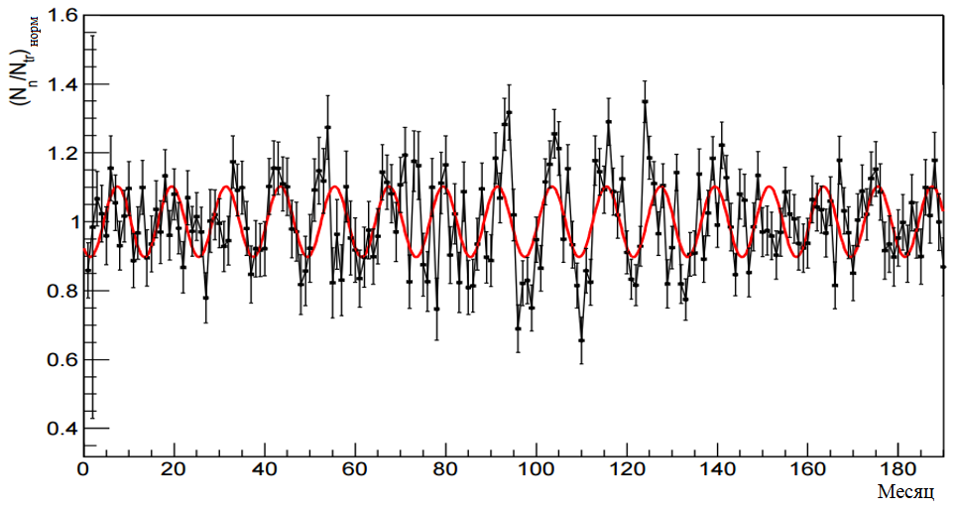
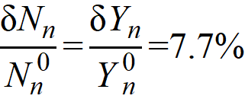
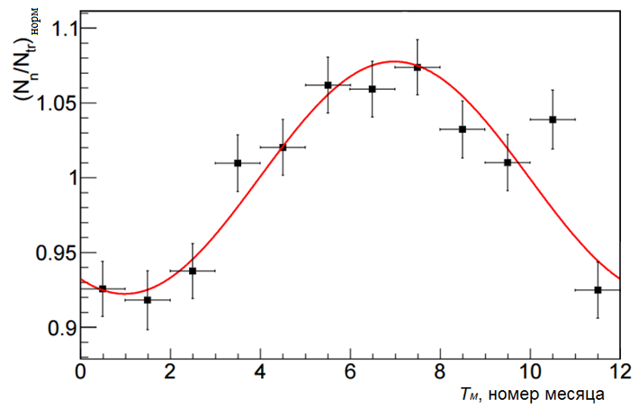
Cosmogenic neutron variations and muon energy variations
the amplitude modulation of the neutrons number per muon
Y_{n}(E_{μ}) ∝ E_{μ}^{0.78}
=
The 10% muon energy variations result in about 8 % variations in the muon-induced neutron yield.
the muon energy changes by 10 % depending on the season
=
E_{μ}^{LVD} = 280 ± 28 GeV
Notes:
Now, I would like to mention measurements of variations in the neutron flux from muons.
Using the epochs folding method for 15 years of detector operation, we obtained that the amplitude modulation of the number of neutrons per muon is about 8 percent.
If we assume that the neutron yield depends on the muons energy to a degree of 0.78, then we find that the muon energy changes by 10 percent depending on the season. The muon intensity changes by one and a half percent.

Slide 8
Conclusion
Data on the measurement of the flux of atmospheric muons with LVD at 3650 m w.e. depth with an average energy of 280 GeV are presented.
The effective temperature coefficient α_{T} is 0.93 ± 0.02.
Now we are analyzing muon and temperature data for 25 years of observations in order to establish the degree of deviation of muon data from harmonic function and identify the source of the fine structure of variations.

Slide 9
Thank you!

