Slide 1



Thunderstorm investigations based on the data obtained by the URAGAN muon hodoscope and
Doppler weather radar DMRL-C
Alexandra KACHURª, Yuri PAVLYUKOV^{b}, Anatoly PETRUKHINª, Natalia SEREBRYANNIK^{b}, Victor SHUTENKOª
ªNational Research Nuclear University MEPhI (Moscow Engineering Physics Institute), Scientific & Educational Centre NEVOD
^{b}Central Aerological Observatory
IV international conference on particle physics and astrophysics
Moscow, 22-26 October 2018

Slide 2
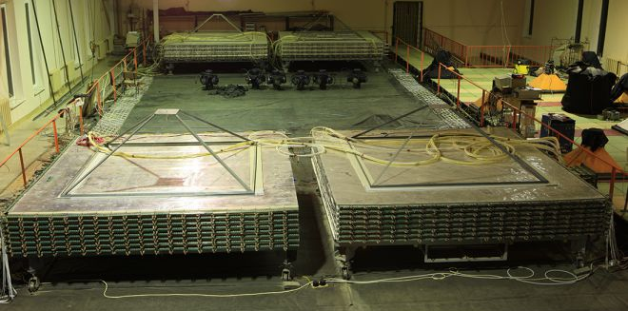
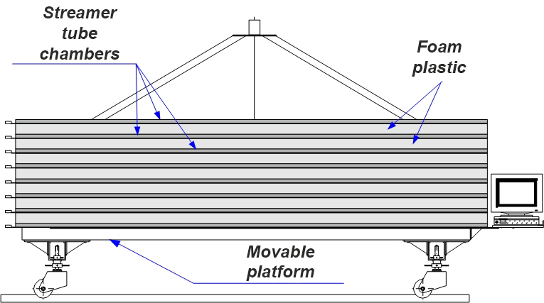
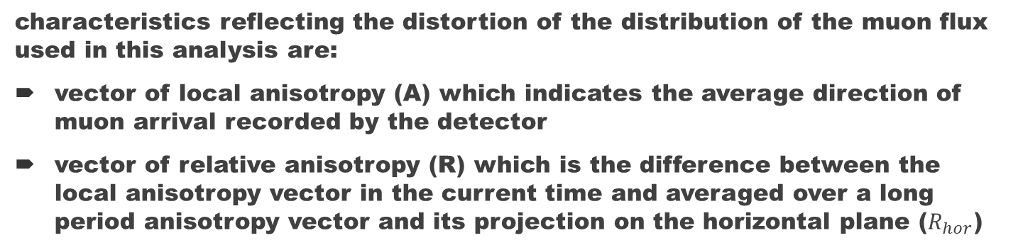
Muon hodoscope URAGAN
provides registration of muons with a high spatial and angular resolution (about 1 cm and 0.8°, respectively) in a wide range of zenith angles (from 0° to 84°)
track parameters are reconstructed in real time and accumulated in a two-dimensional matrix for one minute interval. Such a matrix is a "muon picture" of the upper hemisphere
characteristics reflecting the distortion of the distribution of the muon flux used in this analysis are:
vector of local anisotropy (A) which indicates the average direction of muon arrival recorded by the detector
vector of relative anisotropy (R) which is the difference between the local anisotropy vector in the current time and averaged over a long period anisotropy vector and its projection on the horizontal plane ($R_{hor}$)

Slide 3
Doppler weather (meteorological) radar DMRL-C
Displaying distribution of various meteorological data such as precipitation intensity and velocity and direction of movement of cloud systems
a view range of 250 – 300 km
a maximum detection height of about 20 km
a high spatial resolution (0.5 – 1 km)
Detection of dangerous weather phenomena such as thunderstorms

Slide 4
The research
Muon pictures (muonographs) and meteorological maps obtained every ten minutes by means of two facilities during thunderstorm periods of spring and summer of 2018 (~27 events) are compared with each other
Wavelet analyses of obtained data are performed
Results are illustrated by thunderstorm events occurred in Moscow on July 14, 2018 and August 30, 2018

Slide 5
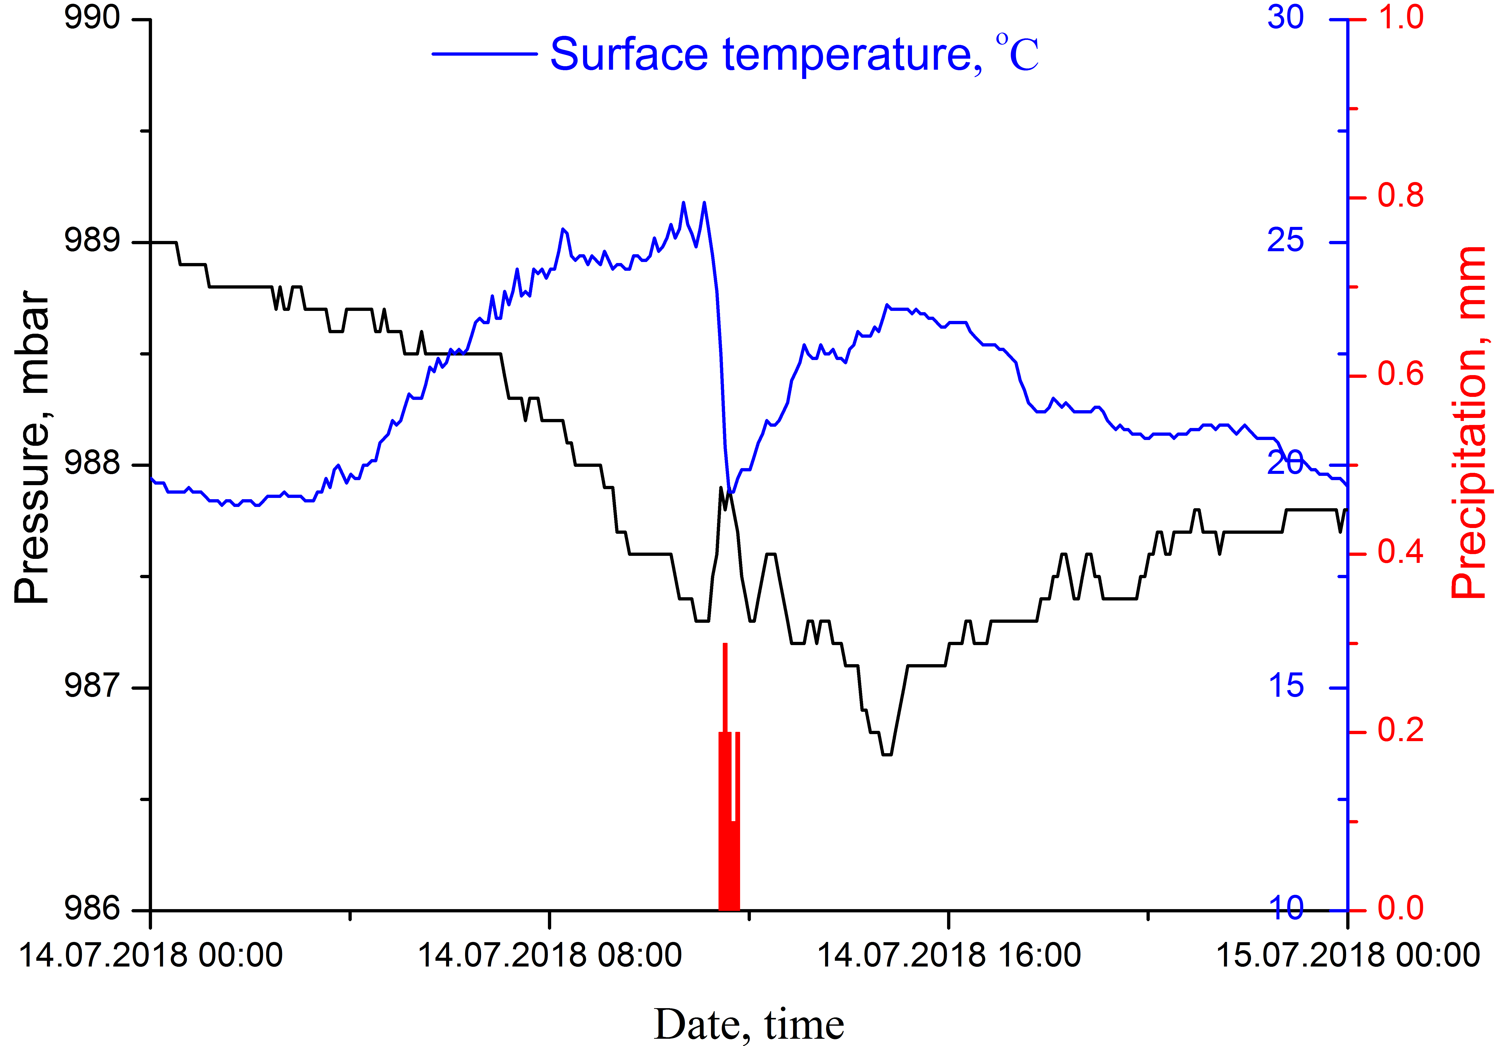
14.07.2018
The thunderstorm was observed at the Domodedovo airport meteorological station at 14:00 (UTC time) and at the VDNKh meteorological station from 14:00 to 17:00

Slide 6
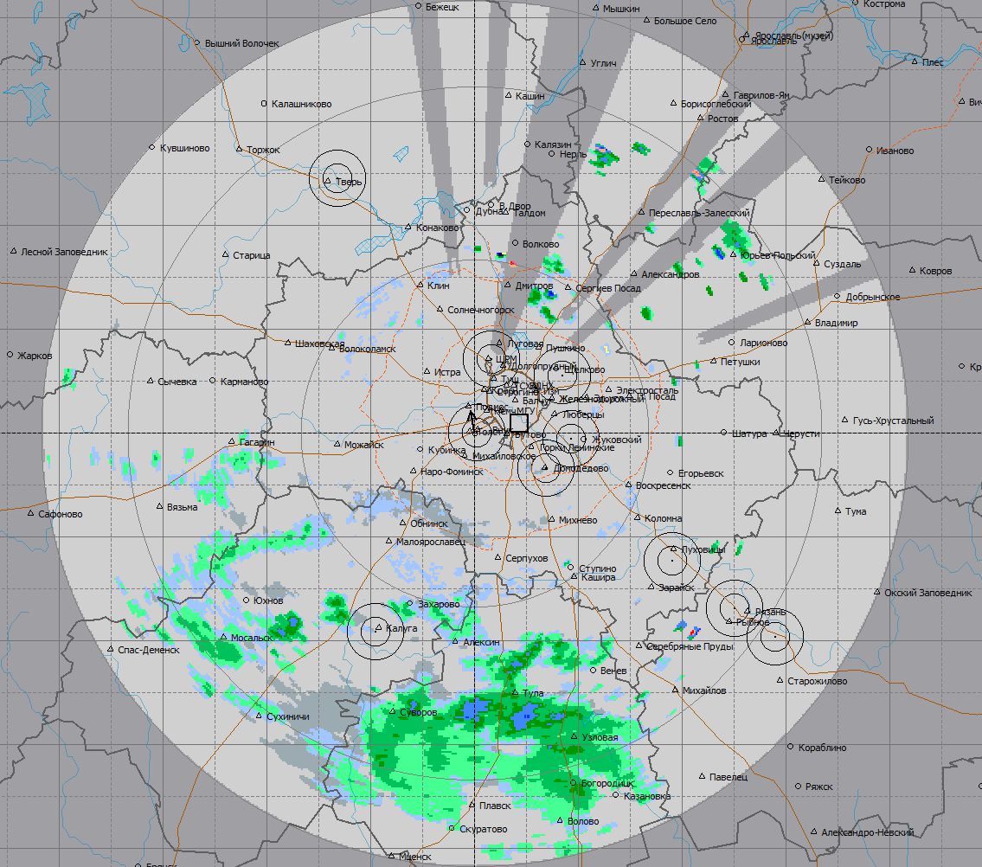
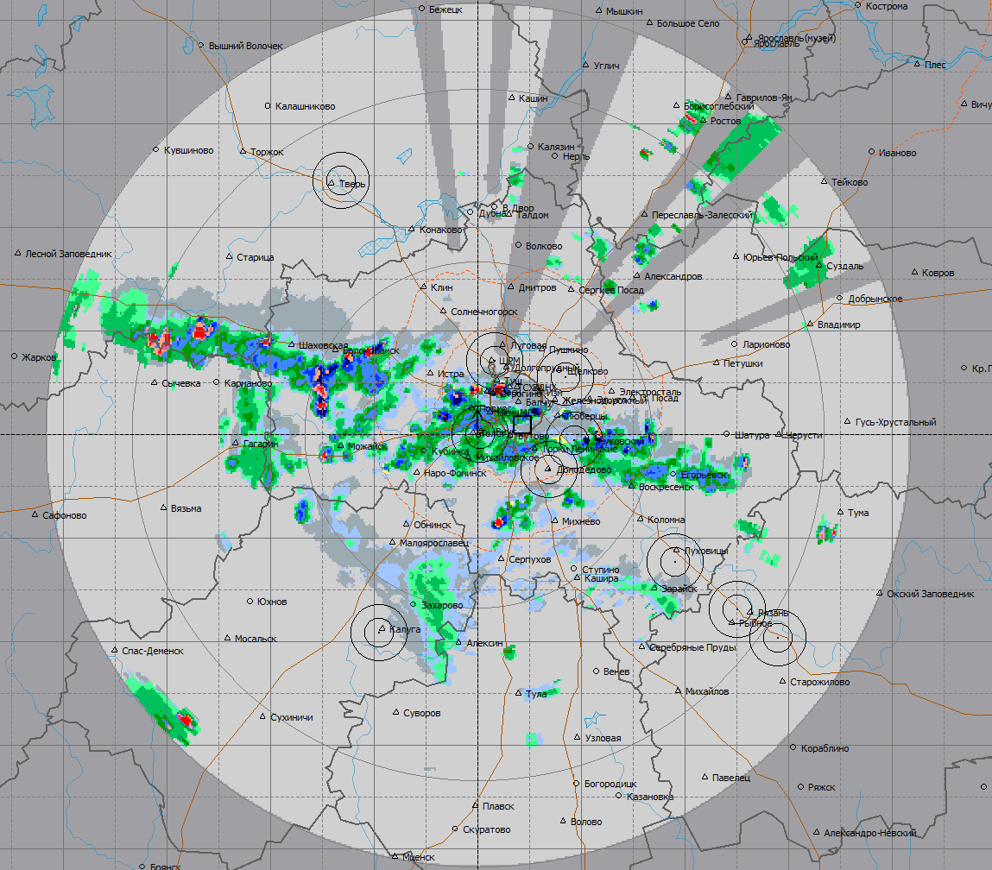
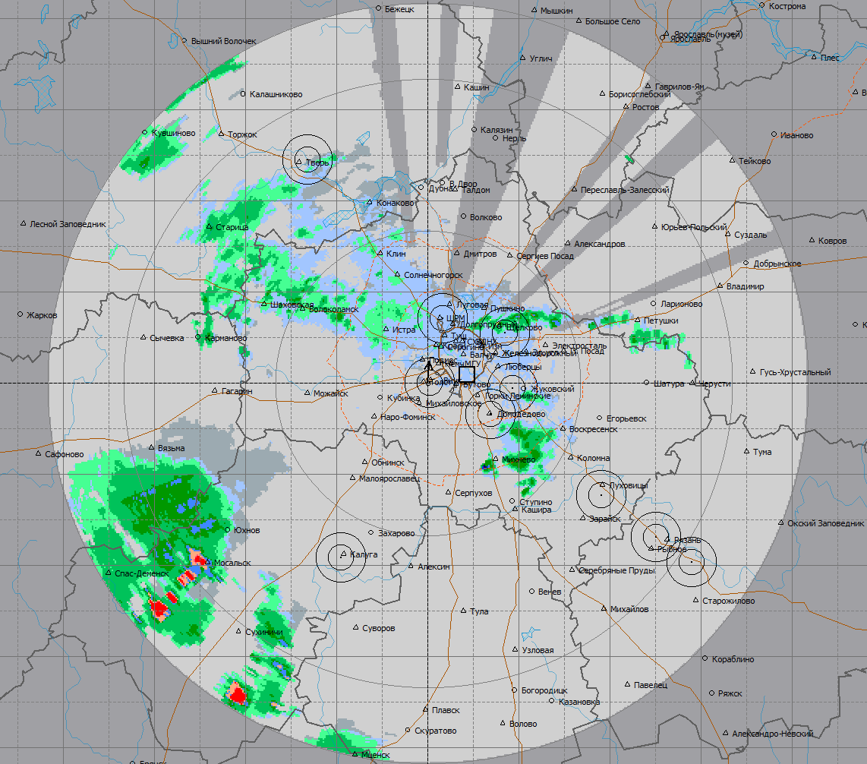

Meteorological maps
Start 07:20
End 19:20
Peak 12:00
Precipitation is weak
Moderate precipitation
Precipitation is strong
Cumuliform clouds
Rain is weak
Moderate rain
Heavy rain
Thunderstorm 30-70%
Thunderstorm 70-90%
Thunderstorm> 30%

Slide 7
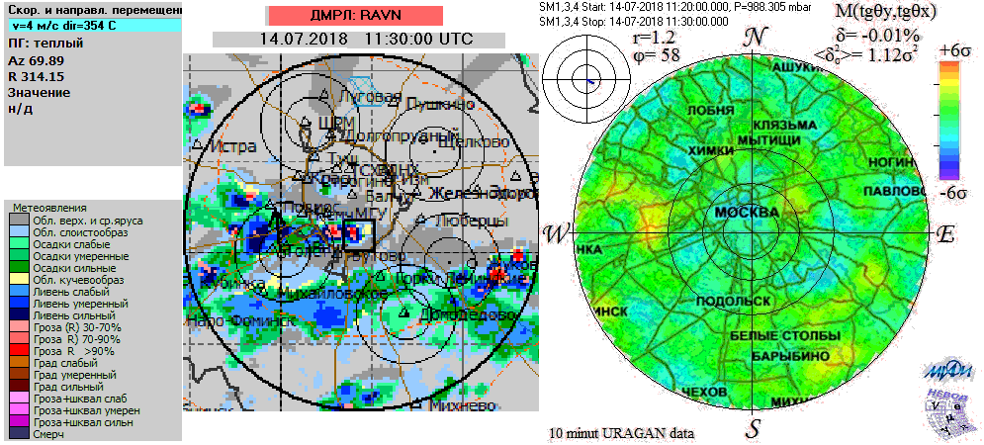
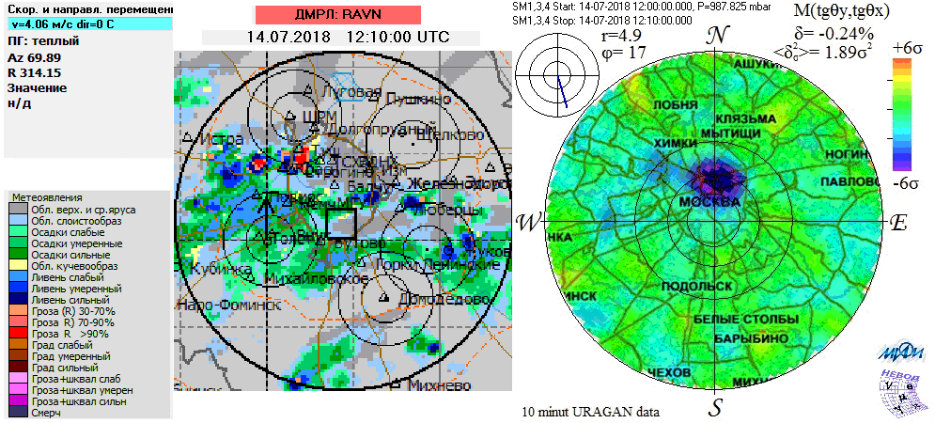
Comparison (11:30 – 13:10)

Slide 8
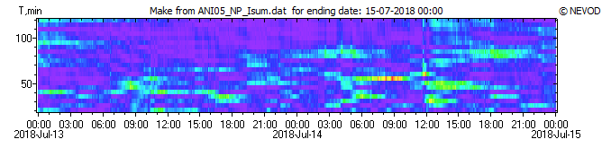
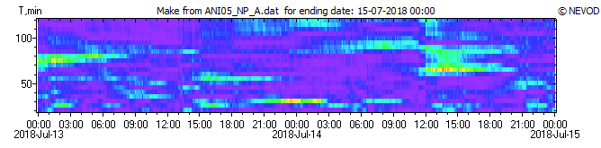
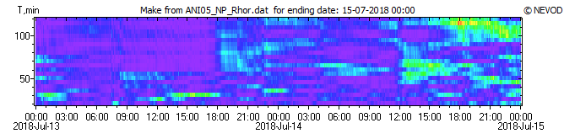
Wavelet analyses of URAGAN data
Isum
A
Rhor

Slide 9
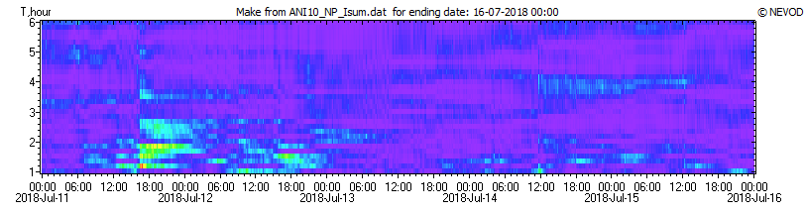
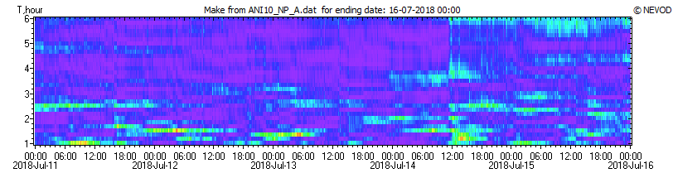
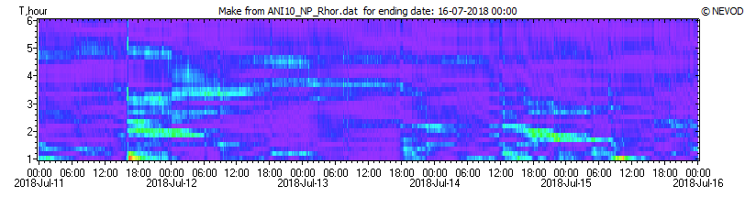
Wavelet analyses of URAGAN data
Isum
A
Rhor

Slide 10
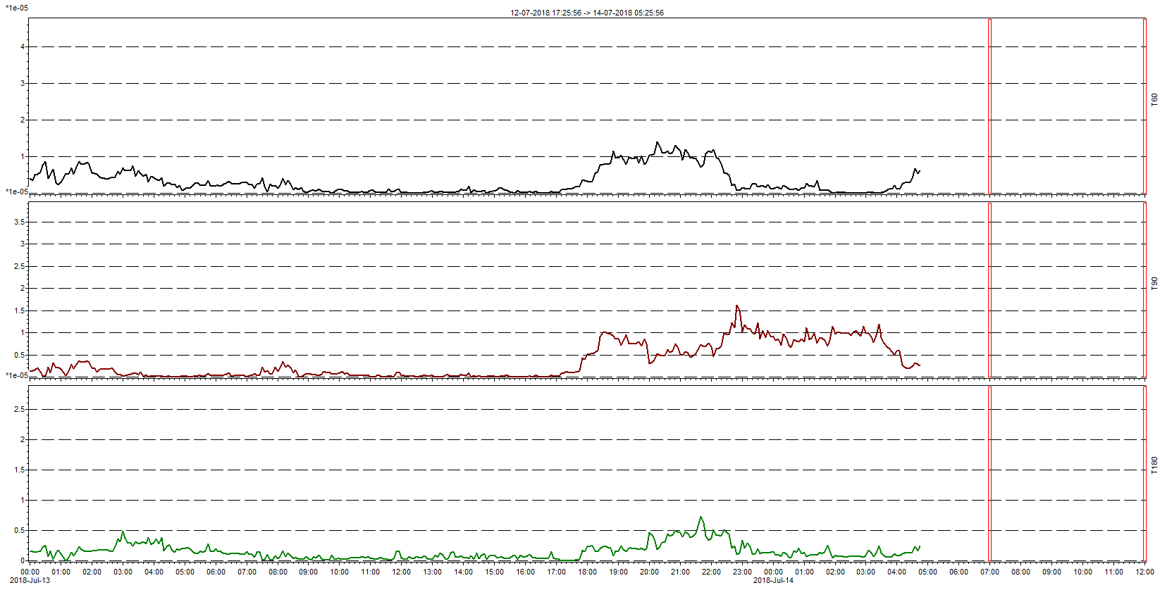
Wavelet analysis: Rhor
T60
T90
T180

Slide 11
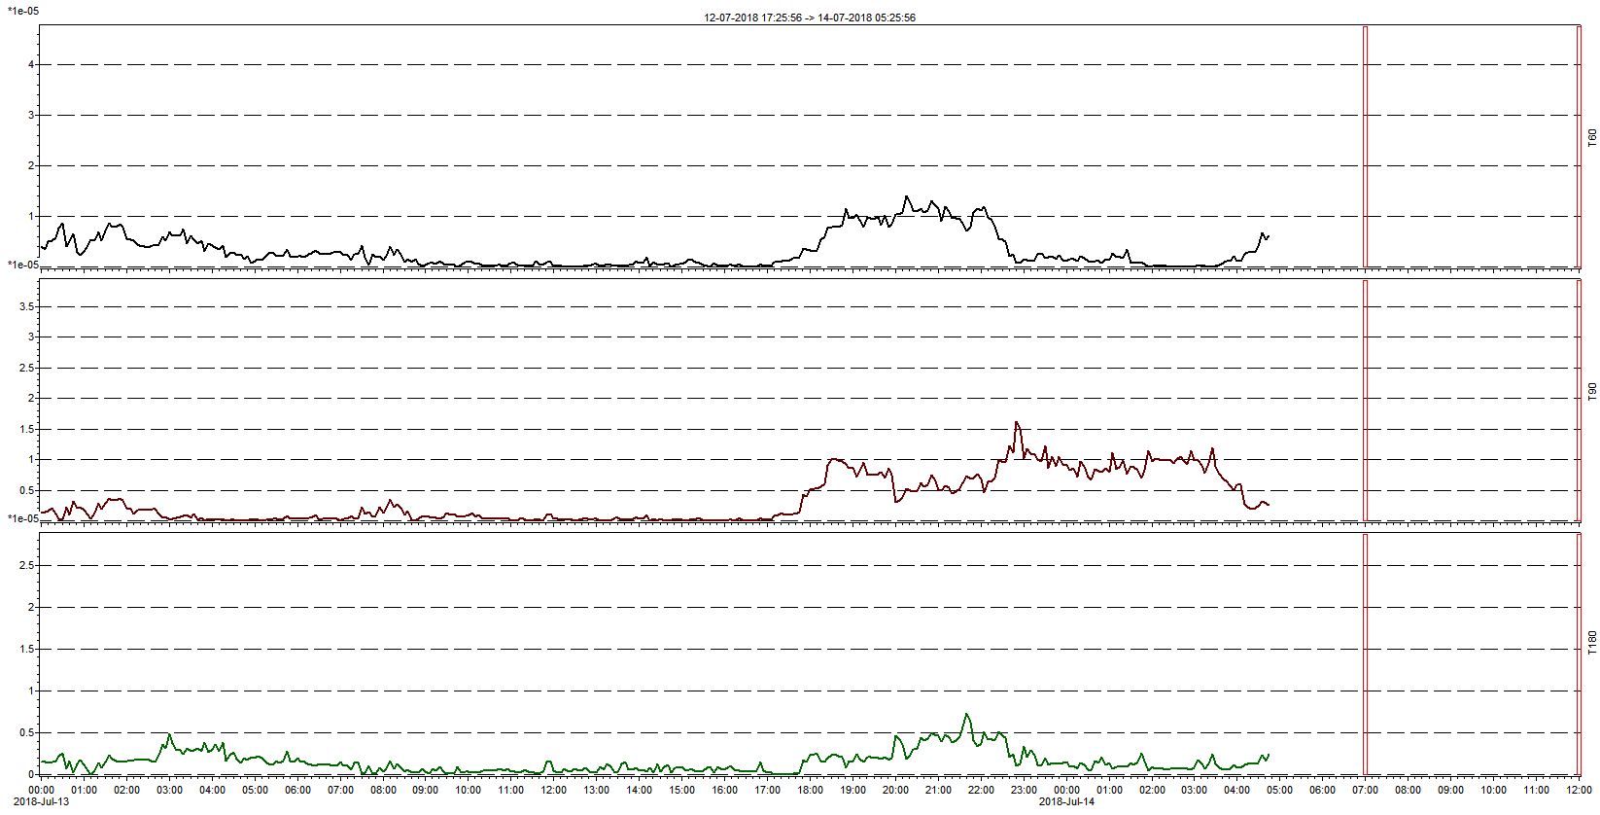
Wavelet analysis: Rhor
T60
T90
T180

Slide 12
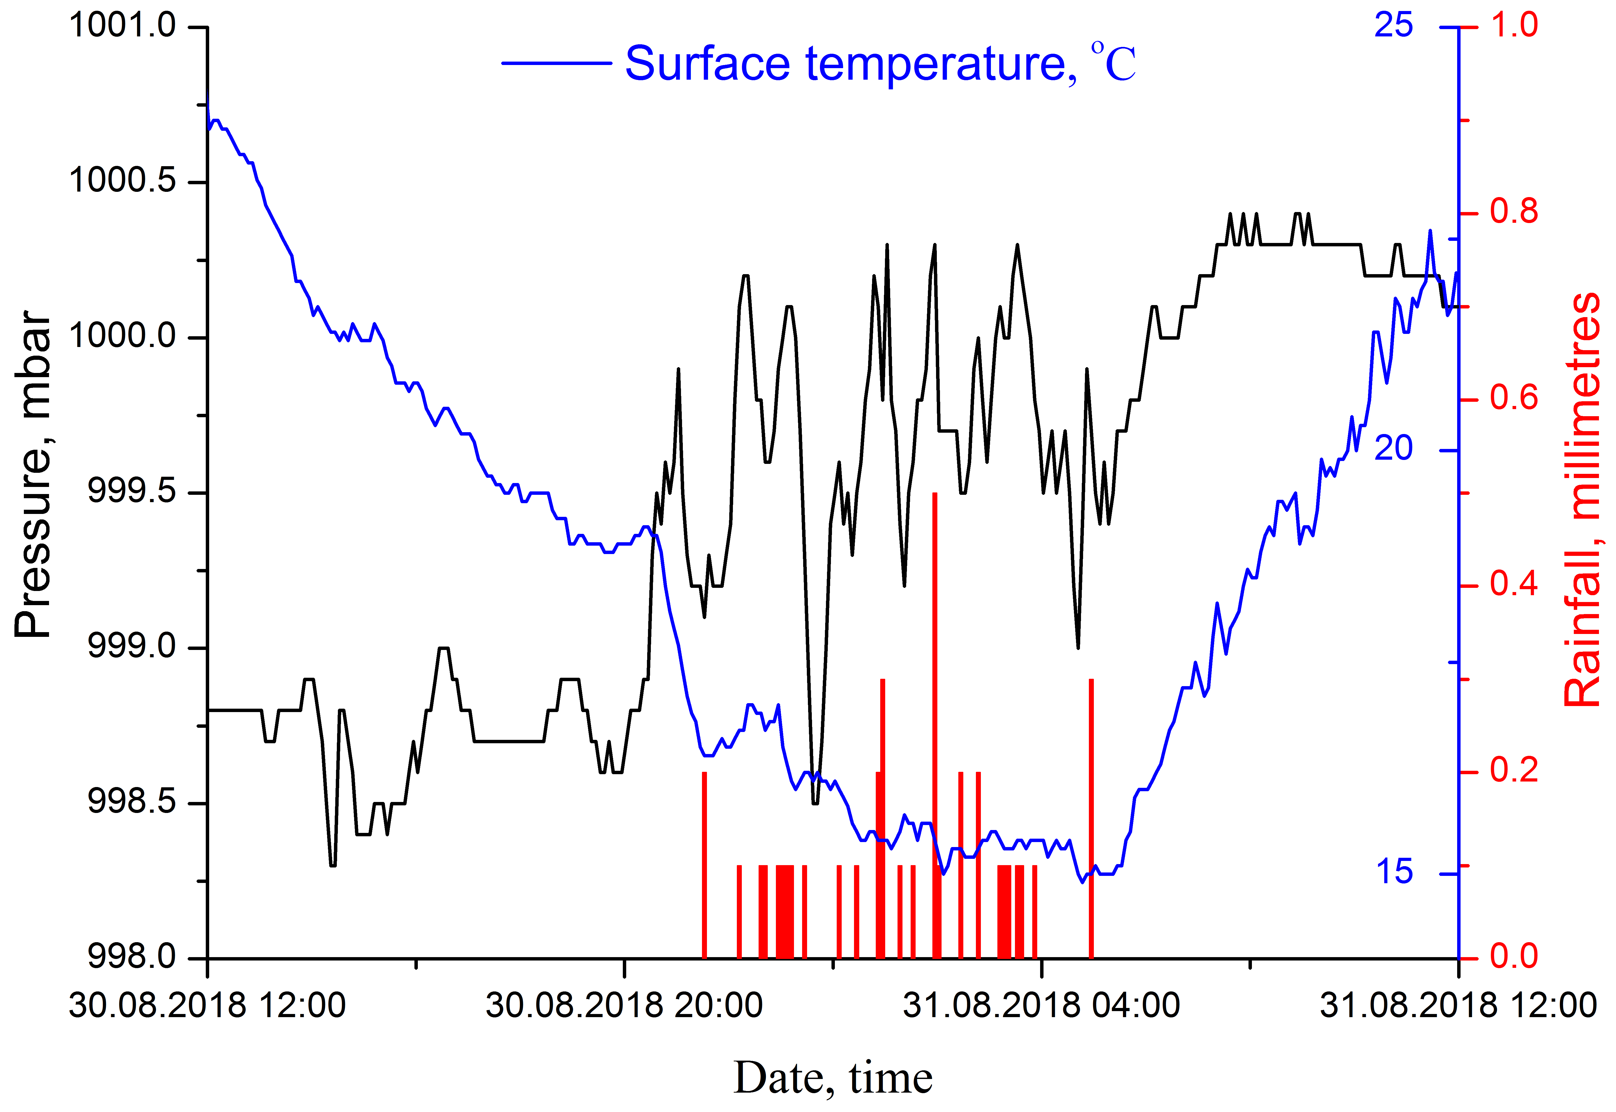
30.08.2018 – 31.08.2018
The thunderstorm was observed at the Domodedovo airport meteorological station from 21:00 30.08 to 05:00 31.08, at the Balchug meteorological station from 21:00 30.08 to 05:00 31.08 and at the VDNKh meteorological station at 23:00 30.08

Slide 13
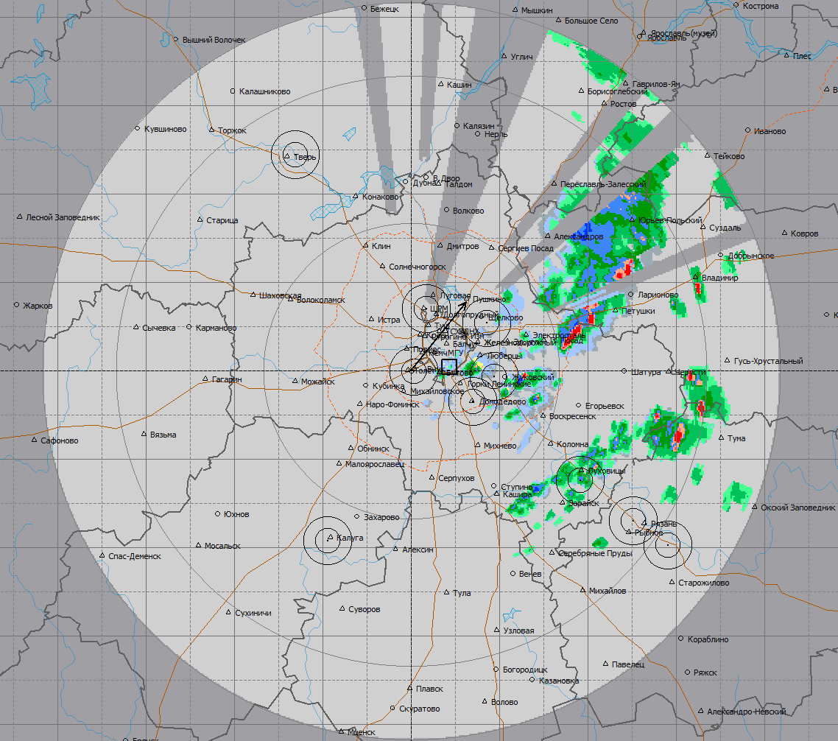
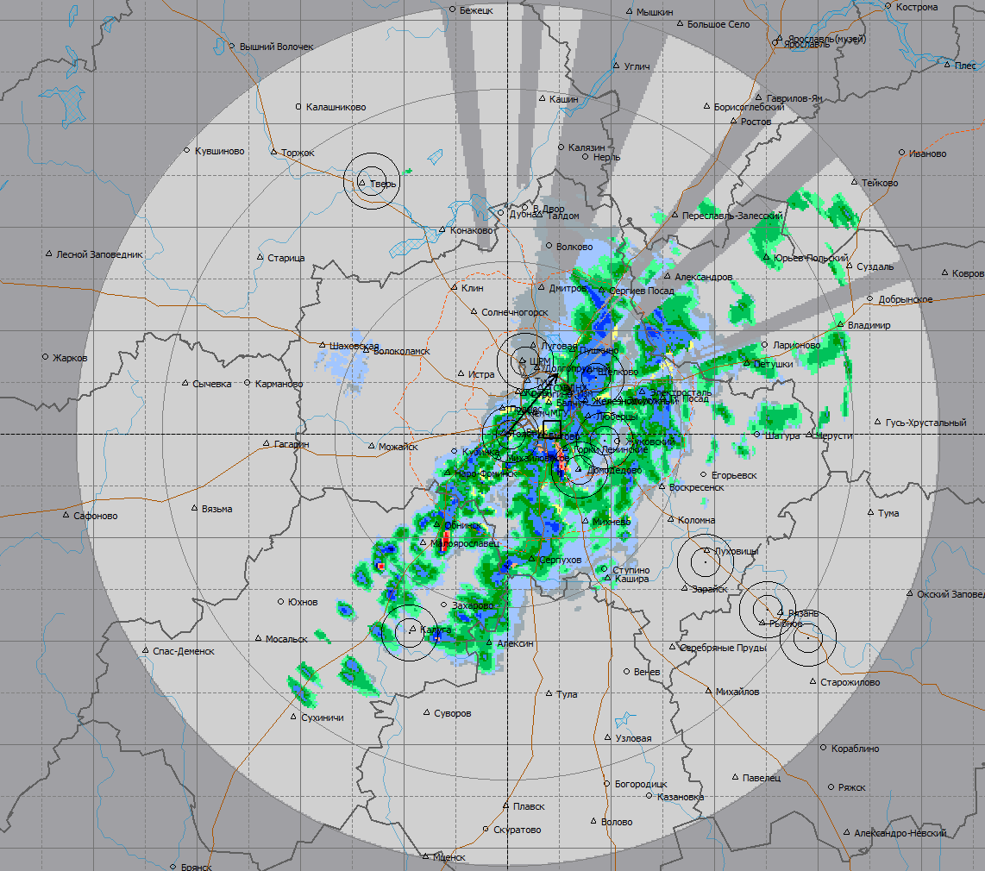
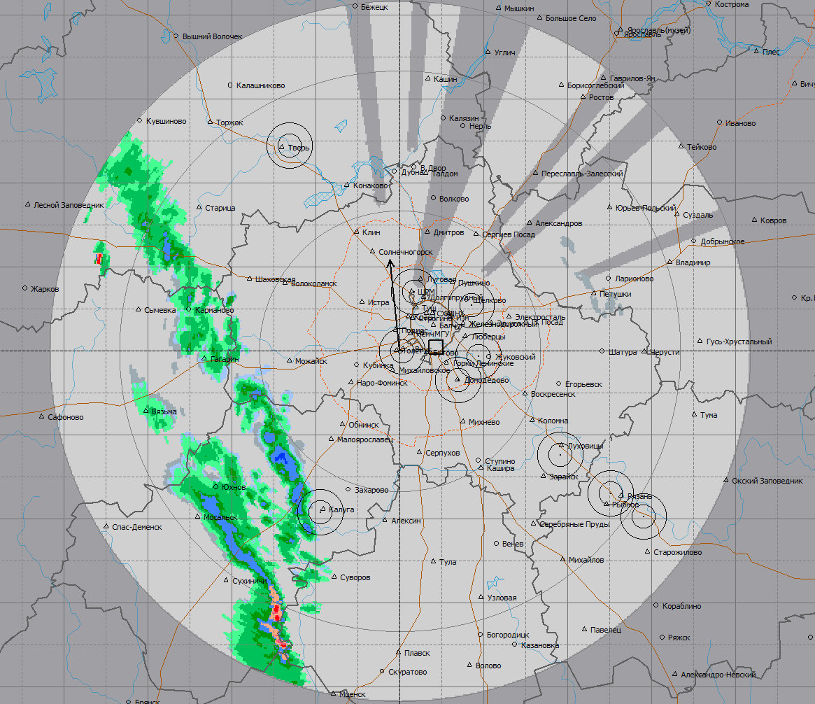
Meteorological maps
Peak 30.08 23:50
Start 30.08 05:00
End
31.08 07:00
Precipitation is weak
Moderate precipitation
Precipitation is strong
Cumuliform clouds
Rain is weak
Moderate rain
Heavy rain
Thunderstorm 30-70%
Thunderstorm 70-90%
Thunderstorm> 30%

Slide 14
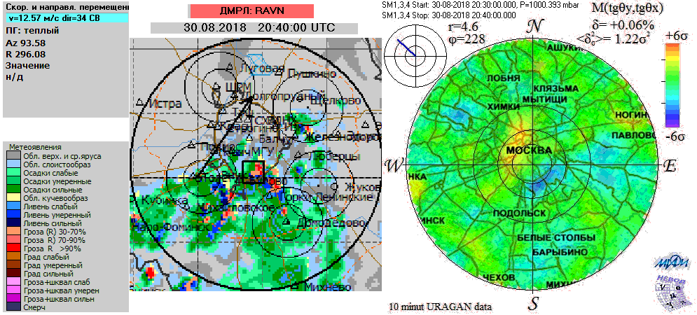
Comparison (20:30 – 05:20)

Slide 15
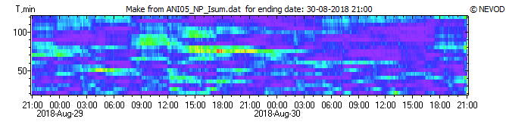
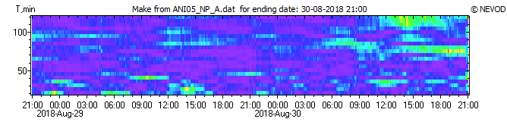
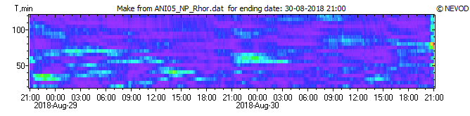
Wavelet analyses of URAGAN data
Isum
A
Rhor

Slide 16
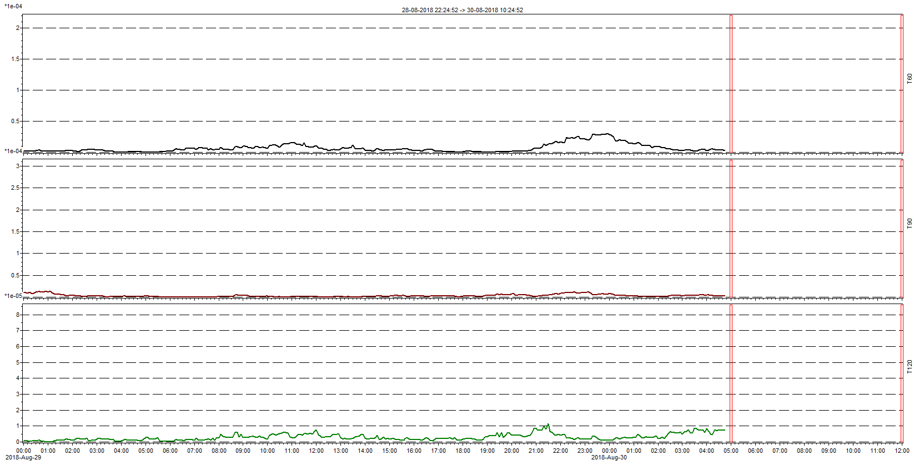
Wavelet analysis: Rhor
T60
T90
T120

Slide 17
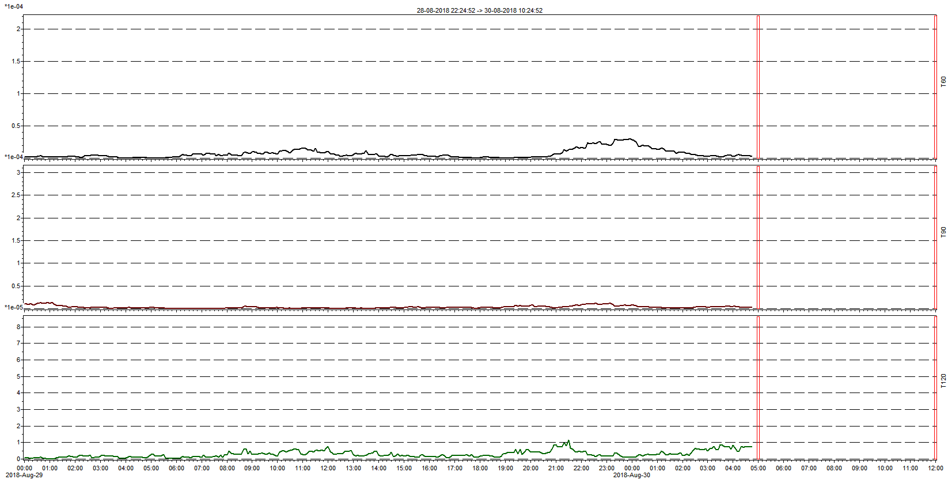
Wavelet analysis: Rhor
T60
T90
T120

Slide 18
Conclusions
Results obtained from the analysis of data provided by MH URAGAN are consistent with DMRL-C data
Characteristics of the muon flux provide a good reaction to the passage of a thunderstorm
Wavelet analysis of different time series shows that before and during the passage of a thunderstorm there are periodic disturbances in the characteristics of the muon flux. Periods of those disturbances are ranging from 60 to 180 minutes

Slide 19
Thank you for your attention!

Slide 20

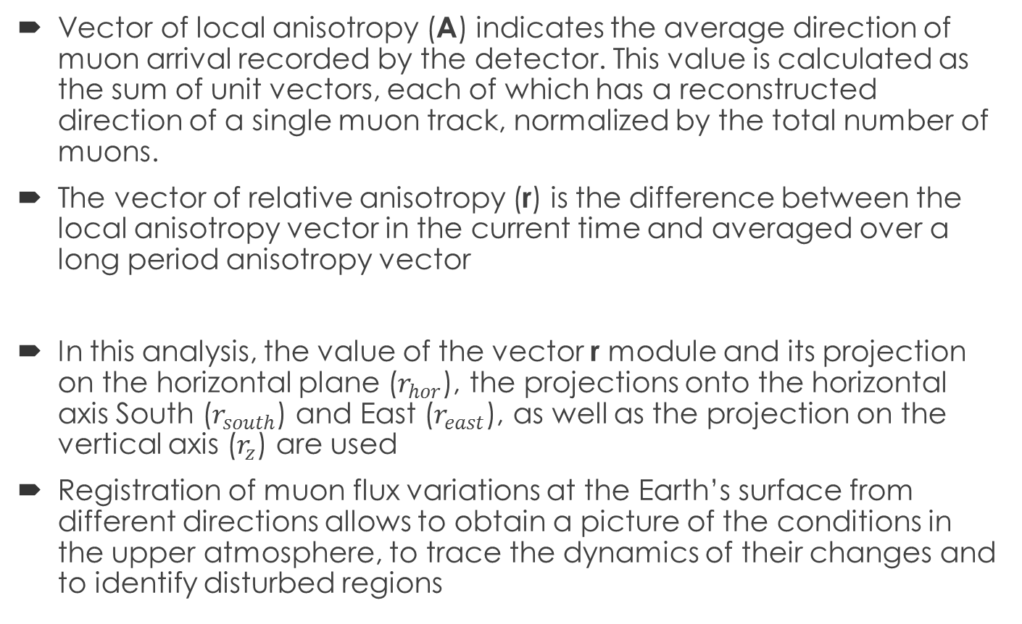
Characteristics reflecting the distortion of the distribution of the muon flux
Vector of local anisotropy (A) indicates the average direction of muon arrival recorded by the detector. This value is calculated as the sum of unit vectors, each of which has a reconstructed direction of a single muon track, normalized by the total number of muons.
The vector of relative anisotropy (r) is the difference between the local anisotropy vector in the current time and averaged over a long period anisotropy vector
In this analysis, the value of the vector r module and its projection on the horizontal plane ($r_{hor}$), the projections onto the horizontal axis South ($r_{south}$) and East ($r_{east}$), as well as the projection on the vertical axis ($r_{z}$) are used
Registration of muon flux variations at the Earth’s surface from different directions allows to obtain a picture of the conditions in the upper atmosphere, to trace the dynamics of their changes and to identify disturbed regions

Slide 21
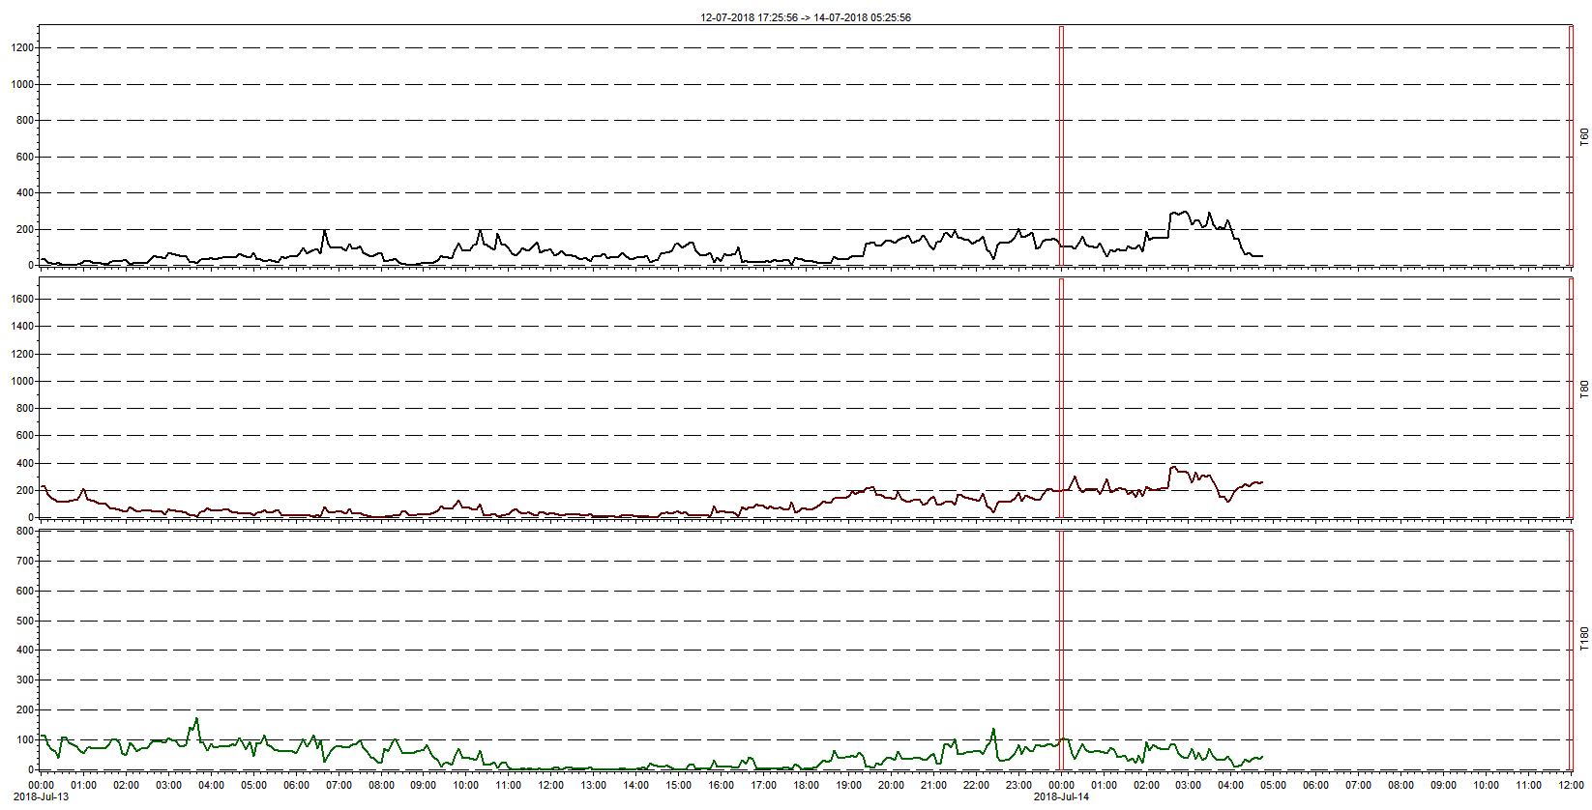
14.07 Wavelet analysis: Isum
T60
T80
T180

Slide 22
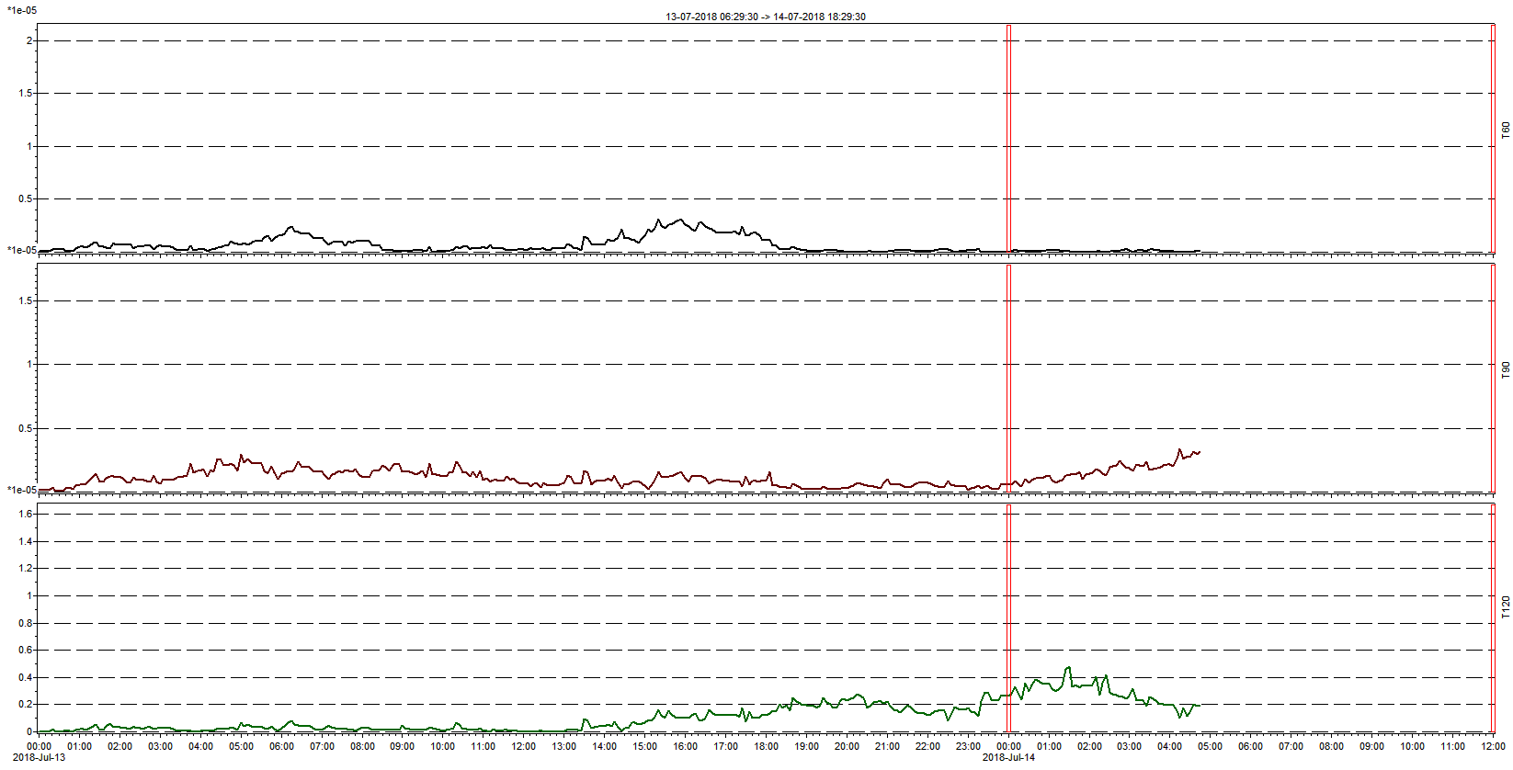
14.07 Wavelet analysis: A
T60
T90
T120

Slide 23
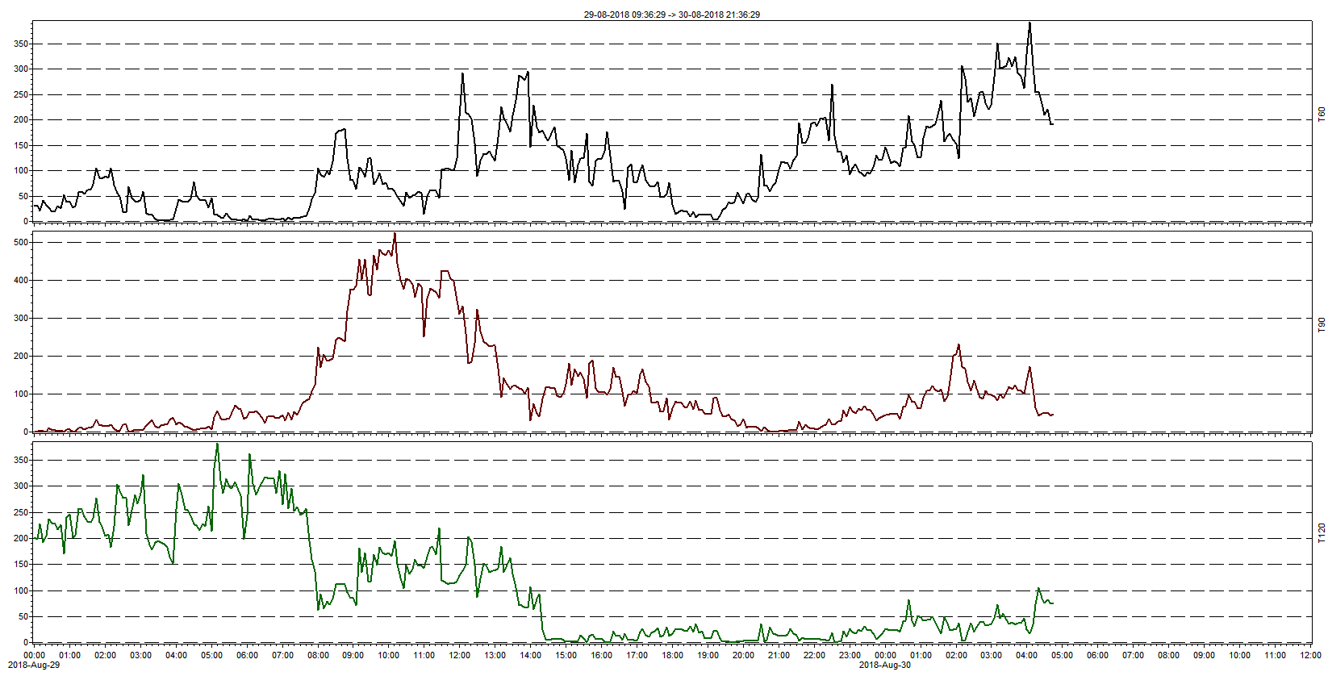
30.08 Wavelet analysis: Isum
T60
T90
T120

Slide 24
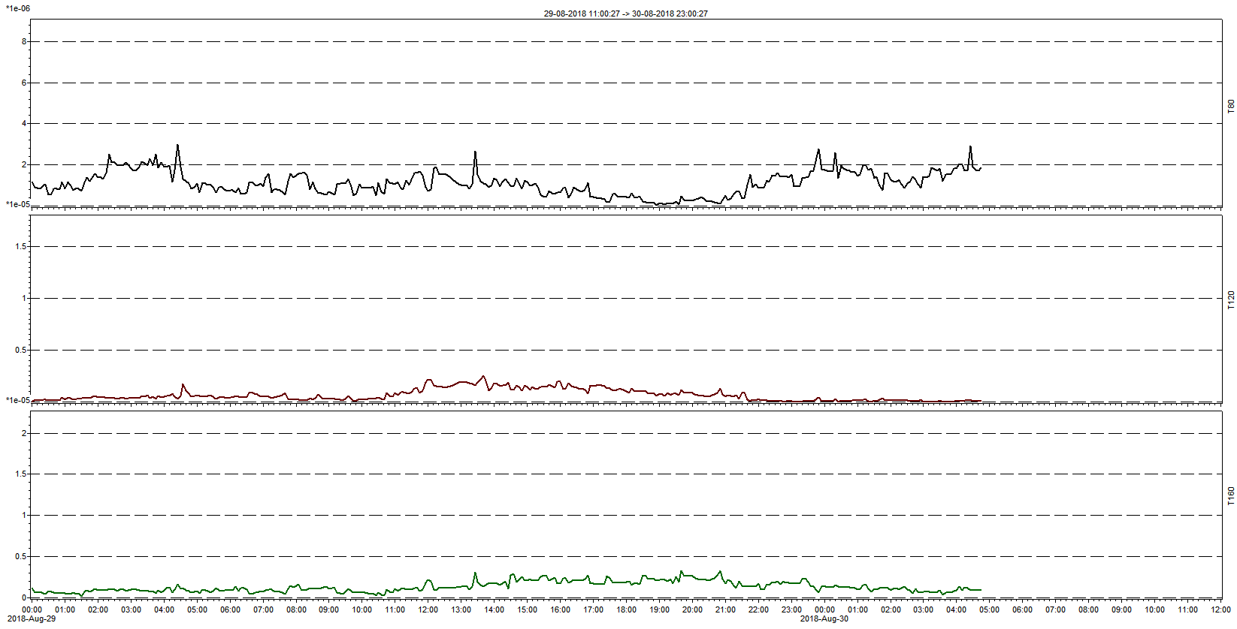
30.08 Wavelet analysis: A
T80
T120
T160

Slide 25
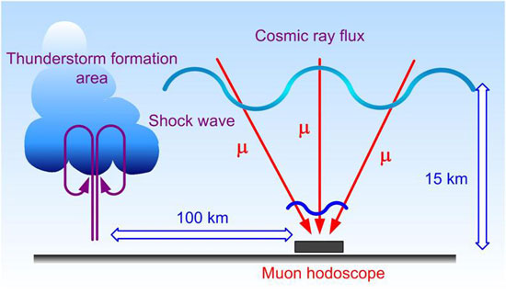
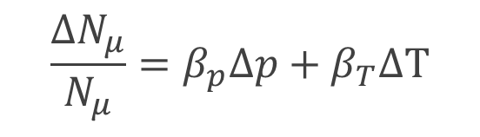
Muon diagnostics
Formation of the muon flux: in the atmosphere at an altitude of 10 - 20 km
The top of a typical thunderstorm cell: at a height of 8 - 12 km
The higher the temperature, the:
higher pion generation point
longer geometric path of the muon to the surface of the Earth
higher probability of decay
The muon flux is modulated by changes in the basic thermodynamic parameters of the atmosphere.
$$\frac{{∆N}_{μ}}{N_{μ}}=β_{p}∆p+β_{T}∆T$$
The greater the pressure, the
greater muons absorption (due to an increase the amount of substance)

Slide 26
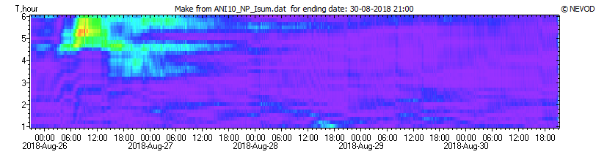
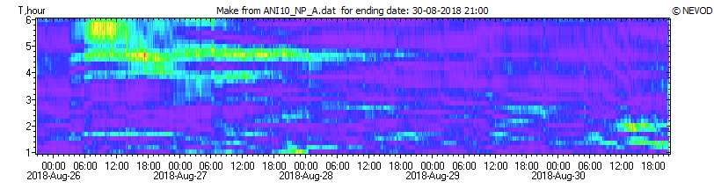
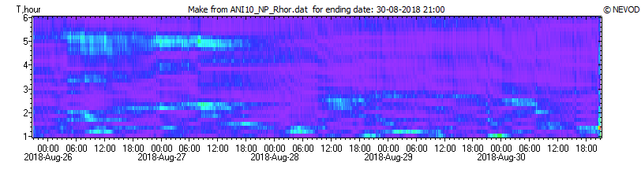
Wavelet analyses of URAGAN data

