Slide 1

European XFEL:
Novel Technologies for Superior Science
IV International Conference on Particle Physics and Astrophysics, 22 - 26.10.18, Moscow
Serguei Molodtsov
European XFEL, Scientific Director

Slide 2
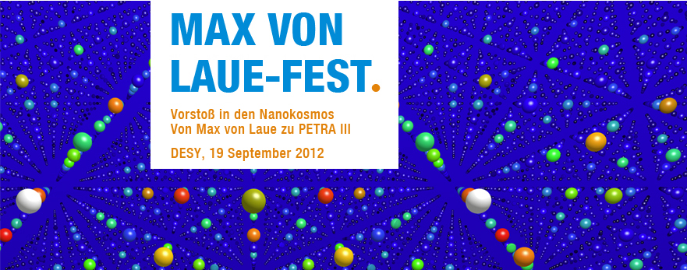
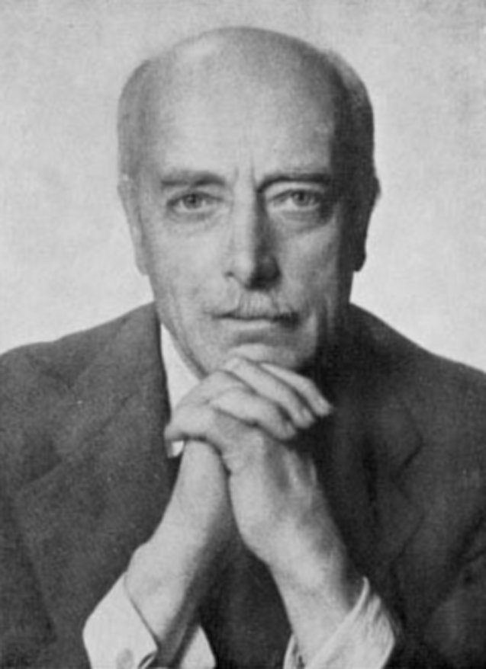
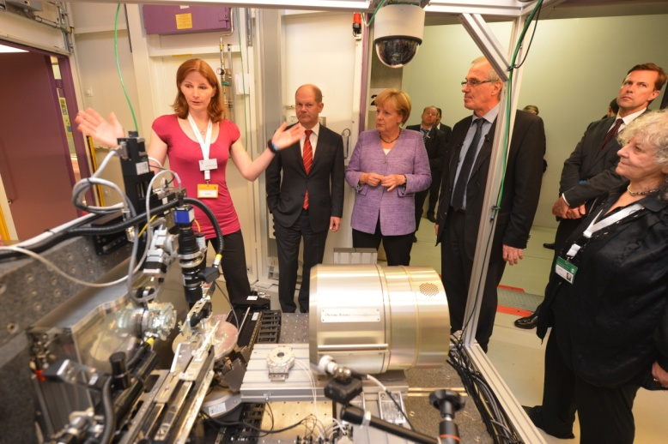
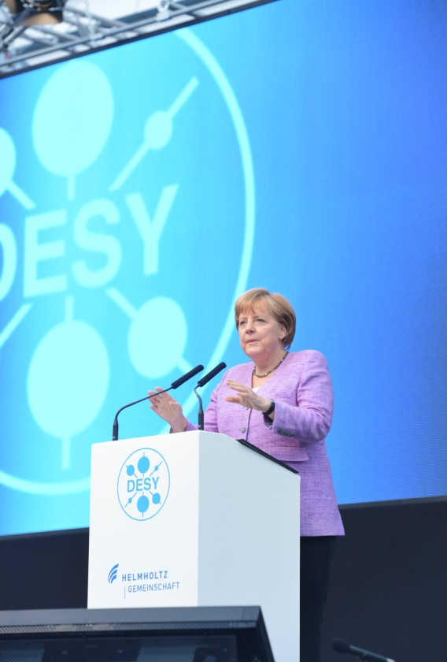
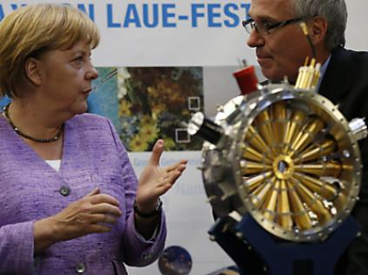
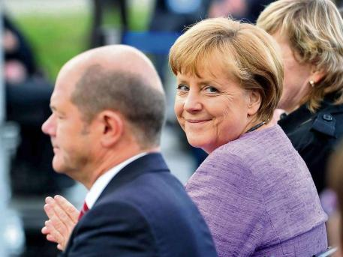
Max von Laue celebration at DESY

Slide 3
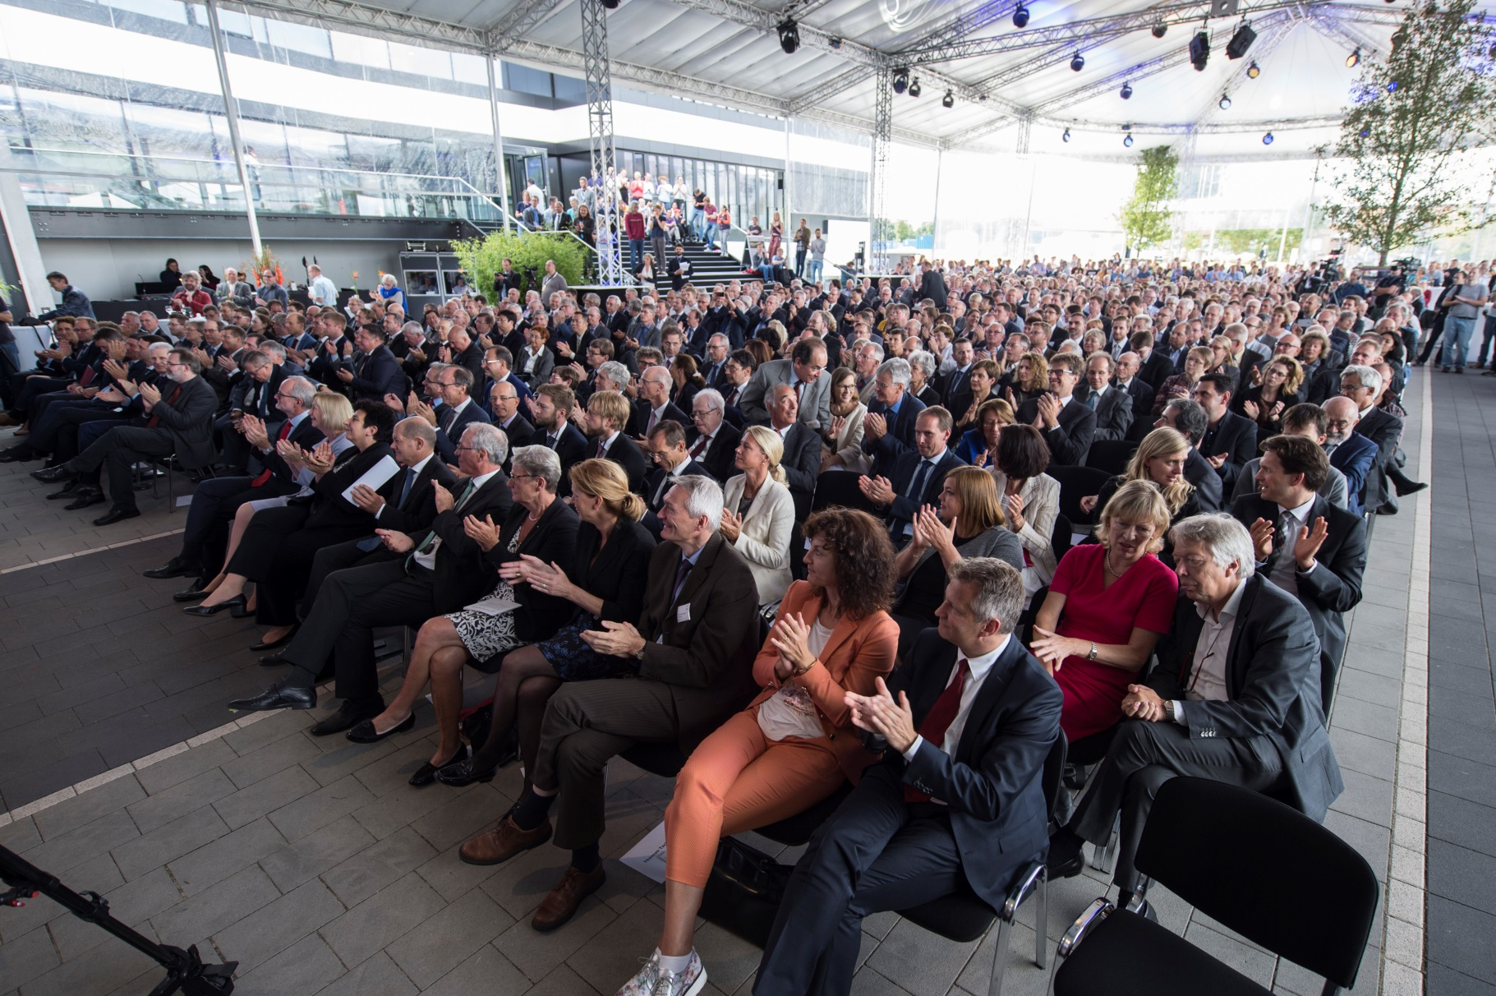
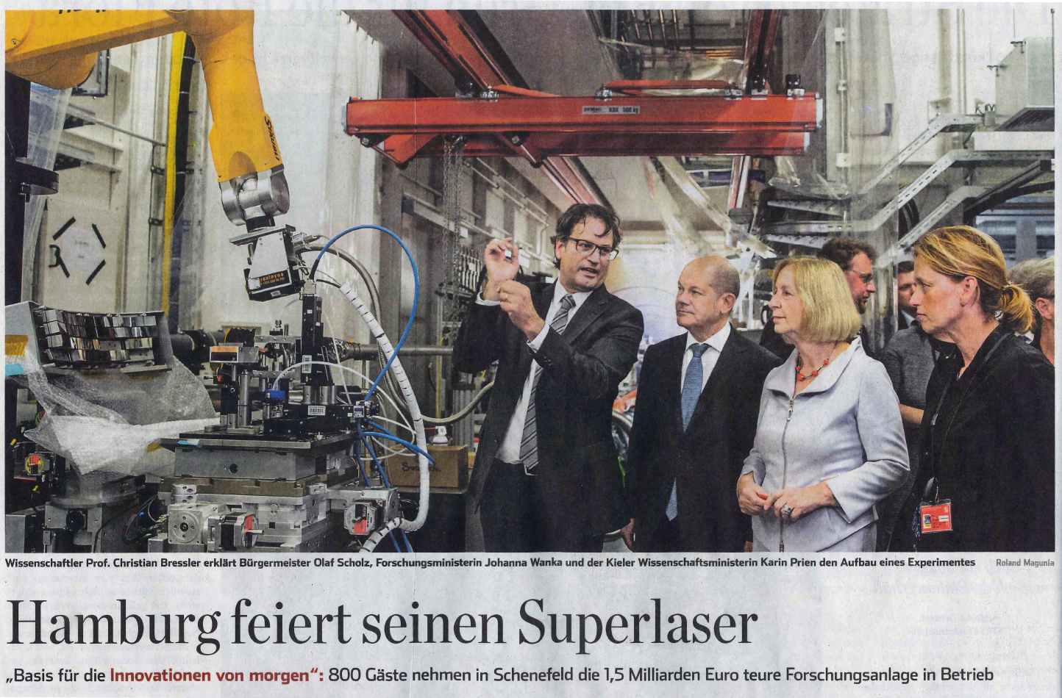
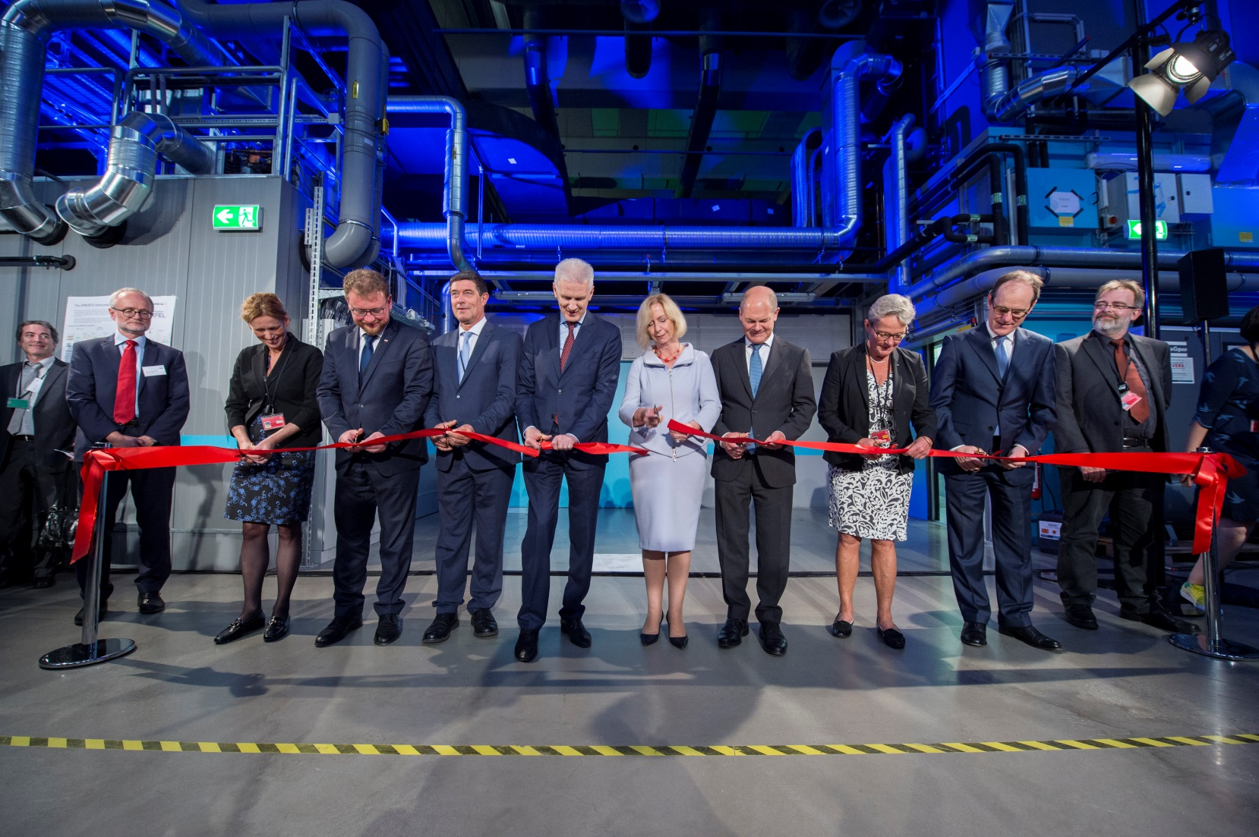
European XFEL inauguration (Sept. 1, 2017)

Slide 4
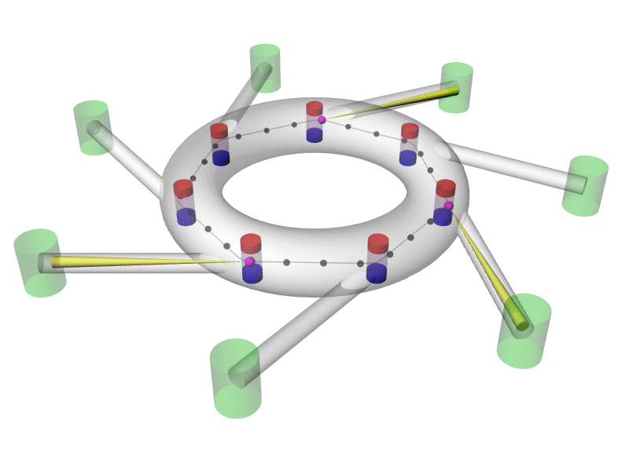
Synchrotron radiation (dipoles)

Slide 5
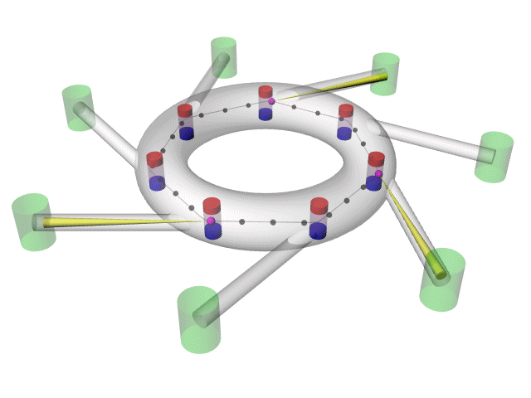
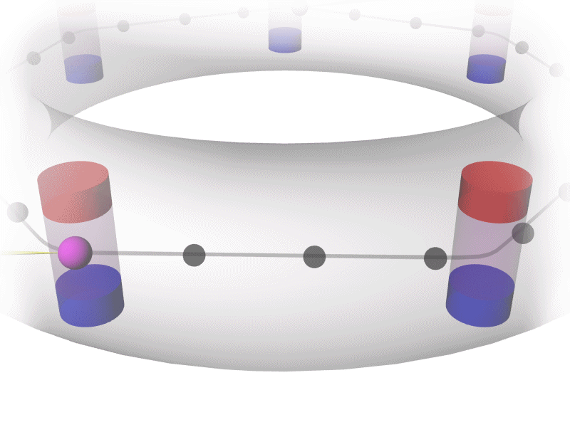
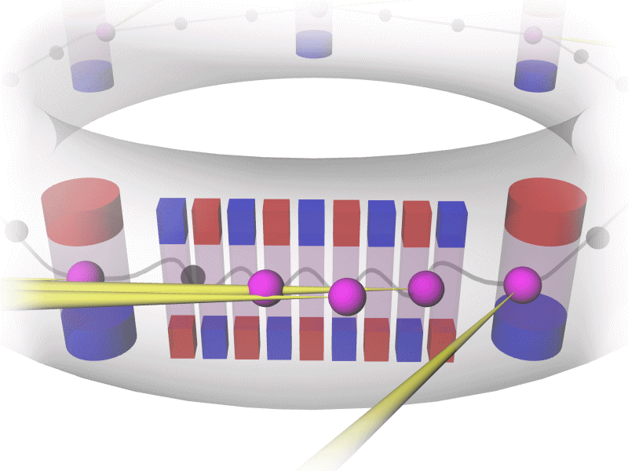
Synchrotron radiation (undulators)

Slide 6
X-Rays
New Generation Sources
Free Electron Lasers (XFELs)

Slide 7
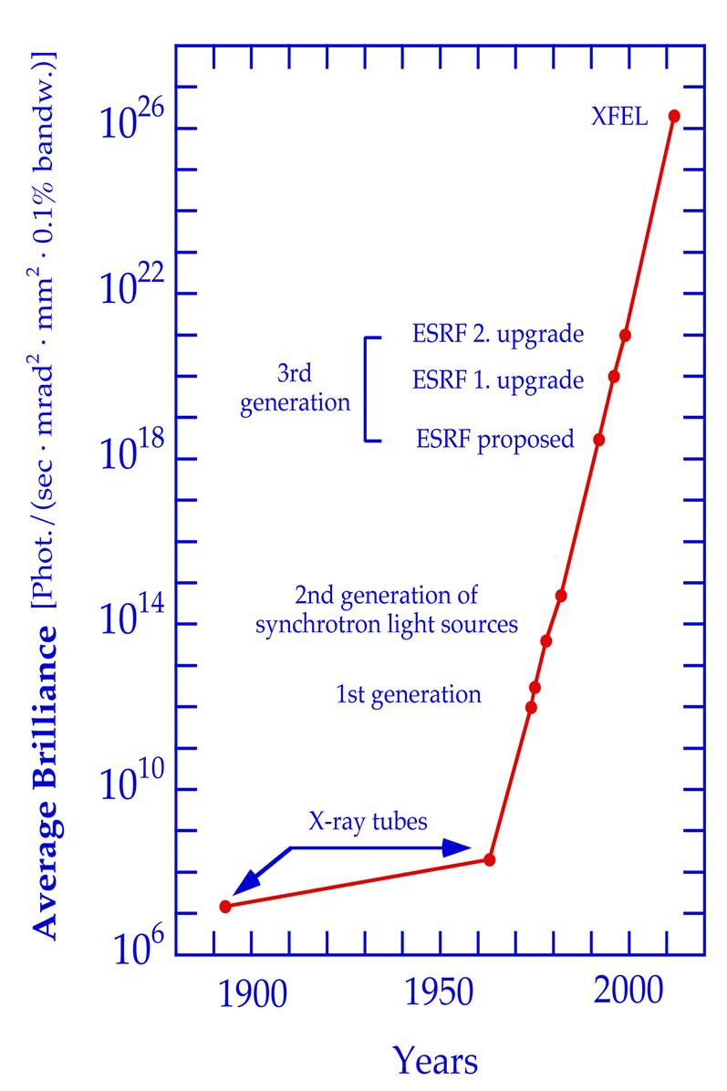
Main advantages of XFELs
FELs
Photons
PETRA III
2-100 fs
DORIS III
Photons
time

Slide 8
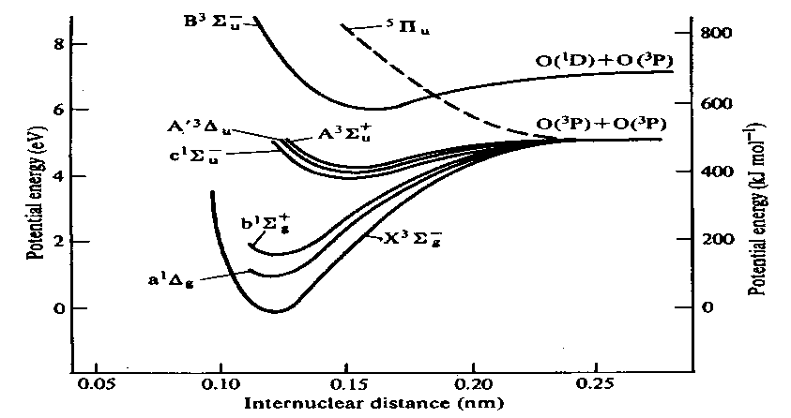

wavelength down to < 0.1 nm ==> atomic-scale resolution
ultrashort (<1 ps) pulses
==> “molecular movies”
ultra-high peak brightness,
transverse spatial coherence
==> imaging of single nanoscale objects, possibly down to individual macromolecules (no crystals)
==> investigation of matter under extreme conditions…

Slide 9
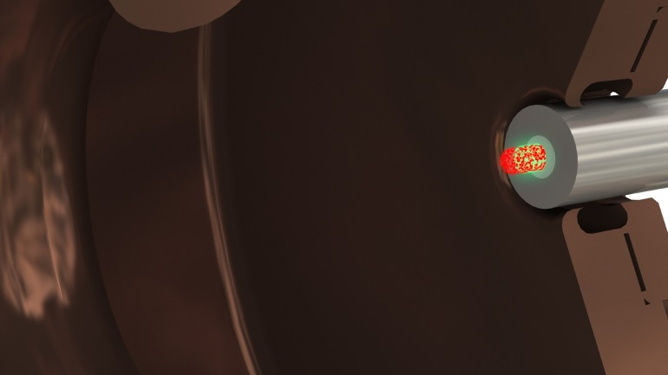
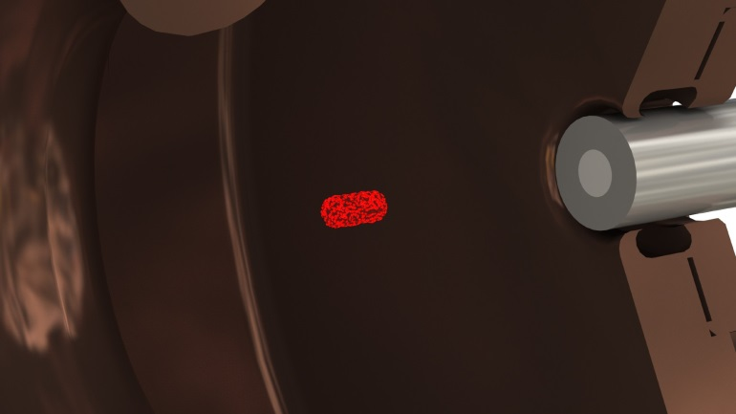
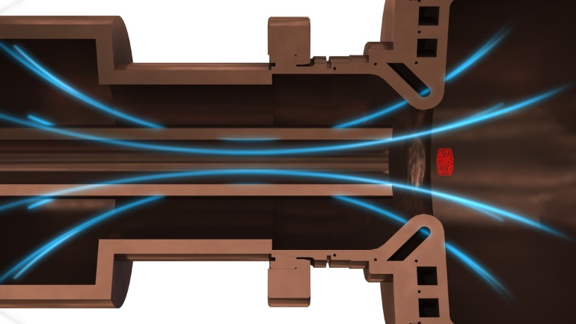
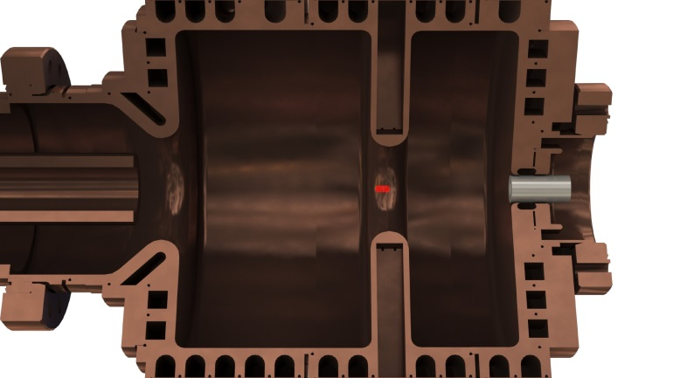
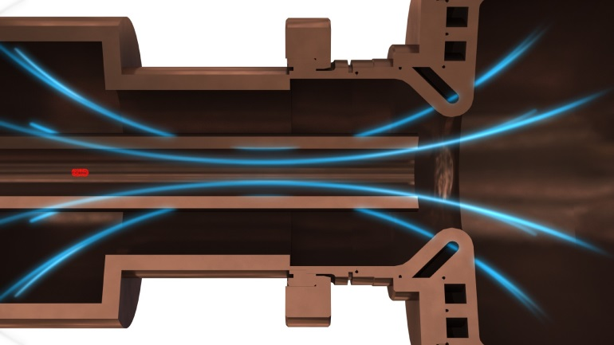
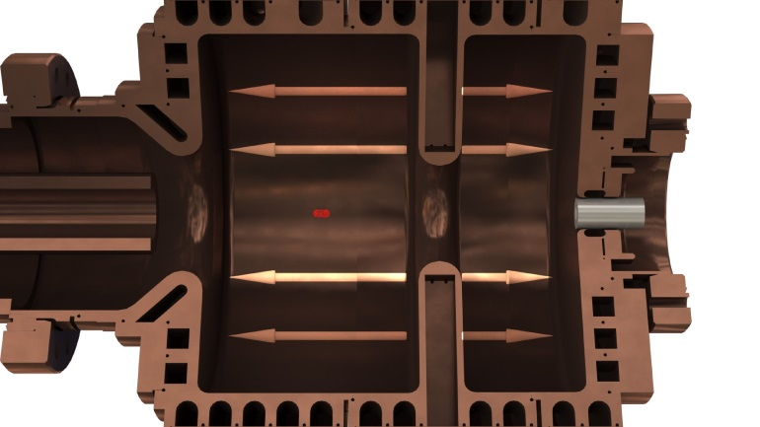
Injector: creating bunches of electrons
Optical laser strikes Cs₂Te surface, releasing a cloud of electrons
Electrons move into a magnetic field, shaping into a bunch
Small accelerator module “fires” bunch into the main electron accelerator

Slide 10
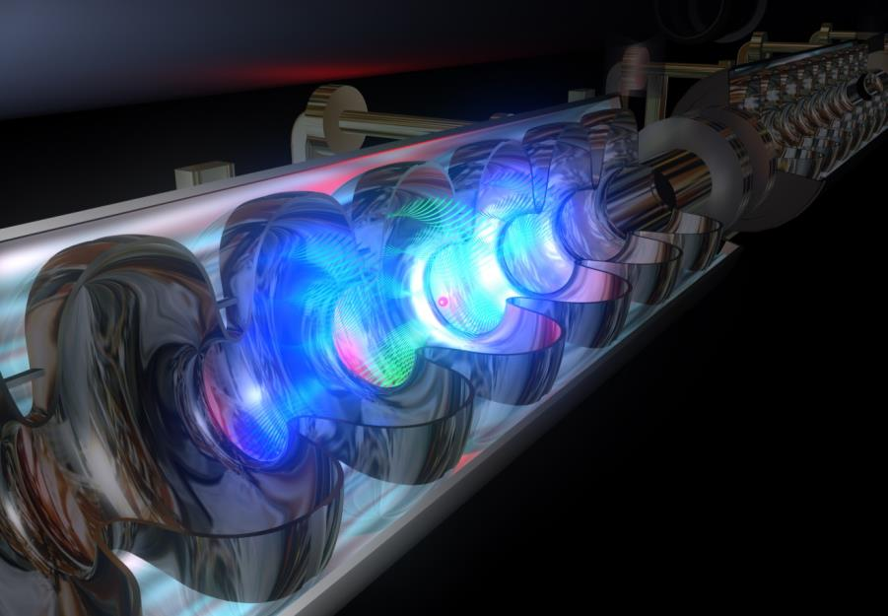
Accelerator: electrons at close to light speed
100 accelerator modules over 2 km bring the electron bunch to near light speed and high energies
Superconducting niobium cavities powered by intense radio frequency accelerate electrons

Slide 11
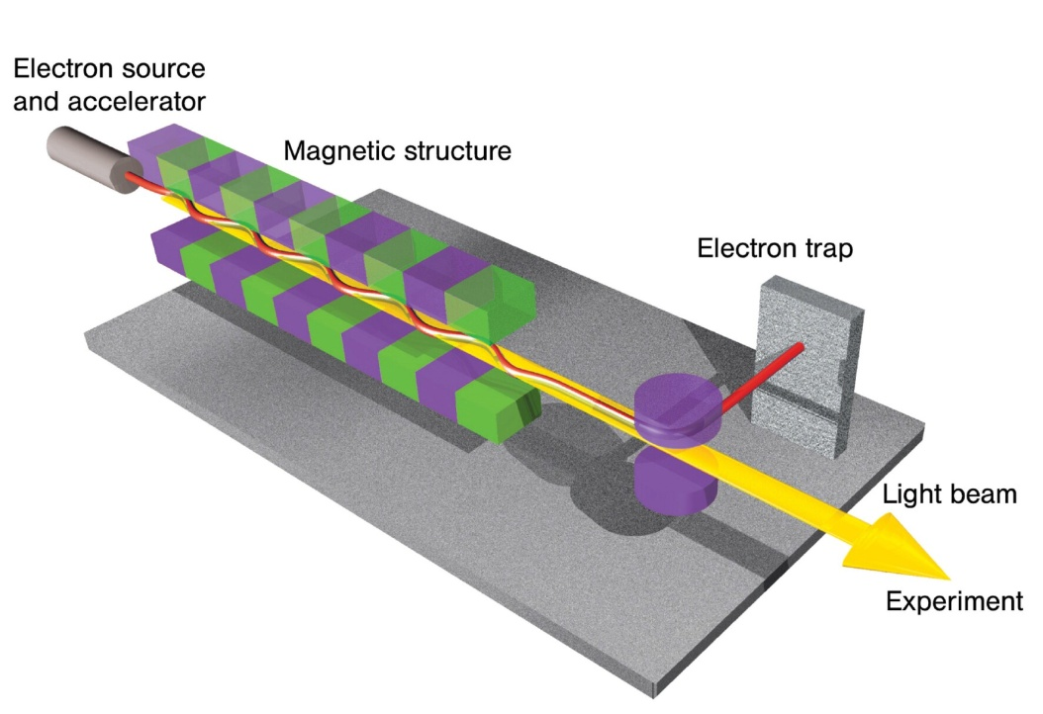

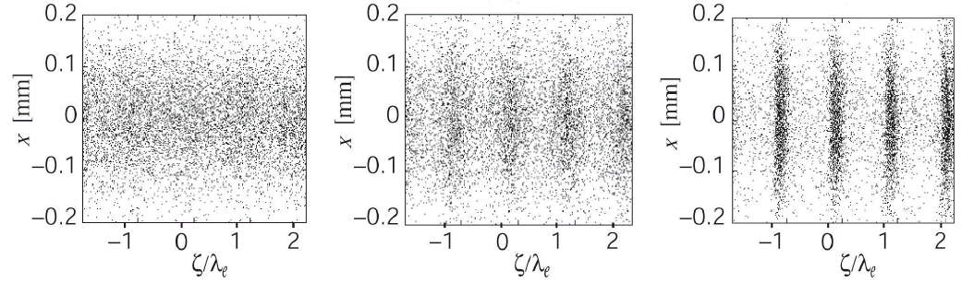
Basics of SASE FEL process
Undulator
E.L. Saldin
E.A. Schneidmiller
M.V. Yurkov

Slide 12
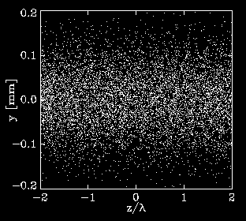
Basics of SASE FEL process
Undulator
E.L. Saldin
E.A. Schneidmiller
M.V. Yurkov

Slide 13
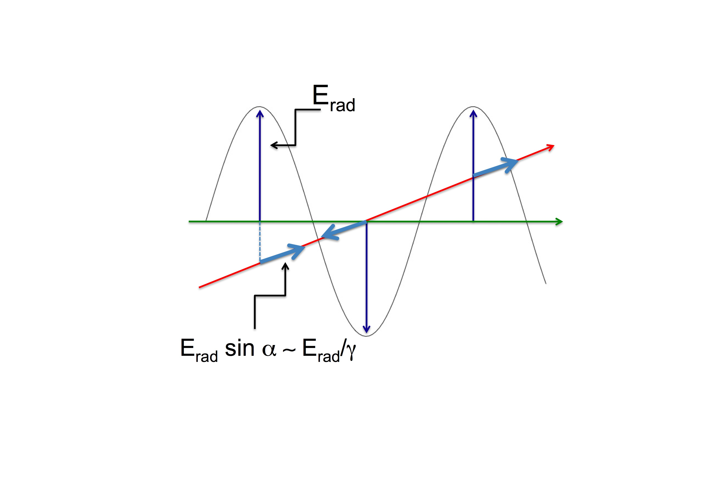
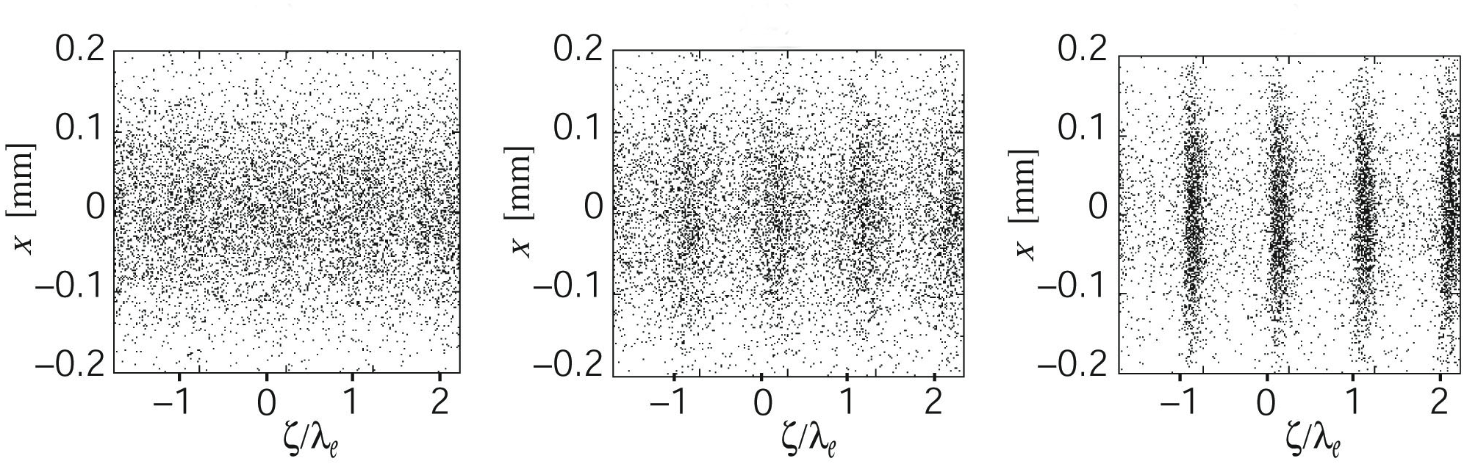
Origin of microbunching
Electron trajectory
Undulator axis
Radiation electric field has a small component parallel to electron velocity, which can accelerate or decelerate electrons
α
13

Slide 14
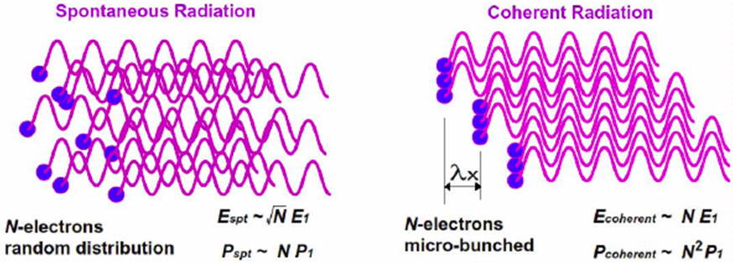
Spontaneous vs. coherent radiation in undulators

Slide 15
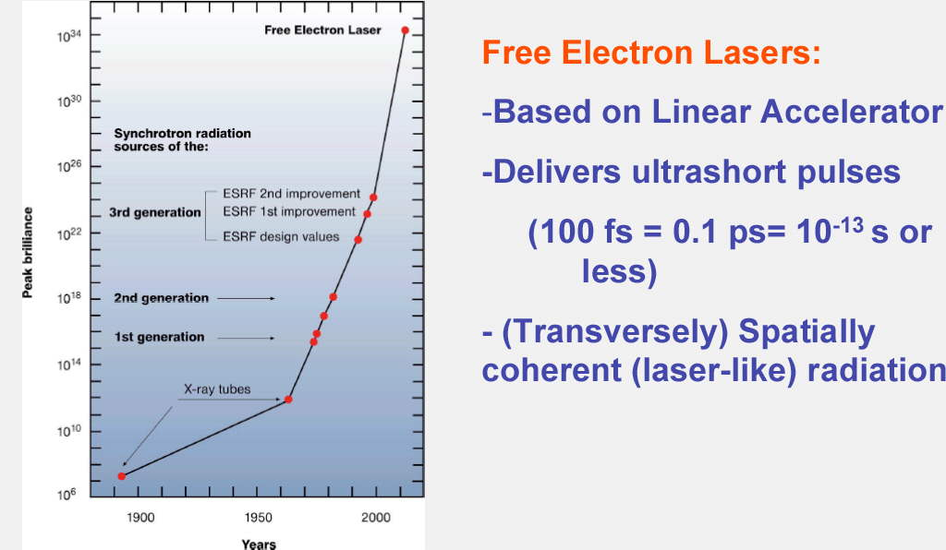
Peak brilliance of X-Ray sources vs. time

Slide 16

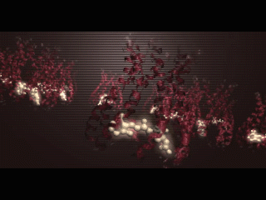
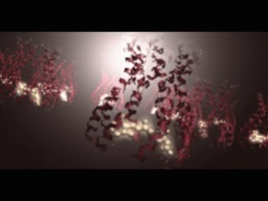
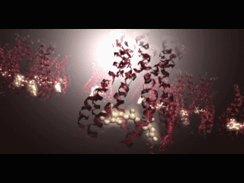
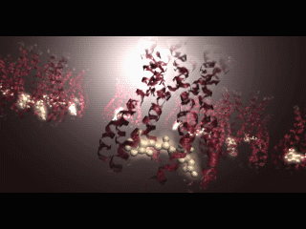
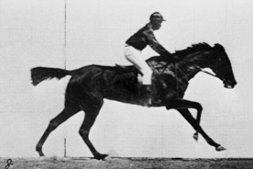
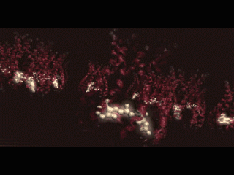
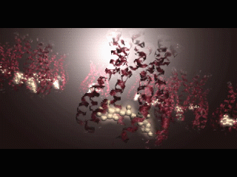
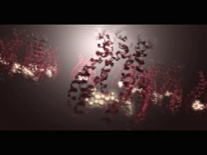
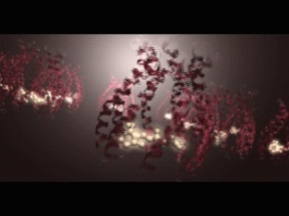
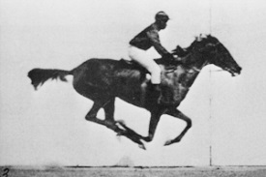
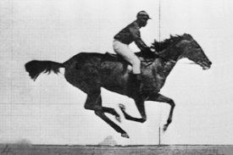
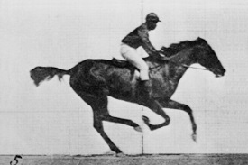
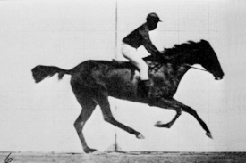
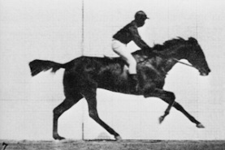
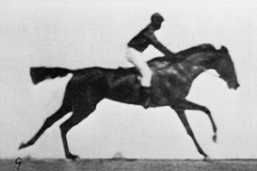
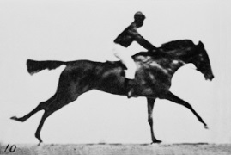
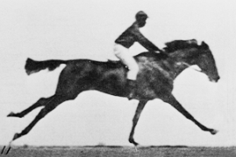

Making molecular movies
Eadward Muybridge
1892
European XFEL
2017

Slide 17
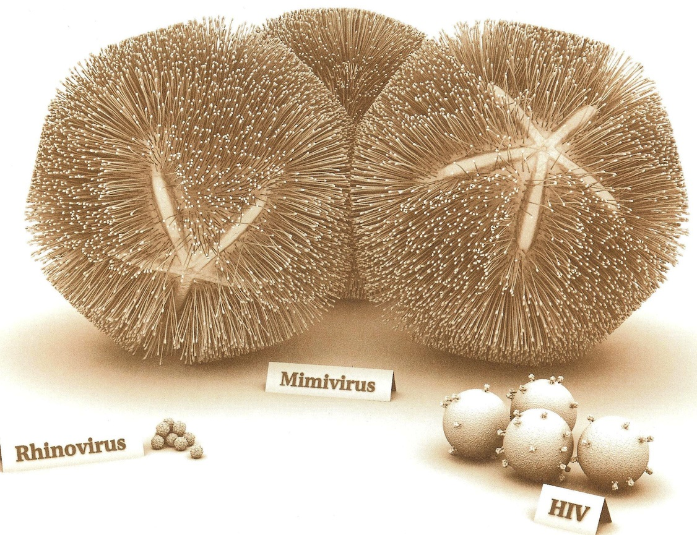
Tremendous variety of bio-objects to be studied
Single protein
molecule
Rhinovirus capsid (done)
http://www.americanscientist.org/issues/feature/2011/4/giant-viruses

Slide 18
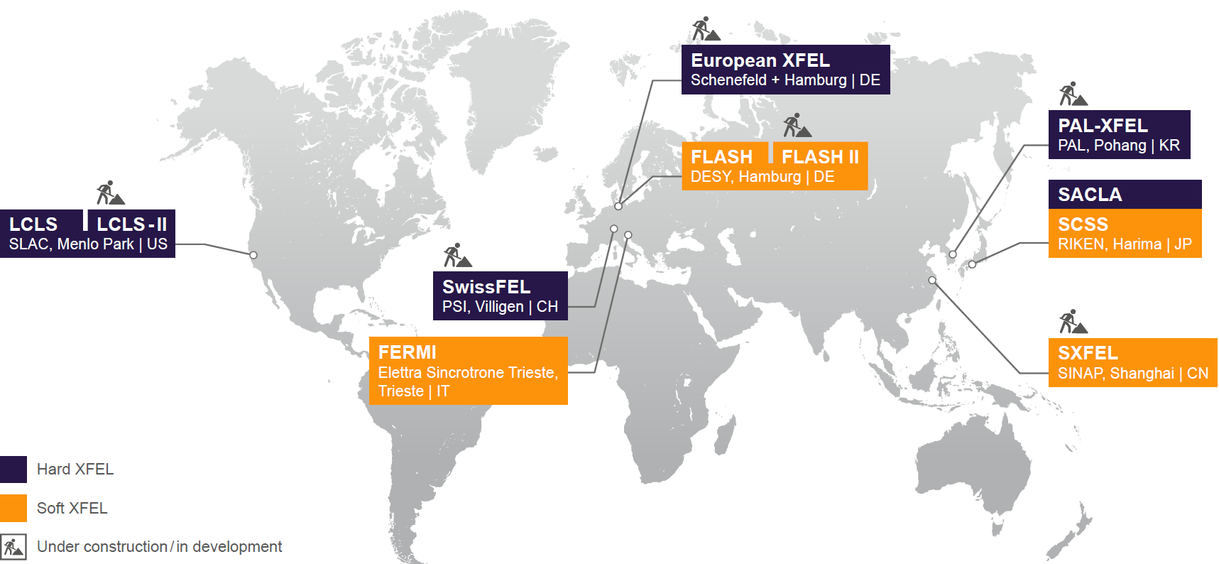
X-ray free-electron lasers worldwide

Slide 19
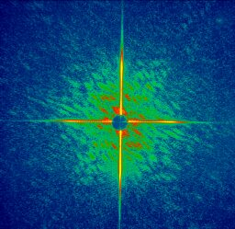
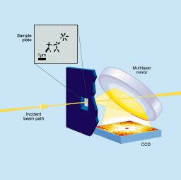

Experiments at FLASH (H. Chapman, CFEL, Hamburg)
A single shot image
A coherent diffraction pattern recorded from a single 25 fs pulse
Diffraction pattern from a subsequent pulse showing that the sample was destroyed after recording the image
A nanoscale object can be imaged by a single femtosecond FEL pulse before the sample explodes

Slide 20


Single particle imaging (J. Hajdu, Uni Uppsala)
Beam
dump
Aerosol sample injector
10⁻⁶ mbar
LCLS X-ray pulses
Detector assembly
Measured hit rates match theoretical values

Slide 21




Single particle imaging (J. Hajdu, Uni Uppsala)
Individual exposures
Self-consistent 3D data set
Electron density map
From 2D to 3D structure determination

Slide 22








Imaging picoplankton organism “on the fly”
PICOPLANKTON are the most
abundant photosynthetic cells in
the oceans (discovered in 1988)
single shot
diffraction pattern
reconstruction
13.5 nm
~10 fs
1 micron
This cell was injected into vacuum
from solution, and shot through the
beam at 200 m/s
J. Hajdu, I. Andersson, M. Svenda, M. Seibert (Uppsala)
S. Boutet (SLAC)
M. Bogan, H. Benner, U. Rohner, H. Chapman (LLNL)

Slide 23





Resonant Inelastic X-ray Scattering
Selective excitations pump
Selective excitations probe (RIXS)
Excitation Energy (eV)
Ament et al., Rev.Mod.Phys. 83, 75 (2011)
Guarise et al., PRL 105, 157006 (2010)

Slide 24



RIXS: Low energy excitations in solids
Sr₂CuO₂Cl₂
La₂CuO₄
L. Braicovich, et al.,
Phys. Rev. Lett. 104, 077002 (2010)
M. Guarise, et al.,
Phys. Rev. Lett. 105, 157006 (2010)
YBa₂Cu₃O_{7-δ}
M. Le Tacon, et al., Nature Phys. 7, 725 (2011)

Slide 25

All these time-resolved in pump-probe experiments!

Slide 26



Recombination of carriers in solar cells

Slide 27
Liquid-liquid phase transition in Si
HDL
LDL
M. Beye, et al. PNAS 2010 107 (39) 16772-16776
27

Slide 28

Hamburg, 30.11.2009: European XFEL Convention signing ceremony
Initiated by Kurchatov Institute. Total costs ≈1.500 MEUR.

Slide 29

European XFEL - a leading new research facility
NordNordWest / CCA-SA-3.0

Slide 30





How it works – closer look at the facility
Scientific instruments and instrumentation
2017 – 27.000 p/s
European XFEL
Electron injector
Undulator systems
Superconducting electron accelerator

Slide 31

Testing accelerator modules prior to installation

Slide 32

Accelerator module test facility

Slide 33

Power RF – installation check

Slide 34

Undulators in tunnel

Slide 35
Photon energy ranges
35
Carbon K-edge:
284 eV
N 1s: 410 eV
3 keV
12.4 keV
20 keV
O 1s: 543 eV
P 1s: 2145 eV
S 1s: 2470 eV
SASE 3
SASE 1 / 2
17.5 GeV
0.73 – 3 keV
6.4 – > 25 keV
Electron energy sets
14.0 GeV
0.47 – ~3 keV
4.1 – > 20 keV
10.5 GeV
0.26 – ~2 keV
3.0 – > 15 keV
FLASH
0.02 – 0.3 keV
200 eV
1 keV
10 keV

Slide 36

Photon beamlines

Slide 37

The European XFEL - Science
Undulator Segment | FEL radiation energy [keV] | Wavelength [nm]
SASE 1 | 3 - over 24 (Hard XR) | 0.4 - 0.05
SASE 2 | 3 - over 24 | 0.4 - 0.05
SASE 3 | 0.27 – 3 (Soft XR) | 4.6 – 0.4
Orange color: X-ray optics & Beam Transport

Slide 38


FXE – femtosecond X-ray experiments
Ultrafast photo-induced processes
in liquids and solids

Slide 39





X-ray emission spectroscopy on Fe(bpy)₃ solution: #2016 (Gawelda et al.)
30 bunches, 9.3 keV, ~100uJ/pulse, focused to ~20 um
Difference Iron K$β$ spectra
von Hamos spectrometer
8 x Si(531)
GreatEyes CCD detector
Laser/X-ray delay scan

Slide 40




Scattering on aqueous Fe(bpy)₃ solution: #2016 (Gawelda et al.)
30 bunches/train, 9.3 keV, ~100uJ/pulse, focused to ~20 um
FXE, 6 ps delay, ~ 2 min collection time
Large Pixel Detector, 4.5 MHz framerate
Scattering from 100 um jet, 5 trains summed
Synchrotron, 100 ps delay, 8h collection time

Slide 41

Artist’s impression of the SPB/SFX Instrument
Sample injector
Upstream interaction region
1Mpx AGIPD

Slide 42



SPB/SFX – Single Particle, Biomolecules and Serial Femtosecond Crystallography
Coherent imaging and serial crystallography
  Structural biology
  High intensity science(100 nm focus)
Injection / sample chamber

Slide 43


Many thousands of frames of diffraction data was collected
and successfully analysed to give a structure!
Results from XFEL2012, initial refinement:
Rwork/Rfree: 0.168 / 0.193
Average BISO: 34.9
RMSD bonds (Å): 0.003
RMSD angles (°): 0.592
This is the first realisation of the European XFEL’s purpose—a complete experiment from start-to-end demonstrated in the very first user experiment at the facility at the SPB/SFX instrument
(Data September 2017, Analysis November 2017). That is, structural biology works at XFEL!

Slide 44
The European XFEL - Science
Undulator Segment | FEL radiation energy [keV] | Wavelength [nm]
SASE 1 | 3 - over 24 (Hard XR) | 0.4 - 0.05
SASE 2 | 3 - over 24 | 0.4 - 0.05
SASE 3 | 0.27 – 3 (Soft XR) | 4.6 – 0.4
Orange color: X-ray optics & Beam Transport

Slide 45


SCS (Spectroscopy & Coherent Scattering) science programme and techniques
Ultrafast Studies of electronic, spin and atomic structures on the nanoscale
Strongly correlated materials
Femtomagnetism
Applied material science
Chemistry
Catalysis
Basic energy science
Pump-probe methods, single-shot experiments & nonlinear studies
X-ray absorption spectroscopy
Resonant x-ray diffraction
Coherent diffraction imaging
Small-angle x-ray scattering
Resonant inelastic x-ray scattering
Reflectivity

Slide 46





SQS (Small Quantum Systems)
Sorokin et al., PRL 99 (2007)
FLASH
atoms, molecules, ions, clusters, nanoparticles
Non-linear phenomena
Intensity > 10¹⁸ W / cm²
e⁻
e⁻
Multiple ionization
Multi-photon processes
e⁻
Xe 21+
→ 50 photons
hν
e⁻
Time-resolved studies
Pulse durations: 2 - 100 fs
Pump-probe: NIR/XUV, XUV/XUV
CH₃I → CH₃⁺ + I^{n+}
Molecular dynamics
Element specific Soft X-rays
Erk et al., Science 345
(6194), 288 (2014)
LCLS
Imaging experiments
Spatial coherence
Ag
nano-
particles
Size and shape selection
Cluster dynamics
Barke et al.,
Nat.Comm.6, 6187 (2015)
FLASH

Slide 47
The European XFEL - Science
Undulator Segment | FEL radiation energy [keV] | Wavelength [nm]
SASE 1 | 3 - over 24 (Hard XR) | 0.4 - 0.05
SASE 2 | 3 - over 24 | 0.4 - 0.05
SASE 3 | 0.27 – 3 (Soft XR) | 4.6 – 0.4
Orange color: X-ray optics & Beam Transport

Slide 48



MID (Materials Imaging and Dynamics)
EXPERIMENT HUTCH
OPTICS HUTCH
t₁ t₂ t₃
1M pixels
4.5 MHz
200 μm pixels
X-ray Photon Correlation Spectroscopy
Δt

Slide 49



HED (High-Energy Density)
Ultrafast dynamics and structural properties of matter at extreme states
  Highly excited solids→ laser processing, dynamic compression, high B-field
  Near-solid density plasmas→ WDM, HDM, rel. laser-matter interaction
  Quantum states of matter→ high field QED (future upgrade)
Combination of high excitation with various X-ray techniques
  Use of various pump sources: optical laser, XFEL, B-fields (60 T pulsed)
  Various X-ray probe techniques: XRD, SAXS, XRTS, hrIXS, XI, XAS….

Slide 50

Thank you for your attention !

