Slide 1
Integrated simulation of fragmentation, evaporation, and gamma-decay processes in the interaction of cosmic-ray heavy ions with the atmosphere using PHITS
T.Ogawa, S.Hashimoto, T.Sato
Japan Atomic Energy Agency
K.Niita
Research Organization for Information Science and Technology
T.Kamae
Univ. Tokyo / SLAC National Accelerator Lab.

Slide 2

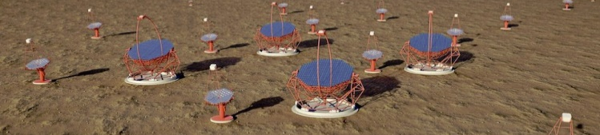
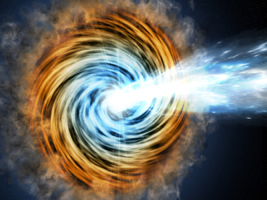

Importance of cosmic gamma-rays
http://www.icrr.u-tokyo.ac.jp/
https://www-glast.stanford.edu/
Cosmic gamma-rays
  in GeV range are observed
    Evolution of universe
    Mechanism of particle acceleration, etc.
    by satellites and Cherenkov telescope arrays
  GeV-class gamma-rays are from
    Gamma-ray bursts, Pulsar, Blazars
    Galactic cosmic-ray heavy ions
Need for
simulation codes !
Decay γ (MeV)
×
Lorentz factor (~1000)
= GeV class
MeV~GeV
N
Blazar
TeV class GCR
Notes:
Pulser : Rotating neutron stars
Blazer : Objects falling to black hole in the middle of galaxy

Slide 3
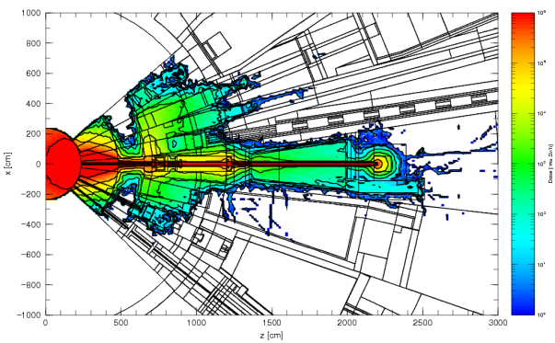
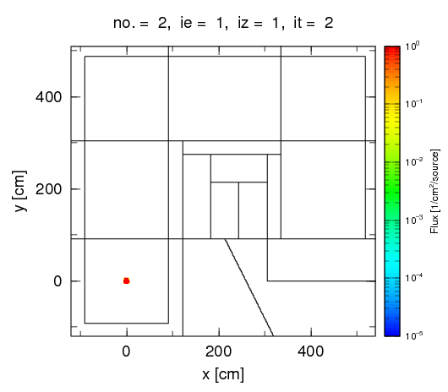
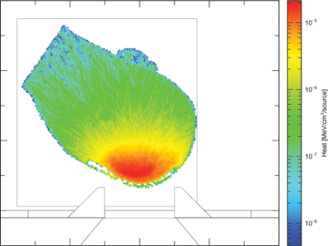
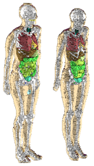
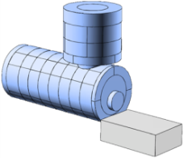
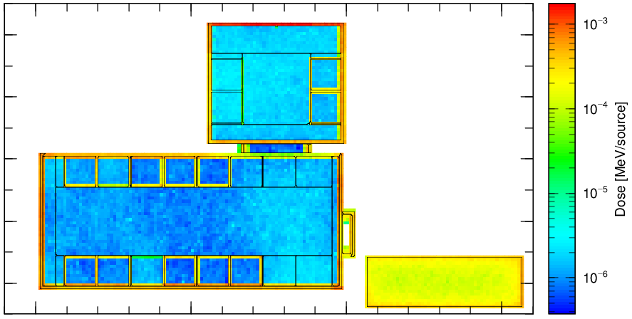

Simulation code package PHITS
This talk is dedicated to applicability of PHITS
  PHITS ≒ MCNPX, MARS, FLUKA, Geant4…
Accelerator Design
Radiation Therapy & Protection
Transport of 662 keV gamma-rays in maze
Space & Geoscience

Slide 4
Simulation scheme
Nucleus-nucleus collisions
Evaporation
γ-rays are from fragments
PHITS simulates 3 steps
Cosmic ray
heavy ion
Air (N, O, etc)
Prompt gamma-decay
Level
structure
Doppler effect

Slide 5
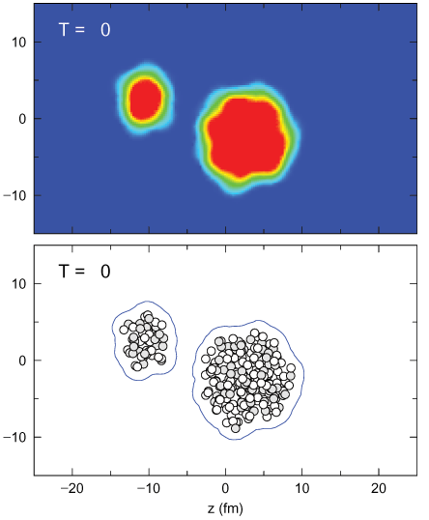
Nucleus-nucleus reaction model
JAERI Quantum Molecular Dynamics*
  Time evolution 3x10⁻²² (s) is tracked
    ~3x10⁻²⁴ (s) time steps are repeated
  Nucleons = Gaussian wave packets
  Interaction between particles
    Strong force (Skyrme) + Coulomb
    Pauli blocking
    Reaction channels: Elastic + Δ + N* + String + Hyperon
p
p
n
p
n
p
n
n
n
n
p
n
Attraction
n
p
Repulsion
Decay
Fragmentation
Mesons (π, K, η…)
⁵⁶Fe 800 MeV/u on ²⁰⁸Pb →
* K.Niita et al., PRC, 52, 2620, (1995)
* T.Ogawa et al., PRC, 92, 024614 (2015)

Slide 6
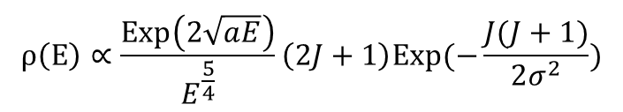
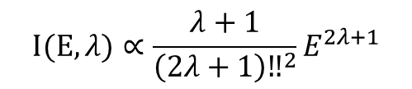
Prompt gamma-decay model*
Level density
Energy
Angular
momentum
$$ρ\left(E\right)∝\frac{Exp\left(2\sqrt{aE}\right)}{E^{\frac{5}{4}}}\left(2J+1\right)Exp(−\frac{J(J+1)}{2σ^{2}})$$
Theory-based
Above 3 MeV, a lot of levels are not identified
Transition strength
E: Energy
J: Angular
momentum
λ: Shift of J
$$I(E,λ)∝\frac{λ+1}{{\left(2λ+1\right)‼}^{2}}E^{2λ+1}$$
3 MeV
& A > 40
Data file based
Levels
De-excited based
on ENSDF data
Ground
state
Energy
ENSDF includes data on
energy, spin, parity, deexcitation
Corresponds to
gamma-ray peaks
Ground state
* T.Ogawa, et al., Nucl. Instrum. Meth. B, 325, 35-42 (2014)
** A.Gilbert, et al., Can. Jour. Phys., 43, 1446-1496 (1965)

Slide 7
Model benchmark (fragmentation)
²⁰⁸Pb(^{Nat}C,x)X @ 158AGeV
10³
Exp (Scheidenberger et al.)*
Exp (Cecchini et al.)**
PHITS (JQMD+Evaporation)
Production X-section (mb)
10²
10¹
0
10
20
30
40
50
60
70
80
Product charge
PHITS can predict fragmentation cross sections accurately
* C. Scheidenberger et al., Phys. Rev. C 70, 014902 (2004)
** S. Cecchini et al., Nucl. Phys. A707, 513 (2002).

Slide 8
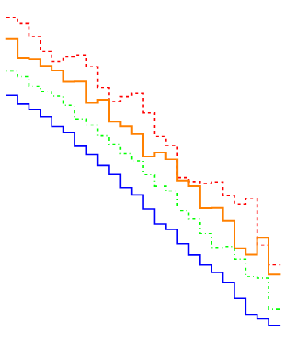
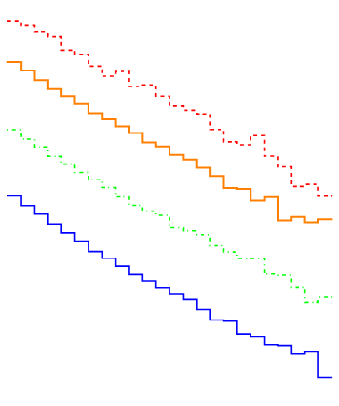
Model benchmark (particle yield)
Particle production in Pb-Pb collision
Proton production
π⁻ production
From string decay
Lines:
PHITS
10⁷
Lines:
PHITS
10⁶
10¹
10⁵
Invariant cross section (/GeV²/primary)
10⁴
10⁰
Invariant cross section (/GeV²/primary)
158 AGeV
10³
80 AGeV (1/2)
40 AGeV (1/4)
Exp*
10²
10⁻¹
20 AGeV (1/8)
158 AGeV
10
80 AGeV(x10⁻¹)
0
0.2
0.4
0.6
0.8
1.0
1.2
1.4
40 AGeV(x10⁻²)
20 AGeV(x10⁻³)
Exp**
Transverse mass (GeV/c²)
1
0
0.5
1.0
* C.Alt et al., Phys. Rev. C, 73, 044910 (2006)
** S.V..Afanasiev et al., Phys. Rev. C, 66, 054902 (2002)
** C.Alt et al., Phys. Rev. C, 77, 024903 (2008)
Transverse mass (GeV/c²)

Slide 9
Model benchmark (gamma-ray)
10¹
^{Nat}C(p,xγ) @800MeV
¹²C
¹⁶O
¹⁵N
PHITS
10⁰
PHITS can predict gamma-ray yields
  in high energy spallation reactions
Prompt gamma-rays are spread up to 10 MeV (= nucleon binding energy)
¹⁴N
10⁻²
¹³C
¹¹C
10⁻¹
Exp
¹⁴N
10⁻²
Production X-section (mb)
Production cross section (μb/MeV/sr)
Energy (MeV)
10²
10⁻³
^{Nat}Fe(p,xγ) @3GeV
10¹
Exp
10⁰
PHITS
10⁻⁴
10⁻¹
Energy (MeV)
Energy (MeV)
* G. L. Morgan et al., ORNL-Report, 5575, (1979)

Slide 10
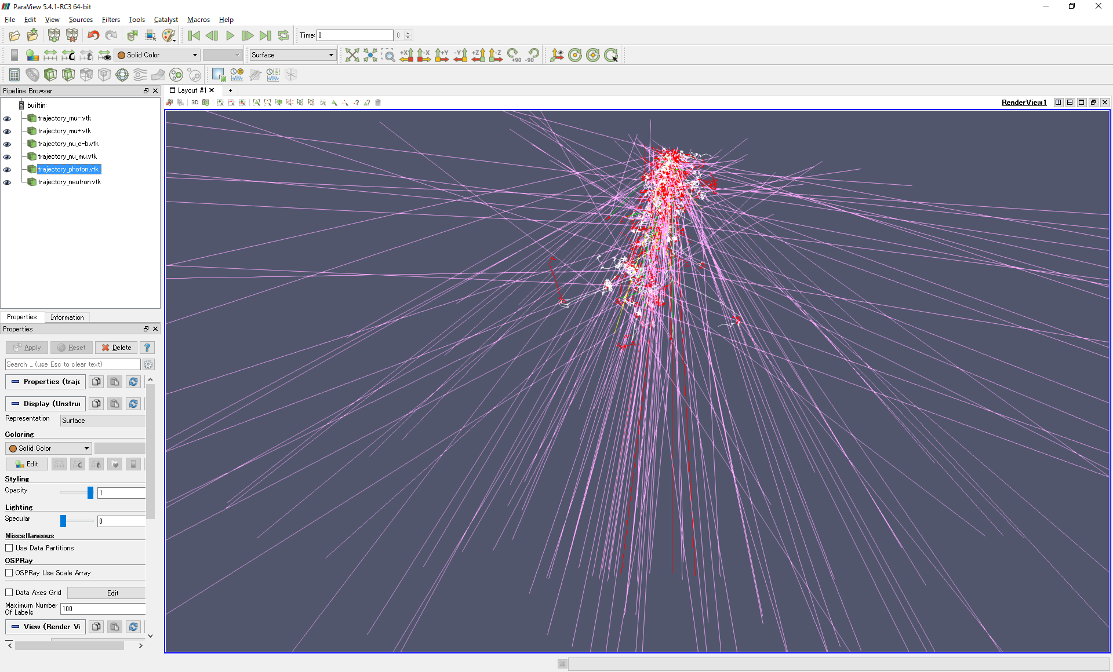
Result (single event)
100AGeV ¹²C
Simulation of 1 event
  Projectile: ¹²C
  Target: Nitrogen
  Energy: 100 AGeV
All particles are predicted
  n,p from nuclear collision
  μ+ν from π± decay
  γ from π⁰ decay and prompt gamma decay
10km
μ, γ
ν
n

Slide 11


Result (single event)
Simulation of γ-ray detection
  410 MeV and 646 MeV
  Angle : 0.17 deg.
Angle in
Nucleus frame
¹²C
98.3°
This event is …
646 MeV
7.65
30.4°
0.17°
4.44 MeV×$\frac{γ}{1−βcos⁡(θ+0.17)}=$ 646
3.21 MeV γ
¹²C
410 MeV
4.44
PHITS considers
〇 Structure data
〇 Doppler effect
〇 in Event-by-event
Robust simulation tool.
4.44 MeV γ
0 (Ground)
3.21 MeV×$\frac{γ}{1−βcos⁡(θ)}=$ 410

Slide 12
Result (averaged over events)
10³
¹⁰B
⁶Li
¹¹B
⁷Li
¹⁰Be
1 AGeV
10²
¹⁰B
¹⁰B
¹¹B
10¹
¹⁰B
¹¹B
¹¹B
Production cross section (mb/MeV)
¹¹B
¹¹B
¹¹B
10⁰
Air
(N+O)
10⁻¹
10⁻²
Energy in fragment frame (MeV)
Integral trend of gamma-rays (peaks) are predicted
→ Useful for detector performance, experiment planning…

Slide 13
Summary
Strong needs for simulation of gamma-rays
  from cosmic-ray heavy ion fragments
PHITS can simulate such gammas by
  Nucleus-nucleus reaction dynamics model (JQMD)
  Statistical decay model (GEM)
  Prompt gamma-decay model (EBITEM)
Cosmic-ray reactions (Ion, γ…) are simulated
  event-by-event
  considering frame transform (Lab⇔CM⇔Rest)
  nuclear level structure

Slide 14

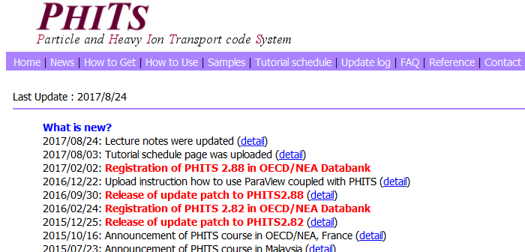

PHITS license
Citizens of OECD/NEA databank countries
  Ask OECD/NEA databank
  http://www.oecd-nea.org/tools/abstract/detail/NEA-1857
  PHITS is sent as DVD in a few weeks
  License charge : 0 ₽ (free)
To know more about PHITS…
  http://phits.jaea.go.jp/index.html
  Request for tutorial courses is welcome
  speak to me in coffee breaks!
Russia is a member!!

Slide 15
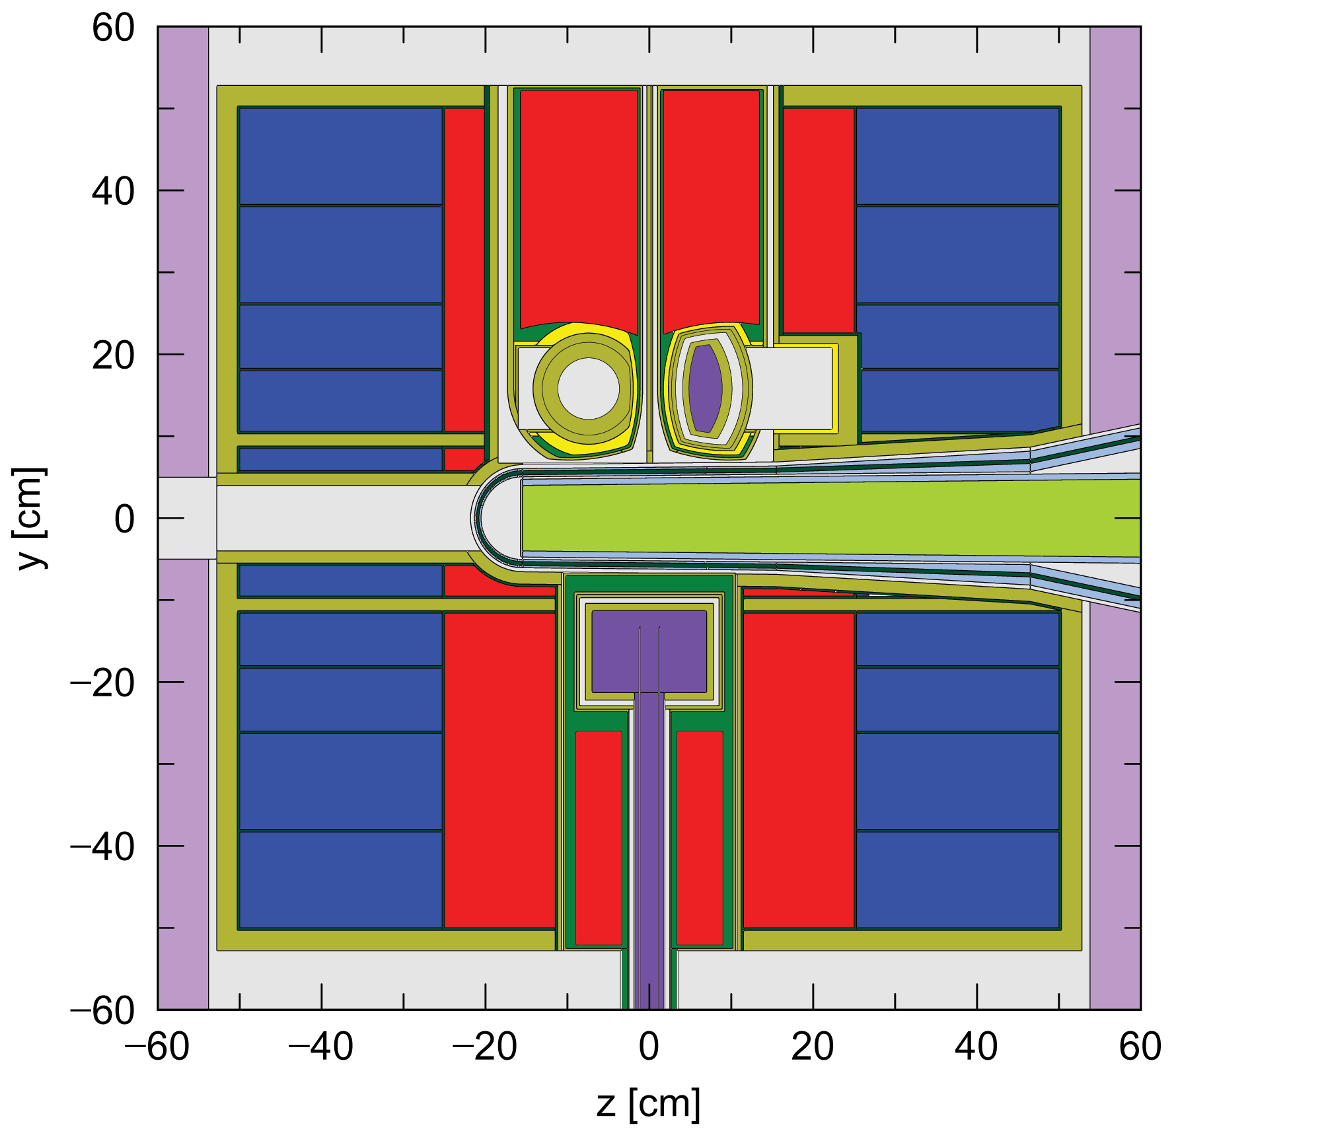
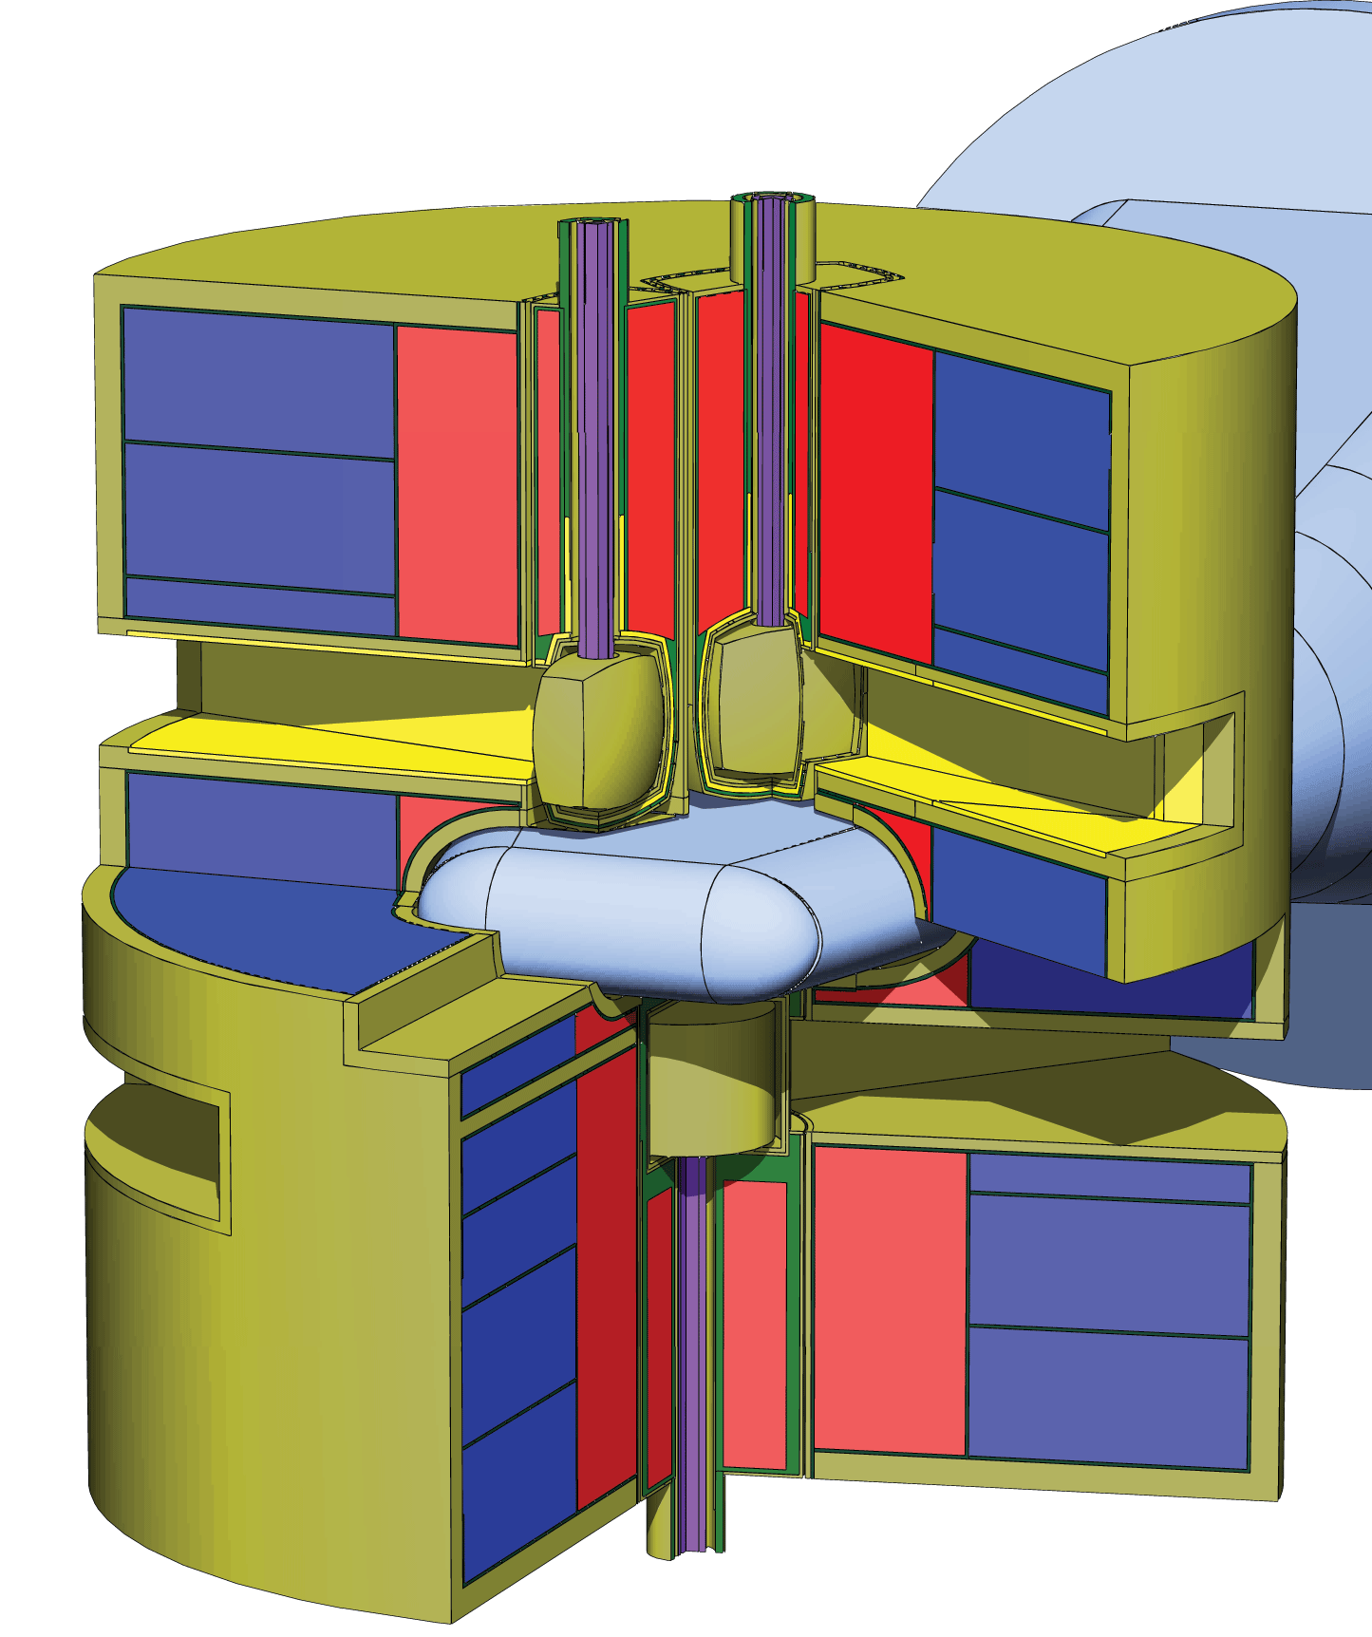
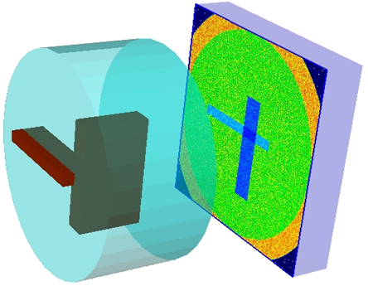
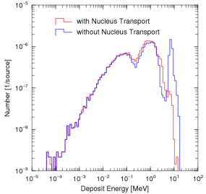
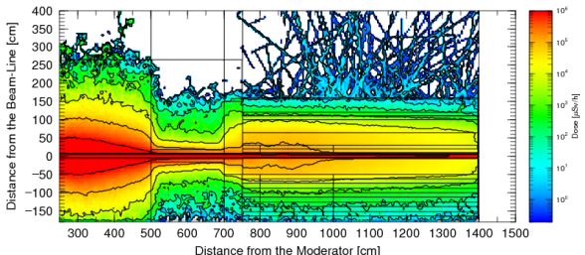
User Interfaces of PHITS
Source code:
Input file:
Fortran (Intel Fortran 11.1, Gfortran 4.71 or later)
Free-format text
You do not have to write Fortran program nor compile PHITS
Geometry
GG format
Graphic Utility:
(ANGEL)
SimpleGEO*
Tally functions
Geometry drawn by ANGEL
SimpleGEO
Particle flux, Heat, Particle yield, Ionization density, etc.
Output Data
Text data, histograms, contour maps
Platforms
Windows, Mac and Linux (MPI & OpenMP parallelization available)
* GUI-based software originally for FLUKA, http://theis.web.cern.ch/theis/simplegeo/

Slide 16
Map of Reaction Models Used in PHITS
Neutron
Proton, Pion
(other hadrons)
Nucleus
Muon
e⁻ / e⁺
Photon
1 TeV
1 ATeV
1 TeV
Ionization
ATIMA
EGS5
Intra-nuclear cascade (JAM)
+ Evaporation (GEM)
Quantum
Molecular
Dynamics
(JQMD)
+
Evaporation
(GEM)
Virtual Photo-Nuclear
JAM/
JQMD
+
GEM
Photo-Nuclear
JAM/
QMD
+
GEM
+
JENDL
+
NRF
3.0 GeV
Intra-nuclear cascade (INCL4.6)
+
Evaporation (GEM)
d
t
³He
α
EGS5
Low ← Energy → High
20 MeV
200 MeV
Nuclear Data Library
(JENDL-4.0)
10 AMeV
1 MeV
1 keV
1 keV
1 keV
10⁻⁵ eV
Models are switched depending on energy / particle species
*Switching energies can be changed in input file of PHITS

Slide 17
Nucleus-Nucleus reaction models
Lab Energy
10 AMeV
3 AGeV
~10 ATeV
JQMD
JAMQMD
N + N -> N + N (Elastic)
N + N -> N + Δ (1232 MeV)
N + N -> N + N*(1440 MeV)
Up to N* -> N + π + π
is considered
In-medium effect on σ_{elastic}
N + N -> N + N (Elastic)
N + N -> N + Δ (1232-1950 MeV)
N + N -> N + N* (1440-1990 MeV)
+ string production
Applicable up to 10 ATeV
(all possible modes are considered)
・Force between nucleons (Skyrme + Coulomb + Symmetry)
・Initial state nucleus is configured by random packing of nucleons
・Clusterization of nucleons in the final state (t=150fm/c)
Notes:
7:45

Slide 18
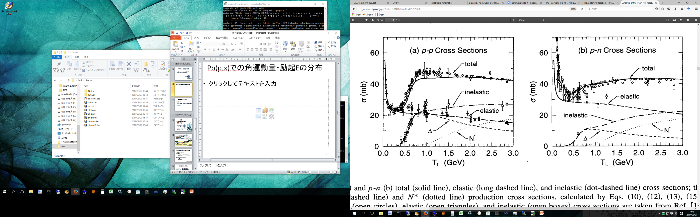

Cross sections in JQMD/JAMQMD
proton-proton
Nucleon-nucleon cross sections are
parameterized based on experimental data
(also nucleon-meson cross sections)
Cross section (mb)
Inelastic = Total (fit) - Elastic (fit)
In JQMD “inelastic” is combination of
N+N -> N + Δ(1232 MeV)
N+N -> N + N*(1440 MeV)
In JAMQMD (> 3 AGeV)
inelastic consists of various channels
N+N -> Δ(1232 MeV) + Δ(1232 MeV)
N+N -> N + Δ*(>1232 MeV)
N+N -> N*(1440 MeV) + N*(1440 MeV)
・・・・・・
Lab energy (GeV)
proton-neutron
Cross section (mb)
Lab energy (GeV)
K. Niita et al, Phys. Rev. C52 (1995) 2620
Notes:
9:00

Slide 19
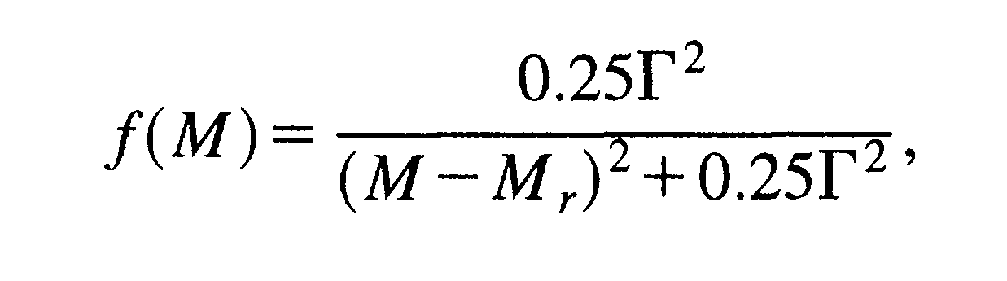
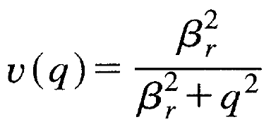
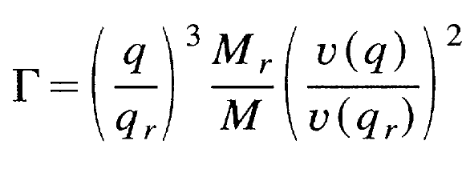
Quantities important for Homework 3
Delta mass distribution
・・・Breit-Wigner but Γ depends
β_{r} =300 (MeV)
1232 (MeV)
×110 (MeV)
q = momentum
M = mass
Inelastic (Δ prod) cross section
e.g., pp reaction
total
Inelastic = Total - Elastic
Δ⁺⁺, Δ⁺ branching
Δ , N* branching
is explained in the next slide
σ (mb)
Δ
N*
E_{lab} (GeV)
K. Niita et al, Phys. Rev. C 52 (1995) 2620
Notes:
14:00

Slide 20
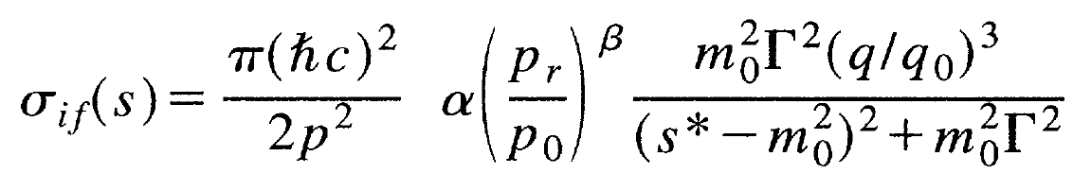
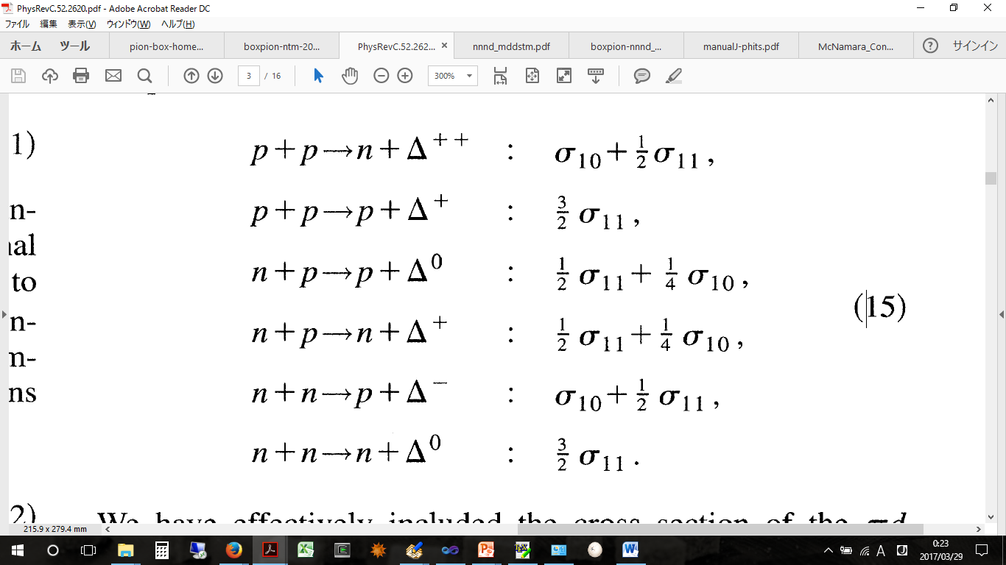
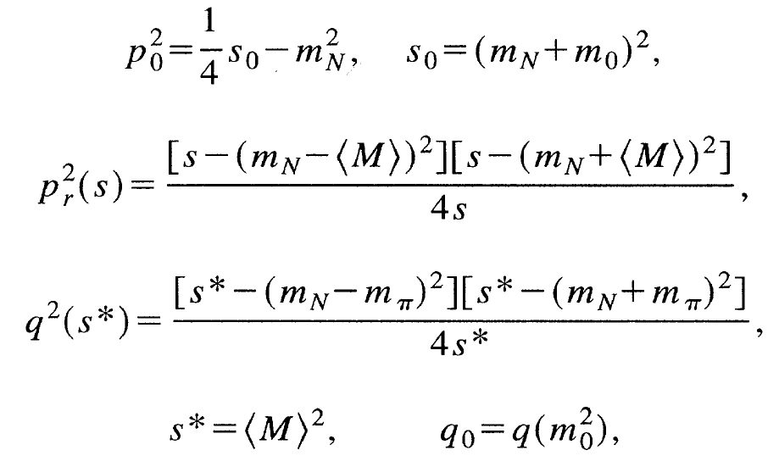
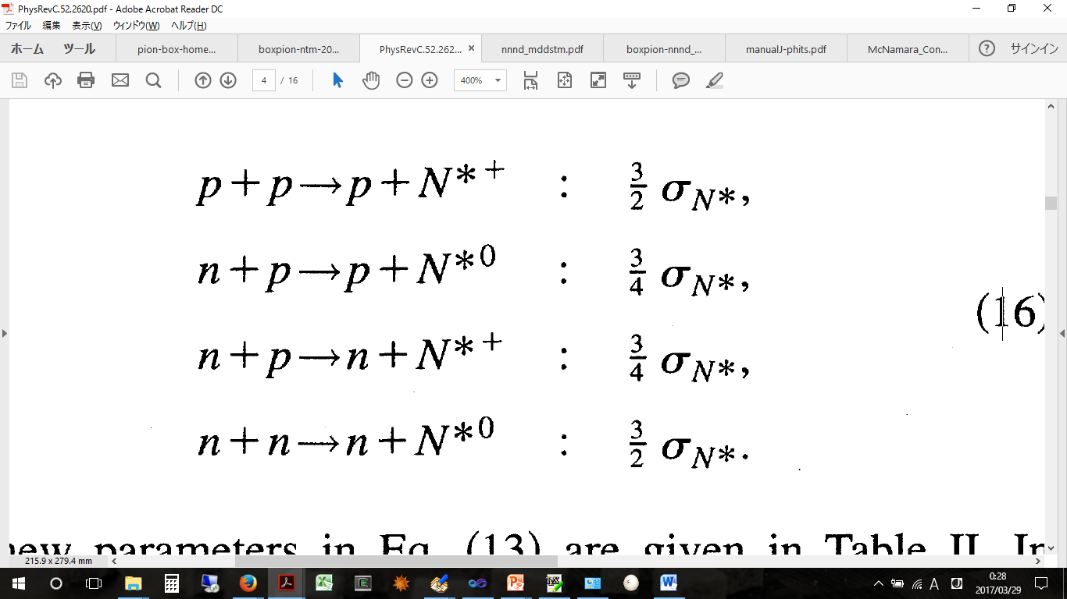
Resonance cross section
← B.W. distribution
with correction
i, f means initial/final isospin
↑ Quantities to correct cross sections
σ_{N*} = σ₀₁
B. J. VerWest and R. A. Amdt, Phys. Rev. C 25, 1979 (1982).

Slide 21
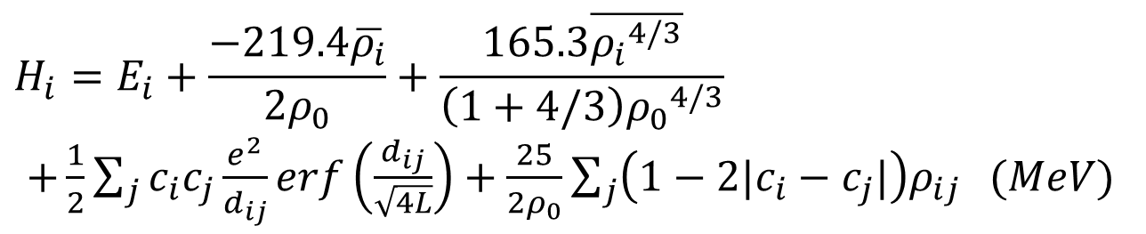
Hamiltonian in JQMD/JAMQMD
Hamiltonian of i-th nucleon
Local nucleon density
$$H_{i}=E_{i}+\frac{−219.4\overline{ρ_{i}}}{2ρ_{0}}+\frac{165.3\overline{{ρ_{i}}^{4/3}}}{\left(1+4/3\right){ρ_{0}}^{4/3}}$$
$+\frac{1}{2}\sum_{j}{c_{i}c_{j}\frac{e^{2}}{d_{ij}}erf\left(\frac{d_{ij}}{\sqrt{4L}}\right)}+\frac{25}{2ρ_{0}}\sum_{j}{\left(1−2|c_{i}−c_{j}|\right)ρ_{ij}} (MeV)$
Skyrme type force
Coulomb force
Symmetry force
Sum over
nucleons
L (“width” of nucleons)
ρ₀ (Saturation density)
Binding energy
Compressibility (K)
: 2 (fm²)
: 0.168 (nucleon/fm³)
: 16 (MeV)
: 237.3 (MeV)
Pauli-force is not included
Pauli-principle is considered in nucleus initialization and collision

Slide 22


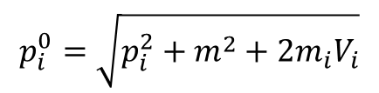

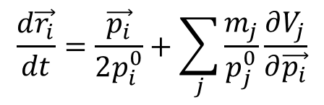
Equation of motion in JQMD/JAMQMD
JQMD/JAMQMD Ver.1
$$\frac{d\vec{r}}{dt}=\frac{\vec{p}}{m}+\frac{∂V}{∂\vec{p}}$$
p : momentum of nucleon
r : coordinate of nucleon
m: mass
V: potential
$$\frac{d\vec{p}}{dt}=−\frac{∂V}{∂\vec{r}}$$
→ not Lorentz covariant interaction
→ frame dependent
JQMD/JAMQMD Ver.2 (Available since 2016)
$$\frac{d\vec{r_{i}}}{dt}=\frac{\vec{p_{i}}}{2p_{i}^{0}}+\sum_{j}{\frac{m_{j}}{p_{j}^{0}}\frac{∂V_{j}}{∂\vec{p_{i}}}}$$
$$p_{i}^{0}=\sqrt{p_{i}^{2}+m_{}^{2}+2m_{i}V_{i}}$$
$$\frac{d\vec{p_{i}}}{dt}=−\sum_{j}{\frac{m_{j}}{p_{j}^{0}}\frac{∂V_{j}}{∂\vec{r_{i}}}}$$
→ Lorentz covariant description*
→ Frame independent
*D. Mancusi et al, PRC, 79, 014614 (2009)

