Slide 1
Scission point calculations and physical treating of the “Ni-bump” in ²⁵²Cf(sf)
Yu.V. Pyatkov^{1,2}, D. V. Kamanin², A. A. Alexandrov², I. A. Alexandrova², Z. I. Goryainova², V. Malaza³, N. Mkaza³, E. A. Kuznetsova², A. O. Strekalovsky², O. V. Strekalovsky², and V. E. Zhuchko²
¹National Nuclear Research University MEPhI (Moscow Engineering Physics Institute), Moscow, Russia
²Joint Institute for Nuclear Research, Dubna, Russia
³University of Stellenbosch, Faculry of Military Science, Military Academy, Saldanha 7395, South Africa

Slide 2
Collinear cluster tri-partition (CCT).
One of the most populated modes : “Ni-bump”.

Slide 3
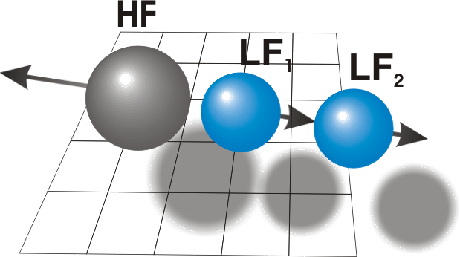
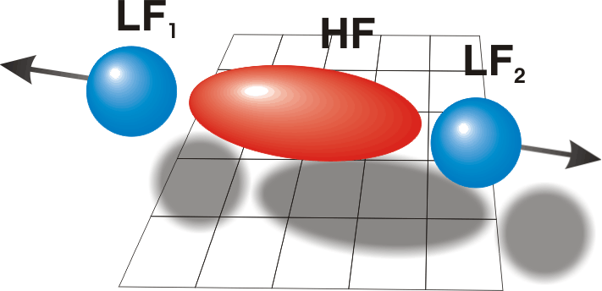
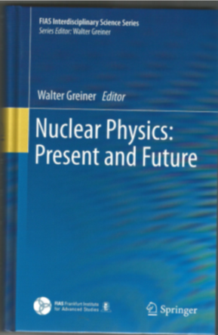
Collinear cluster tri-partition (CCT) – status quo
Prescission ternary
configurations
supposed to be in game
http://fobos.jinr.ru/

Slide 4
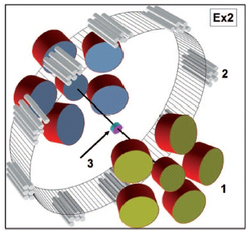
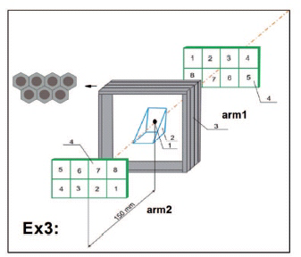
Spectrometers used
FOBOS setup
COMETA setup

Slide 5
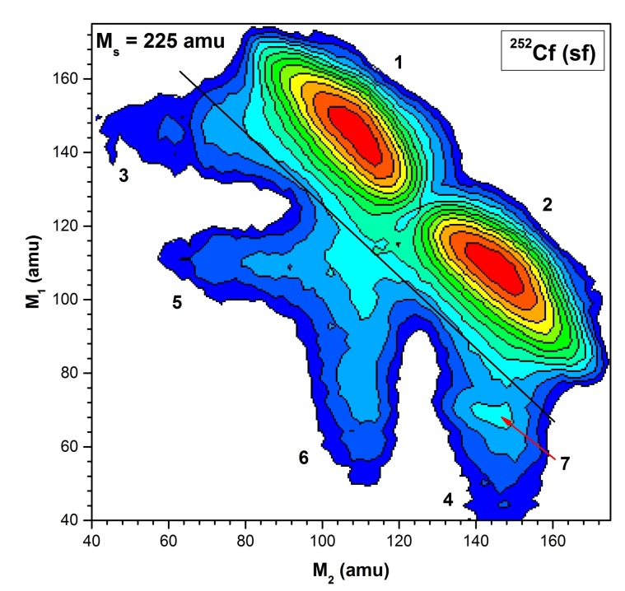
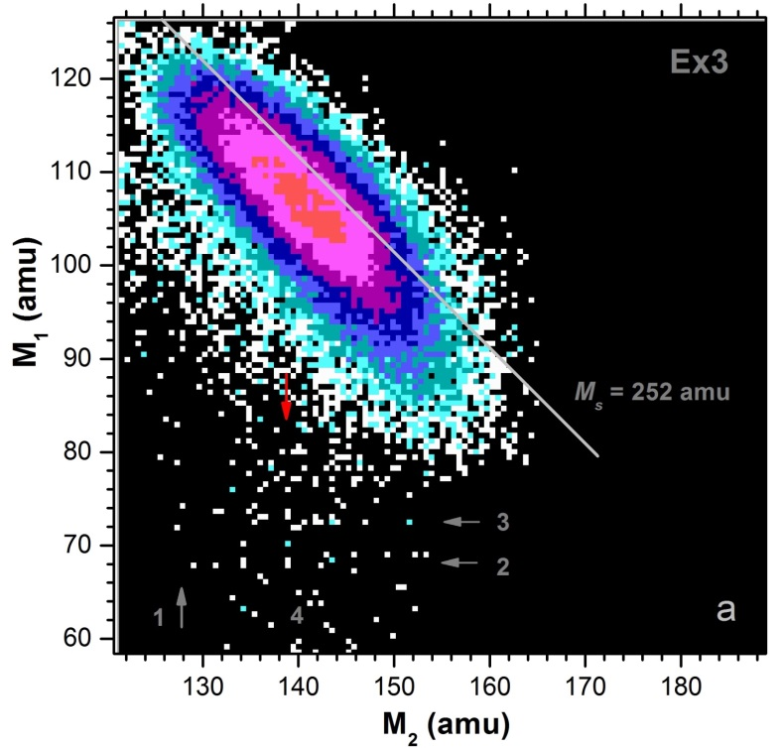
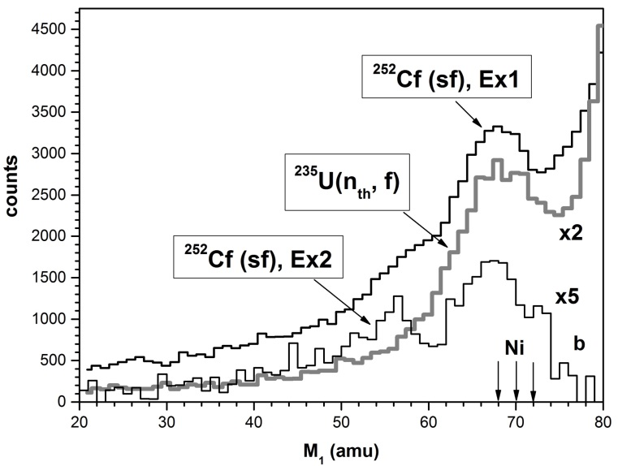
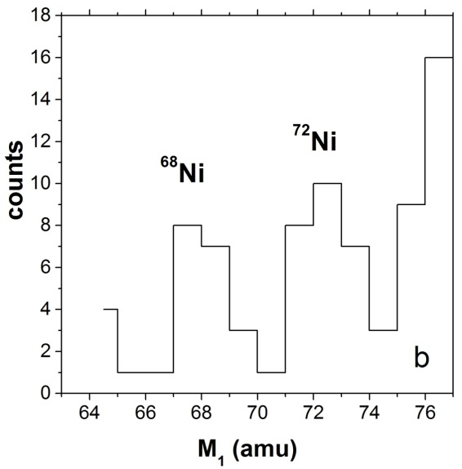
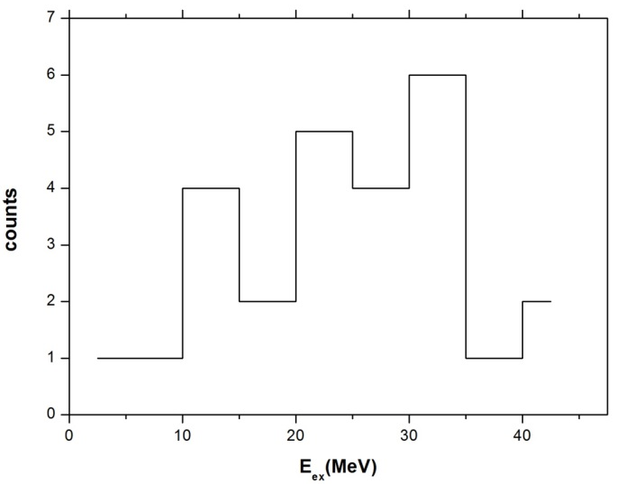
“Ni-bump” in the FF mass-mass distribution
FOBOS setup
COMETA setup

Slide 6
“Ni-bump” : parameters of the fragments involved

Slide 7
True ternary fission – theoretical background
(all in all ~20 publications during last 5 years )

Slide 8
True ternary fission – theoretical background
PHYSICAL REVIEW C 94, 064615 (2016)
Ternary fission of a heavy nuclear system
within a three-center shell model
A. V. Karpov
Macroscopic part of the potential energy for fission of ²⁵²Cf calculated for zero values of the deformation parameters (b) and nuclear shapes (a) depending on elongation and mass of third fragment (italic numbers).
~23fm

Slide 9
True ternary fission – theoretical background
A.K. Nasirov, R.B. Tashkhodjaev and W. von Oertzen, Eur. Phys. J. A 52, 135 (2016).

Slide 10
Our scission point calculations

Slide 11
Scenarios of the CCT modes manifested in “Ni-bump”

Slide 12
Results of the scission point calculations for “Ni-bump”

Slide 13
Presumable CCT mechanism

Slide 14
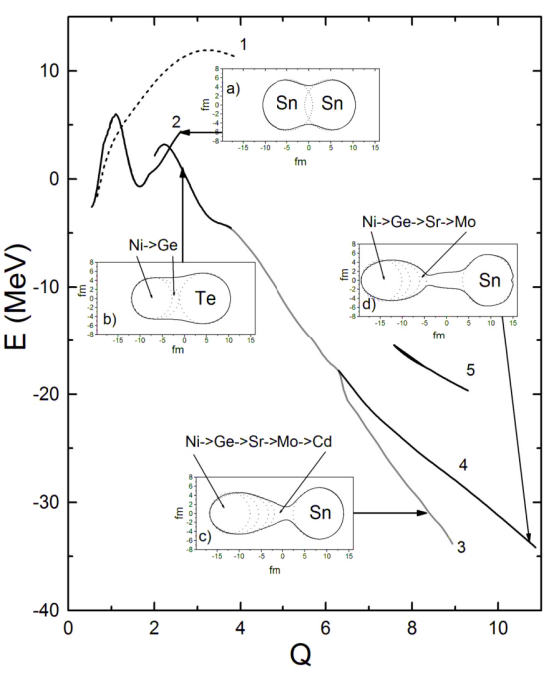
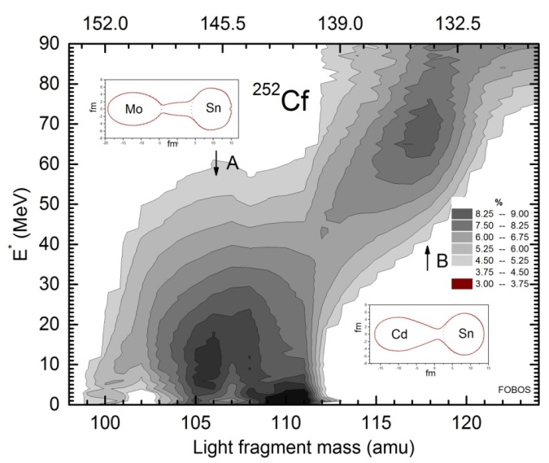
Strongly deformed prescission shapes of the ²⁵²Cf nucleus
Y of ν_{tot} = 6 and ν_{L}/ ν_{H} = 6/0: 2.19 % and 0.72 % for ²⁴⁸Cm and ²⁵²Cf resp.
V.A. Kalinin, V.N. Dushin, V.A. Jakovlev et al., In Proceedings of the “Seminar on Fission Pont D’Oye V”, Castle of Pont d’ Oye, Habay-la-Neuve, Belgium, 16–19 September, 2003, p. 73–82.
Yu.V. Pyatkov, V.V. Pashkevich, Yu.E. Penionzhkevich et al., Nucl. Phys. A. 624, 140 (1997).

Slide 15
Summing up: scenario behind the “Ni-bump”
Forming of very elongated prescission configuration;
First rupture → forming of the excited di-nuclear system;
Brake-up of this system due to (presumably) cluster decay
from very excited state.

Slide 17
Conclusions
The most desirable approach to independent experimental verification of the CCT consists in involvement of the methodic alternative to the 2V–2E method used in our work. In this sense, the mass-separator Lohengrin seems to be a good choice.
Registration of the Ni isotopes with the energy less than 25 MeV at the mass-separator Lohengrin can be recommended as the primary experiment for verification of the CCT.
Detailed version (PRC , accepted ):
http://arxiv.org/abs/1709.00170

