Slide 1
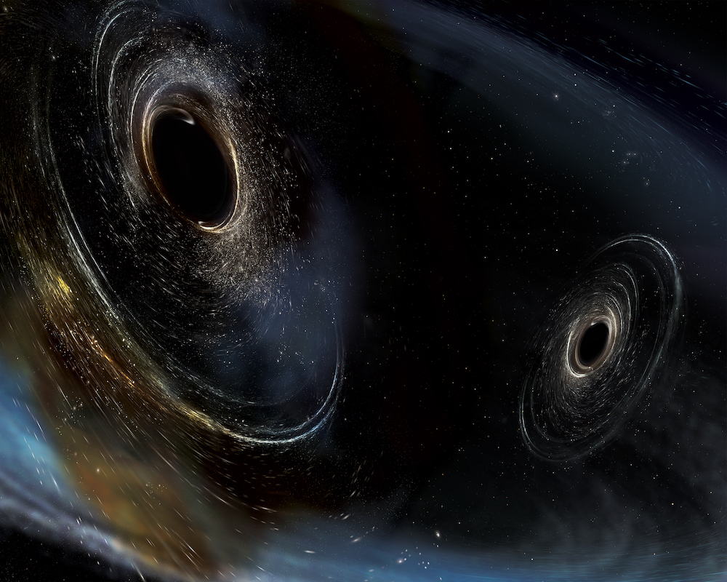
«Gravitational Wave Astronomy: results and prospects»
Konstantin Postnov
SAI MSU
ICPPA-2017
Blinnikov, Dolgov, PK 1409.5736, Blinnikov, Dolgov, Porayko, PK 1611.00541,
Dolgov, PK 1702.07621, 1706.05519, PK, Kuranov 1706.00369
Image credit: LIGO/Caltech/MIT/Sonoma State (Aurore Simonnet)

Slide 2
Brief history
1916, A. Einstein
1920-1930 (Einstein , Eddington, Rosen, …)
1962, М.Е.Gertsenstein, V.I.Pustovoit – laser interferometers -- idea
1970s, development (R.Weiss, R.Driver etc.)
End of 1980s, start of the LIGO project
2002-2010, LIGO/Virgo first runs
2010-2015, LIGO/Virgo upgrade
14/09/2015, first detection

Slide 3
Main results (official)
4.5 reliable detections – coalescences of BH-BH binaries with masses 15-30 M_sun from distances 500-1000 Mpc
Coalescence rate ~12-213 Gpc⁻³ yr⁻¹
Agreement with GR within a few %
No reliable EM, neutrino, etc., counterparts

Slide 4
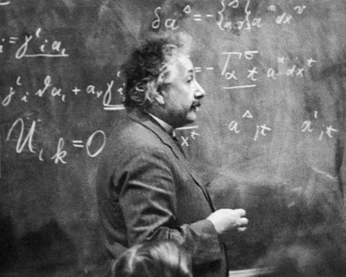
1. General Relativity
А. Einstein, 1915
Gravity = space-time curvature
01.10.2017

Slide 5
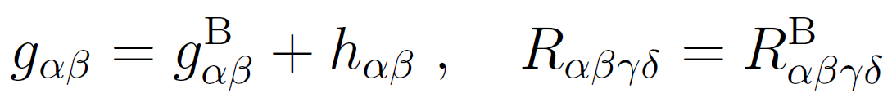
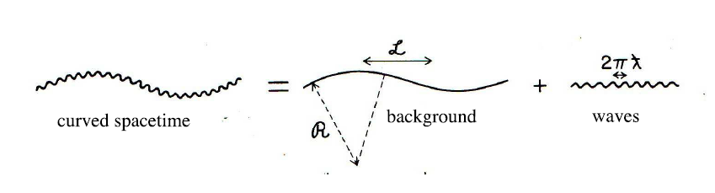
GW – ‘ripples’ of space-time

Slide 6
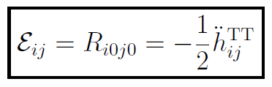

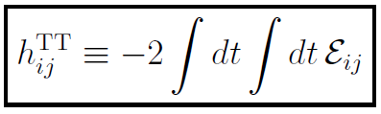
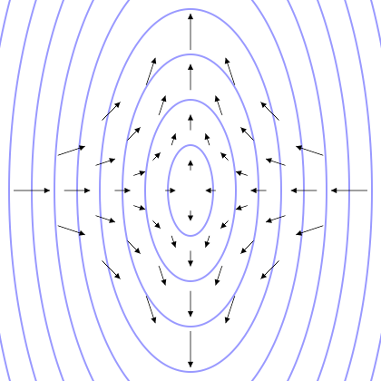

GE creates tidal acceleration field in a freely faling (local Lorents) reference frame
01.10.2017

Slide 7
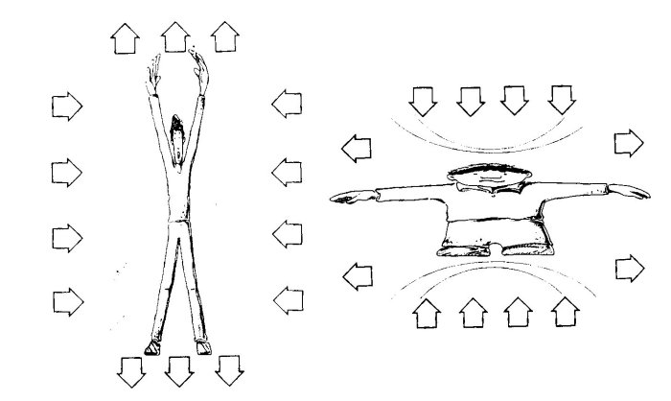
GW amplitude h = relative expansion/compression
01.10.2017

Slide 8

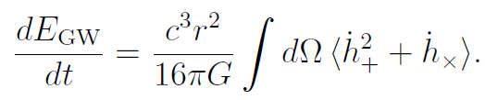
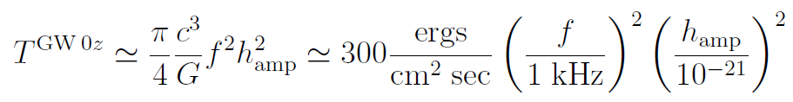
GW energy flux
Energy density
Energy flux

Slide 9
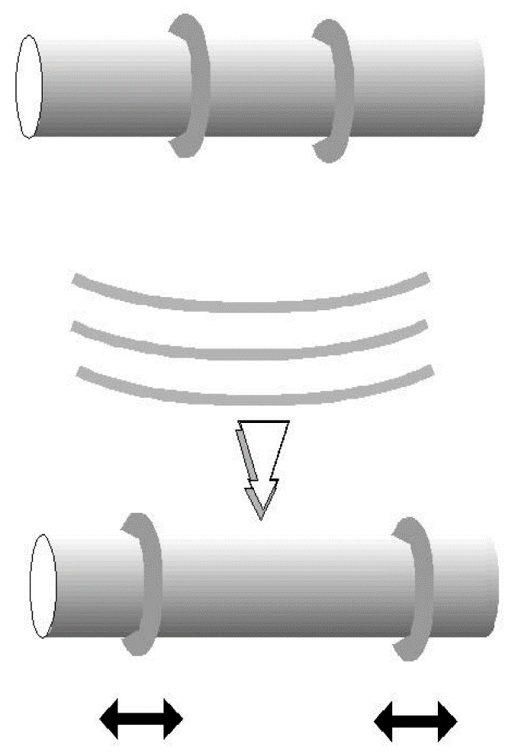
Simple argument by R.Feynmann (1957)
“I was surprised to find that a whole day of the conference was spent on this issue and that ‘experts’ were confused. That’s what happens when one is considering energy conservation tensors, etc. instead of questioning, can waves do work?”

Slide 10
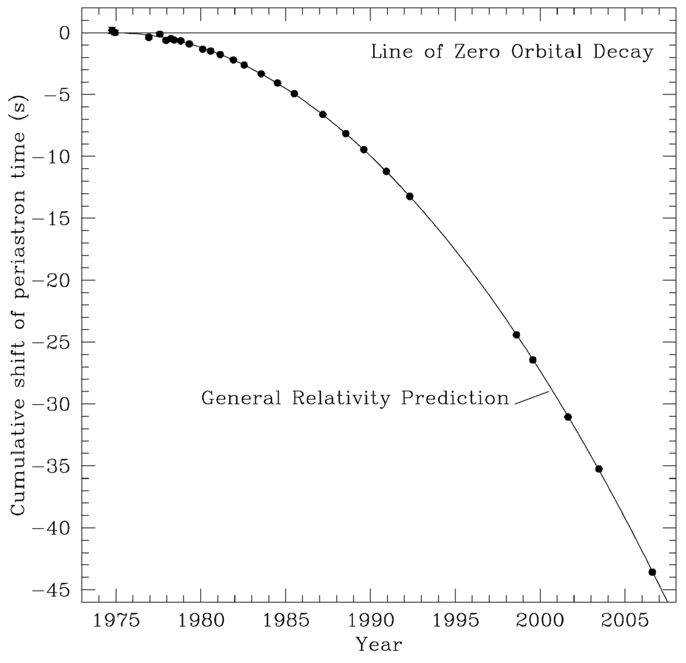
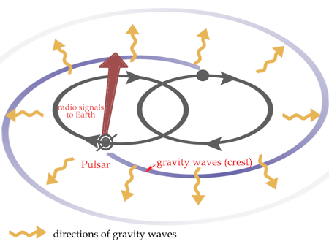
E pur si existare!
1974, двойной пульсар PSR 1913+16 (Халсе, Тейлор)
Уменьшение орбитального периода в
точном соответствии с ОТО (~0.1%)

Slide 11
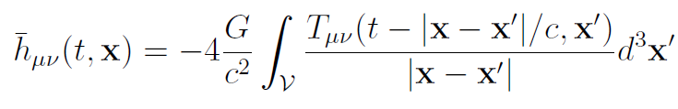


GW emission
Lowest order - quadrupole radiation (slow motion approximation v/c<<1):

Slide 12
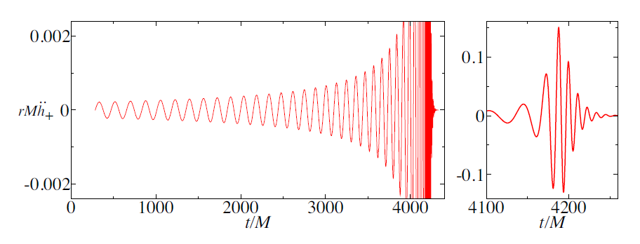
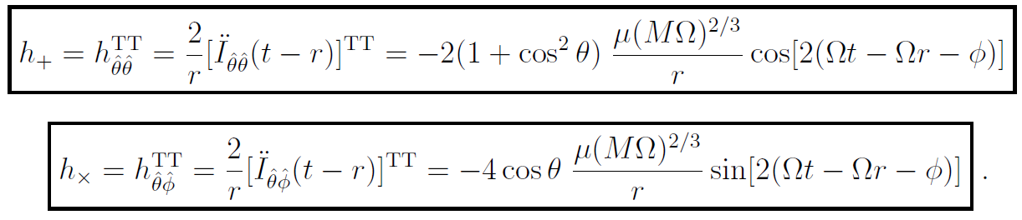
Signal from a coalescing binary

Slide 13
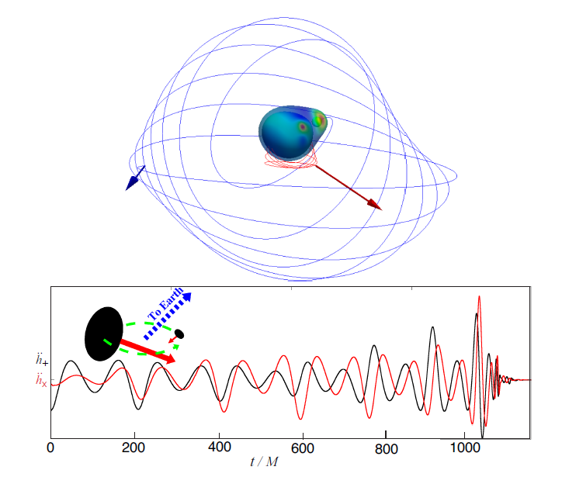
More complicated signal from a BH binary

Slide 14
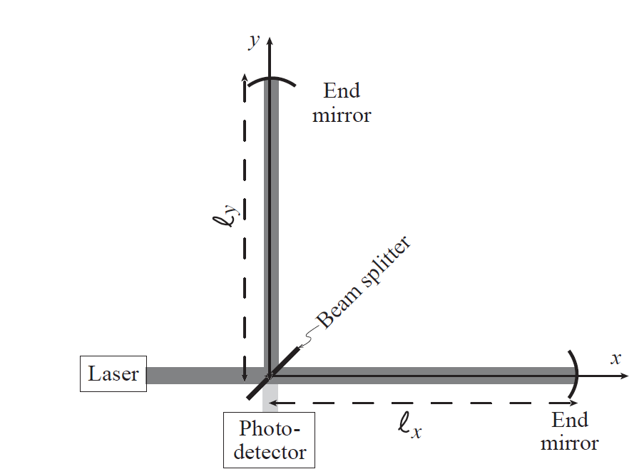
2. Laser interferometer

Slide 15



How does it work
Разность фаз в плечах интерферометра
Модуляция интенсивности

Slide 16
LIGO interferometers
D. Reitze Physics-Usp. 2017

Slide 17
Noise budget

Slide 18
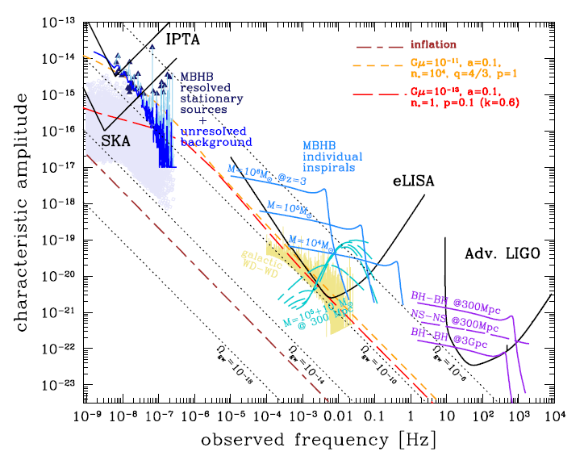
3. Astrophysical sources
Credit: A. Sesana

Slide 19
2015 – start of GW astronomy
Abbott+ 2016, LIGO/VIRGO Collab.

Slide 20
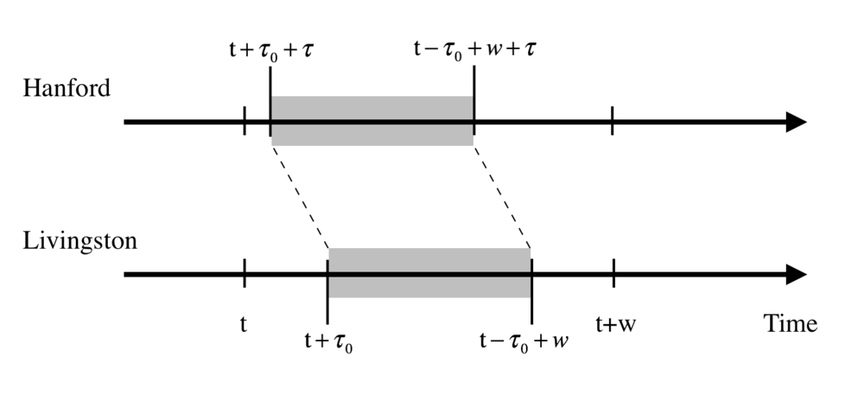
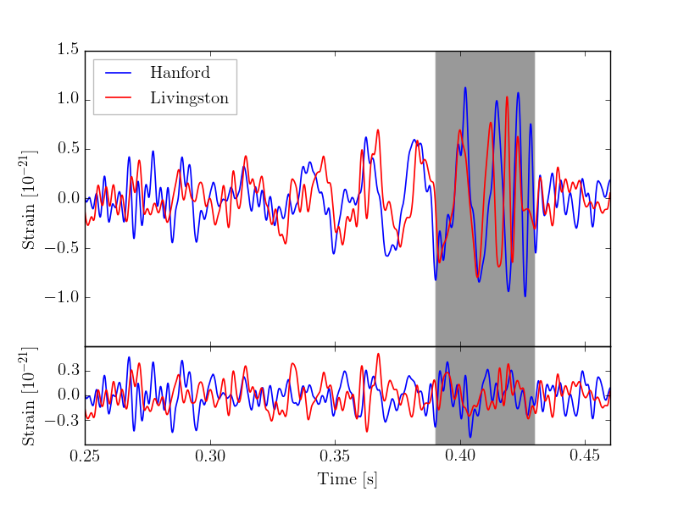
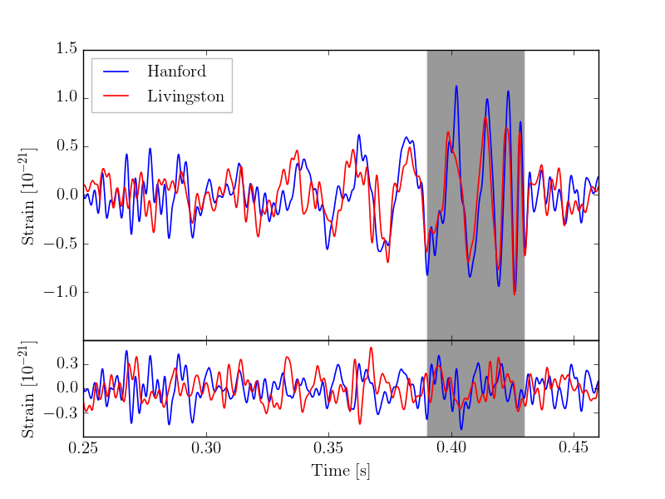
Независимый анализ (1706.04191)

Slide 21
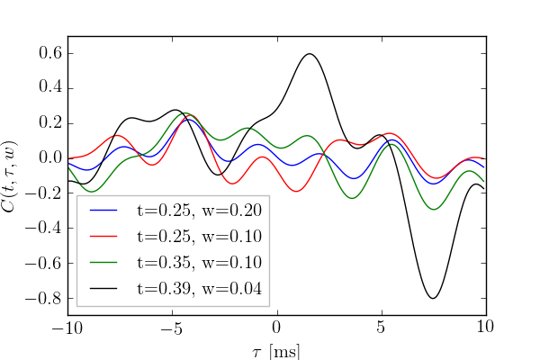
Корреляции в остаточном шуме?
LVC готовит большую статью с подробным разъяснением

Slide 22
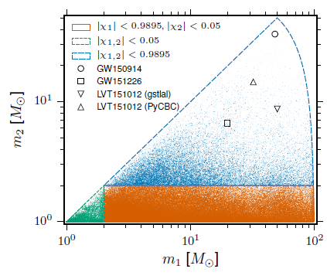




4. Parameters of coalescing binaries from GW observations

Slide 23
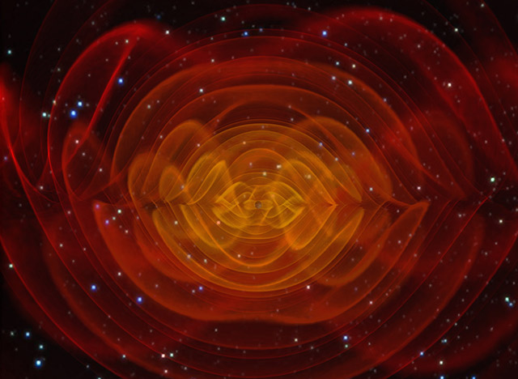
Recovered model signal

Slide 24
aLIGO O1 results (09.2015-01.2016)
LIGO O2 (11.2016-08.2017): 8 новых событий из он-лайн анализа

Slide 25
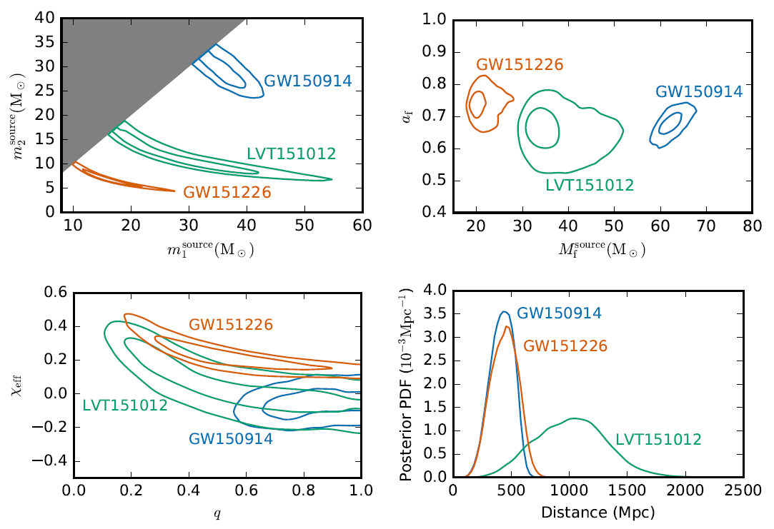

Slide 26
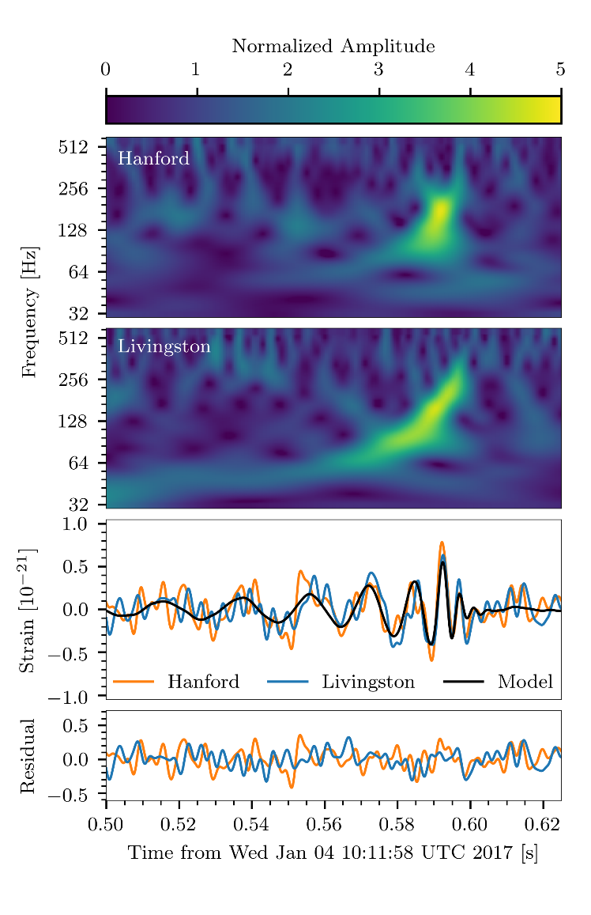
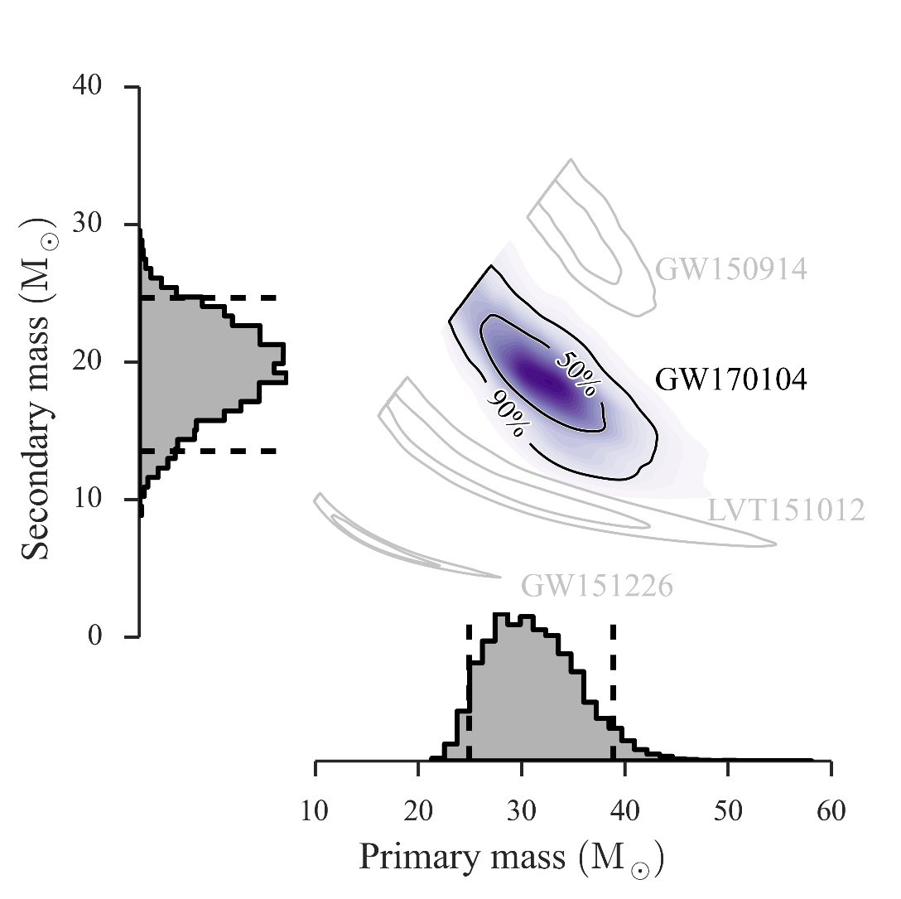
LIGO О2 run results: GW170104 & GW170814
PRL 118, 221101 (2017)

Slide 27
GW170104: spin constraints
With probability 82% effective spin is negative
➔ spin of one BH is antiparallel to orbital angular momentum
Special assumptions on the binary evolution are required
PRL 118, 221101 (2017)

Slide 28
GW170814 first BH-BH coalescence found by three detectors
PRL in press

Slide 29
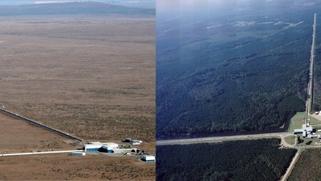
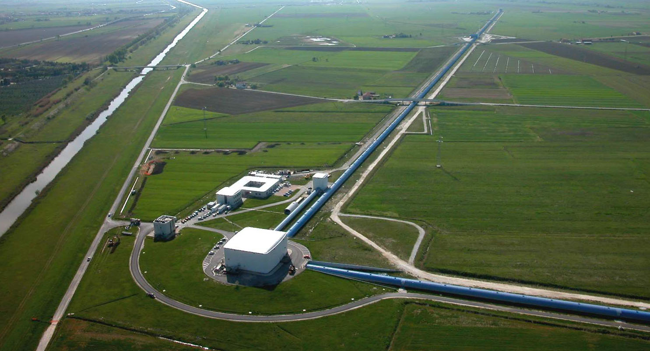
Последние официальные новости:
С 1 августа по 25 августа 2017 3 действующих интерферометра (2 LIGO + VIRGO) работали синхронно. Возможно несколько успешных детектирований!

Slide 30
GW170814

Slide 31
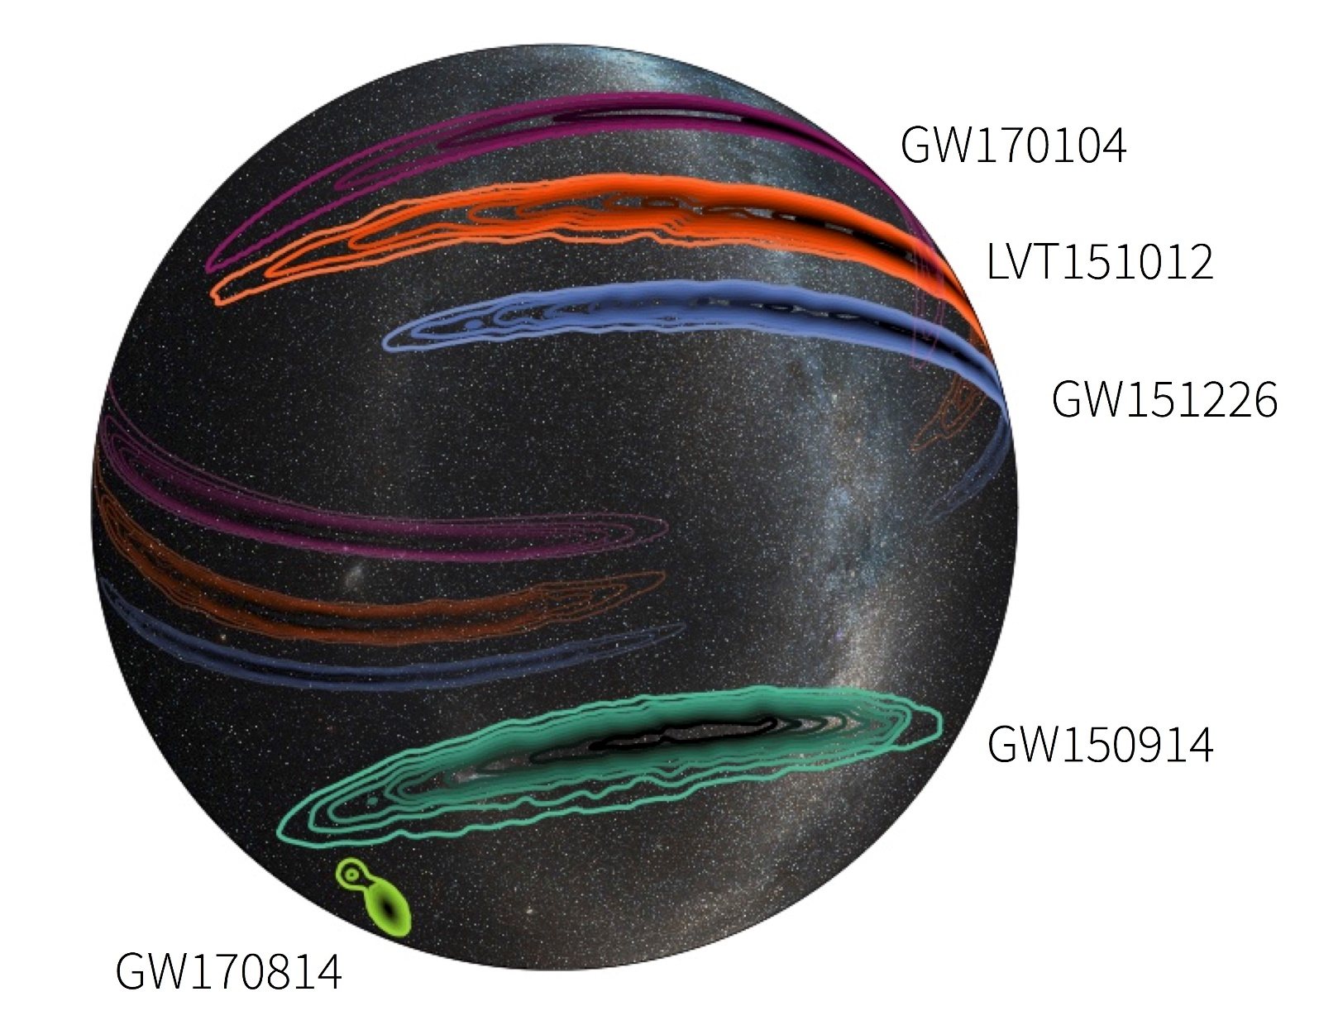
Sky localization by GW detectors

Slide 32
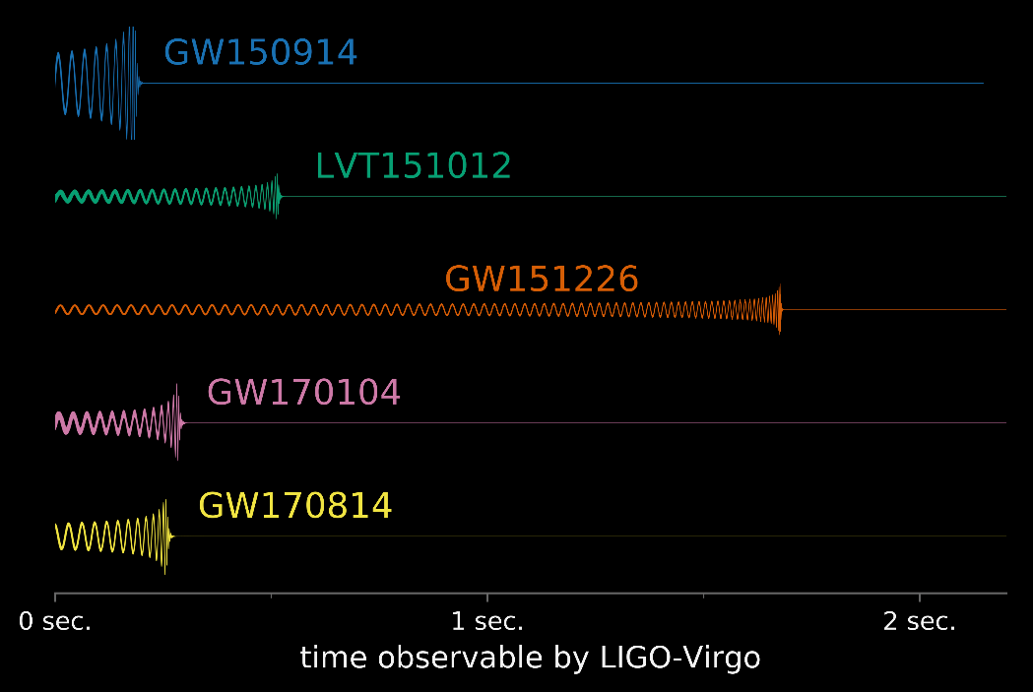
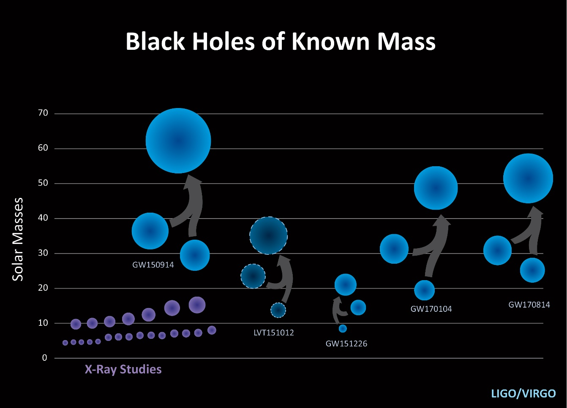

Slide 33
Can these BH-BH systems be drawn from one distribution or originate from different progenitors?

Slide 34
Astrophysics
Stellar evolution channels:
  From massive binary systems (Tutukov, Yungleson 73, Lipunov, PK, Prokhorov 87, 97…Fryer+ 02, Kinugawa+ 14,16, Belczynski+16, Eldridge&Stanway 16…)
  Dynamical formation in dense globular clusters (Sigurdsson, Hernquist 1993…Rodriguez+16)
Primordial BH binaries (Nakamura+97, Ioka+, Sasaki+16, Eroshenko 16, Blinnikov+ 16)

Slide 35
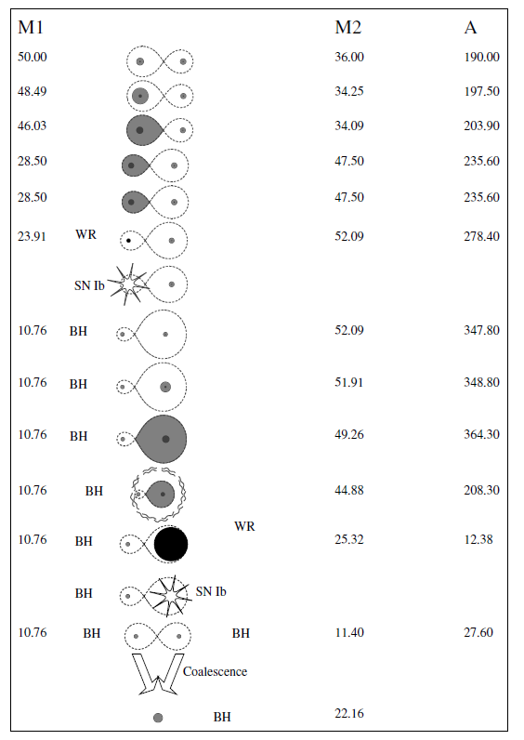


BH formation parameters
  initial mass (>20 M)
  Collapsing mass fraction
  Possible BH kick velocity
Lipunov PK Prokhorov 1987 MNRAS)

Slide 36
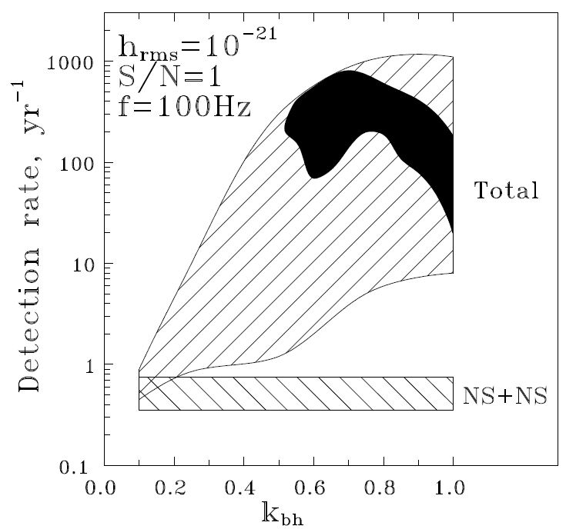
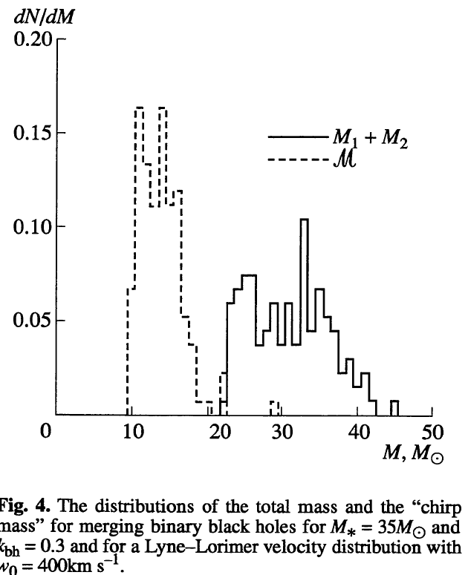
Lipunov, PK. Prokhorov, 1997 Ast. Lett, MNRAS, New Astronomy

Slide 37
Major uncertainties
BH formation parameters
  mass-loss of progenitors (small at low metallicity)
  Mass of the BH formed (tuned to produce required BH mass), additional kick…
Binary evolution parameters
  Non-conservative stages (common envelop treatment…)

Slide 38
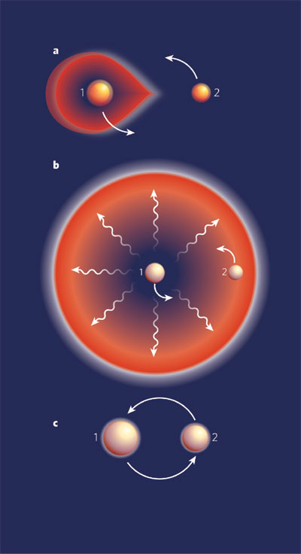
Common envelope
Compare binding energy of stellar envelope and orbital energy:
Hydro calculations give controversial results (Ohlman+16)

Slide 39
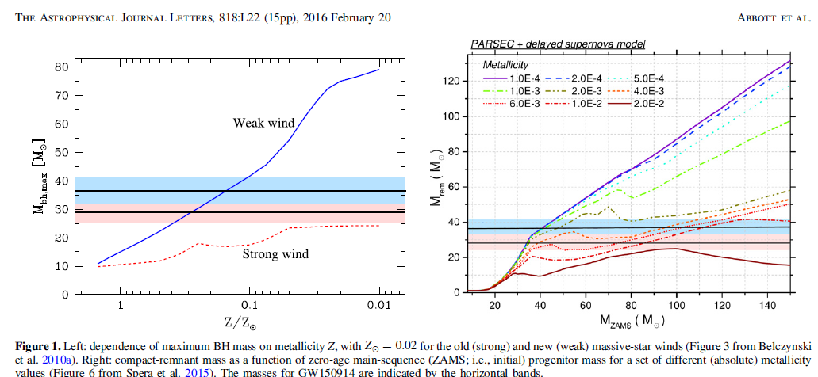
Metallicity effects
No strong mass loss when low metal abundance ➔ higher BH mass

Slide 40
Standard binary scenario for GW150914
<0.1 solar metallicity
40-100 M
No SN explosion
Common envelope
Original spin directions
Belzcynski+ 2016

Slide 41
Problems in binary formation scenario
BH components should have substantial rotation before merging, which is not observed in GW150914, GW170104, GW170814 (see also Kushnir+16)
PopIII low-metallicity stars may be subdominant formation channel (Hatrtwig+16, Dvorkin+ 16)

Slide 42
Can CE be avoided?
Yes, at the expense of fast rotation leading to quasi-homogeneous evolution (Marchant+16, Mandel & deMink 16)

Slide 43
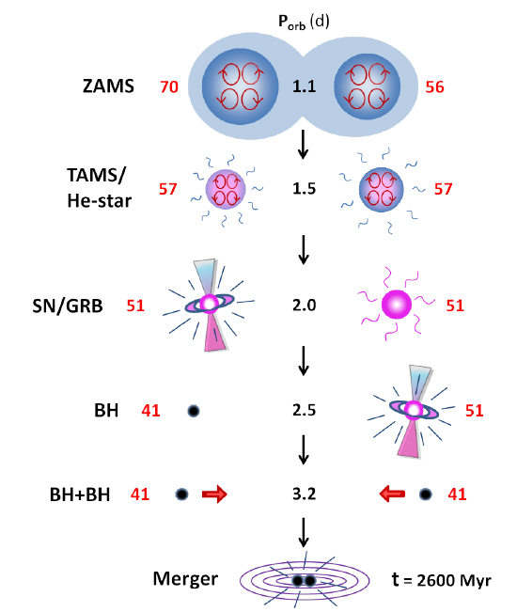
New scenarios (fast rotation and chemically homogeneous evolution to avoid uncertain common envelope stage
arXiv:1601.03718

Slide 44
But rapid rotation of BH remnant cannot be avoided
Or substantial kick velocity during BH formation should be assumed to have small BH spin projections onto orbital angular momentum

Slide 45
BHs in GW150914 had (almost) zero spins prior to merging
Credit: S.Babak, for LIGO collab.

Slide 46
BH spin constraints in GW170104
BH spin seems to be counteraligned with orbital angular momentum
Effective spin is consistent with zero within errors
Difficult to obtain in standard binary evolution scenario
PRL 118, 221101 (2017)

Slide 47
Evolution of stars with solar abundance cannot produce massive BH
arXiv:1706.0369

Slide 48
Evolution of stars with zero metal abundance (primordial, PopIII stars) can produce massive BH
Under assumptions that
  All mass of the pre-collapse star goes into BH
  Common envelope stage is very effective
  Core-envelope rotation coupling is very strong

Slide 49
PopIII (zero metal) stars
arXiv:1706.0369

Slide 50
Initial rotation effect

Slide 51
Viable alternatives/complementary channels
Dynamical formation in globular clusters
Primordial binary black holes
Schwarzschild (almost) BH can be formed ➔ no problem with angular momentum excess

Slide 52
Dynamical BBH formation in globular clusters
Globular clusters formed @ z=3.5
M_{gc}=3-5 x 10⁵ M
Low-metallicity 0.01-0.05 of Z_{solar},
Dynamical interactions lead to BBH formation and ejection from the cluster
Rodriguez+ 16

Slide 53
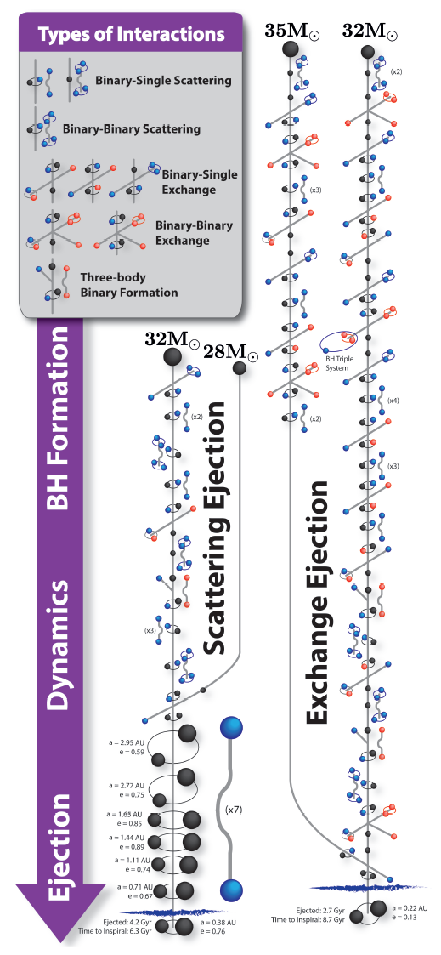
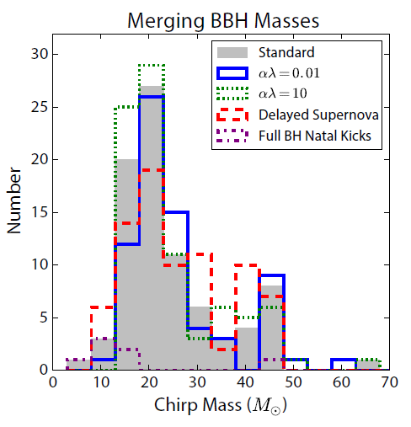
Rodriguez+ 16

Slide 54
Primordial BHs
Can form in the early Universe (Carr, Hawking 74) and significantly contribute to DM
Can be seeds for early galaxy formation
Can form merging binary BHs (Nakamura+ 97)
GW150914 can be a PBH (Bird+ 16, Blinnikov, Dolgov, PK, Porayko 16…)
Can a universal PBH mass distribution be responsible?

Slide 55


Particular model: primordial BH in the modified supersymmetric baryogenesis scenario (Affleck-Dine mechanism)
Dolgov + (1993, 2009): inflation field coupled with renormalizable scalar baryon field
High-B bubbles with almost model-independent mass distribution

Slide 56
Small-scale B –number fluctuations originally are isocurvature perturbations, but after QCD phase transition @ 100-200 MeV are transformed into large density perturbations at astrophysically large but cosmologically small scales (Dolgov, Silk, PRD47 (1993) 4244)
High-B bubbles could form primordial BHs, compact stellar-mass objects or dense primordial gas clouds. Primordial BHs can be seeds for early galaxy formation (Dolgov+ Nucl.Phys. B807 (2009) 229, Dolgov, Blinnikov PRD89 (2014) 021301)

Slide 57




Estimate of mass distribution
A. Fraction of DM in MACHOs is 0.1 for mass range 0.1-1 Msun
B. Primordial BH make up to all cosmological DM
C. Density of primordial BH with M> 10⁴ = density of observed large galaxies
(in units c=h=1)

Slide 58
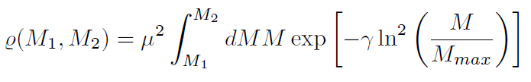





Total energy density in the mass range M₁, M₂:
holds independently of ₄₃ if
MACHO fraction 0.1 ➔
(B) Ω_{pbh}= Ω_{dm} holds if
(A)+(B) ➔ (C) can be satisfied

Slide 59
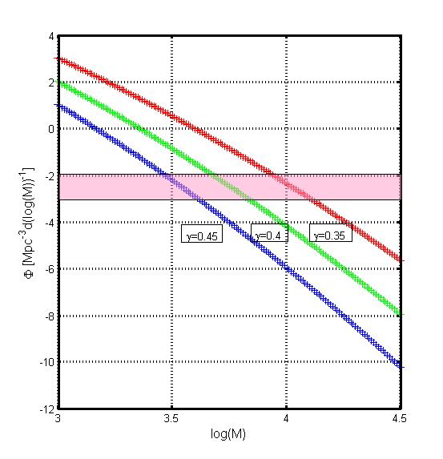
Space density of massive PBH with M> 10⁴M
Total PBH mass is normalized to 1/6 Ω_{m}
Blinnikov, Dolgov, PK, Porayko 2016 JCAP 11 036

Slide 60
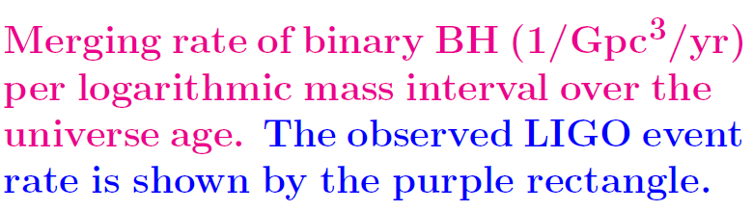
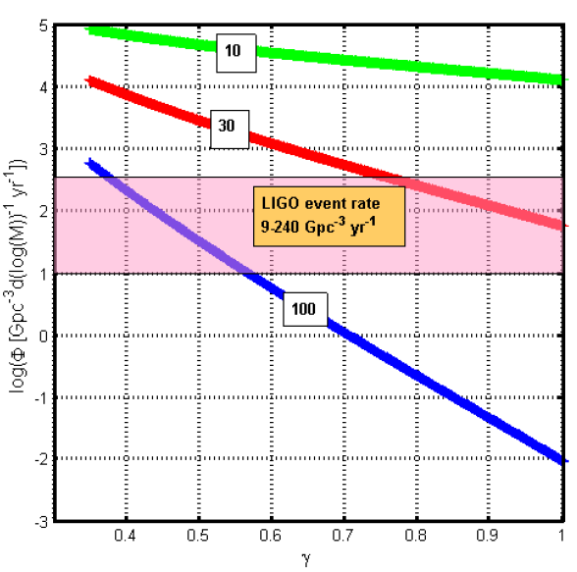
10-100 M

Slide 61
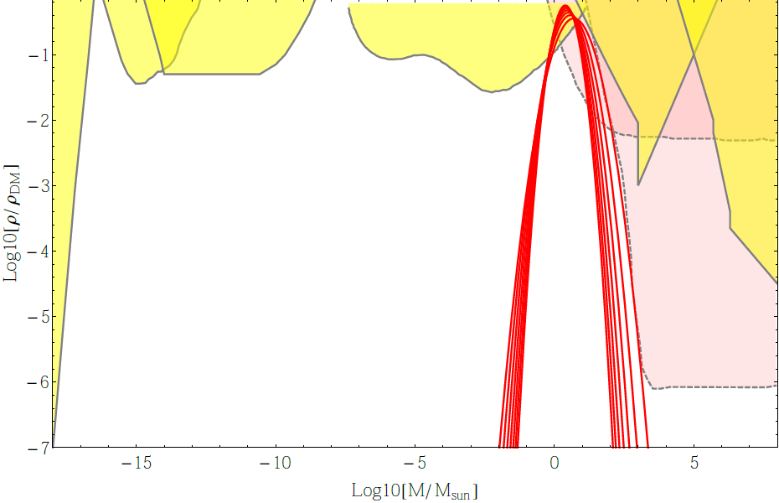
HR
NS-C
MACHO
EROS
ER-II
FL
DF
FIRAS
WMAP
Blinnikov, Dolgov, PK, Porayko 2016 JCAP 11 036

Slide 62
Testable predictions
Specific PBH mass spectrum peaked at a few – 10 M. Massive PBH (>10⁴ M) as seeds of inverted galaxy formation (Dolgov, Silk 94, Dolgov+ 08, Bosch+ 12, etc.)
Low spins (as in GW150914,GW170104,GW170814)
Specific demographics: association with low-mass galactic halos where the binary PBH formation is dynamically favored ( Bird+ 16)
No (bright) electromagnetic, neutrino etc counterparts…
Can be tested in the nearest LIGO observations!

Slide 63
Intermediate mass BHs
Stellar-mass BHs | Intermediate-mass BHs | Supermassive BHs
3-100M | 100-10⁴M | 10⁴ -10⁹M
Core collapses | First supermassive stars, dynamical formation in GC | Growth (accretion, mergings) in galaxy centers
X-ray binaries | GC cores, ULX | Galaxy cores, AGNs

Slide 64
Modern SMBH growth simulations:
M_{BH}~10⁴-10⁵ M seeds rapidly grow due to gas accretion and galaxy mergings by z~5
In DM halos <10¹² M no significant seed BH growth is observed. In more massive halos BH mass increases rapidly to form self-regulating M_{BH}-M_{DM} halo relation
Shape of SMBH mass function does not change after z~5
➔ primordial BH mass function shape is unimportant for M>10⁴ -10⁵M

Slide 65
GC formation
Globular clusters (GC) are oldest baryonic structures. Have no massive DM halos.
In standard cosmogony are formed at z~12-5 from baryons filling DM minihalos, M_{b}~M_{h}
Baryonic structures have initial mass about Jeans mass
At z>20 structures with M<10⁴ M never collapse since T_{vir} < T_{CMB}

Slide 66
SMBH in galaxies
If all PBH > 10⁴ M formed SMBH ➔ n_{IMBH} (z=0)~10²-10³ Mpc⁻³ ➔ n_{IMBH} (z=10) )~10⁵-10⁶ Mpc⁻³ , comparable to expected DM halo number density with ~10⁴ M in Press-Shechter formalism

Slide 67
primordial AD IMBHs with mass of a few thousand solar masses can be important additions to the standard paradigm of the early structure formation in the hierarchical cosmogony
Dolgov, PK 2017 JCAP 04 036

Slide 68
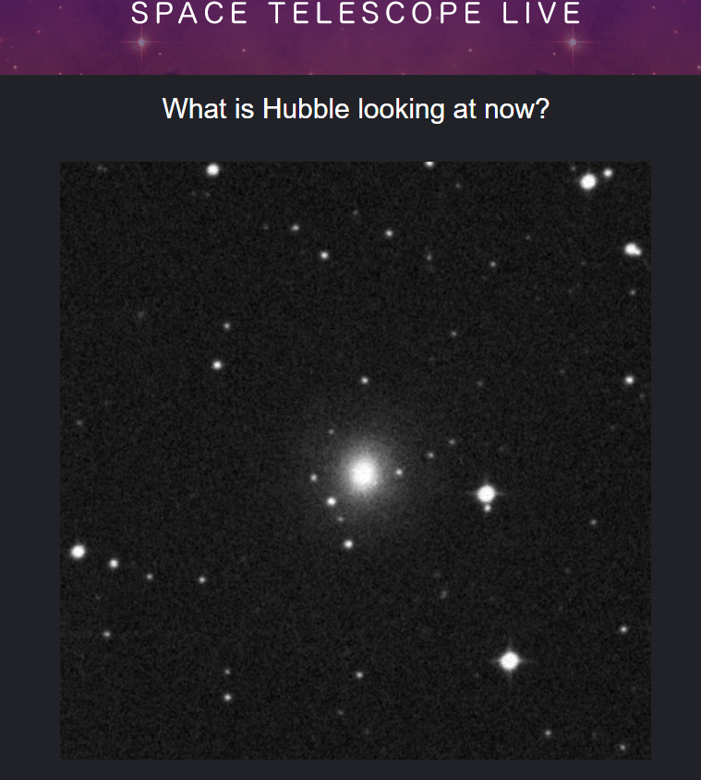
Possible other sources (non-official GW170817)

Slide 69
Binary neutron stars
LIGO horizon for BNS ~80 Mpc (Virgo – 20 Mpc)
GW170817 – time coincidence with short GRB170817A (Fermi GBM, INTEGRAL)
Gamma-ray emission from BNS coalescence first predicted in 1984 г. (Blinnikov, Novikov, Perevodchkova and Polnarev. SvAL)
Localization of the optical counterpart in NGC4993 (40 Mpc)
First detection of coalescing binary NS!
Official press-conference LIGO/Virgo on Oct 16 – keep tuned!

Slide 70
Conclusions
First LIGO events confirm existence of binary BH
Masses and merging rate can be explained by the standard astrophysical binary massive star evolution, but low (or zero) BH spins of GW150914, GW170104, GW170814 require special explanation.
Dynamical formation in dense globular clusters is not excluded
Primordial BH mass spectrum in modified Affleck-Dine scenario can explain both observed properties of GW150914, GW170104, GW170814 can provide significant fraction of DM, can explain present-day SMBH number density and be seeds of early globular cluster formation
Increasing statistics of binary BH mergings can be used to test (constrain) PBH hypothesis

Slide 71
THANK YOU!

Slide 72
Possible electromagnetic counterparts
GW error-boxes are too large (~50-1000 sq.deg)
Both GW150914 and GW170104 were (marginally) found to be associated (within +/- 0.5 s) by a gamma-ray burst

Slide 73
GW-EM conversion in external magnetic field (1706.05519)
Dolgov, Ejli 2012
2 eigenvalues:

Slide 74
However, in real conditions too small…

Slide 75
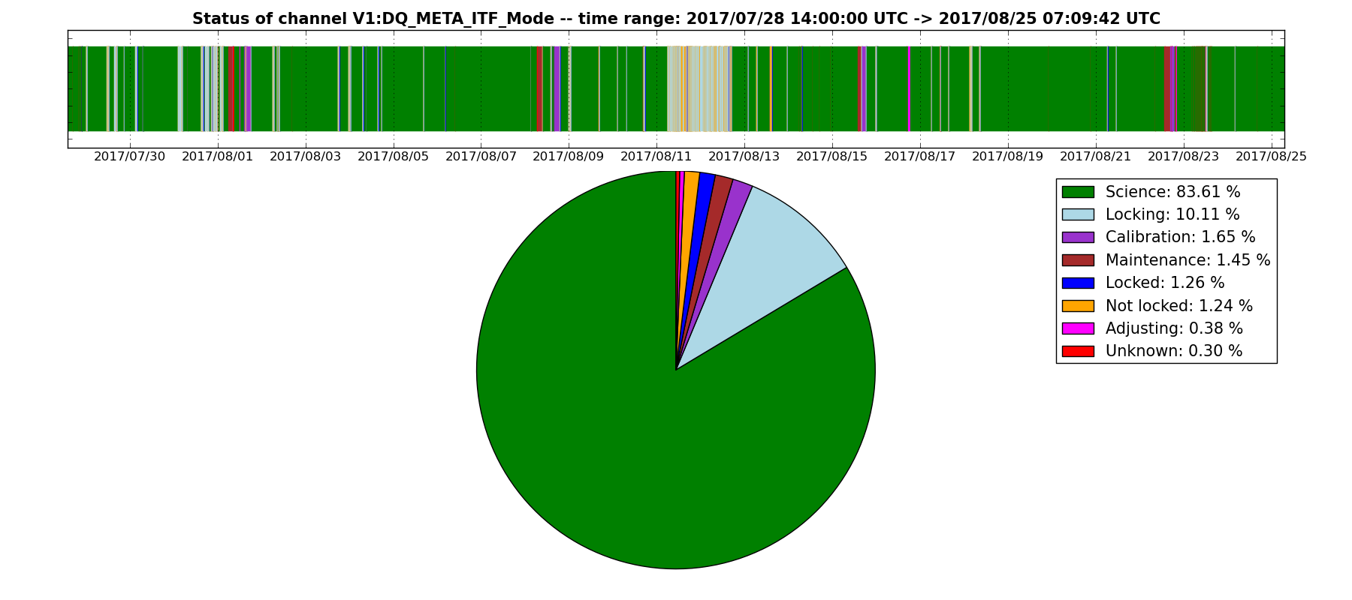
Работа VIRGO в августе 2017

Slide 76
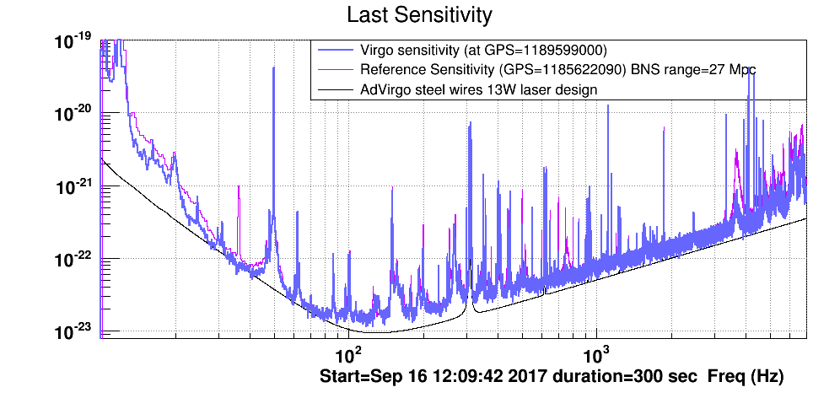
Чувствительность VIRGO

Slide 77
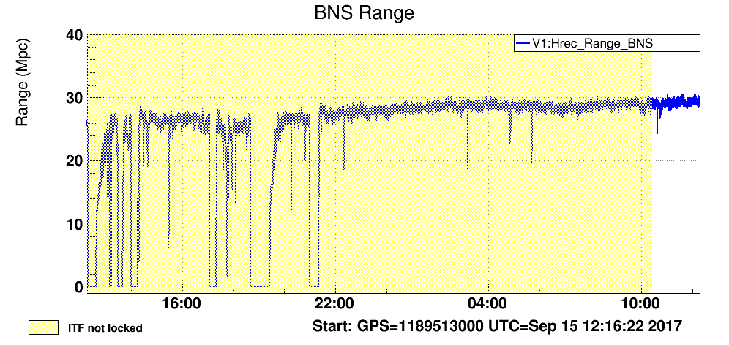
VIRGO вновь на дежурстве с 15 сентября
Горизонт видимости VIRGO для ДНЗ

Slide 78
Ожидания от наземных детекторов
ДЧД ~3/мес (~2/нед >2018)
Независимое измерение H₀ с точностью лучше 5%
ДНЗ (открыты?) и НЗ+ЧД (ожидаются)
Кросс-корреляционные поиски стохастического сигнала от ДЧД и др. механизмов (фазовые переходы GUT) @ ~ 100 Hz

Slide 79
Credit: B. Schutz

Slide 80
ГВ-астрономия полной сетью интерферометров
ДНЗ ~100 в год, ДЧД ~ 1000 в год. ДЧД @ z>1.
ДНЗ → ограничения на УС НЗ, физика GRB
Тесты ОТО: горизонт ЧД от измерения хвостов фазы звона. Отклонения от ОТО
Статистические измерения M, J для НЗ и ЧД в двойных системах → механизмы формирования (стандартные, в шаровых скоплениях, первичные ЧД).
…

Slide 81

План будущего развития LIGO
3 Projects of future LIGO detectors:
A⁺
Voyager
Cosmic Explorer
https://dcc.ligo.org/LIGO-T1500290/public

Slide 82

40-км LIGO Cosmic Explorer (2035)
Sensitivity of detectors with different lengths.
Solid curves are for a 40km long detector
LIGO Scientific Collaboration,arXiv:1607.08697 [astro-ph.IM]

Slide 83



8. Космический интерферометр LISA (ESA+, 2034)
www.elisascience.org

Slide 84
Главные источники – слияния массивных двойных ЧД в галактиках
Все галактики имеют центральную СМЧД
Галактики сливаются → образование двойных СМЧД
Двойные СМЧД могут слиться за Хаббловское время

Slide 85


Успешная работа LISA Pathfinder
2015-2016
2 46-мм Au-Pt 2 кг массы
Проверка технологии свободного от сноса движения
www.elisascience.org

Slide 86


Slide 87
Галактические двойные БК
~10⁷ в Галактике; проверочные источники: GAIA, LSST
ГВ сигнал почти монохроматический

Slide 88
Анализ данных LISA
Главная трудность: сигнал доминирован многими источниками

Slide 89
9. Пульсарный тайминг (Сажин 1978, Detweiler 1979)
Используются стабильные мс пульсары для детектирования КВ в диапазоне (10⁻⁹ − 10⁻⁷ Hz).
* Источники – двойные СМЧД (10⁷ − 10¹⁰M) в ядрах галактик
Сигнал почти монохроматический
Специфическая корреляция остаточных уклонений в тайминге разных пульсаров
© D. Champion

Slide 93
Заключение
Первые события LIGO подтвердили существование двойных ЧД
Массы и темп слияния ДЧД могут быть получены в стандартном сценарии эволюции массивных двойных систем, однако каналы динамического образования в плотных скоплениях ил из первичных ЧД тоже возможны.
В ближайшие годы сеть интерферометров LIGO-Virgo-KAGRA сможет значительно увеличить статистику зарегистрированных ДЧД и ДНЗ
Космический проект ESA LISA получил поддержку (2034)

Slide 94
Поиск электромагнитных сигналов
Области локализации пока большие (~200-1000 кв. град.)
GW150914 и GW170104, возможно, совпадали (с точностью +/- 0.5 с) со слабыми гамма-всплесками
От GW170817 – гамма- и оптическое (NGC4993 OT) излучение – слияние двойных НЗ

Slide 95
Российские проекты
Полноправный участник LIGO-Virgo collaboration (МГУ физ. Ф-т, ИПФ РАН)
Российские астрономы участвуют в поисках возможных ЭМ и нейтринных сигналов
Собственный проект – ОГРАН в БНО (ГАИШ, ИЯИ РАН, ИЛФ РАН)

Slide 101

Bright future for GW astronomy!

