Slide 1



Measurements, status and plans of the TOTEM experiment at the LHC
Fabrizio Ferro INFN Genova

Slide 2
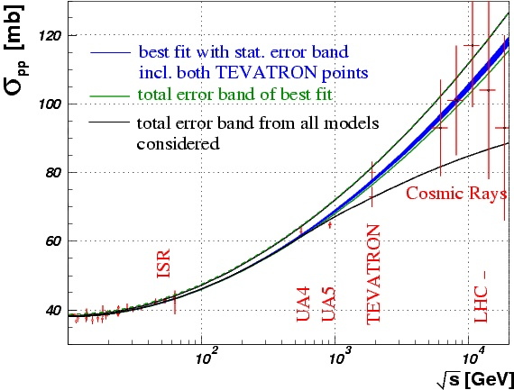
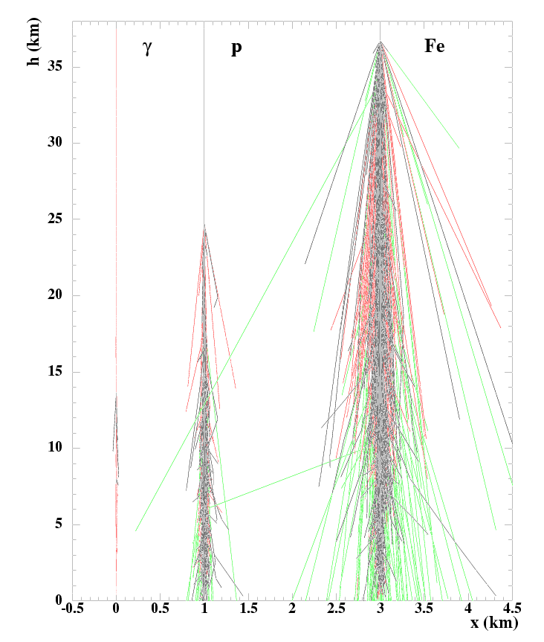
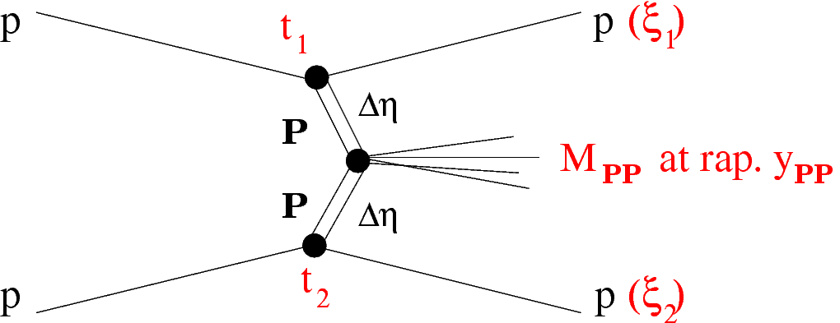
TOTEM physics (in a glance)
TOTEM (main) physics goals are the measurement of the total, elastic and inelastic proton-proton cross sections at several energies and the study of the diffractive processes
Elastic scattering
Total p-p cross section
Forward particle production
b
Diffraction

Slide 3
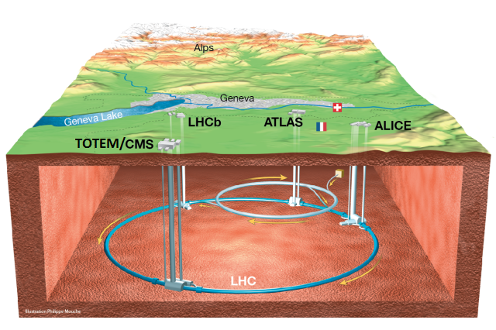
TOTEM at the LHC
TOTEM is installed at IP5 together with CMS
IP5

Slide 4
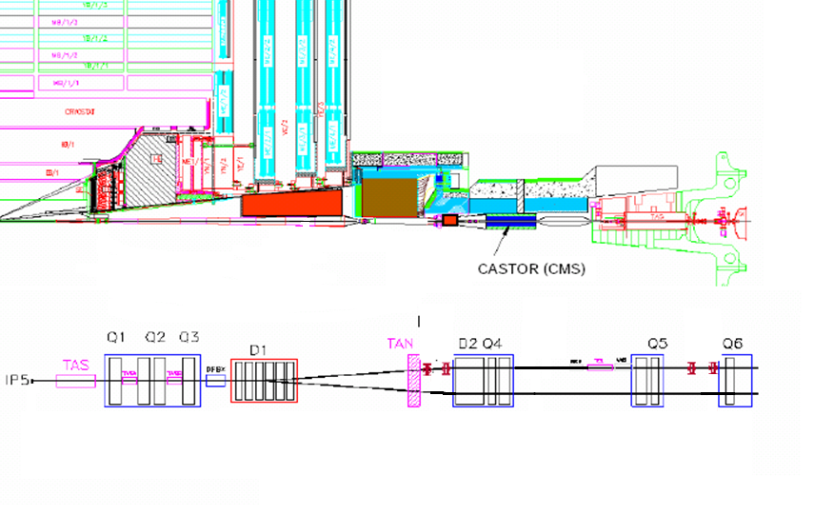


Experimental apparatus (Run 1)
Inelastic telescopes and proton tagging detectors
Inelastic telescopes
CMS
T1:
$$3.1<|\text{η}\text{|<4.7}$$
T2:
$$5.3<\left|η\right|<6.5$$
T1
T2
IP5
Roman Pots
(inside LHC tunnel)
RP (147m)
RP (220m)

Slide 5
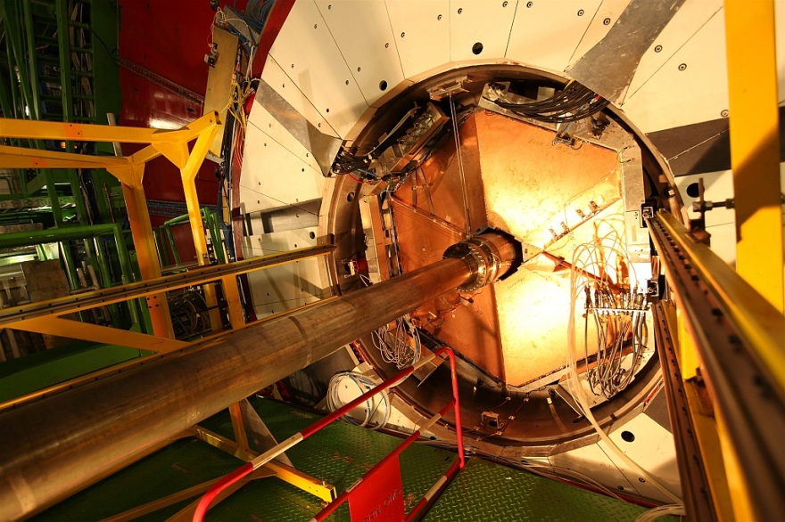
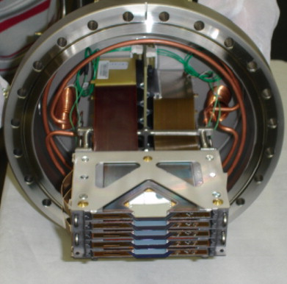
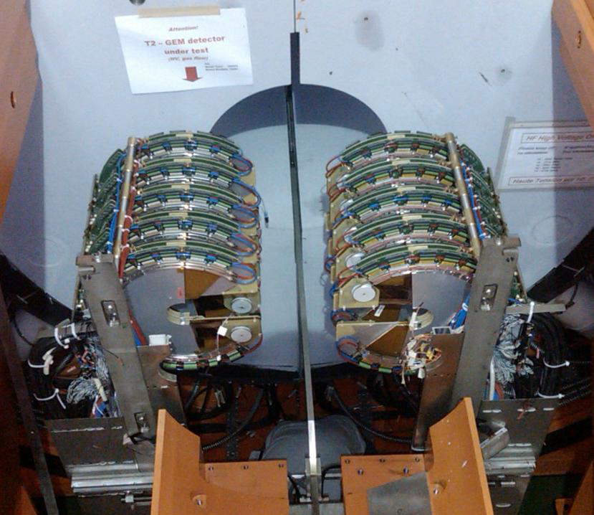
Inelastic telescopes
Roman Pot dets.
Inelastic event counting, charged multiplicity, rapidity gaps
Detection of the leading protons
Roman pot stations in the LHC tunnel at 147m and 220m from IP (both sides)
10 edgeless (<50μm) Si micro strip detectors per pot
Resolution ~15μm
T1
5 CSC planes
3.1<|η|<4.7
Δφ = 2π
T2
10 GEM planes
5.3<|η|<6.5
Δφ = 2π
Horizontal pot
Vertical pots
BPM

Slide 6
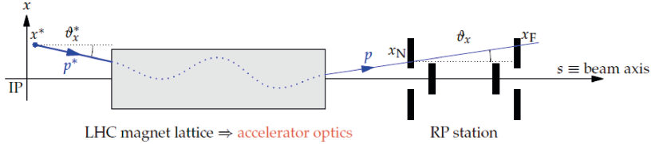



Proton reconstruction and beam optics
(x*, y*): vertex position
(θ_{x}*, θ_{y}*): emission angle: t ≈ −p²(θ_{x}*² + θ_{y}*²)
ξ = Δp/p: momentum loss (elastic case: ξ = 0)
L_{x}, L_{y}: effective lengths (sensitivity to scattering angle)
v_{x}, v_{y}: magnifications (sensitivity to vertex position)
D_{x} : dispersion (sensitivity to momentum loss); D_{y} ~ 0:
Reconstruction of proton kinematics inverting the transport equation
Excellent beam optics understanding needed
[New J. Phys. 16 (2014) 103041]

Slide 7
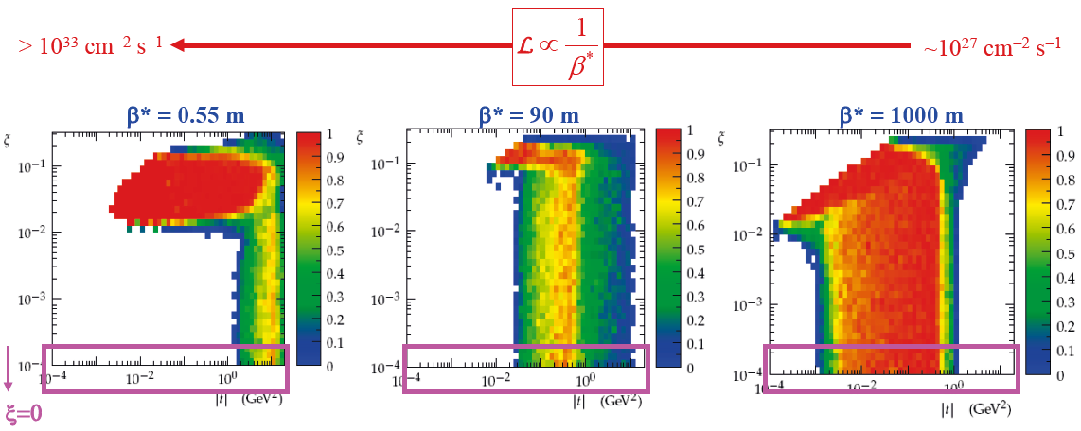
Proton acceptance
Acceptance for elastic and diffractive protons depends on LHC optics and TOTEM running scenario (e.g. approach to the beam)
t ≈ −p² Θ^{∗ 2}: four-momentum transfer squared; ξ = Δp/p: fractional momentum loss
typically
|t| > O(1 GeV²) |t| > O(10⁻² GeV²) |t| > few 10⁻⁴ GeV²
Elastic scattering: special case with ξ = 0

Slide 8
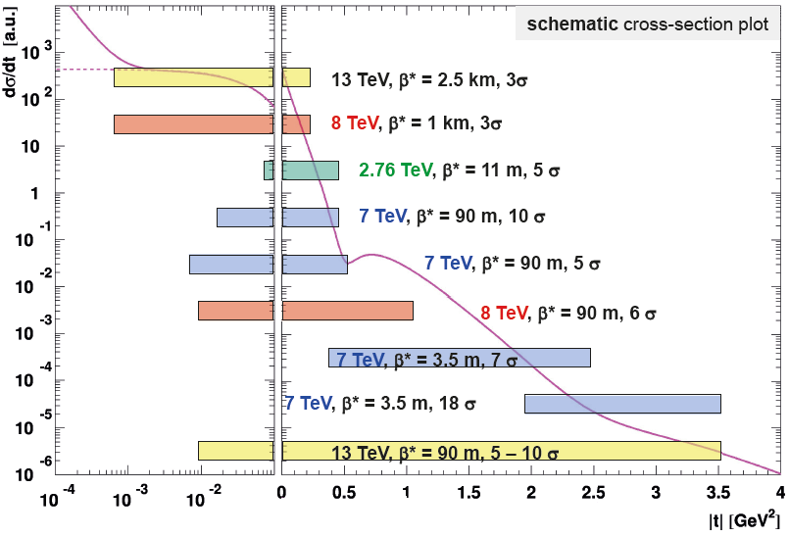
Elastic scattering: data sets vs t ranges
analysis ongoing
[EPJC 76 (2016) 661]
[to be published]
[EPL 96 (2011) 21002]
[EPL 101 (2013) 21002]
[NPB 899 (2015) 527-546]
[EPL 95 (2011) 41001]
analysis ongoing

Slide 9
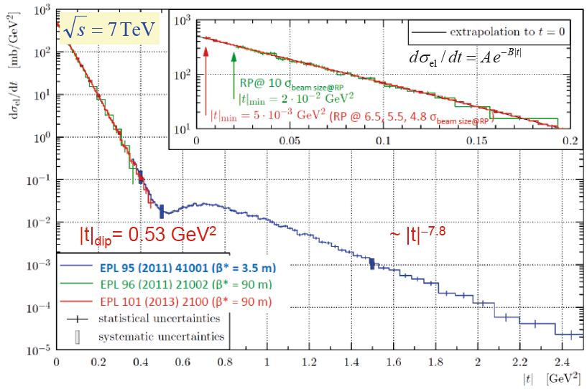
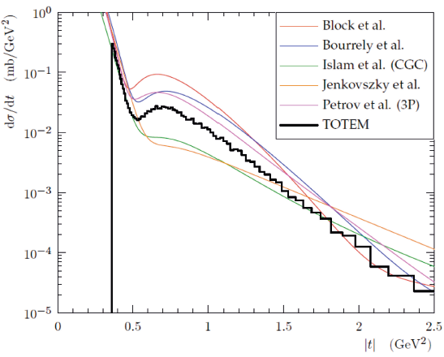
Elastic scattering at 7 TeV
Comparison with models

Slide 10
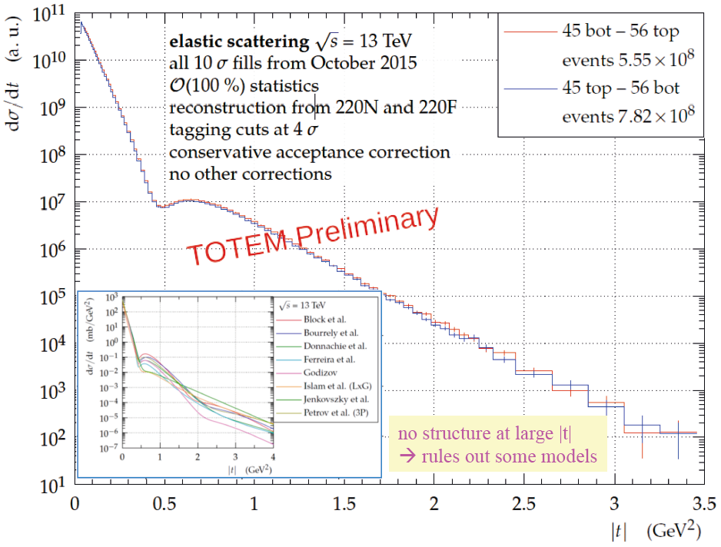
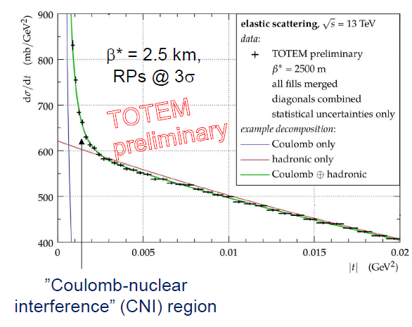
Elastic scattering at 13 TeV

Slide 11
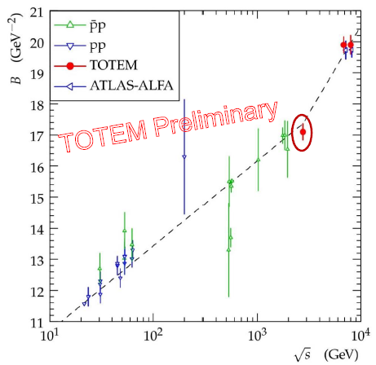
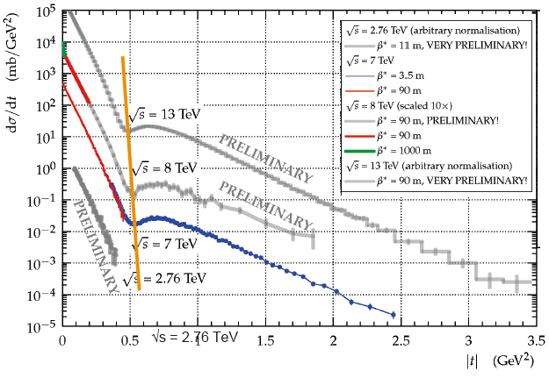
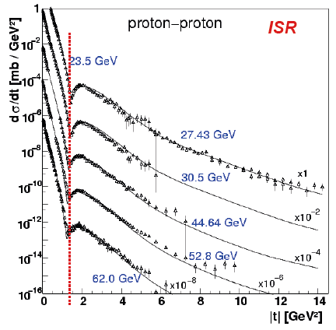

Elastic scattering trends
Diffractive slope parameter B
Diffractive dip position
B ∝ ln$$s → ln√s² @ LHC: larger impact from
contribution of multi-Pomeron exchanges
Dip position decreases with increasing √s

Slide 12
Elastic scattering at low t
Usually called the “exponential region”
Peak is fitted with a polynomial exponential
The peak at “first glance”
Difference wrt pure exponential
Simple exponential ruled out with a significance of 7.2 σ
Differences of the order of ~1%. Very high statistics and very good control of systematics.
[NPB 899 (2015) 527]

Slide 13
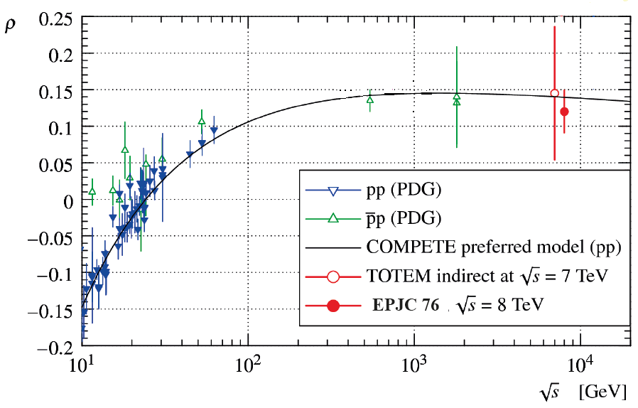
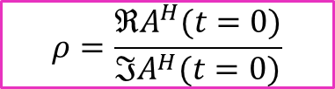
Elastic scattering: measurement of ρ
$$ρ=\frac{ℜA^{H}(t=0)}{ℑA^{H}(t=0)}$$
@13TeV expected soon
Totem direct measurement at 8 TeV: ρ = 0.12 ± 0.03
Indirect measurement done at 7 TeV
First pp measurement of ρ since ISR era
Results at 13 TeV expected soon
Requested run at 900 GeV to fill the gap
Sensitivity to Odderon (J^{PC}=1⁻⁻) states

Slide 14
Total pp cross section: measurements
2.76 TeV
  Luminosity independent σ_{tot} = (84.7 ±3.3) mb using ρ = 0.145 [COMPETE]
7 TeV
  Luminosity independent σ_{tot} = (98.0 ± 2.5) mb using ρ = 0.14[COMPETE]
  ρ independent σ_{tot} = (99.1 ± 4.3) mb
  From elastic scattering only
    σ_{tot} = (98.3 ± 2.8) mb
    σ_{tot} = (98.6 ± 2.2) mb
8 TeV
  Luminosity independent
    σ_{tot} = (101.7 ± 2.9) mb
    σ_{tot} = (101.5 ± 2.1) mb
    σ_{tot} = (102.9 ± 2.3) mb
13 TeV
  Results expected soon, analysis ongoing
Different extrapolations to the optical point

Slide 15
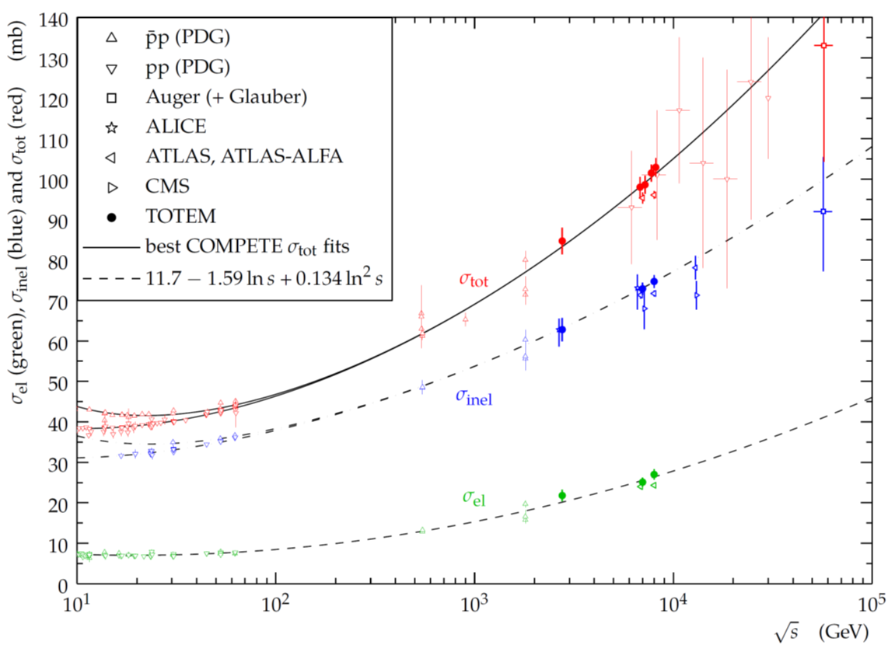
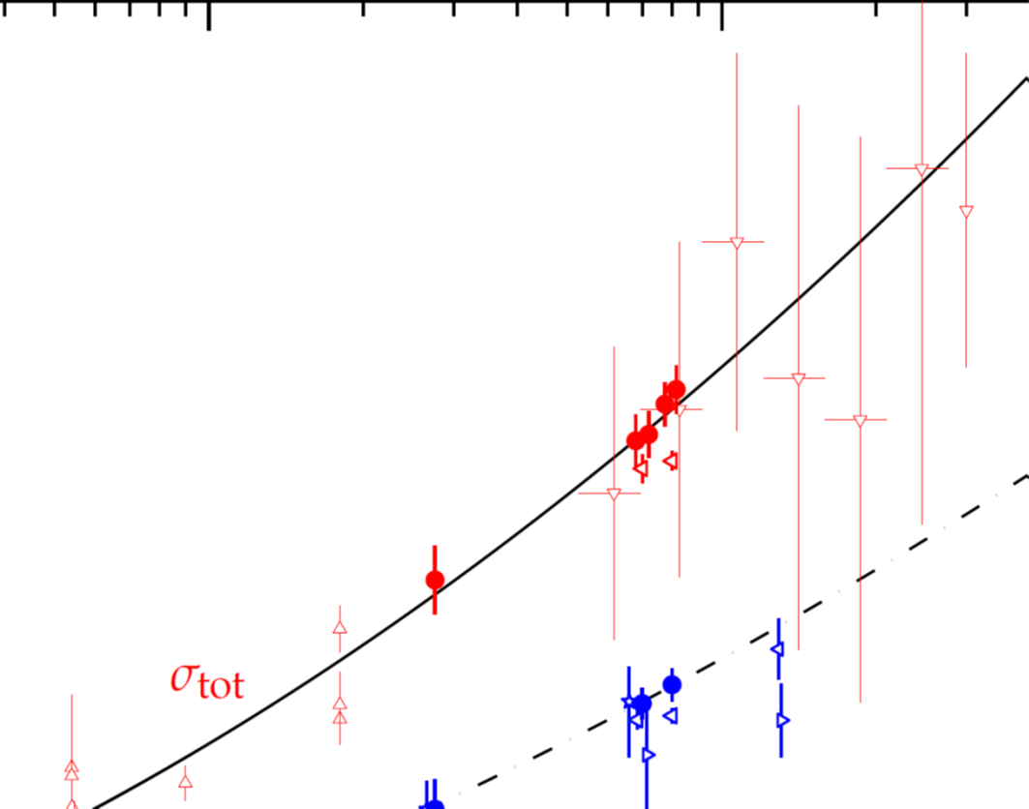
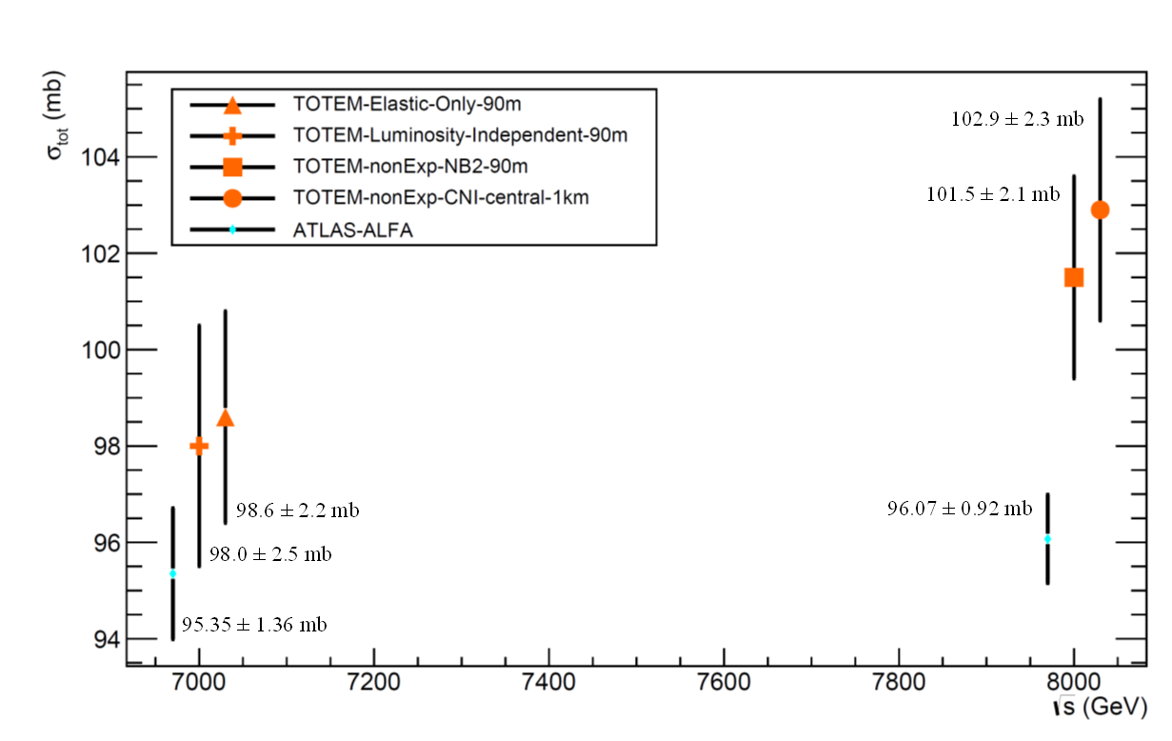
Total pp cross section: measurements
zoom
7 and 8 TeV
2.76
TeV
CDF
E710
S-dependence compatible with ln²s growth
Run and measurements at 0.9 TeV expected in late 2017

Slide 16
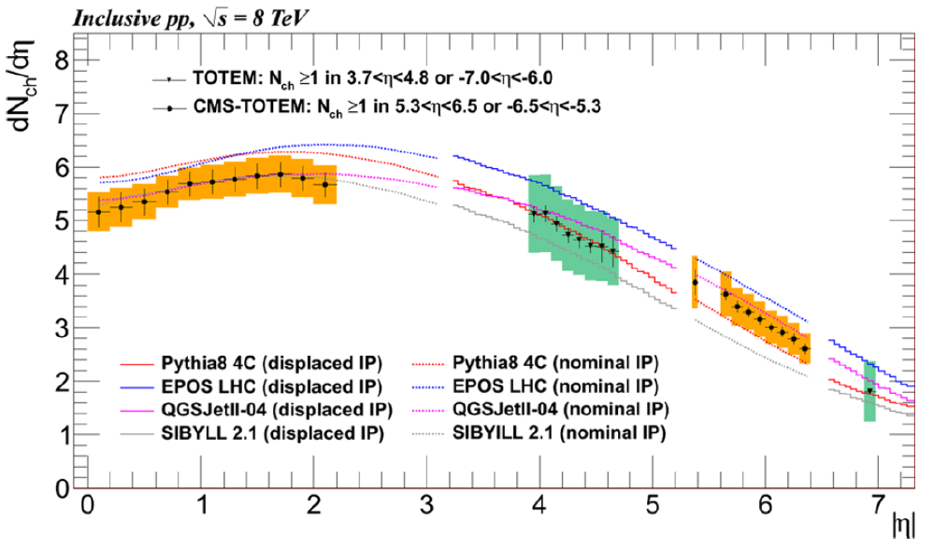
Charged-particle pseudorapidity density
MC tuning in the forward region
Valuable information for Cosmic Ray physics simulations
Measurements done with T2 and CMS central detector
T2 with displaced vertex
CMS
T2

Slide 17
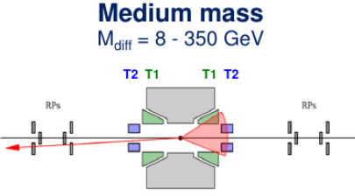
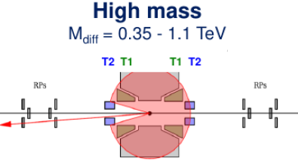
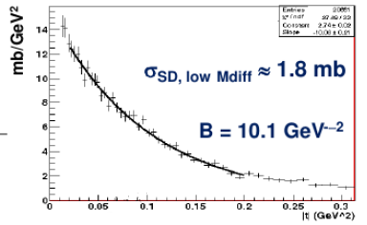
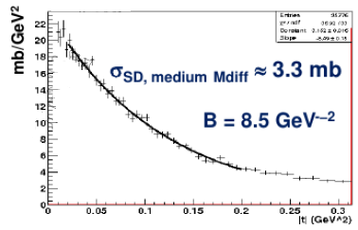
Single diffraction (preliminary)
PRELIMINARY
PRELIMINARY
PRELIMINARY
Estimated uncertainties: ΔB~15%, Δσ~20%
σ_{SD} = 6.5 ± 1.3 mb in the range 3.4 GeV < M_{diff} < 1.1 TeV
Preliminary results. Not all corrections included

Slide 18
Central Exclusive Production (with CMS)
CMS and TOTEM work together to performs CEP studies
CMS-TOTEM Trigger information are exchanged and data can be merged offline
Central exclusivity can be verified via rapidity gaps and forward proton tagging
selection rules for system X:
  J^{PC} = 0⁺⁺, 2⁺⁺, … (PP, gg)
  J^{PC} = 1⁻⁻ (γP)

Slide 19
Central Exclusive Production (with CMS)
Low mass resonances and glueballs
At low (x ~ 10⁻³ – 10⁻⁴) LHC becomes (a sort of) gluon-gluon collider and CEP is ideal for glueball production
  CEP with M_{X} ~ 1 – 4 GeV produced very purely from gg
0⁺⁺(2⁺⁺) glueball candidates: f₀ (f₂) resonances in 1.3 -1.8 GeV(> 2 GeV) mass range
Strategy:
  determine σ_{CEP} of glueball candidates
  characterize their decays: π⁺π⁻, Κ⁺Κ⁻, ρ⁰ρ⁰…
CMS+TOTEM advantages:
  Good reconstruction of charged-particle-only events using dedicated low pT tracking
  Good particle ID and mass resolution (σ(M) ~ 30 MeV) using CMS tracker
  RP protons from TOTEM to assure exclusivity (p_{T,RP} ~ p_{T,tracker} , vtx_{RP} ~vtx_{tracker})
CMS+TOTEM 2015: L = 0.4 pb⁻¹ of high β* with dedicated low mass CEP trigger

Slide 20

High luminosity proton detector physics
CTPPS: CMS-TOTEM Precision Proton Spectrometer
Exclusive Production:
  photon-photon fusion
  gluon-gluon fusion in colour-singlet state (J^{PC} = 0⁺⁺, 2⁺⁺ ...)
Tracking detectors + timing detectors in the Roman Pots
  Exclusive WW
  Exclusive dijets
  Inclusive missing mass/missing energy
CERN-LHCC-2014-021

Slide 21
CTPPS setup in a snapshot
Currently taking data, first results being published
See e.g.: http://cds.cern.ch/record/2265781?ln=en

Slide 22
Conclusions
TOTEM has taken data at the LHC at 2.76, 7, 8 and 13 TeV
Elastic pp scattering
  s-dependence of forward slope: acceleration at √s ~ 3 TeV ?
  non-exponentiality at low t
  Coulomb-nuclear interference at very low t: sensitivity to Odderon contribution
Total cross section
  s-dependence generally compatible with ln² s growth
  non-negligible differences (mainly) in σ_{inel} probably related to MC corrections
Preliminary measurements of single diffractive cross sections
Measurement of charged dN/dη multiplicity: MC tuning, CR impact
CEP
  Low mass resonances and glueballs: public results expected soon
High luminosity CEP
  CTPPS: new detectors for present and future data taking in nominal LHC runs

Slide 23

Thank you!

Slide 24
References
Measurement of Elastic pp Scattering at sqrt(s) = 8 TeV in the Coulomb-Nuclear Interference Region - Determination of the \rho Parameter and the Total Cross-Section
CERN-PH-EP-2015-325, Eur. Phys. J. C76 (2016) 661
Evidence for Non-Exponential Elastic Proton-Proton Differential Cross-Section at Low |t| and sqrt(s) = 8 TeV by TOTEM
CERN-PH-EP-2015-083, Nucl. Phys. B 899 (2015) 527-546
Measurement of the forward charged particle pseudorapidity density in pp collisions at sqrt(s) = 8 TeV using a displaced interaction point
CERN-PH-EP-2014-260 Eur. Phys. J. C75 (2015) 126
LHC Optics Determination with Proton Tracks Measured in the Roman Pots Detectors of the TOTEM Experiment
CERN-PH-EP-2014-066 , New J. Phys. 16 (2014) 103041
Measurement of pseudorapidity distributions of charged particles in proton-proton collisions at sqrt(s) = 8 TeV by the CMS and TOTEM experiments
CERN-PH-EP-2014-063 arXiv:1405.0722 EPJC 74 (2014) 3053
Performance of the Totem Detectors at the LHC
CERN-PH-EP-2013-173 arXiv:1310.2908 [physics.ins-det] Int. J. Mod. Phys. A
Double diffractive cross-section measurement in the forward region at LHC
CERN-PH-EP-2013-170 Phys. Rev. Lett. 111 (2013) 262001
A luminosity-independent measurement of the proton-proton total cross-section at sqrt s = 8 TeV
CERN-PH-EP-2012-354 Phys. Rev. Lett. 111, 012001 (2013)
Luminosity-independent measurements of total, elastic and inelastic cross-sections at sqrt s = 7 TeV
CERN-PH-EP-2012-353, EPL 101 (2013) 21004
Measurement of proton-proton inelastic scattering cross-section at sqrt s = 7 TeV
CERN-PH-EP-2012-352, EPL 101 (2013) 21003
Measurement of proton-proton elastic scattering and total cross-section at sqrt s = 7 TeV
CERN-PH-EP-2012-239, EPL 101 (2013) 21002, HepData
Measurement of the forward charged particle pseudorapidity density in pp collisions at sqrt s = 7 TeV with the TOTEM experiment
CERN-PH-EP-2012-106, EPL 98 (2012) 31002
First measurements of the total proton-proton cross section at the LHC energy of sqrt s = 7TeV
CERN-PH-EP-2011-158, EPL 96 (2011) 21002
Proton-proton elastic scattering at the LHC energy of sqrt s = 7 TeV
CERN-PH-EP-2011-101, EPL 95 (2011) 41001, HepData

Slide 25
Back up slides

Slide 26
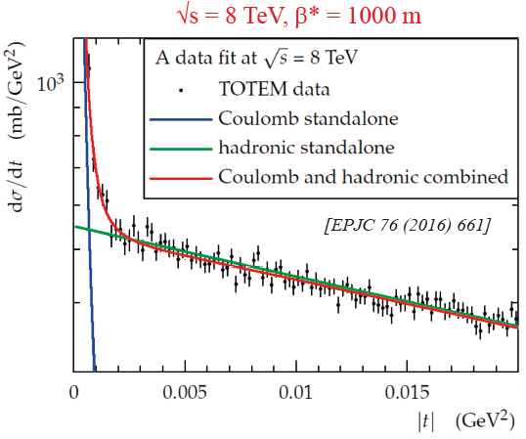
Elastic scattering in the CNI region
t_{min} = 6∙10⁻⁴ GeV²
Data available at 8 and 13 TeV
CNI with constant B and constant hadronic phase (labelled ”SWY”) excluded by TOTEM 8 TeV data
Usage of most common CNI formula, simplified West-Yennie (SWY) not valid

Slide 27
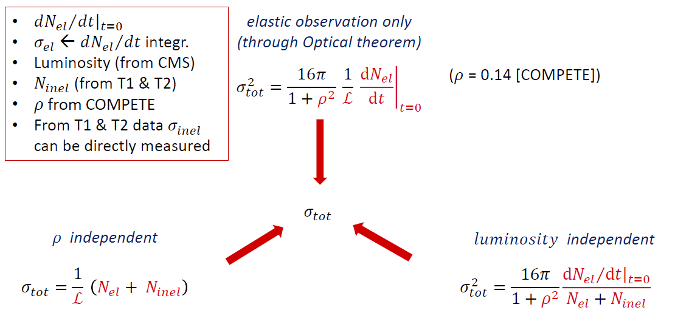
Total pp cross section: strategies
𝜎𝑒𝑙 and 𝜎𝑡𝑜𝑡 from 𝑑𝑁𝑒𝑙/d𝑡 →𝜎𝑖𝑛𝑒𝑙 inclusive of low mass diffraction

Slide 28
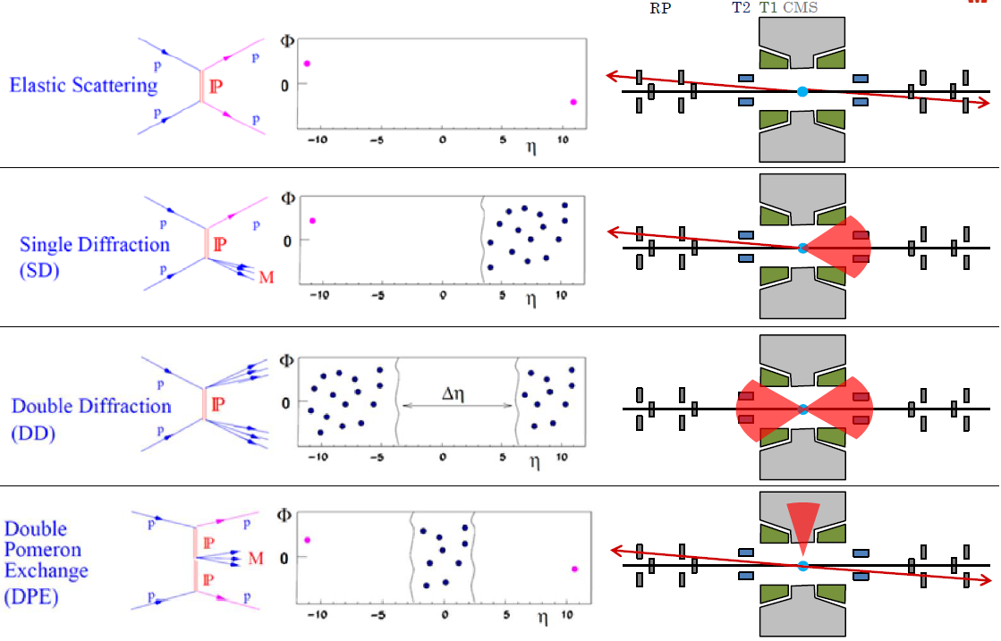
Diffractive event topology

