Slide 1
Anomalous events in TUS data
Blinov Aleksandr
Joint Institute for Nuclear Research

Slide 2
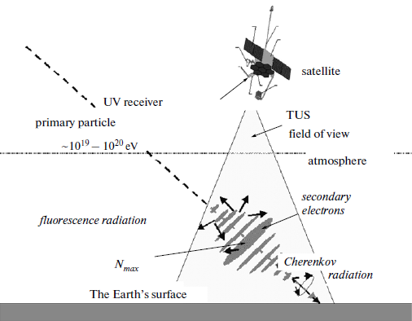
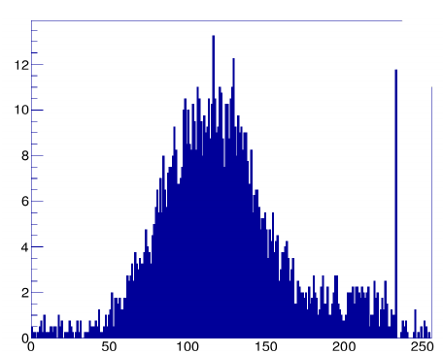
Extensive Air Shower (EAS)
Process of data obtaining
ESAF MC event, E = 10^20 eV, θ = 60º
2

Slide 3
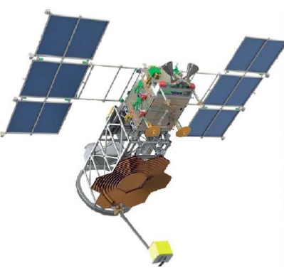
Detector TUS
FoV of space telescope TUS 4.5º × 4.5º
Amount of PMT’s – 256
Area of mirror – 2 m²
Focal distance – 1,5 m
Schematic representation of the TUS detector
3

Slide 4
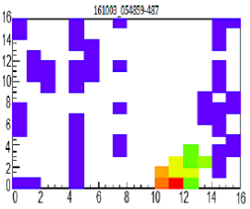
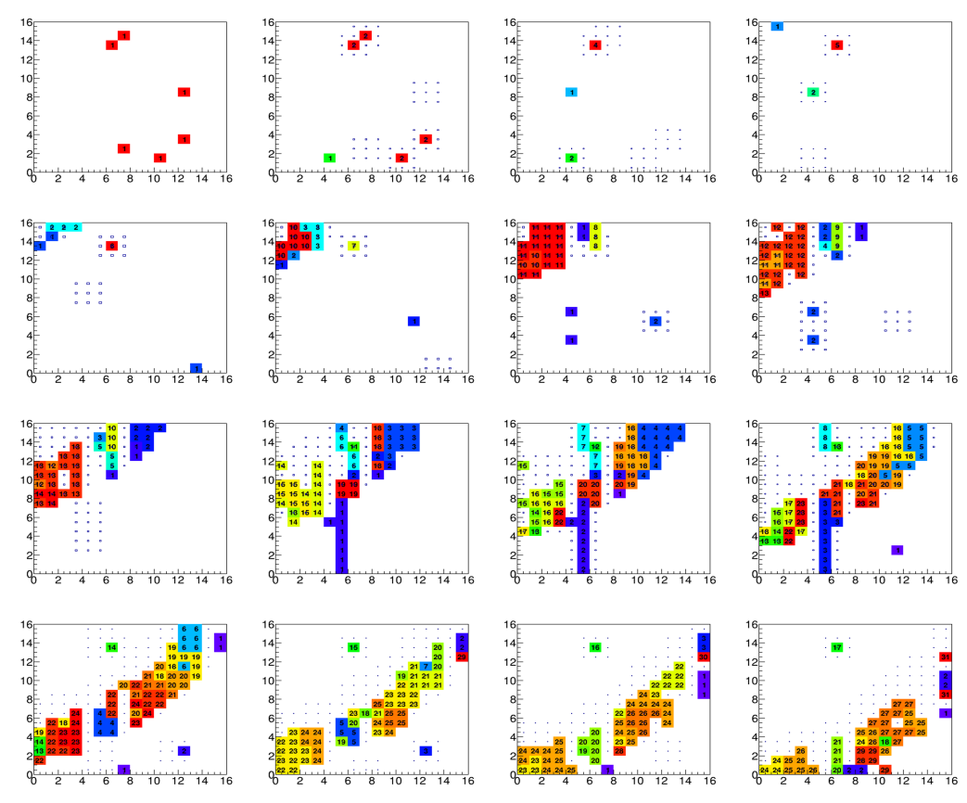
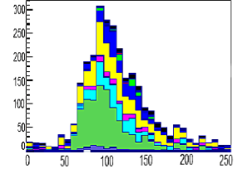
Events in TUS data
Image of the candidate’s event in EAS with triggered pixels
Stack histogram of the candidate event in the EAS
Frame – by – frame unfold of the ELVE event
4

Slide 5
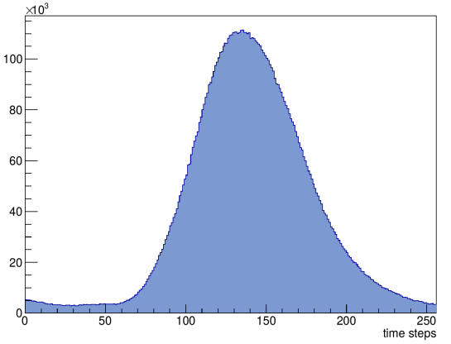
Anomalous event 170818
Integral amplitude of the event 170818
Frame – by – frame unfold of the event 170818 with 4 time steps in each histogram
5

Slide 6
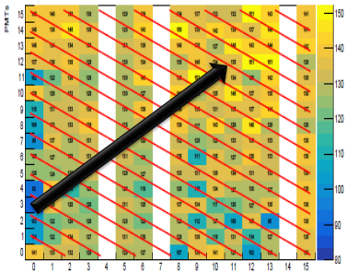
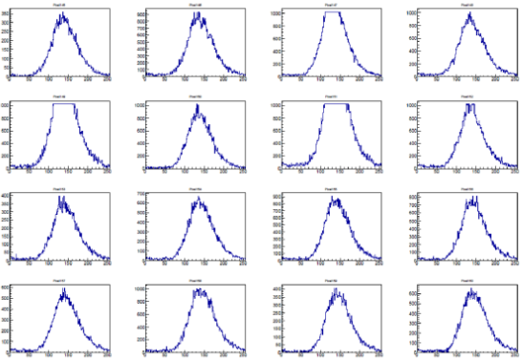

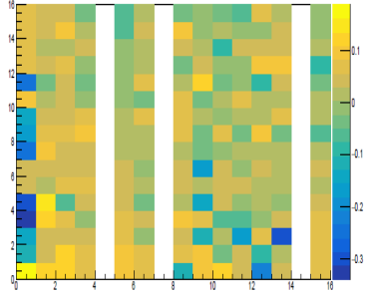
Anomalous event 170818
The dependence of the amplitude of the time in 10 module
6

Slide 7
Another few anomalous events
Integral amplitude
7

Slide 8
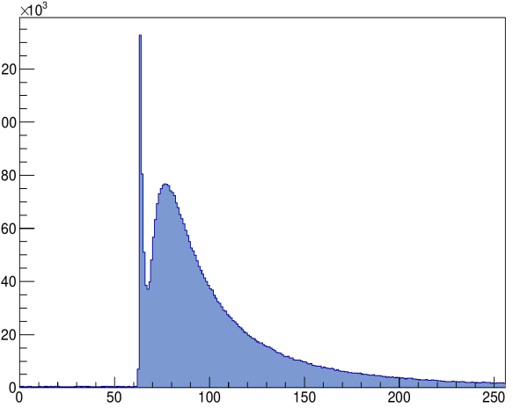
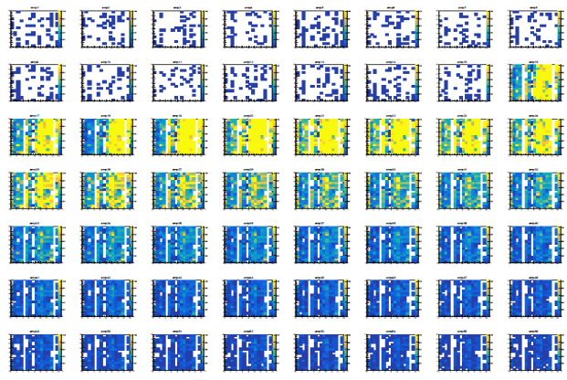
Hybrid event 170728
Integral amplitude of the event 170728
Frame – by – frame unfold of the event 170728 with 4 time steps in each histogramm
8

Slide 9
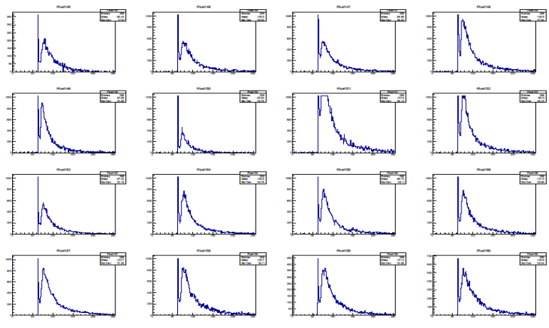
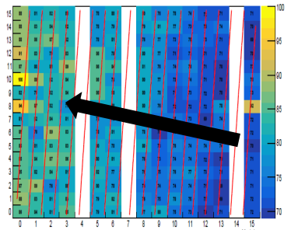
Hybrid event 170728
The dependence of the amplitude of the time in 10 module
9

Slide 10
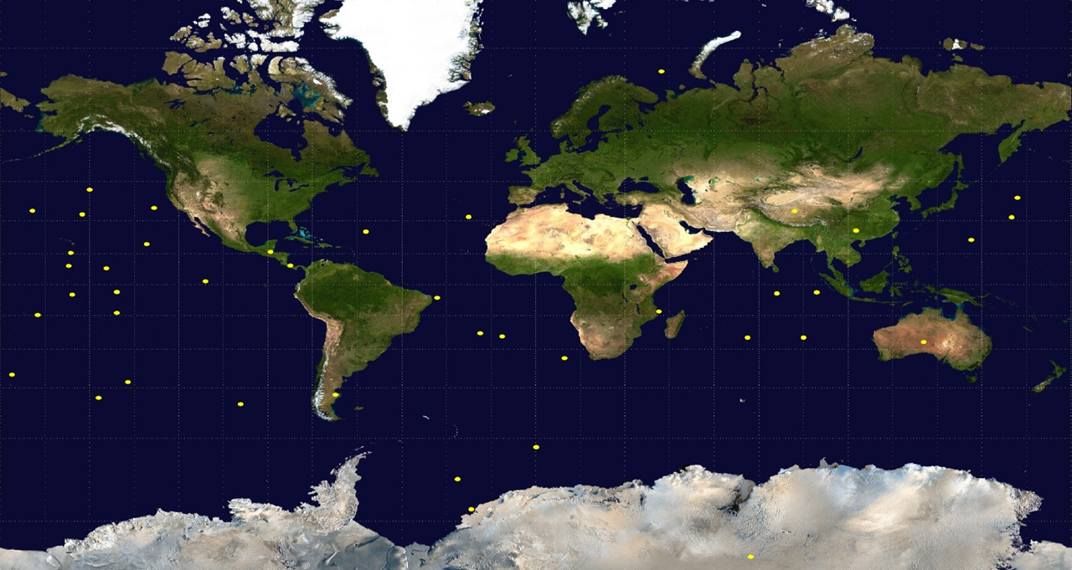
Location of the anomalous events
10

Slide 11
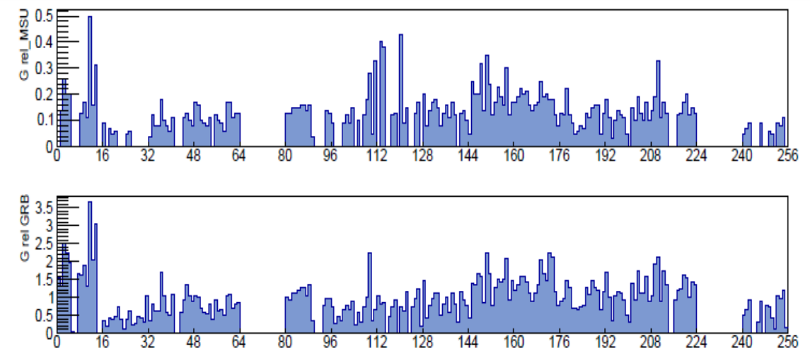
Relative calibration
11

Slide 12
Possible physical interpretations
Gamma-ray burst
Synchrotronic radiation e⁻/e⁺
Upward EAS
Out-of-aperture event – lightning reflected by solar panels or another part of satellite
12

Slide 13
Conclusions
For now, dozens of the anomalous events were found.
The most probable nature of hybrid events – upward EAS. The others anomalous events – out-of-aperture event – reflection of lightning by construction of satellite.
The narrow peak in hybrid events doesn’t trigger, therefore, there may be more of them.
13

Slide 14
Thank you for your attention!

