Slide 1

The modulation of positively and negatively charged particles at 1 GV rigidity during 23-24 solar cycles
P. Mukhin V. Mikhailov
NRNU MEPhI + the PAMELA collaboration

Slide 2
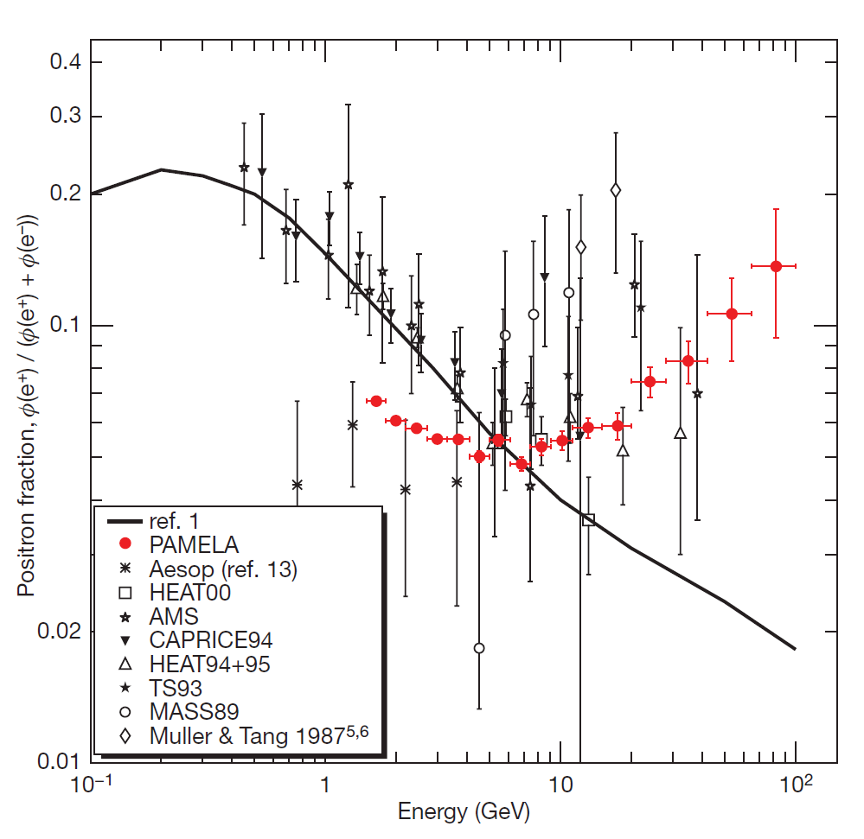
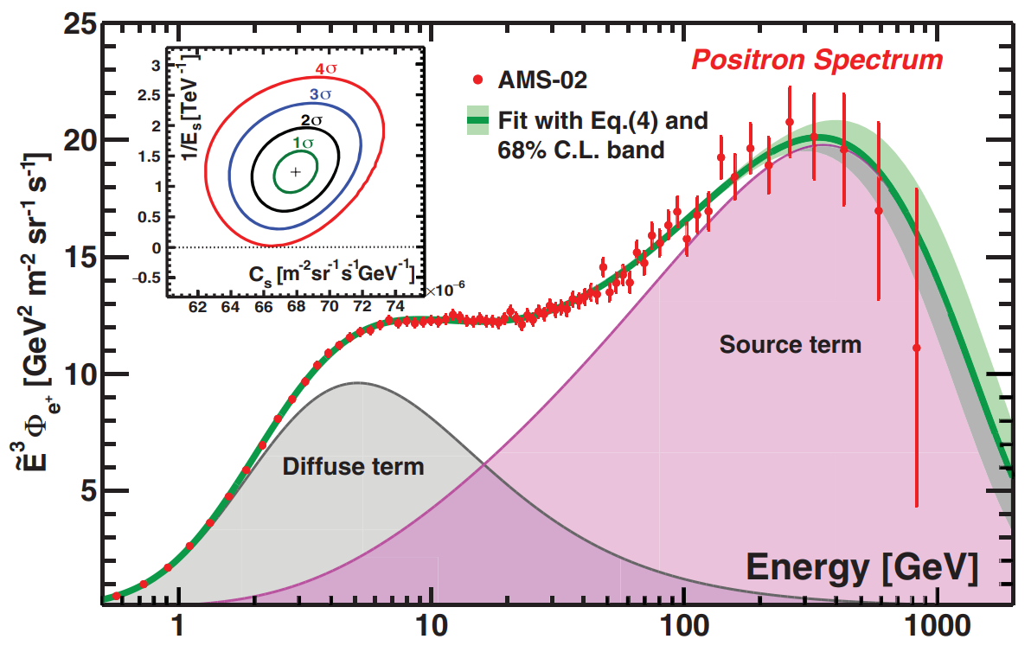
Electrons & Positrons: High Energies
Positron fraction
Dark Matter?
Pulsars?
Phys. Rev. Lett. 122, 041102 (2019)
Nature 458, 607–609 (2009)

Slide 3
Potential Sources
Supernovae → Secondary production in interstellar medium
Dark Matter
  Primordial Black Holes
  …
Phys. Rev. Lett. 122, 041102 (2019)
Phys. Rev. Lett. 119, 021103 (2017)
Phys. Rev. Lett. 122, 041102 (2019)
Phys. Rev. Lett. 122, 041104 (2019)
Nature Astr. 3, 485–486 (2019)
a.k.a. «The light side of dark matter»

Slide 4
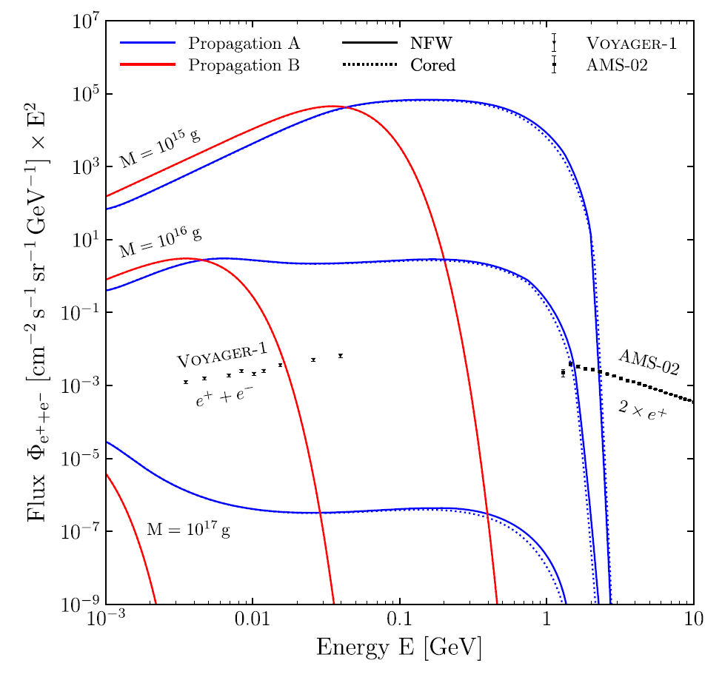
Electrons & Positrons: low Energies
(PBH)
Nature 458, 607–609 (2009)
Phys. Rev. Lett. 122, 041104 (2019)

Slide 5
Electrons & Positrons: low Energies
PAMELA energy range
Nature 458, 607–609 (2009)
Phys. Rev. Lett. 122, 041104 (2019)

Slide 6
PAMELA
Detects:
  e–, e⁺: 50 MeV – hundreds of GeVs
  p: 80 MeV – TeVs
  Nuclei (He, etc.): …
The satellite orbit:
  350-600 km
  Inclination 70°
Work Time: 2006 – 2016 (Solar cycle 23 – cycle 24)

Slide 7
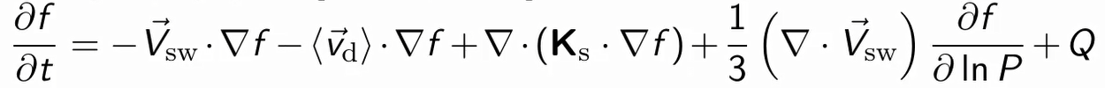
Cosmic-ray propagation in heliosphere
sources
intensity
solar modulation
of low energy particles
solar wind
particle drift
diffusion
adiabatic solar wind expansion
~ causes charge-sign dependence of modulation
Parker, 1965; Potgieter et al., 2017 +

Slide 8
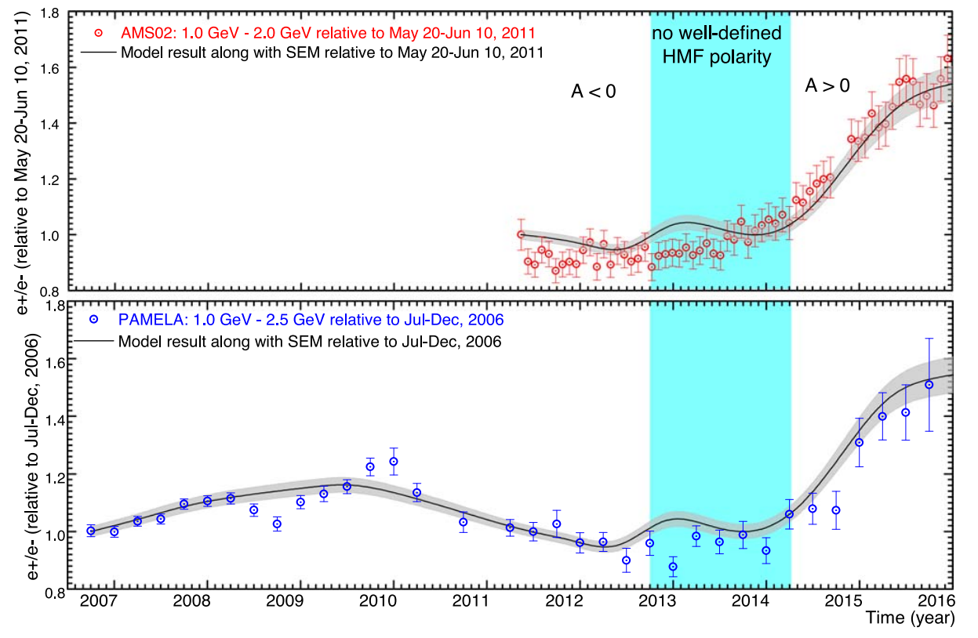
Flux Ratio > 1 GeV
ApJ 909:215 (2021)
to provide new data for lower energies (< 1 GeV) to observe features

Slide 9
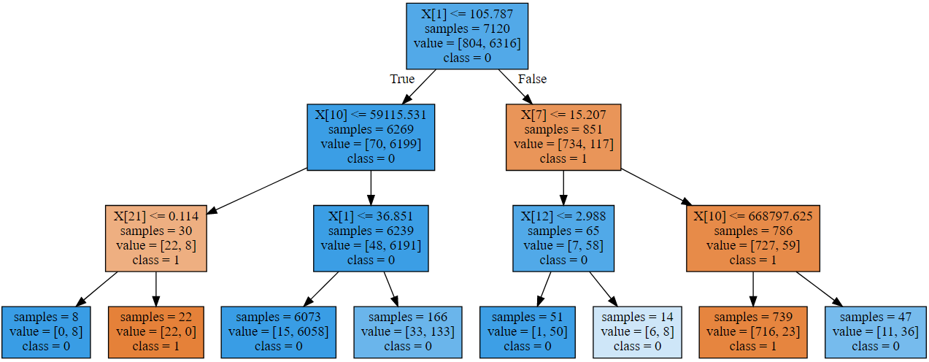
Multivariate analysis: Decision Tree
Method: Boosted Decision Tree (BDT) — to divide events into 2 classes
  background (protons)
  signal (electrons)

Slide 10
Multivariate analysis: Event Selection
20+ relevant parameters to be analyzed
→ anticoincidence
→ velocity, dE/dx
→ rigidity, dE/dx
→ energy deposit in showers
→ energy deposit
→ neutron detector trigger

Slide 11
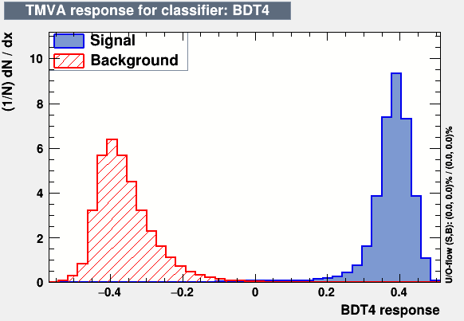
Multivariate Analysis
Training: modeling in GEANT4
  signal: electrons
  background: protons
Testing: the PAMELA database
~ 1.5 times increase of statistics of selected e+, e–
An example of the BDT parameter response

Slide 12
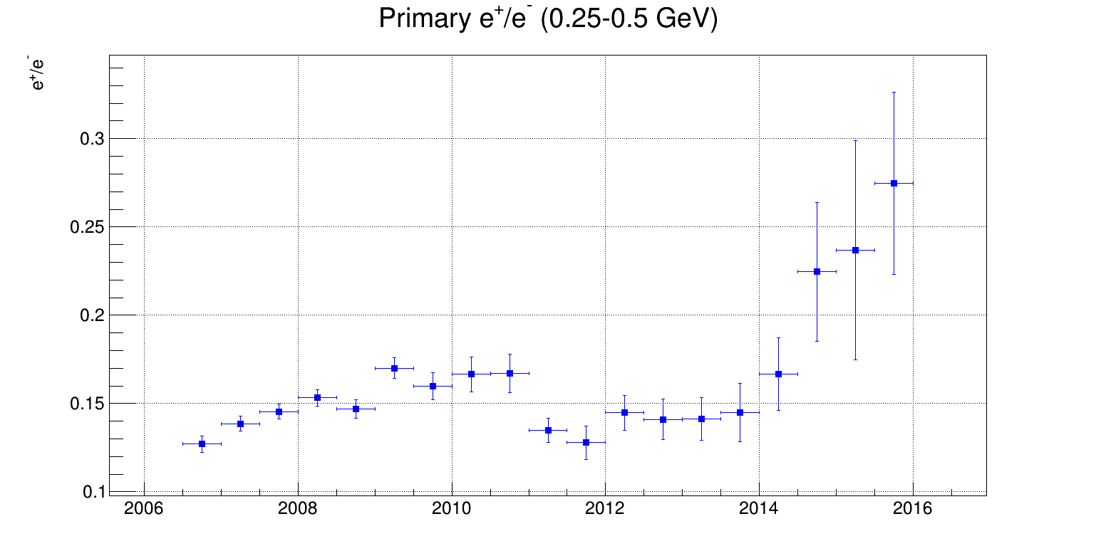
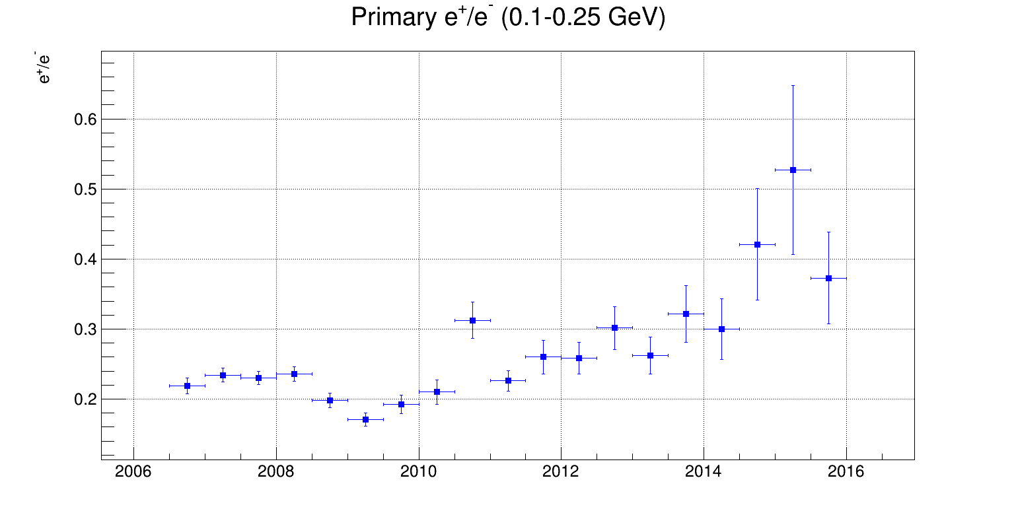
Results
e+/e–: 0.25–0.5 GeV
A<0
A<0
A<0
A feature is observed in 2008
A rise in 2014-2015…
(expected)
A>0
e+/e–: 0.1–0.25 GeV
PRELIMINARY
A<0
A>0

Slide 13
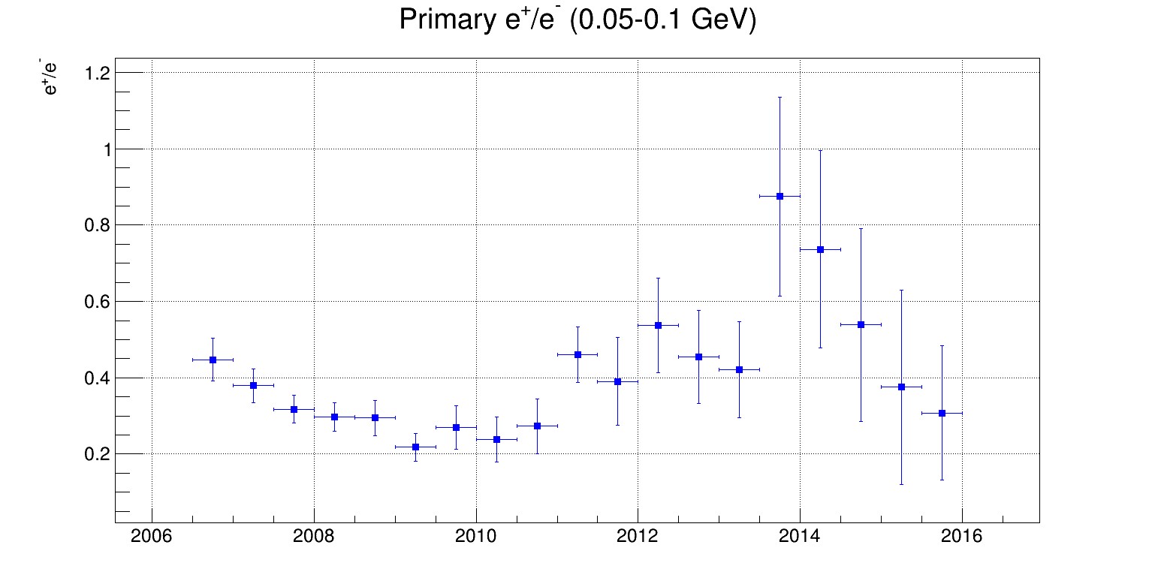

e+/e–: 0.25–0.5 GeV
Results
A<0
Different charge-sign modulation dependence? (2006-2008)
A>0
e+/e–: 0.05–0.1 GeV
A<0
A>0
PRELIMINARY

Slide 14
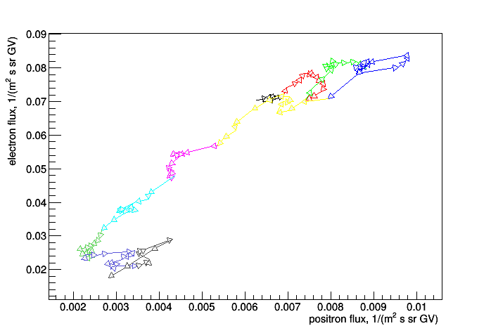
Electron vs Positron count rate Regression
← Solar min (2009)
R = 0.5 – 2.5 GV
1/s
2006
2007
2008
2009
2010
2011
2012
2013
2014
2015
Stat. errors are not shown
Data is smoothened
A<0
PRELIMINARY
A>0
Solar max (~2014) →
1/s

Slide 15
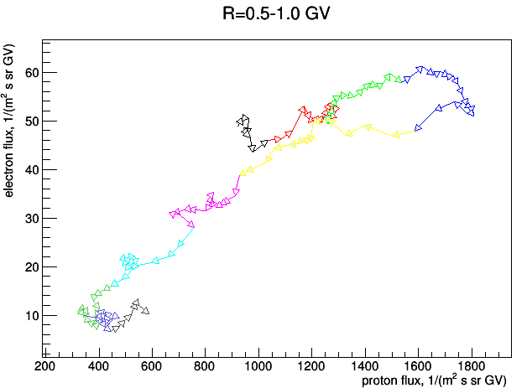
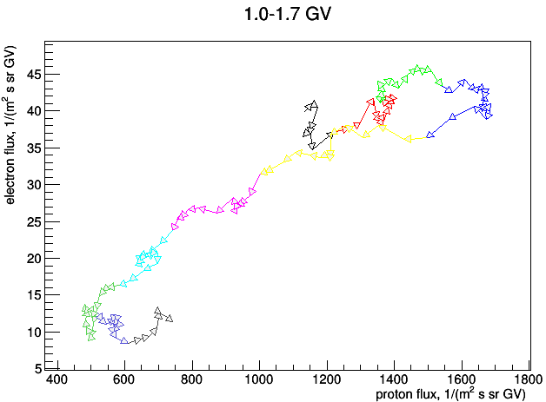
Electron vs Proton
Flux Regression
2006
2007
2008
2009
2010
2011
2012
2013
2014
2015
PRELIMINARY

Slide 16
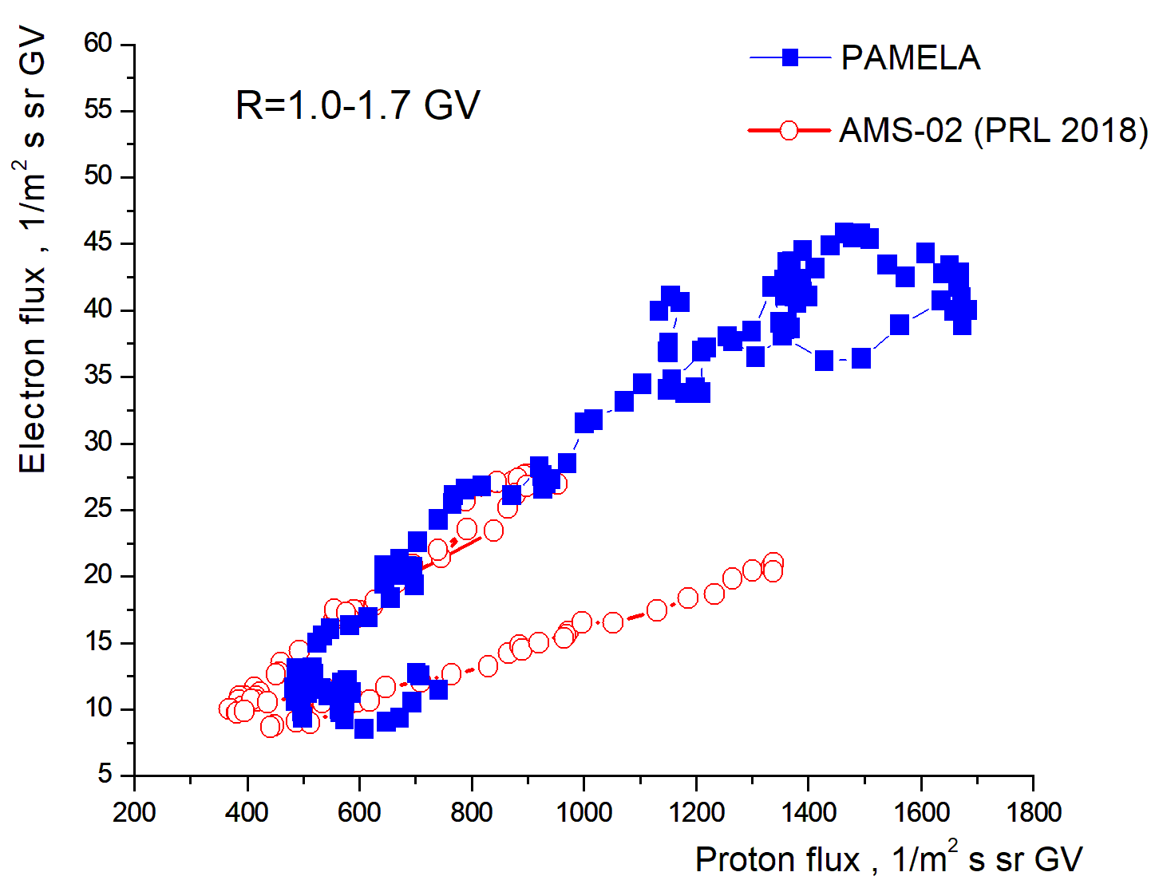
Hysteresis
2006
2009
2011
A<0
PAMELA: 2006-2015
AMS-02: 2011-2017
2017
2014
PRELIMINARY
A>0

Slide 17
Summary
New results on e+, e– fluxes < 1 GeV obtained
Modulation features are observed
The results can be applied for works on modeling cosmic-ray propagation in heliosphere
It may be possible to better separate solar modulation and source components
Thank you for your attention

Slide 18
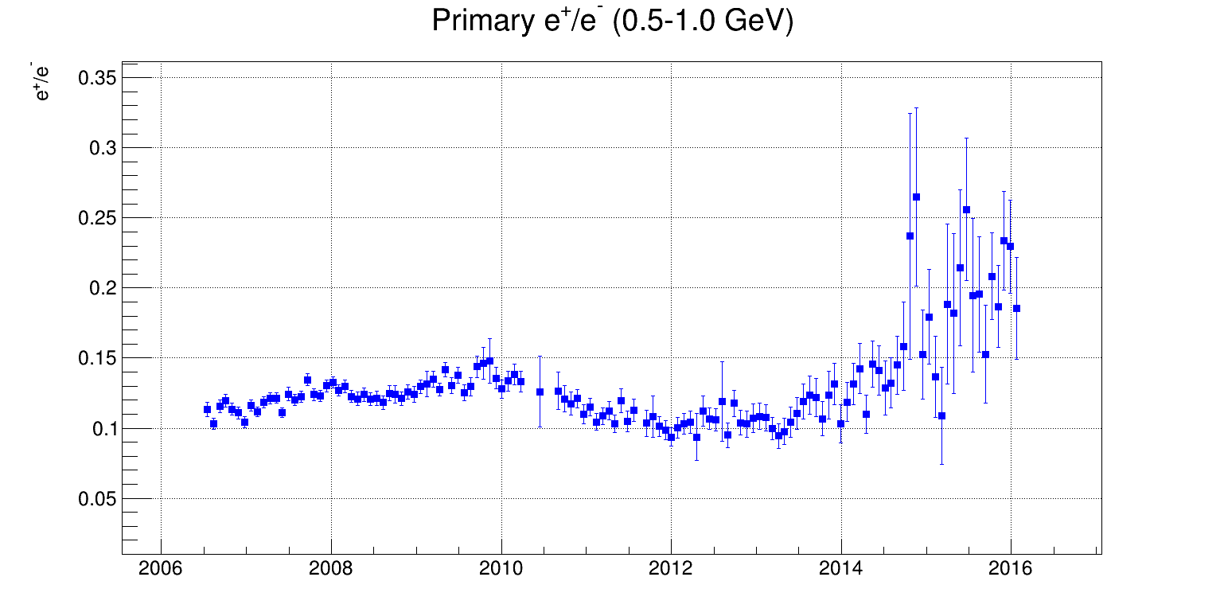
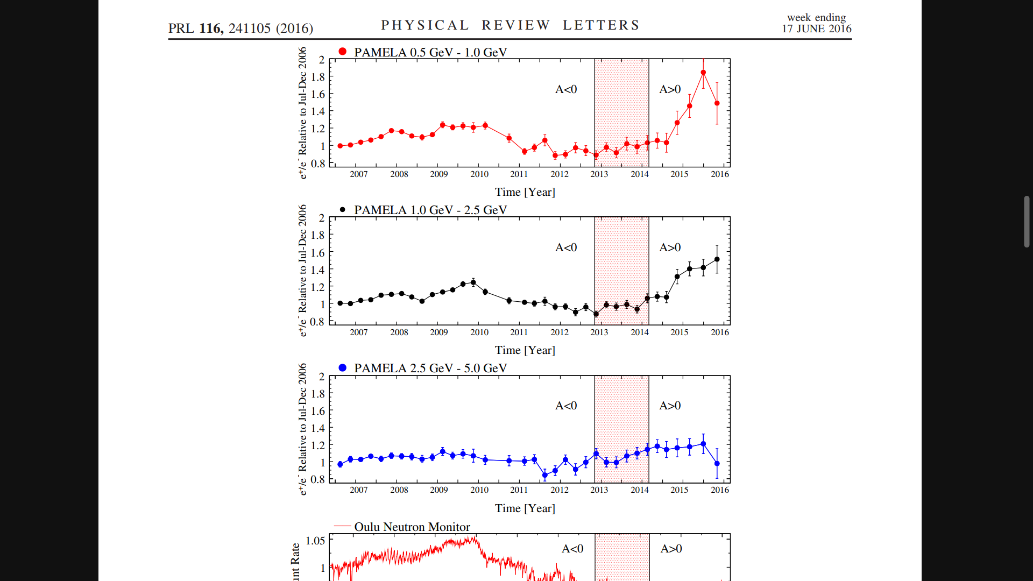
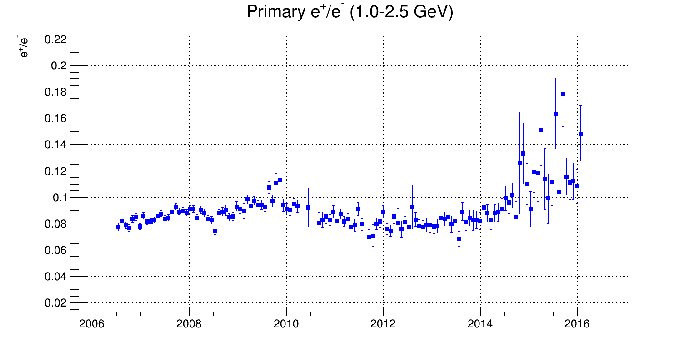
Results
e+/e–: 0.5–1.0 GeV
A<0
A>0
AGREEMENT
e+/e–: 1.0–2.5 GeV
A<0
A>0
PRL 116, 241105 (2016)
PRELIMINARY
This work

Slide 19
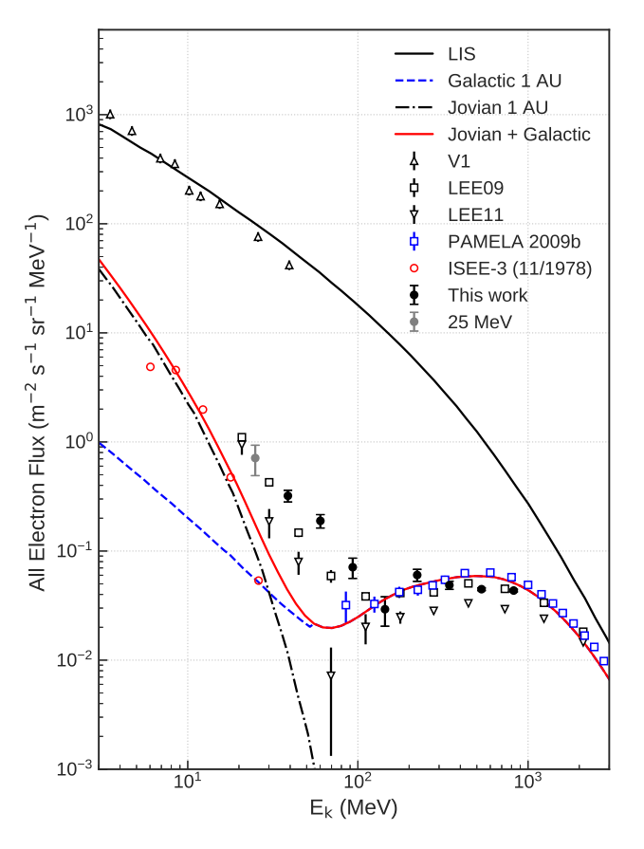
Electron spectra
ApJ 903:21 (2020, AESOP)

Slide 20
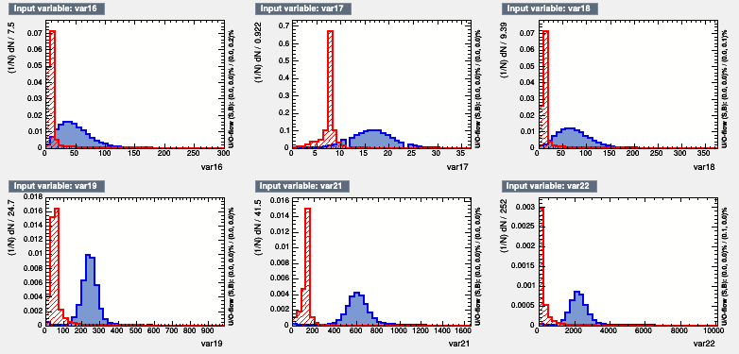
Multivariate analysis
Separating 20+ parameters for 2 event classes

