Slide 1
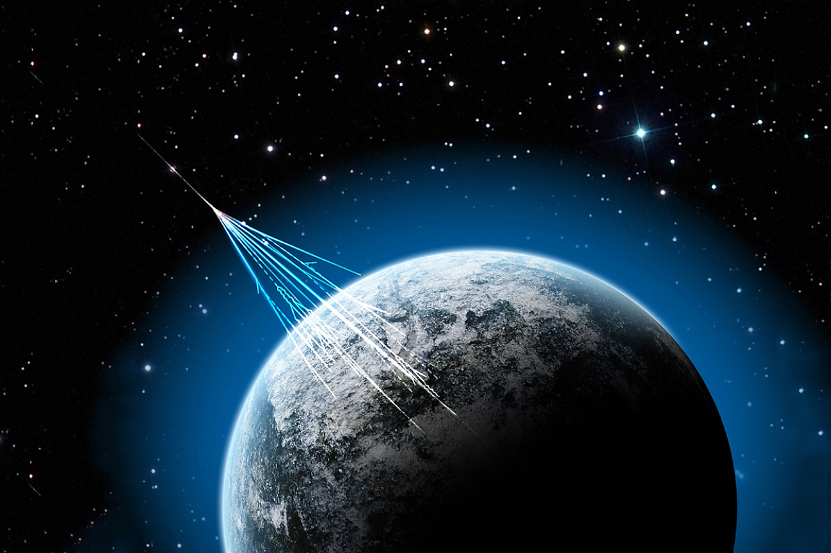


Multicomponent studies of extensive air showers detected by the installations of the Experimental complex NEVOD
S.S. Khokhlov, M.B. Amelchakov, A.G. Bogdanov, A.N. Dmitrieva, D.M. Gromushkin, R.P. Kokoulin, A.Yu. Konovalova, K.R. Nugaeva, A.A. Petrukhin, A.D. Pochestnev, I.A. Shulzhenko, E.A. Yuzhakova
The 6th International Conference on Particle Physics and Astrophysics
December 1, 2022

Slide 2
Introduction
EAS studies are the only source of information on nucleus-nucleus interactions at very high energies;
A large number of experimental results have not yet been explained within the frameworks of a unified approach;
To solve the accumulated problems, it is necessary to detect hadron, muon and electron-photon EAS components independently in frames of a single experiment.

Slide 3
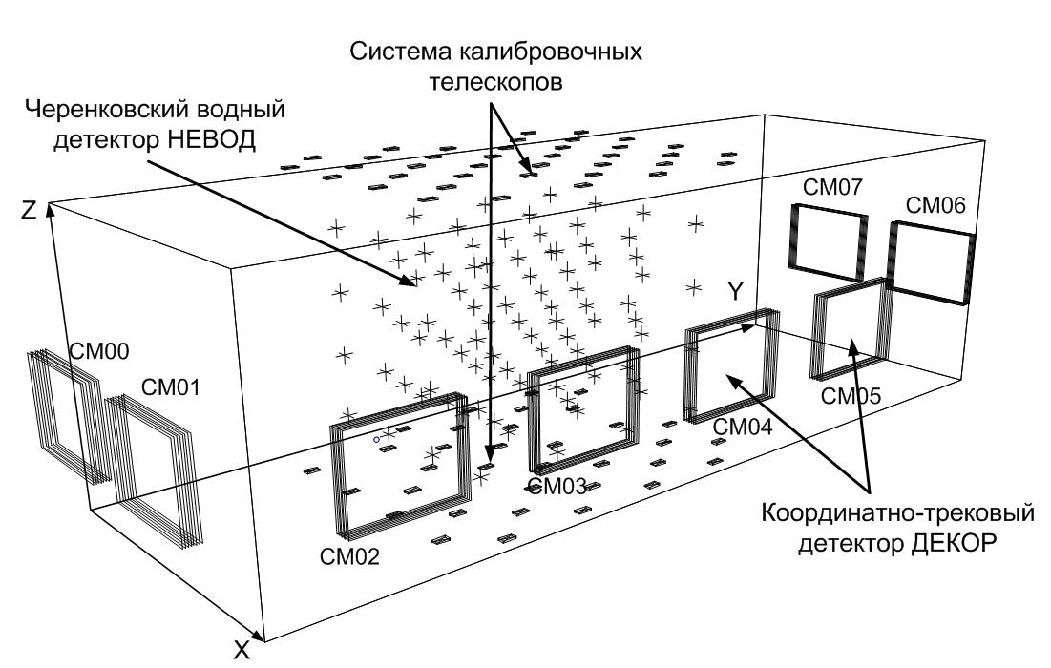
General layout of the NEVOD complex
Calibration Telescope System (CTS)
Cherenkov water detector NEVOD
SM07
SM06
SM00
SM01
SM05
SM04
SM03
Coordinate detector DECOR
SM02

Slide 4
Coordinate-tracking detector DECOR
8 supermodules x 8 layers of plastic streamer tube chambers

Slide 5
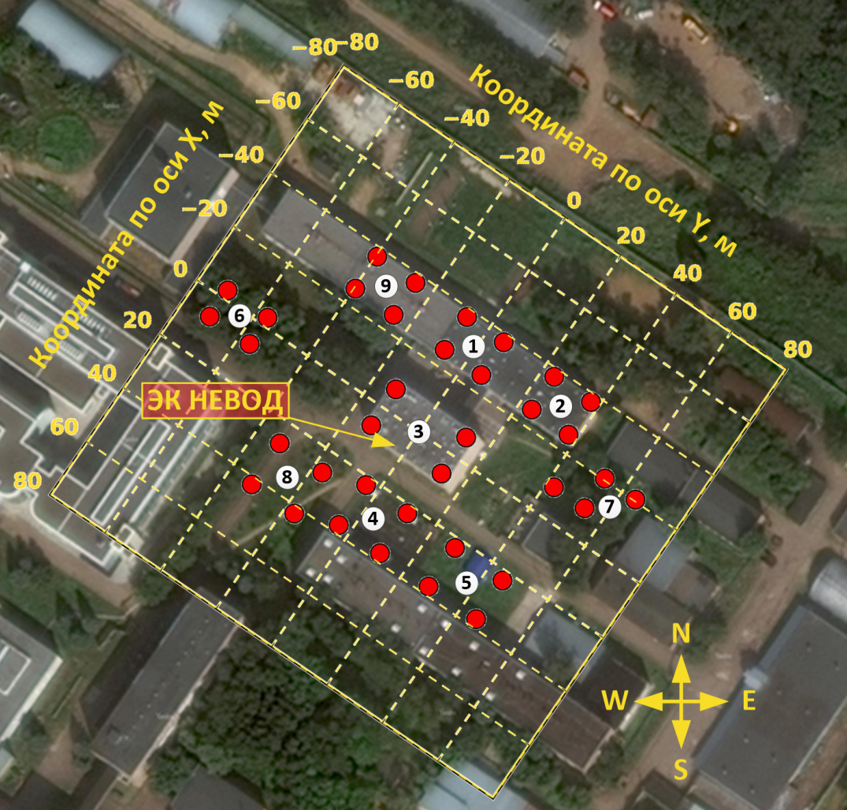
NEVOD-EAS array
144 detectors;
36 detector stations;
9 clusters;
Cluster size: 15 × 15 m²;
Array area: 10⁴ m²;
Energy range: 10¹⁵ - 10¹⁷ eV.

Slide 6
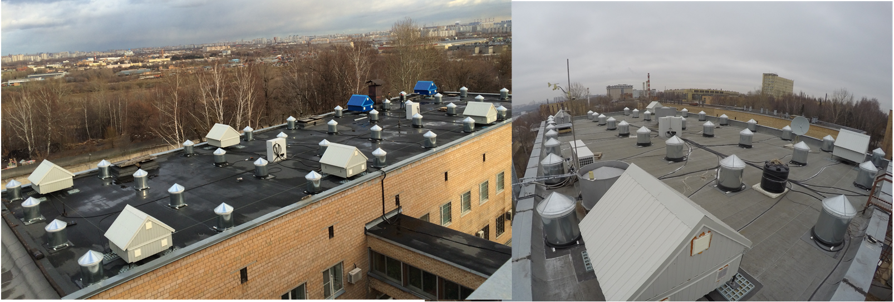
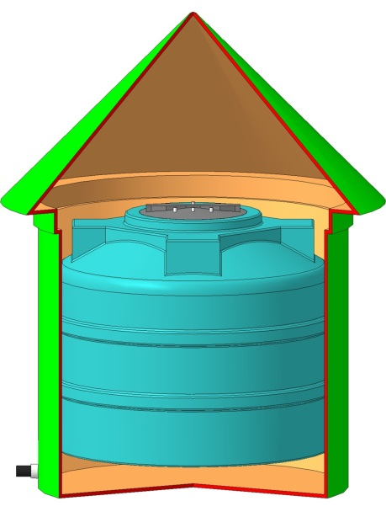
URAN array
72 en-detectors;
6 clusters;
Scintillator: ZnS(Ag) + B₂O₃;
Energy range: 10¹⁵ - 10¹⁷ eV.

Slide 7
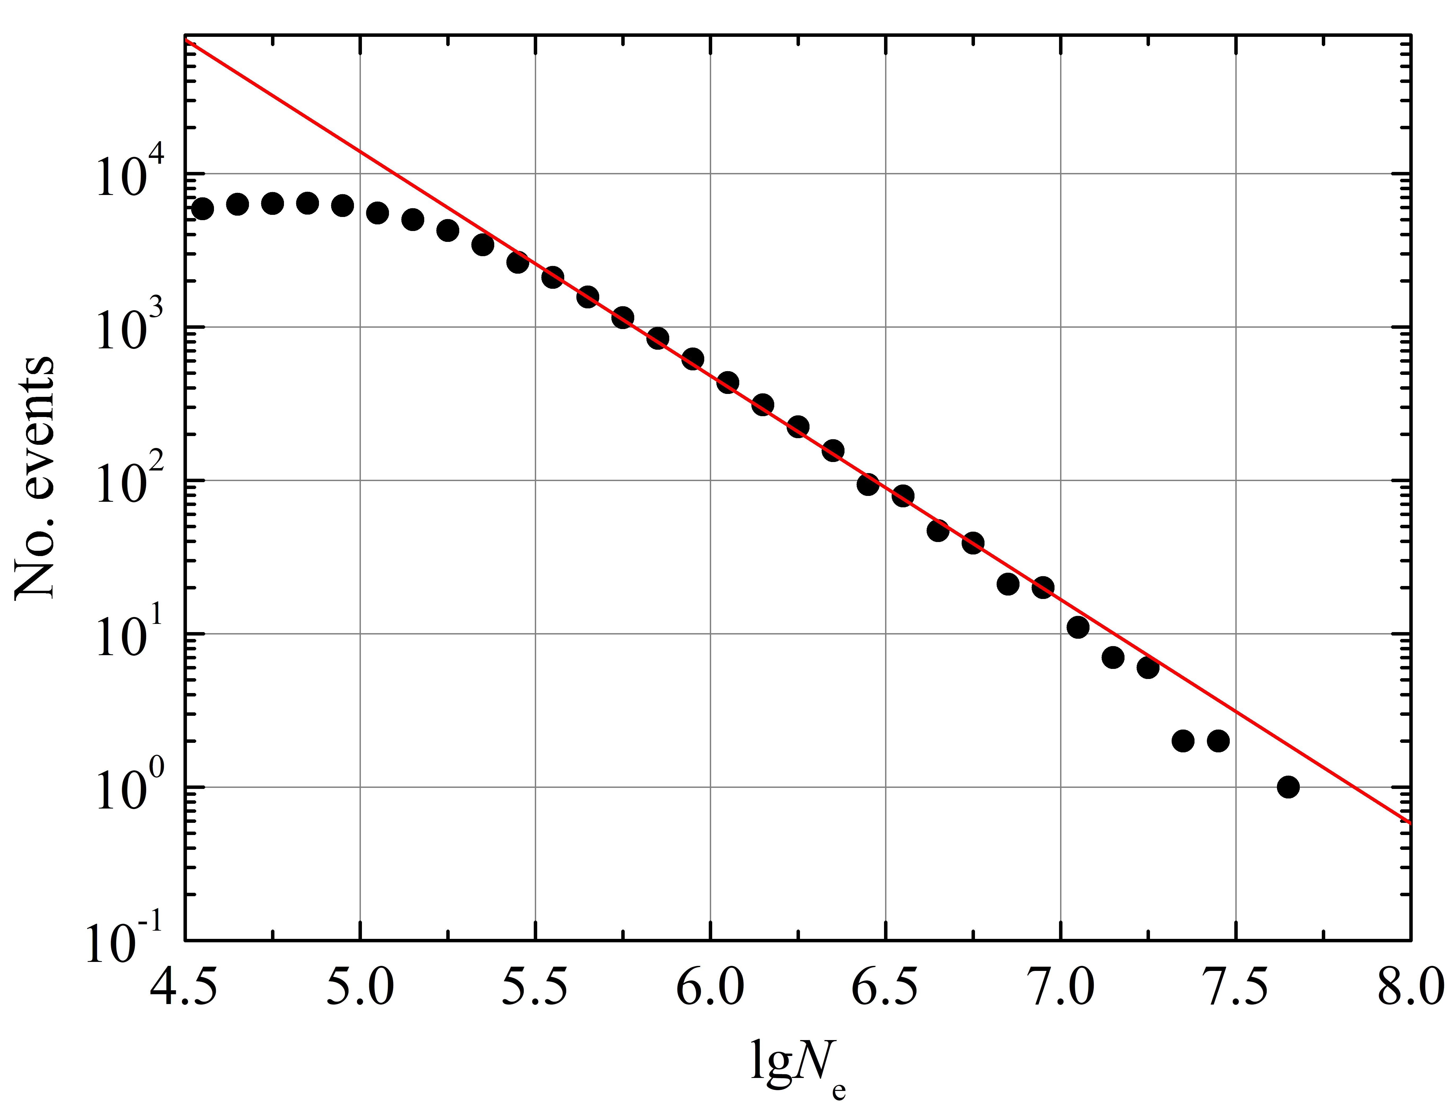
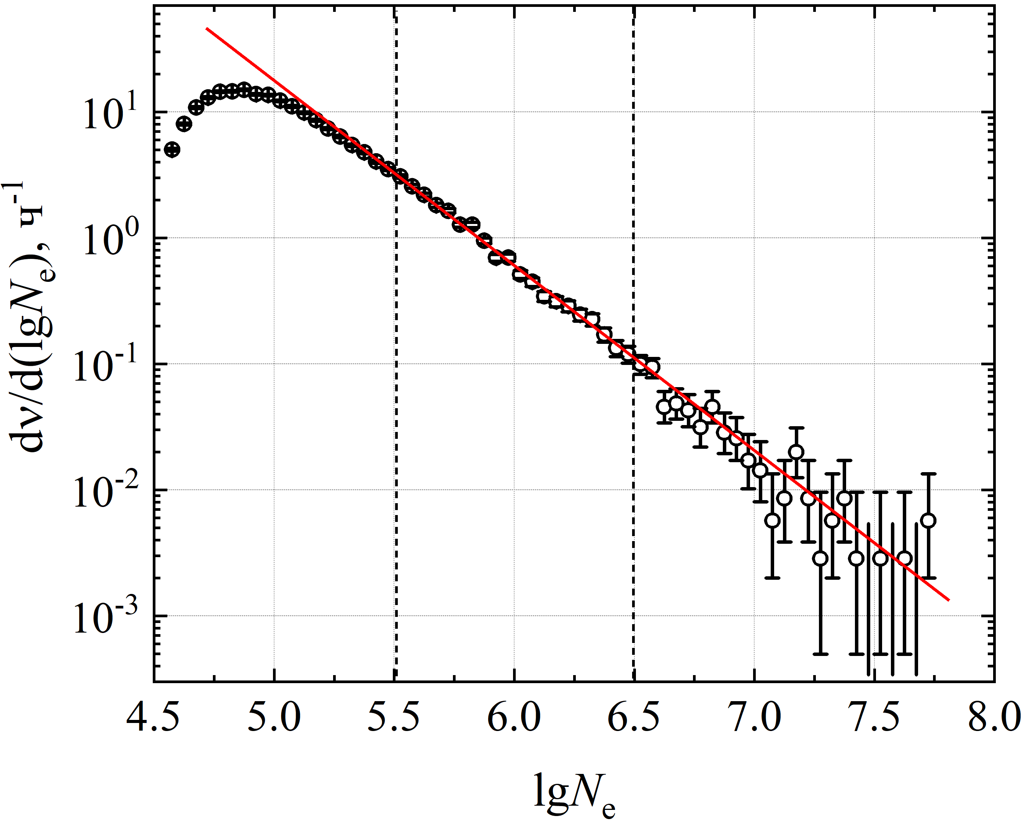
Studies of electron-photon component at the NEVOD-EAS array
Simulated EAS size spectrum
Experimental EAS size spectrum
CORSIKA: QGSJET-II-04 + FLUKA 2020.0.3
Exponent γ = -2.48 ± 0.03
Exponent γ = -2.46 ± 0.03

Slide 8
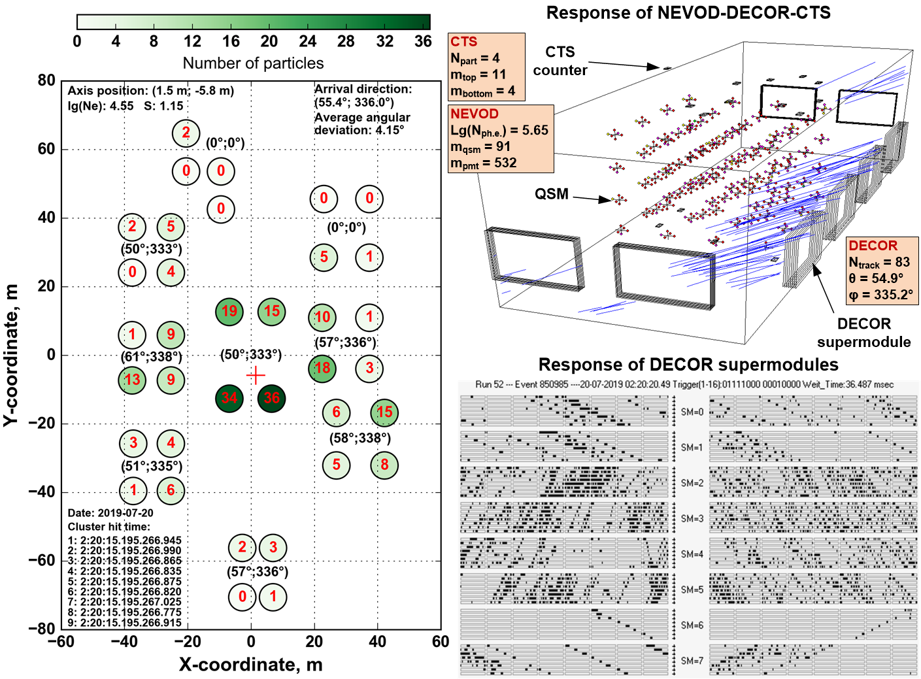
Example of joint event

Slide 9
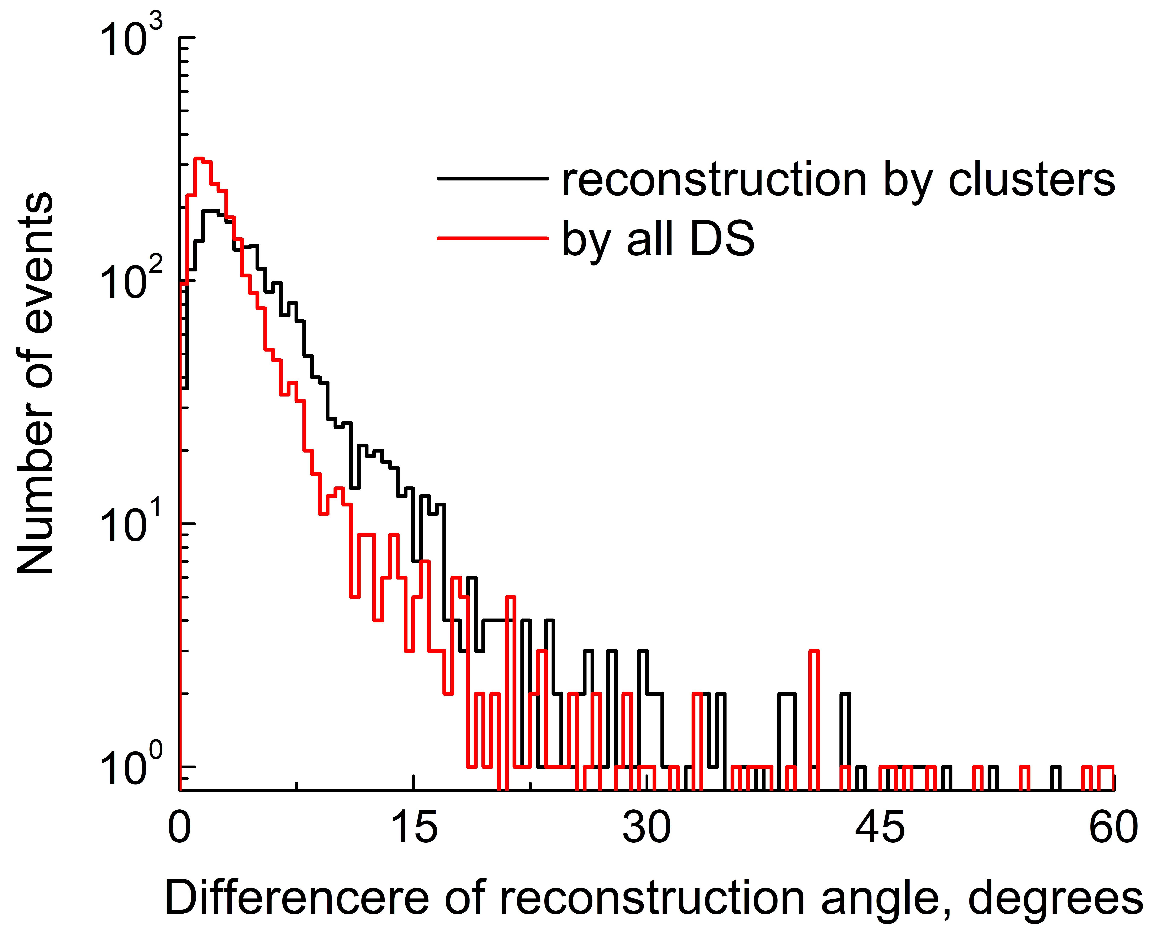
Estimation of the arrival direction accuracy
Accuracy: 3.5°

Slide 10
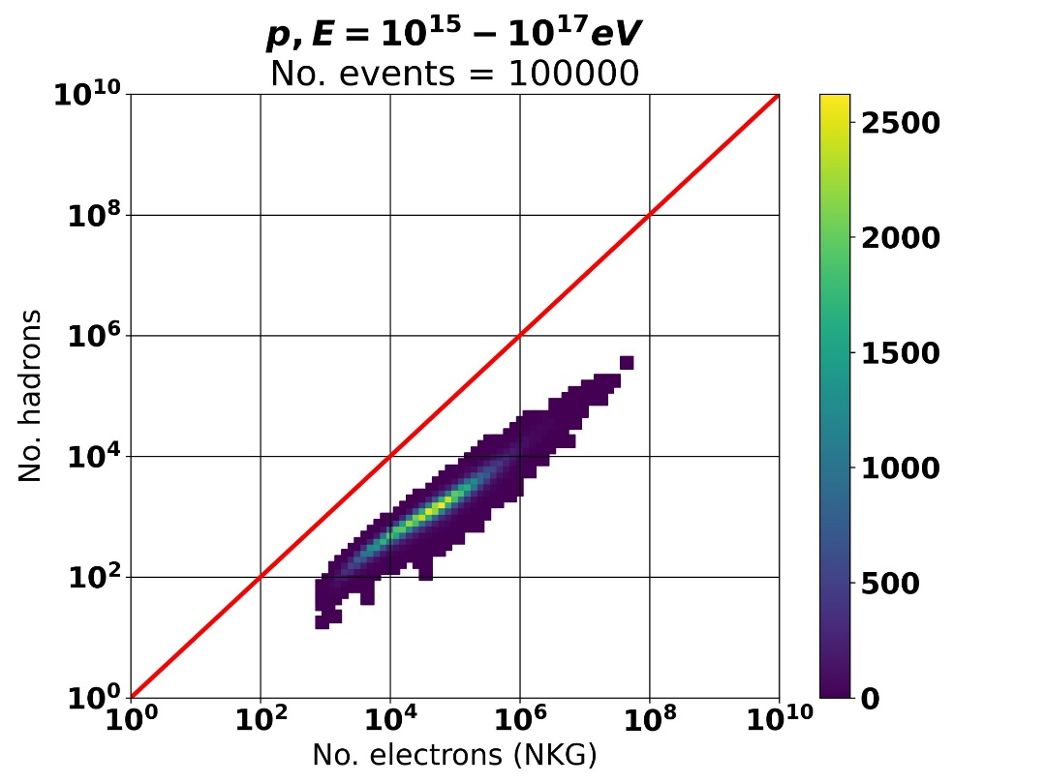
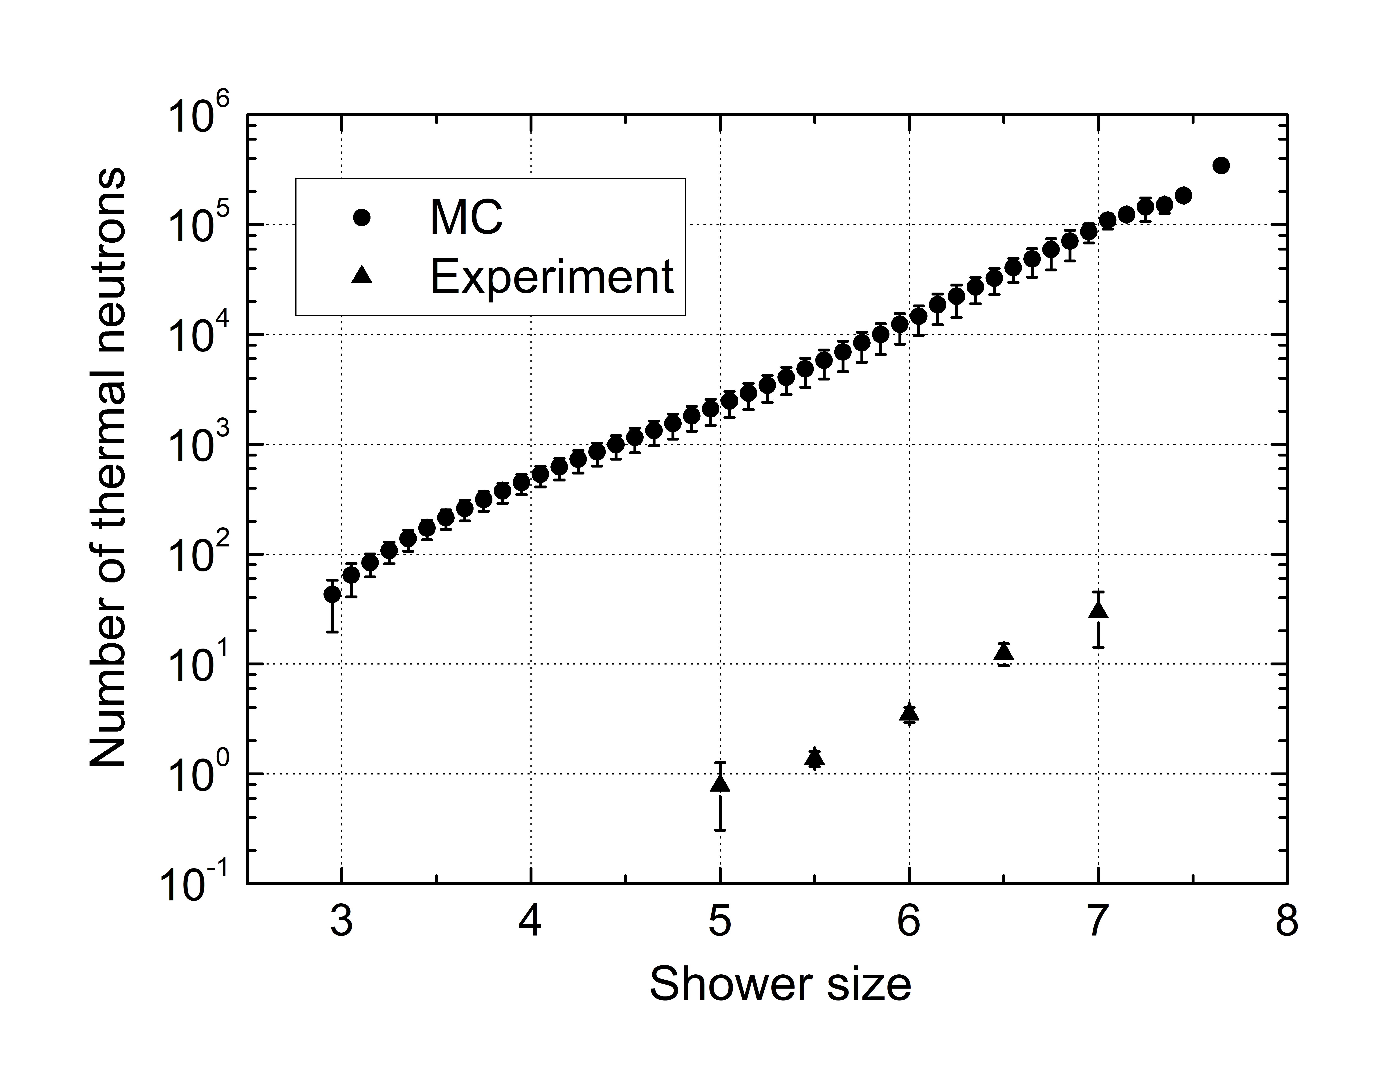
Researches of the hadron component of EAS
Correlation of shower size and hadrons
Dependence of the number of thermal neutrons on the shower size
CORSIKA: QGSJET-II-04 + FLUKA 2020.0.3
Experimental data: URAN array

Slide 11
Conclusion
A comparison of particle directions in air-showers reconstructed with DECOR and NEVOD-EAS array gives angle accuracy of 3.5°;
A cross analysis of experimental and simulated events shows that the number of thermal neutrons detected with URAN array is directly proportional to the number of hadrons in an air-shower;
The Experimental complex NEVOD makes it possible to carry out simultaneous studies of the electron-photon, muon and hadronic components of extensive air showers.

Slide 12
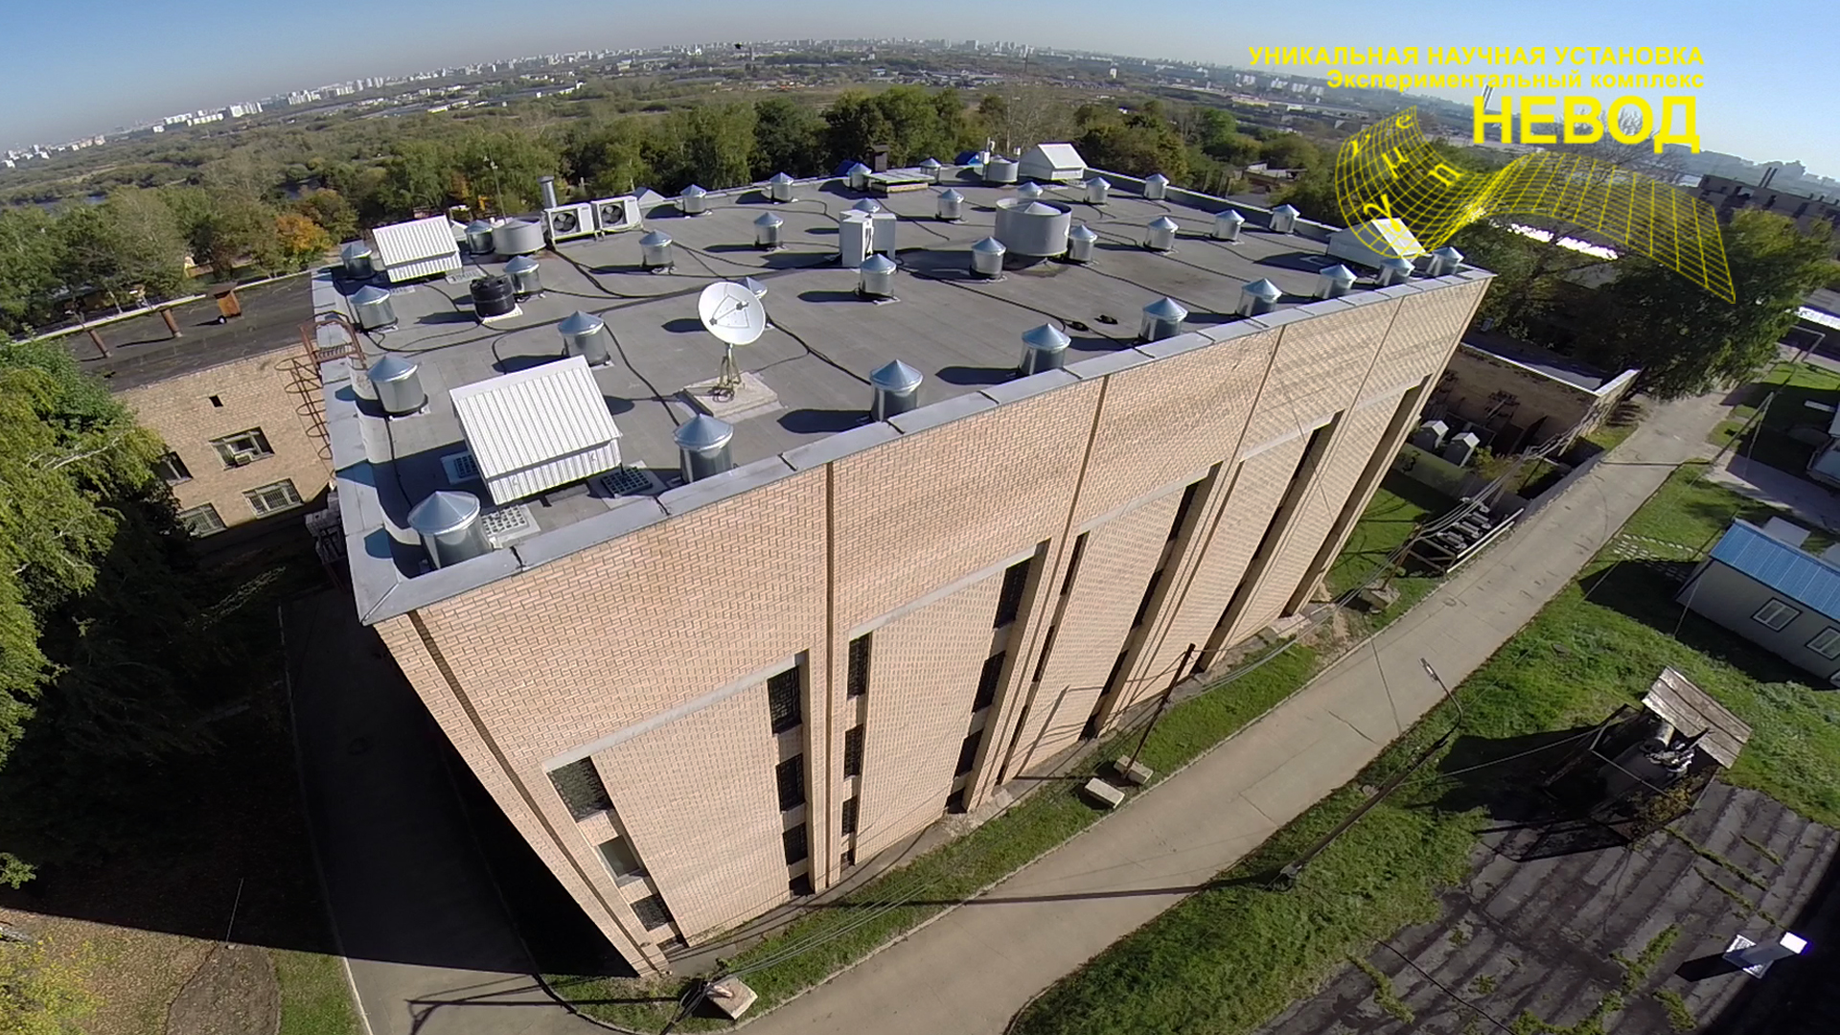
Thank you for your attention!
http://nevod.mephi.ru/

