Slide 1
Towards a possible discovery of dark photons with a multi-cathode counter
Anatoly Kopylov
Institute for Nuclear Research of RAS
In collaboration with: Igor Orekhov, Valery Petukhov et al

Slide 2
The aim of experiment: to search for Dark Matter Virial theorem: kinetic energy of gravitationally bound objects should be equal to – 0.5 of their potential energy Zwicky (1937) – analyses of red shifts of the Coma Cluster of galaxies: surprisingly high mass-to-light ratio Enigma 1: to-day, according to a combination of all data: the dark matter accounts for about 84 % of the matter content of the Universe (Planck 2018 results) Enigma 2: why dark matter is distributed in galaxy by a spherical halo while baryonic matter – in the plane of galaxy ? → CDM is not particles but waves, → m_{γ’} < 100 eV
Lam Hui arXiv:2101.11735v1

Slide 3
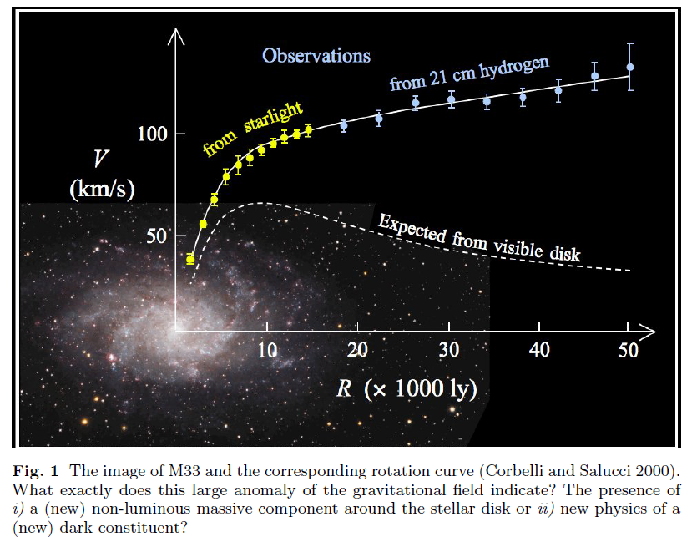
Why Dark Matter?
The only empirical evidence
for dark matter to-day is
provided by astronomical
observations.
P. Salucci arXiv:1811.08843

Slide 4
What is a nature of dark matter?
M.S.Turner arXiv:2109.01760

Slide 5
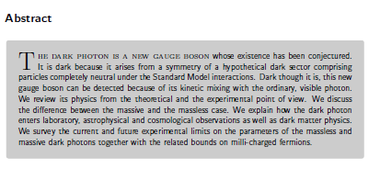
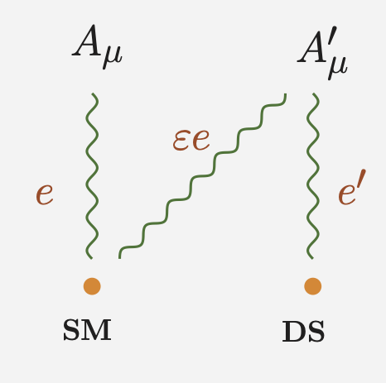
The dark Photon
M. Fabbrichesi, E. Gabrielli, G. Lanfranchi
The Physics of the Dark Photon, Springer Briefs in Physics (Springer, 2021)

Slide 6
V. Dzunushaliev, V. Folomeev, A.Tlemisov
Linear Energy Density and the Flux of an Electric Field in Proca Tubes
Symmetry 2021, 13, 640. https://doi.org/10.3390/sym13040640
V. Dzunushaliev, V. Folomeev
Axially symmetric particlelike solutions with the flux of a magnetic field in the non-Abelian Proca-Higgs theory
Phys. Rev. D 104, 116027 (2021)
V. Dzunushaliev, V. Folomeev
Proca balls with angular momentum or flux of electric field
arXiv:2112.06227v.2 [hep-th] 16 Feb 2022

Slide 7
PHELEX – PHoton-ELectron EXperiment
multicathode counter technique as an extension of
a method of a dish antenna to higher masses (energies)
ρ_{CDM} ≈ 0.3 GeV/cm³
^{ρ}⊙ = (0.43 ± 0.06) GeV/cm3 (Salucci et al 2010)
Galactic dark matter halo.
But locally, near the Sun?
Primordial Solar dark matter halo?
arXiv:2007.11016
(N.B.Anderson, A.Partenheimer,
and T.D.Wiser)
θ – angle between electric field of a photon and the surface
χ- dimensionless parameter quantifying a kinetic mixing
(D.Horns, J.Jackel, A.Lindner, A.Lobanov, J.Redondo, A.Ringwald , “Searching for wispy cold dark matter with a dish antenna” Journal of Cosmology and Astroparticle Physics, vol.4. article 16, 2013)
In our case: due to low reflectivity of the surface
the photon gets absorbed and emits an electron
Sensitivity:

Slide 8
R.B.Cairns and J.A.R.Samson Journal of optical society of America Vol. 56, Number 11, November 1966, 1568-1573
10
30
eV

Slide 9
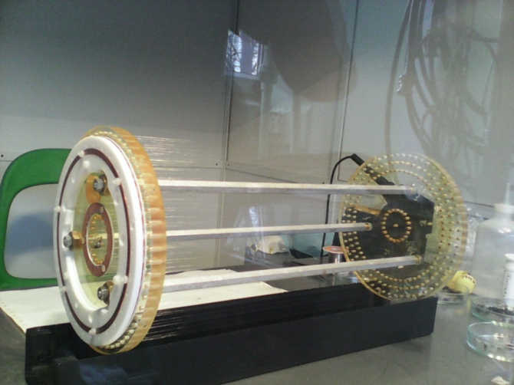
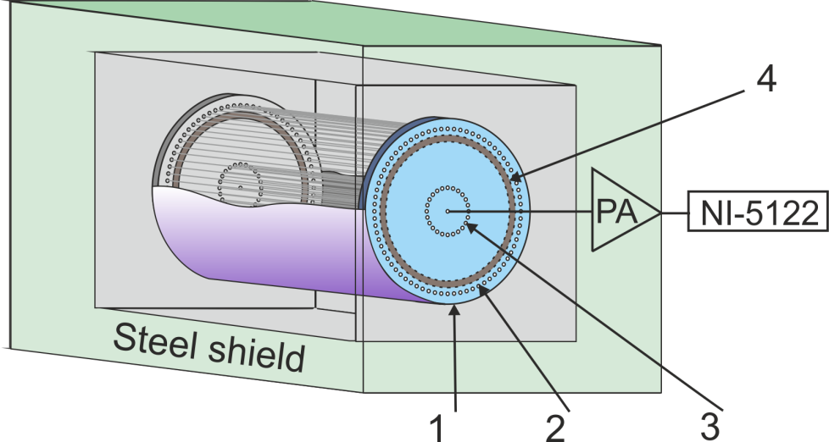
Multicathode counter technique as an extension of a method of dish-antenna

Slide 10
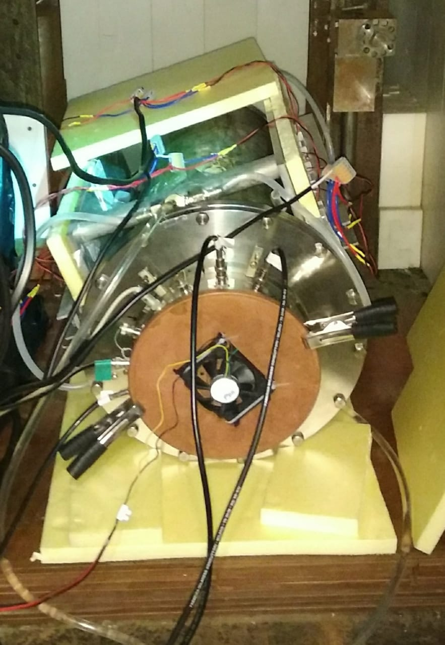
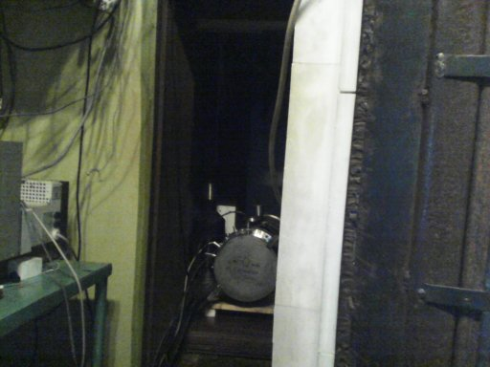
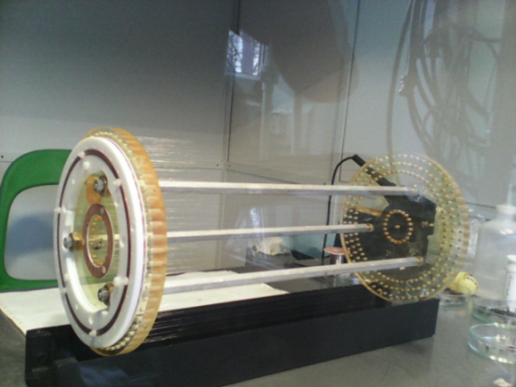
Multi-cathode counter: assembling and testing

Slide 11
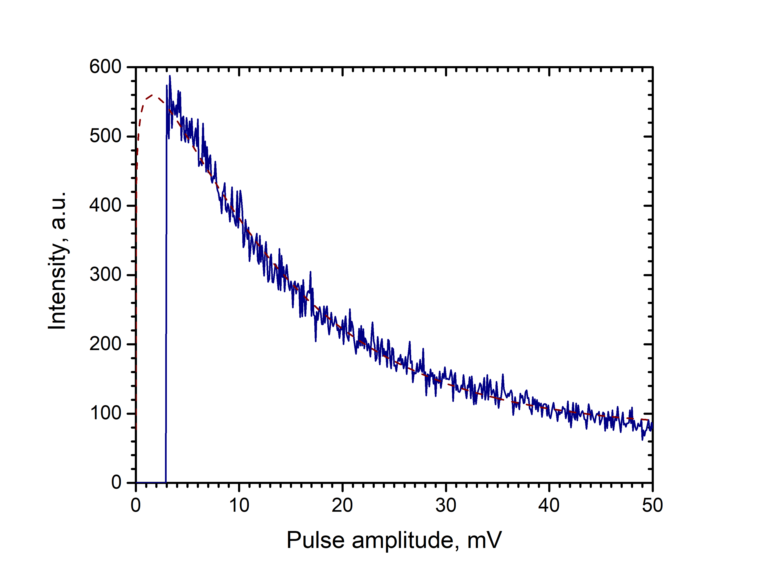
Single-electron pulses
Polya distribution
Pulse from muon crossing the counter
Pulse from single electron
From muons at sea level: ≈ 15 pulses per second → ≈ 15% dead time (10 ms per each pulse)

Slide 12
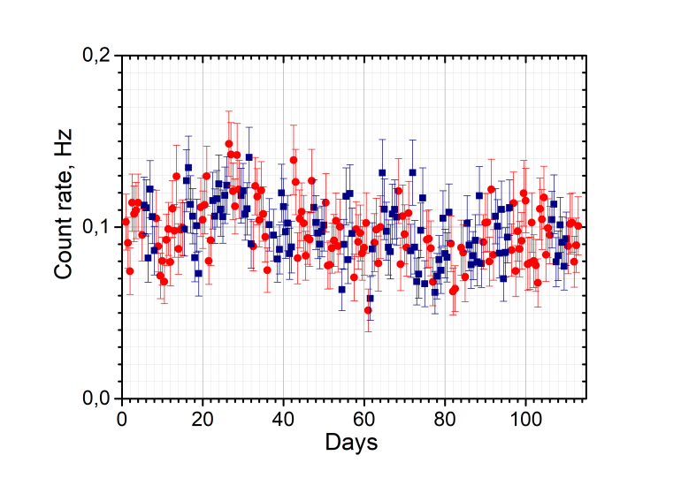
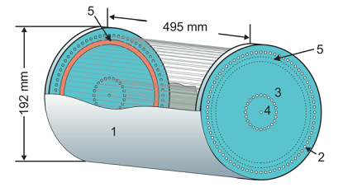
Principle of a multicathode counter: Retarding potential of the second cathode in configuration 2 The effect: r_{MCC} = R₁ – R₂
HV2
HV1
ΔU = HV2 – HV1
R₁ – red, R₂ - blue

Slide 13
New measurements Al – (Ne + CH₄(10%) 1 Bar)
Red – configuration 1
Blue – configuration 2
871 points;
In previous
measurements – 200
points

Slide 14
New upper limit
New result:
C1-C2 = - 0.00018 ± 0.00101 Hz
Then @ 95 C.L.
R_{MCC} = 1.646σ/ε = 0.00164/0.608 =
= 0.0027
ε – efficiency of counting
Χ < 3×10⁻¹²
Included in:
R. L. Workman et al., (Particle Data Group) Prog. Theor. Exp. Phys. 2022, 083C01 (2022)

Slide 15
Assembling of the new counter View through a quarz window
New
development

Slide 16
Cathode of the counter

Slide 17
EVIDENCE BASE: Directionality of the counting
θ – angle between a field of a hidden photon and the surface
χ- dimensionless parameter quantifying a kinetic mixing
Field along the axes of the counter
(D.Horns, J.Jackel, A.Lindner, A.Lobanov, J.Redondo, A.Ringwald , “Searching for wispy cold dark matter with a dish antenna” Journal of Cosmology and Astroparticle Physics, vol.4. article 16, 2013)
Field normal to the axes of the counter
By rotation of the counter – variation of the count rate
If the surface is mirror-like!
The counter with a matt surface –
for the control measurements

Slide 18
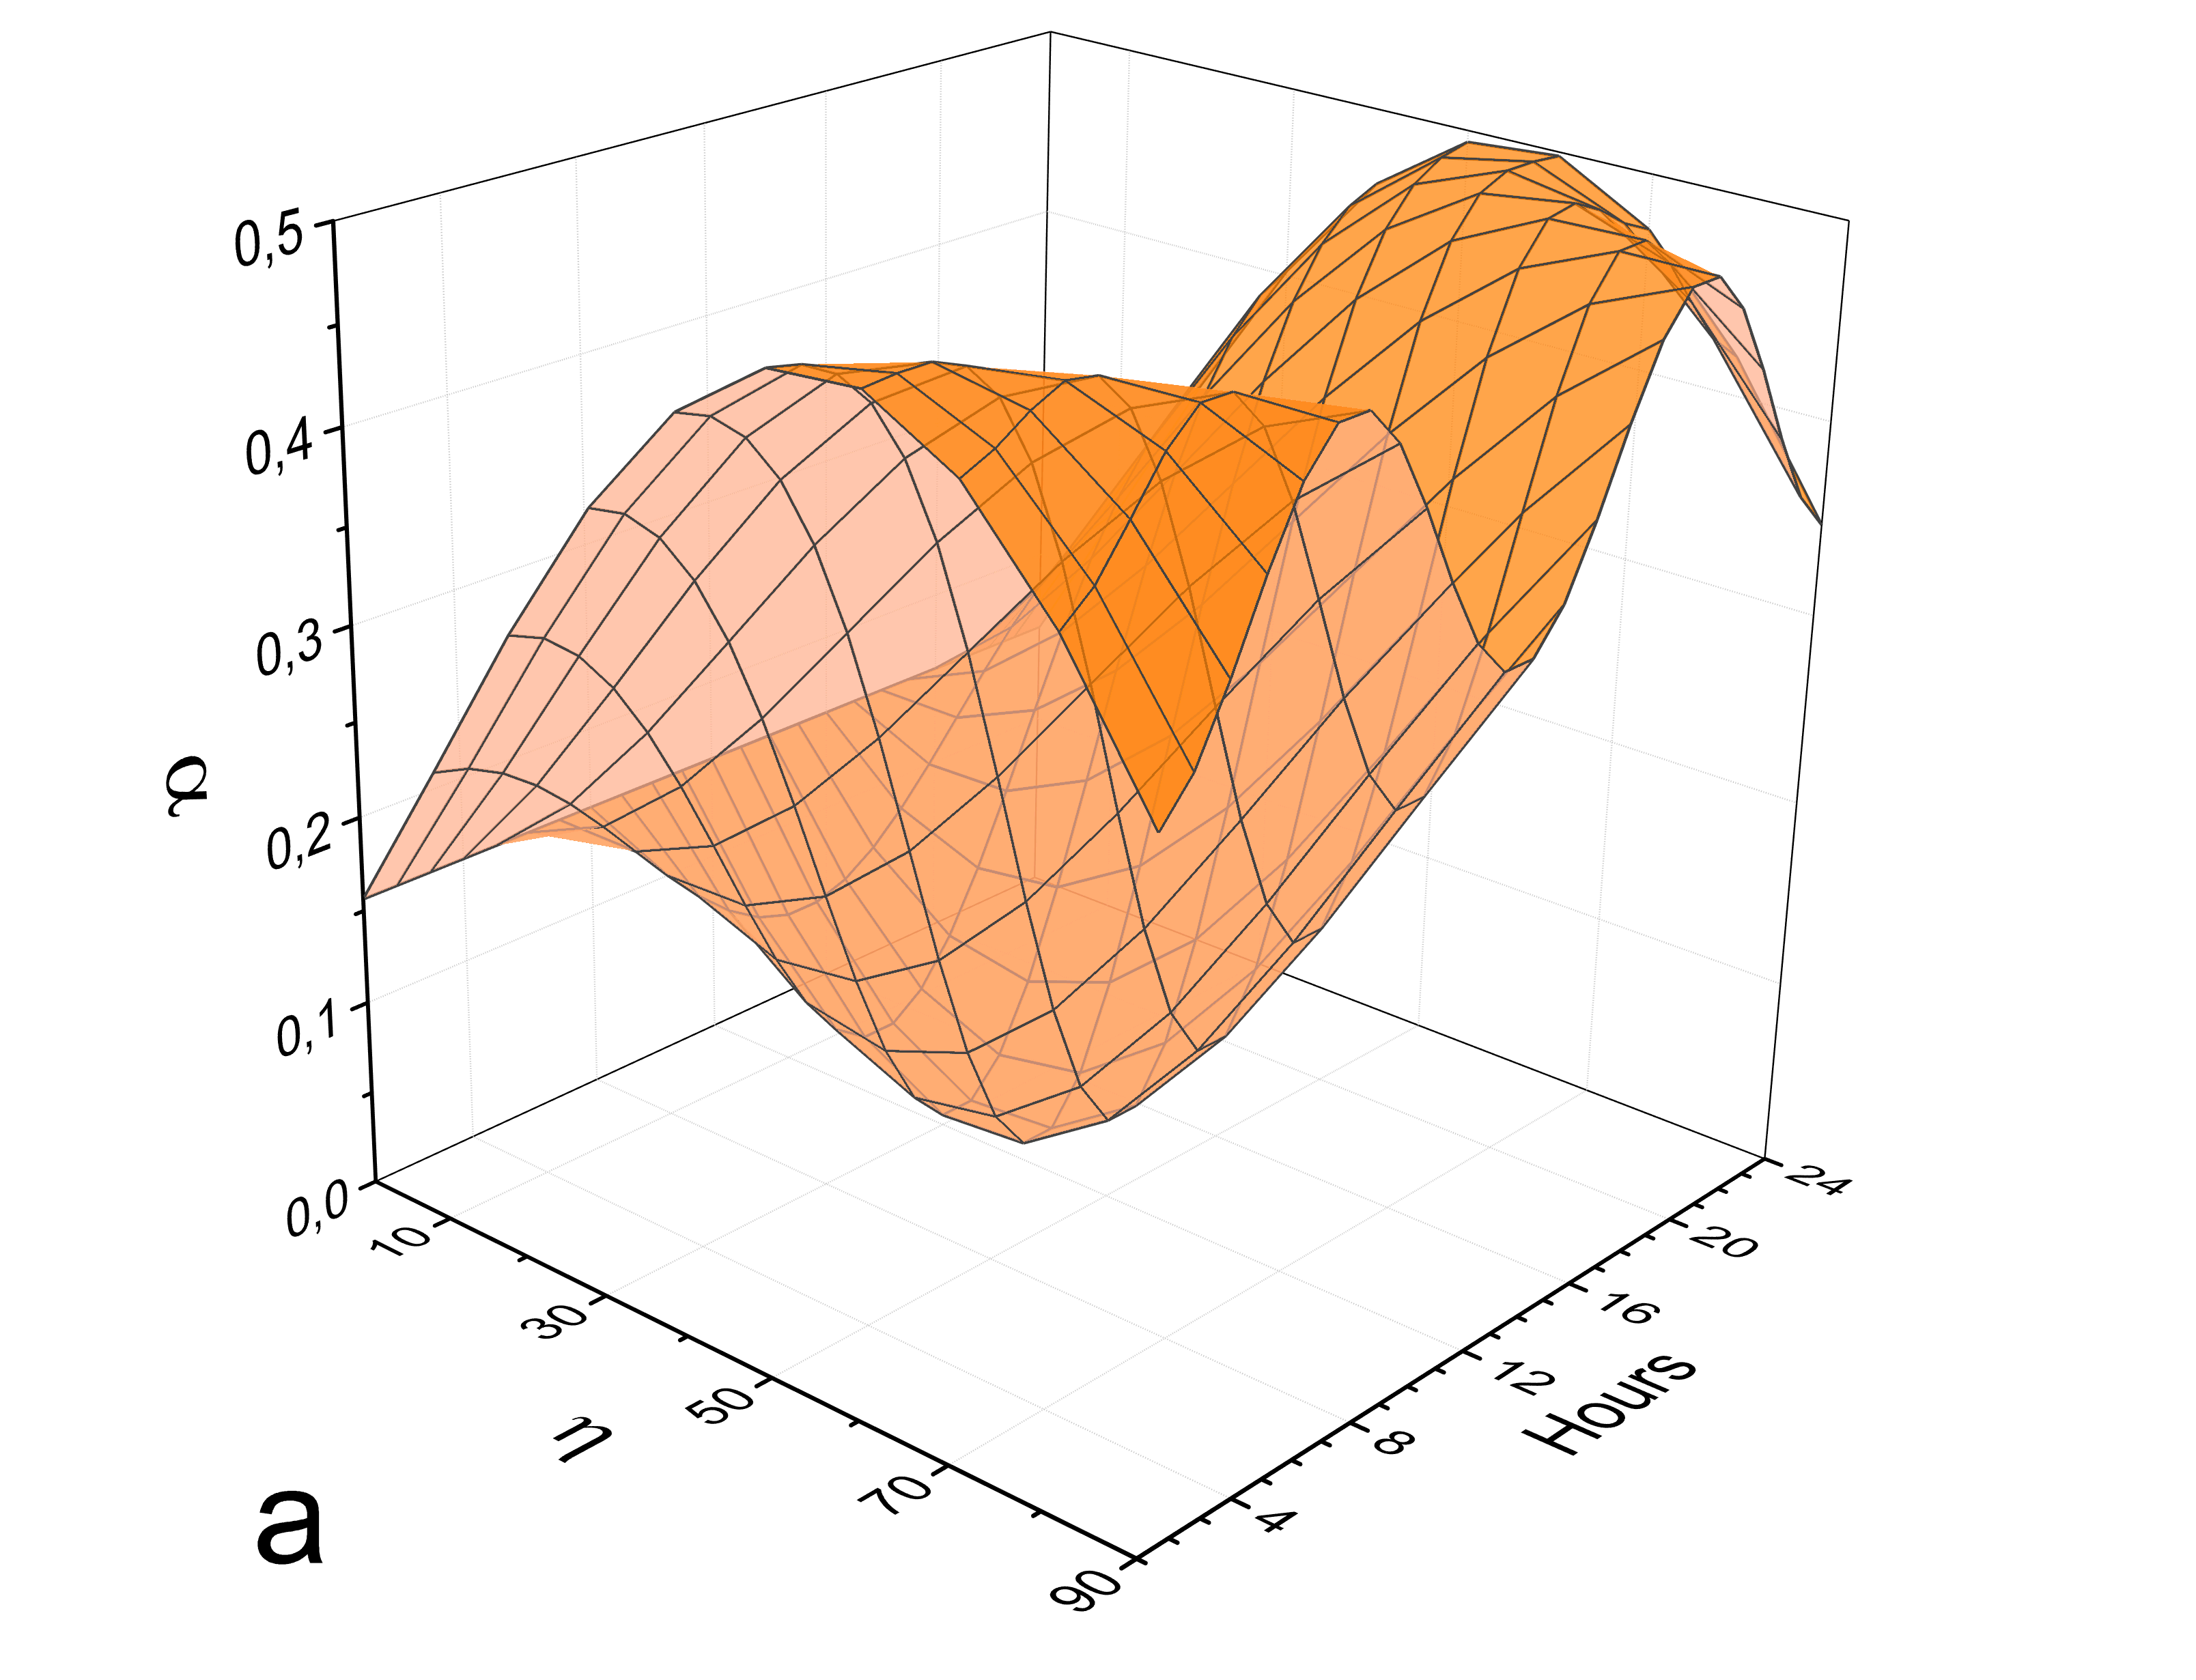
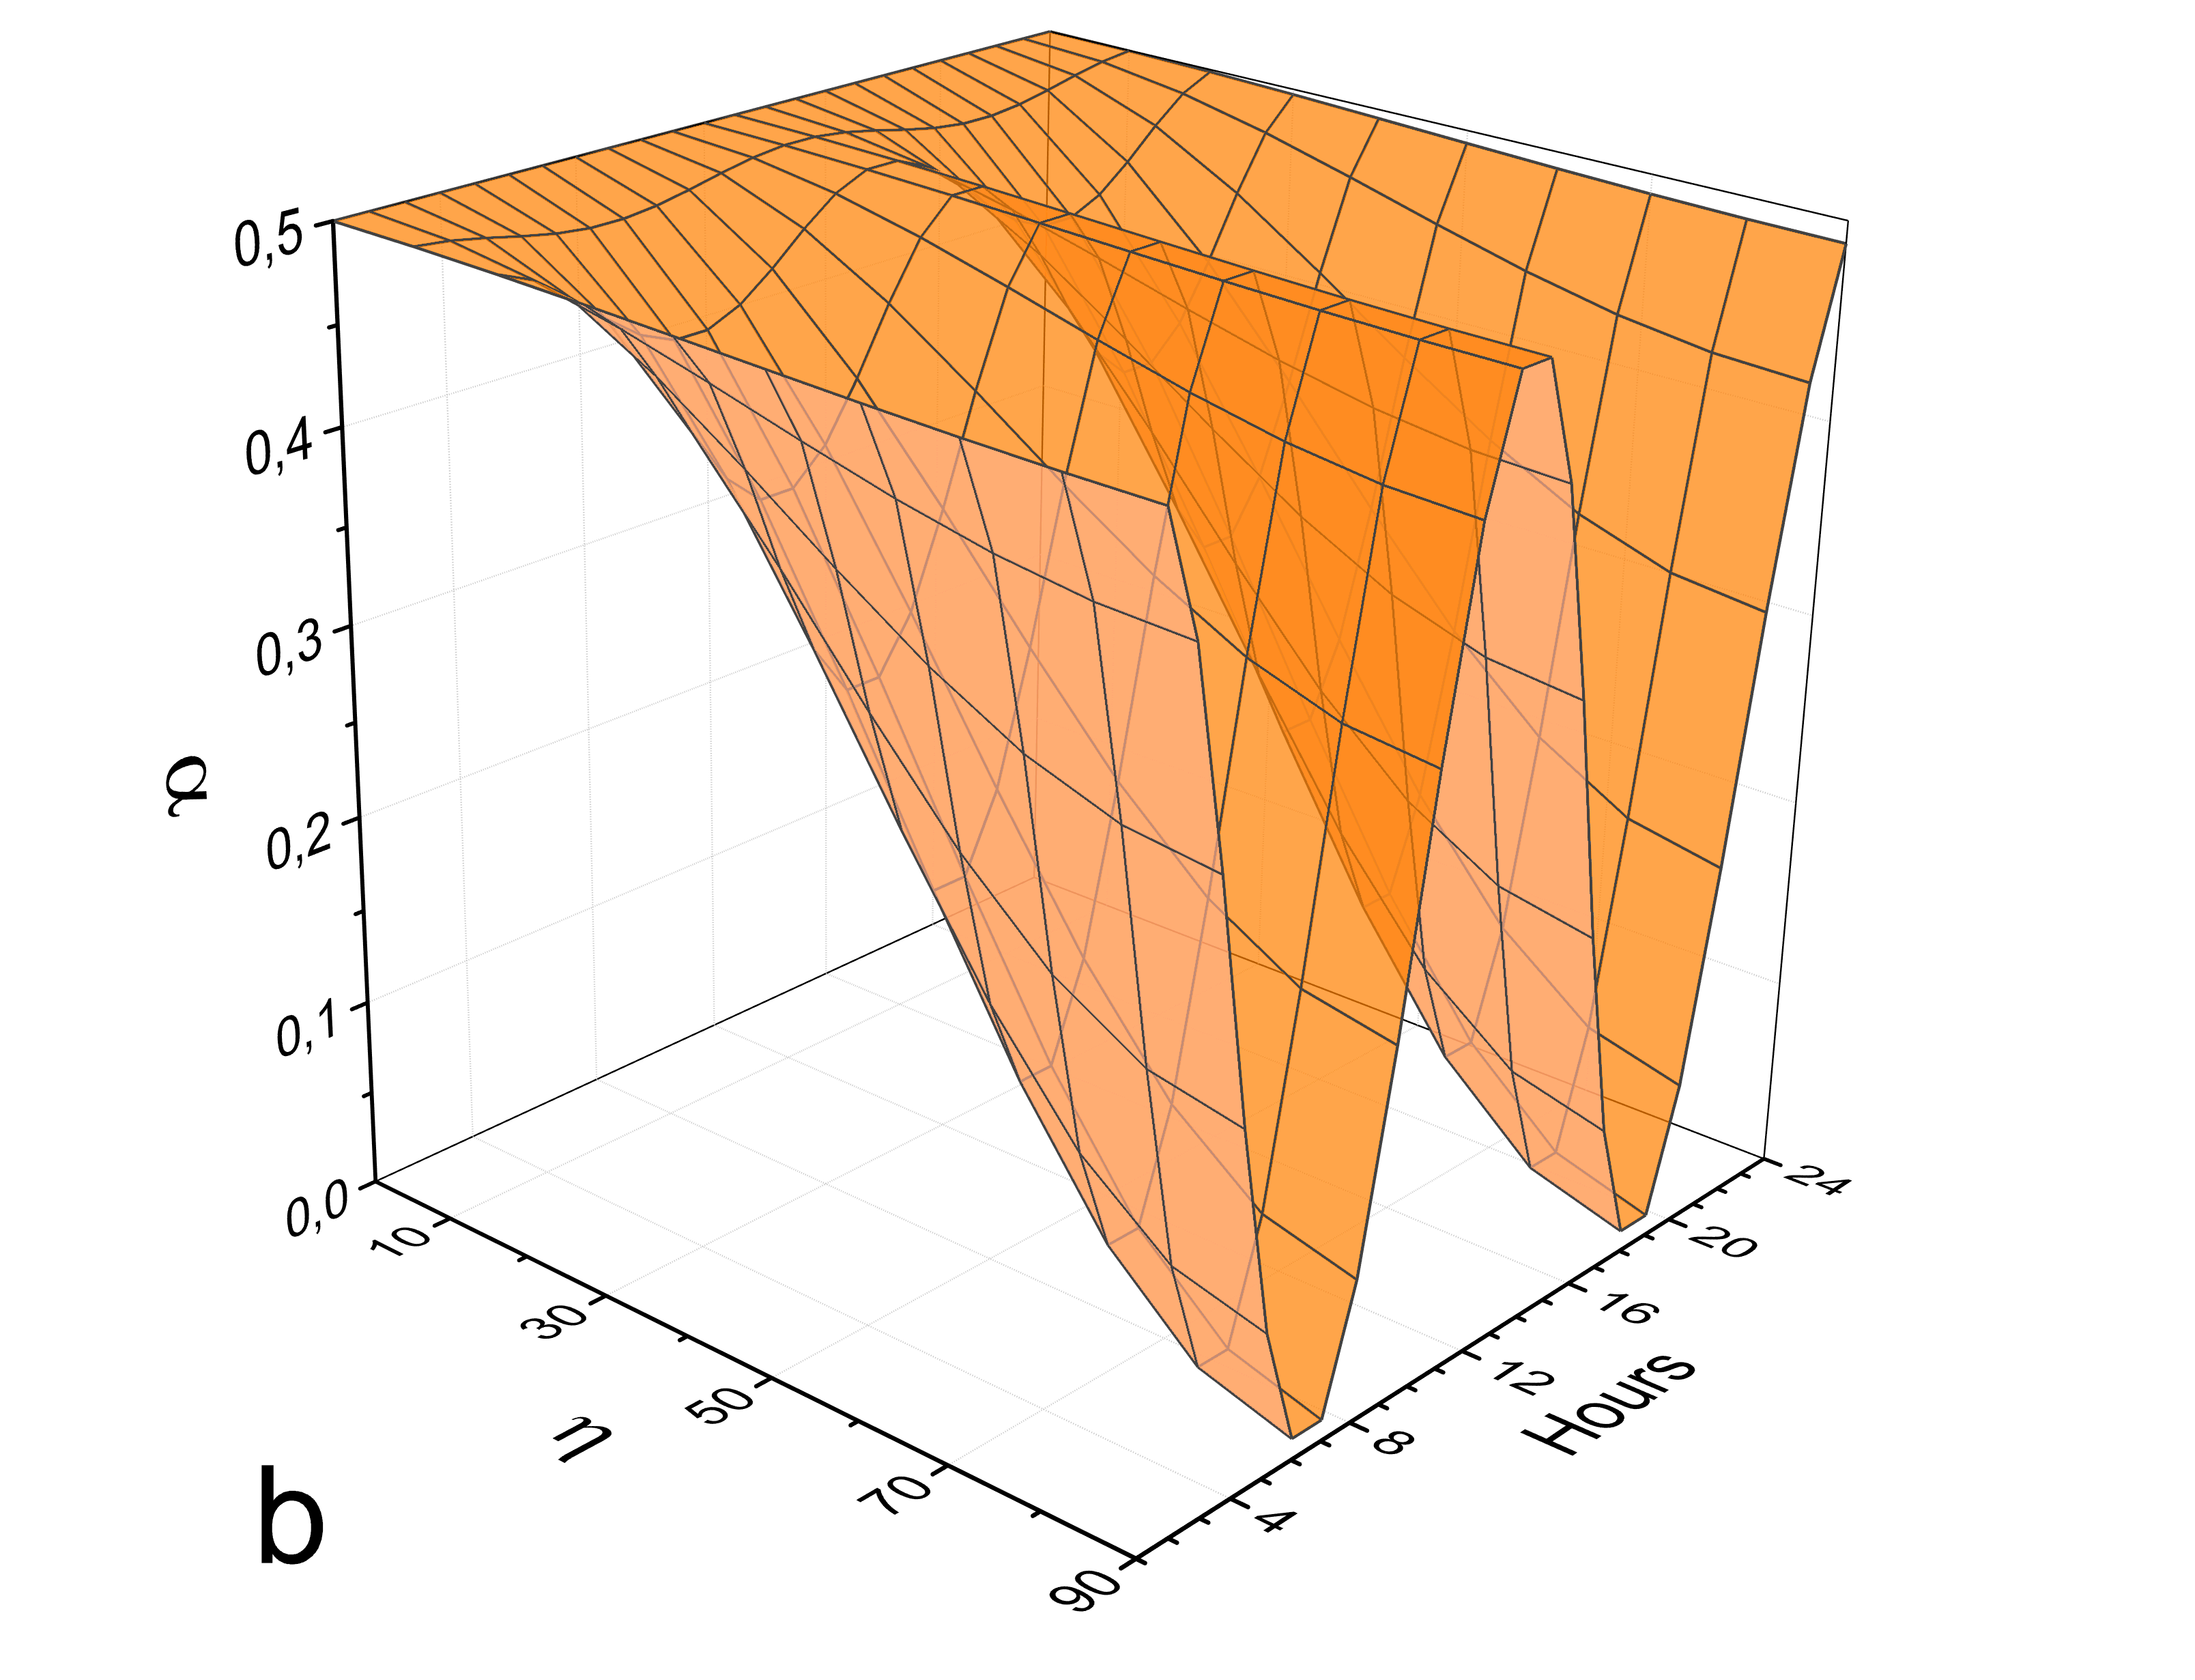
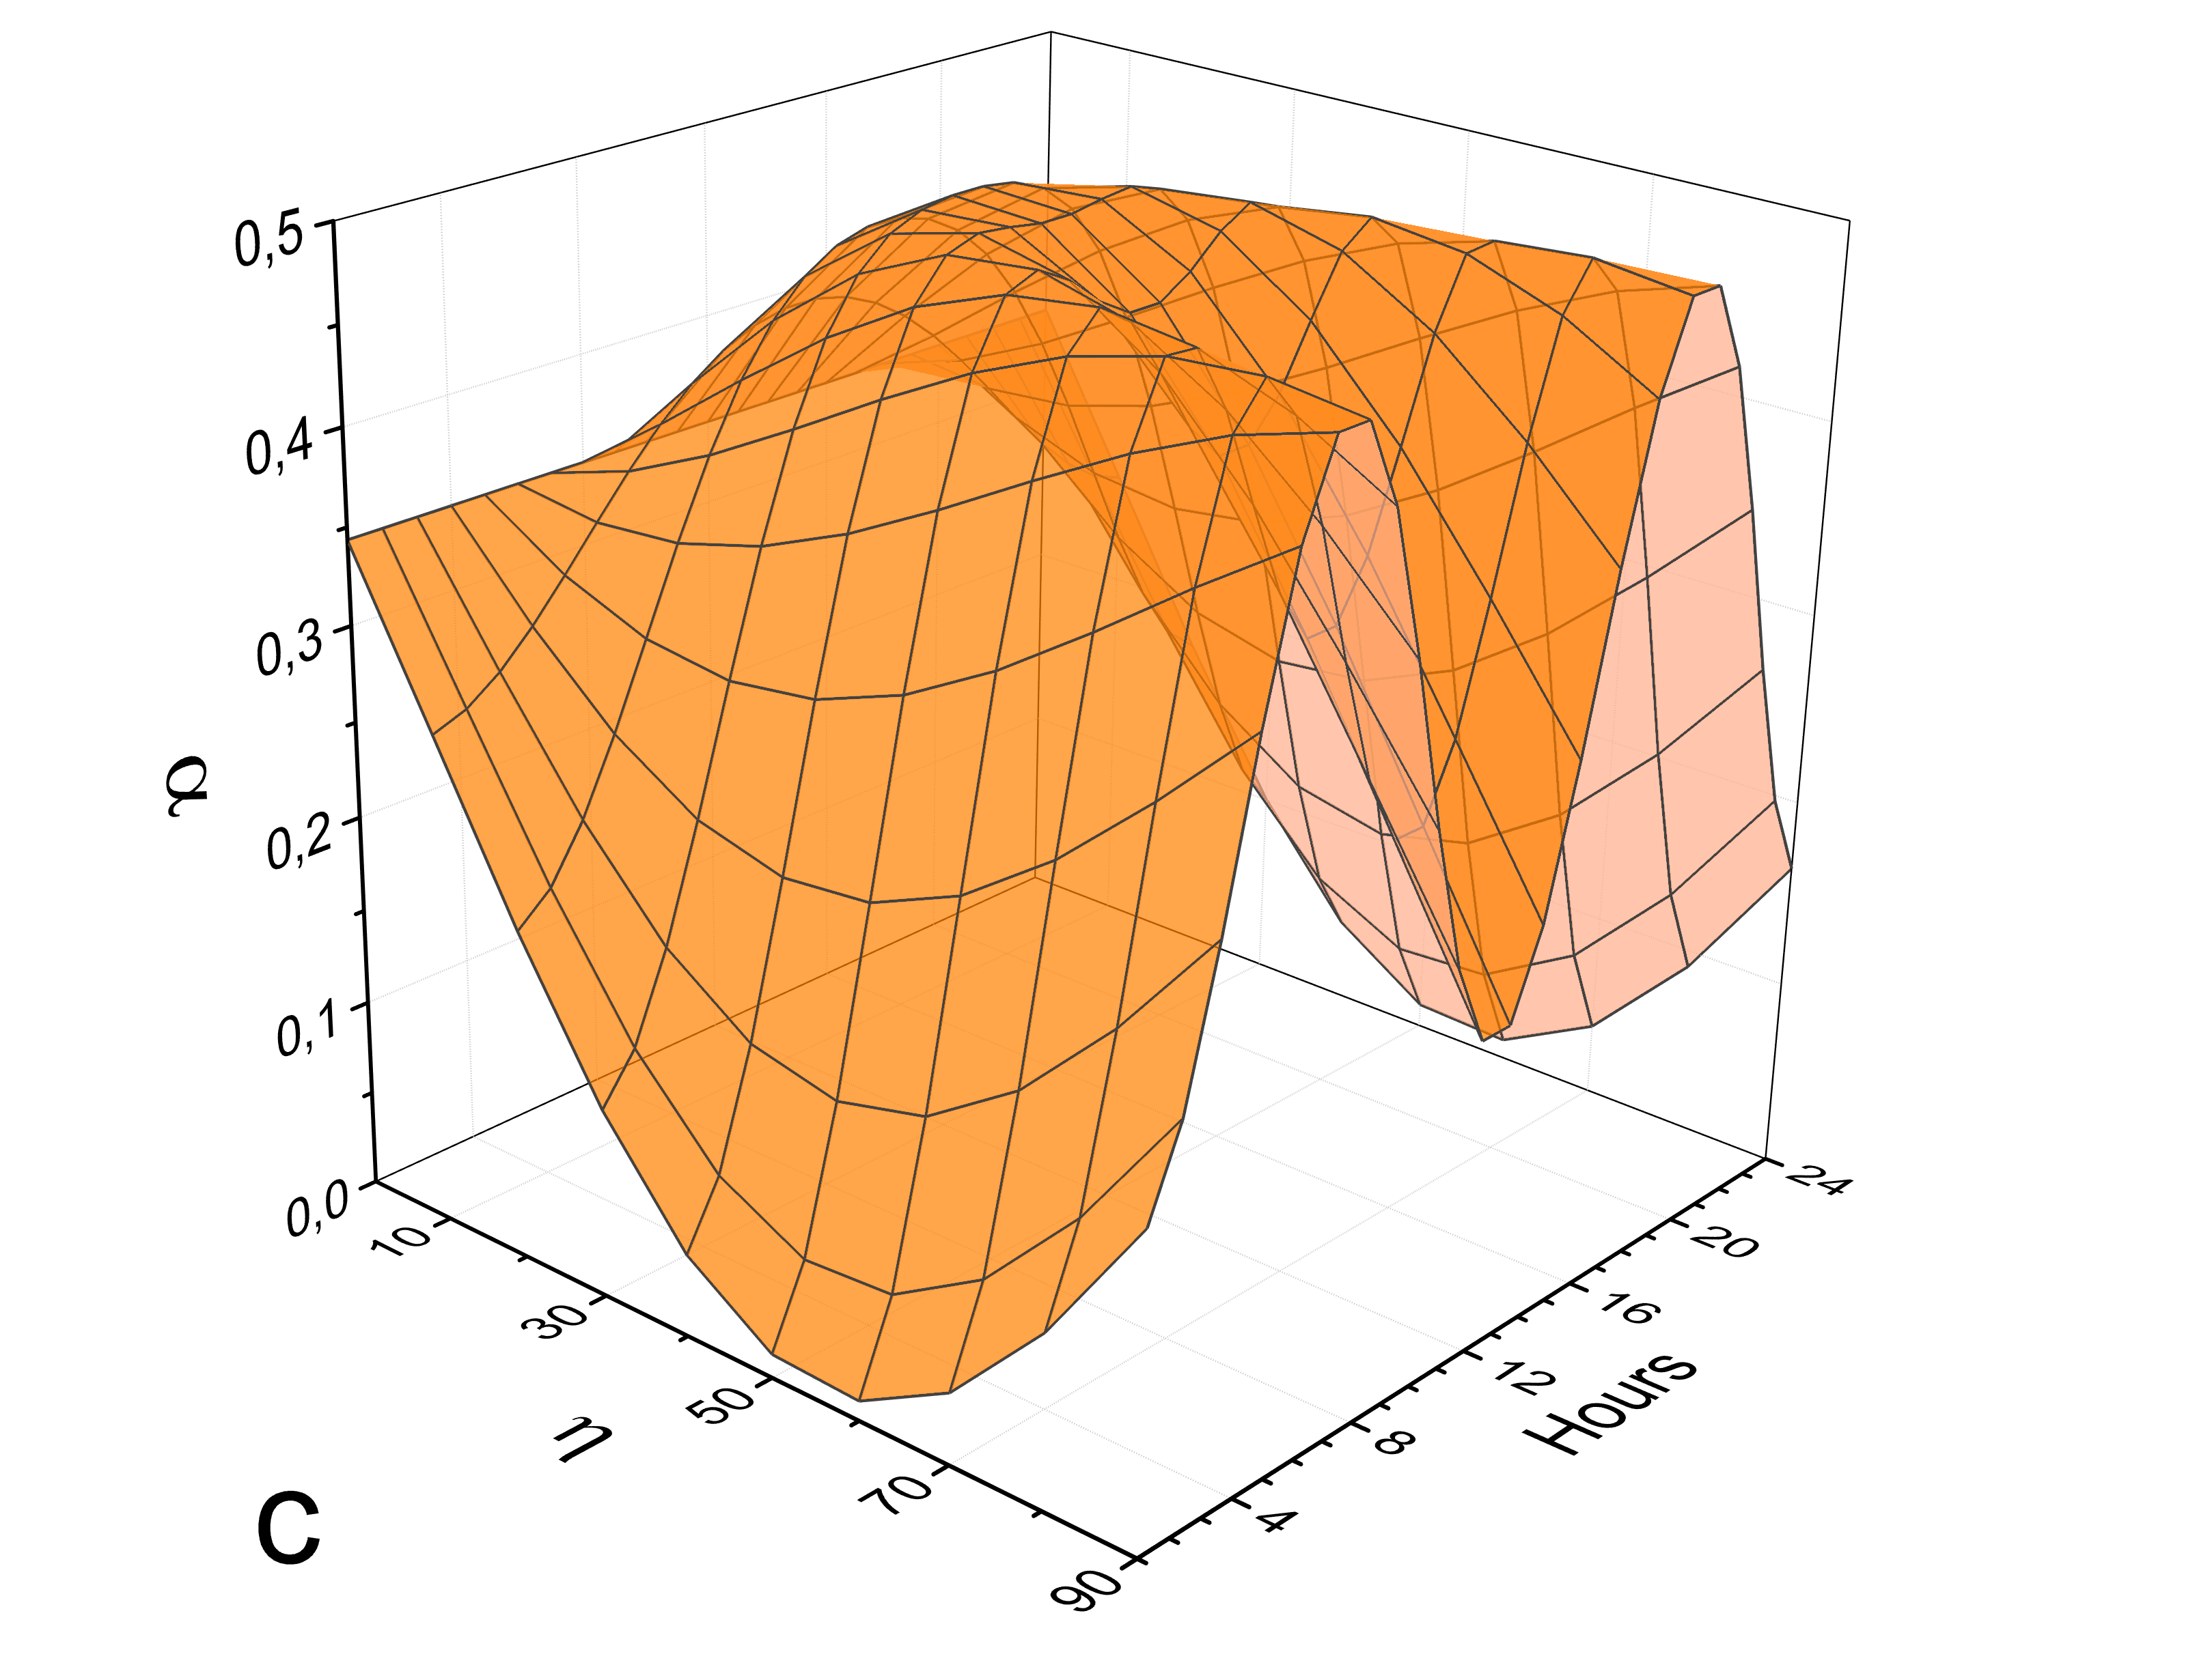
Diurnal variations, Moscow, Russia 55º 45’ N
Vertical orientation
East-West orientation
North-South orientation

Slide 19
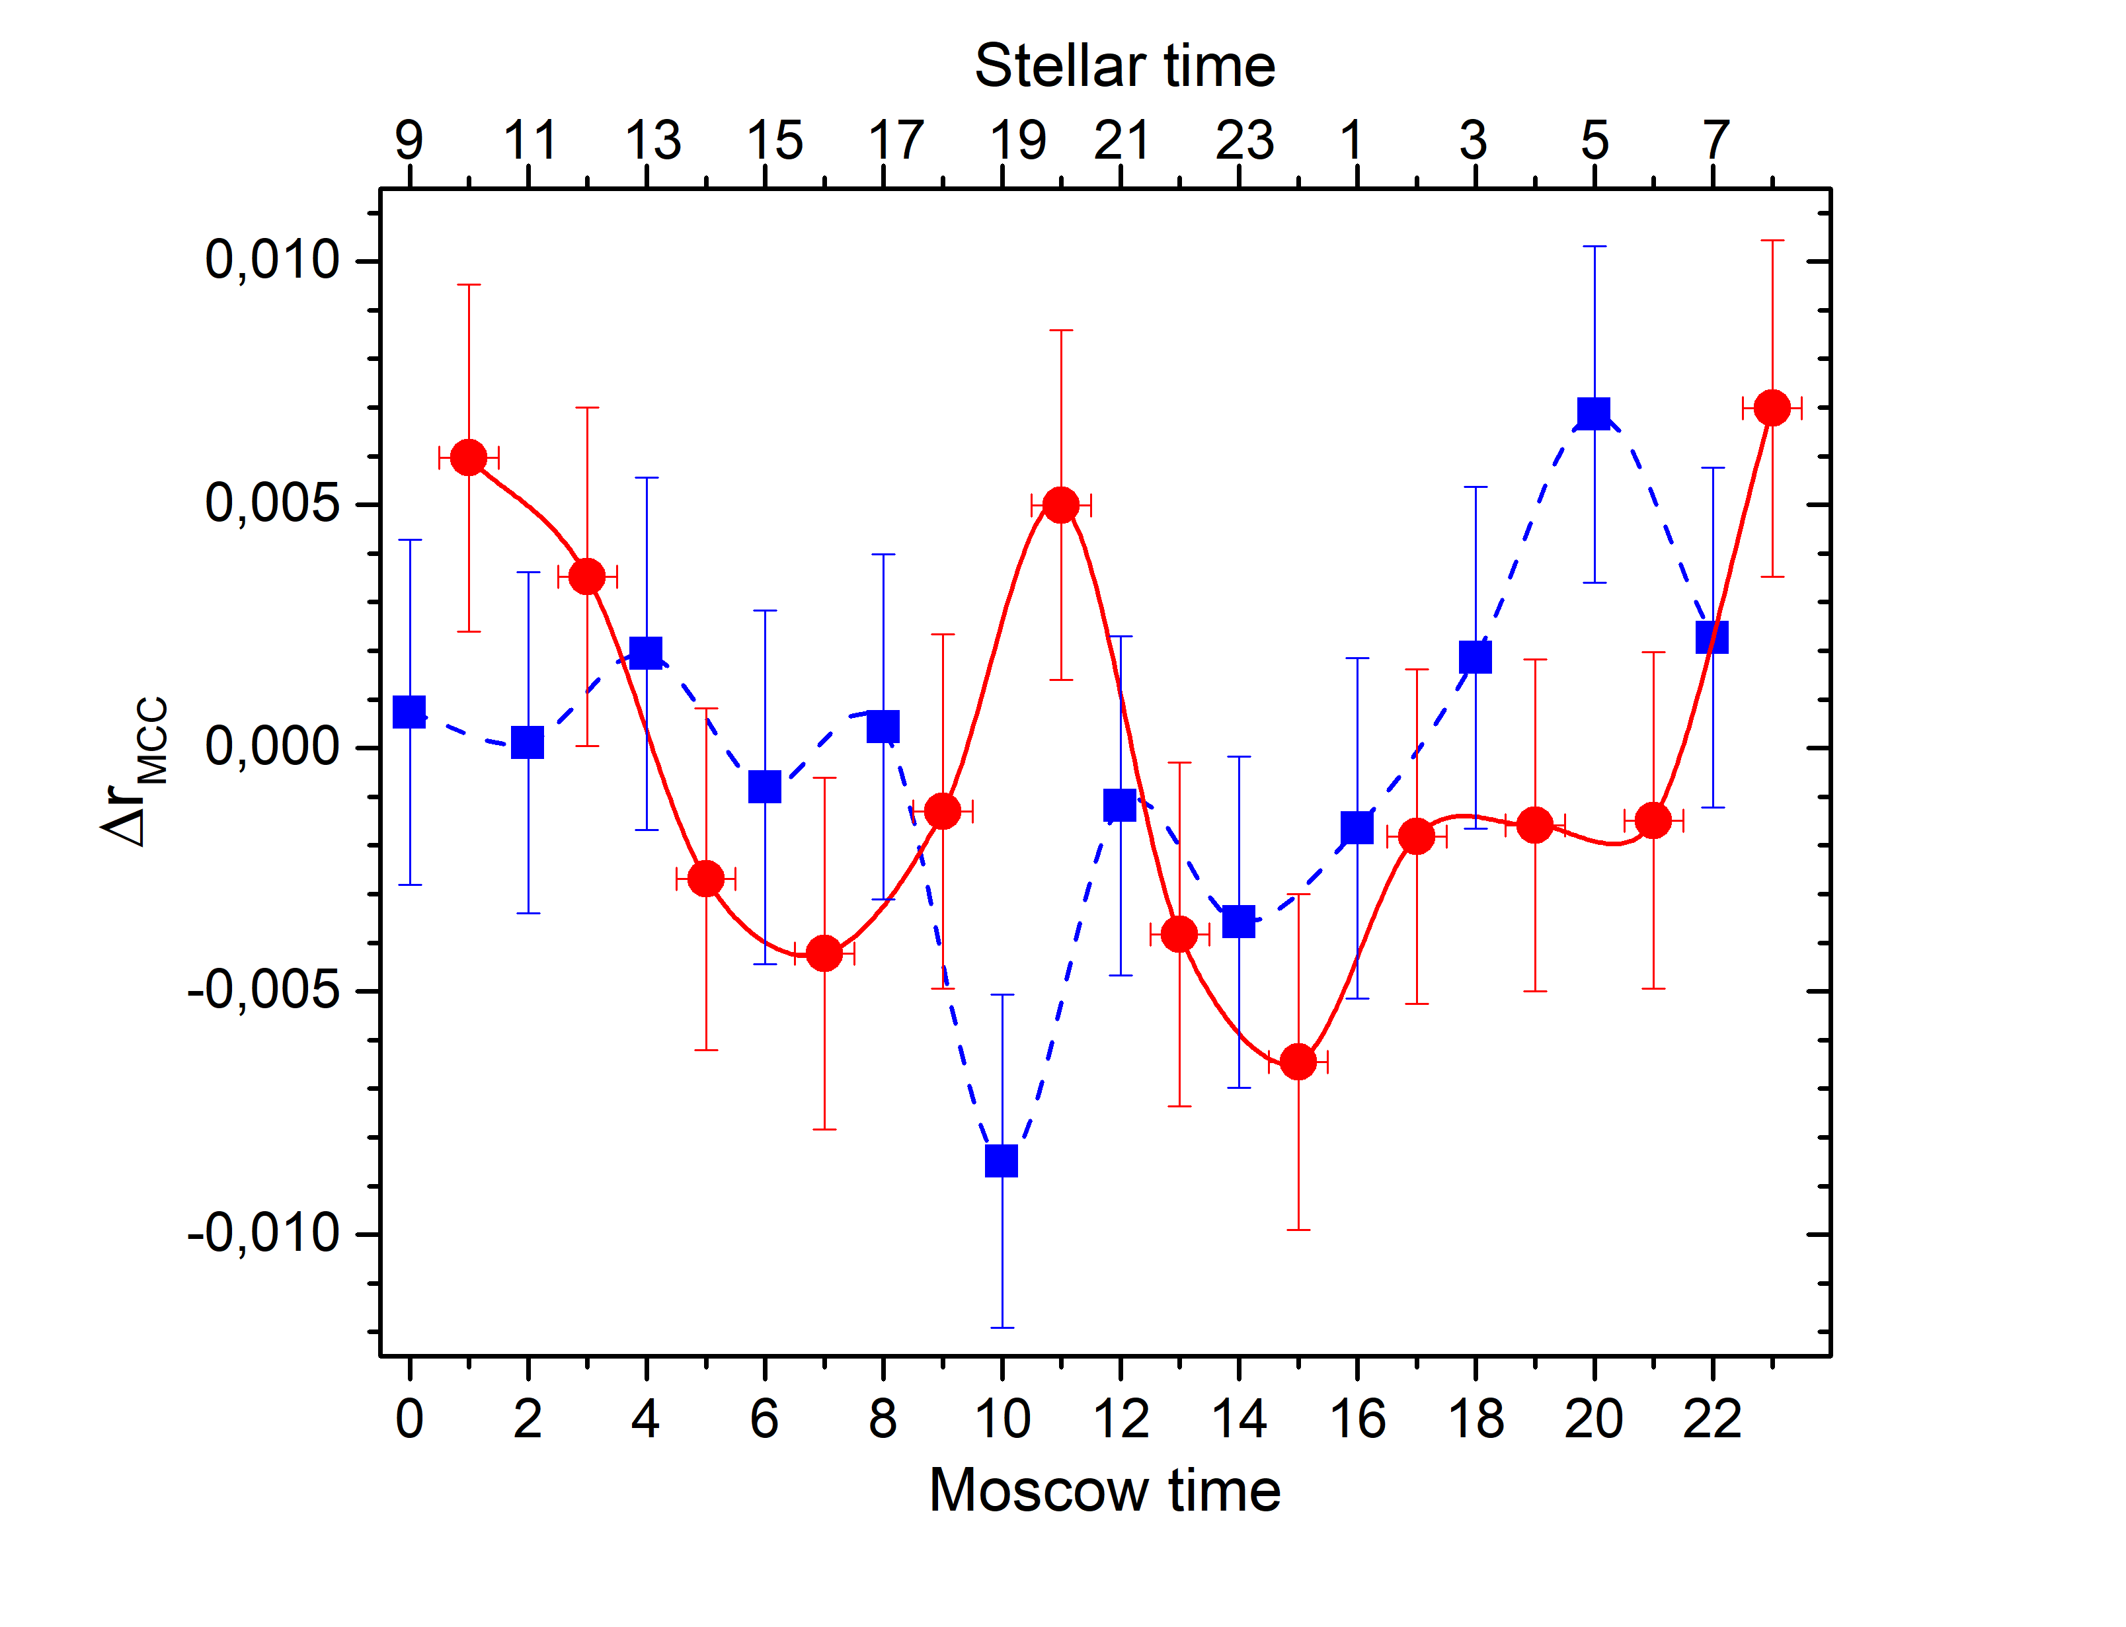
Diurnal variations in solar (red and lower scale) and stellar (blue and upper scale) frames one solar day = 24 hours, one sidereal day = 23 hours 56 minutes

Slide 20
Evidence base:
Diurnal variations should show symmetry relative the moment 12-00
(the moment 00-00 is when the vector of E-field is in meridian
where detector is placed) independent of the model
The curve of diurnal variations depends upon:
Orientation of the counter (vertical, horizontal EW, NS)
- Geographical latitude where detector is placed
- Quality of the surface of the cathode (polished – rough)
The observation (if any) of diurnal variations with a characteristic signature of the temporal symmetry will prove the existence of dark photons with a certain polarization and will enable to determine the vector of the electric field in stellar or solar coordinates.

Slide 21
Summary
The method has shown its efficiency. The measurements have been performed at the ground level laboratory in Troitsk (Moscow)
The results obtained have been included in a world compilation of data by Particle Data Group: R. L. Workman et al., (Particle Data Group) Prog. Theor. Exp. Phys. 2022, 083C01 (2022)
The method is unique in the way it enables to get a strong evidence base that the observed signal is really from dark photons

Slide 22
Our publications:
1. A.K., I.Orekhov, V.Petukhov, PHELEX: Present Status, Moscow University Physics Bulletin, 2022, Vol. 77, pp, 315-318. DOI: 10.3103/S0027134922020539
2 . A.K., I.Orekhov, V.Petukhov, Diurnal Variations of the Count Rates from Dark Photons, Particles 2022, 5, 180-187. https://doi.org/10.3390/particles5020016
3. A.K., I.Orekhov, V.Petukhov, Multi-cathode counter as a detector of dark photons, Physics of Atomic Nuclei, 2022, Vol.85, No. 6, pp 1-9, (2022).
DOI: 10.31857/S0044002722060083
4. A.K., I.Orekhov, V.Petukhov, Present Status of the Experiment on the Search for Dark Photons by a Multi-Cathode Counter, Physics of Atomic Nuclei, 2021, Vol.84, No. 6, pp 860-865
5. A.K., I.Orekhov, V.Petukhov, On the possibility of observing diurnal variations in the count rate of dark photons using a multicathode counters, Physics of Particles and Nuclei, 2021, Vol.52, No.1, pp. 31 - 38
6. A.K., I.Orekhov, V.Petukhov, First results and future prospects with PHELEX, Journal of Physics, Conference Series, 1690 (2020) 012002, doi:10.1088/1742-6596/1690/1/012002
7. A.K., I.Orekhov, V.Petukhov, Results from a hidden photon dark matter search using a multi-cathode counter, JCAP, 07, 008 (2019)

Slide 23
Our publications:
8. A.K., I.Orekhov, V.Petukhov, Method of search for hidden photons of Cold Dark Matter using a multi-cathode counter, Physics of Atomic Nuclei, Vol.82, No. 9, pp 1-8, (2019) 9. A.K., I.Orekhov, V.Petukhov, Search for Hidden Photon Dark Matter using a Multi-Cathode Counter. Proceedings of the 4th International Conference on Particle Physics and Astrophysics (ICPPA-2018), Journal of Physics: Conference Series, 1390 (2019) 012066 10. A.K., I.Orekhov, V.Petukhov, A multi-cathode counter in a single-electron counting mode, NIM A, 910, 164 (2018)

Slide 24
Dr. Anatoly Kopylov
Thank you for your attention

