Slide 1
ICPPA-2022
Investigation of FSR photon suppression in two positron decay mode of dark matter particles by means of MC generators
R. Barak, K. Belotsky, E. Shlepkina
NRNU MEPhI
Moscow, 01/12/2022

Slide 2
Introduction
Problem of the origin of positron anomaly in cosmic rays (experiments “PAMELA”, “AMS-02”, …).
Explanation of this anomaly by means of decay or annihilation of DM particles.
Contradiction with the results of the experiment (Fermi) on measuring the isotropic cosmic gamma background (IGRB).

Slide 3
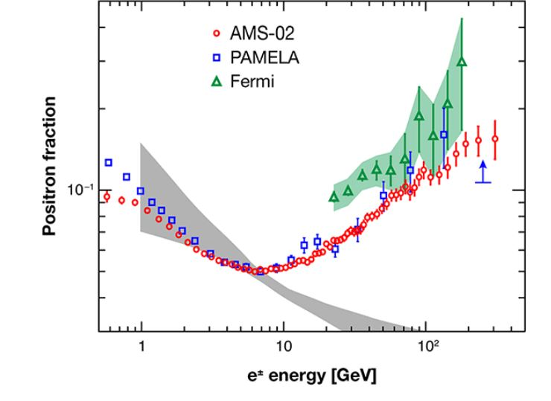
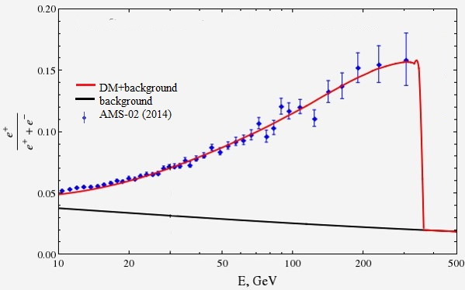
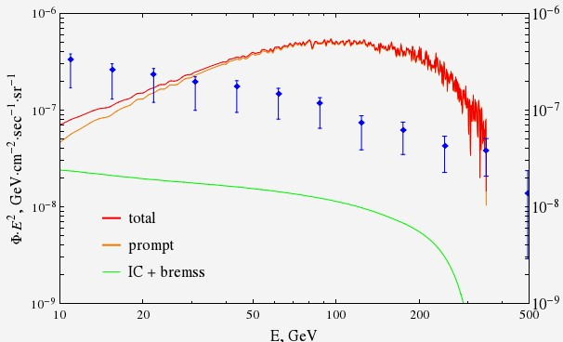
Problem of DM explanation of positron anomaly in cosmic rays
In good agreement with data from PAMELA and AMS-02
ee,μμ,ττ
Contradiction arises with data on IGRB of Fermi-LAT

Slide 4
THE SIMPLEST MODELS FOR THE DECAY OF A DARK MATTER PARTICLE
In this work the following models of the dark matter particle were investigated:
Minimization of photon yield:
Conventional mode which leads to contradiction with IGRB
Mode of interest in this work

Slide 5
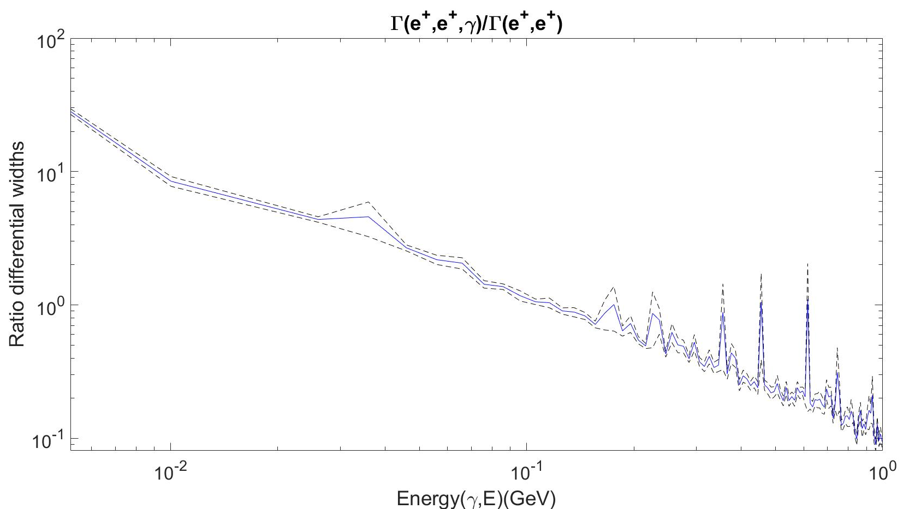
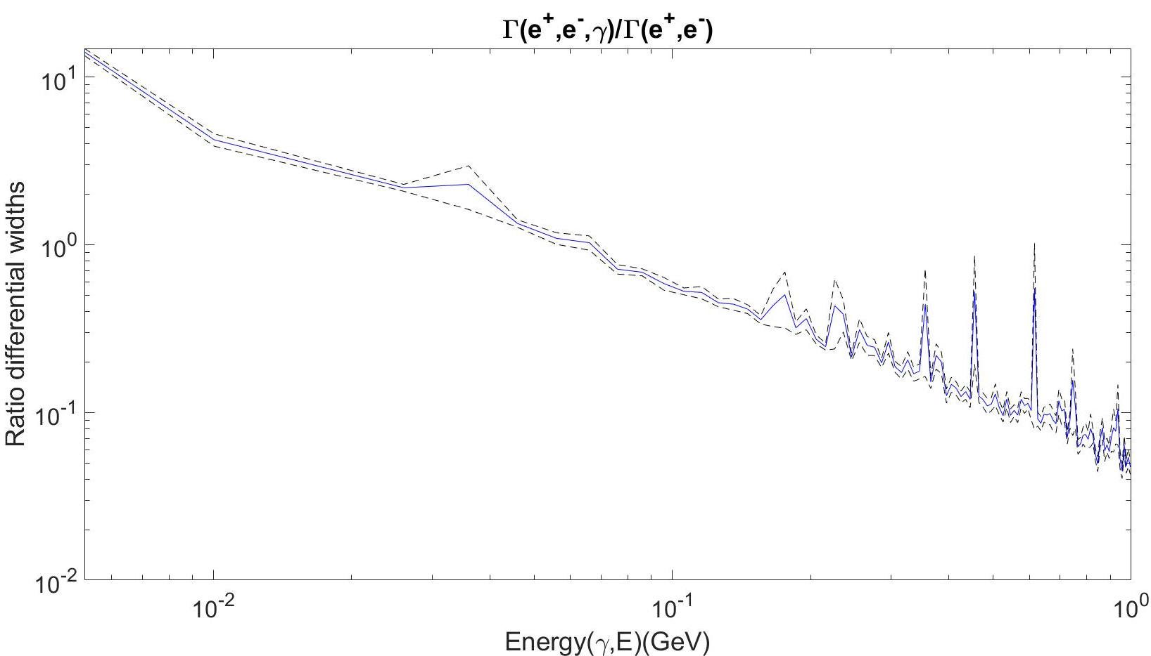
Photon spectra for the two modes
e+ e+ γ
e+ e- γ
e+ e- γ

Slide 6
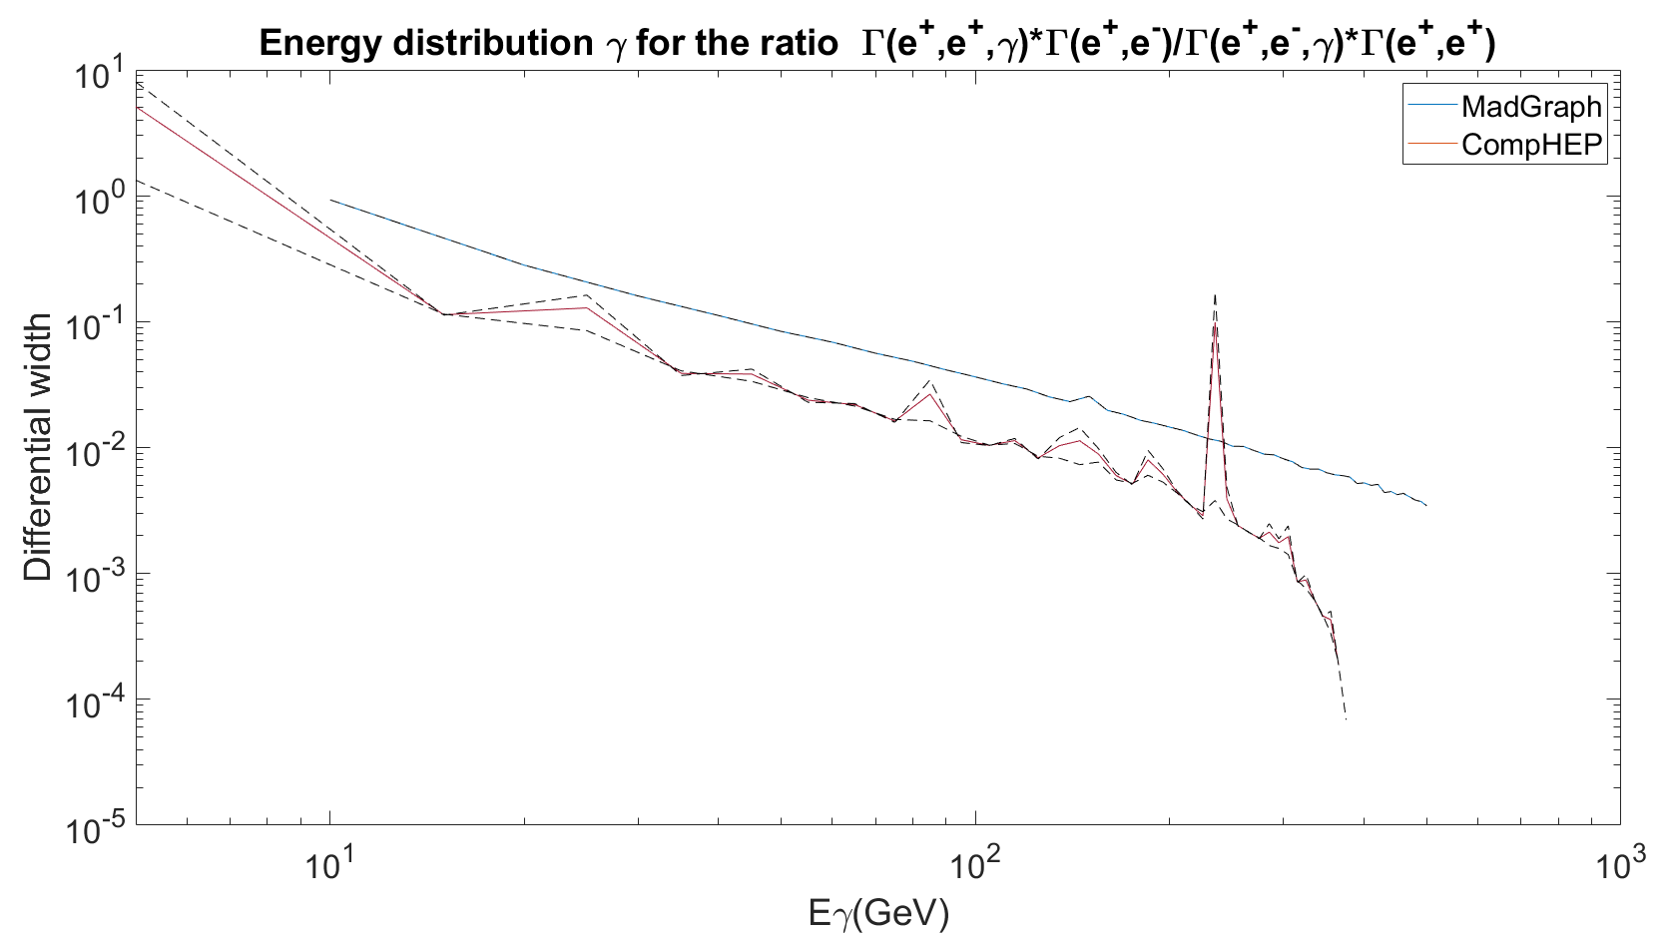
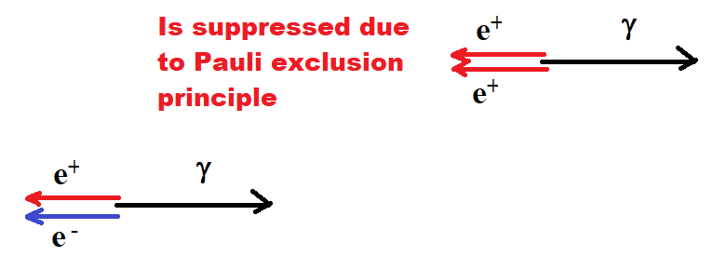
The ratio of two modes
CompHEP
MadGraph

Slide 7
Conclusion
Several simple models for the decay of a dark matter particle were considered and modeled.
Simulations were performed using CompHEP and MadGraph MC generators.
Near the end of the spectrum, the photon suppression in case of e+e+ decay is 100 greater in comparison to e+e- decay.

Slide 8
Thank you for your attention!

Slide 9
Backup

Slide 10
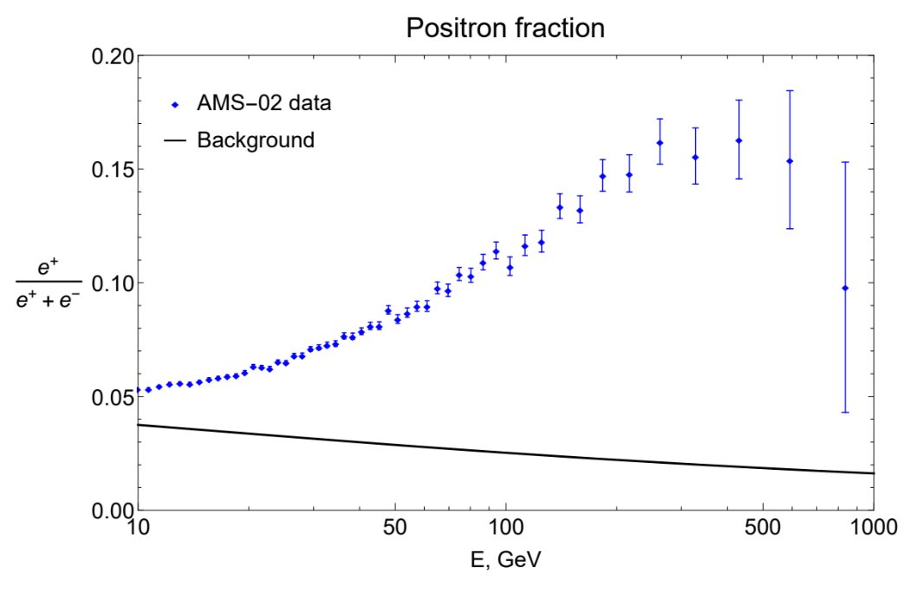
Positron anomaly

