Slide 1
Measurements the analyzing power in pp and p(bar)p elastic scattering at the SPASCHARM facility at U70.
A.A. Bogdanov, V.P. Ladygin, V.V. Mochalov, V.V. Moiseev,
M.B. Nurusheva, V.L.Rykov, P.A. Semenov
Study of spin effects in elastic proton-proton and antiproton-proton scattering at the SPASCHARM experiment at U-70 of IHEP, Protvino, is discussed. Polarized target will be used to measure analyzing power A_{N} of the elastic reactions.
Two different detectors for recoil proton registration were analyzed. The first one is supposed to use scintillation counters, the second detector is based on proportional chambers. Efficiency of registration of elastic pp scattering is compared for two configurations of the experimental setup.

Slide 2
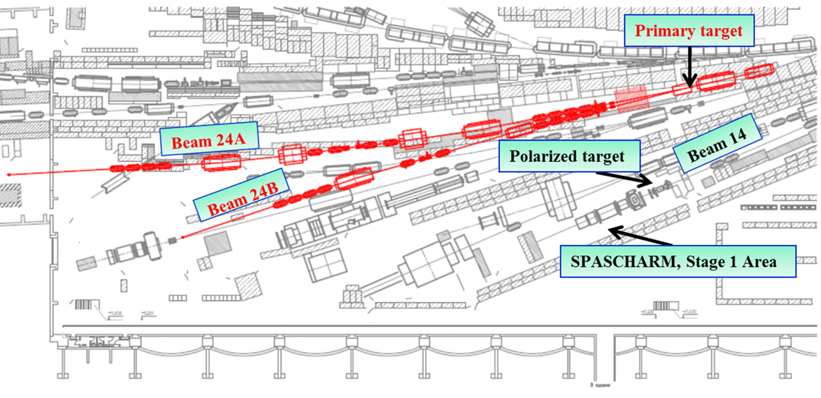
POLARIZED BEAM CHANNEL 24 AT IHEP
SPASCHARM POLARIZED BEAM OPTION
Beam will be delivered to primary target (up to 2∙10¹³ p/cyc.) to create secondary beams in the beam-line 24
24A – polarized beam channel (polarized protons and antiprotons, unpolarized hadron and electron beams)
24B – unpolarized hadron and electron beams

Slide 3
SPASCHARM EXPERIMENT PHYSICS
Single–spin asymmeties: inclusive and exclusive reactions, including elastic, of the light (u, d, s – quarks) hadrons in the beam fragmentation region with polarized beam or target
The hyperon and vector mesons polarization and depolarization
Study dependence on kinematic values (0<x_{F} <1, 0< p_{T}<2.5, 12<E_{Beam} <70 GeV), event multiplicity and atomic number with high precision due to full azimuthal coverage within the wide aperture
Double-spin asymmetry A_{LL} in charmonium production to study gluon polarization ∆ G/G(x) at large x_{F}
The comprehensive physics program of the fixed target SPASCHARM experiment (SPin ASymmetry in CHARMonia) is described in detail in the Conceptual Design Report [1]
[1] Abramov V V et al. IHEP Preprint 2019-12 (in russian)

Slide 4
New measurements at SPASCHARM will significantly extend the energy range of the spin studies in elastic scattering and will give unique possibility to compare elastic pp and p(bar)p scattering.
The experimental program for the study of elastic scattering makes it possible to measure elastic scattering spin observables at 16 GeV/с
Ultimate goal is to measure the complete set of 12 observables: σ, AN, P, ANN, ALL, ASL, DNN, DLS, KNN, KLS, NLLN, NSLN for direct reconstruction of elastic pp and p(bar)p scattering amplitudes at SPASCHARM experiment (analyzing power, spin correlations, depolarization coefficients, polarization transfer coefficients from the beam to the recoil particle, polarizations of the recoil particle).
Analyzing power AN is important and required for SPASCHARM polarimetry.

Slide 5
At the largest accelerator complex in Russia, the U-70 of the National Research Center Kurchatov Institute (NRC KI) - IHEP, Protvino a significant base for conducting world-class research in the fixed target SPASCHARM experiment (SPin ASymmetry in CHARMonia) has been created
Universal channel 24A and the SPASCHARM setup are
created to study the fundamental issues of strong interactions and
spin physics, in the interactions of polarized protons
and antiprotons with nucleons and nuclei.
The combination of a wide range of beams and targets with the possibility of simultaneous detection of charged and neutral particles in the final states of reactions makes it possible to carry out a wide program of experimental studies.
The SPASCHARM scientific program includes several series of measurements

Slide 6
The criteria to select elastic processes
To estimate the S / (S + B) ratio, 10⁶ events were simulated using the PYTHIA 8 generator. The signal is elastic pp scattering. Background - diffraction processes as A + B → X + B, A + B → A + X in which only two charged particles enter the detector. The geometry and resolution of the detector were taken into account In the simulation. Separation was carried out using the two-dimensional distribution tg1 * tg2 of the difference in angles (phi1-phi2).

Slide 7
Two-dimensional histogram. Multiplying of tangents of polar angles and the difference of azimuthal angles. Only for elastic processes 164612
Separation was carried out using the two-dimensional distribution tg1 * tg2 of the difference in angles
Two-dimensional histogram. Multiplying of tangents of polar angles and the difference of azimuthal angles. Only for diffractive processes 34178

Slide 8
Possibility of separating elastic pp scattering
Fig. 2 Distribution of scattered protons depending on the polar angle. Blue distribution correspond to elastic processes. Red distribution correspond to diffraction processes.
Fig. 1 Distribution of recoil protons depending on the polar angle. Blue distribution correspond to elastic processes. Red distribution correspond to diffraction processes
Elastiс p+p→p+p event is signal to analyze. Main background is single p + p→p + X, p + p →X + p and double diffraction processes Signal S / (S + B) = 0.995 Background. 10⁵ events were simulated using the PYTHIA 8 generator.

Slide 9
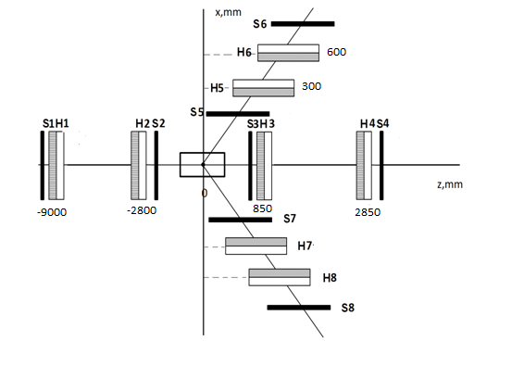
Detector
Hodoscopes | Distance from PT ( mm) | Total dimensions (mm) | Dimension of scintillator width x thickness x length (mm) | Numbers of PM
 | Z | X × Y | X Y | X Y
 |  | Beam | Hodoscopes
H1 | -9000 | 40 × 40 | 6 × 3 × 40 6 × 3 × 40 | 9 9
H2 | -2800 | 40 × 40 | 6 × 3 × 40 6 × 3 × 40 | 9 9
 |  | Forward | Hodoscopes
H3 | 850 | 62 × 45 | 6 × 3 × 62 6 × 3 × 45 | 15 11
H4 | 2850 | 182 × 86 | 6 × 3 × 182 6 × 3 × 86 | 45 21
 |  | Recoil | Hodoscopes
 | X | Z × Y | Z Y | Z Y
H5 - H7 | 300 | 322 × 228 | 9 × 5 × 322 9 × 5 × 228 | 51 37
H6 - H8 | 600 | 432 × 430 | 9 × 5 × 432 9 × 5 × 420 | 71 69

Slide 10
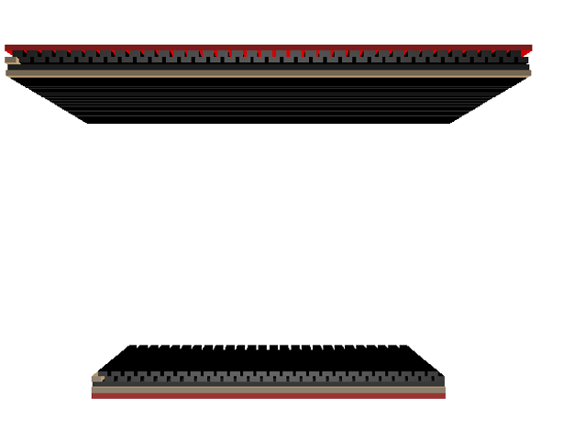
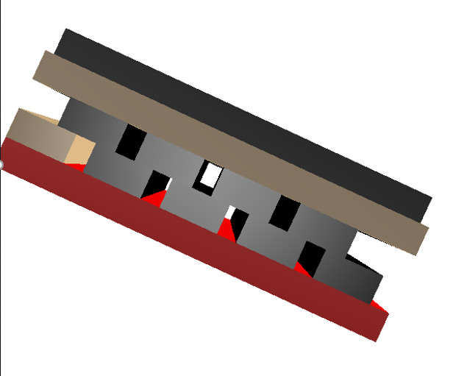
Scintillator “Comb” hodoscope
The calculations were carried out
for hodoscopes with a scintillation element size of 6 mm
(that is, a step of 2 mm)
Element S3H3
Elements S5H5 , S6H6

Slide 11
Слайд № 12
It was assumed that hodoscopes from scintillation would be used for all detector. However, the amount of matter on the beam path in the "comb" hodoscope is larger by 67% with the same thickness of the scintillator rods as in the single-layer hodoscope.

Slide 12
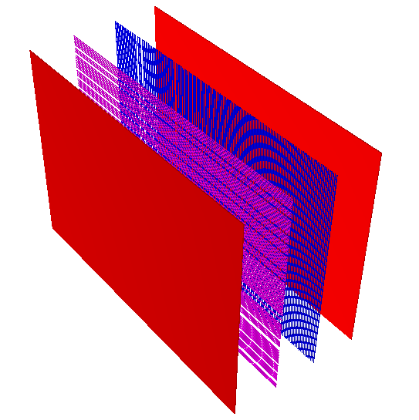
Proportional chambers and scintilliator
The distance between the planes is 9.7 cm . The distance between the wires is 2 mm. The width and length correspond to the dimensions of the detectors H5-H8, which in turn depends on the distance from the target
However, the amount of matter on the beam path in the "comb" hodoscope is larger by 67% with the same thickness of the scintillator rods as in the single-layer hodoscope.
Element S4H4
Elements S5H5.

Slide 13
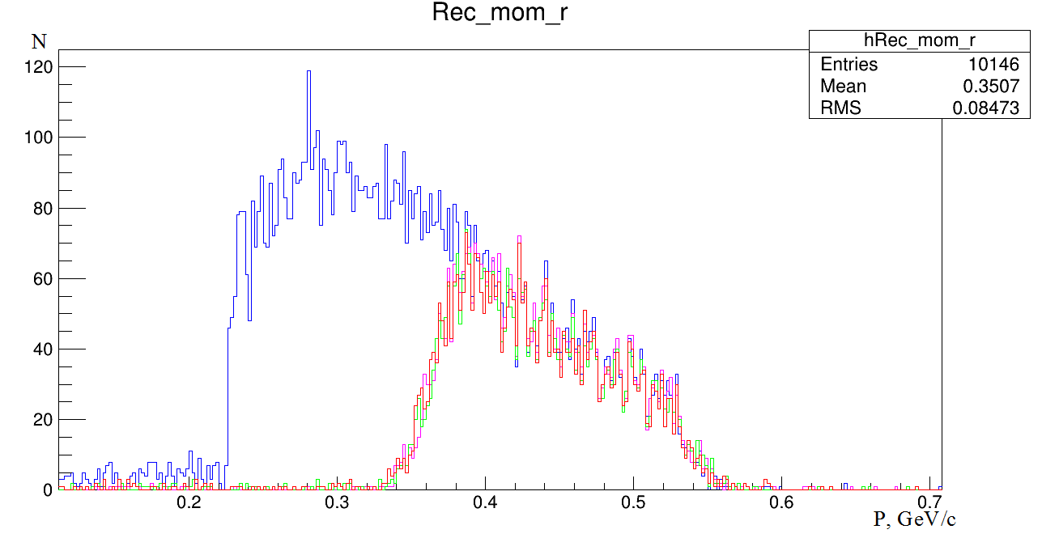
Number of events of two different detector setup
Polarized target without magnetic field for Scintillator detector setup 3971
Liquid hydrogen target without magnetic field for Scintillator detector setup 4080
Polarized target with magnetic field for Scintillator detector setup 3956
Liquid hydrogen target without magnetic field for Proportional chamber detector 10146
Momentum distribution
of the recoil proton
If the recoil arm is made from scintillators, then the efficiency is about 2.5 times less than if the recoil detectors are made from proportional chambers.

Slide 14
As a result of the simulation, it turned out that the efficiency of recording elastic events in different versions of the detector is different. If the recoil and scattering arm is made from scintillators, then the efficiency is about 2.5 times less than if the recoil detectors are made from proportional chambers. To confirm this, a simulation was carried out in which the substance of the scintillators was replaced by argon. The results are shown below.

Slide 15
The beam run time estimation
Estimation of the required time to measure the polarization in pp scattering at 45 GeV/c for −t = [0.040÷0.475] (GeV/c)² carried out under the assumption of ideal operation (efficiency 100%) polarimeter in this t region. Luminosity L = νIN_{A}ρx, where ν = 0.1 — duty cycle of a beam, I — intensity beam per cycle, N_{A} = 6∙10²³ — Avogadro's number, ρ — density of polarized target, x —target thickness.. Оценка проведена для I = 10⁷ p/cycle, liquid hydrogen target density ρ = 0.07 g/sm³, and target length x = 50 sm. The luminosity will be 2.1∙10³⁰ sm⁻²s⁻¹.
The total expected number of events N(t₀) = L dσ/dt(t₀) ΔtΔϕ/ϕ with an average value of t₀ = 0.22 (GeV/c)² for the region of Δ t = 0.03 (GeV/c)², with azimuth acceptance Δϕ/ϕ = 0.17 (when using two arms spectrometers), differential cross section dσ/dt(t₀) (0.22) = (8.326±0.073) mb/(GeV/c)² for one hour of accelerator operation will be 2.1∙10³⁰∙8.326∙10⁻²⁷∙0.03∙0.17∙3.6∙10³ = 3.21∙10⁵ protons/hour.
It takes less than a day to measure the analyzing power with an accuracy of 5%.!!!
For 16 GeV/c with our cutoff (previous slide) - lower limit from 0.25 we can reach 5% accuracy in 2-3 days for pp scattering and accuracy 10% for p(bar)p scattering in 5-7 days

Slide 16
Number of events of two different detector setup
Polarized target without magnetic field for Scintillator detector setup 3971
Liquid hydrogen target without magnetic field for Scintillator detector setup 4080
Polarized target with magnetic field for Scintillator detector setup 3956
Liquid hydrogen target without magnetic field for Proportional chamber detector 10146
Momentum distribution
of the recoil proton
For 16 GeV/c with our cutoff - lower limit from 0.25 we can reach 5% accuracy for pp scattering in 2-3 days and accuracy 10% for p(bar)p scattering in 5-7 days

Slide 17
Discussion and conclusion
Full Monte Carlo was prepared to study feasibility to measure elastic pp and p(bar)p scattering in the SPASCHARM experiment at 16 GeV.
MC study demonstrated possibility to study spin effects in elastic scattering in non-investigated region:
Fast MC study demonstrated the possibility to suppress background and select elastic process.
Real MC shows, that registration efficiency (region) become significantly (3 times) better if proportional chambers replace traditional scintillator hodoscopes (these chambers are already designed and can be manufactured in few months).
Analyzing power in pp and p(bar)p can be measured and compared. We can reach 5% accuracy in 2-3 days for pp scattering and accuracy 10% for p(bar)p scattering in 5-7 days.

Slide 18
Thank you for attention

