Slide 1




MiniSPD test bench for testing
of SPD detectors prototypes
N. Barlykov, V. Dudin, T. Enik, A. Ivanov,
*E. Kokoulina, A. Kutov, E. Martovitski, V. Nikitin,
V. Popov, R. Shuliakovsky
On behalf of the SPD Collaboration
JINR, Russia, *P.O. Sukhoy GSTU, Belarus
6th International Conference on Particle Physics and Astrophysics 29.11.2022-02.12.2022

Slide 2


NICA (Nuclotron based Ion Collider fAcility)
Start of construction: 2013.
Our accelerator complex is being created at the JINR, LHEP (Dubna, RF).
The main aims are the study of:
the properties of dense baryonic matter, a special state of matter in the first moments after the Big Bang, formation of quark-gluon plasma (MPD);
spin structure of proton (deuteron) (SPD).
2
E. Kokoulina
MiniSPD test bench for testing of SPD detectors prototypes
6th ICPPA, Moscow, Russia

Slide 3
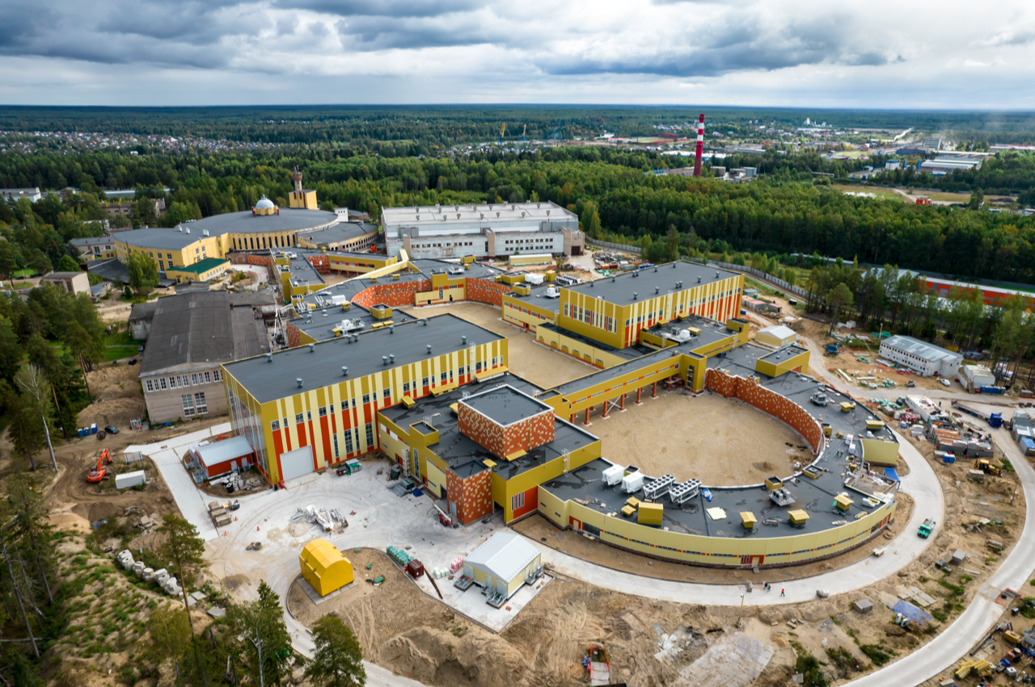
NICA aerial view, April 2022
E. Kokoulina
MiniSPD test bench for testing of SPD detectors prototypes
6th ICPPA, Moscow, Russia

Slide 4
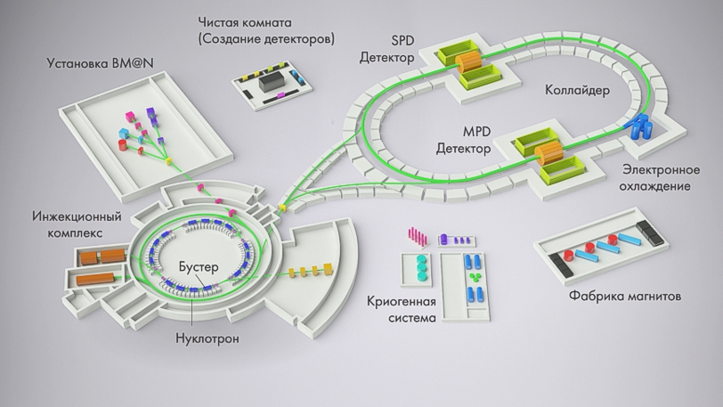
Clean Room
SPD
Detector
BM@N setup
Collider
MPD
Detector
Electronic
cooling
injection complex
Booster
Plant of Magnets
Cryogenic system
Nuclotron
NICA scheme
3

Slide 5

The main tasks of SPD project
Spin is one of the fundamental properties of elementary particles. It cannot be explained by a static view of the proton:
total spin = s(q) + s(g) + angular momentum = 1/2.
It’s not just the number 1/2. It is the result of interaction between quarks and gluons, more probably gluons.
The origin of spin is a fundamental problem of physics. Our SPD (Spin Physics Detector) project is aimed at study spin properties of nucleons and light nuclei.
How are quarks and gluons, their spins distributed in space and on momentum inside the nucleon?
2102.00442[hep-ex]Conceptual design of the Spin Physics Detector (A. Guskov)
4
E. Kokoulina
MiniSPD test bench for testing of SPD detectors prototypes
6th ICPPA, Moscow, Russia

Slide 6
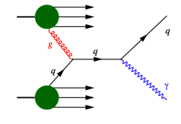
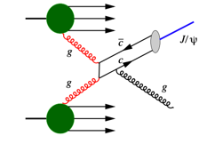
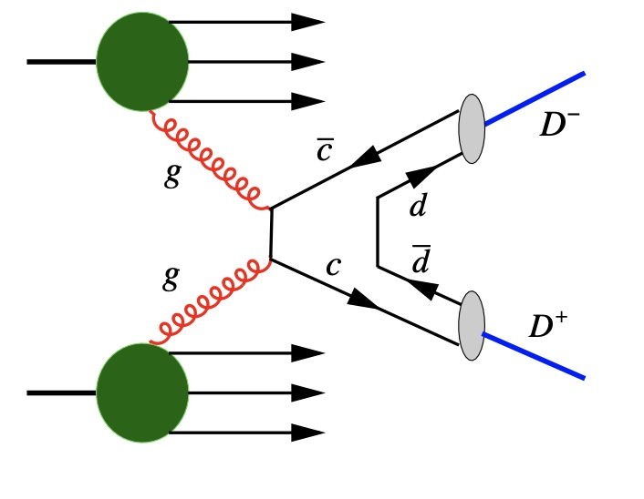
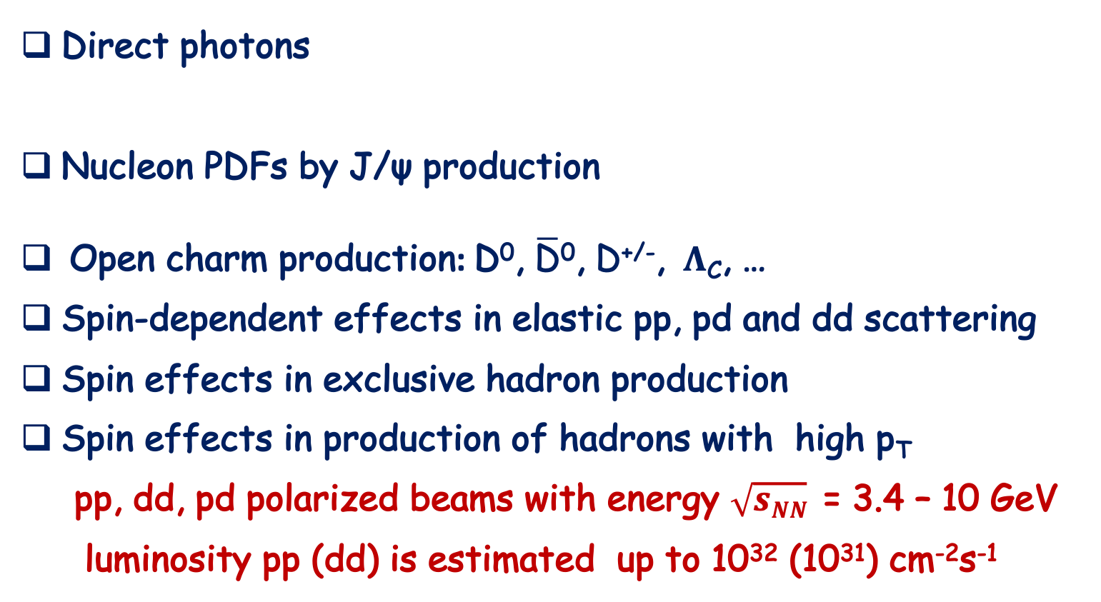
The main tasks of SPD project
Direct photons
Nucleon PDFs by J/ψ production
Open charm production: D⁰, $\overline{\text{D}}$⁰, D^{+/-}, $Λ$_{C}, …
Spin-dependent effects in elastic pp, pd and dd scattering
Spin effects in exclusive hadron production
Spin effects in production of hadrons with high p_{T}
pp, dd, pd polarized beams with energy $\sqrt{sNN}$= 3.4 – 10 GeV
luminosity pp (dd) is estimated up to 10³² (10³¹) cm⁻²s⁻¹
[SPD Collab. Phys.Part.Nucl. 52 (2021) 6]
5
E. Kokoulina
MiniSPD test bench for testing of SPD detectors prototypes
6th ICPPA, Moscow, Russia

Slide 7
Why do we need MiniSPD?
MiniSPD is a setup for testing SPD detector prototypes with cosmic muons
MiniSPD is used to test the Data Acquisition System (DAQ) of SPD
MiniSPD is used to test the Detector Control System (DCS) of SPD
MiniSPD is used to teach students how to work with real detectors
6
E. Kokoulina
MiniSPD test bench for testing of SPD detectors prototypes
6th ICPPA, Moscow, Russia

Slide 8
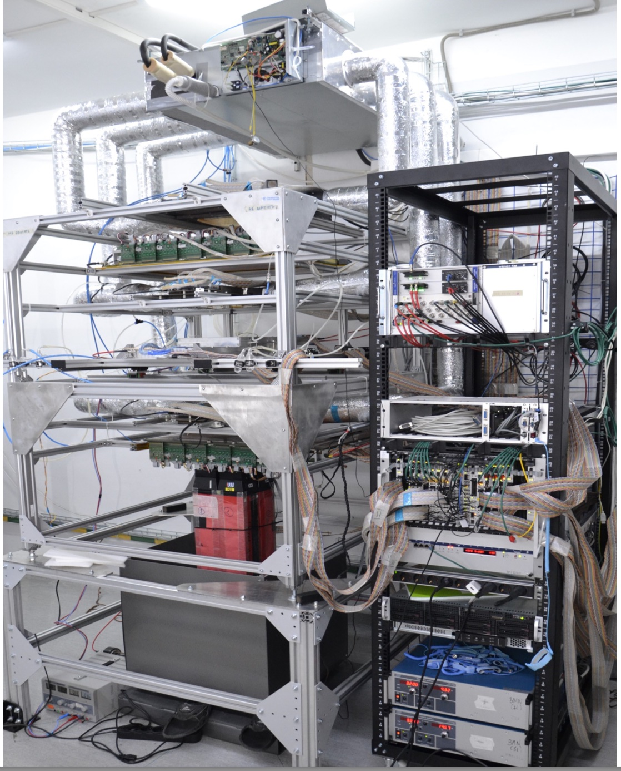
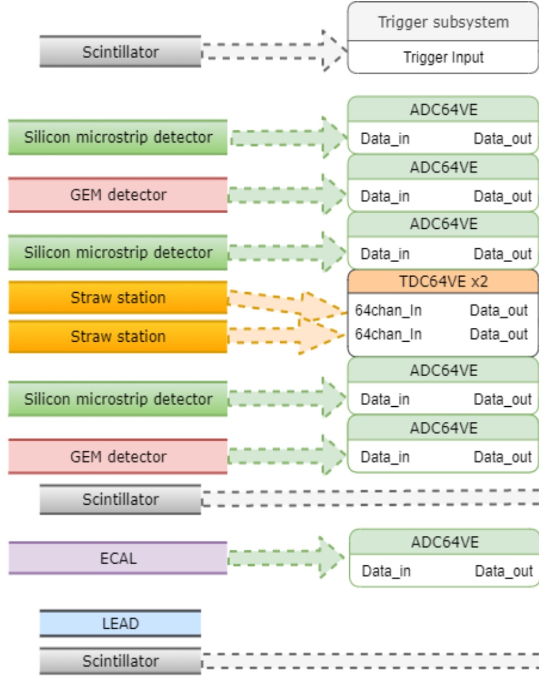
MiniSPD stand for testing SPD’s elements
Top
scintillator
Si
Trigger subsystem consists of 2
scintillators.
Top: ScintPos[1] = 3 mm.
Bottom: ScintPos[2] =
931,5 mm.
Si
Si
Bottom scintillator
7
E. Kokoulina
MiniSPD test bench for testing of SPD detectors prototypes
6th ICPPA, Moscow, Russia

Slide 9
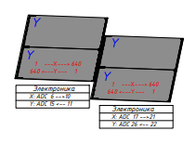
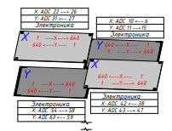
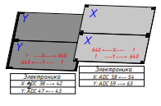
Description of Si-modules
Coordinates (top/bottom): X – light, U – dark.
1
3
4
7
8
2
5
6
1 - U/X, 2 – U/X
3 – X/U, 4 – Y/U
5 – U/X, 6 – X/U
7 - U/X, 8 – X/U
U-coordinate, ±2.5˚
Numeration of strips
left -> right: X1, X2, X4, X5, X7, U1,
U2, U3, U4, U5, U7;
right -> left: X3, X6, X8, U6, U8.
Thickness – 0.3 mm
Number of strips – 640
Pitch – 0,095 mm
8
E. Kokoulina
MiniSPD test bench for testing of SPD detectors prototypes
6th ICPPA, Moscow, Russia

Slide 10
MiniSPD stand for testing Si-detectors
Top scintillator
We select events when top and bottom scintillators trigger.
One, two or three
Si-plates can trigger.
The simulation shows
that the scintillator response efficiency is close to 99.99 %.
1
2
tracks of muons
3
4
5
6
7
8
bottom scintillator
9
E. Kokoulina
MiniSPD test bench for testing of SPD detectors prototypes
6th ICPPA, Moscow, Russia

Slide 11
MiniSPD stand for testing Si-detectors
We compare our MC simulation of 50 000 muon tracks with experimental data (~ the same number) obtained from the operation of two scintillator triggers and Si-plates at the MiniSPD stand.
10
E. Kokoulina
MiniSPD test bench for testing of SPD detectors prototypes
6th ICPPA, Moscow, Russia

Slide 12
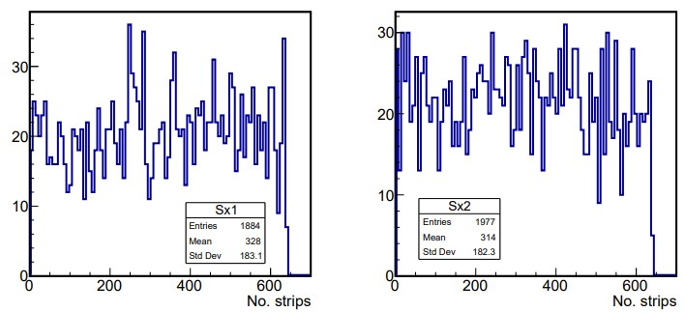
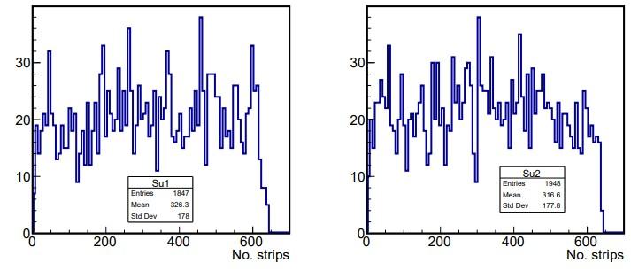
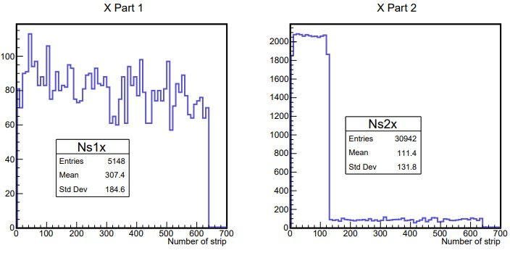
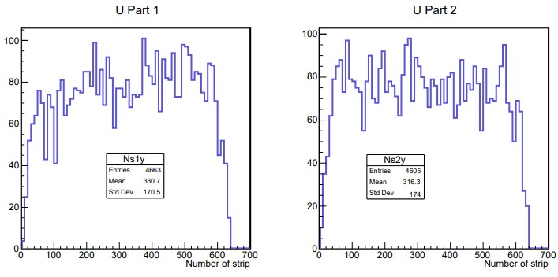
Strip number distributions for X1, X2, U1, U2 plates
MC
DATA
X1 - good work
X2 ~ 100 channels make enhanced noise
good work
11
E. Kokoulina
MiniSPD test bench for testing of SPD detectors prototypes
6th ICPPA, Moscow, Russia

Slide 13
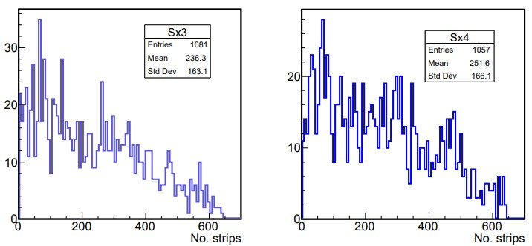
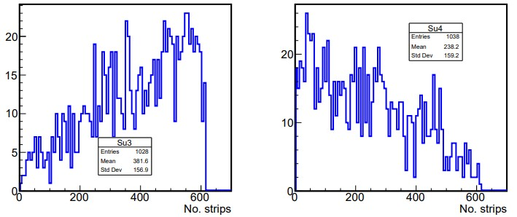
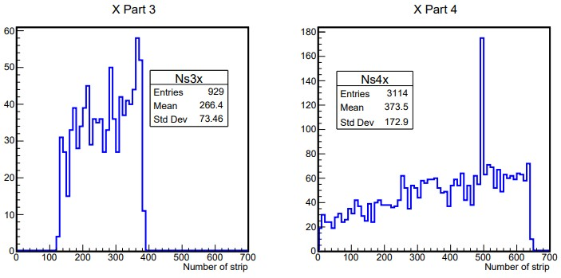
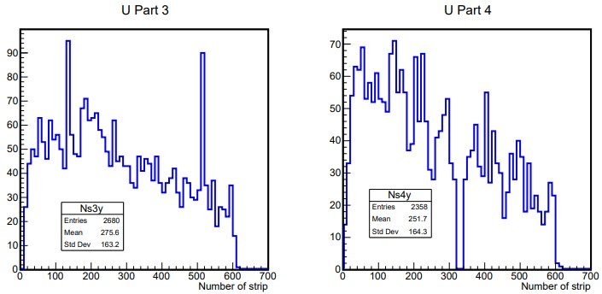
Strip number distributions for X3, X4, U3, U4 plates
MC
DATA
X3 ~ ½ of strips
don’t work
X4 – there are noise channels
U3 - noise channels
U4 - dead channels
12
E. Kokoulina
MiniSPD test bench for testing of SPD detectors prototypes
6th ICPPA, Moscow, Russia

Slide 14
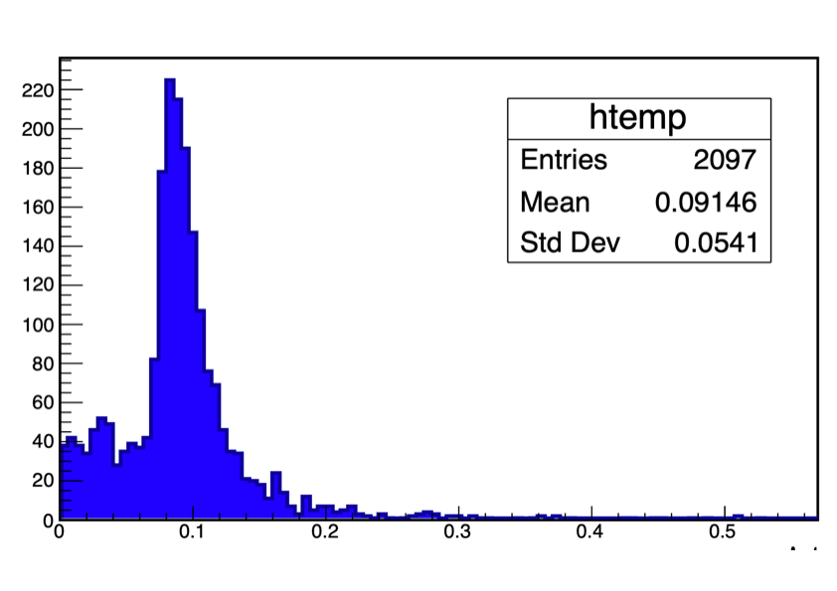
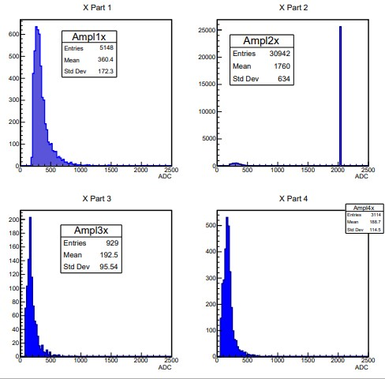
Lower registration threshold on energy
Ed, MeV
ADC
<ADC> ~ <Edep> (energy deposition in a single strip), the lower threshold of ADC ~ the lower threshold registration of energy deposition (E_cut). Using good planes (X1, X6, U2, U8) we get
30 keV < E_cut < 60 keV and its average value is equal ~ 55 keV.
13
E. Kokoulina
MiniSPD test bench for testing of SPD detectors prototypes
6th ICPPA, Moscow, Russia

Slide 15
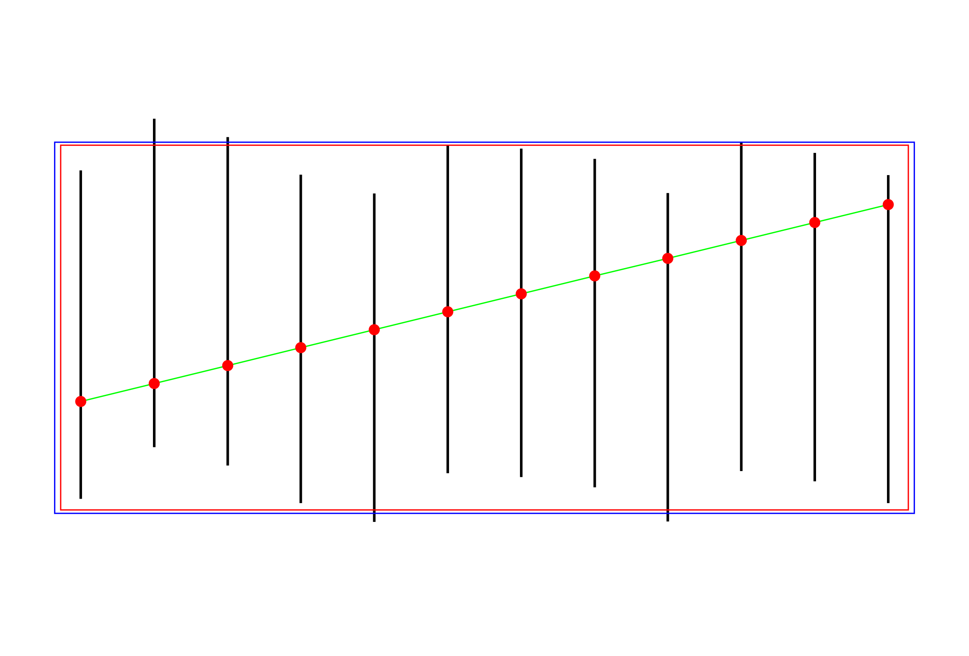
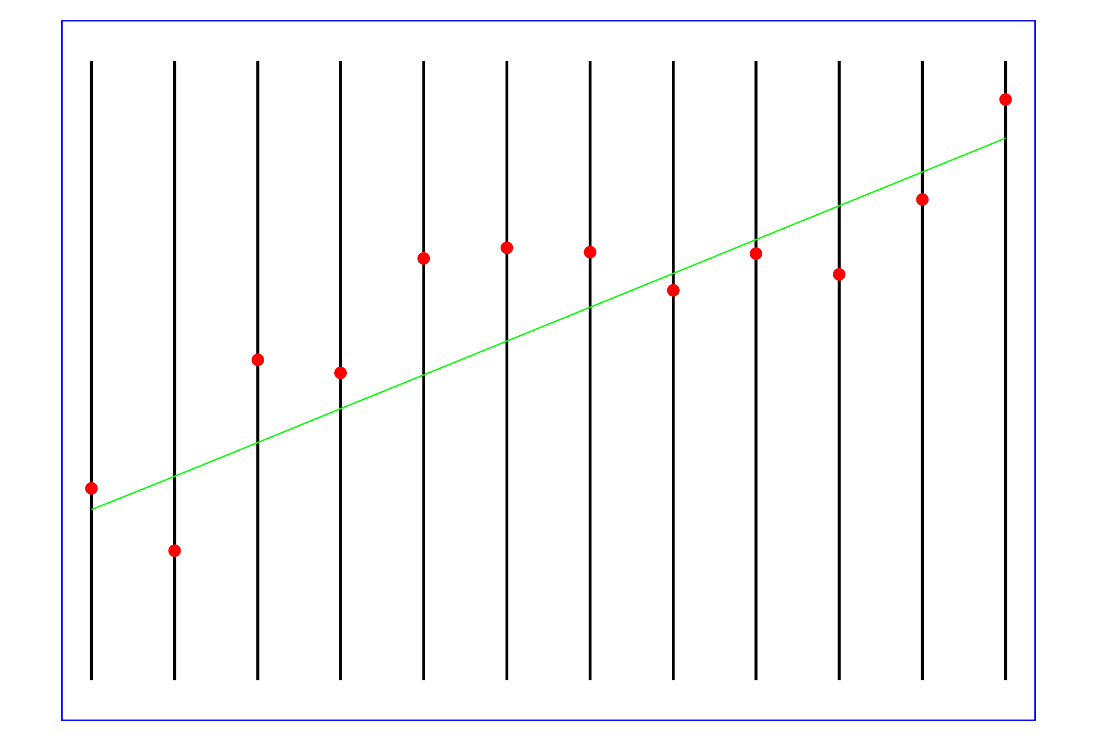
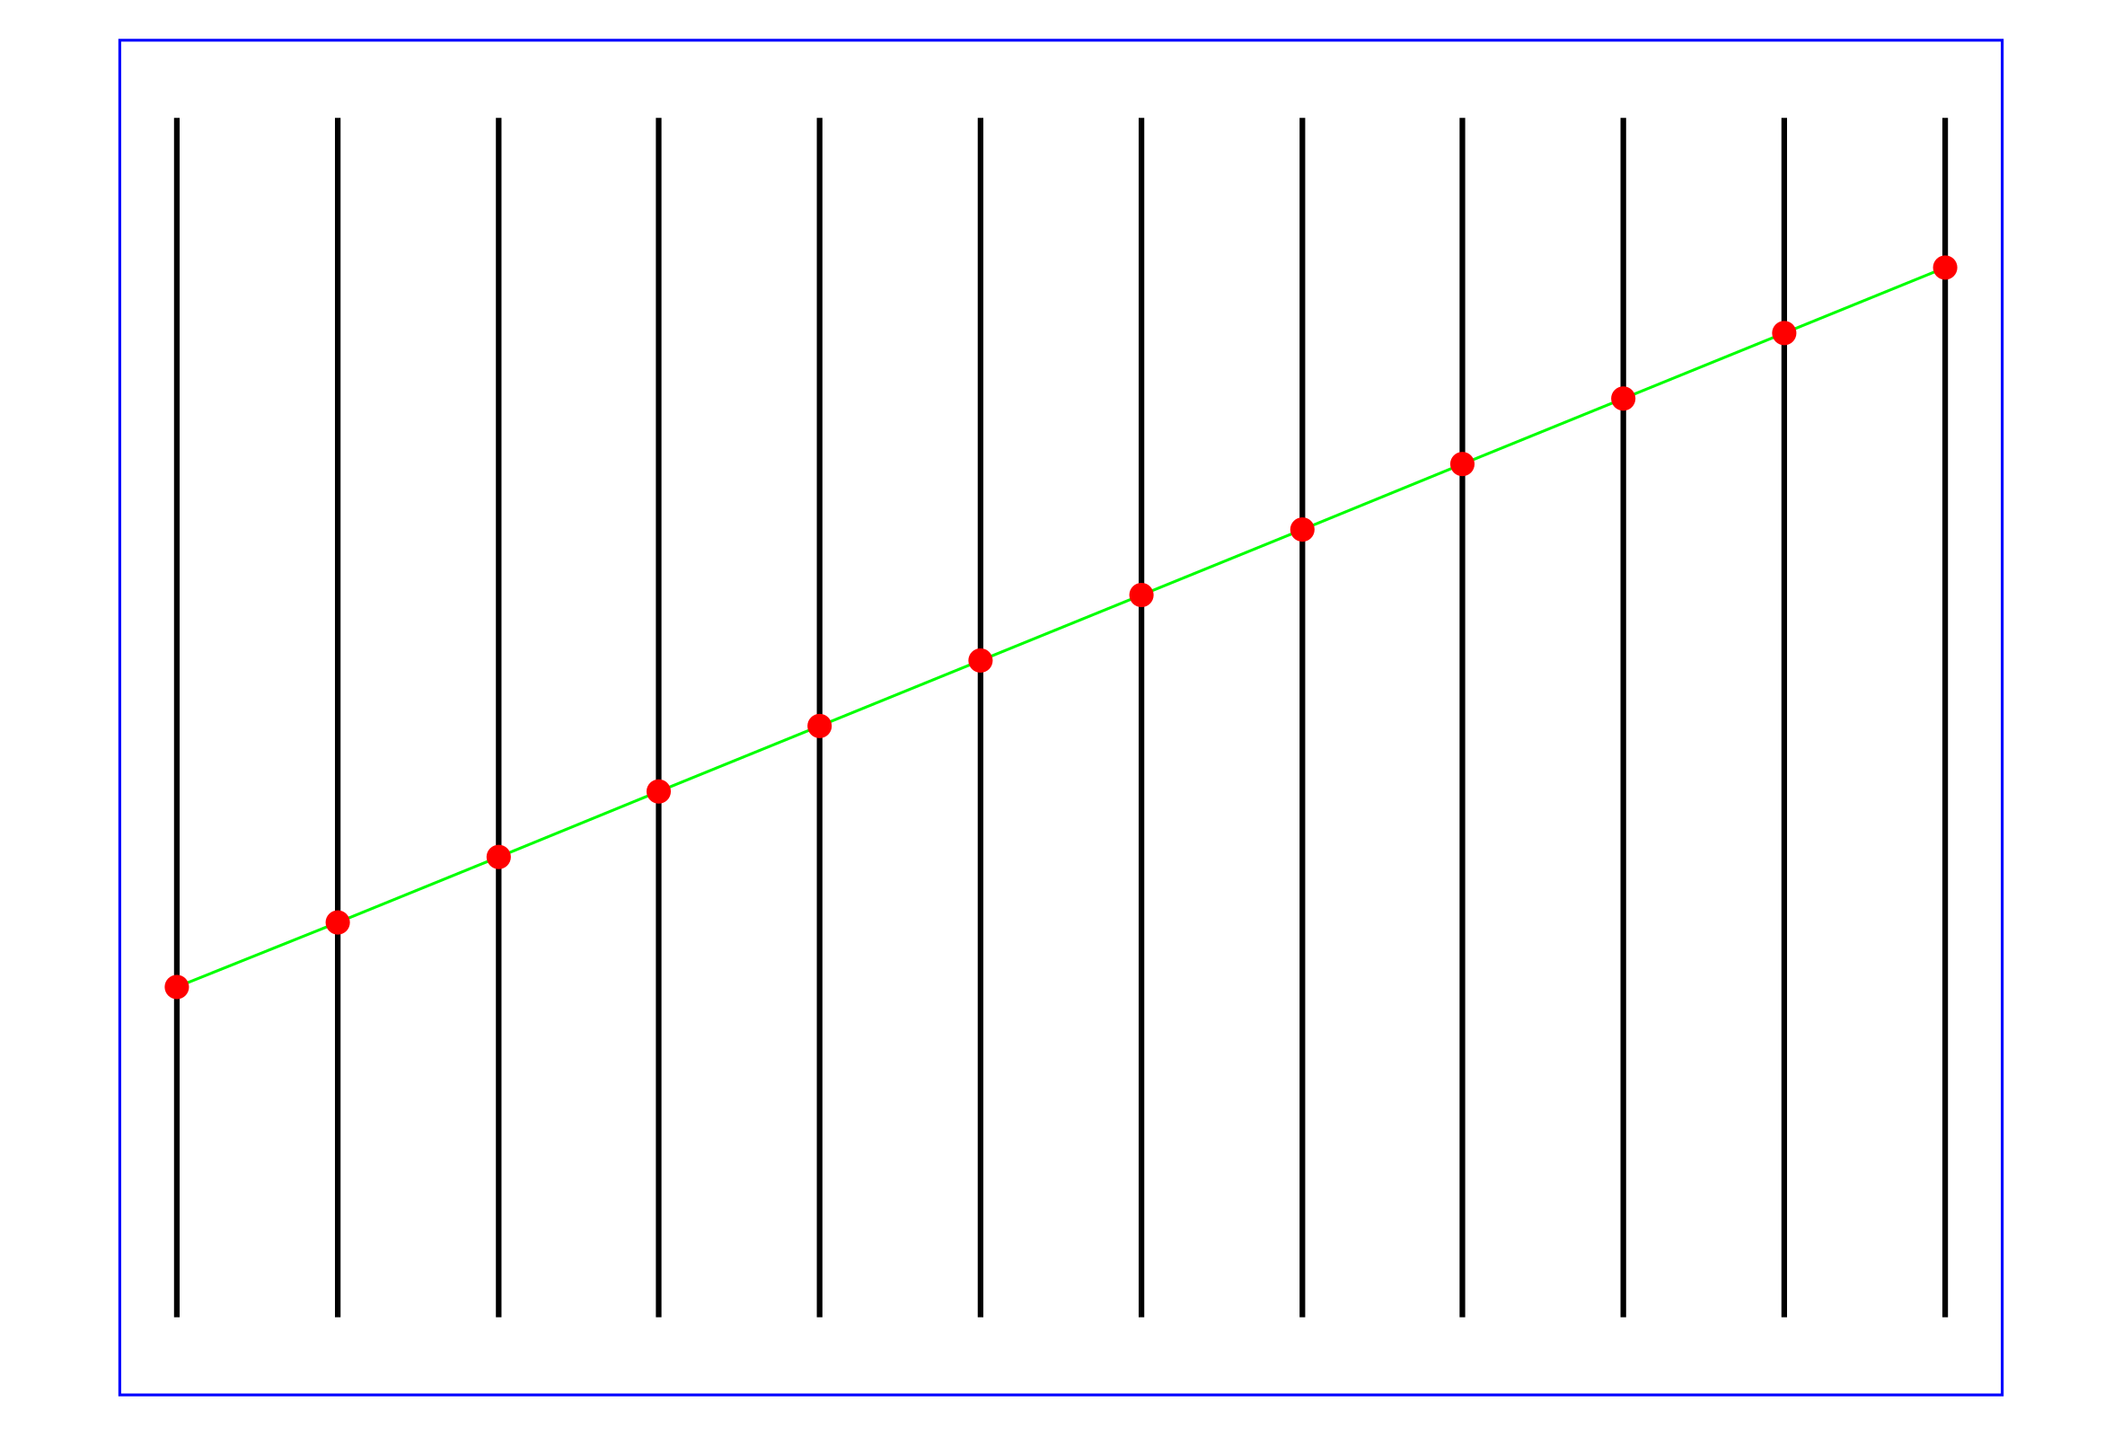

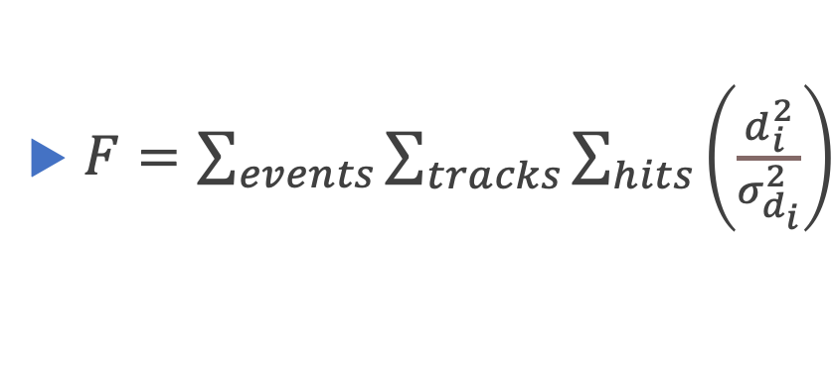
Alignment from minimization of residuals of F
Reality
Nominal geometry
Aligned detectors
$F=\sum_{events}{\sum_{tracks}{\sum_{hits}{\left(\frac{d_{i}^{2}}{σ_{d_{i}}^{2}}\right)}}}$
,
$$d_{i}=u_{fit}−u_{mes}$$
Large number of parameters: track parameters (4 * number of tracks)
and shifts(numbers of detectors), number of hits >> parameters.
$$u_{fit}→u_{j}\left(z_{i}\right)=\left(x_{0}+t_{x}z_{i}\right)cos\left(α_{i}\right)+\left(y_{0}+t_{y}z_{i}\right)sin\left(α_{i}\right)+Δu_{i}$$
14
E. Kokoulina
MiniSPD test bench for testing of SPD detectors prototypes
6th ICPPA, Moscow, Russia

Slide 16
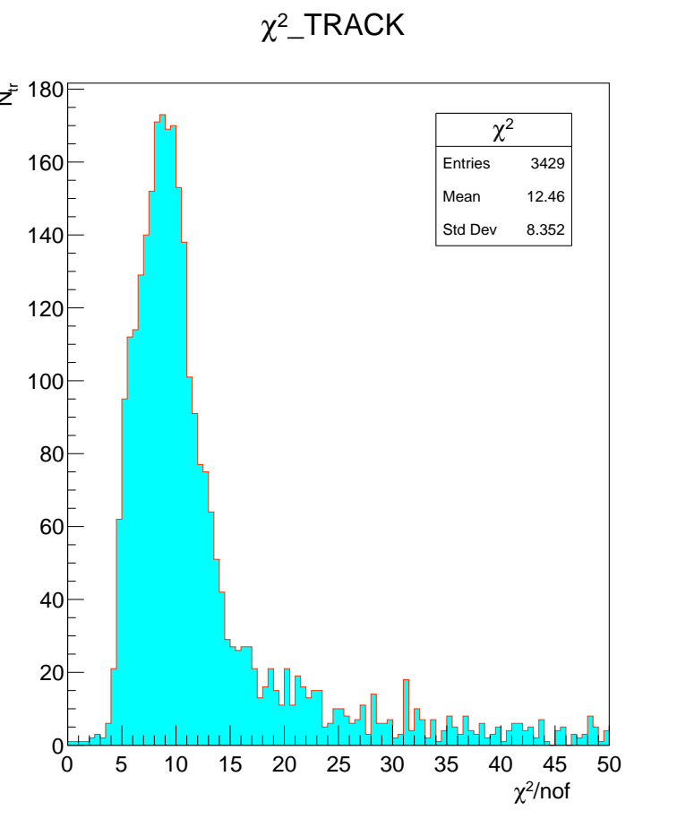
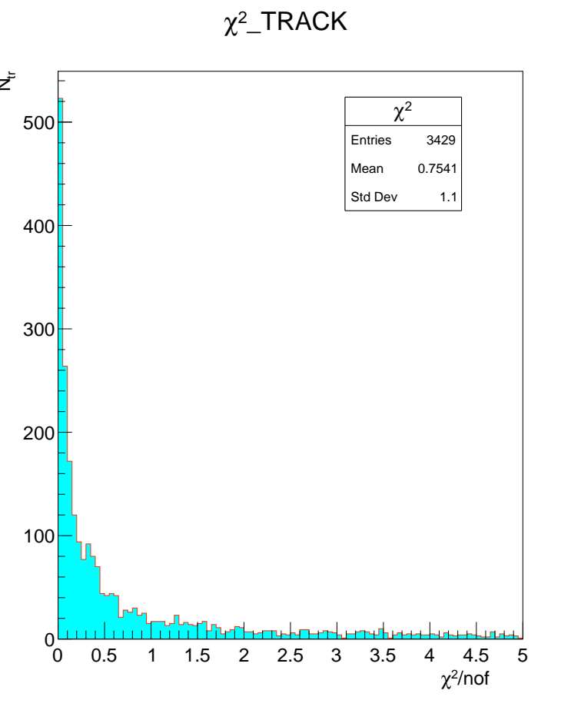
Millipede procedure improves $χ2−distr.$
χ² distributions
Shifts for part 5 (mm)
Result of fit for global parameters
===============
I initial final
--- ----------- -----------
1 0.00000 0.00000
2 0.00000 0.00000
3 0.02798 0.02841 - x-side
4 0.97531 0.97572 - u-side
5 0.00000 0.00000
6 0.00000 0.00000
Total 3428 local fits,
1335 rejected.
148-file
Before alignment
After alignment
15
E. Kokoulina
MiniSPD test bench for testing of SPD detectors prototypes
6th ICPPA, Moscow, Russia

Slide 17
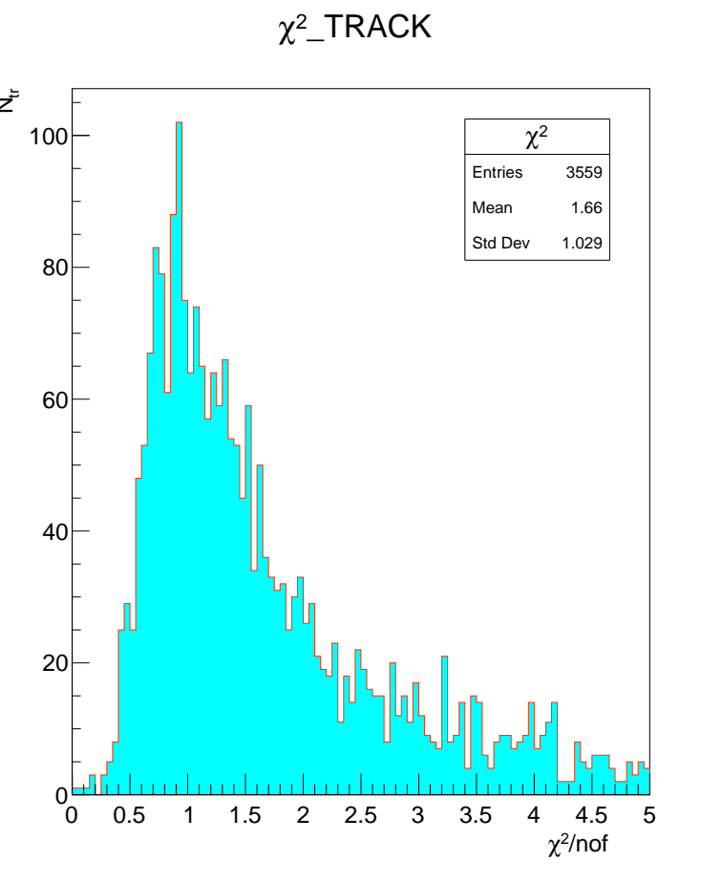
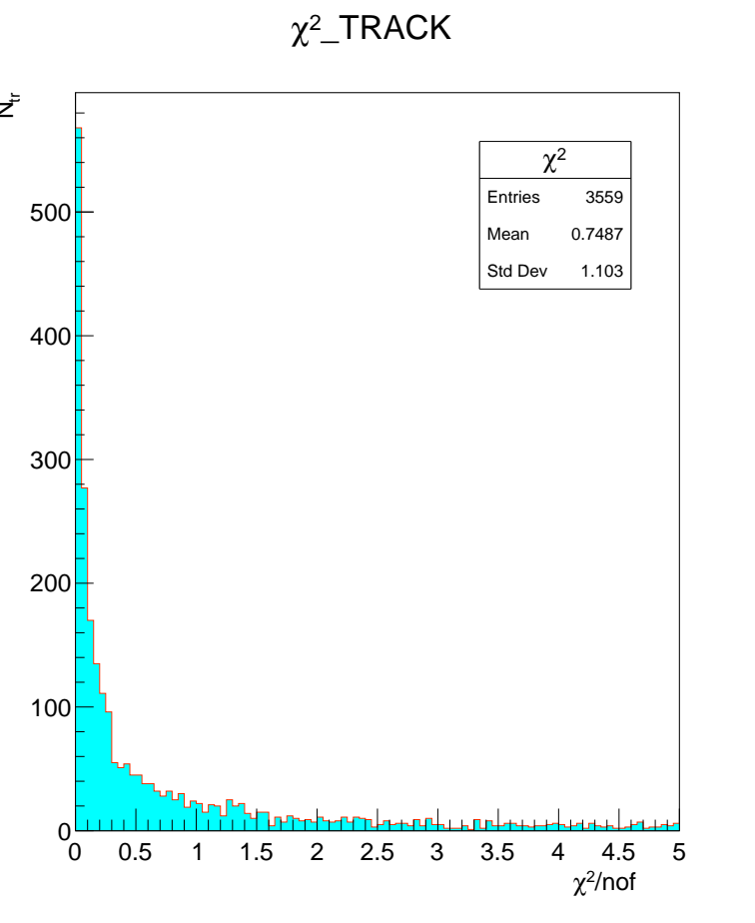
Millipede procedure improves $χ2−distribution$
Shifts for part 4 (mm)
Result of fit for global parameters
- - - - - - - - - - - - - - - - - - - - - - - - - -
I initial final
----- ----------- -----------
1 0.00000 0.00000
2 0.00000 0.00000
3 -0.00378 -0.00365 - x-side
4 0.34720 0.34735 - u-side
5 0.00000 0.00000
6 0.00000 0.00000
- - - - - - - - - - - - - - - - -
Total 3558 local fits,
1409 rejected.
Before alignment
After alignment
16
E. Kokoulina
MiniSPD test bench for testing of SPD detectors prototypes
6th ICPPA, Moscow, Russia

Slide 18
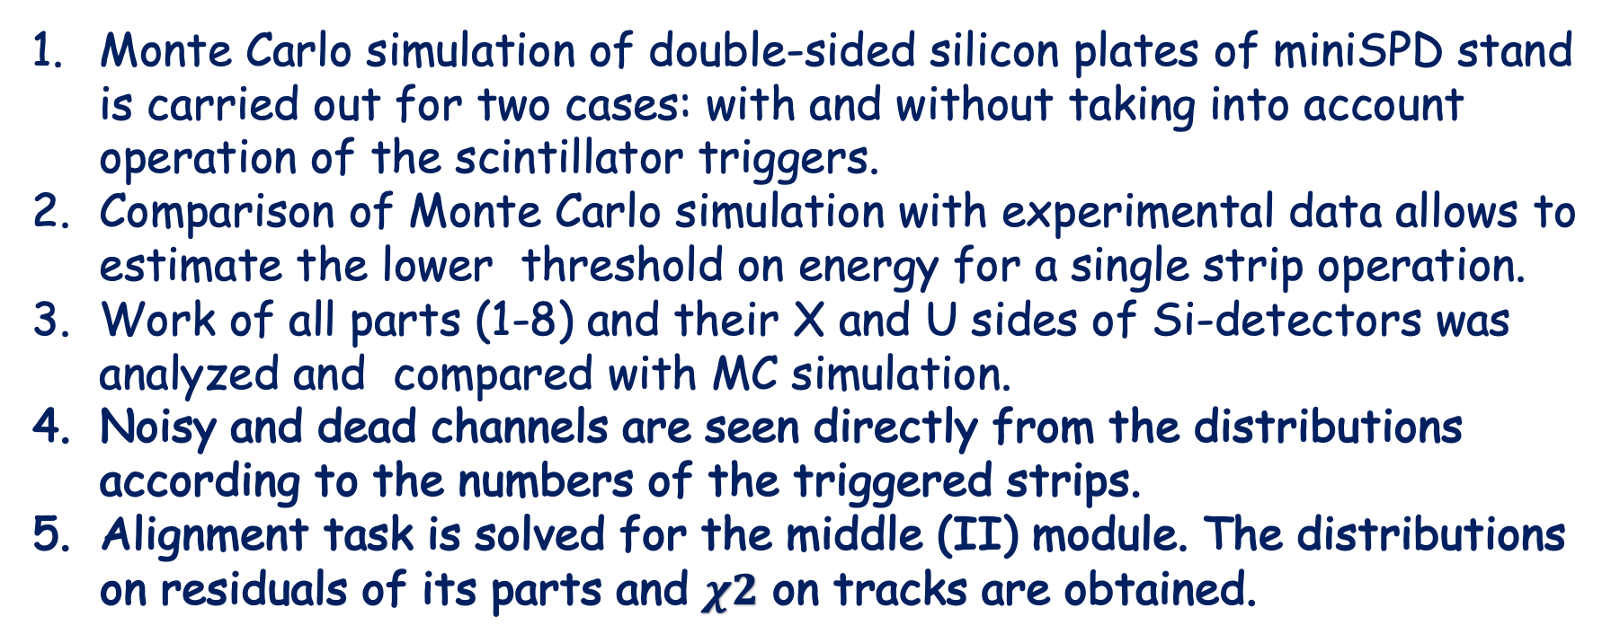
Results
Monte Carlo simulation of double-sided silicon plates of miniSPD stand is carried out for two cases: with and without taking into account operation of the scintillator triggers.
Comparison of Monte Carlo simulation with experimental data allows to estimate the lower threshold on energy for a single strip operation.
Work of all parts (1-8) and their X and U sides of Si-detectors was analyzed and compared with MC simulation.
Noisy and dead channels are seen directly from the distributions according to the numbers of the triggered strips.
Alignment task is solved for the middle (II) module. The distributions on residuals of its parts and $χ2$ on tracks are obtained.
17
E. Kokoulina
MiniSPD test bench for testing of SPD detectors prototypes
6th ICPPA, Moscow, Russia

Slide 19
Outlook
We continue carrying out MC simulation of straw (drift) tubes to compare its with experimental data obtained at MiniSPD stand.
We also plan carrying out Monte Carlo simulation of the electromagnetic calorimeter work (8 modules).
It will allows us to start solving our basic task, studying (direct) soft photon yield and the pionic condensate formation (restoration of 𝜋⁰) in pp (pd, dd) interactions at high multiplicity.
https://www.youtube.com/watch?v=wCqX_rNi-60&feature=emb_imp_woyt
18
E. Kokoulina
MiniSPD test bench for testing of SPD detectors prototypes
6th ICPPA, Moscow, Russia

Slide 20
Backup
E. Kokoulina
MiniSPD test bench for testing of SPD detectors prototypes
6th ICPPA, Moscow, Russia

Slide 21
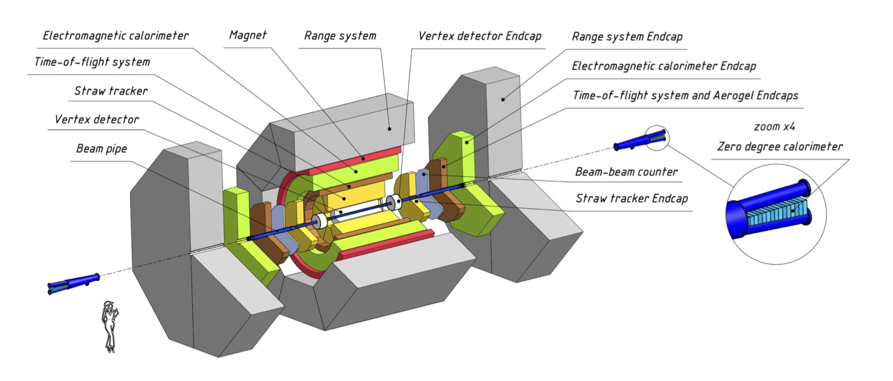
General layout of SPD setup
2102.00442[hep-ex]
6
E. Kokoulina
MiniSPD test bench for testing of SPD detectors prototypes
6th ICPPA, Moscow, Russia

Slide 22
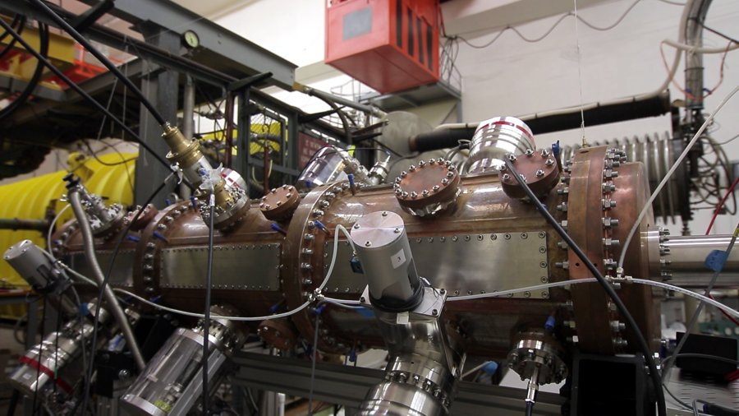
Light Ion Linear Accelerator (LU-20)
E. Kokoulina
MiniSPD test bench for testing of SPD detectors prototypes
6th ICPPA, Moscow, Russia

Slide 23
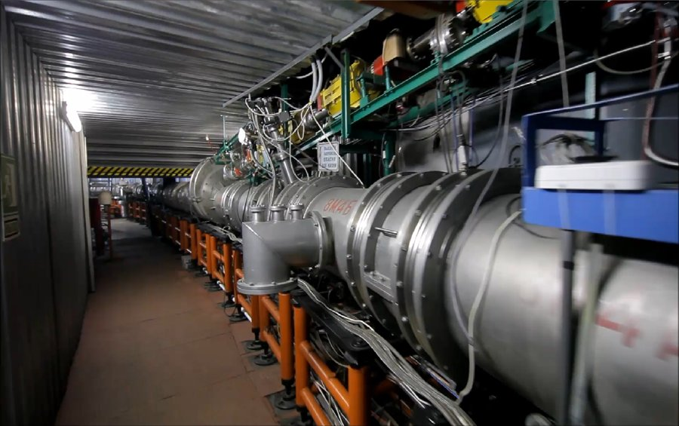
Nuclotron – superconducting heavy ion accelerator
5
E. Kokoulina (kokoulina@jinr.ru)
MiniSPD stand for testing Si-detectors
NPCS, 21.06.22, Minsk, Belarus

Slide 24
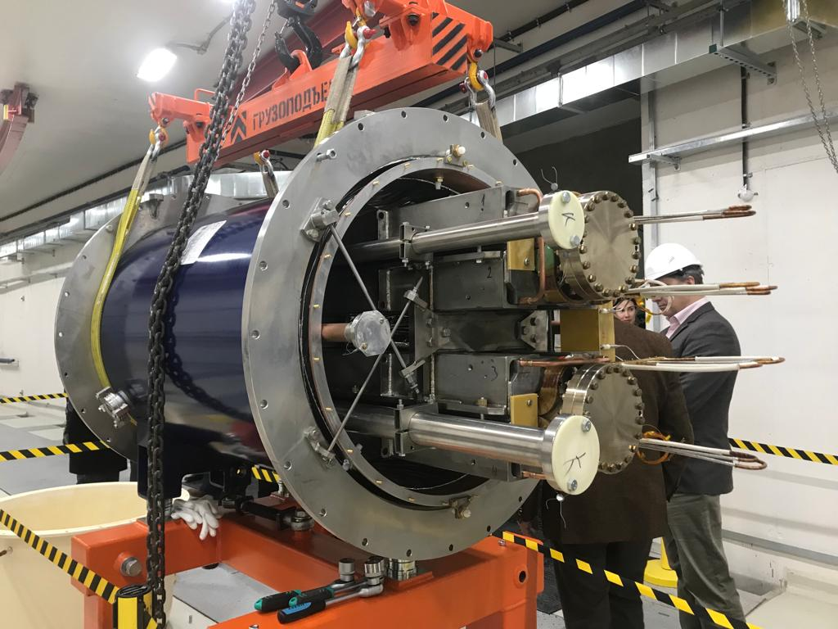
First magnet in collider’s tunnel
On 28 December last year, the first superconducting magnet was installed in the tunnel of the NICA accelerator complex. Moreover, a testing system of the MPD solenoid was launched. The magnet factory produces superconducting magnets not only for the NICA project but also for the German project FAIR. The next purchasers of Dubna magnets will be China and CERN.
6
E. Kokoulina
MiniSPD test bench for testing of SPD detectors prototypes
6th ICPPA, Moscow, Russia

Slide 25
Layout of silicon plates at MiniSPD stand
Modules of two-sided Si-plates: dark color indicates oblique (U, 2.5̊) strips, light - vertical (X) strips
The top (I) module consists of two parts: left (1) and right (2) plates
The middle (II) module consists of 4 parts. We numerate them 3, 4, 5 and 6 parts from left to right.
The bottom (III) module is similar to I with numeration of left and right: 7 and 8.
Our coordinate system
Y
X
Two planes of
Straw tubes
Z
12
E. Kokoulina
MiniSPD test bench for testing of SPD detectors prototypes
6th ICPPA, Moscow, Russia

Slide 26
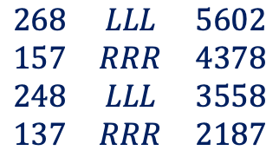
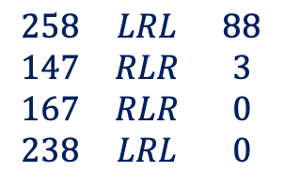
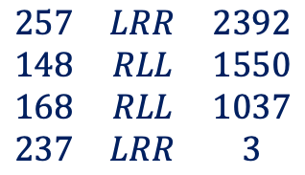
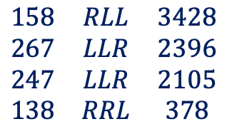
Combinations of Si-modules for passing tracks
N file
Comb.
N tracks
part, N
angle, deg
$$\begin{matrix}268 & LLL & 5602 \\ 157 & RRR & 4378 \\ 248 & LLL & 3558 \\ 137 & RRR & 2187\end{matrix}$$
2
1
1 | +2.5
2 | +2.5
3 | -2.5
4 | +2.5
5 | +2.5
6 | -2.5
7 | -2.5
8 | +2.5
Vertical
tracks
I
4
5
$$\begin{matrix}158 & RLL & 3428 \\ 267 & LLR & 2396 \\ 247 & LLR & 2105 \\ 138 & RRL & 378\end{matrix}$$
II
6
3
LLR
Oblique
tracks
$$\begin{matrix}257 & LRR & 2392 \\ 148 & RLL & 1550 \\ 168 & RLL & 1037 \\ 237 & LRR & 3\end{matrix}$$
III
Low level
of noise
$$\begin{matrix}258 & LRL & 88 \\ 147 & RLR & 3 \\ 167 & RLR & 0 \\ 238 & LRL & 0\end{matrix}$$
The same orientation for U-coord. is only for
148, 158, 248 combin.
IV
8
7
26
E. Kokoulina
MiniSPD test bench for testing of SPD detectors prototypes
6th ICPPA, Moscow, Russia

Slide 27
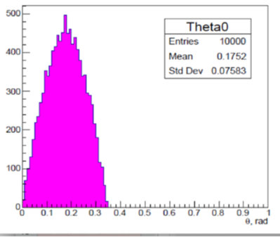
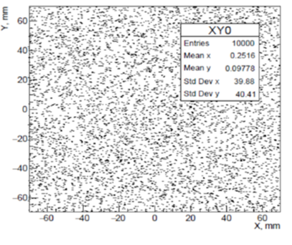
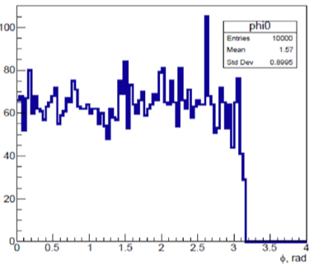

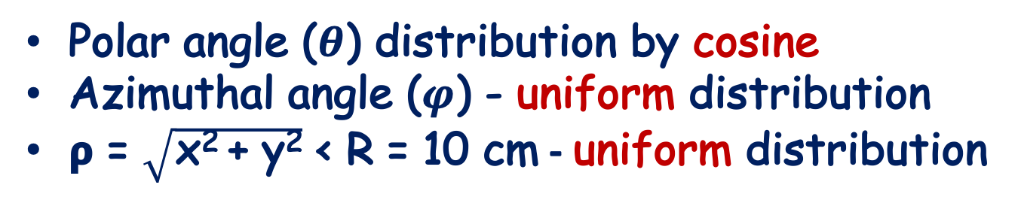

Simulation of cosmic muons (170 MeV)
Polar angle ($θ$) distribution by cosine
Azimuthal angle ($φ$) - uniform distribution
𝞀 = $\sqrt{\text{x}\text{2 }\text{+ }\text{y}\text{2}}$ < R = 10 cm - uniform distribution
- $10$ < $θ<10$
𝞀 < 10 cm
0 < $φ<2 π$
14
E. Kokoulina
MiniSPD test bench for testing of SPD detectors prototypes
6th ICPPA, Moscow, Russia

Slide 28
Simulation of triggered strips
Adding of StripStepping.cc to SteppingAction.cc
We use GEANT4 for simulation. In StripStepping for
every module and its parts:
Connect the triggered strip number with X-coordinate, define U-coordinate for the same plane, the strip number on U-plate and its E_dep (energy deposition).
Sorting of the triggered strip numbers in ascending order for elimination of repeating numbers (for X & U).
Accounting for crossing the border of the triggered strip when making a stepping.
9
E. Kokoulina
MiniSPD test bench for testing of SPD detectors prototypes
6th ICPPA, Moscow, Russia

Slide 29
Simulation of cosmic rays by Geant4 at theta = 50 deg.
y
z
x
miniSPD
15
E. Kokoulina
MiniSPD test bench for testing of SPD detectors prototypes
6th ICPPA, Moscow, Russia

Slide 30
Positioning of Si-plates
Plane | X, mm | Y, mm | Z, mm | Size, mm
X1, U1 | -28,55 | 0 | 35,0 | 63 x 126
X2, U2 | 31,55 | 0 | 50,3 | 63 x 126
X3, U3 | -32,55 | -27,55 | 387,8 | 63 x 63
X4, U4 | 27,55 | -32.55 | 395,1 | 63 x 63
X5, U5 | -27,55 | 32,55 | 395,1 | 63 x 63
X6, U6 | 32,55 | 27,55 | 387,8 | 63 x 63
X7, U7 | -28,55 | 0 | 893,5 | 63 x 126
X8, U8 | 31,55 | 0 | 886,2 | 63 x 126
E. Kokoulina
MiniSPD test bench for testing of SPD detectors prototypes
6th ICPPA, Moscow, Russia

Slide 31
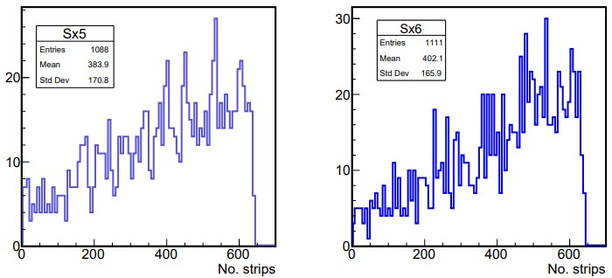
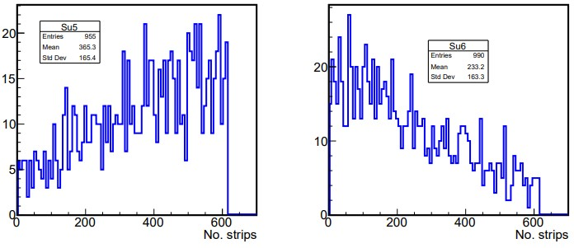
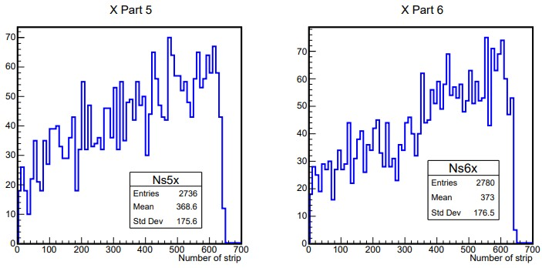
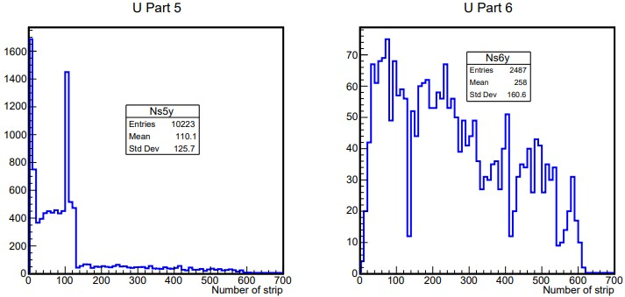
Strip number distributions for X5, X6, U5, U6 plates
MC
DATA
X5 and X6 - good work
U5 ~1/4 channels
make noise
U6 - almost good
work
20
E. Kokoulina
MiniSPD test bench for testing of SPD detectors prototypes
6th ICPPA, Moscow, Russia

Slide 32
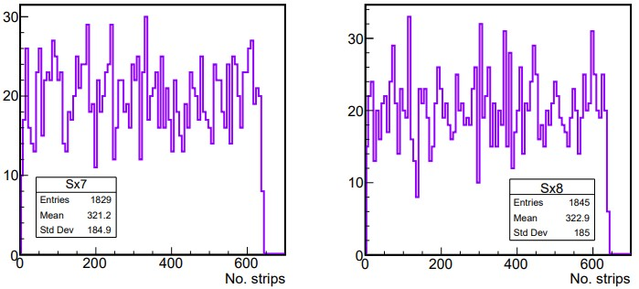
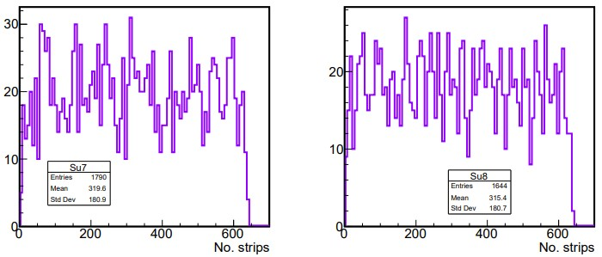
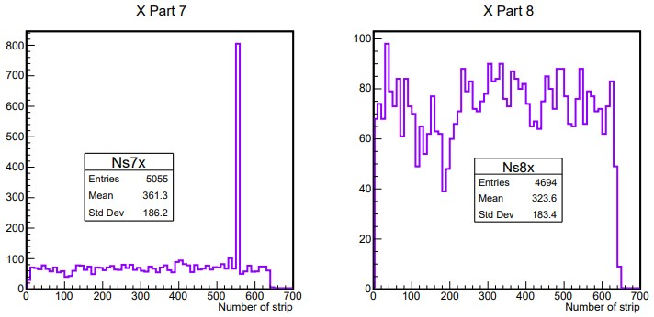
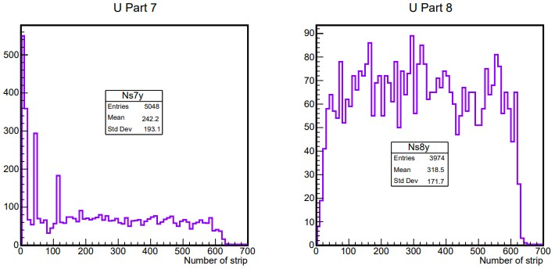
Strip number distributions for X7, X8, U7, U8 plates
MC
DATA
X7 – there are few noise channels
X8 – work
almost well
U7 – there are
some noise channels
U8 works well
21
E. Kokoulina
MiniSPD test bench for testing of SPD detectors prototypes
6th ICPPA, Moscow, Russia

Slide 33

ADC for X & U plates (* – issues with electronics)
*
*
*
*
*
13
E. Kokoulina
MiniSPD test bench for testing of SPD detectors prototypes
6th ICPPA, Moscow, Russia

Slide 34


ADC for X & U plates (* – issues with electronics)
*
*
*
23
E. Kokoulina (kokoulina@jinr.ru)
MiniSPD stand for testing Si-detectors
NPCS, 21.06.22, Minsk, Belarus

Slide 35








Residual distributions
Before alignment
After alignment
Before alignment
After alignment
X4
X5
X5
X4
U4
U4
U5
U5
Parts 1,4,8
Parts 1,5,8
28
E. Kokoulina
MiniSPD test bench for testing of SPD detectors prototypes
6th ICPPA, Moscow, Russia

Slide 36

Access to intermediate and high values of Bjorken x
SPD is low energy but still collider experiment (compared to fixed target). Nearly 4π coverage
Two injector complexes available ⇒ mixed combinations p↑-d and p-d↑ are possible
E. Kokoulina
MiniSPD test bench for testing of SPD detectors prototypes
6th ICPPA, Moscow, Russia

Slide 37


SPD compared to other spin experiments
Main present and future gluon-spin-physics experiments
E. Kokoulina
MiniSPD test bench for testing of SPD detectors prototypes
6th ICPPA, Moscow, Russia

Slide 38

Tentative running plan for SPD (I stage)
Physics goal | Required time | Experimental conditions
Spin effects in p-p scattering dibaryon resonances | 0.3 year | p_{L,T} - p_{L,T} , $\sqrt{s }$ < 7.5 GeV
Spin effects in p-d scattering, non-nucleonic structure of deuteron, $\overline{p}$ yield | 0.3 year | d _{tenzor} - p, $\sqrt{s }$ < 7.5 GeV
Spin effects in d-d scattering hypernuclei | 0.3 year | d _{tenzor} - d _{tenzor}, $\sqrt{s }$ < 7.5 GeV
Hyperon polarization, SRC, ... multiquarks | together with MPD | d _{tenzor} - p, $\sqrt{s }$ < 7.5 GeV
Total cost ~ 100 M$
E. Kokoulina
MiniSPD test bench for testing of SPD detectors prototypes
6th ICPPA, Moscow, Russia

Slide 39

Tentative running plan for SPD (II stage)
Physics goal | Required time | Experimental conditions
Gluon TMDs, SSA for light hadrons | 1 year | p_{T} - p_{T} , $\sqrt{s }$ < 27 GeV
TMD-factorization test, SSA, charm production near threshold, onset of deconfinement, p ̄ yield | 1 year | d _{tenzor} - p, $7<\sqrt{s }$ < 27 GeV, (scan)
Gluon helicity, ... | 1 year | p_{L} - p_{L}, $\sqrt{s }$ < 27 GeV
Gluon transversity, non-nucleonic structure of deuteron, ”Tensor polarized” PDFs | 1 year | d _{tenzor} -d _{tenzor} , $\sqrt{s NN }$ = 13.5 GeV or/and d _{tenzor} – p_{T}, $\sqrt{s NN }$ = 19 GeV
E. Kokoulina
MiniSPD test bench for testing of SPD detectors prototypes
6th ICPPA, Moscow, Russia

