Slide 1
Et About an accuracy of ECal/MPD calibration with cosmic muons.
M.Bhattacharjee^{1,3}, S.A.Bulychjov², Yu.F.Krechetov¹,
V.V. Kulikov², M.A. Martemianov², M.A. Matsyuk², A.Yu.Semenov¹, I.A. Tyapkin¹
¹ Joint Institute for Nuclear Research, Dubna, 141980, Russia
² NRC “Kurchatov Institute" , Moscow, 123182, Russia
³ Gauhati University, Guwahati, Assam 781014, India
VI-th International Conference on Particle Physics and Astrophysics,
MEPhI, 29 November – 2 December 2022

Slide 2
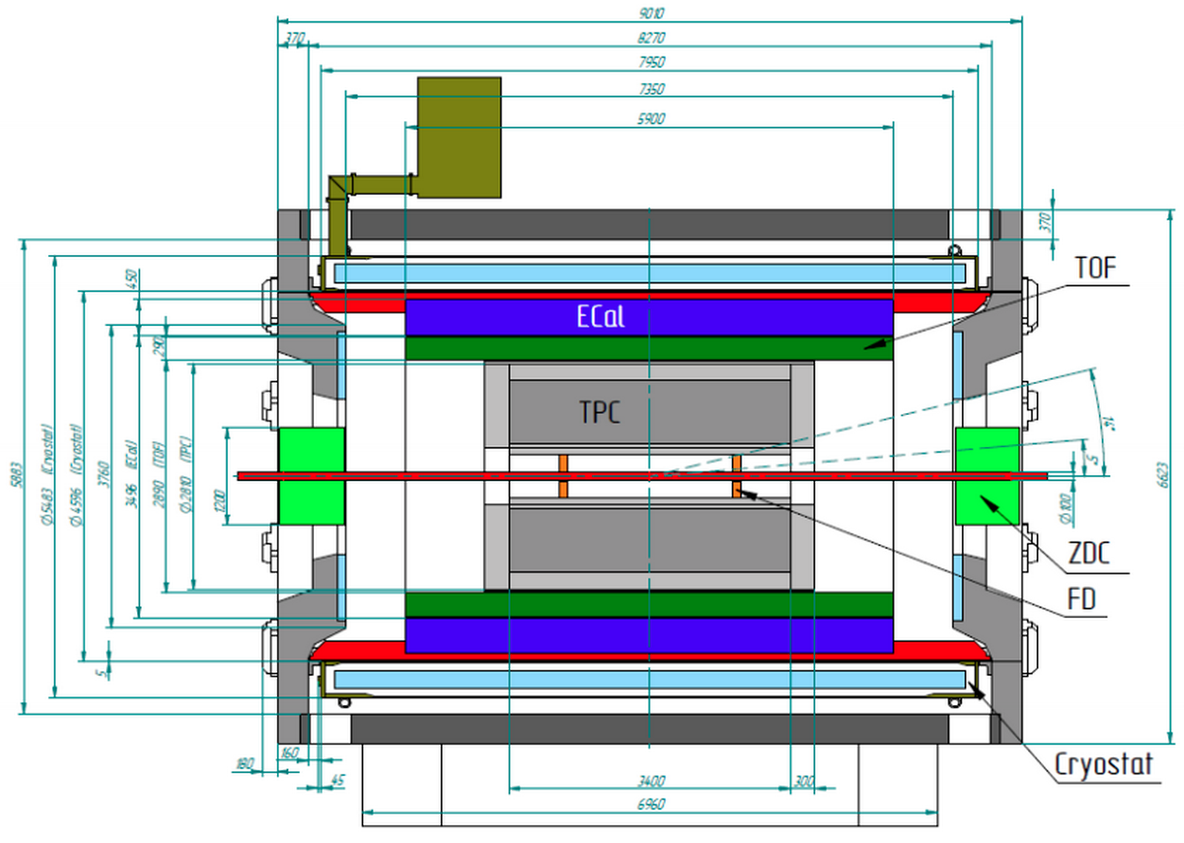
MPD/NICA detector
ECal(barrel)
Rin = 1.72 m, Rout = 2.21 m, L = 6 m
# Towers =38400
Shashlyk type 210 plates of 1.5 mm Sc and 0.3 mm Pb
pierced by WLS fibers.
Weight = 60 tons.
Modules are produced
in Russia 50% and
in China 50%.
30% of modules were delivered
and tested in Dubna.
Notes:
On the stage 1 we consider to have TPC, TOF, ECal?, FHCal and FFD systems

Slide 3
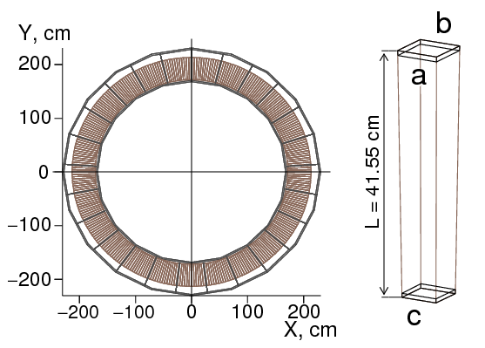
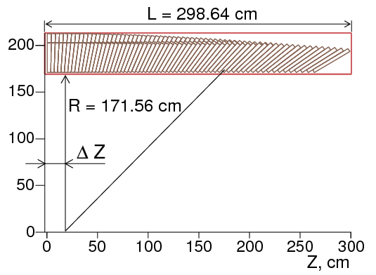
ECal half-sector structure
Tower
Approximate shape of the tower is truncated pyramid with the base of 4x4 cm² and vertex angles 0.9⁰ in YZ plane and 1.2⁰ in XY plane. Towers are arranged in projective geometry. It needs 64 different types of towers.
Tower ->Module->Cluster->Half-Sector ->Sector
1 2x8 2x8 3 2
38400 2400 150 50 25
1.5 kg ~25 kg ~ 0.4 t ~1.2 t

Slide 4
Two Methods of ECAL Calibration Tests with Cosmic muons
µ
M1
µ
M4
Hit multiplicity =1
Hit multiplicity >1, here M>3
~6 MeV
60 MeV
ADC40
Tower 89 #32
Tower 89 #32
32
Fixed at 31.5 cm ←Track length in Sc → Wide range
Fixed at 60 MeV ← Energy deposition → 5-7 MeV(at the peak maximum )
Close to vertical only ← Tower orientation → Any
Large (>7 days) ← Data taking time → Small (few hours)
Large as 10 MeV ← Data taking threshold → 1-2 MeV (noise <0.3 MeV)

Slide 5
Comparison of two methods of ECAL calibration
Both methods give identical results with good accuracy and can be used for stand alone tower calibration. But only the second one can be use for calibration control of the whole ECAL where different orientation of the towers has to be taken into account.
σ = 2.7%
ADC40
32

Slide 6
ECal calibration problems with cosmic muons
Calibration is based on the 6 MeV peak in energy deposition in the tower connected with their thickness. Such calibration was previously used in few experiments (L3, ATIC and may be others) but in horizontal orientation of the towers only. Our aim is to use this such type of calibration for any orientation of the towers.
Energy deposition can depend on tower orientation,
On type of the tower,
On method of the event selection.
We hope that all this problems can be solved with accurate MC calculations, precision can be estimated and compared with desired accuracy which is few times better than 5% energy resolution of the ECal for 1 GeV photons. We performed such calculations for two assemblies of 4 modules (8x8 towers) for 2 module types #1 and #8 with Geant4 in MpdRoot environment. Geometry description of the modules were directly taken from ECal simulation software.

Slide 7
MC simulation of cosmic muon flux
Z
Y
φ
r
X
H
R
θ
R
Modules
Main feature of the developed MC generator is simulation of CR events in a plane from zero to infinity. It simulates muons that hit cylinder inside which the modules are placed. At initialization, distribution along r is calculated and later used for random determination of r. After R was defined, φ and θ are randomly determined in accordance with their probability distributions: uniform and cos²(θ). Energy distribution is independent of θ. For R=40 and H=50 cm half of muons enter cylinder from the top and half from the side surface.

Slide 8
Fit function
Data
MC
FitFunc(x) = A + B*(x-a) for x<a
FitFunc(x) = C*exp(-β*(x-a)) for x>a
smeared by gaus distribution.
Fit parameters are in reasonable agreement between measurements and MC indicating that the width of the peak is mainly defined by fluctuations of ionization losses and β .

Slide 9
Event selection method by hit multiplicity
0⁰
Mod.1 90⁰
90⁰
Mod.1
Mod.1 0⁰
Mod.8
0⁰
90⁰
Mod.8
Type1
90⁰
0⁰
The number of hits in the tower
#28 for time of 2 hours decreases with increasing multiplicity. M4 seems to be a reasonable choice.
ED slightly decreases with increasing multiplicity. Module 1 demonstrates
the maximum decline of only 2%.

Slide 10
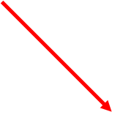
Corrections for tower types of module 8
M4
Module 8
σ = 0.8%
Before correction
σ = 1.4%
After correction
Assembly of four modules (8x8 towers). Energy deposition in the towers change by 4%. Linear correction completely eliminate this effect to the level less than 1%.

Slide 11
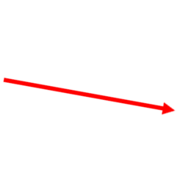
Corrections for towers of module 1
M4
Module 1
Before correction
σ = 1.2%
σ = 1.5%
After correction
Assembly of four modules (8x8 towers). For the Module 1 (with almost vertical towers) correction for the tower type is not needed.

Slide 12
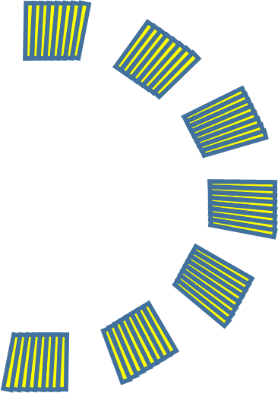
Polar angle dependence of energy deposition
0⁰
Y
1
8
Z
Y
Module 1
90⁰
4%
X0
5%
Module 8
180⁰
Energy deposition in the tower (averaged over the module) depends on the module type and its polar angle. This difference is of the order of 5% and can be taken into account by this MC calculations.

Slide 13
Conclusion and future plans
MC calculations show that response of ECal towers to
cosmic muons depends on tower orientation in space and
type of the tower. But this dependence is not large and is of
the order of 5-10%.
It was shown that corrections obtained with this
calculations can be used for calibration of the whole ECal
with an accuracy of 1-2% which is adequate to ECal
requirements.
Proposed event selection method, based on hit multiplicity,
well suited to obtain these corrections in a few hours of
data taking.
More reliable estimation of the time needed for calibration
can be obtained with MC calculation for the whole MPD
detector. We hope to make them in near future.

Slide 14
Thank You

