Slide 1


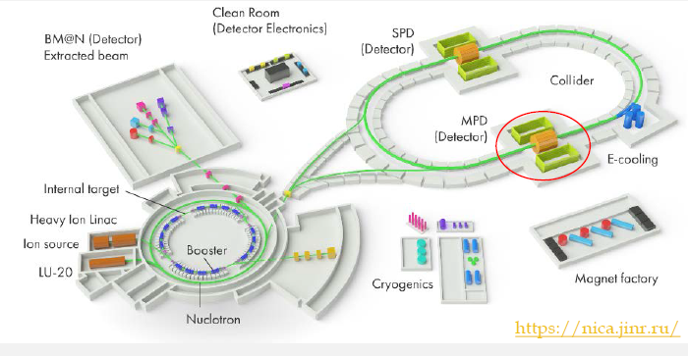
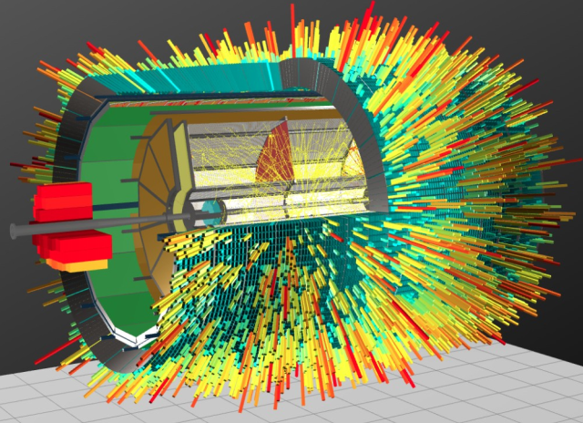
MPD TPC Status (02.12.2022)
  TPC:
    vessel assembly, ROC chambers, gating grid system
  Sub-systems:
    Electronics
    LV+HV system (CAEN)
    Gas and cooling systems
    Laser calibration
  Integration TPC to MPD
    Electronics platform
    Cabling and piping
    Installation TPC to MPD
  Time schedule
Presented by S.Movchan

Slide 2
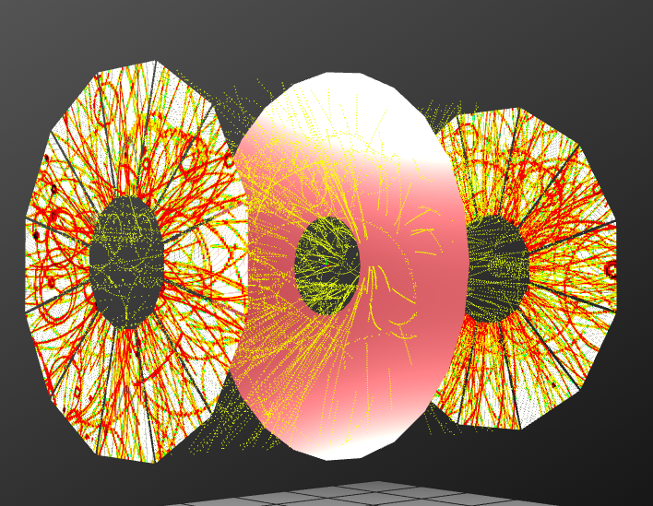
MPD TPC main parameters
Item | Dimension
Length of the TPC | 340cm
Outer radius of vessel | 140cm
Inner radius of vessel | 27 cm
Outer radius of the drift volume | 133cm
Inner radius of the drift volume | 34cm
Length of the drift volume | 170cm (of each half)
HV electrode | Membrane at the center of the TPC
Electric field strength | ~140V/cm;
Magnetic field strength | 0.5 Tesla
Drift gas | 90% Ar+10% Methane, Atmospheric pres. + 2 mbar
Gas amplification factor | ~ 10⁴
Drift velocity | 5.45 cm/µs;
Drift time | < 30µs;
Temperature stability | < 0.5°C
Number of readout chambers | 24 (12 per each end-plate)
Segmentation in φ | 30°
Pad size | 5x12mm² and 5x18mm²
Number of pads | 95232
Pad raw numbers | 53
Pad numbers after zero suppression | < 10%
Maximal event rate | < 7 kHz ( Lum. 10²⁷ )
Electronics shaping time | ~180 ns (FWHM)
Signal-to-noise ratio | 30:1
Signal dynamical range | 10 bits
Sampling rate | 10 MHz
Sampling depth | 310 time buckets

Slide 3
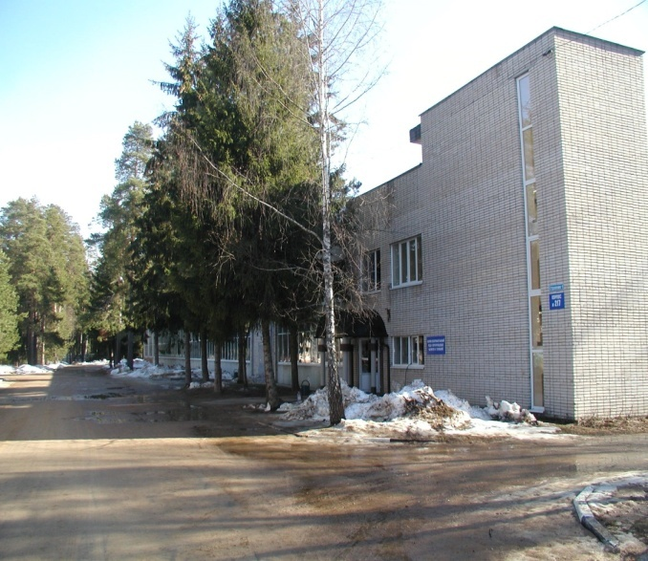
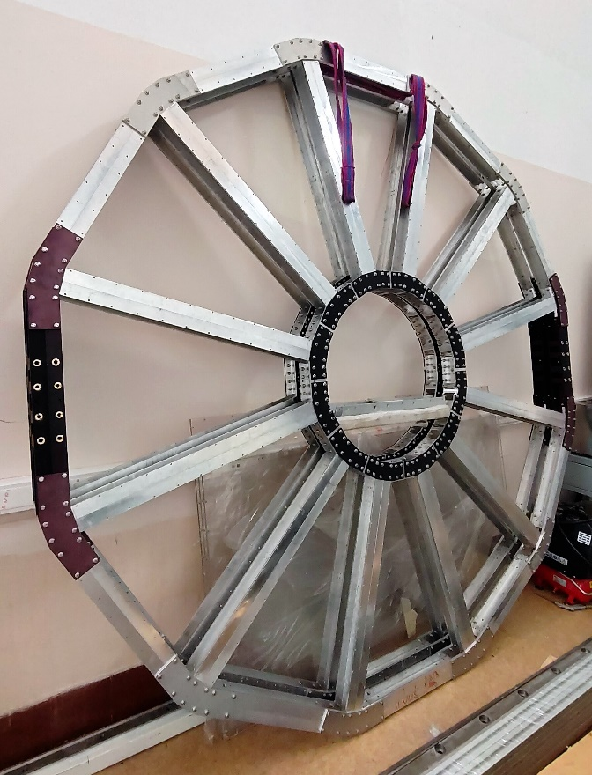
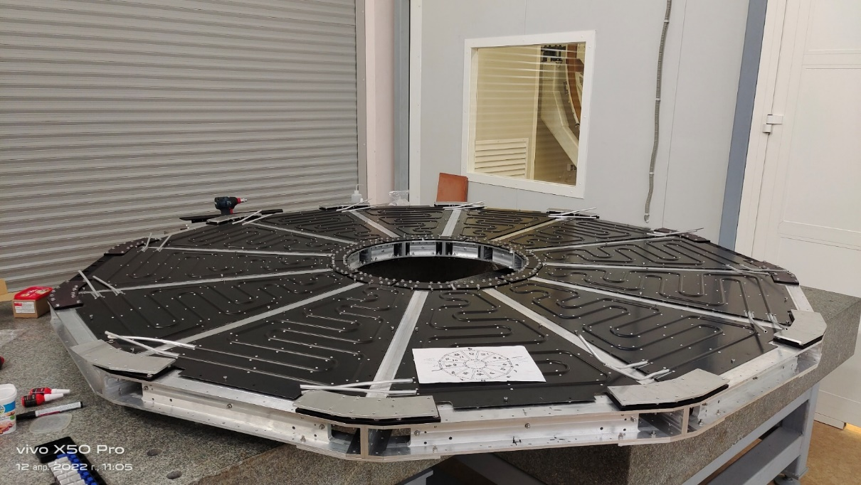
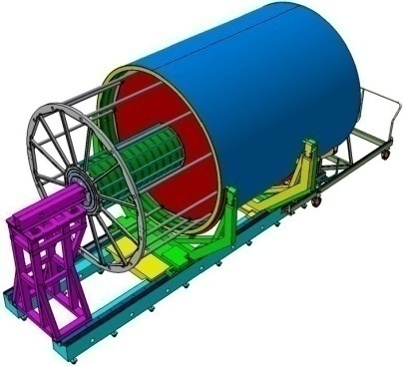
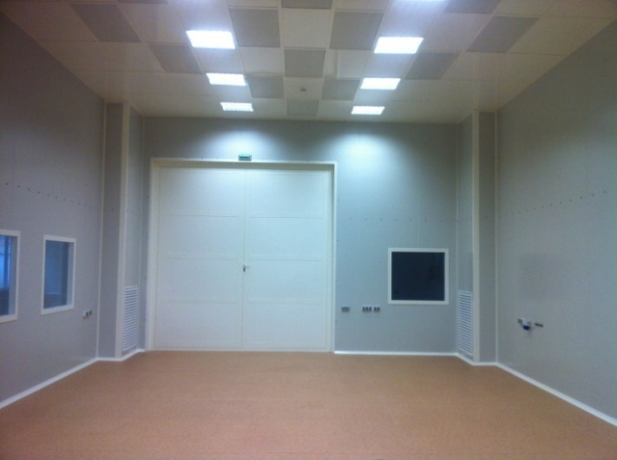
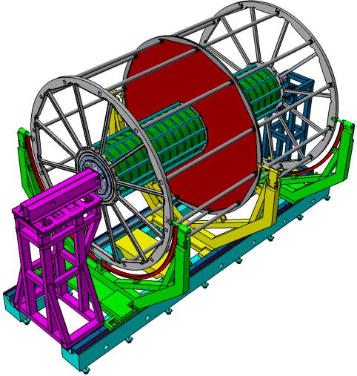
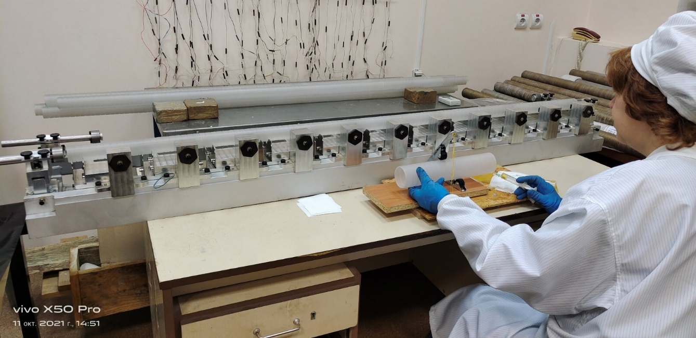
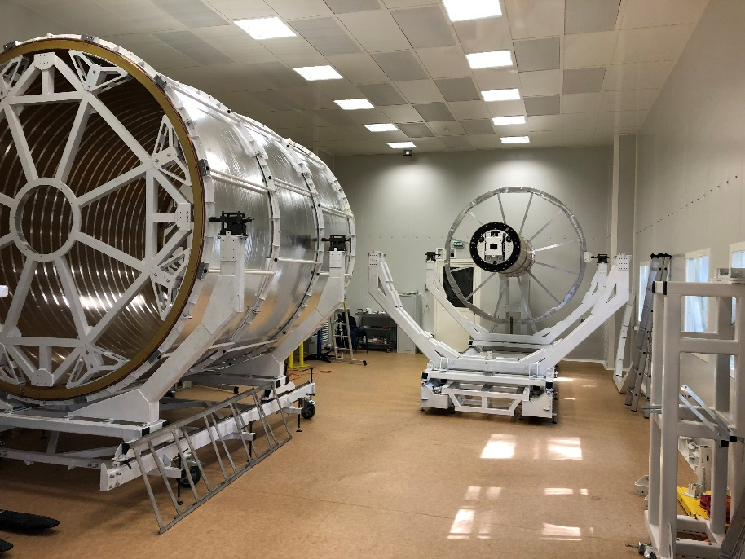
TPC vessel assembly
Bld. 217
Service wheel thermal panels (12pc)
Both service wheels - assembled
ISO-6
  C1-C2 and C3-C4 cylinder – assembled
  TPC service wheels (2pc) - assembled
  HV membrane – tested
  TPC field cage assembly - Jan-Feb 2023
  TPC vessel ready – March 2023
Rods (30 pc) - assembled
TPC vessel assembly – in progress

Slide 4
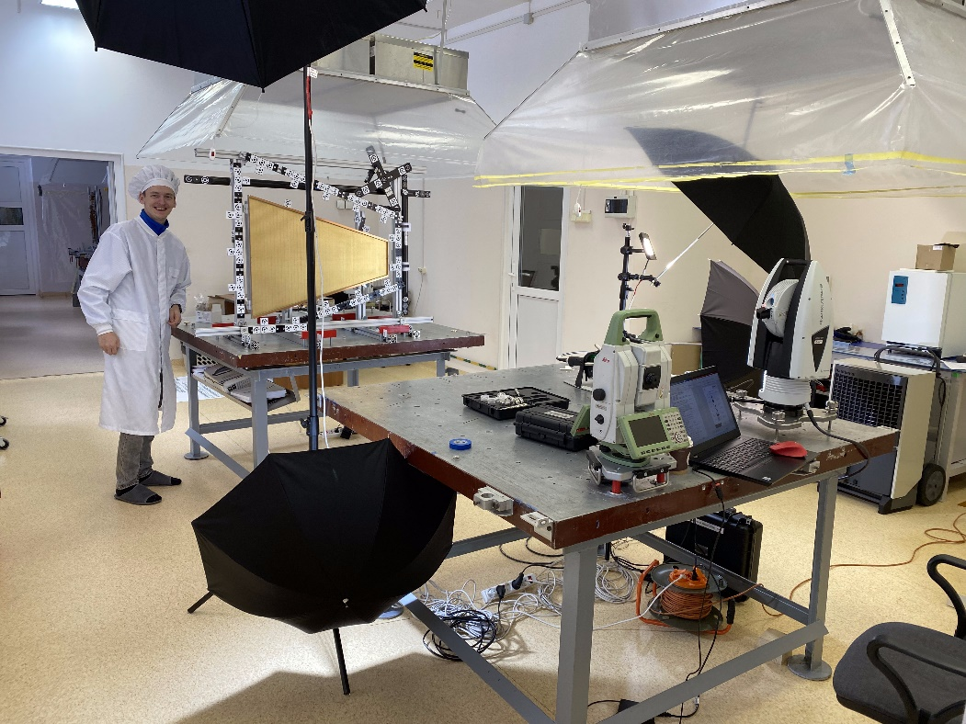
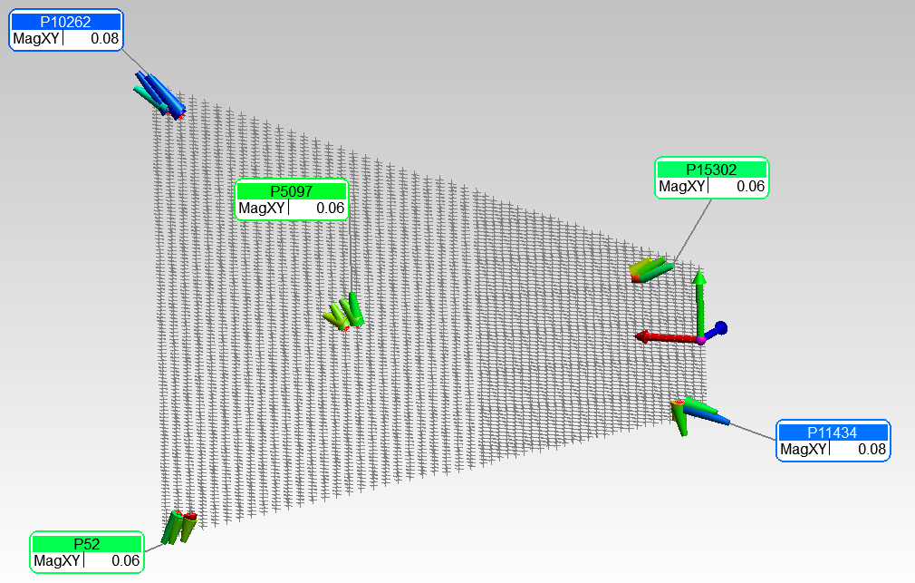
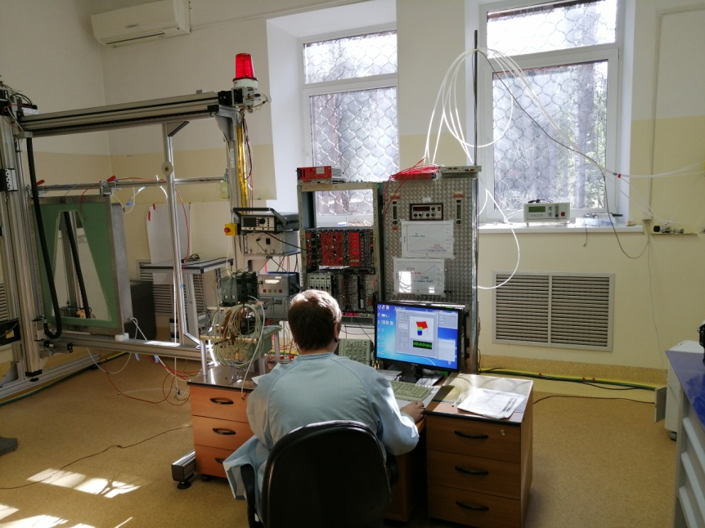
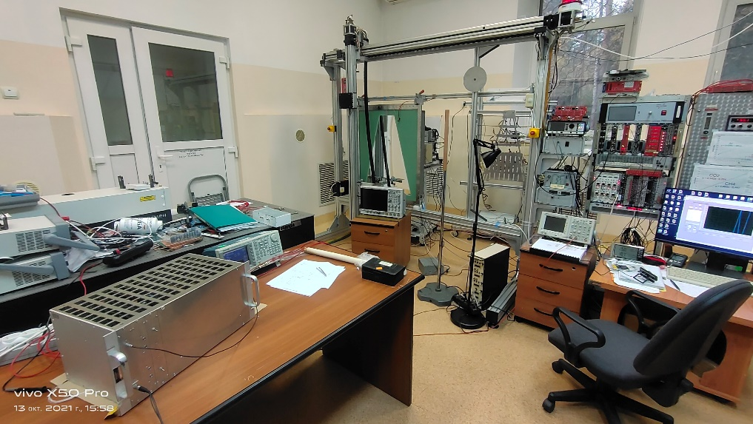
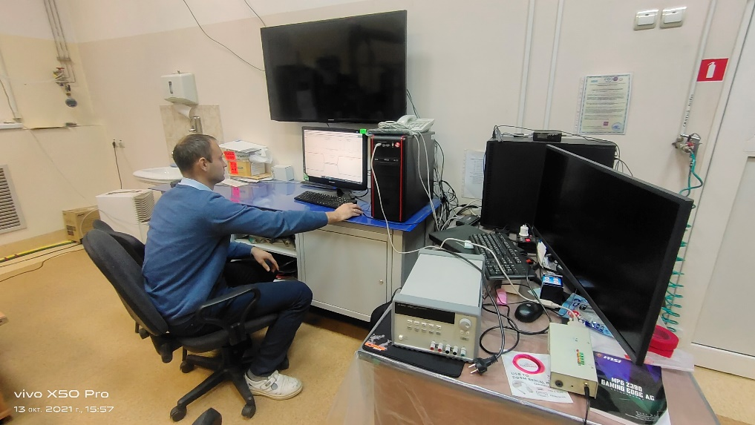
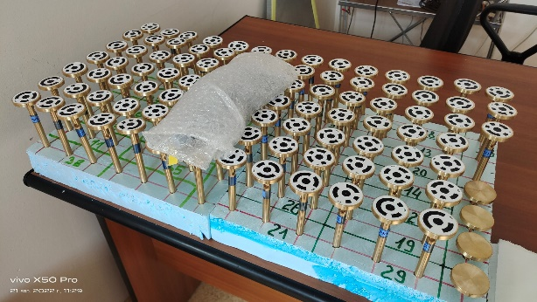
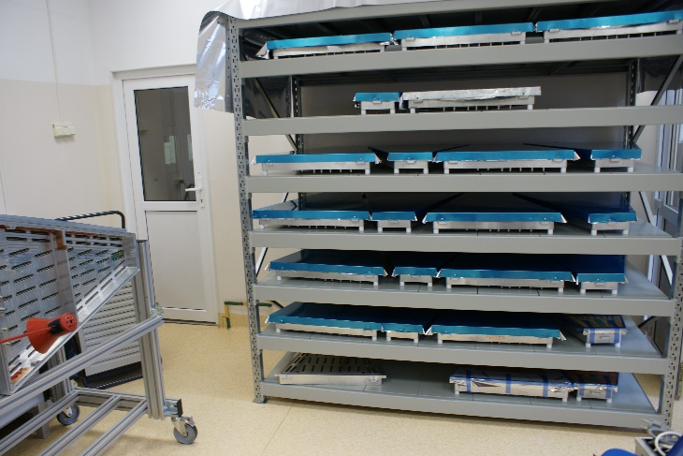
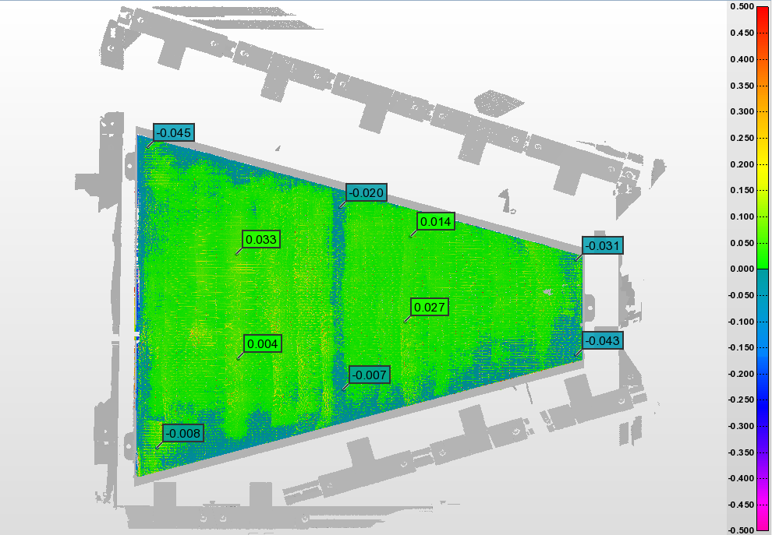
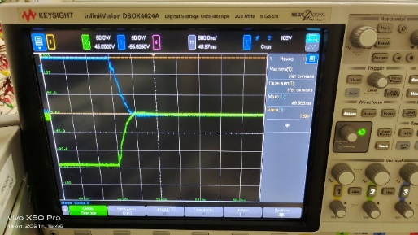
ROC chambers and gating grid system (GGS): status
Test set up for pads calibration
Check pads geometry
Test set up for ROC certification
ROC gating grid system: test set up
systematic - up to 150 mkm
Leica MS60 - 1 second resolution
Leica AT960 +/-10 mkm +5 mkm/m
Leica AT403 +/-15 mkm +6 mkm/m
Scanner AS1+AT960 +/-50 mkm
Full set of ROC alignment marks
24 pc ROCs – tested
Pad plane unflatness: example
Pulse rise time
- 500 ns, OK!
+/- 30 mkm
Summary:
- measurements to do for all ROCs
- calibration of ROC marks and
3968 pads respect to ROC
“reference hole” - in progress
24 pc serial ROCs – READY!
Mass-production – started
Delivery to JINR – Feb 2023

Slide 5
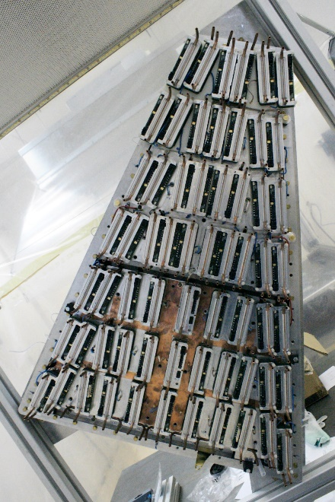
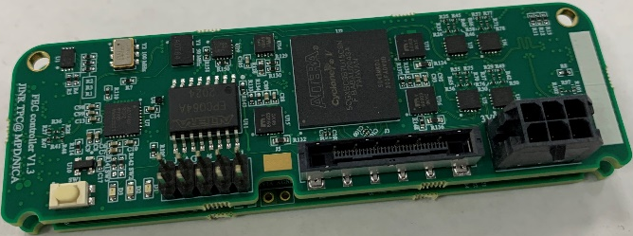
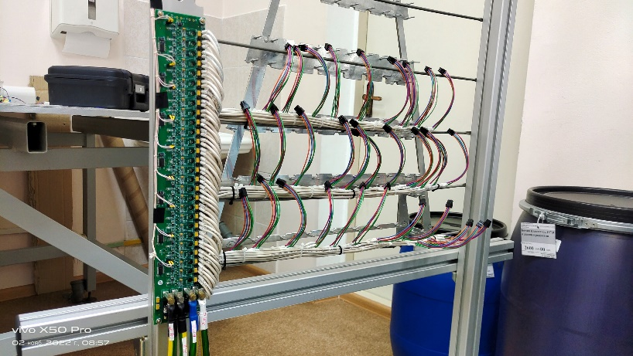
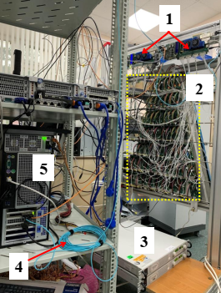
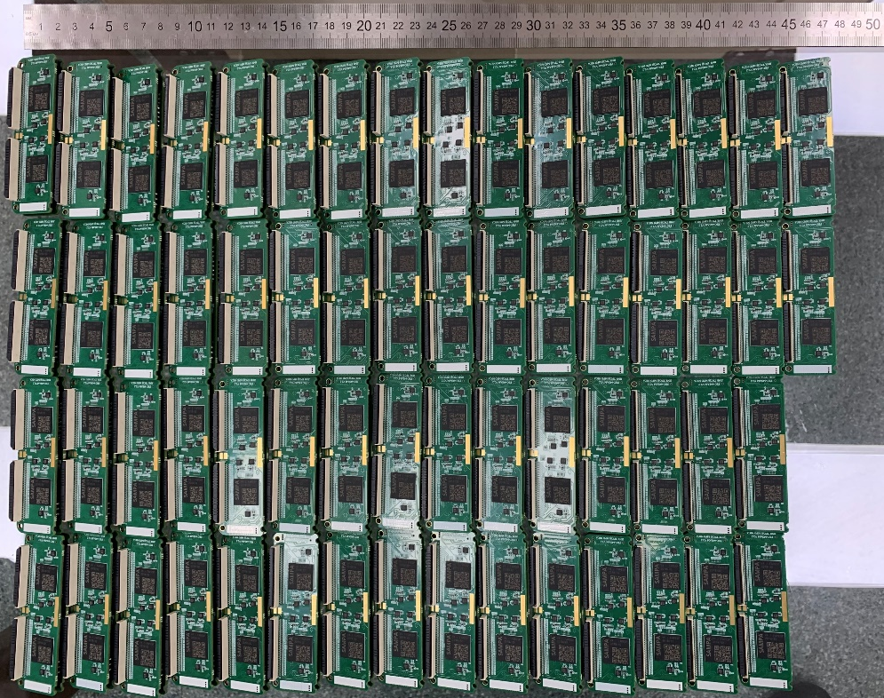
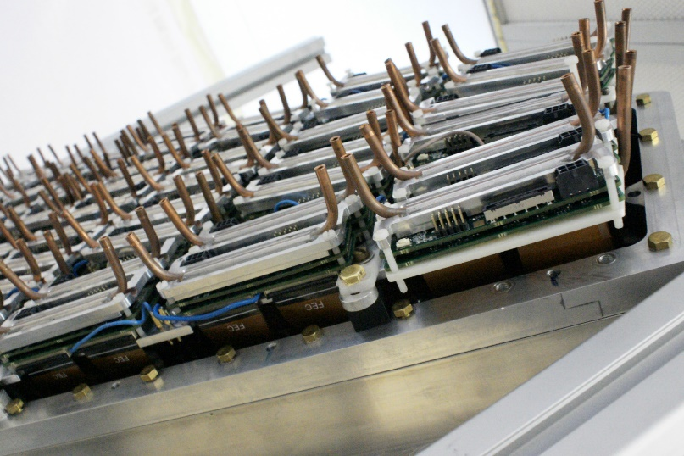
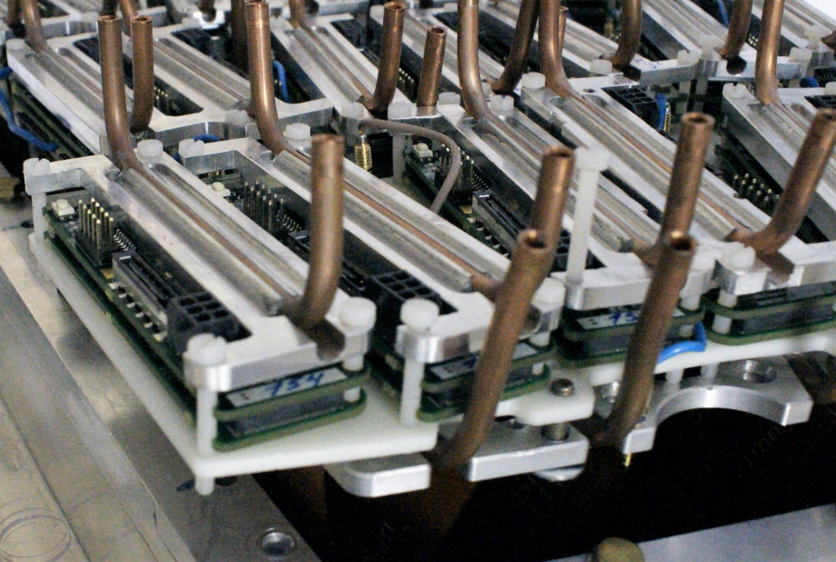
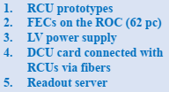
TPC Sub-systems: electronics
FE water cooling
Production version of the FE card:
DAQ prototype:
62 FE cards, RCU prototypes,
ROC, 2pc LVDBs, server interface
board - tests ongoing
LVN9 stabilizer
60 pc LVN9 were send back to Minsk:
- modification connection of power cables to LVN9 - in progress
- modification of LVN9 output voltages to FECs - in progress
- test of LVN9 with cooling radiator under full load (analog – 70 A, digital – 50 A) – in progress
N=727 pc
(48%)
727 FECs of 1500 were produced.
Tests of the FEC basic functionality were shown the target characteristics (Noise and stability).
Testing of the readout system for one ROC is ongoing.
11 ROCs chambers will be completed
at the end of 2022.

Slide 6
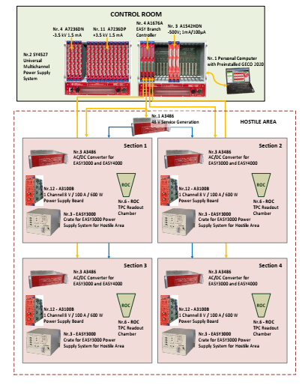
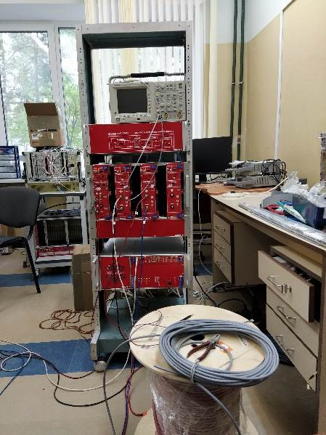
TPC Sub-systems: LV+HV (CAEN)
LV&HV system based on CAEN rad. hard design:
(up to 2000 Gauss and 15 kRad)
- power converters A3486 AC/DC (380 V -> 48 V) – 15+3 pc
- EASY3000 crates - 14+2 pc
- LV module - A3100B (8V/100A) - 48+8 pc
- LV module - A3100HBP (14V/50A) - 6 +2 pc
- HV modules –A3540P (+4kV/1mA) - 8+3 pc
- HV modules –A3540N (- 4kV/1mA) - 2+2 pc
Status:
LV+HV system: JINR-CAEN contract signed
Expected delivery date to JINR: August 2023
test system – tests ongoing
LV cables (halogen free, low smoke):
new cable S=50 mm2 – contract signed
delivery date to JINR - Feb 2023
HV cables - ordered

Slide 7
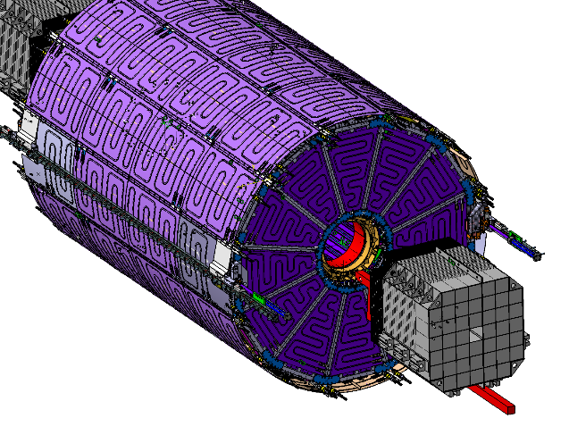
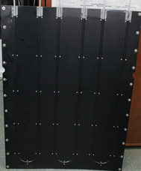
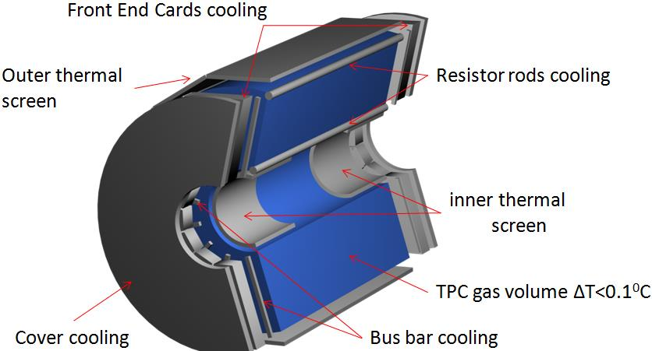
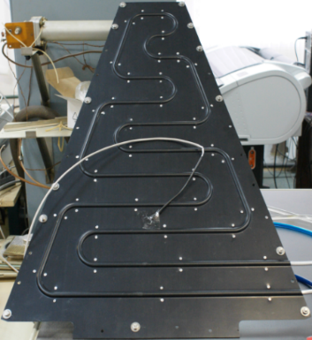
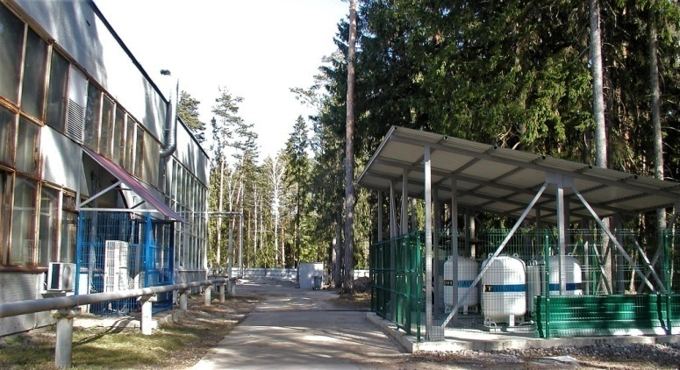
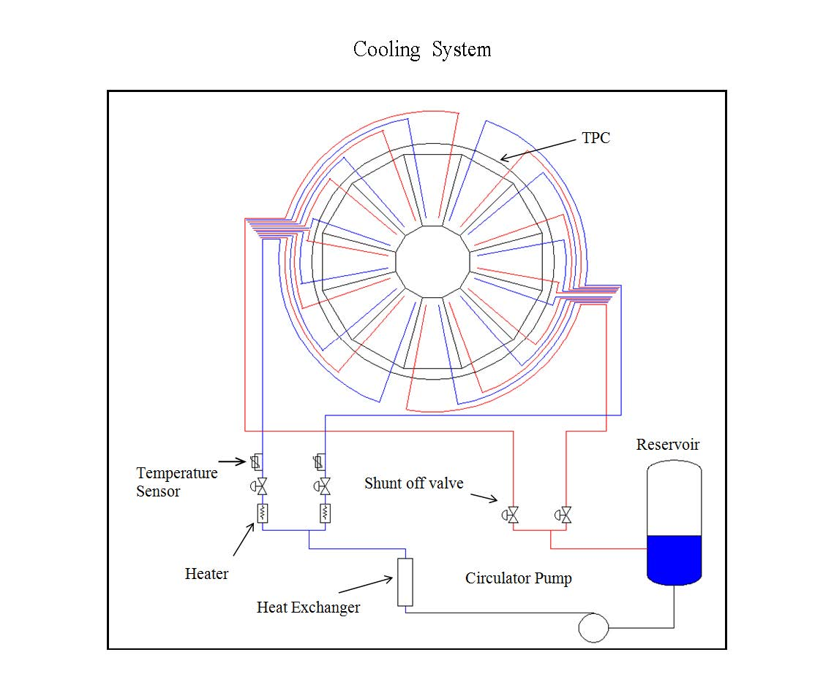
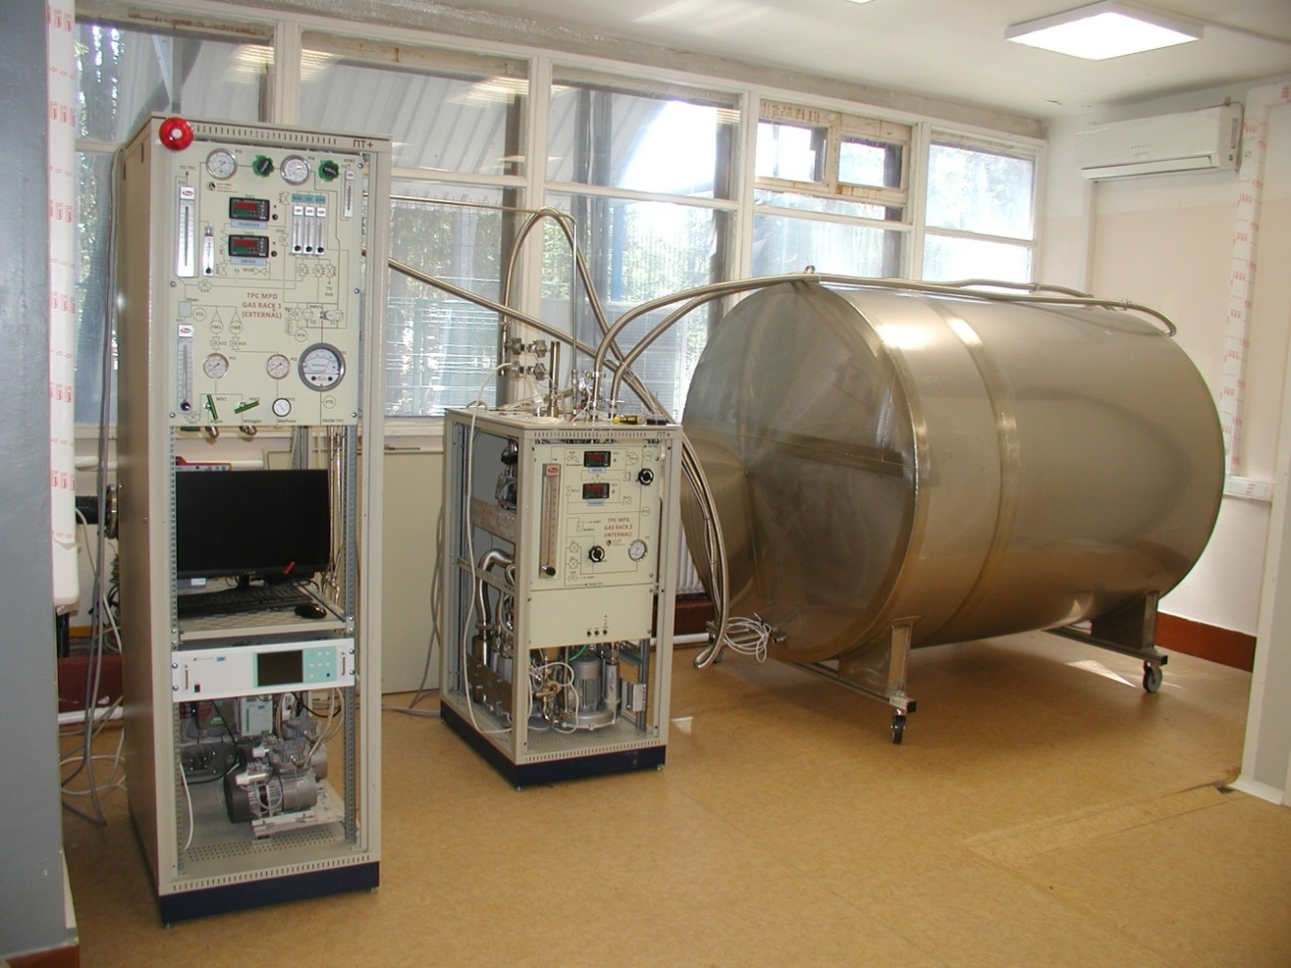
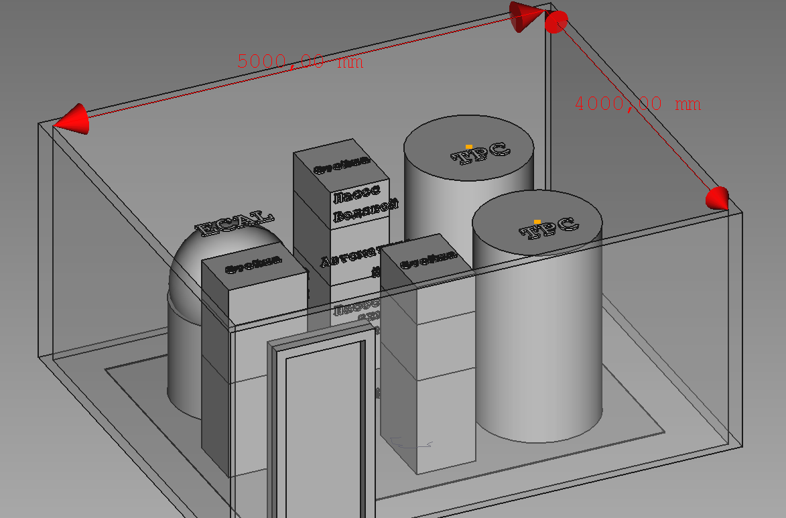
TPC Sub-systems: gas and cooling
Full set – delivered
Gas system (Ar/CH4, 90:10)
Water cooling system
Gas supply
MPD hall
Racks
TPC volume
imitator
S=1.2x3.6 m2
h=2.2 m
MPD
contract JINR-INP BSU (Minsk) – in progress
delivery – 30 September 2023
operation under manual control – during beam test 2024
fully automatic control – 30 September 2024
Tests - in progress
(H20 and Q2 sensors are replaced)
S=4x5 m2
h=2.5 m

Slide 8
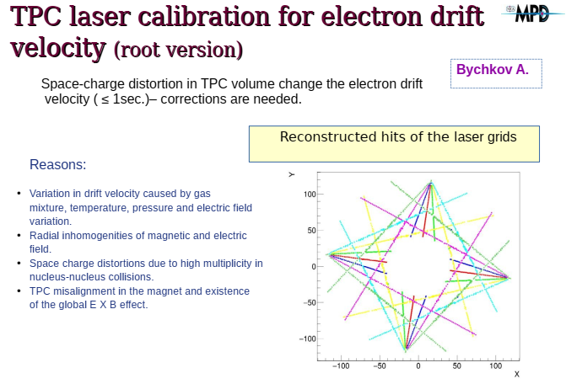
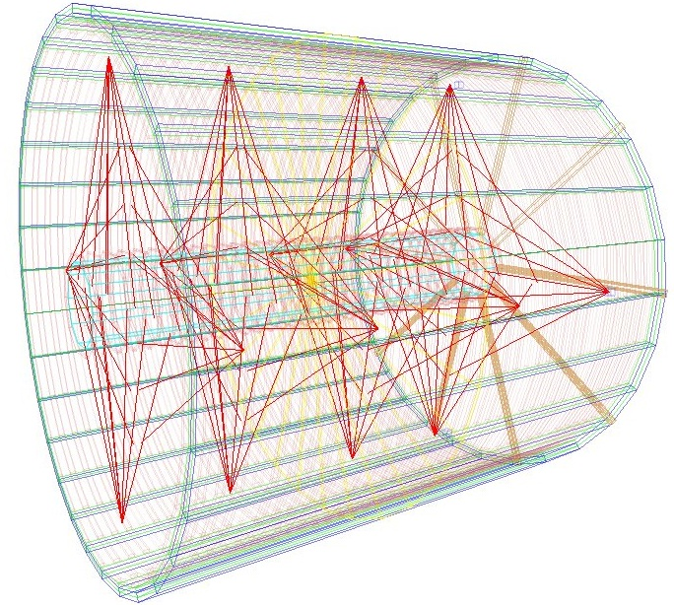
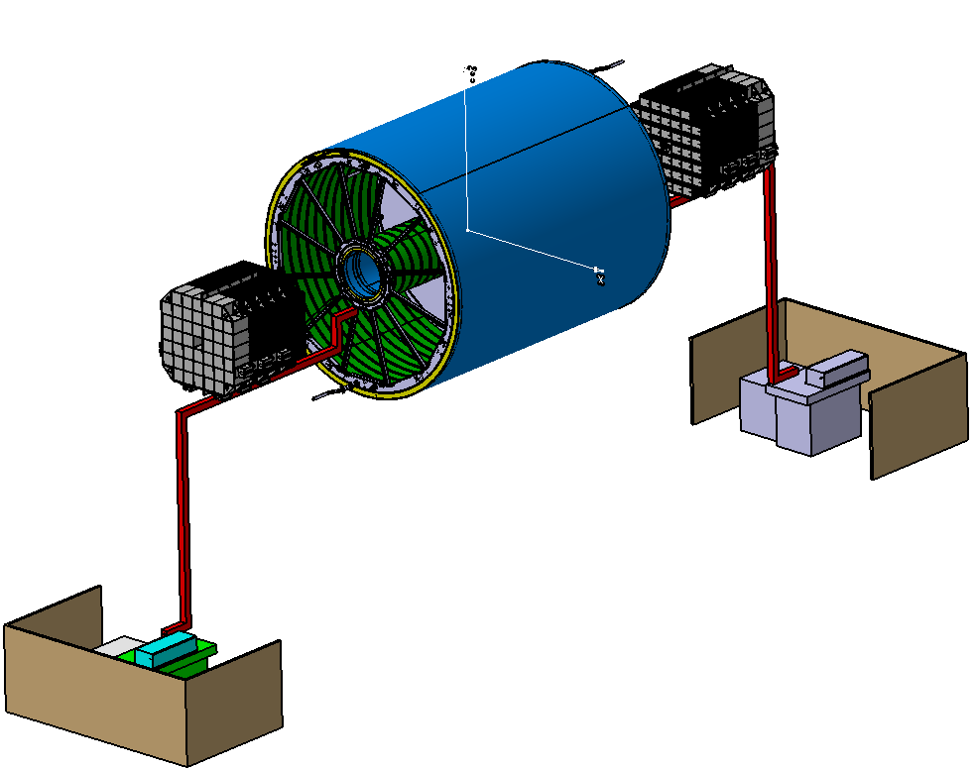
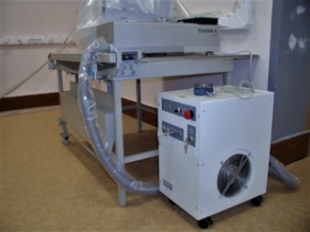
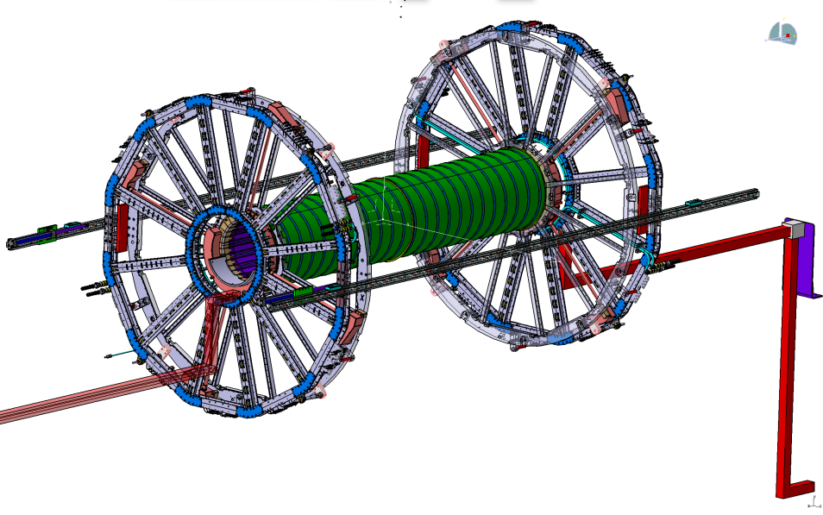
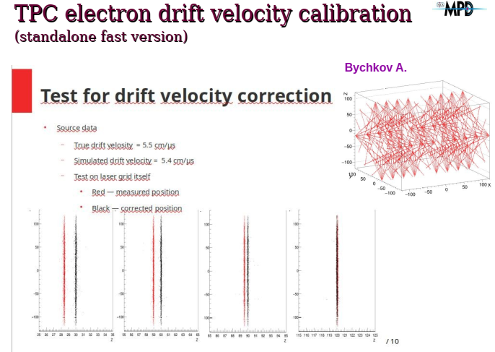
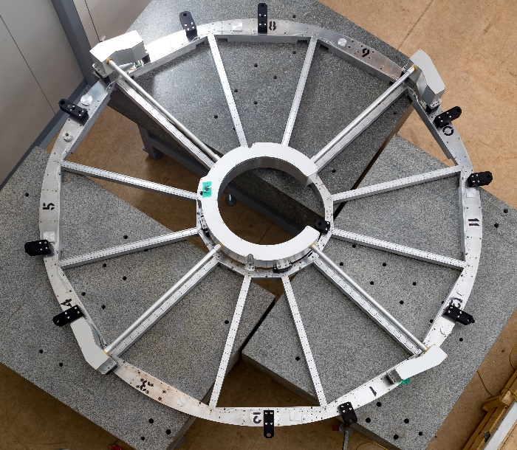
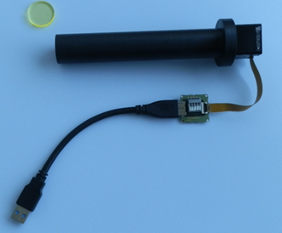
TPC Sub-systems: laser calibration
Scheme for ½ TPC
TPC
laser
laser
Laser “planes” - 4
Micro-mirrors bundles per plane - 4
Beams from micro-mirrors bundle - 7
Laser “tracks” (N =112х2) - 224
Laser beam splitter
Laser beam monitor
micro-mirror
bundles

Slide 9
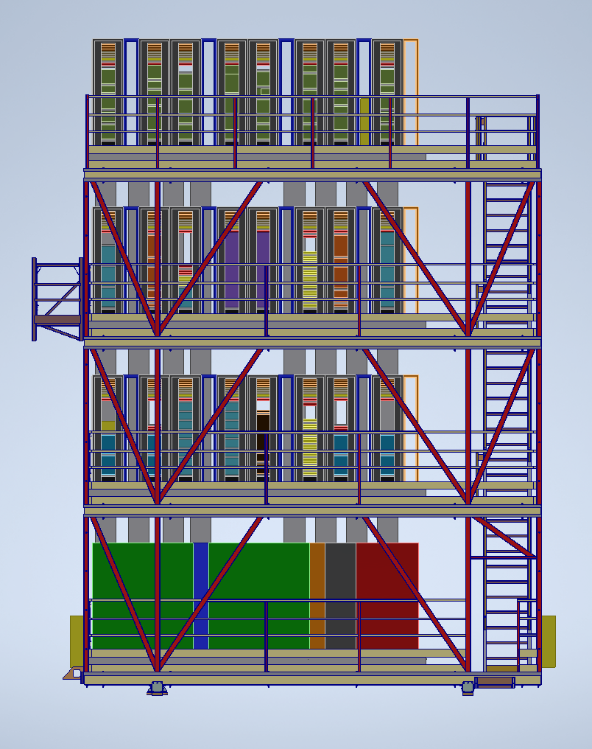
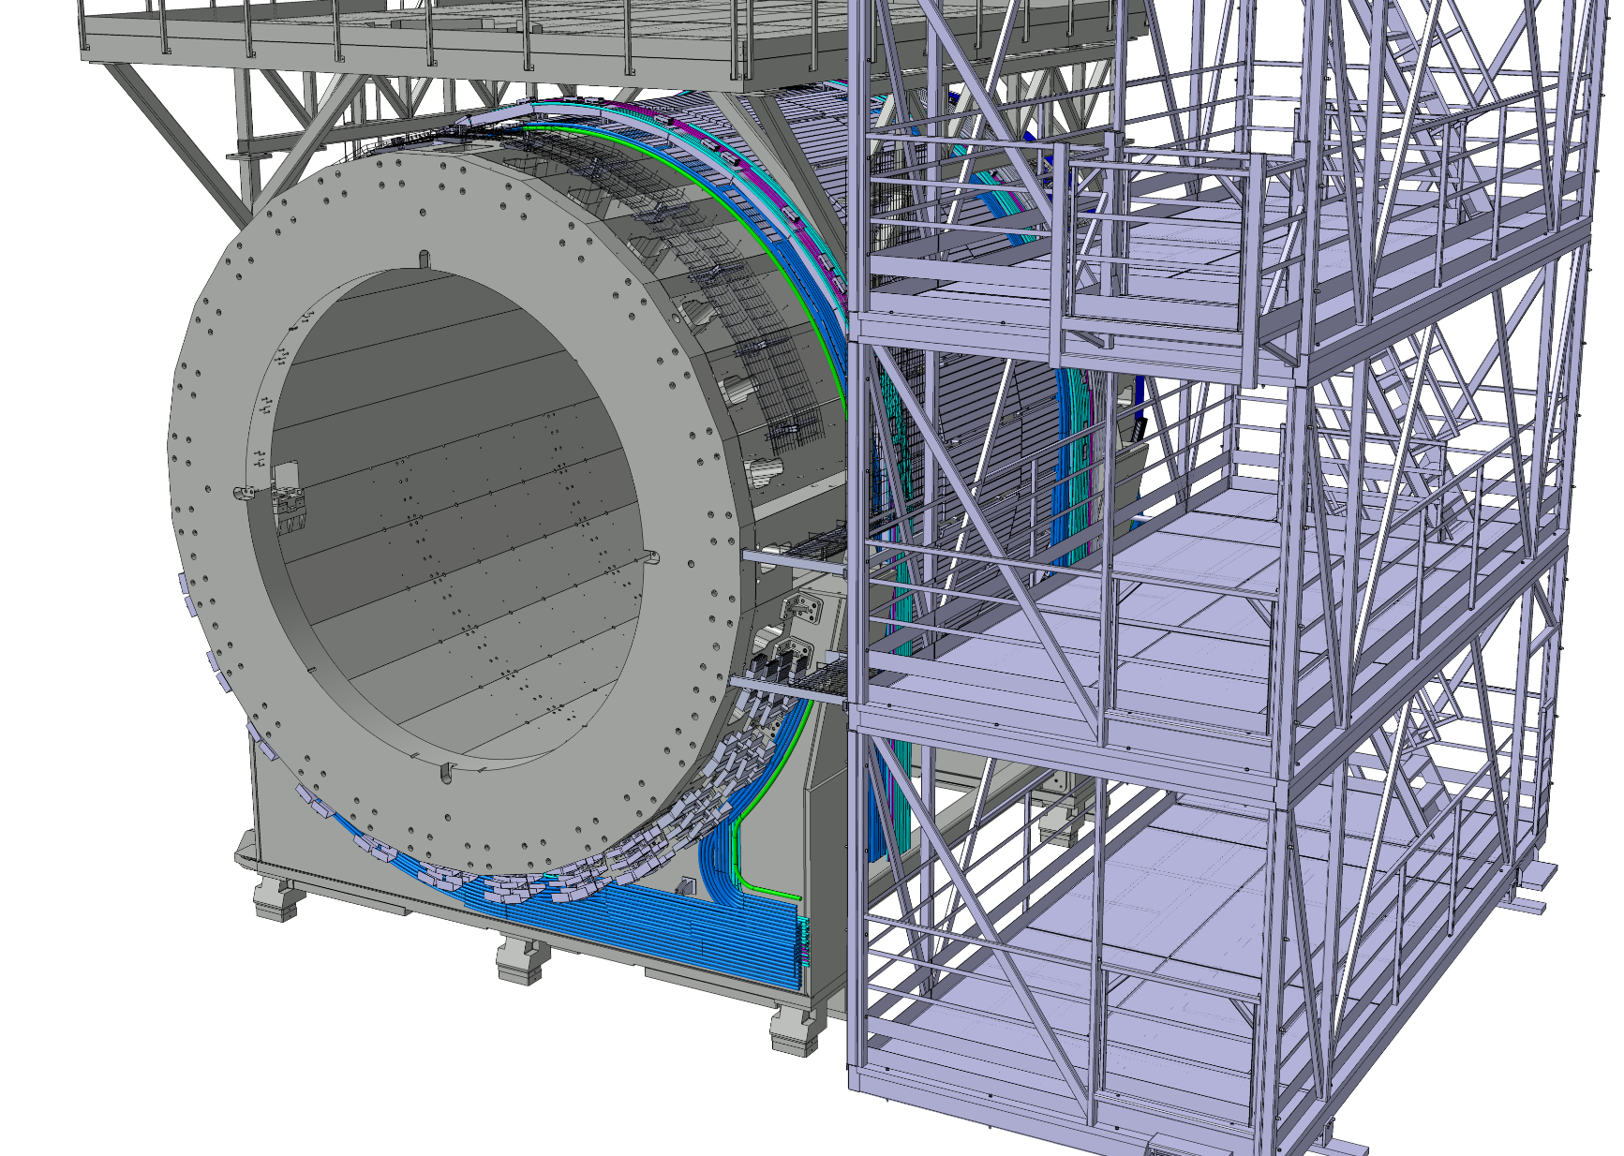
NICA-MPD-Platform (NMP)
Common view
TPC equipment
TPC + ECAL
cooling
Design and integration –
in progress …

Slide 10
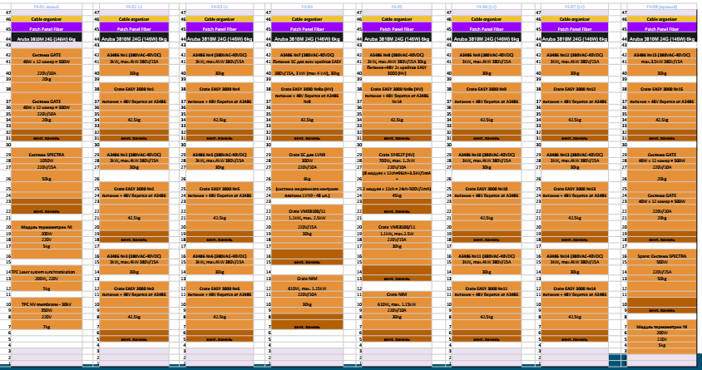
MPD electronic platform
TPC equipment in racks on the 4th floor

Slide 11
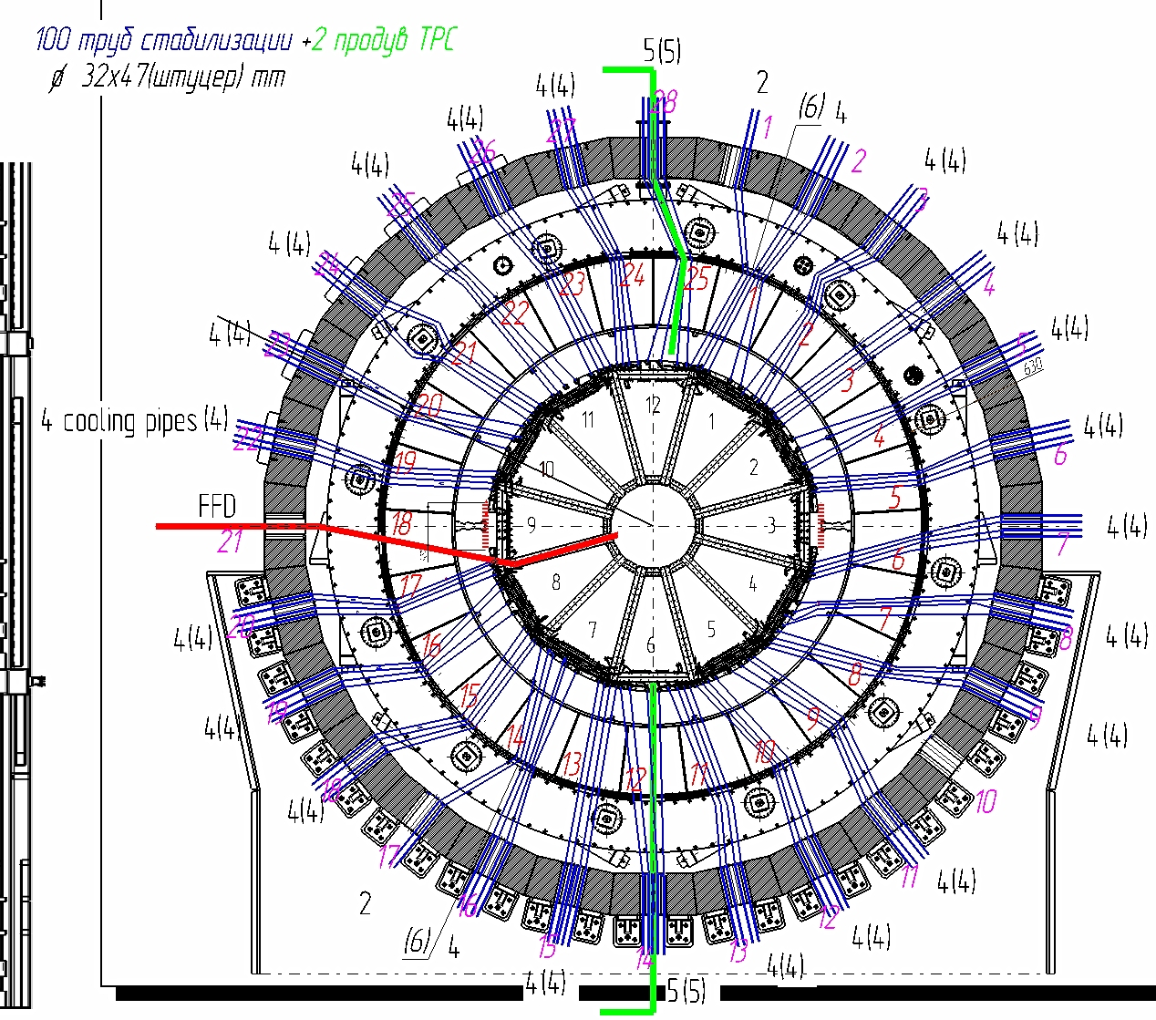

TPC cabling and piping
W side: cooling and gas pipes scheme
TPC list of cables and pipes

Slide 12


TPC cabling and piping
Structures for
cables and pipes
fixation
Prototype for cabling and piping
Integration …
TPC
Beam pipe
TPC+TOF+ECAL cabling – finished
Piping – not started yet
Design - in progress

Slide 13







Tooling for Installation TPC to MPD
Bld. 217
Bld. 217 (MPD)
24 tons,
max=0.41 mm
Design under discussions
4 units for adjustment X, Y, Z
Tooling manufacture –
Jan-July 2023
Delivery to JINR –
August 2023

Slide 14
Time schedule and conclusion
Status:
  Integration TPC to MPD:
  TPC racks (8pc) - layout optimization in progress
  TPC rails (calculations, manufacture) - Feb 2023 –> June 2023 on critical path !!!
  rails installation to MPD - July 2023
  Tooling for installation TPC to MPD:
  design - under discussion
  tooling manufacture - Jan-July 2023 (7 month)
  delivery to JINR - August 2023
  TPC+ECAL cooling systems installation – up to Sept 30 2023
  TPC schedule:
  TPC installation to MPD Oct-Nov 2023
  cabling and piping Sept-Nov-Dec 2023
  MPD commissioning Jan-Feb 2024
Thank you !

