Slide 1
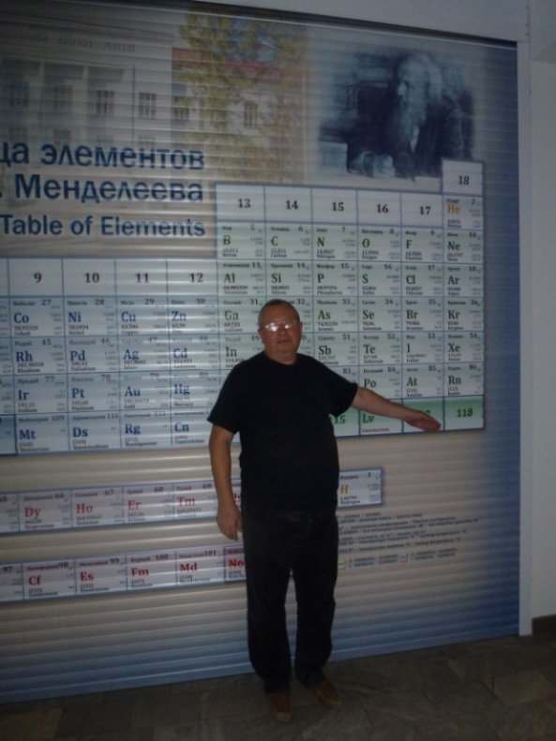
Analog spectrometer of the DGFRS-2 setup: status and developments
Yu.S.Tsyganov¹, D.Ibadullaev^{1,2,3}, A.N.Polyakov¹, A.A.Voinov¹, M.V.Shumeiko¹
1- JINR, Dubna 2- INP, Almaty, 3- Humilev University, Astana
6th International Conference on Particle Physics and Astrophysics
* In more wide sense : collaboration FLNR(Dubna, Russia), ORNL( Oak Ridge, USA), IMP (Lanzhou, China)
Introduction. Field of interest: Synthesis of SHE at the Dubna Gas-Filled Recoil Separator
New gas-filled separator (DGFRS-2)
New spectrometer complex of the DGFRS-2. Examples of application in HI induced nuclear reaction. Flexible scenario(algorithms) of “active correlations” method
SUMMARY
Field of interest: Nucl. Phys.→ heavy ion induced complete fusion reactions->synthesis/properties SHE→
detection system → RT algorithm of background signals suppression
-1

Slide 2
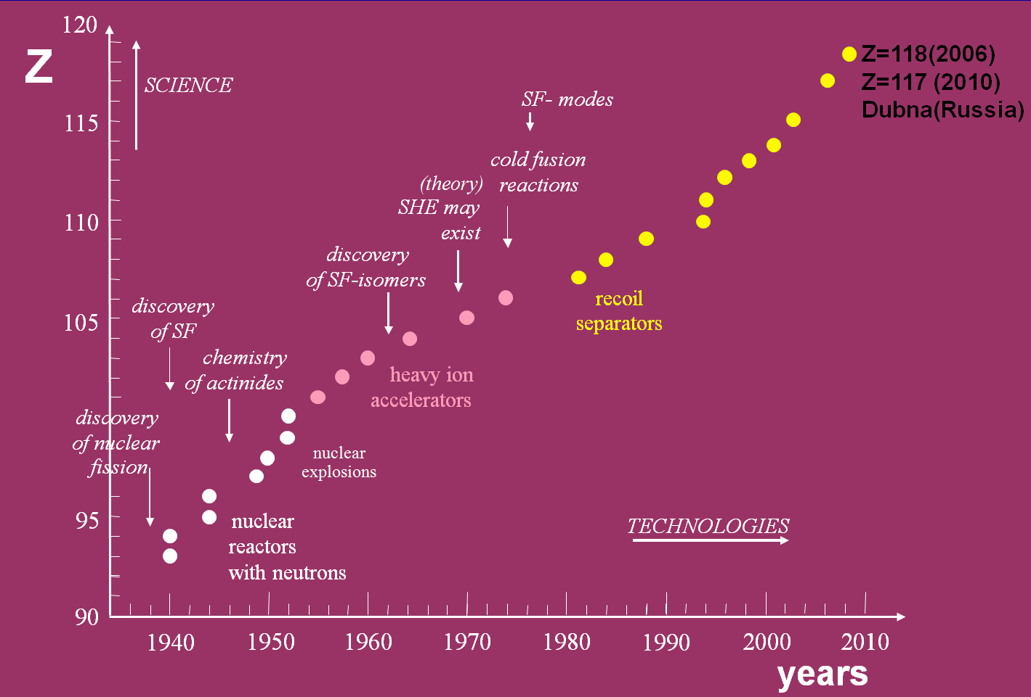
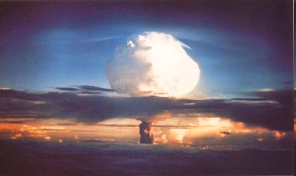
History SHE in brief…
Z=114-118
The Dubna Gas Filled Recoil Separator
FLNR, JINR

Slide 3
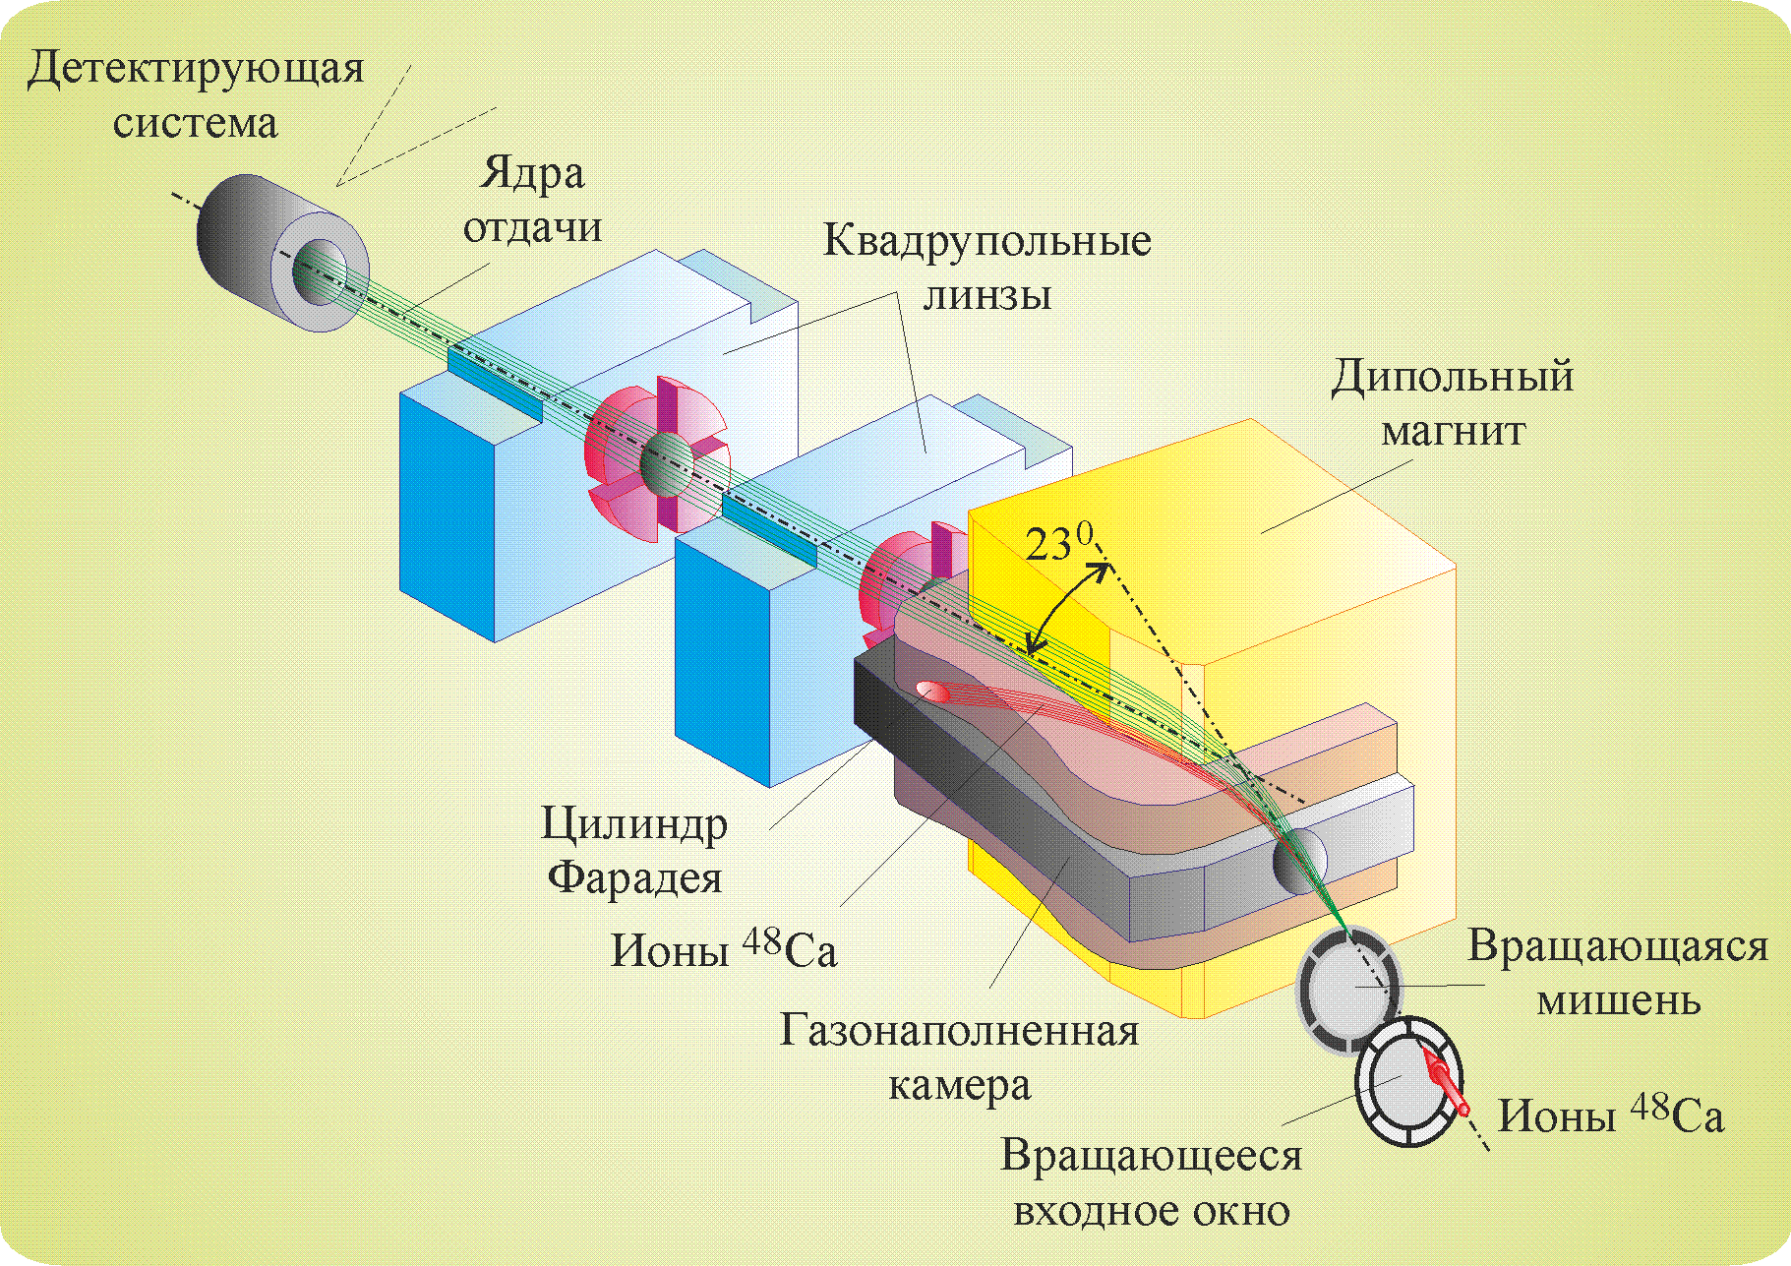
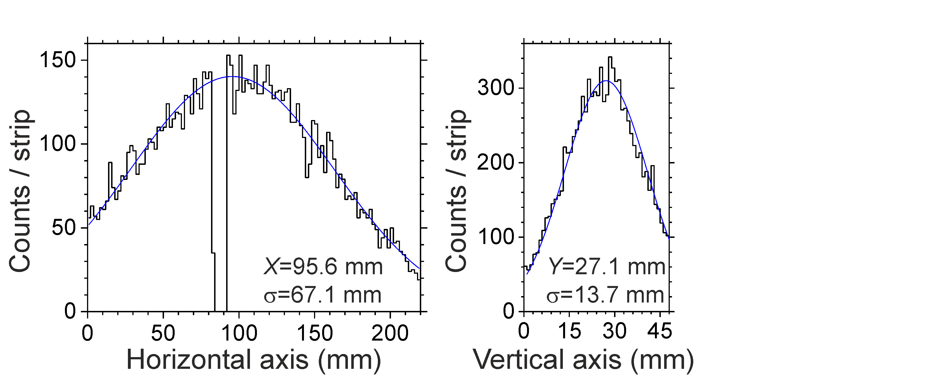
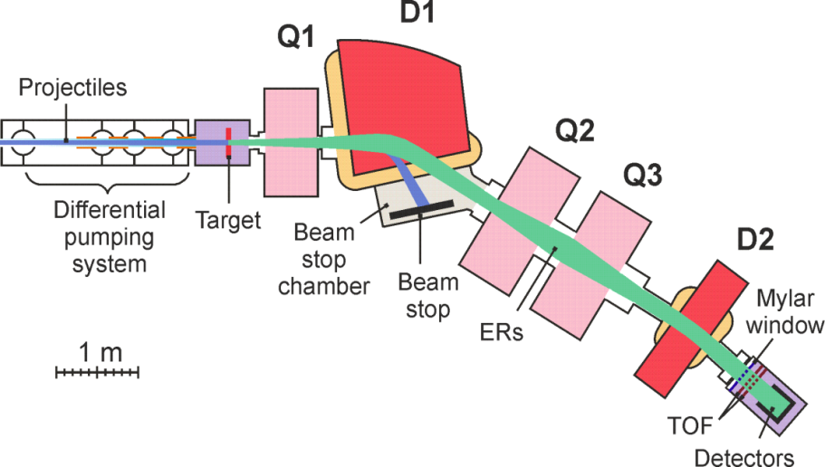
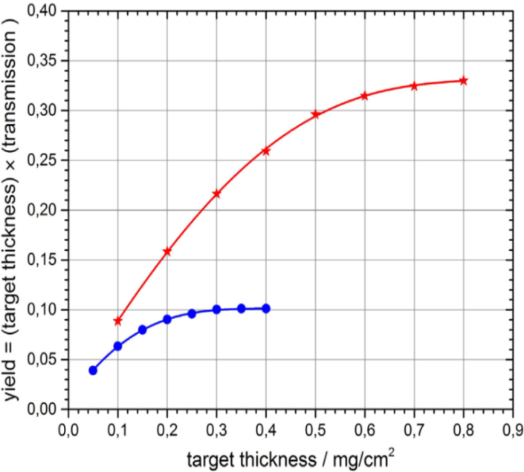
sum of technologies…
Cyclotron ~ 1 pµA…10 (⁴⁸Ca beam, ⁵⁰Ti,⁵⁸Fe, ⁵⁴Cr in a nearest future >5 pµA)
Actinide target (rotating) to apply high intensity for a long time
differential pumping system
Gas –Filled Separator ( to suppress primary beam and other backgrounds )
Detection system ( DSSD+ΔE(gaseous)+electronics + software(Builder C++) )
DGFRS-1
DGFRS-2
DGFRS-2
new Dubna Gas-Filled Recoil Separator
(since 2020)
factor of 3
DGFRS-1

Slide 4
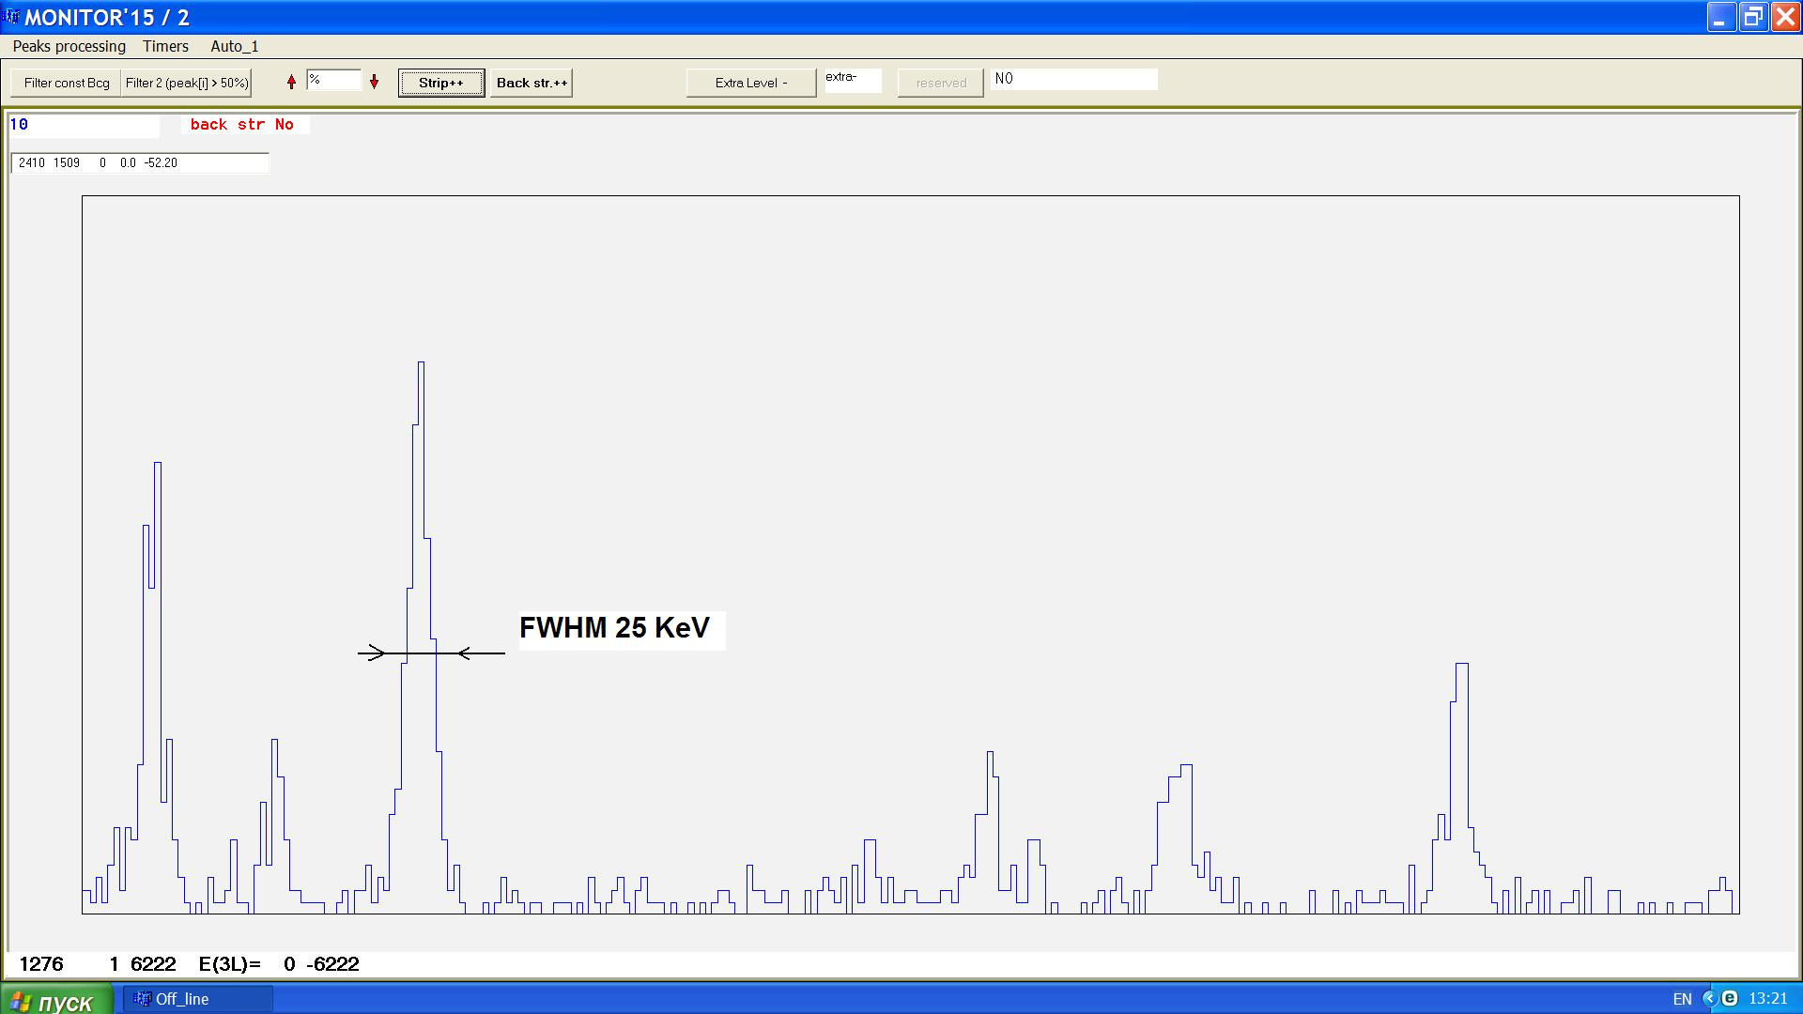
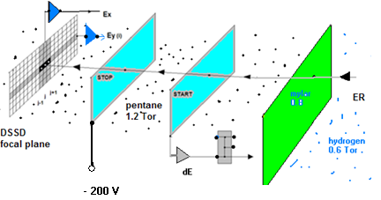
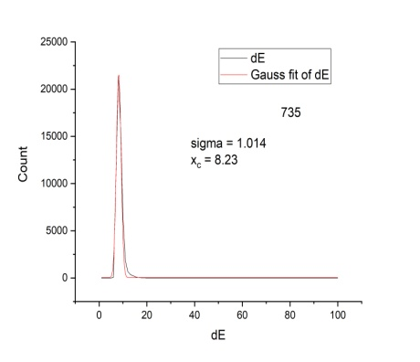
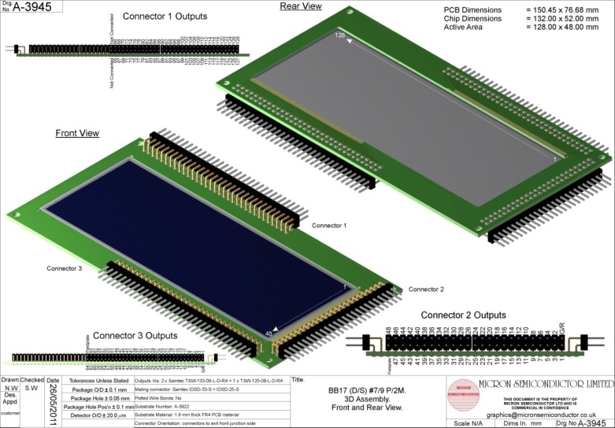
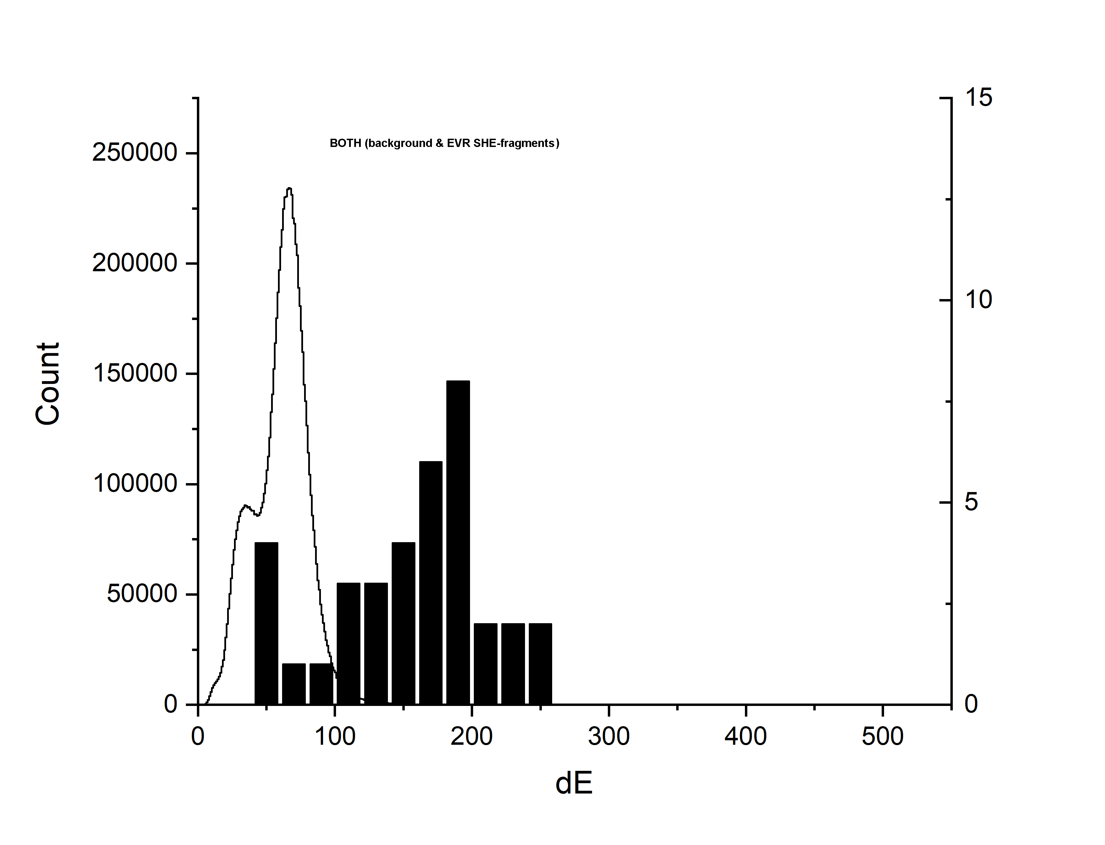
ΔE low pressure pentane-filled DGFRS#2 detector
Cathode 20µ-1mm…
W(Au) wire @ expense ~4L/month liquid
`
~35-45 ~2y
..or..reverse order
D(a-c)~ 6 mm; h_{a} =2 mm; h_{c}=1mm
W(a)=20 µ; W(c) =10 µ.
V_{c}=-40, V_{a}=+320 , V_{ADD} =-200 V
Alpha 5.4
~8.2 ch
240 mm x 60 mm
background
Z=114
EVR
²⁴²Pu+⁴⁸Ca→²⁸⁷Fl+3n (~2..3 pµA)

Slide 5
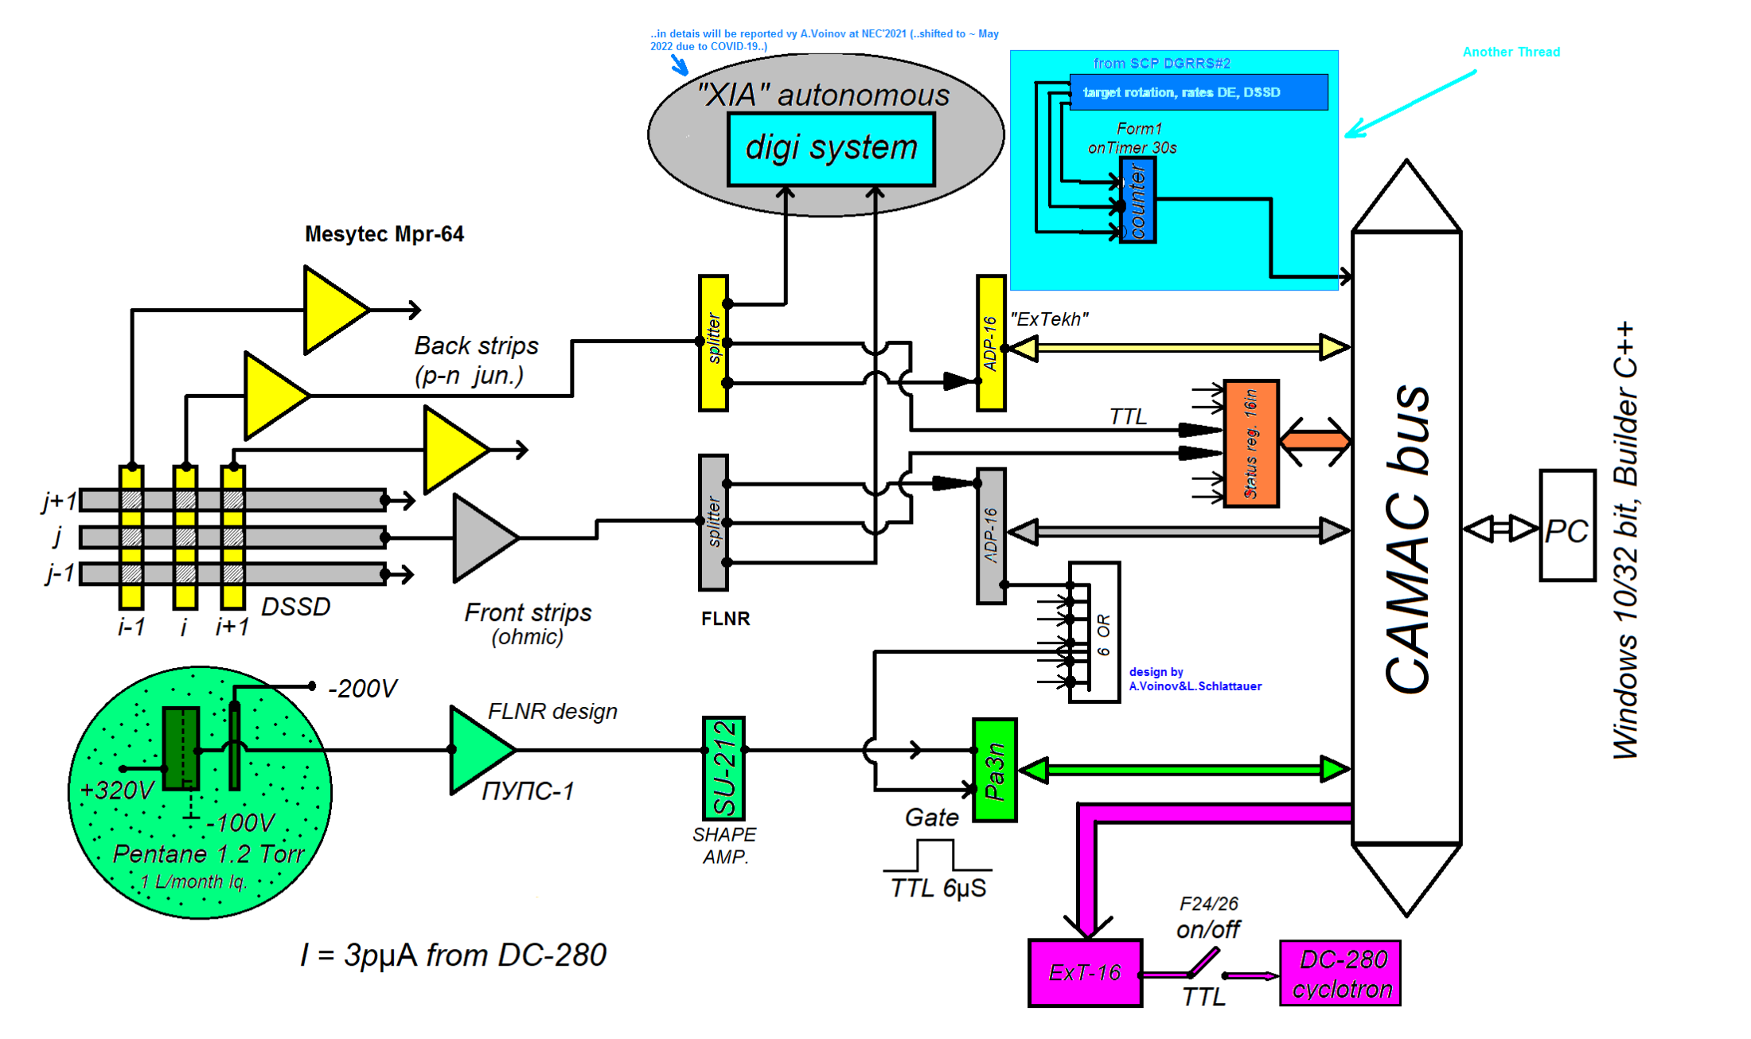
Block-diagramm of THE DGFRS#2 analog spectrometer
256 electronics channels
3 ΔE (in use 2)
+3 technological(counter 8in 16 bit)
+16 (reserved, not in use now)
subsystems: ΔE, RT (beam stop), SCP(3).
..others – standard spectrometry
In red – status register
∑=278 channels
0.2µs
TTL
4in/8out

Slide 6
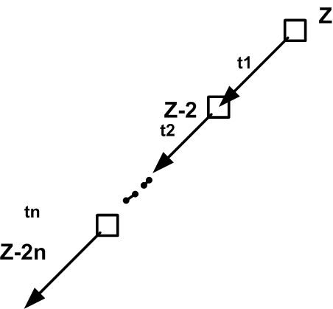
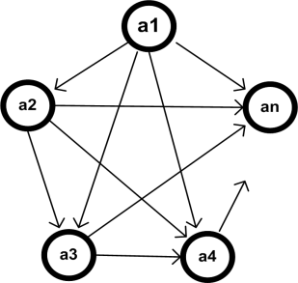
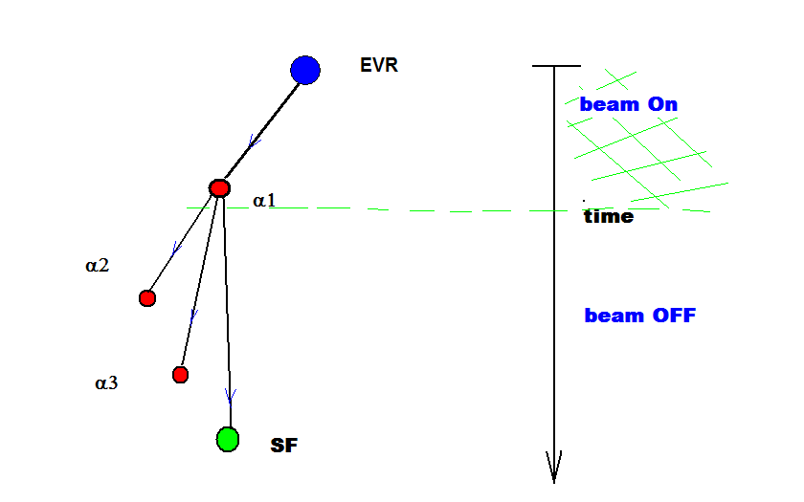
…for Dynamic Background Suppression.
Active correlations method
It means that:
To search for in a real-time mode pointer to a potential ER(implanted)-alpha correlation;
To create short break points in target irradiation; (def)short =
To detect forthcoming alpha decays (or even SF decay) in a background free mode, that is , when suppression factor in the value of probability to be a random decreases by several orders of magnitudes (6-9, usually, depending on number of chains).
N(N-1)/2 graph edges
If N- number of nodes
Data flow
…
ti
N
t1
t2
START
EXPERIMENT
End
Experiment
Off- line
Data processing
(careful)
Short break points (pauses) in the target irradiation process 1,2…i..N

Slide 7
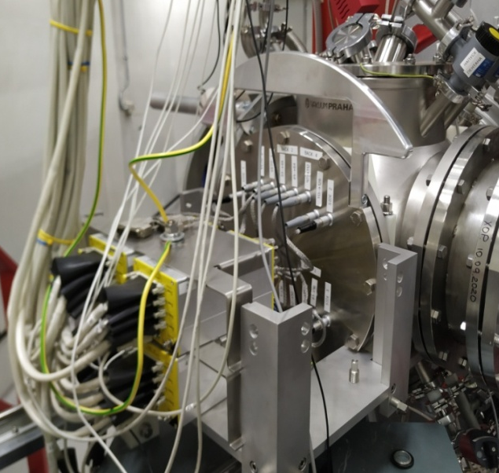
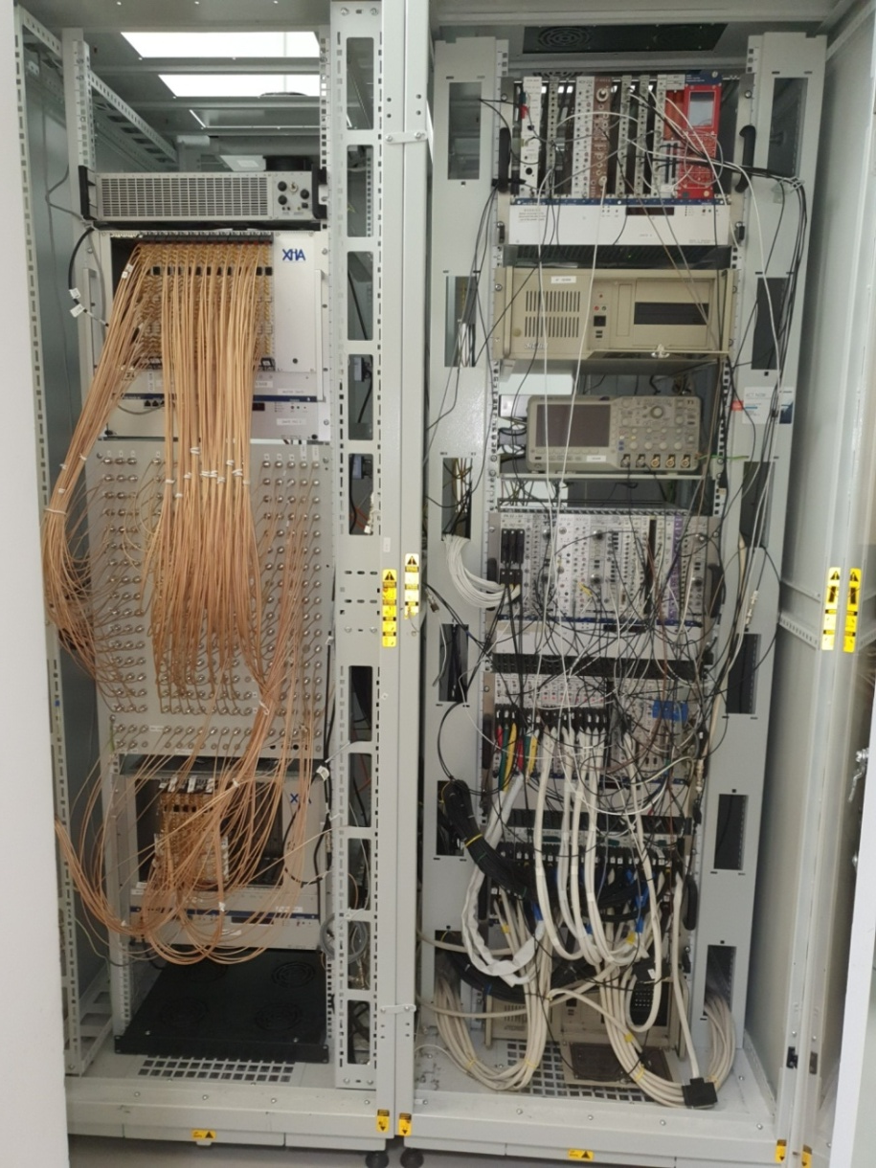
Implementation of the spectrometer…(view, few words, both..digital+analog)
digital
analog
Flange with DSSD, preamps…
Crate with splitters to branch the signals

Slide 8
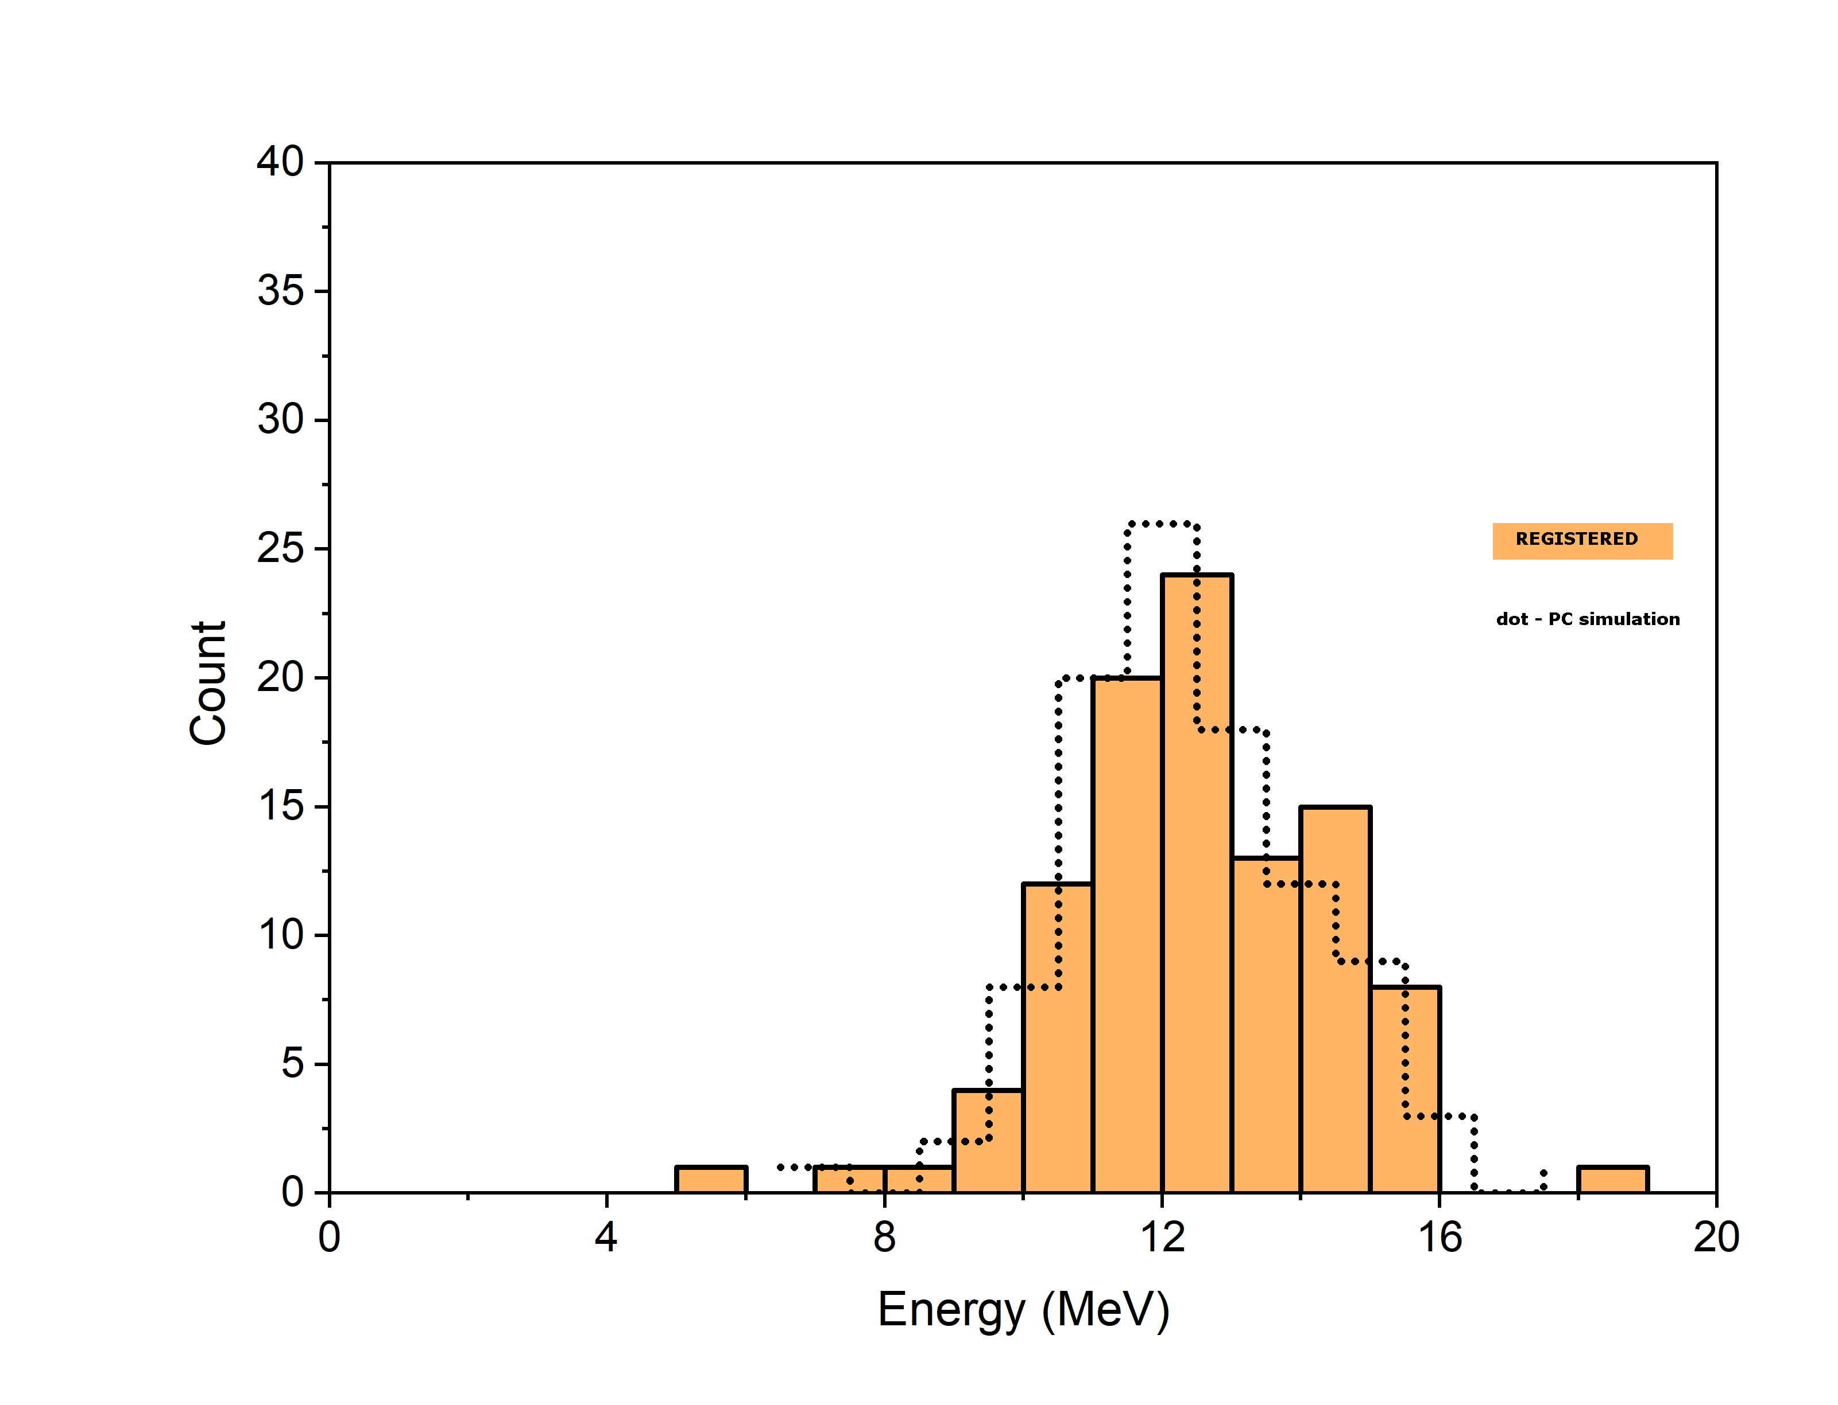
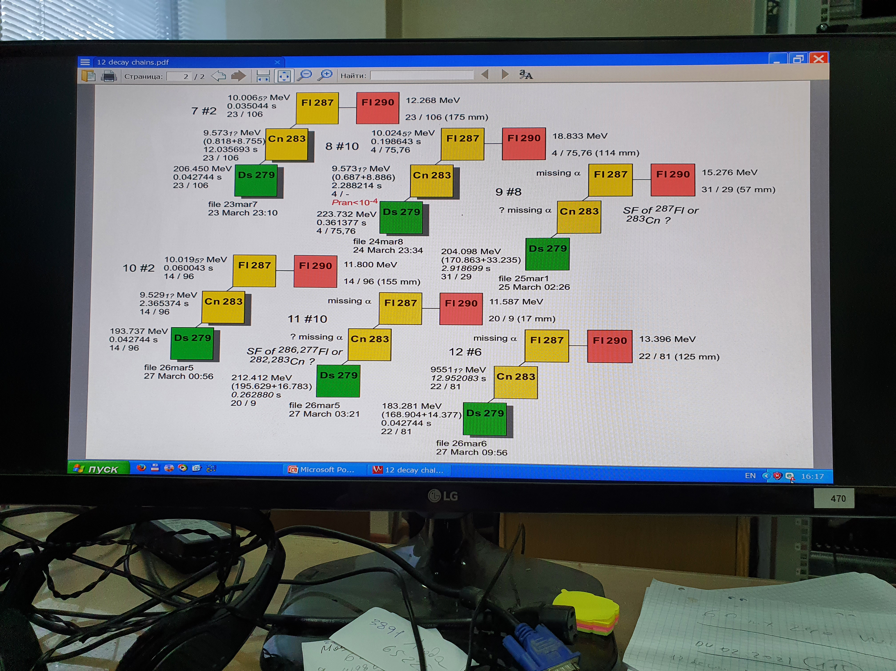
EVR (²⁸⁷Fl)REGISTERED 100 events
dot – PC simulation
Yu.Tsyganov
NIM A 378(1996)
pp.356-359
²⁴²Pu+⁴⁸Ca→²⁸⁷Fl+3n
Experiment | Time | Yield
²⁴³Am(⁴⁸Ca,2-5n)²⁸⁶⁻²⁸⁹Mc | ~161 days | 125 decay chains
²⁴²Pu(⁴⁸Ca,3-4n)²⁸⁶⁻²⁸⁷Fl | ~82 days | 94 decay chains
²³⁸U(⁴⁸Ca,3n)²⁸³Cn | ~49 days | 16 decay chains
²³²Th(⁴⁸Ca,3-4n)²⁷⁶⁻²⁷⁷Ds | ~82 days | ~6 decay chains

Slide 9
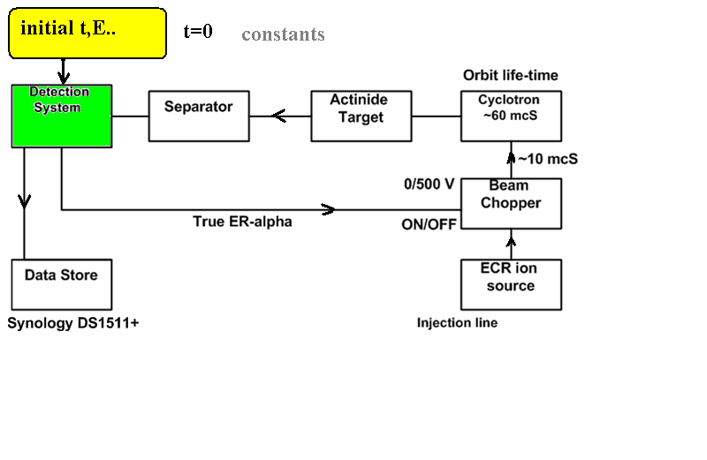
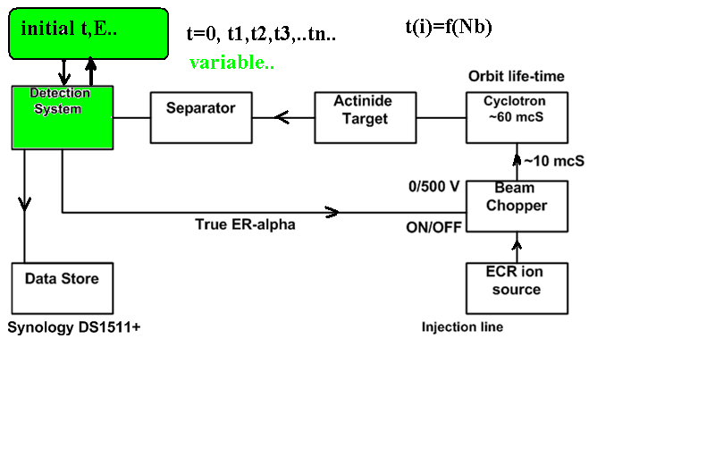
Flexible algorithm- main idea…
to make the initial conditions more open…
“initial”
→ ER (E_{min}, E _{max}), (ΔE_{min/max}), t^{corr}_{ER-α}, t_{pause}…
Standard mode :
Flexible mode:
t_{ER-alpha}=const (input file)
t^{i}_{ER-alpha}=f(N_{b}^{i-1})
iterations
C++ on Timer

Slide 10
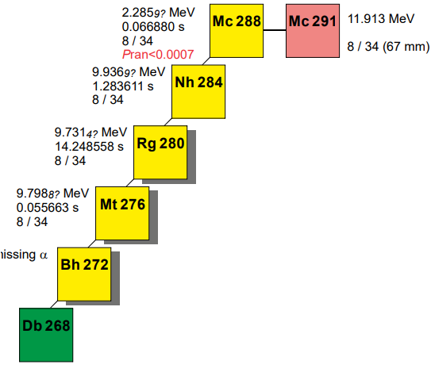
1) Natural (trivial) algorithm
n steps, 1 < n < N₀ OR beam stop occurs
t₀^{ER-a}=1 s …t_{fin}^{ER-a}=10 s
Beam off

Slide 11
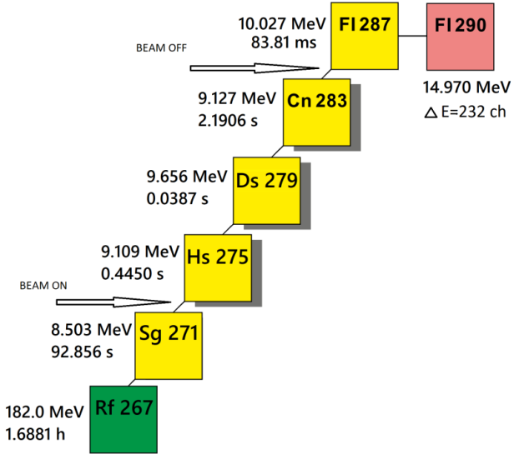
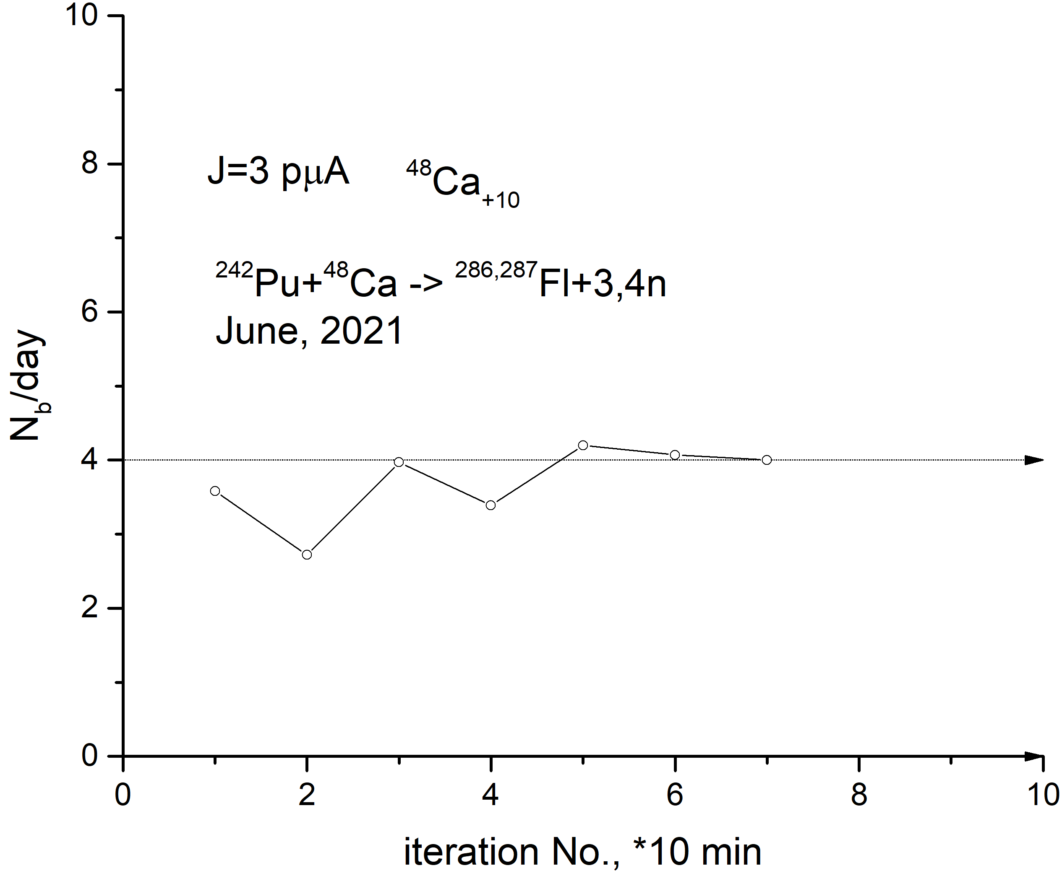
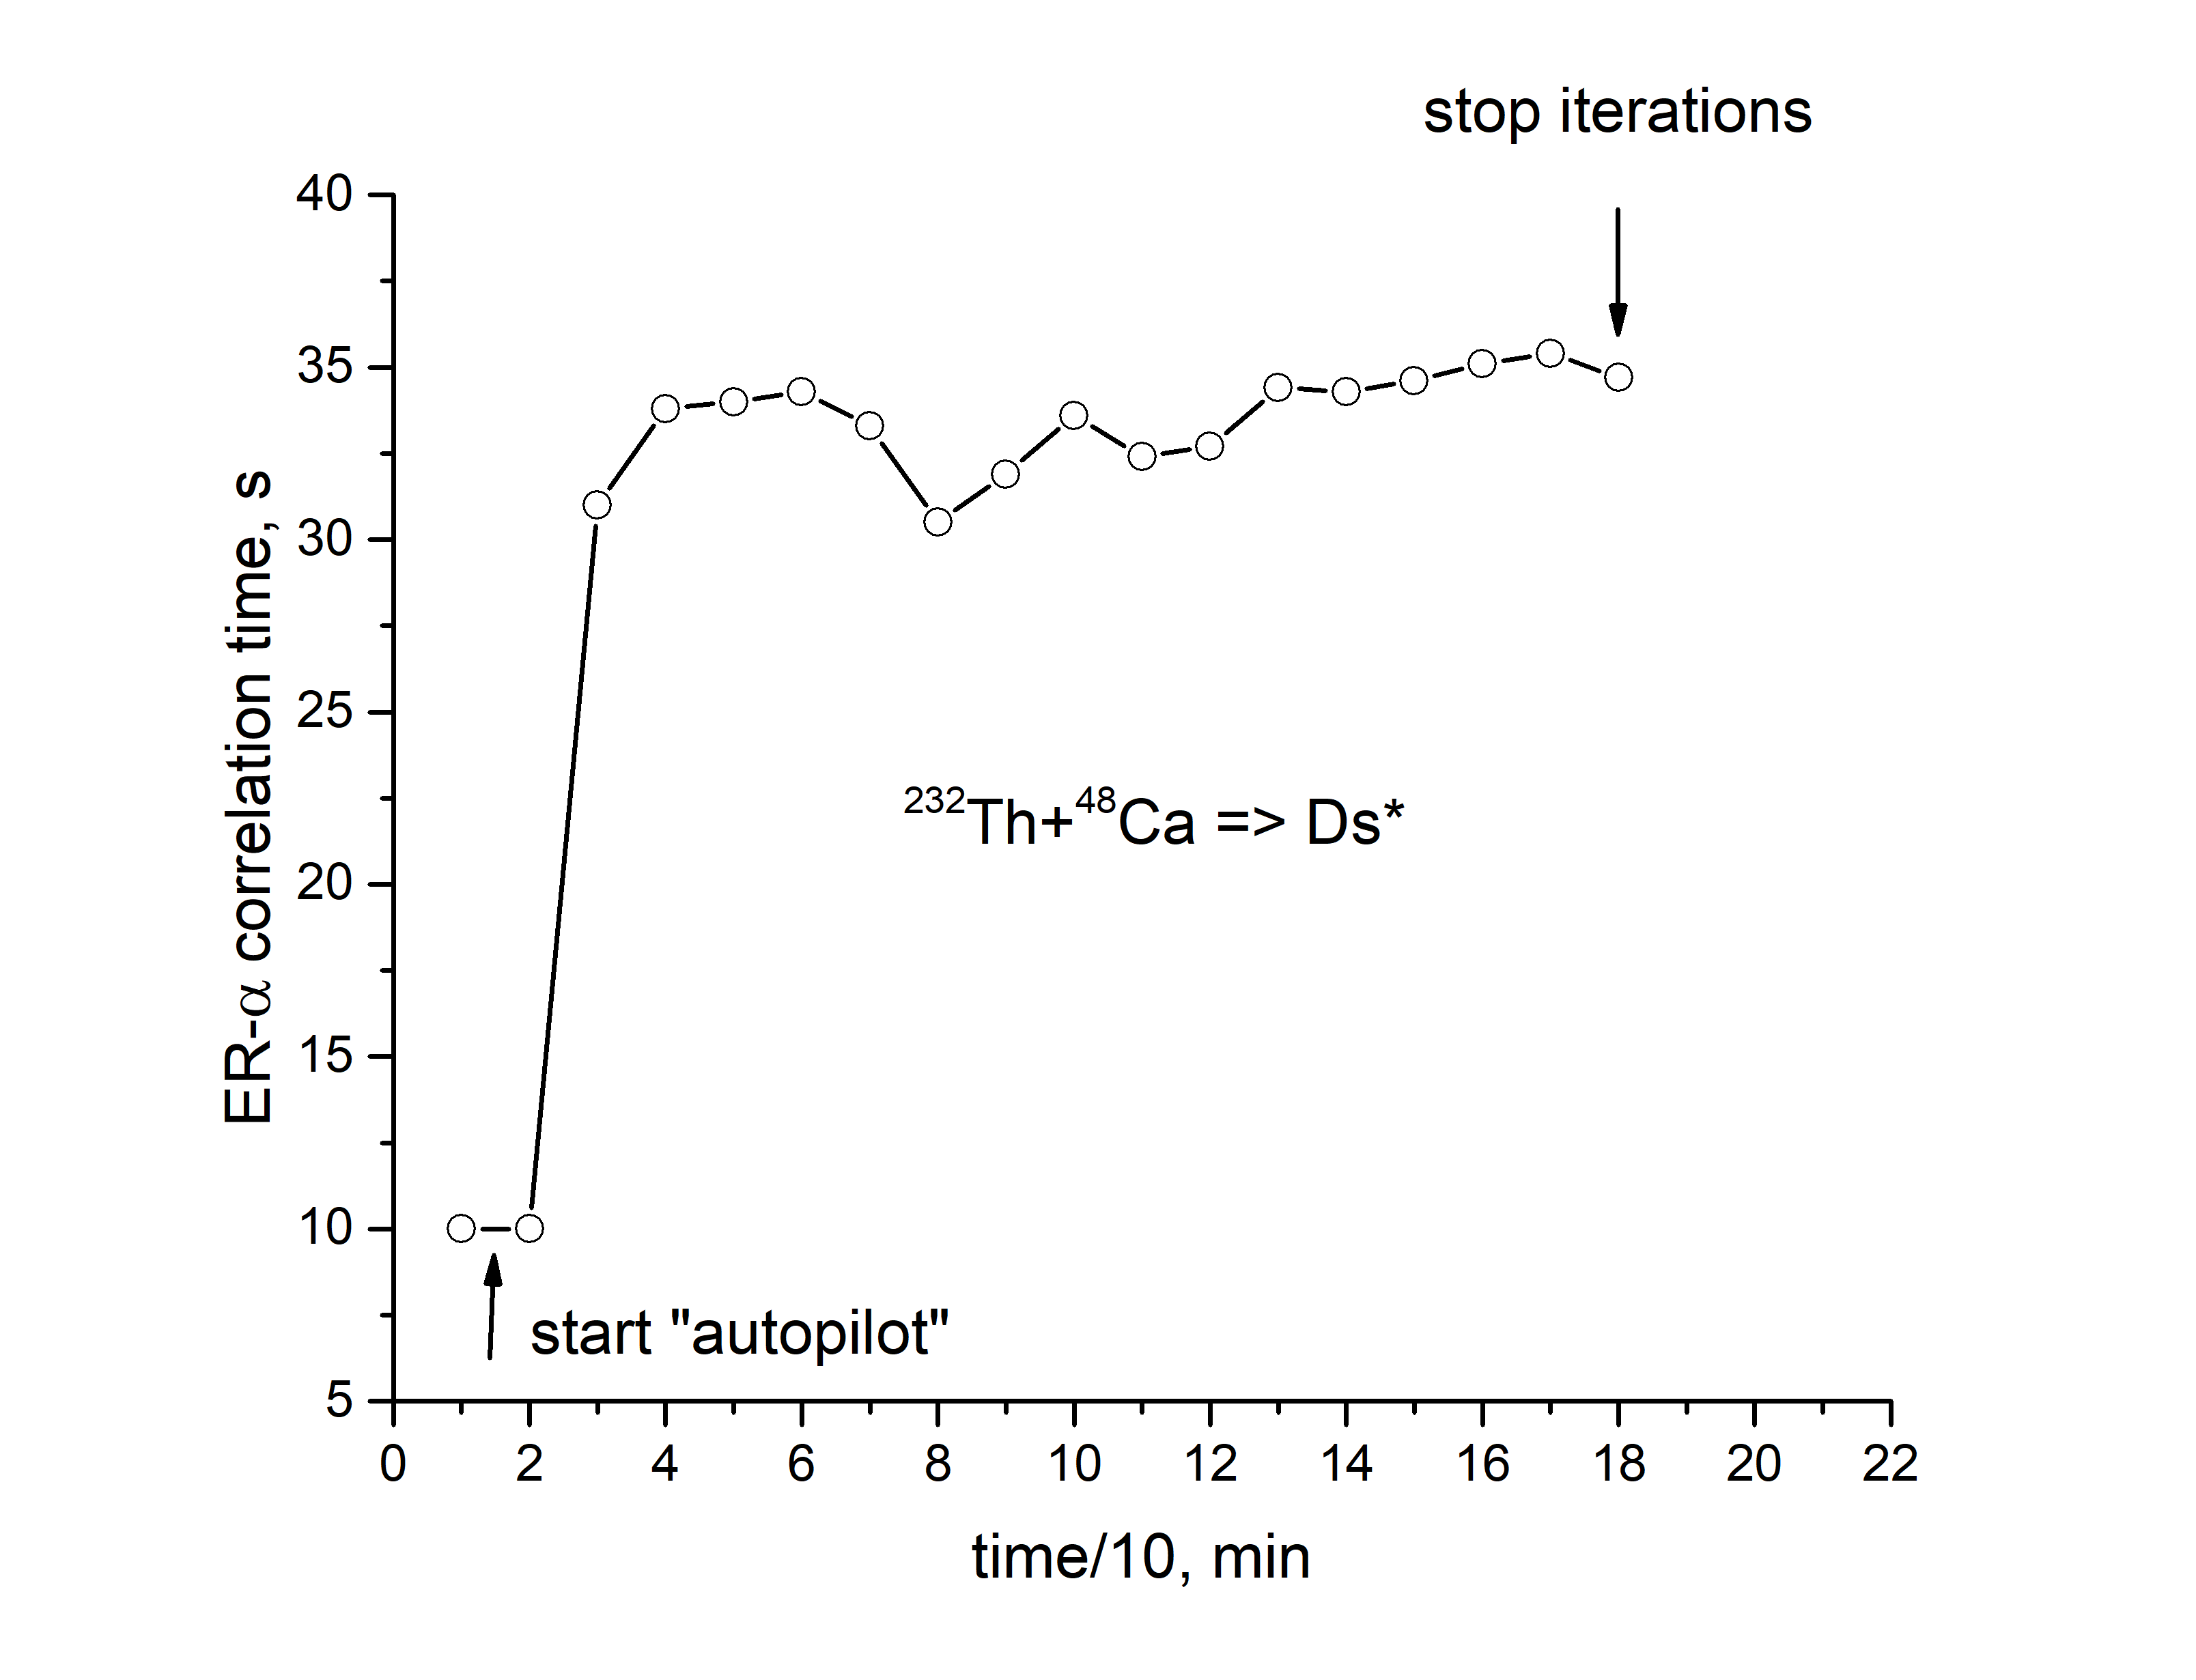
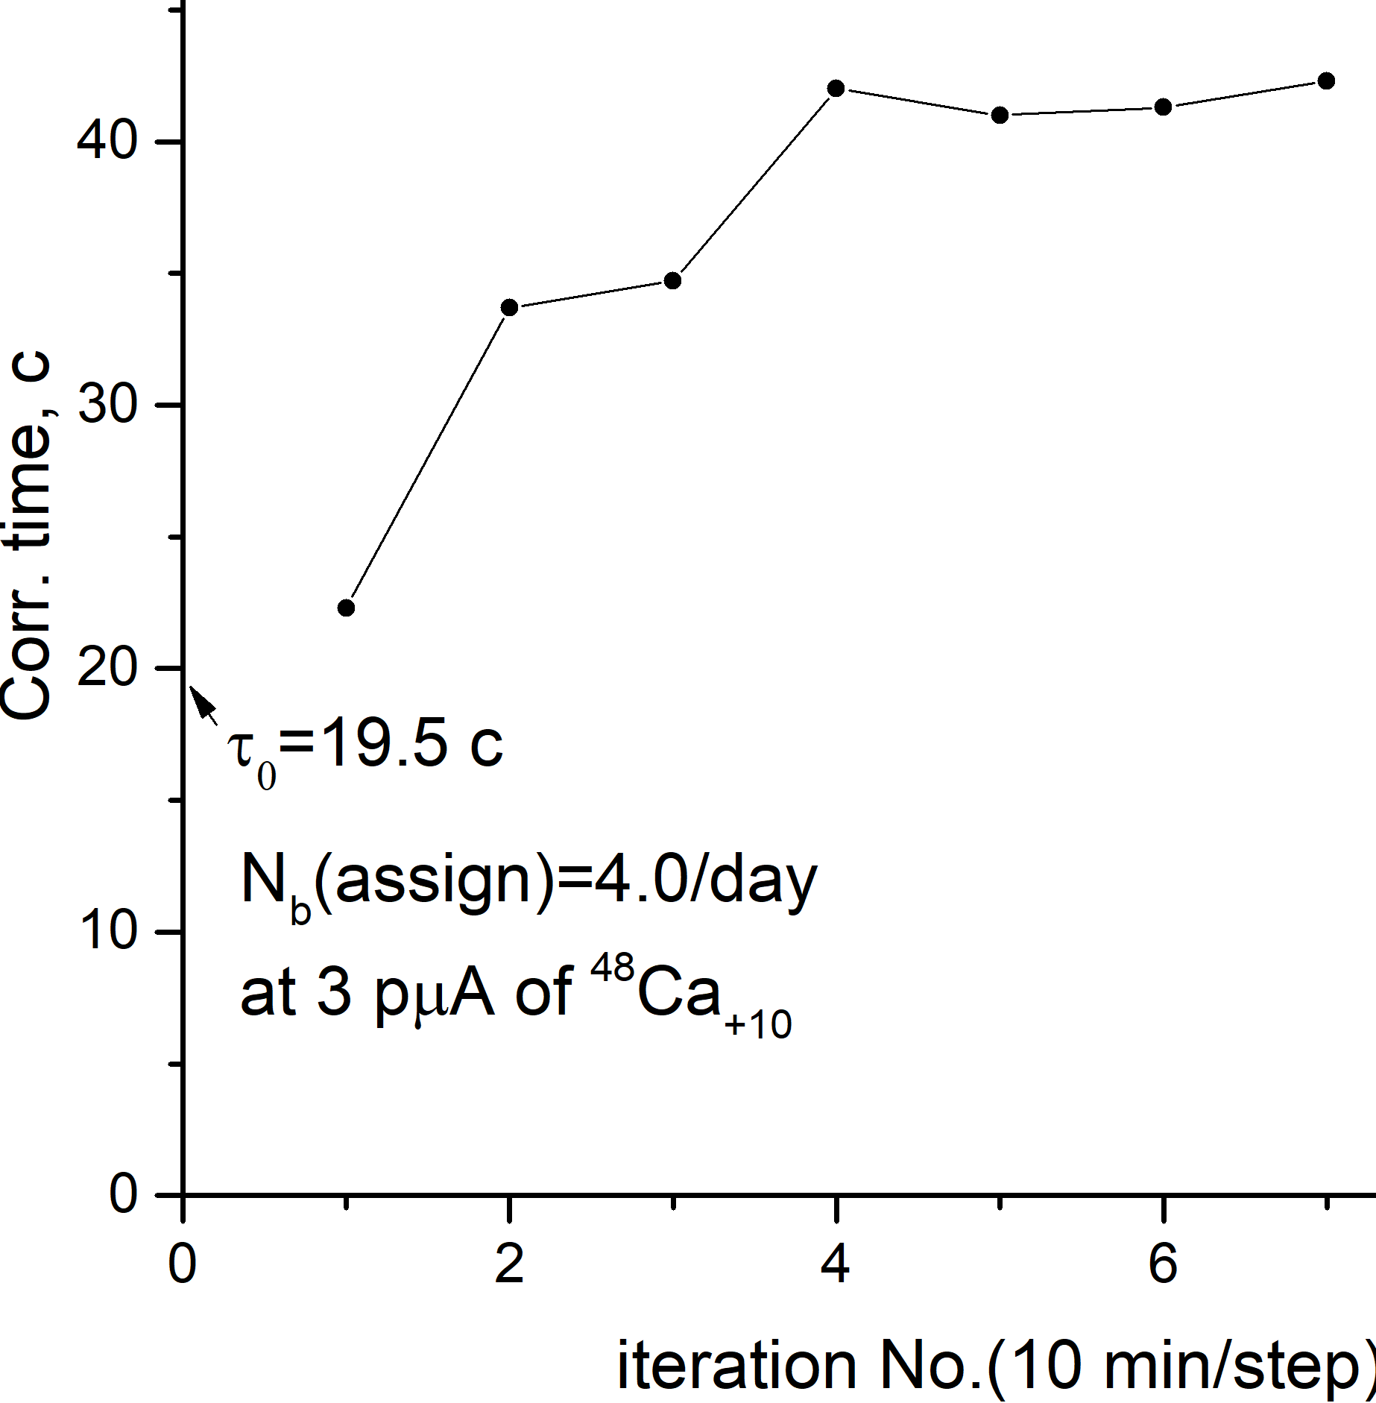
2) Flexible scenario for RT background suppression method
(probability)
#1 N_{b}/day as an optimizing parameter,
N_{b} is “ER-α “ random correlation number expectation
t₀=50 ms...t_{fin}=19,7 s
N_{b} < N₀ – one can consider as an optimization criterion;
It means, that, if (e.g.) N_{b}=10 and T_{PAUSE}=100 s,
Then → beam loss value is equal to: 1000 s= 100*1000/24/3600=
0.12%
.. Is a very good compromise value!
To start this process →
In the YDA C++ code
→press Button “Autopilot1”…
Beam intensity ~ 1.6 pµA
²⁴²Pu+⁴⁸Ca→²⁸⁷Fl+3n
June 2022
~4 pmcA

Slide 12
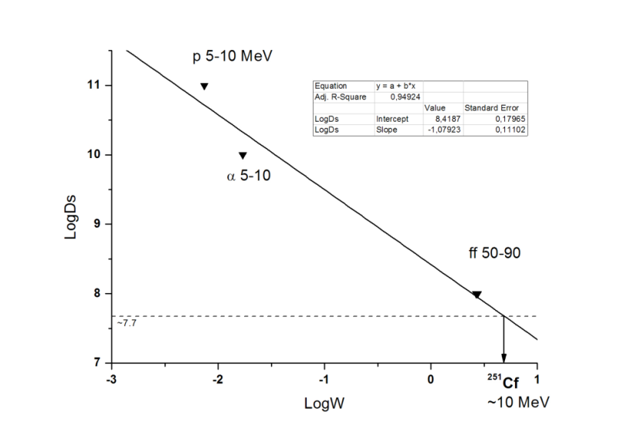
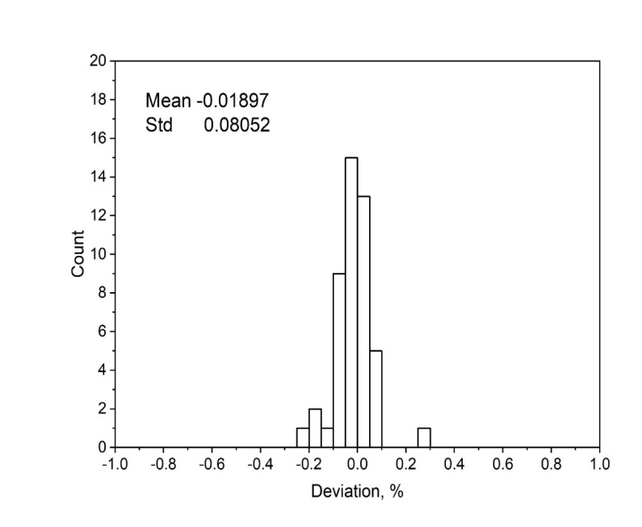
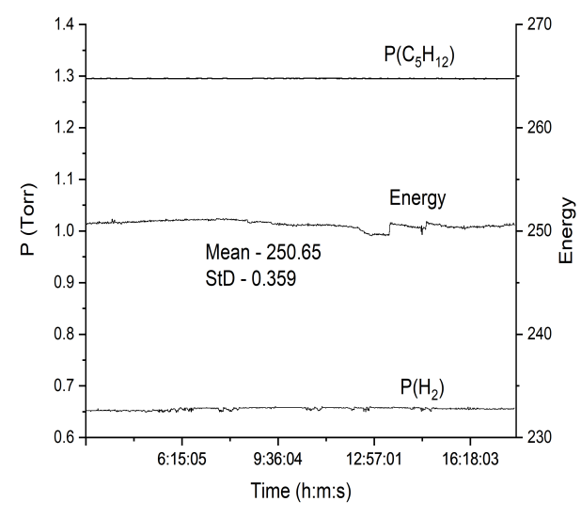
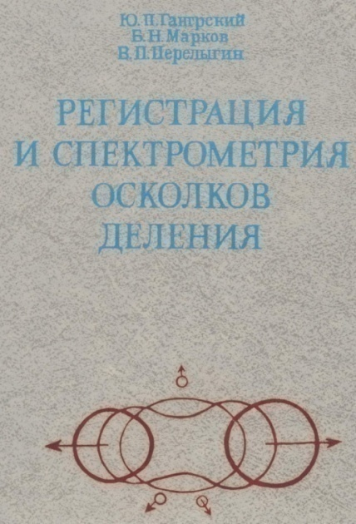
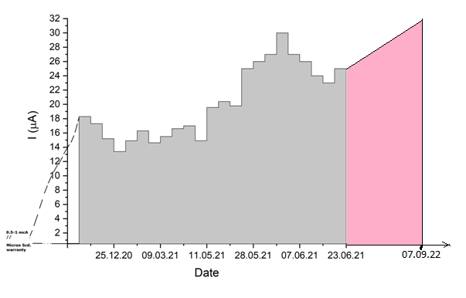
…few words about DSSSD (radiation) stability (itself, param’s)
// as a rough estimate…
~5 months
of irradiation
48 front strips
U-400
Table 17 from p. 92
Three ref. points: p,α, FF
Base –
Wilkins formula for PHD

Slide 13
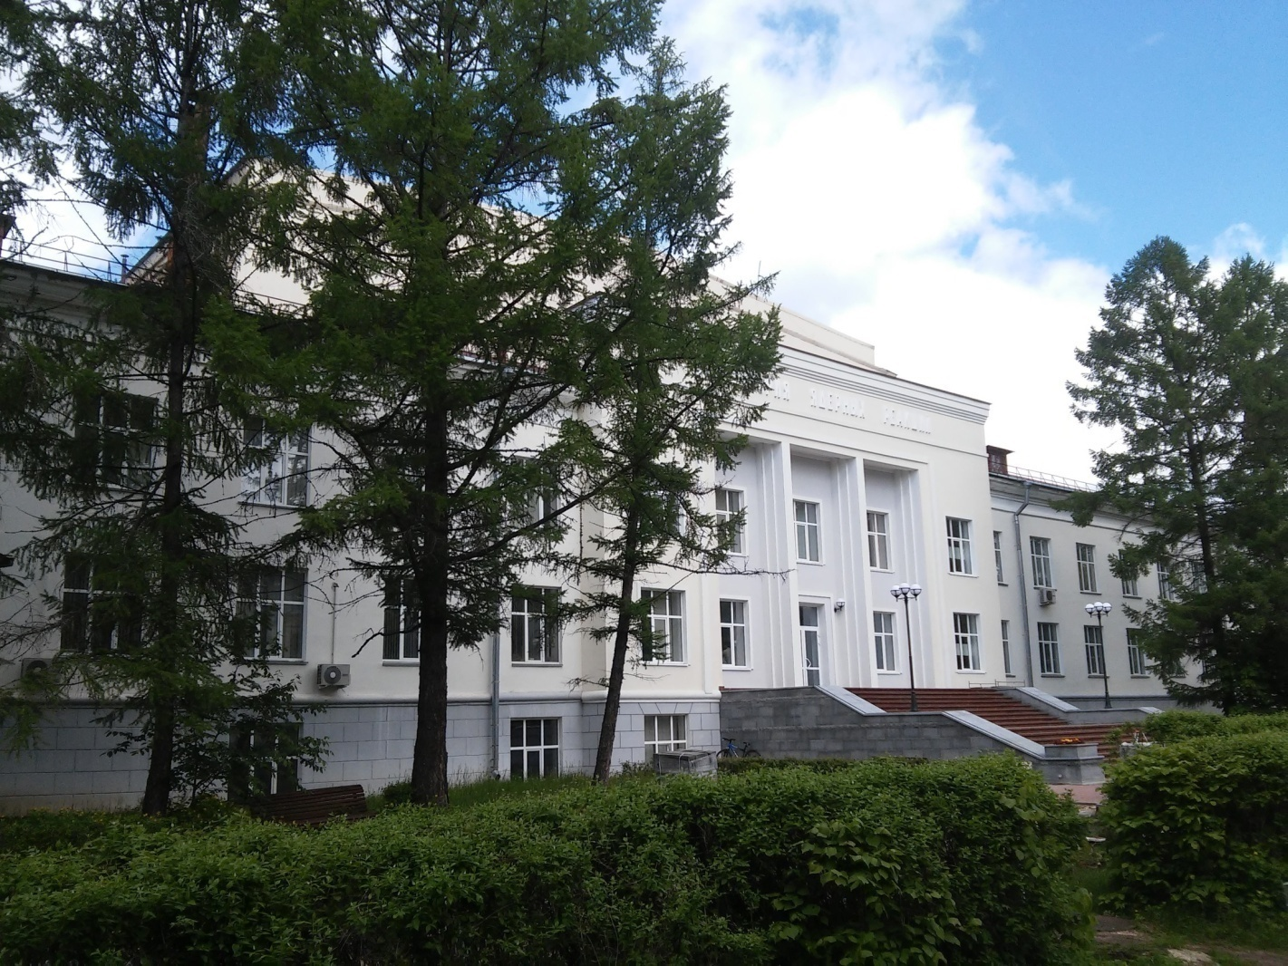
6th International Conference on Particle Physics and Astrophysics
FLNR
summary:
Long-term experiments were successfully performed with a new analog spectrometer
2) flexible scenario for ER-alpha sequences search algorithm has been tested during a few hours tests in the ⁴⁸Ca beams up to ~7 pμA;
3) System is ready for nearest future experiments with ⁴⁸Ca, ⁵⁰Ti,⁵⁴Cr projectile.

Slide 14
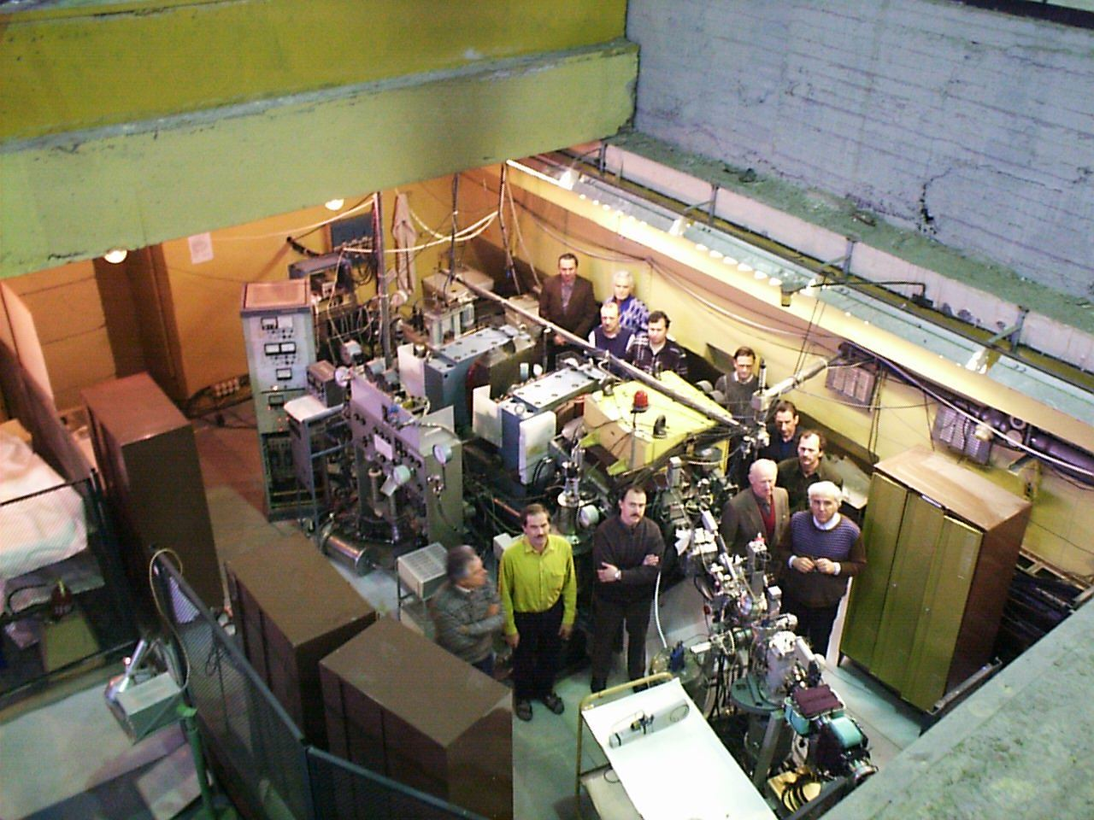
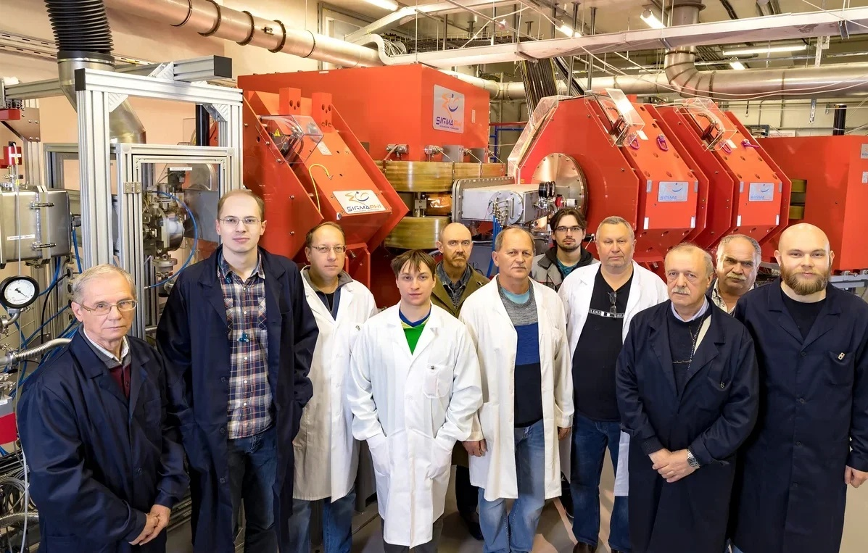
New discovery is
only a new discovery,
but, new methodology
is several new discoveries!
© Prof. V.V. Volkov (FLNR, JINR)
Thank you for attention !
The DGFRS-1 team; ~1999
All the new superheavy nuclei in the reactions
with ⁴⁸Ca at JINR were discovered with
use of the DGFRS-1 alone !!!
The DGFRS-2 team 2020
There are no applied sciences,
there are only
applications of Science!
(L. Paster (?) )
( star markers –MEPHI as Alma Mater)

