Slide 1
Low-pressure Time Projection Chambers for Experiments with Low-energy Ions
A. Bondar, A. Buzulutskov, V. Parkhomchuk,
A. Petroghitsky, T. Shakirova, A. Sokolov,
Budker Institute of Nuclear Physics,
Novosibirsk State University
December 2, 2022

Slide 2
Outline
Accelerator mass spectrometry
New concept of ion identification. Proof of Concept
Experimental setup
Measurements of energy spectra and track ranges
TPC with optical readout

Slide 3
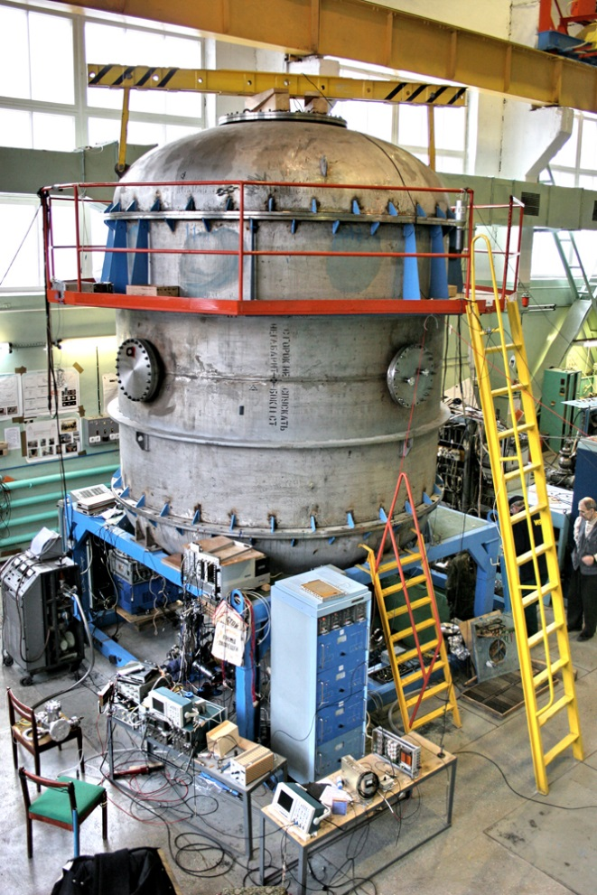
Accelerator mass spectrometry
Accelerator mass spectrometry (AMS) is an ultra-sensitive method of counting individual atoms. Usually it is the rare radioactive atoms with a long half-life. The archetypal example is ¹⁴C which has a half-life of 5730 years and an abundance in living organisms of 10⁻¹² relative to stable ¹²C isotope.
AMS facilities operate in more than 100 physical laboratories worldwide, one of which is located in Novosibirsk at Geochronology of the Cenozoic Era Center for Collective Use.

Slide 4
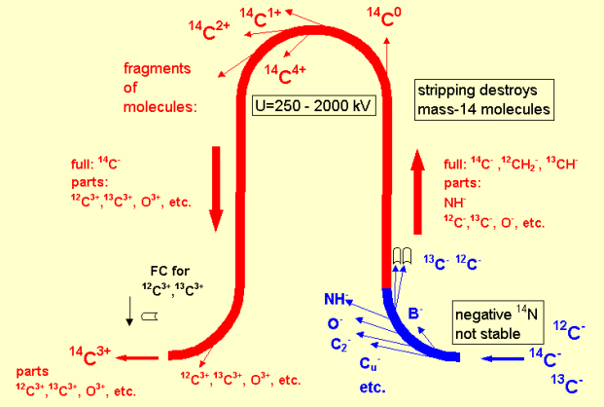
BINP AMS
1. Formation of an ion beam from atoms of the test sample
2. Ion selection at low energy
3. Ion acceleration
4. Recharging of atomic ions and destruction of molecular ions in magnesium target
5. Ion selection in a high voltage terminal
6. Ion acceleration
7. Ion selection at high energy
8. Identification and counting of ions
BINP AMS provides reliable separation of a pure beam of radiocarbon ions from the accompanying ion background.

Slide 5
Isotopes used in AMS
Analyzed isotopes | Half life | Stable isotopes | Stable isobars
¹⁰Ве | 1,39 million years | ⁹Be | ¹⁰B
¹⁴C | 5730 years | ^{12,13}С | ¹⁴N*
²⁶Al | 717 thousand years | ²⁷Al | ²⁶Mg*
³⁶Cl | 301 thousand years | ^{35,37}Cl | ³⁶Ar*, ³⁶S
⁴¹Ca | 102 thousand years | ^{40,42,43,44}Ca | ⁴¹K
¹²⁹I | 15,7 million years | ¹²⁷I | ¹²⁹Xe*
* - isobars that do not form stable negative ions.
In the current AMS BINP setup the time-of-flight technique is used for the isotopes separation. But that technique there is a serious problem of separating the isobars - different chemical elements having the same atomic mass. The typical example are radioactive isotopes ¹⁰Be and ¹⁰B.

Slide 6
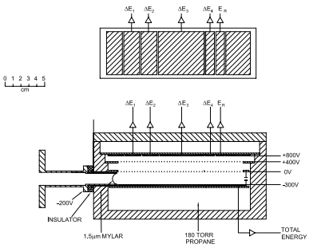
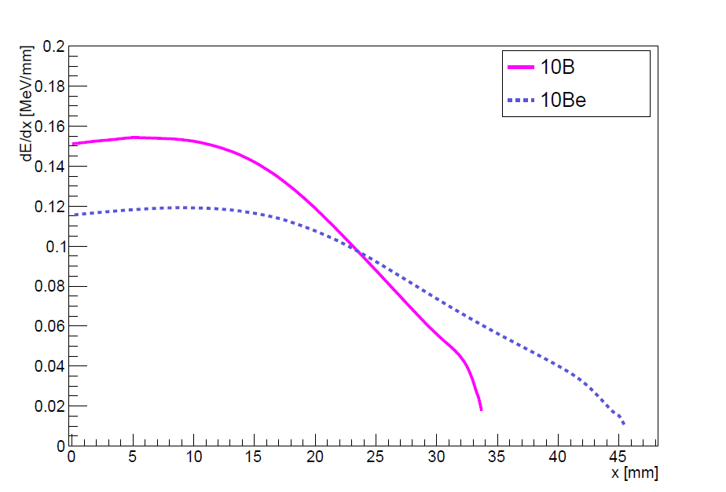
Traditional concept of ion identification at AMS
Detectors used to count the AMS isotope:
silicon detectors;
time-of-flight systems (BINP AMS);
ionization chambers.
∆Е-Е detectors
A cross section through the multi-element ionization chamber. The upper panel shows a plan view of the anode electrode.
Ions track lengths at 50 Torr of i-C₄H₁₀
6

Slide 7
New concept of ion identification: low-pressure TPC
Schematic layout
Cathode
Shaping amplifiers
Ion beam from AMS
or alpha particles
Ion track
Ionization
$$\vec{E}$$
Isobutane
Charge-sensitive
preamplifiers
Si₃N₄ window
GEM
Anode
Oscilloscope

Slide 8
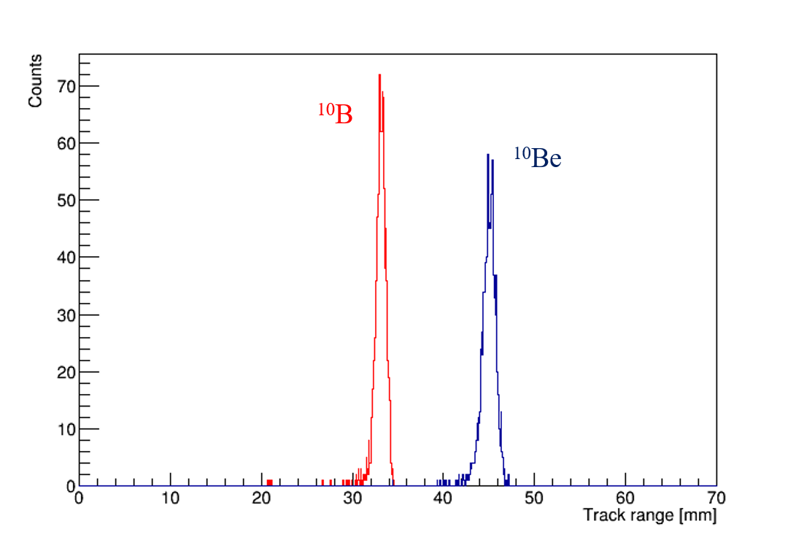
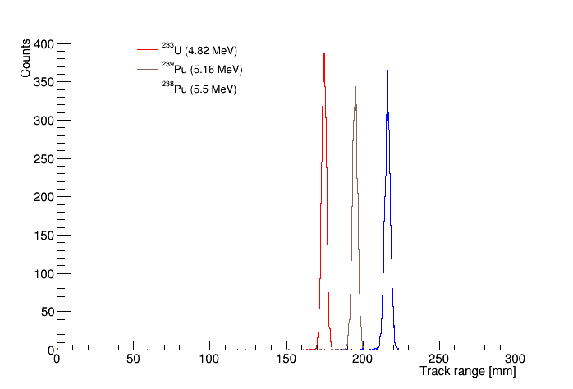
Proof of concept: measuring track ranges
SRIM (The Stopping and Range of Ions in Matter Software) –
is a collection of software packages which calculate many features of the transport of ions in matter.
Track ranges distributions in the low-pressure TPC for 4.025MeV ¹⁰B and ¹⁰Be ions for 200 nm silicon nitride window and 50 torr isobutane, obtained using SRIM simulation.
Ion ranges distributions in the low-pressure TPC for alpha particles with different energies for 200 nm silicon nitride window and 50 torr isobutane, obtained using SRIM simulation.

Slide 9
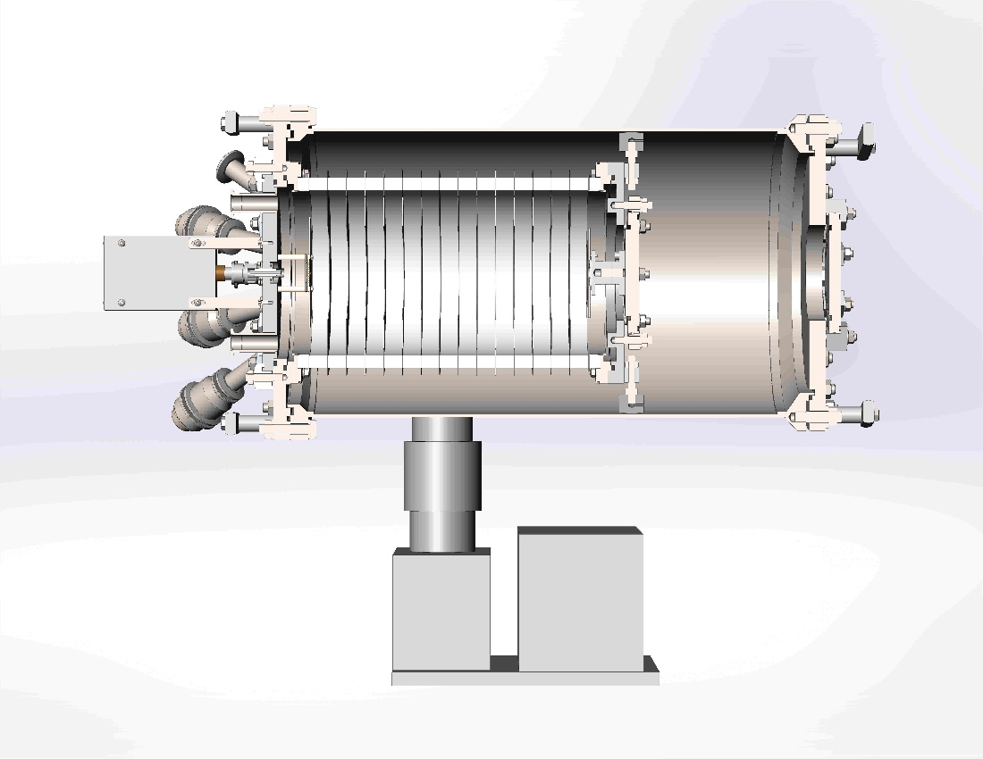
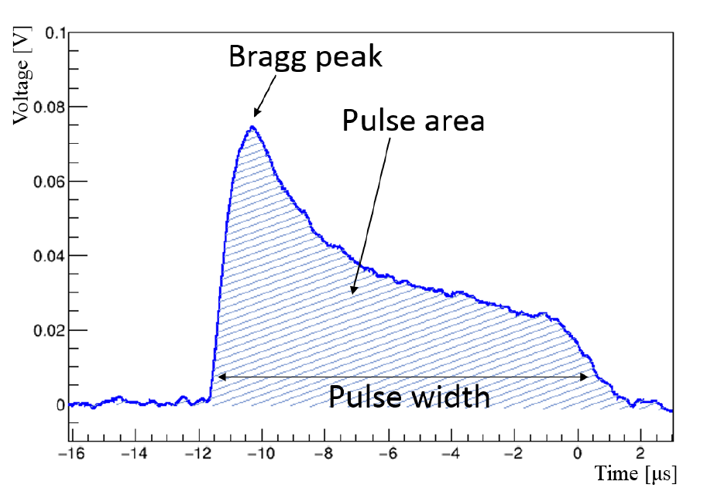
TPC Prototype: Principle of operation
Typical waveform shape of the signal from the alpha particle in low-pressure TPC
300
178
²³³U, ²³⁸Pu, ²³⁹Pu
source
Diameter – 178 mm
Length – 300 mm
pulse width $\sim$ track range
pulse area $\sim$ energy

Slide 10
Test installation appearance

Slide 11
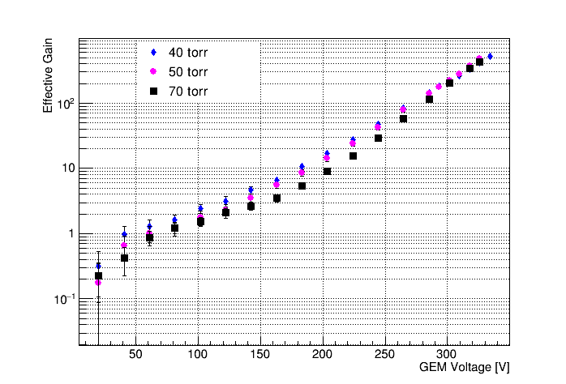
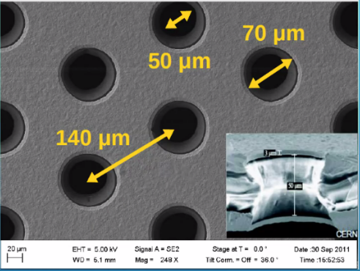
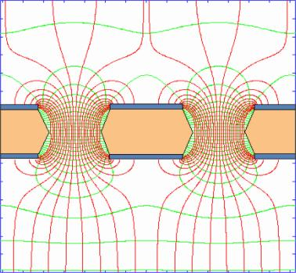
Effective gain of GEM
GEM effective gain as a function of the voltage in isobutane at pressures varying from 40 to 70 torr in the low-pressure TPC.
Electric field inside the holes.
50 µm
11

Slide 12
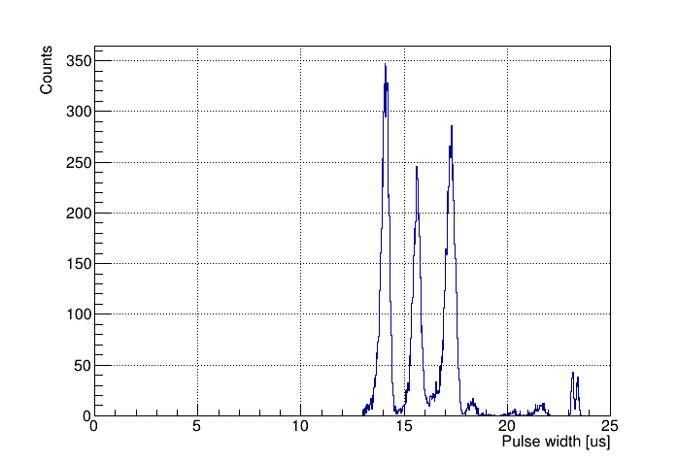
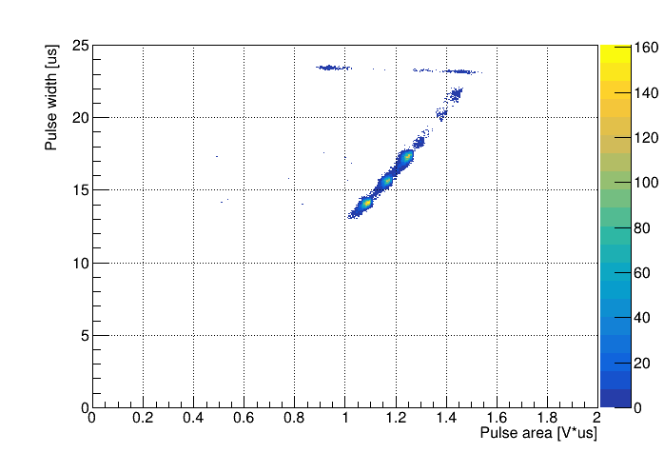
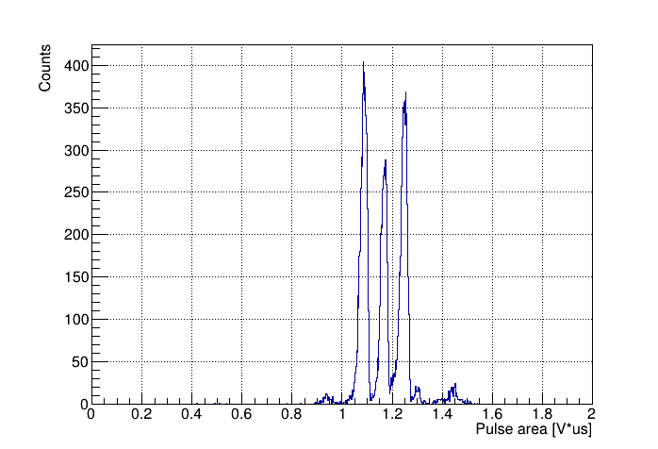
The measurement of track ranges
The alpha-particle source
²³³U, ²³⁹Pu, ²³⁸Pu
$$E_{α}=4,816 МэВ$$
$$E_{α}=5,157 МэВ$$
$$E_{α}=5,499 МэВ$$
Pressure = 50 Torr
Gain = 225
Shaping time = 200 ns
2D plot of pulse width versus pulse area and their axis projection spectra for alpha particles from ²³³U (4.8 MeV), ²³⁹Pu (5.2 MeV) and ²³⁸Pu (5.5 MeV) source, measured in low-pressure TPC in Isobutane at 50 Torr and GEM gain of 225.
The pulse width and pulse area spectra reflect those of the track range and energy.
12

Slide 13
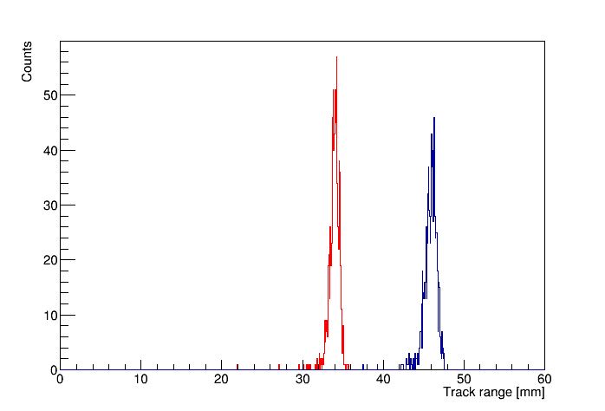
Results
Source | Shaping time | Gain | Pressure | Sigma/Range, % | Separation in sigma between two peaks
3 isotopes | 200 ns | 225 | 50 Torr | 1.24 | 8
¹⁰B
¹⁰Be
Using these results and SRIM code simulations, it is shown that isobaric boron and beryllium ions can be effectively separated at AMS, providing efficient dating at a 10 million years scale. This technique will be applied in the AMS facility in Novosibirsk.
Spectra of ion ranges for ¹⁰B and ¹⁰Be with energy 4.025 MeV in Isobutane at 50 Torr simulated with SRIM.
13

Slide 14
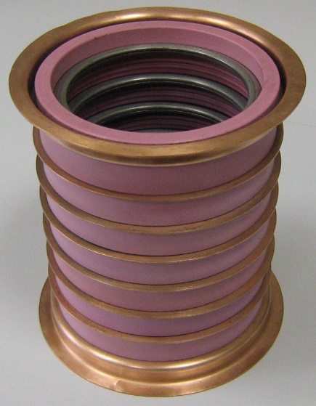
TPC for BINP AMS
70 mm
110 mm

Slide 15
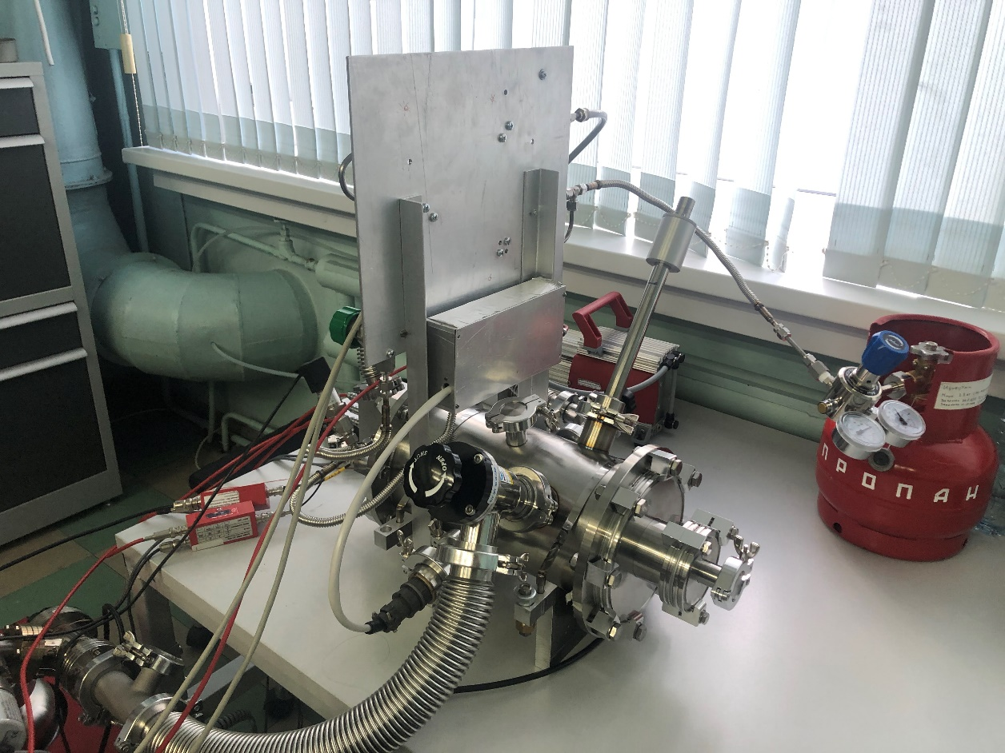
TPC for BINP AMS

Slide 16
Measuring reaction cross-section of p+¹¹B → 3α + 8.7 MeV
Neutronless Fusion Reaction
Large fuel reserves: 80% of natural boron – ¹¹B isotop;
no radiation in energy production: no neutrons are produced, no problem of disposal of "activated" materials, no radioactive waste;
Direct production of electricity: reaction products are 3 α-particles.
TAE (Tri Alpha Energy) Technologies
Controlled fusion in a field reversed configuration and direct energy conversion.
“It aims to manufacture a prototype commercial fusion reactor by 2030.”
HB11 Energy
HB11 Energy aims to create a new source of clean, safe and reliable energy using laser technology to fuse Hydrogen and Boron-11.
https://tae.com
https://hb11.energy/

Slide 17
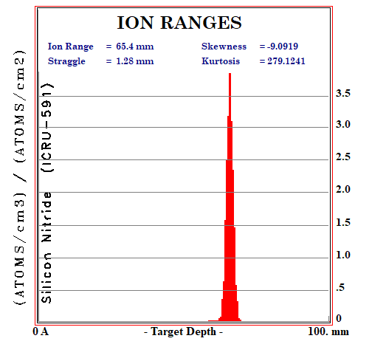
TPC with Optical ReadOut
PMT
R11065
Version 1:
continuous beam
Quartz window
Gating grids
Cathode
$$\vec{E}$$
α
E = 4 MeV
GEM
(anode)
Si₃N₄
window
α
E = 1 MeV
Orca-flash 4.0
CMOS camera
p
E = 2 MeV
α
E = 4 MeV
Lens Kowa
16 mm
B(CH₃O)₃ (100 torr) + CF₄ (150 torr)
Glass window
PMT
R11065
Quartz window
Семинар секции плазмы ИЯФ
17

Slide 18
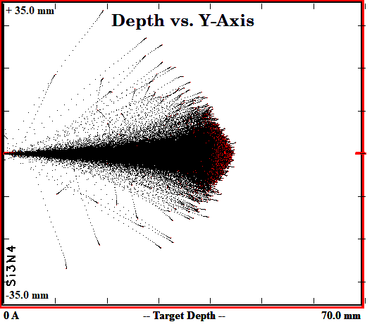
TPC with Optical ReadOut
Version 2
Pulse beam
Cathode
GEM
(anode)
$$\vec{E}$$
α
E = 4 MeV
Si₃N₄
window
Beam killer
α
E = 1 MeV
Orca-flash 4.0
CMOS camera
p
E = 0.7÷1 MeV
α
E = 4 MeV
Lens Kowa
16 mm
B(CH₃O)₃ (100 torr) or
B(CH₃O)₃ (100 torr) + He (150 torr)
Glass window

Slide 19
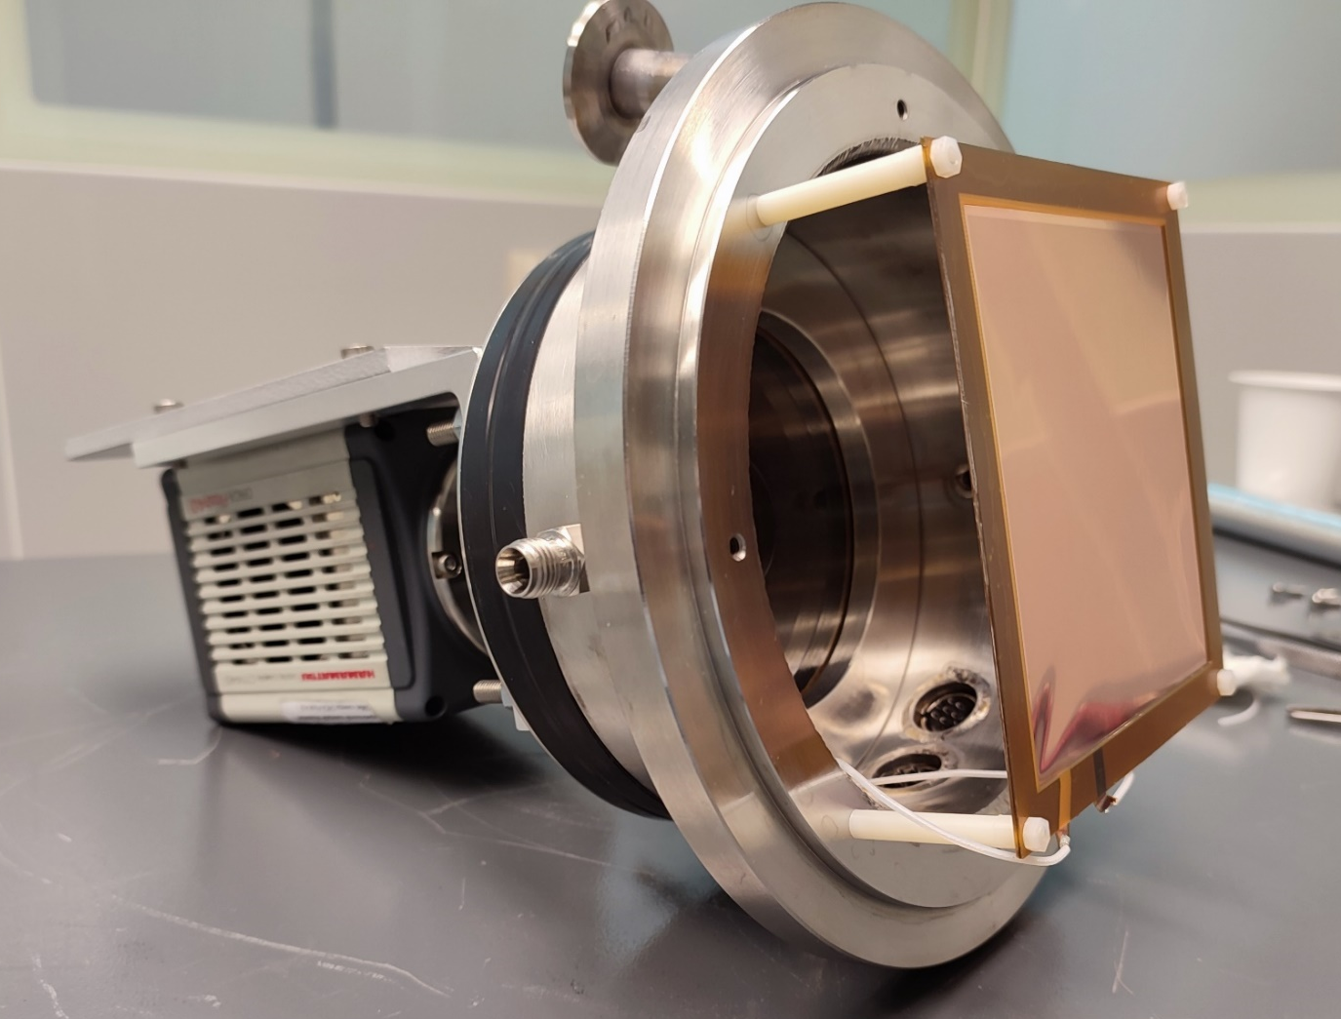
TPC with Optical Readout
Photo of assembly with the GEM, an optical window and the camera ORCA-Flash4.0;
Only one GEM has shown. In the final version, the triple GEM was used.
Size of GEM 10x10 cm² fully matched with the camera matrix size 11x11 mm². The spatial resolution in that case is about 50µm.
The maximum frame rate of the camera is 100 Hz.

Slide 20
TPC with Optical Readout
TPC with the optical readout installed.
High voltage divider for the triple GEM is open.

Slide 21
TPC with Optical Readout
Optical readout testing.
The sum of 100 consecutive frames with a shutter speed of 100 ms.
Gas amplification is about 1000.
Gas medium is pure CF₄ with 300 Torr absolute pressure.

Slide 22
Conclusion
A new concept of the detector for the accelerator-based mass spectrometer was proposed for identifying ions by their stopping range in gas;
A low-pressure TPC based on this concept have been made and successfully tested;
The TPC is ready for the installation on AMS;
The new idea of the optical readout from TPC was suggested and successfully tested;
The concept of two experiments with the use of the low-pressure TPC is proposed.

Slide 23
Thank you for your attention!
23

Slide 24
Backup slides
24

Slide 25
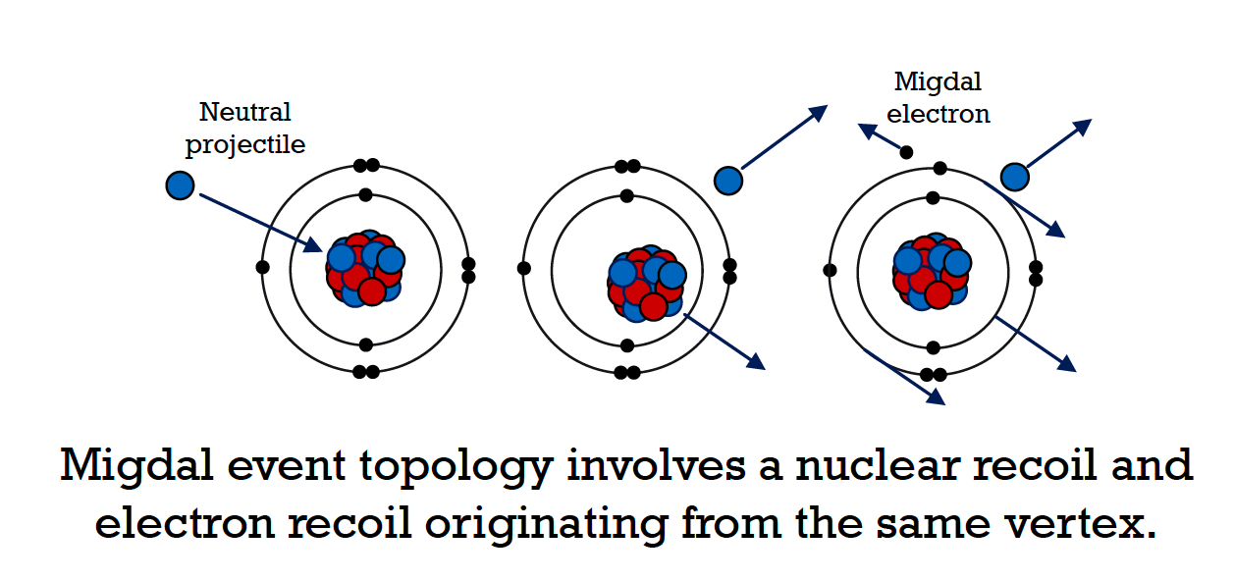
Migdal effect
Looking for a rare (10⁻⁵) atomic phenomenon never before observed in the nuclear scattering
Migdal effect increases sensitivity of DM experiments to low mass WIMPs
Aim of the MIGDAL experiment - unambiguous observation and measurement of the Migdal effect using a low pressure Optical TPC
Signal signature: “V-like” shaped event with two tracks from electron and NR with different dE/dx and sharing the same vertex

Slide 26
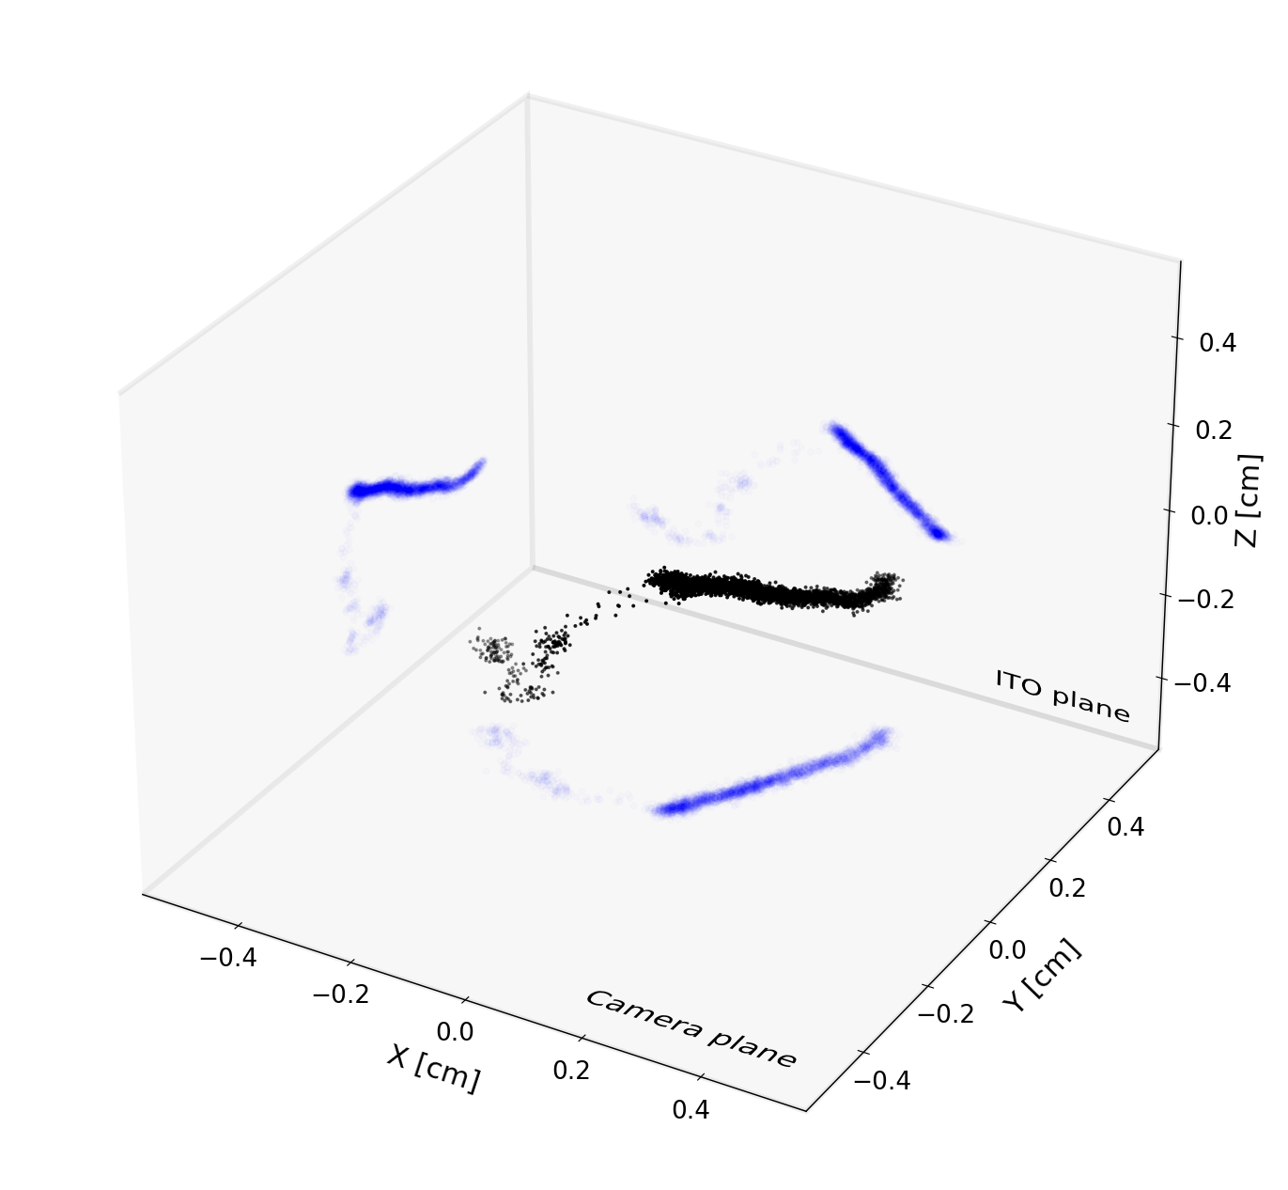
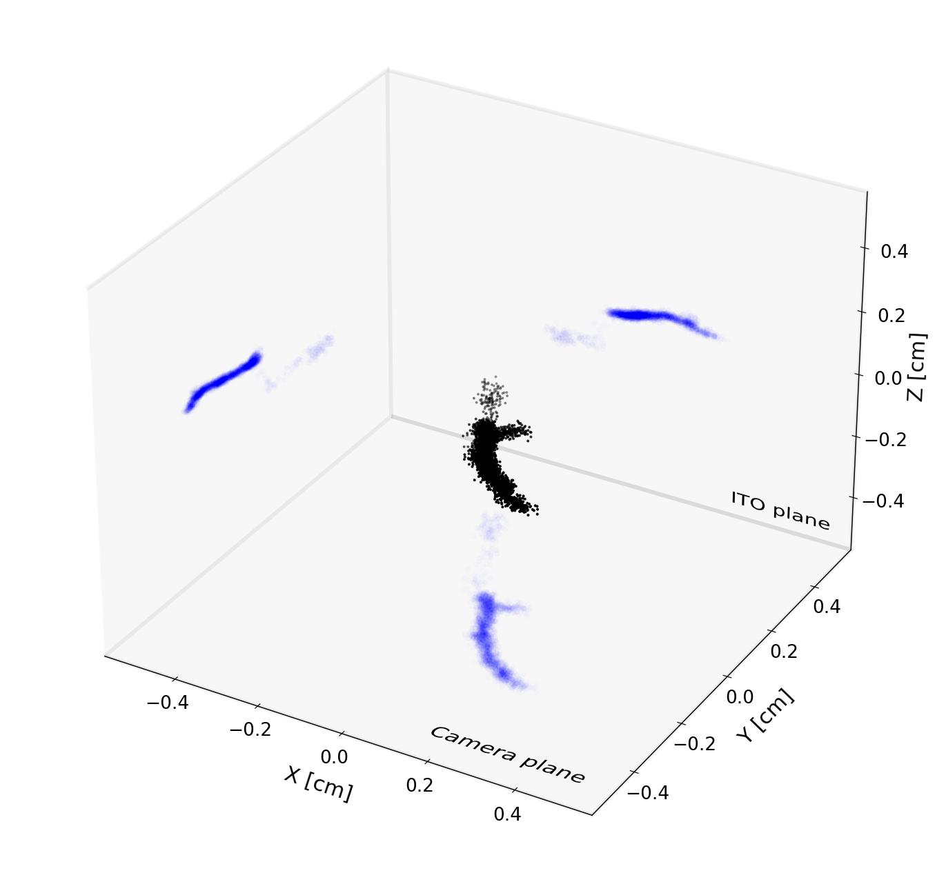
Simulated Migdal events in 100% CF₄ at 50 Torr
Electron
Secondary recoil
Primary recoil
Ionisation from electron using DEGRAD and full recoil cascade simulation using TRIM
150 keV Fluorine recoil and 7.5 keV electron
150 keV Fluorine recoils and 5 keV electron (secondary recoil clearly visible)

Slide 27
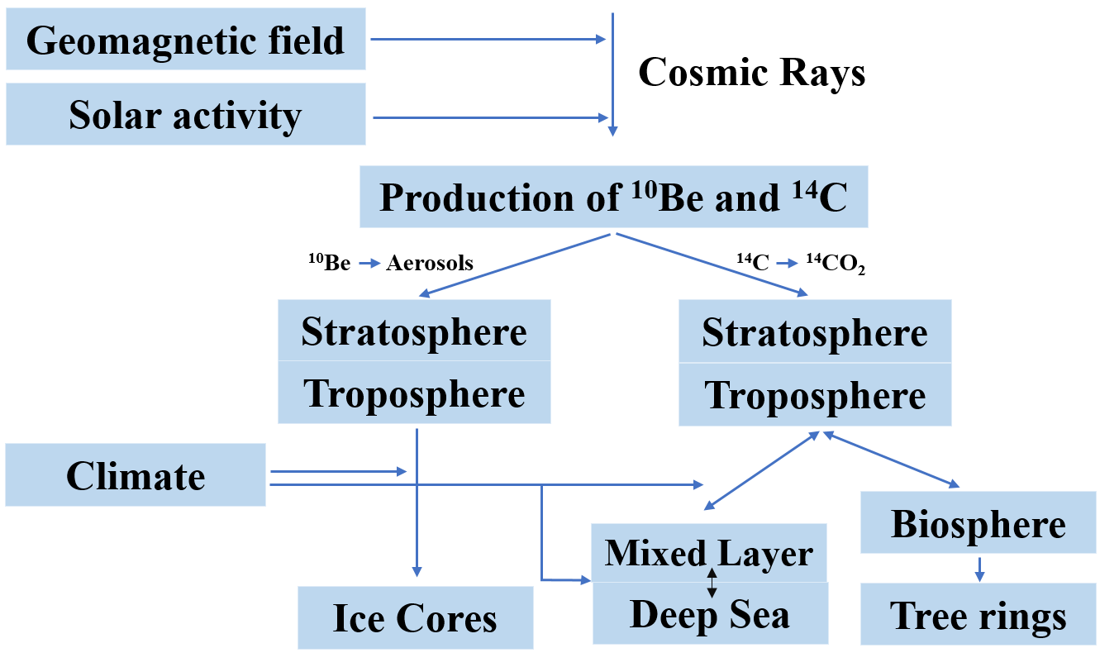
Formation and application ¹⁰Be
Application in-situ and
meteoric ¹⁰Be:
exposure dating to identified the growths and decays of the Antarctic ice sheet;
understanding ice shelf collapse history;
paleomagnetic excursions history reconstructions using ice cores;
understanding the erosion rates using depth profiles of mid latitudes outcrops;
identifying the timing of formation of the impact crater and so forth.
Time intervals of dating:
¹⁴C from 300 years to 40-60 thousand years
¹⁰Be from 1 thousand years to 10 million years

Slide 28
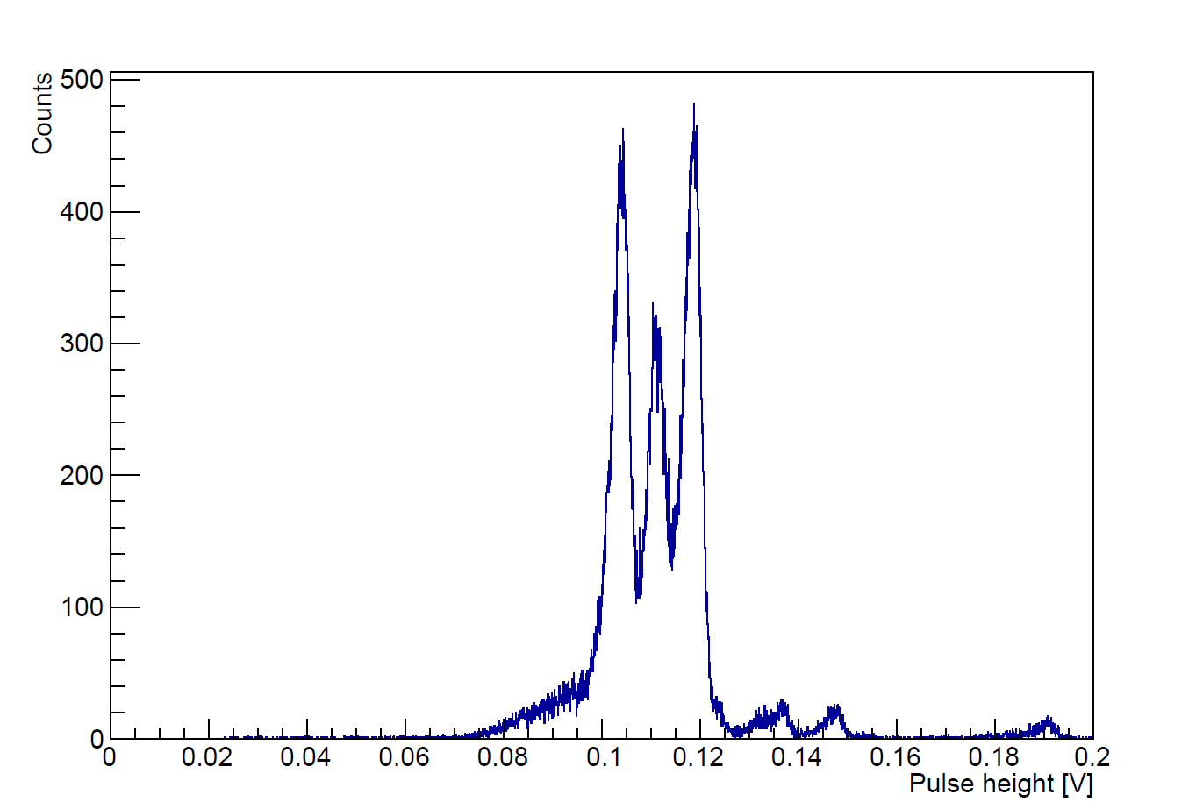
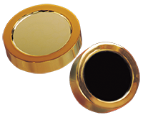
Measurements of energy spectra using semiconductor detector
Alpha particle source– ²³³U, ²³⁹Pu , ²³⁸Pu
$$E_{α}=4,816 МэВ E_{α}=5,157 МэВ E_{α}=5,499 МэВ$$
Si Charged Particle Radiation Detectors for Alpha Spectroscopy
Energy spectrum of alpha particles from ²³³U (4.8 MeV), ²³⁹Pu (5.2 MeV) and ²³⁸Pu (5.5MeV) sources, measured using semiconductor detector
28

Slide 29
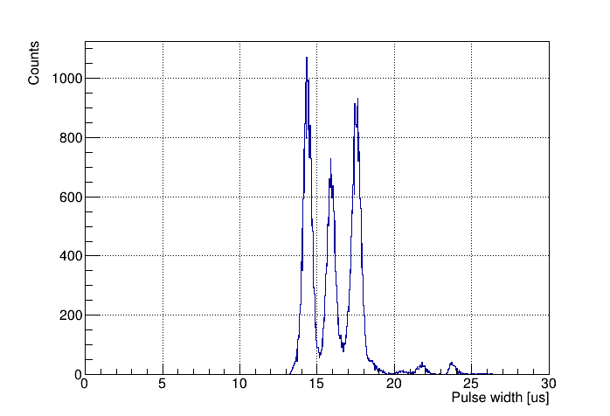
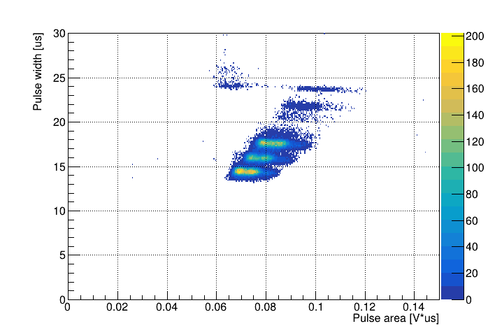
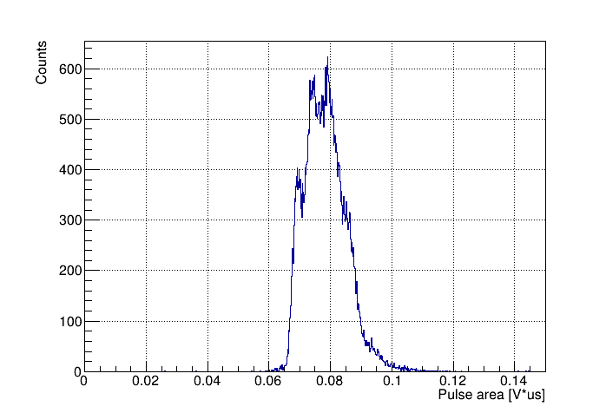
The measurement of track ranges
The alpha-particle source
²³³U, ²³⁹Pu, ²³⁸Pu
$$E_{α}=4,816 МэВ$$
$$E_{α}=5,157 МэВ$$
$$E_{α}=5,499 МэВ$$
Pressure = 50 Torr
THGEM Gain = 67
Shaping time = 200 ns
2D plot of pulse width versus pulse area and their axis projection spectra for alpha particles from ²³³U (4.8 MeV), ²³⁹Pu (5.2 MeV) and ²³⁸Pu (5.5 MeV) source, measured in low-pressure TPC in Isobutane at 50 Torr and THGEM gain of 67.
The pulse width and pulse area spectra reflect those of the track range and energy.
29

Slide 30
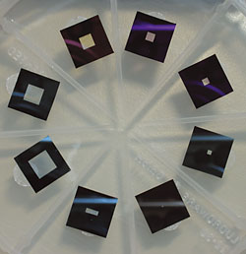
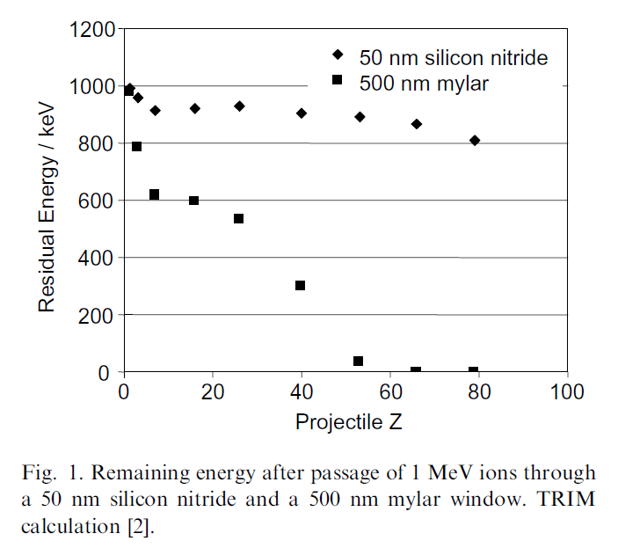
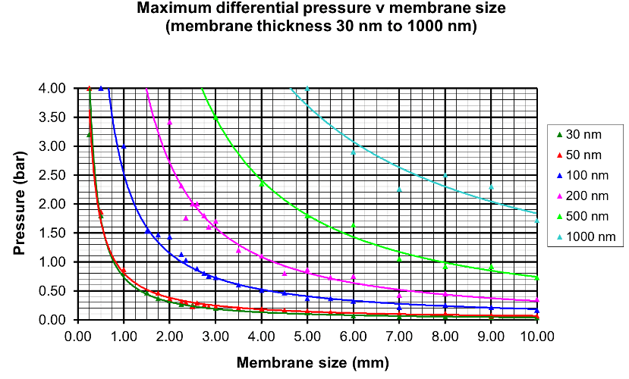
Silicon nitride membrane windows
Figure of silicon nitride membrane windows
M. Dobeli et al., Nucl. Instr. and Meth. B, 219-220 (2004) 415-419 doi:10.1016/j.nimb.2004.01.093
30

Slide 31
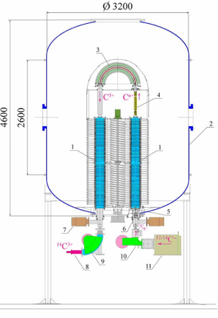
BINP AMS
Характерные особенности УМС ИЯФ:
мишень на парах магния для разрушения молекул $→$ локализованное место развала молекул;
сортировка ионов по энергии сразу после разрушения молекулярных ионов$→$ эффективное отсеивание осколков молекул, т.к. энергия кусков молекулы всегда меньше энергии молекулы;
времяпролетный детектор с регистрацией момента прилета ионов.
Схема УМС ИЯФ:
1 – ускорительная трубка, 2 – бак ускорителя, 3 – электростатический поворот на 180°, 4 – магниевая мишень, 5 – корректор, 6 – электростатическая линза, 7 – вакуумный насос, 8 – детектор ионов, 9 – дипольный магнит спектрометр на высокой энергии, 10 – дипольный магнит спектрометр на низкой энергии, 11 – ионный источник.
31

