Slide 1
Notes to Modernization of the SM
Vladimir Burdyuzha, Oleg Dal’karov
Lebedev Physics Institute, Moscow
National Research Nuclear University, Moscow November 30, 2022

Slide 2
Why modernization of SM is necessary?
Some astrophysical phenomena
«request» an expansion of the SM
As an example:
1) baryon asymmetry;
2) next fundamental level of matter

Slide 3
Introduction
Particles were produced from energy of curvature
(Parker, 1968; Polyakov ,2010)
They may be produced in strong magnetic, electrical
and gravitation fields and during cosmological cycles.
Now in our Universe n=10⁸⁸ but only baryons!!!
Where are anti baryons?
η_{В}≡n_{B}/n_{γ}= 6.05x10⁻¹⁰
η^{CMB}= 6.3 ± 0.3 x 10⁻¹⁰ η^{BBN}= (3.4 - 6.9) x 10⁻¹⁰
Planck experiment Big Bang Nuclei Synthesis

Slide 4
Sakharov’s conditions
In our Universe CPT conservation takes place
To generate the baryon asymmetry dynamically,
Sakharov’s conditions should be fulﬁlled:
1) Baryon number B violation,
2) C-symmetry and CP-symmetry violation,
3) Interactions out of thermal equilibrium.
quarks B=1/3 antiq. B=-1/3; electron L=1 positron L=-1
proton B=1; anti proton B=-1

Slide 5
Forbidden reactions
In forbidden reactions the conservation of B may be broken. Forbidden reactions were introduced in
physics by V. A. Rubakov.
Gorbunov and Rubakov (Introduction in theory of early Universe, 2016)
SO (10) → …SU (3)x SU(2)x U(1) → SU(3)x U(1) →U(1)

Slide 6
Principal moments
Forbidden reactions might be realized on high E
in super symmetry period of the Univ. evolution
up to 10¹² GeV
In the Standard model is absent quarks with q= -2/3 and with q= 1/3. They played an outstanding role in production baryon asymmetry of the Universe. B-L gauge took place then in forbidden reactions. Here scattering of quarks on bosons will be considered. In these reaction quarks had the same q-electric charges
Feynman diagrams are presented:

Slide 7
The forbidden reaction with q= 2/3
\ 2/3 -2/3 / before B-L 1/3 +1/3= 2/3
\ V / after B-L -1/3 +1 = 2/3
---- ------------ electric charges
/ \ before 2/3 + 2/3 = 4/3
/ 2/3 + 1 \ after -2/3 +1 = 1/3
Fig.1 Difference B-L conserved
A particle with electric charge + 1 disappeared-proton but quark with q = -2/3 and positron were appeared. In sum an anti-baryon universe can be realized. Here B-L is gauge

Slide 8
The forbidden reaction with q= -2/3
\ - 2/3 2/3 / before B-L -1/3 -1/3= - 2/3
\ V / after B-L 1/3 - 1 = - 2/3
---- ------------ electric charges
/ \ before -2/3 - 2/3 = - 4/3
/ - 2/3 - 1 \ after 2/3 - 1 = - 1/3
Fig.2 Difference B-L conserved
A particle with electric charge - 1 disappeared-anti-p but quark with q = 2/3 and electron were appeared
In sum an baryon universe can be realized !

Slide 9
Other forbidden reaction might be
\ -2/3 2/3 / before B-L -1/3 -1/3= - 2/3
\ V / after B-L 1/3 - 1 = - 2/3
---- ------------ electric charges
/ \ before -2/3 - 1/3 = -1
/ - 1/3 - 1 \ after 2/3 - 1 = - 1/3
Fig.3 Difference B-L is conserved
Here quark with q= - 2/3 disappear, but quark CM with q= 2/3 and electron were born.

Slide 10
Other forbidden reaction might be
\ 2/3 -1 /3 / before B-L 1/3 +1/3= 2/3
\ V / after B-L -1/3 + 1 = 2/3
---------------- electric charges
/ \ before 2/3 + 1/3 = 1
/ 1/3 + 1 \ after -1/3 + 1 = 2/3
Fig.4 Difference B-L is conserved
Here quark with q= 2/3 disappear, but quark CM with q= -1/3 and positron were born.

Slide 11
Two chains
The direct chain of scattering reactions leading to the baryon universe might be as follows:
Fig. 2 → Fig. 1 → Fig. 3 → Fig. 4
The reverse chain of scattering reactions leading to anti-baryon universe might be as follows:
Fig. 1 → Fig. 2 → Fig. 4 → Fig. 3
When these reactions separated ?

Slide 12
Electroweak anomaly
From Einstein’s equations follow the relation: Romanov,Toms
preprint of MSU (2002) T= α 10¹⁰ t^{-1/2} GeV
If the sphaleron regime (electroweak anomaly) took place within 10⁻¹²-10⁻¹¹ seconds, then it follows from this for-la the Universe cooled down to a temperature T ~ 10¹⁶ K ≡ 10³ GeV. It was the energy of baryon genesis. The fulfillment of the condition in which Γ ≤ 1/H must be.
Spontaneous violation of an interaction probability
might be. Γ is the decay time, 1/H is the Hubble time at
moment of the realization of the reaction (Fig.1)
In our case this inequality holds very well:
(1/H~ 10⁻¹² sec, Γ~ 10⁻²¹ sec).

Slide 13
The first conclusion
In baryon Universe
we have three forbidden reactions Fig.2-Fig.4
which may say about quark composition of
proton – uud
neutron –ddu
Two forbidden reactions gave a quark of SM with q=2/3 (Figs. 2-3 ) and only one reaction gave a quark of SM with q=-1/3
(Fig.4)

Slide 14
The second conclusion
Thus, two quarks out SM participated in principal reactions led our Universe to its modern state!!
q= -2/3 and q= 1/3
Very probably that SM could work up to super symmetric regime ≈ 10¹² GeV
Particle physics must consist of two parts:
(10¹⁹ – 10¹²) GeV - high energy part (SS)
< 10¹² GeV - low energy part –SM

Slide 15
SM
SM – the strict theory of elementary
particles physics which is incredible exact
in its prediction. It consists of 17 fundamental particles: 6 quarks, 6 leptons and 5 bosons. Last 50 years this system
jointed elementary particle physics in single theory which explains all that we are seeing in the Universe besides DE, DM.

Slide 16
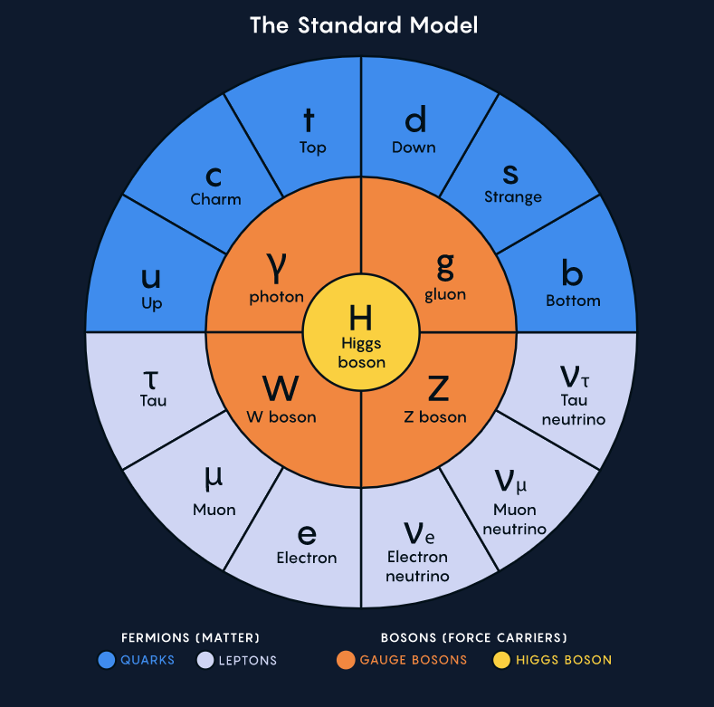
SM

Slide 17
The next fundamental level
DM particles from familons, existence of
three generations of particle, existence of distinguished scales in the Universe, a fractal
distribution of baryons and DM structures are the natural phenomenon in a composite (preon) model of elementary particles. B., Lalakulich, Ponomarev, Vereshkov G. Familon model of dark matter. Astron. Astrophys. Transactions 2004, 23, 453-461.

Slide 18
Particles of SM from preons
The whole set of elementary particles can be
described in the preon version
Particle Preon composition Electric сh.
Positron + + + +1
Down quark - □□ -1/3
Upper antiquark - - □ -2/3
Electronic antineutrino □□□ 0
W⁺ + + + 0 0 0 +1
γ + - 0

Slide 19
Internal structure of SM particles
We considered the simplest boson-fermion-preon model of left chiral quarks and leptons. The basic elements of this model are the chiral fermion preons U^{α}_{L} D^{α}_{L} and the scalar preons of quark φ^{iα}_{a} type and lepton χ^{α}_{l} type. Then, in this model, the internal structure of elementary particles is:
u^{i}_{La} = U^{α}_{L} φ_{a}^{+iαa} u^{i}_{La} = (u^{i}_{L}, c^{i}_{L}, t^{i}_{L})
d^{i}_{La} = D^{α}_{L} φ_{a}^{+iαa} d^{i}_{La} = (d^{i}_{L}, s^{i}_{L}, b^{i}_{L})
ν^{i}_{Ll} = U^{α}_{L} χ^{α}_{l} ν^{i}_{Ll} = ν_{Le} , ν_{Lμ} ,ν_{Lτ}
l^{i}_{Ll} = D^{α}_{L} χ^{α}_{l} l^{i}_{Ll} = (e_{L} , μ_{L} , τ_{L})

Slide 20
More theory
Inside quarks and leptons, the meta gluonic fields G^{ω}_{μν} and the scalar preon fields are in the state of confinement. This effect is similar by its physical nature to the confinement of quarks and gluons inside hadrons, providing the existence of non perturbative meta gluonic and preon condensates. These condensates are described by the following:
<0I (α_{mc}/π) G^{ω}_{μν} G^{μν}_{ω}I0> ~ Λ_{mc}⁴
<0I φ_{a}^{+iα} φ_{b} ^{iα} I0> = V_{ab} ~ - Λ_{mc}² (1)
<0I χ _{l}^{+α} χ^{α}_{m} I0> = V_{lm} ~ - Λ_{mc}² (2)
Here Λ_{mc} is the energy scale of preon confinement, V_{ab},V_{lm} are the condensate matrices. The condensates (1) and (2), together with the gluonic condensates <0I(α_{c}/π)Gª_{μν}G^{μν}_{a}I0> and the quark condensates <0I¯q_{L}q_{R} + ¯q_{R}q_{L}I0> provide a quark mass creation mechanism for all three particle generations.

Slide 21
Consequences of preon model.
V.B. Symmetry 12 (2020) 382
In the frame of this theory DM – a system of familon excitations of vacuum consisting from familons upper quark type, familons lower quark type, and
familons of lepton type. Here a new meta-chromo-dynamical interaction is included which connects preons in quarks and leptons. A familon mass ~ 10⁻⁵ eV

Slide 22
Preon confinement
Inside quarks and leptons metagluon fields and scalar preons fields – in state of the confinement.

Slide 23
The main consequences of preon model
Small mass of familons –the result of super weak interaction Goldstone fields with nonperturbative vacuum condensates. A numerical simulation of the phase transitions (production of quarks and leptons) had shown that interchange of high-symmetry and low symmetry phases took place in the Universe with the contrast of density δρ/ρ ~0.1. Other words in the Universe could produce a large scale structure of dark matter which repeated baryons produced observable large scale structure of the Universe (galaxies, cluster of galaxies and super cluster of g. )

Slide 24
The main consequences of preon model
Because 3 familon subsystems took place then our model gives a possibility of 3th relativistic phase transitions for explanation of the baryon structure hierarchy. We hope that this model will be principal one after discovery of familons. For possibility of structuring of the Universe it is necessary 3 generations of particles. The first generation –observable world, second and third generations are the excitation of the first generation.

Slide 25
It is other indication for the expansion of
the SM
Thank you very much

