Slide 1
Compact extra dimensions as the source of primordial black holes
The 6th International Conference on Particle Physics and Astrophysics Gravity & Cosmology
Nikulin V.V.¹ (vvnikulin@mephi.ru) Krasnov M.A.¹ Rubin S.G.^{1,2}
¹ Particle Physics Department, NRNU MEPhI, Moscow ² N.I. Lobachevsky Institute of Mathematics and Mechanics, KFU, Kazan
Notes:
Проявление неоднородных доп. Измерений в физике ранней Вселенной

Slide 2
Plan
Motivation
Multidimensional $f(R)$-gravity
Domain walls and Primordial Black Holes
Inflationary constraints
Conclusion

Slide 3
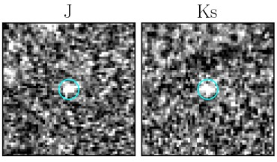
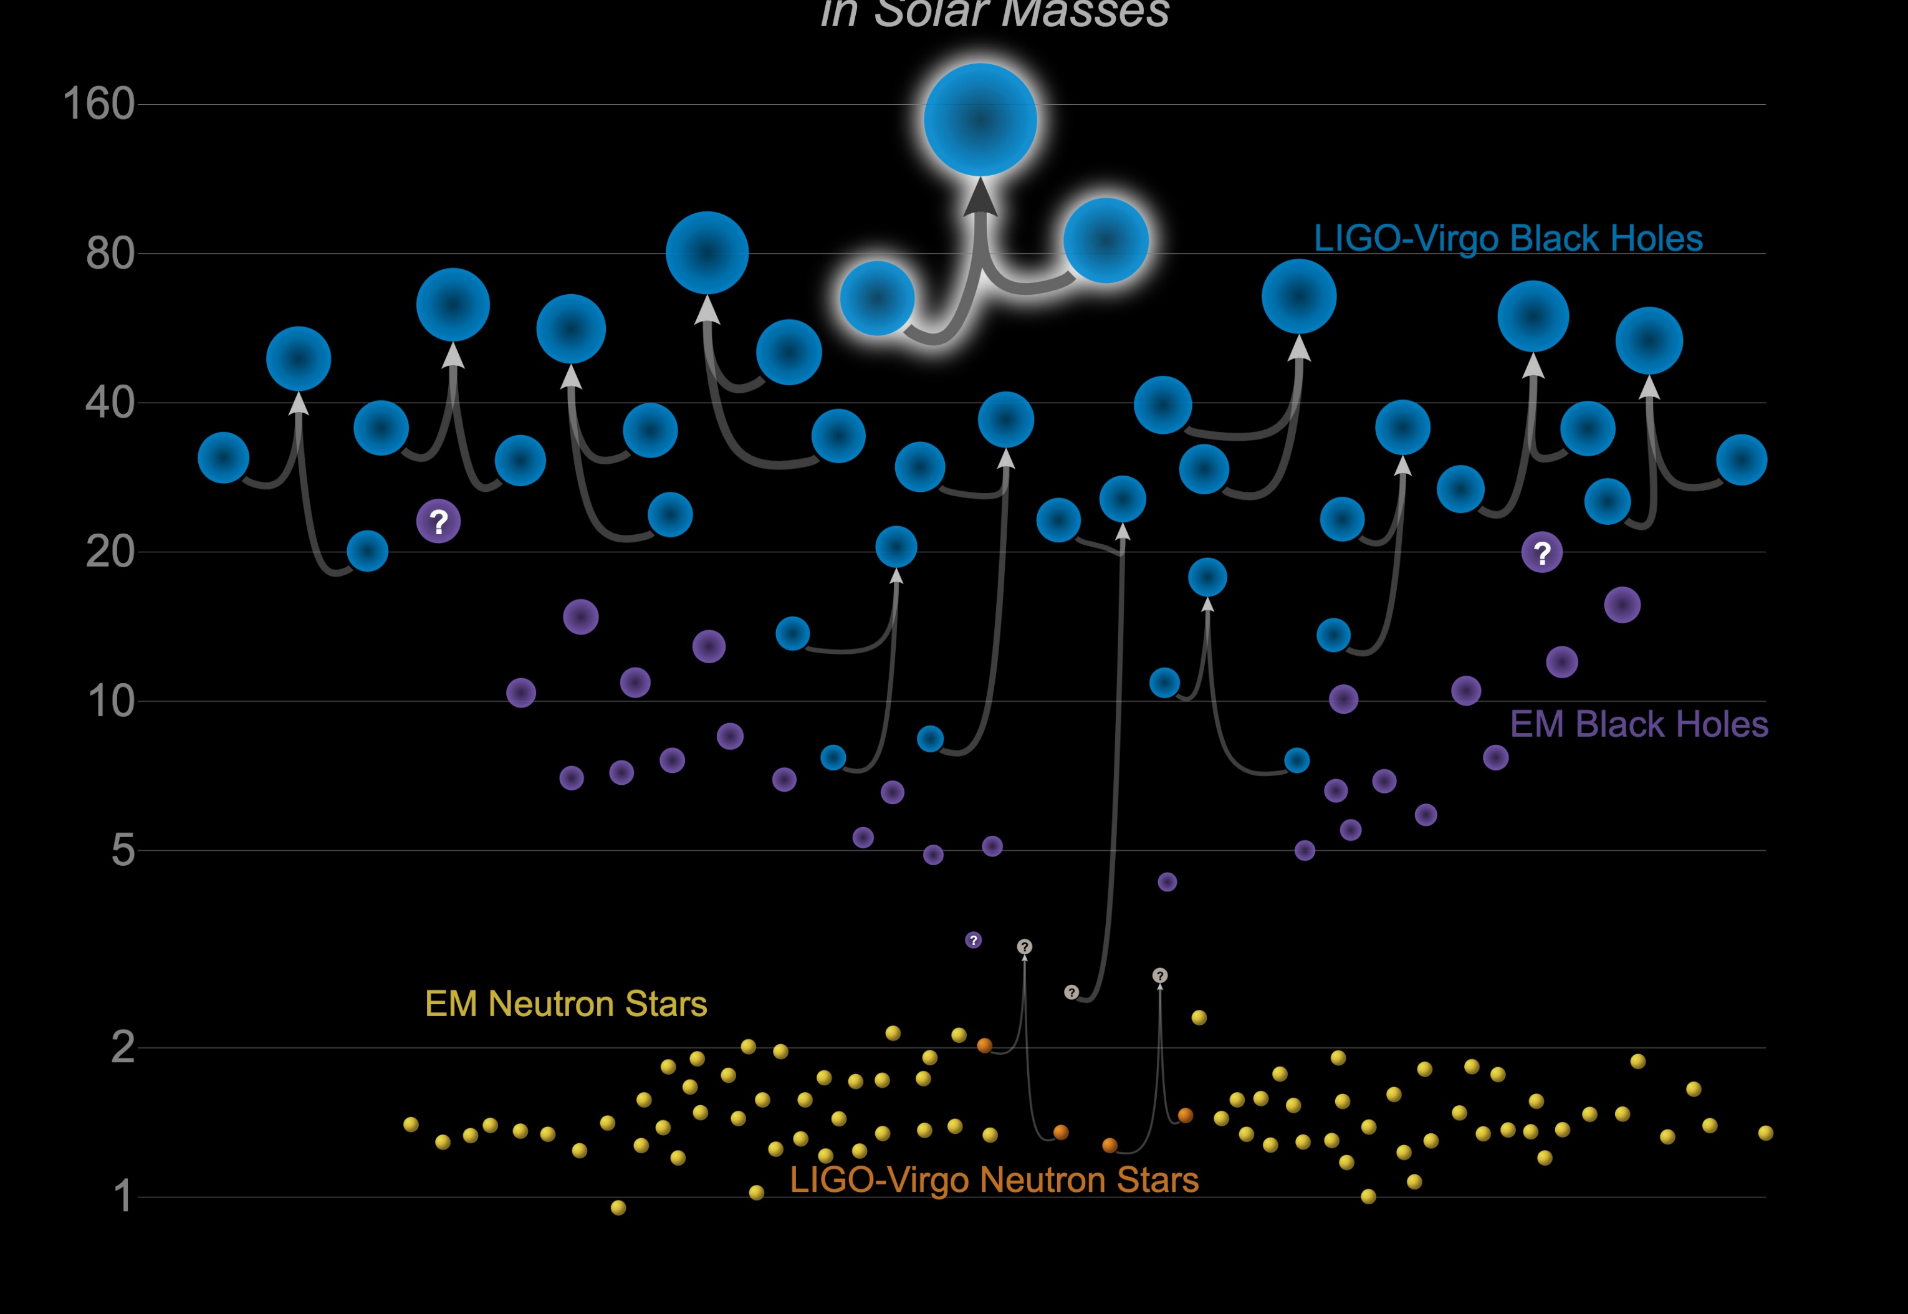
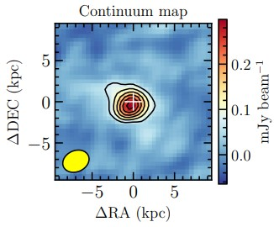
Motivation
Observation of super-early (at z > 5) supermassive quasars
Detection of gravitational waves from BHs of intermediate masses
Fig. 2. Masses of BHs and neutron stars detected by LIGO and VIRGO.
Fig. 1. Quasar J0313-1806 z = 7.64 (670 million years) $M \sim {10}^{10}M☉$

Slide 4
Multidimensional 𝑓(𝑅)-gravity
(1)
Subspace decomposition¹: $M=M_{4}×M_{k}$
Integrating out coordinates of the extra space :
(2)
(3)
¹ K. A. Bronnikov and S. G. Rubin, Phys. Rev. D 73 (2006) 124019 [gr-qc/0510107]

Slide 5
Effective 4-dim theory
Small extra dimensions and slow change approximation ($R_{k}≡φ$):
Conformal transformation:
(4)
(5)
(6)

Slide 6
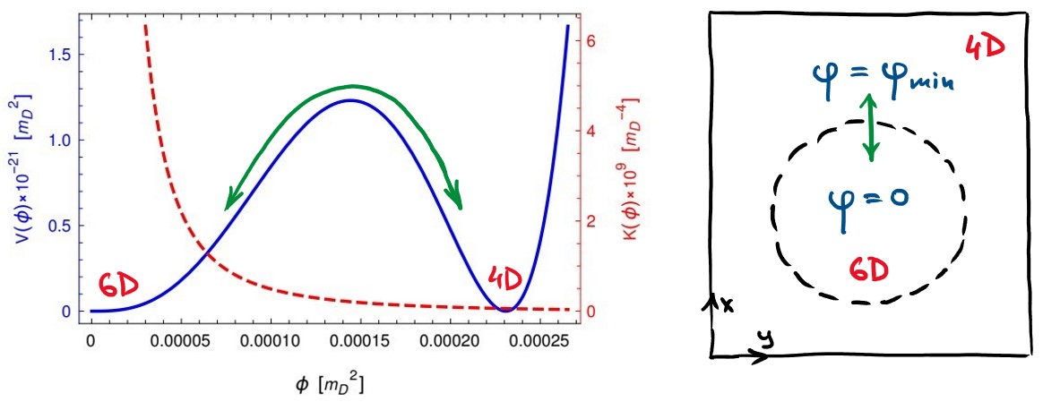
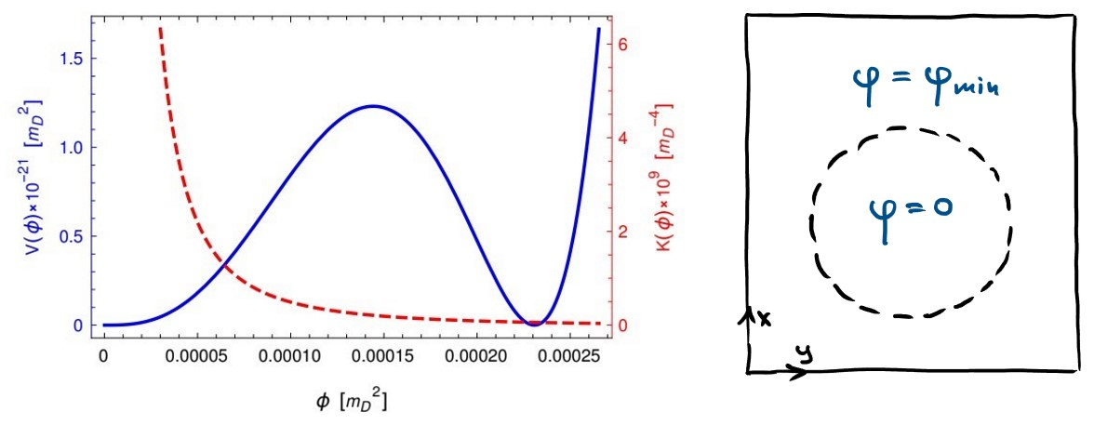
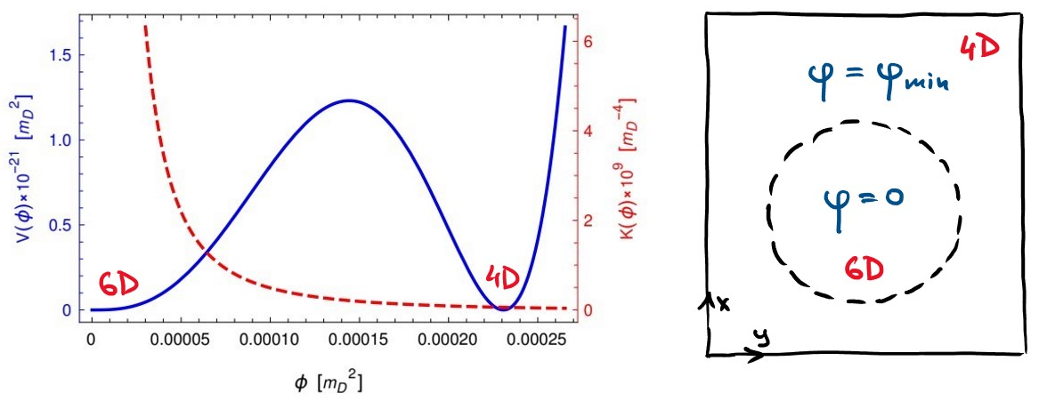
Domain walls in $f(R)$
(7)
Fig. 4. Potential $V(φ)$ and kinetic factor $K(φ)$ of the scalar field for the parameters: $$n = 6, c1 = −8000, c2 = −5000, a2 = −500.$$

Slide 7
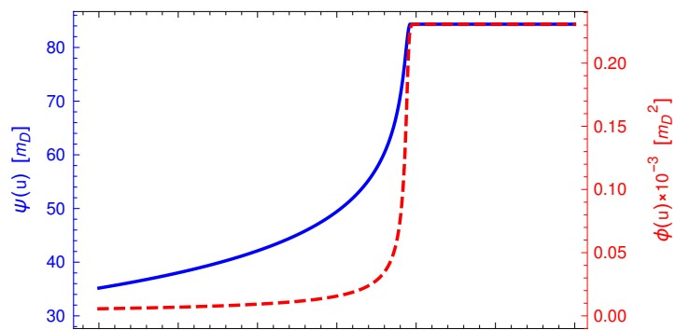
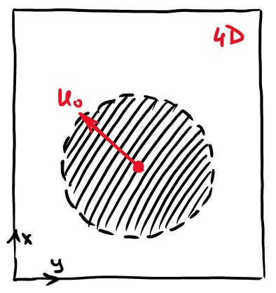
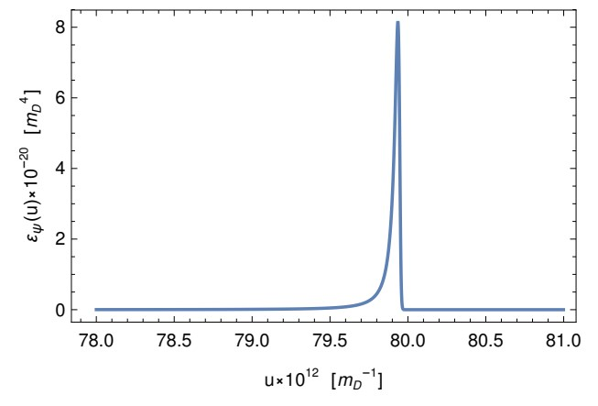
Primordial black holes
(8)
(9)
(10)
$$N_{e}=25 ⟹$$
(11)
Fig. 5. Top - the value of the field when moving through the wall. Bottom - energy density when moving through the wall.

Slide 8
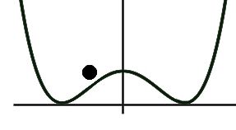
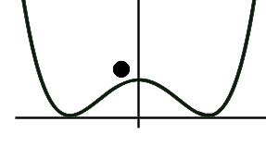
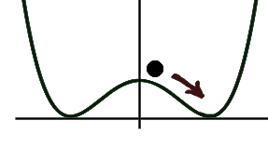
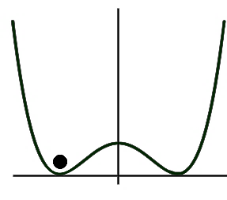
Multiple fluctuations
V(φ)
V(φ)
V(φ)
V(φ)
φ
φ
φ
φ
Fig.6. The gradual formation² of a critical region, which will be further surrounded by a domain wall as a result of repeated fluctuations on a background of the expanding Universe (at the inflationary stage).
² S. G. Rubin, M. Yu. Khlopov and A. S. Sakharov, Grav. & Cosm. 6 (2000) [hep-ph/0005271]

Slide 9
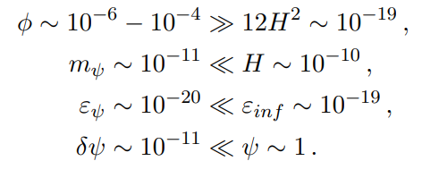
Inflationary constraints
Slow change approximation must continue to satisfy $φ≡R_{n}≫R_{4}$. Curvature of 4-dim space during inflation: $R_{4}≃12 H^{2}$.
The generation of domain walls by quantum fluctuations requires a slow rolling of $ψ$: $\sqrt{V^{′′}\left(ψ_{max}\right)}≪H$.
The domain walls should not be too dense so as not to dominate the inflaton: $ε_{ψ}≪ε_{inf}∼H^{2}m_{4}^{2}$.
The field fluctuations during inflation should not be too large to prevent overproduction of the domain walls: $δψ =\frac{H}{2π}≪ψ.$
(12)
$$H^{J}≳{10}^{13} [GeV]$$
(13)

Slide 10
Conclusion
The existence of a purely gravitational mechanism for the production of primordial black holes is demonstrated in the framework of multidimensional $f(R)$-gravity. No matter fields are required.
The mechanism is based on the production of massive domain walls resulting from quantum fluctuations in a nontrivial effective potential containing several minima.
Domain walls do not disturb the inflaton dominance necessary for cosmological inflation, if the parameters of the $f(R)$-model are chosen correctly.
The generated PBHs are formed very early (at the reheating stage) and have the potential for further accretionary growth.
arXiv:2204.06360 10.3389/fspas.2022.927144

Slide 11
Thank you for attention!
Questions?

