Slide 1
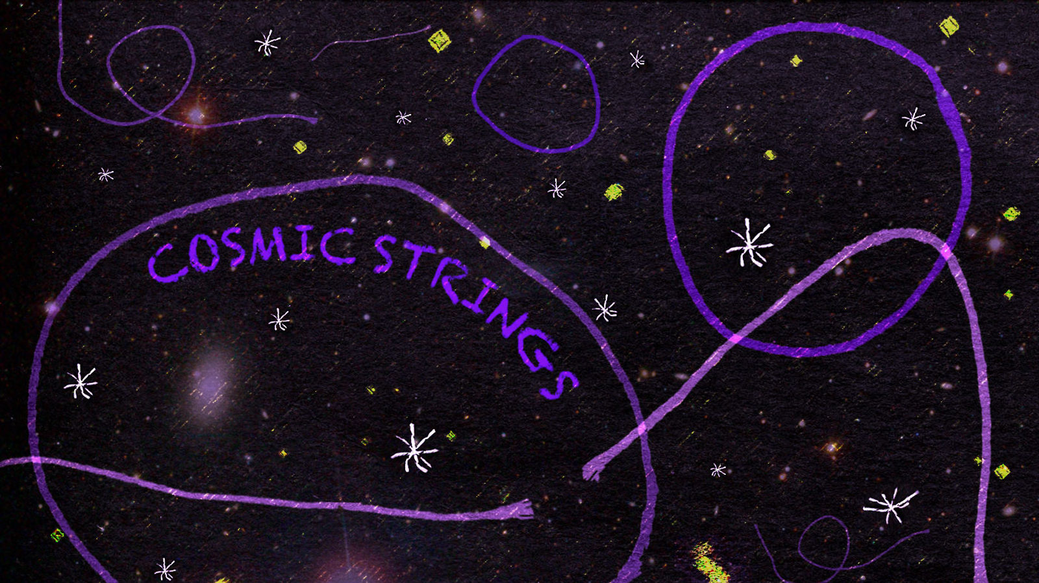
Null cosmic strings as sources of gravitational bursts
E. Davydov, D. Fursaev, V. Tainov
(JINR and Dubna state university)

Slide 2
Null cosmic strings
Other fundamental objects that may contribute to GW background.
So far, cosmic strings have not been discovered - but it took a long time before BH and GW were discovered.
There are point particles moving at the speed of light.
There can be strings, each point of which moves at the speed of light.
Null string is an extended one-dimensional object with non-zero linear energy density.
Their evolution can be described by world sheet
Null velocity vector
Space-like connecting vector
Each point of the string moves along a null geodesic
independently of other points:
Each point of the string does not move along the string:
NO TENSION, but the string does not split into parts.

Slide 3
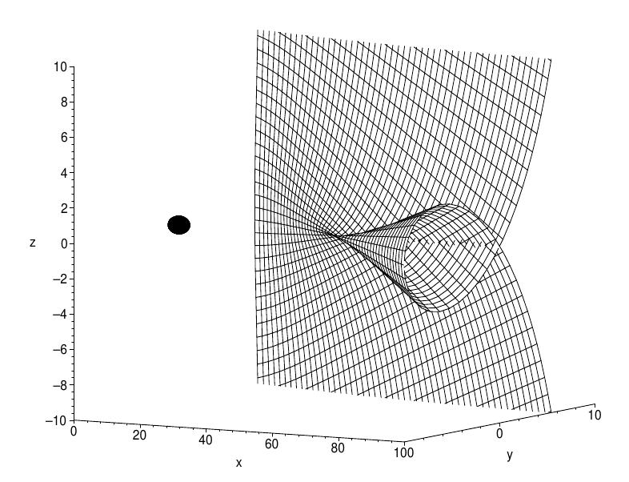
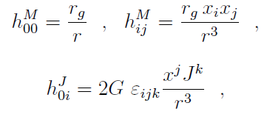
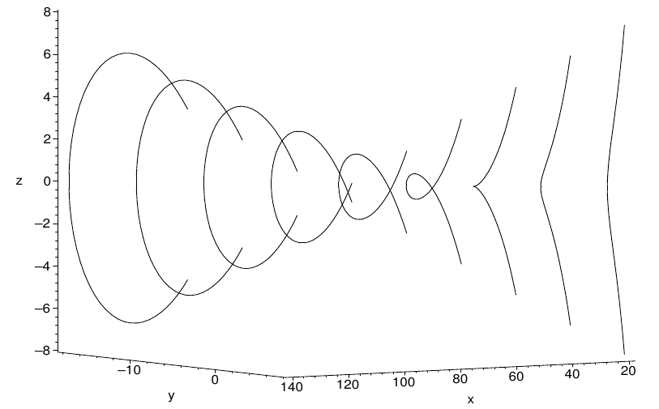
Scattering by compact massive object (BH e.t.c)
Weak field limit:
Straight null string evolution: formation of cusp and loop
E.D., D.V. Fursaev, V.A. Tainov, Null cosmic strings: Scattering by black holes, optics, and spacetime content Phys.Rev. D 105, 8, 083510, (2022)

Slide 4
Stress-energy tensor
Nontrivial string evolution
Nontrivial energy transfer in spacetime
Nontrivial gravitational field
Known case
Straight string
Metric for straight massive string:
,
Lorenz boost:
,
Penrose limit:
,
,
remains finite.
Metric for straight null string:
Penrose limit:
SET for massive string

Slide 5
SET for null string: general case
String action in zero tension limit:
is trajectory,
,
auxiliary vector density
Take
,
and choose `gauge`
Then variation of the action provides null string equations of motion and SET:
SET for arbitrary null string moving in curved space
E.D., D.V. Fursaev, V.A. Tainov, A Note on Stress-Energy Tensor and Variational Principle for Null Strings, (2022), arXiv:2210.09891

Slide 6
Null string as beam of massless particles
We consider flat space for simplicity
Massless particle:
Null string:
World line:
World sheet:
SET:
SET:
where
If no caustics and self-crossings
Shockwave metric (Aichelburg-Sexl solution)
and physical effects are known
Integrate over
Coordinates shift:
E.g. for straight string:
Velocity refraction:
Wake effect:

Slide 7
Null string impact on test particles
Each point of the string, labeled by
, produces gravitational shockwave, which hits test particle at time
Let
,
is unit spacelike vector orthogonal to
and
. The initial trajectory of test particle is
Denote
Then the shockwave will change the coordinate and velocity of test particle as
Depending on the geometry of the string and the location of the test particle, the impact of the entire string may be in the form of a shock wave or a continuous burst. For the burst the coordinate shift will accumulate over time:

Slide 8
Gravitational memory from null string
Consider two close test particles separated by the spacelike vector
After they pass through the region of gravitational burst from the null string, they will already be separated by the vector
It is convenient to write
Here
represents uniform expansion,
- shear,
- twist.
For expanding circular string with world sheet
Tissot circles for different positions of the observer:
Amplitude ~

Slide 9
Conclusion
The study of the null string SET made it possible to justify the consideration of the null string as a beam of massless particles under certain conditions.
Based on this approach, a metric was obtained and the effect of gravitational memory was calculated for arbitrary extended one-dimensional objects moving and evolving (expanding, etc.) at the speed of light.
The accumulation time of a noticeable effect of gravitational memory essentially depends on the location of the observer and the geometry of the string. Both immediate and long-term effects are possible. From the point of view of observations, experiments are preferable where it is possible to measure effects that accumulate over a long period of time.
THANK YOU!

