Slide 1
Constraints on the number of primordial black holes due to interaction with dust
Alexander Melikhov, Elena Mikheeva
LPI RAS
Moscow, 2022

Slide 2
Black hole types
Astrophysical black holes (M = 10-10² M_{Sun})
Intermediate mass black holes (M = 10²-10⁵ M_{Sun})
Supermassive black holes (M = 10⁵-10¹⁰ M_{Sun})
Primordial black holes

Slide 3
What is primordial black hole (PBH)?
The idea was proposed by Zeldovich and Novikov (1966) and further developed by Hawking (1971).
The idea is that at early times large-amplitude overdensities would overcome internal pressure forces and collapse to form black holes.
The mass of a PBH is close to the Habble horizon mass
$$M\sim \frac{c^{3}t}{G}$$

Slide 4
Evaporation of PBH
Black holes radiate thermally with temperature
T$=\frac{ℏc^{3}}{8πkGM}\sim {10}^{−7}{\left(\frac{M}{M_{0}}\right)}^{−1}K$
evaporate completely in time $t_{evap}\sim {10}^{64}{\left(\frac{M}{M_{0}}\right)}^{3}$y
PBHs with masses $M\sim {10}^{15}$ g have evaporated by now
PBH emission spectrum $\frac{dN}{dtdE}=\frac{Γ}{2πℏ}{\left(\exp\left(\frac{E}{kT}\right)−1\right)}^{−1}$,
$Γ=\frac{27G^{2}M^{2}E^{2}}{ℏ^{2}c^{6}}$ is the gray factor

Slide 5
Why is it interesting to study PBHs?
LIGO detection gravitational waves from merging BHs (Abbott B. et. al., 2016)
the intrinsic angular momentum of these BHs is close to zero
the masses of these BHs turned out to be much larger than the masses of BHs known from other observational data
Unsolved question about dark matter: what is it?

Slide 6
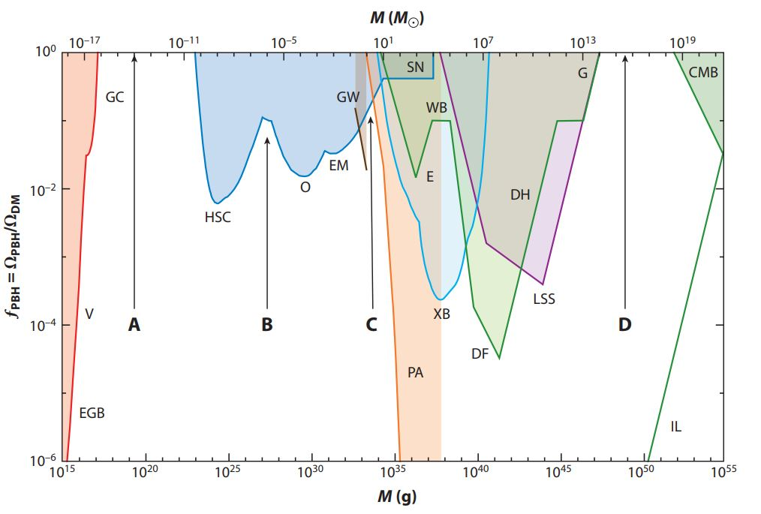
Constraints on PBHs
Carr and Kühnel (2020)

Slide 7
The goal
We adopted a novel method to constrain a number of PBHs in the Universe. The method takes into account the infrared radiation emitted by dust grains irradiated by photons of Hawking radiation. The monochromatic mass function (delta function) and the lognormal distribution were considered as PBH mass functions.

Slide 8
Interstellar dust
The role:
- Dimming of the starlight
- Reddening of starlight: "blue" rays are absorbed more than "red" ones
MRN model (Mathis et. al., 1977): graphites and silicates
$T_{sil}=13.6{\left(\frac{1 μm}{a}\right)}^{0.06}$K
$a_{min}=0.005$ $μm$
$$n\left(a\right)\sim a^{−3.5}$$
$a_{max}=0.25$ $μm$
$T_{gra}=15.8{\left(\frac{1μm}{a}\right)}^{0.06}$K

Slide 9

Energy balance
$$\frac{{dE}^{abs}}{dt}=\frac{{dE}^{rad}}{dt}$$
$$\frac{{dE}^{abs}}{dt}=\iint{πa^{2}Q_{abs}(λ)I_{λ}dλdΩ}$$
$$\frac{{dE}^{rad}}{dt}=4πa^{2}\int{B_{λ}\left(T_{d}\right)}Q_{abs}\left(λ\right)dλ$$
$Q_{abs}(λ)=\left\{\begin{aligned}1, λ≤2πa \\ \frac{2πa}{λ},λ>2πa\end{aligned}\right.$ - absorption efficiency

Slide 10
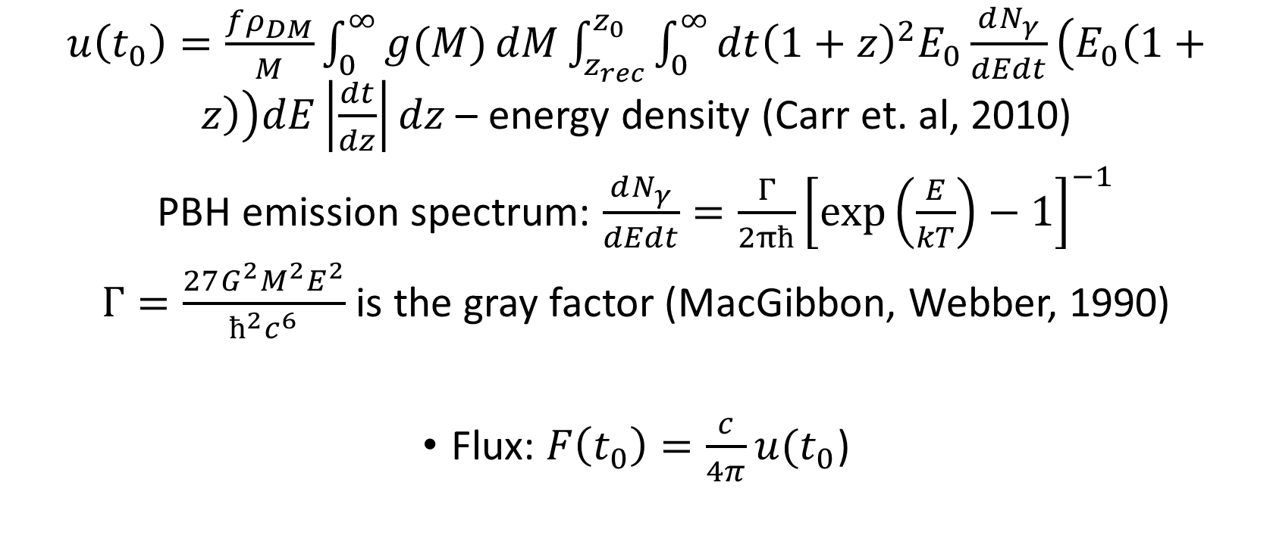
Energy density and flux
$u\left(t_{0}\right)=\frac{fρ_{DM}}{M}\int_{0}^{∞}{g(M)}dM\int_{z_{rec}}^{z_{0}}{\int_{0}^{∞}{dt{\left(1+z\right)}^{2}E_{0}\frac{dN_{γ}}{dEdt}\left(E_{0}\left(1+z\right)\right)dE\left|\frac{dt}{dz}\right|}}dz$ – energy density (Carr et. al, 2010)
PBH emission spectrum: $\frac{dN_{γ}}{dEdt}=\frac{Γ}{2πħ}{\left[\exp\left(\frac{E}{kT}\right)−1\right]}^{−1}$
$Γ=\frac{27G^{2}M^{2}E^{2}}{ħ^{2}c^{6}}$ is the gray factor (MacGibbon, Webber, 1990)
Flux: $F\left(t_{0}\right)=\frac{c}{4π}u(t_{0}$)

Slide 11
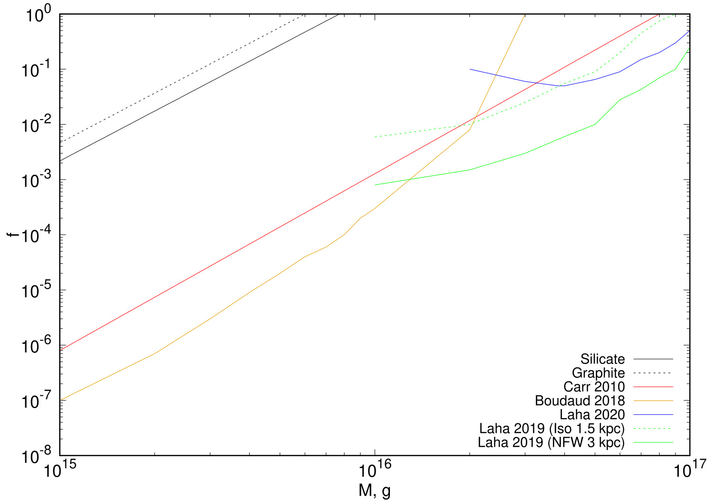
Results for the monochromatic mass function
$$a=0.01μm$$
$$T_{sil}=13.6{\left(\frac{1μm }{a}\right)}^{0.06}$$
$$T_{gra}=15.8{\left(\frac{1μm }{a}\right)}^{0.06}$$

Slide 12
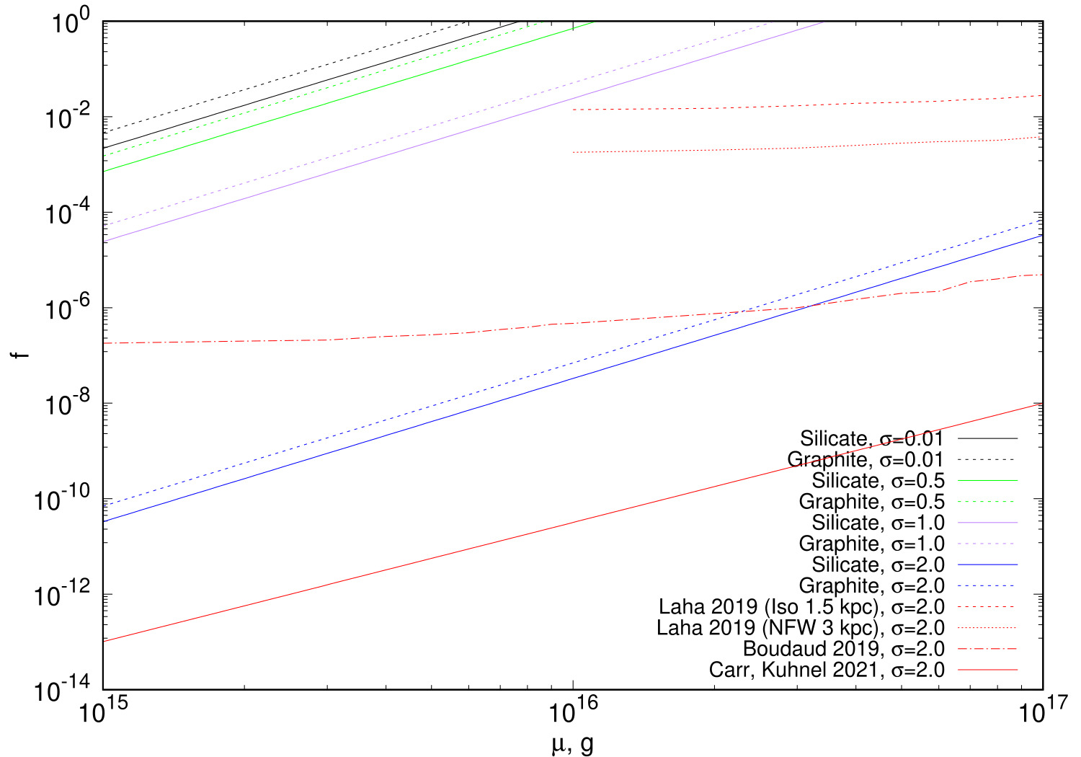
Results for lognormal distribution
$$a=0.01μm$$
$$T_{sil}=13.6{\left(\frac{1μm }{a}\right)}^{0.06}$$
$$T_{gra}=15.8{\left(\frac{1μm }{a}\right)}^{0.06}$$
$$g\left(M\right)=\frac{1}{\sqrt{2π}σM}exp⁡\left(−\frac{\ln^{2}(M/μ)}{2σ^{2}}\right)$$

Slide 13
Conclusions
In this study, the process of heating of dust grains by PBHs uniformly filling the Universe was examined for the first time. The contribution of other radiation sources to dust heating was not considered. The monochromatic mass function and the lognormal distribution were considered in the study. The constraints obtained here for the monochromatic mass function turned out to be weaker than in previous studies, where the constraints were obtained from the PBH contribution to the gamma background. For the lognormal PBH mass distribution, the constraints turned out to be stricter than in [Laha, 2019] and [Boudaud et. al. 2019], but less strict than in [Carr et. al. 2021] for the same value σ=2.

