Slide 1
NATIONAL RESEARCH CENTRE "KURCHATOV INSTITUTE“
Possible analogs of the Hoyle state in heavier 4N nuclei
Notes:
For measuring the radii of excited states we proposed a method based on the analysis of the inelastic diffraction scattering. We applied the model to studying the α- and ³He-scattering on ¹²C. The analysis allowed determining the enhanced radii of some excited states in ¹²C including the famous Hoyle state (0⁺, E* = 7.65 MeV). Besides the diffraction method the inelastic nuclear rainbow scattering also can be used for measuring the radii of unstable states. The enhancement of the radius of the excited state is detected by the shift of the inelastic rainbow minimum relatively the elastic one. The application of this approach to the inelastic scattering leading to excitation of the Hoyle state gave results consistent with those obtained by the diffraction method. Considerable attention has been drawn to the studies of α-cluster states in ¹²C, especially the second 0⁺ state, at E_{x}= 7.65MeV (so called the Hoyle state).

Slide 2
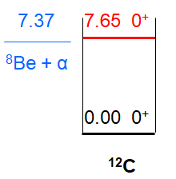
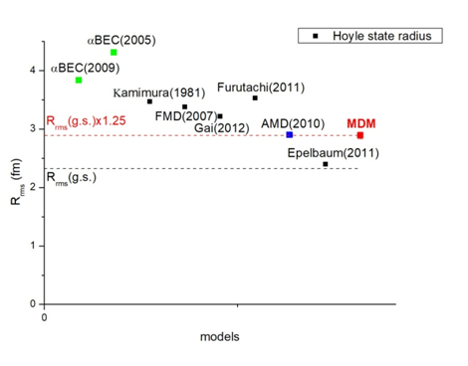
7.65 MeV 0⁺₂ state in ¹²C (Hoyle state)
R_{rms} of the Hoyle state
* Through the Hoyle state, elements heavier than ¹²C are formed in the Universe
* Hoyle's state is not described within the shell model.
* The structure of the state is unknown
A prototype of the α-condensate state?
* Increased radius is predicted within many theoretical models
Our result: 2.9 fm; 60% probability of configuration with 3 α-clusters on the lowest s-orbit
Calculations from first principles: 2.8 fm
(difference between radii of the g.s. and the Hoyle state – 0.36 fm) T. Otsuka et al., Nature Comm. 13, 2234 (2022)
* Stll actual K.C.W. Li et al. Phys. Rev. C 105, 024308 (2022) | T. Otsuka et al., Nature Comm. 13, 2234 (2022)

Slide 3
Method – Modified diffraction model
Diffraction radii are determined from minima (maxima) positions in dσ/dΩ
Elastic scattering
Inelastic scattering (0⁺ → 0⁺)
R_{dif} is the only parameter of the model. As it has the dimension of length it can be directly connected with a real (rms) nuclear radius
Model:
R_{rms} (exc.st) = R_{rms} (gr.st) + [R_{dif} (in) - R_{dif} (el)]
The method was tested in the analysis of the radius of Hoyle state in ¹²C
A.S. Demyanova et al., Int. J. Mod. Phys. E17, 2118 (2008). A.N. Danilov et al., Phys. Rev. C 80, 054603 (2009).

Slide 4
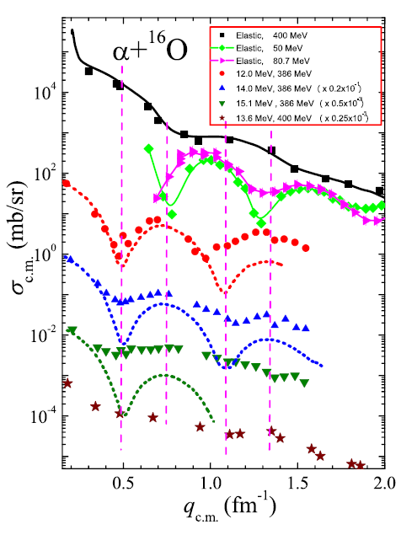
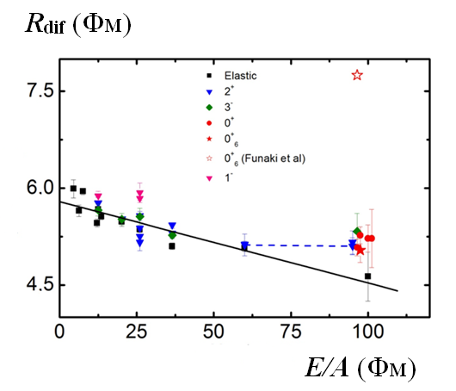
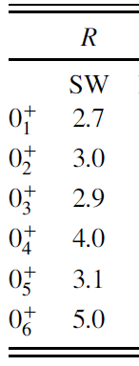
Analogs of the Hoyle state (¹²C, 0⁺₂) in ¹⁶O
αBEC
Y. Funaki et al.,
PRL 101, 082502 (2008).
MDM A. A. Ogloblin et al.,
Phys. Rev. C 94, 051602(R) (2016)
We determined directly the rms radii of ¹⁶O in a number of states with excitation energies
up to 15.1 MeV applying the MDM.
No significant radius enhancement in any states was observed.
We did not confirm the existence of a dilute state with super-large radius associated with the 15.1-MeV 0⁺₆ state, which was predicted by the αBEC model. The rms radius of ¹⁶O in this state was found similar to the radius of ¹⁶O in the ground state.
From this point of view, the 0⁺₆ state cannot be considered as an analog of the Hoyle state in ¹²C.

Slide 5
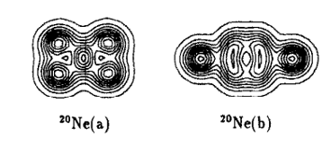
Overview of current situation with ²⁰Ne
Experimental works
S. Adachi et al., Physics Letters B 819, 136411 (2021)
conducted the coincidence measurement of alpha particles inelastically scattered from ²⁰Ne at 0◦ in order to search for the 5α condensed state in ²⁰Ne. Comparing the measured excitation energy spectra and decay branching ratio with the statistical decay-model calculation, found that the newly observed states at E_{x} = 23.6, 21.8, and 21.2 MeV in ²⁰Ne are strongly coupled to the 0⁺₆ state in ¹⁶O. These states are the candidates for the 5α condensed state in ²⁰Ne?
J. Zhang, W.D.M. Rae, Nucl. Phys. A 564, 252 (1993).
Theoretical works
AMD calculations: Y. Kanada-En’yo and K. Ogata, Phys. Rev. C 101, 064308 (2020)
In the structure calculation of ²⁰Ne with AMD, ¹⁶O + α cluster structures were obtained in the parity-doublet K^{π} = 0⁺₁ and K^{π} = 0⁻₁ bands, and the ¹²C +2α-like structure was obtained in the K^{π} = 2⁻ band. The AMD calculation reproduced the experimental B(E2) of in-band transitions. It also described the experimental form factors of the 0⁺₁ , 2⁺₁ , and 4⁺₁ states
R. Bijker and F. Iachello Nuclear Physics A 1006, 122077 (2021).
Available experimental data in ²⁰Ne can be described in terms of the bi-pyramidal cluster configuration suggested by Brink in 1970. All observed bands with band-heads up to an excitation energy of about 12 MeV can be accounted for in terms of the vibrationless ground state band, of the nine vibrational modes expected on the basis of D_{3h} symmetry (3 singly degenerate and 3 doubly degenerate), and of six of the double vibrational bands expected on the basis of D_{3h} symmetry. Strong evidence for a quasimolecular structure of ²⁰Ne with D3h symmetry.

Slide 6
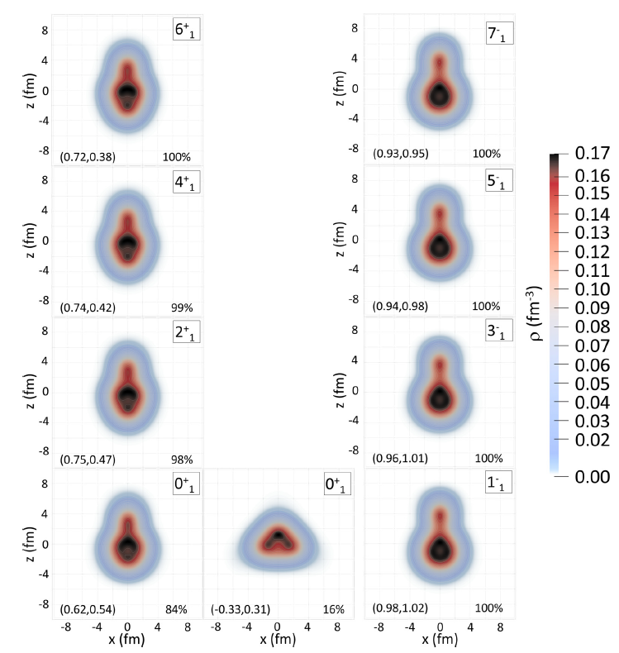
Overview of current situation with ²⁰Ne
Theoretical works
framework based on energy density functionals: P. Marević et al., Phys. Rev. C 97, 024334 (2018)
The structure of the lowest positive- and negative-parity bands of ²⁰Ne has been analyzed using a beyond mean-field approach based on relativistic energy density functionals both for the ground-state band as well as for the excited K^{π} = 0± bands. A good agreement with experimental results for the energies of the lowest positive-parity states, as well as with available data on low-energy negative-parity states. In particular, the spectroscopic properties of ²⁰Ne have been calculated at a level of accuracy comparable to those obtained using more specific models, such as antisymmetrized molecular dynamics.
ab initio calculations: A.C. Dreyfuss et al., Phys. Rev. C 102, 044608 (2020).
The formalism was demonstrated in a study of the ¹⁶O + 𝛼 cluster structure of ²⁰Ne, through inspection of the relative motion wave
functions of the clusters within the ²⁰Ne ground state and the 1⁻ resonance (ab initio SA-NCSM calculations). The importance of correlations in developing cluster structures was shown.

Slide 7
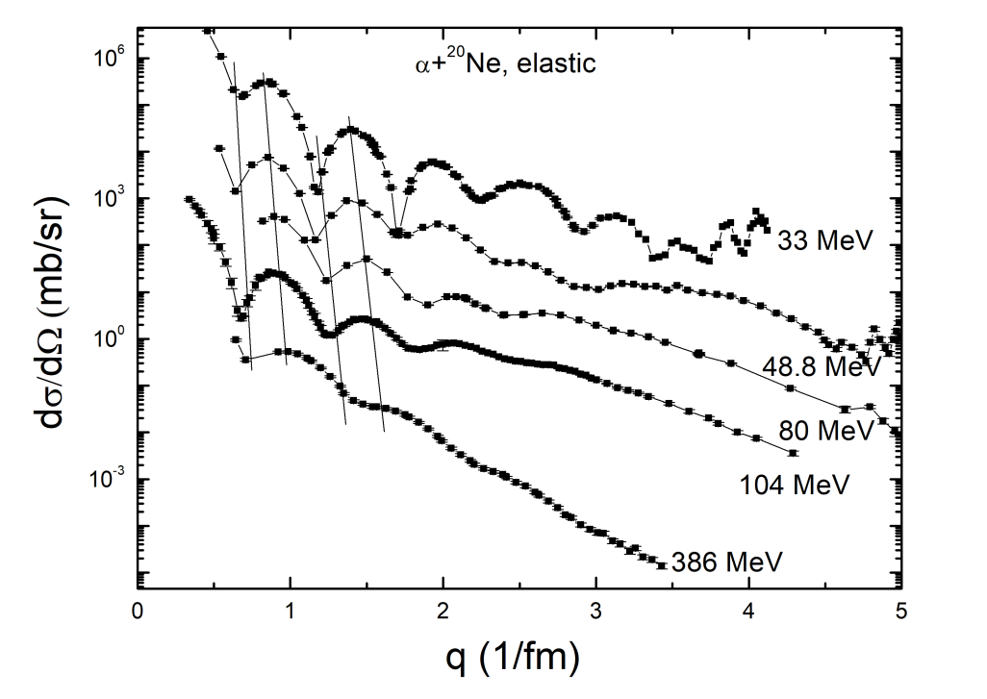
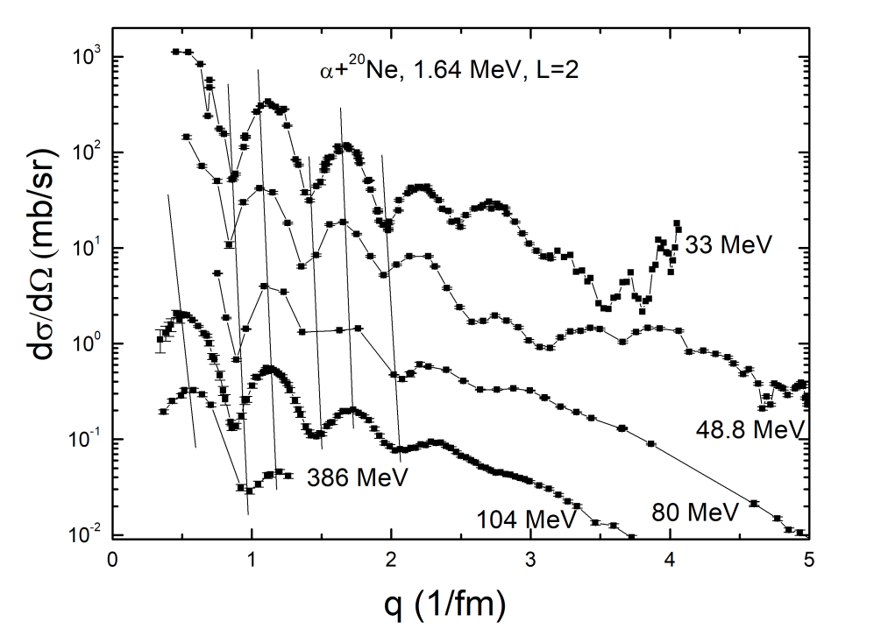
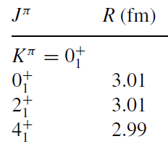
g.s. 0⁺ – 1.64 MeV 2⁺ – 4.25 MeV 4⁺
Band K^{π} = 0⁺₁
¹⁶O + 𝛼 cluster structure
Normal radius
𝑅_{rms} (g.s.)= 2.87 ± 0.03 fm
𝑅_{rms}(1.63) = 3.0 ± 0.2 fm
AMD: Y. Kanada-En’yo and K. Ogata, Phys. Rev. C 101, 064308 (2020).

Slide 8
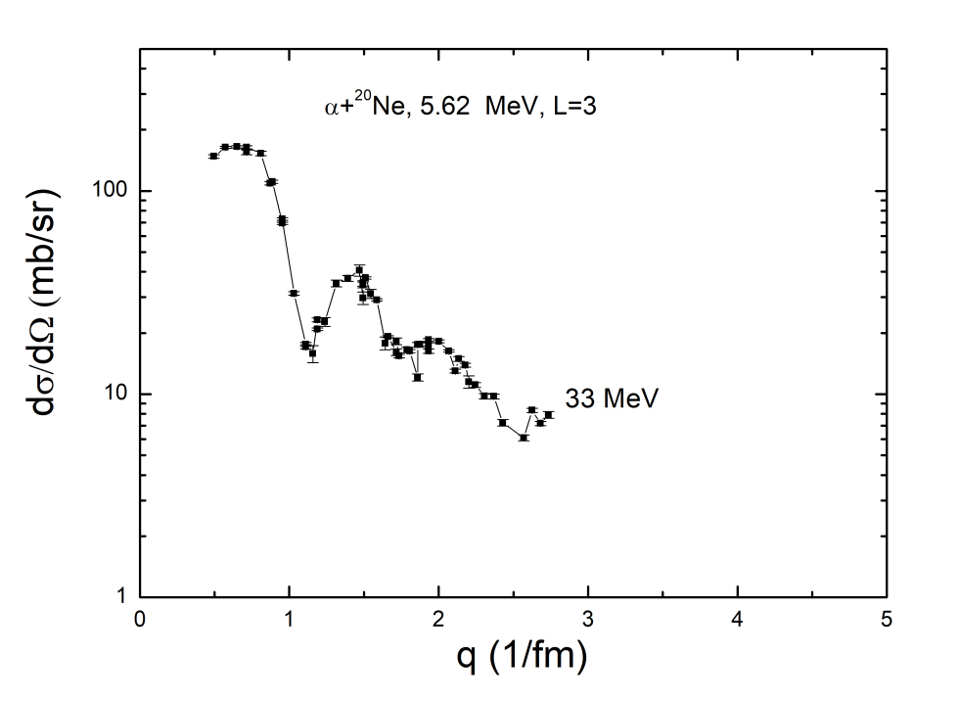
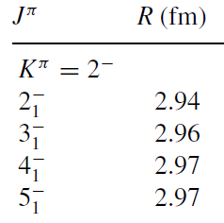
4.97 MeV 2⁻–5.62 MeV 3 ⁻–7.00 MeV 4 ⁻–8.45 MeV 5 ⁻
Band K^{π} = 2⁻
𝑅_{rms} (g.s.)= 2.9 ± 0.1 fm
¹²C + 2𝛼 cluster structure
Normal radius
AMD: Y. Kanada-En’yo and K. Ogata, Phys. Rev. C 101, 064308 (2020).

Slide 9
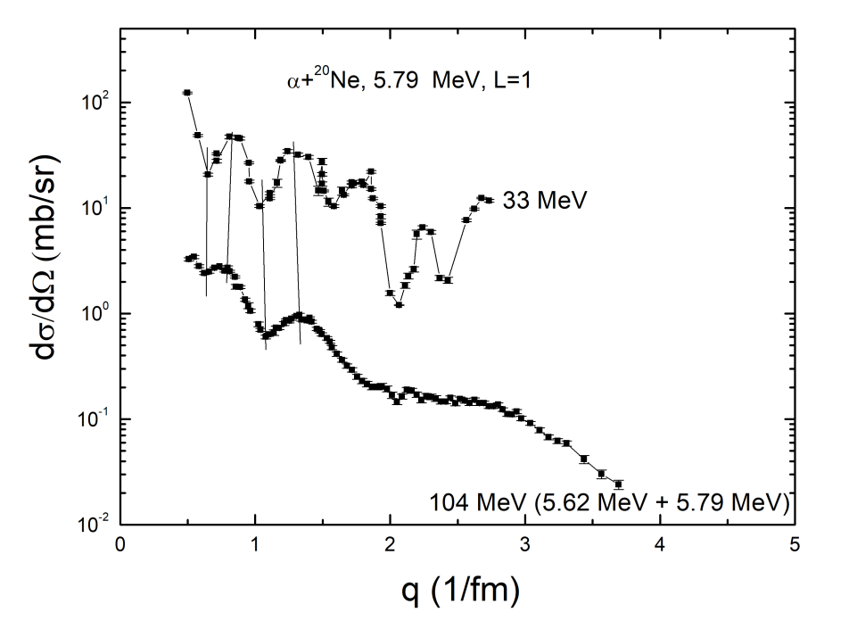
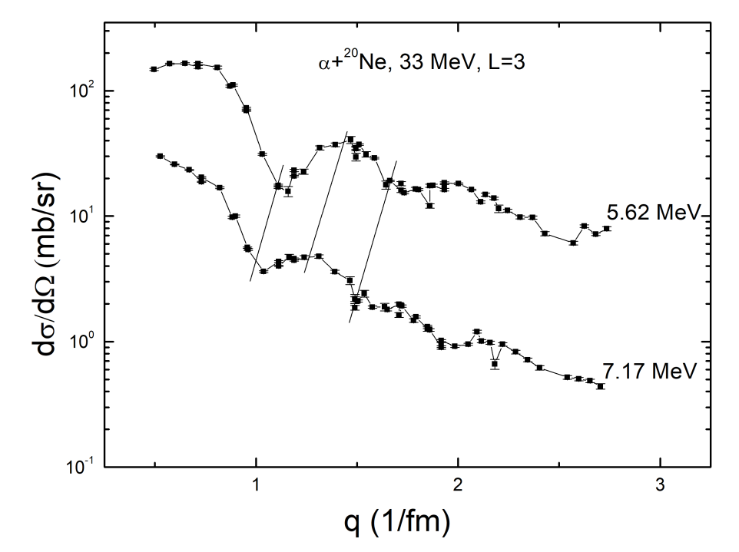
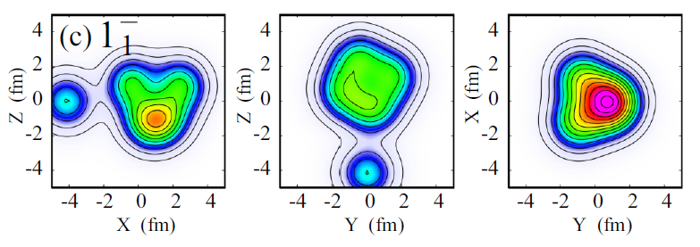
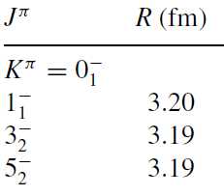
5.79 MeV 1⁻ – 7.17 MeV 3⁻ – 10.26 MeV 5⁻
Band K^{π} = 0⁻₁
¹⁶O + 𝛼 cluster structure
10% radius increase
𝑅_{rms}(5.79) = 3.4 ± 0.2 fm
𝑅_{rms}(7.17) = 3.4 ± 0.2 fm
AMD: Y. Kanada-En’yo and K. Ogata, Phys. Rev. C 101, 064308 (2020).

Slide 10
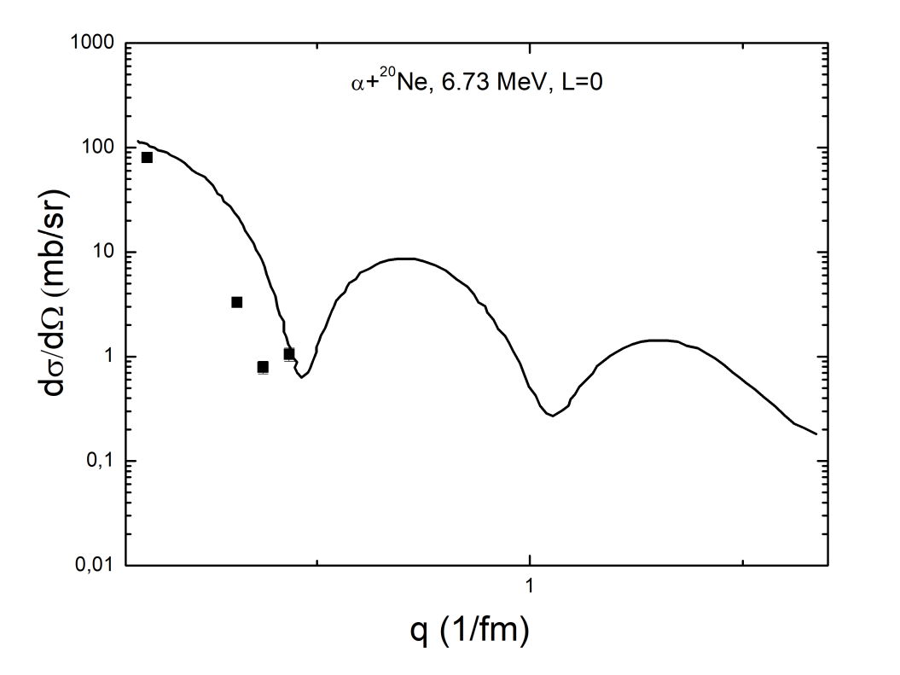
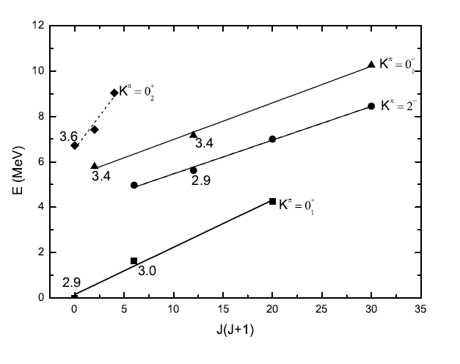
6.73 MeV 0⁺ – 7.42 MeV 2⁺ – 9.03 MeV 4⁺
Band K^{π} = 0⁺₂
𝑅_{rms} (g.s.)= 2.87 ± 0.03 fm
𝑅_{rms}(6.73) ∼ 3.6 fm
We obtained 25% radius increase for this state comparing to the g.s. radius.
Practically the same increase we observed for the Hoyle state in ¹²C.
The 6.73 MeV state is located 2 MeV above the 𝛼-emission threshold, so our result can be the argument for the possible alpha-condensate structure.
Perspectives: we need to check other high-lying 0⁺ states, new experimental data are needed
Current results are published: A.S. Demyanova et al., arXiv:2206.09475 (2022)

Slide 11
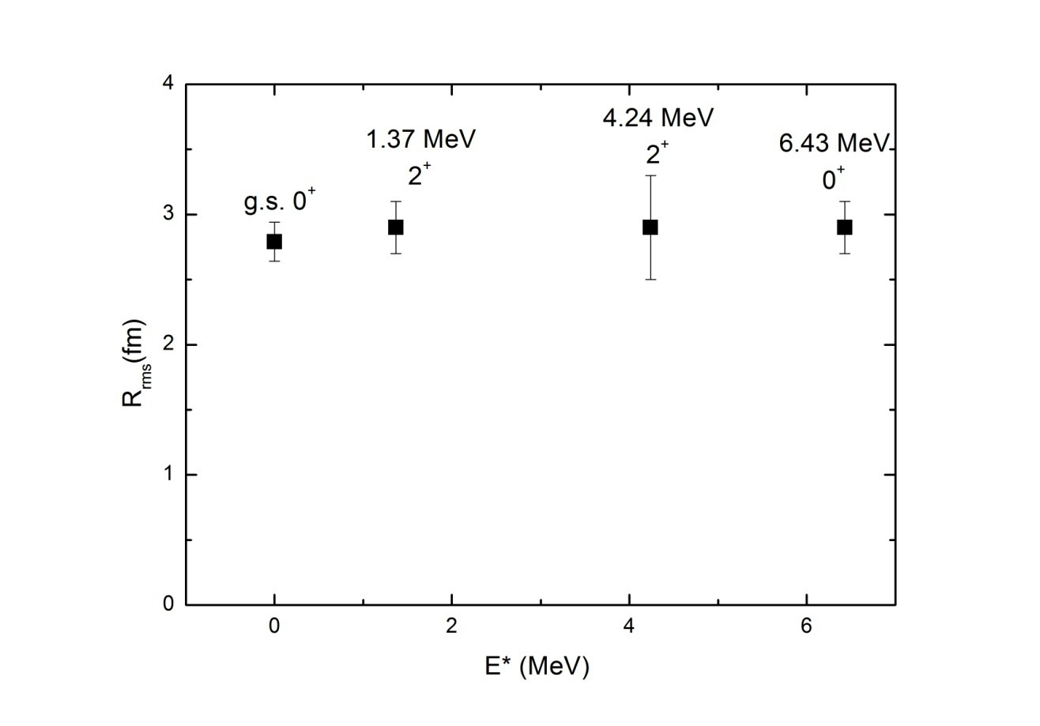
Next goal – ²⁴Mg
Preliminary results for low-lying states
Currently no radius enhancement was observed for low-lying excited of ²⁴Mg
Perspectives: we need to check other high-lying states, especially 0⁺
Our colleagues last results: Dong-Xi Wang et al., Chin. Phys. C (2022), to be published: A number of resonances up to 30 MeV excitation in ²⁴Mg with the α+²⁰Ne cluster configuration were observed, most of the states are decaying to ²⁰Ne in the g.s. and two first excited states (experiment ¹⁶O(¹²C,²⁴Mg->α+²⁰Ne)α).

Slide 12
Conclusions
The rms radii of ¹⁶O in a number of states with excitation energies up to 15.1 MeV were determined. No significant radius enhancement in any states was observed.
The 𝑟𝑚𝑠 radii of ²⁰Ne in a number of states with excitation energies up to 7 MeV were determined. 20% radius enhancement was obtained for the K^{𝜋} = 0⁻₁ band members. Moreover, our estimates of the radius of the 0⁺₂ state, the head of the K^{𝜋} = 0⁺₂ band, showed 25% radius increase. Obtained result can speak in favor of possible 𝛼-condensate structure of the 0⁺₂ state
Preliminary results for the ²⁴Mg - no significant radius enhancement in any states was observed, analysis is in process
Next goal – ²⁸Si

