Slide 1
Baksan Large Neutrino Telescope project
A. Lukanov, V. Gavrin, A. Fazliakhmetov, T. Ibragimova, B. Lubsandorzhiev, D. Nanzanov, A. Shikhin, A. Sidorenkov, N. Ushakov, D. Voronin
ICPPA, 2022

Slide 2
Main goals of the project
Geoneutrino flux measurements
Registration of neutrinos from the Sun’s CNO cycle
Registration of isotropic flux of antineutrinos accumulated in the Universe as a result of gravitational collapses of the nuclei of massive stars and the formation of neutron stars and black holes
Study of a supernova explosion by recording the intensity and spectrum of a neutrino burst in the case of a supernova explosion with a collapsing core
Registration of total antineutrino flux from all nuclear power reactors
A number of applied tasks, such as promotion for a revival of development and production of vacuum and solid state photodetectors in Russia

Slide 3
Project stages
First stage - prototype with 0.5 tons of liquid scintillator located in gallium-germanium neutrino telescope (GGNT) laboratory of Baksan Neutrino observatory (BNO)
Second stage - prototype with 5 tons of liquid scintillator also located in GGNT laboratory. Testing of applied scientific and technical methods
Third stage - detector with ≈100 tons of liquid scintillator
Fourth stage - detector with 10 kTons of liquid scintillator, which could solve whole range of project goals

Slide 4
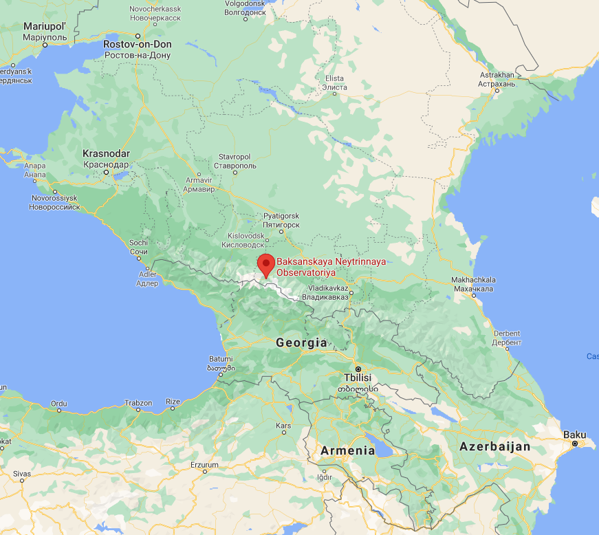
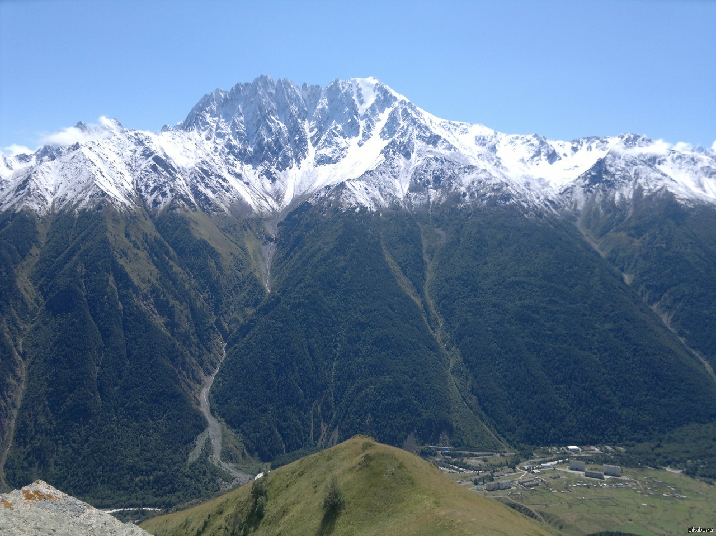
Location of Baksan neutrino observatory
Andirchi Mountain
Baksan Neutrino observatory and v. Neutrino
4

Slide 5
Map of nuclear power plants location
SNO+
Borexino
BNO
Jinping
KamLAND
JUNO
ICPPA, 2022
5

Slide 6
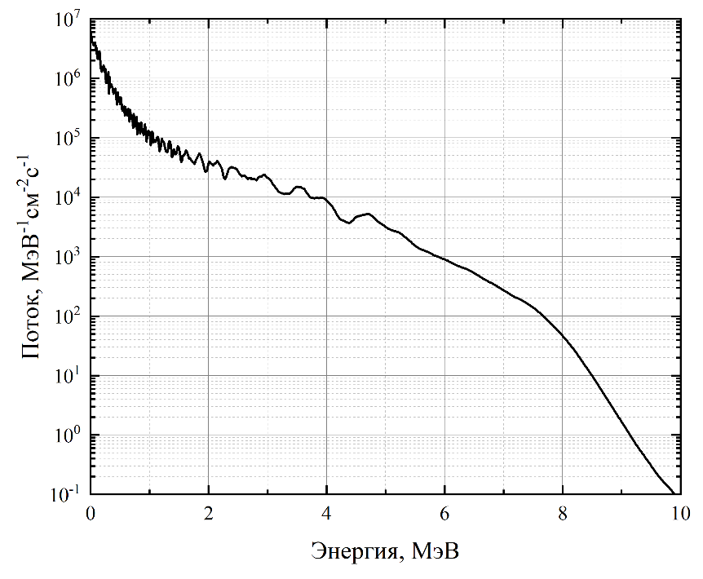
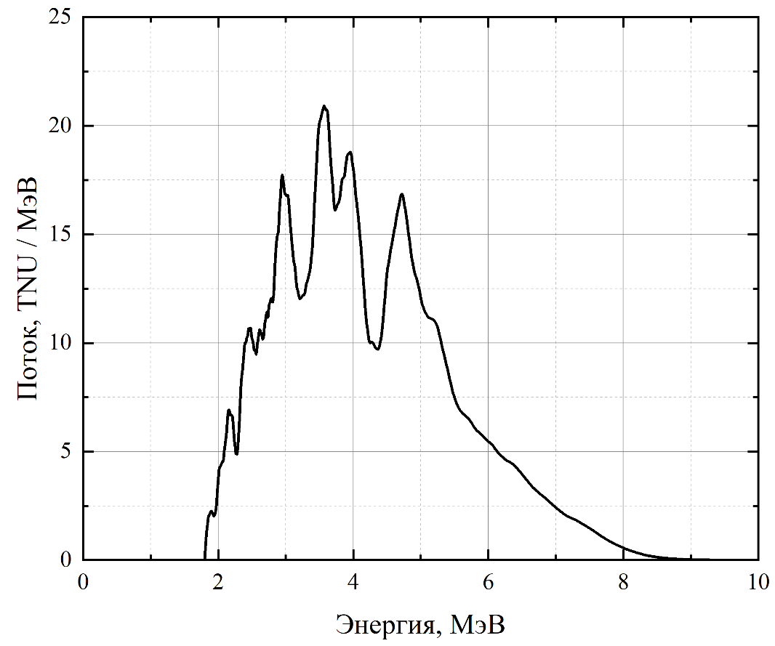
Reactor neutrino flux in GGNT laboratory
Flux, MeV⁻¹cm⁻²s⁻¹
Flux, TNU/MeV
Energy, MeV
Energy, MeV
Location | Geoneutrino flux, TNU | Reactor neutrino flux in geoneutrino range, TNU | N_{react}/N_{geo}
BNO | 50.8 | 13.2 | 0.26
Gran Sasso (Borexino) | 40.7 | 23.2 | 0.57
Kamioka (KamLAND) | 34.5 | 43.7 | 1.27
Sudbury (SNO+) | 50.8 | 51.7 | 1.02
Jinping | 59.4 | 5.6 | 0.09
Pyhasalmi | 51.5 | 19.4 | 0.38
Hawaii | 12.5 | 1.1 | 0.09
JUNO | 39.7 | 307.8 | 7.75
ICPPA, 2022
6

Slide 7
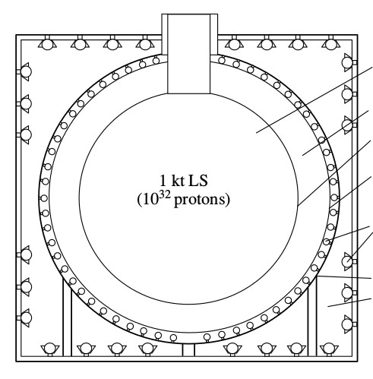
Supposed construction of Large volume detector
Liquid scintillator
Buffer zone filled with non-scintillating organic liquid
Transparent reservoir
Linear alkyl benzene (LAB)
10kT
Radon protection
PMTs
Non-transparent reservoir
Water (Cherenkov detector)
ICPPA, 2022
7

Slide 8
First stage of the project
Polypropylene water reservoir
Stainless steel frame
Twenty 10-inch PMTs Hamamatsu R7081-100 WA-S70
Scintillator is contained within acrylic sphere with a radius 0.5 m
ICPPA, 2022
8

Slide 9
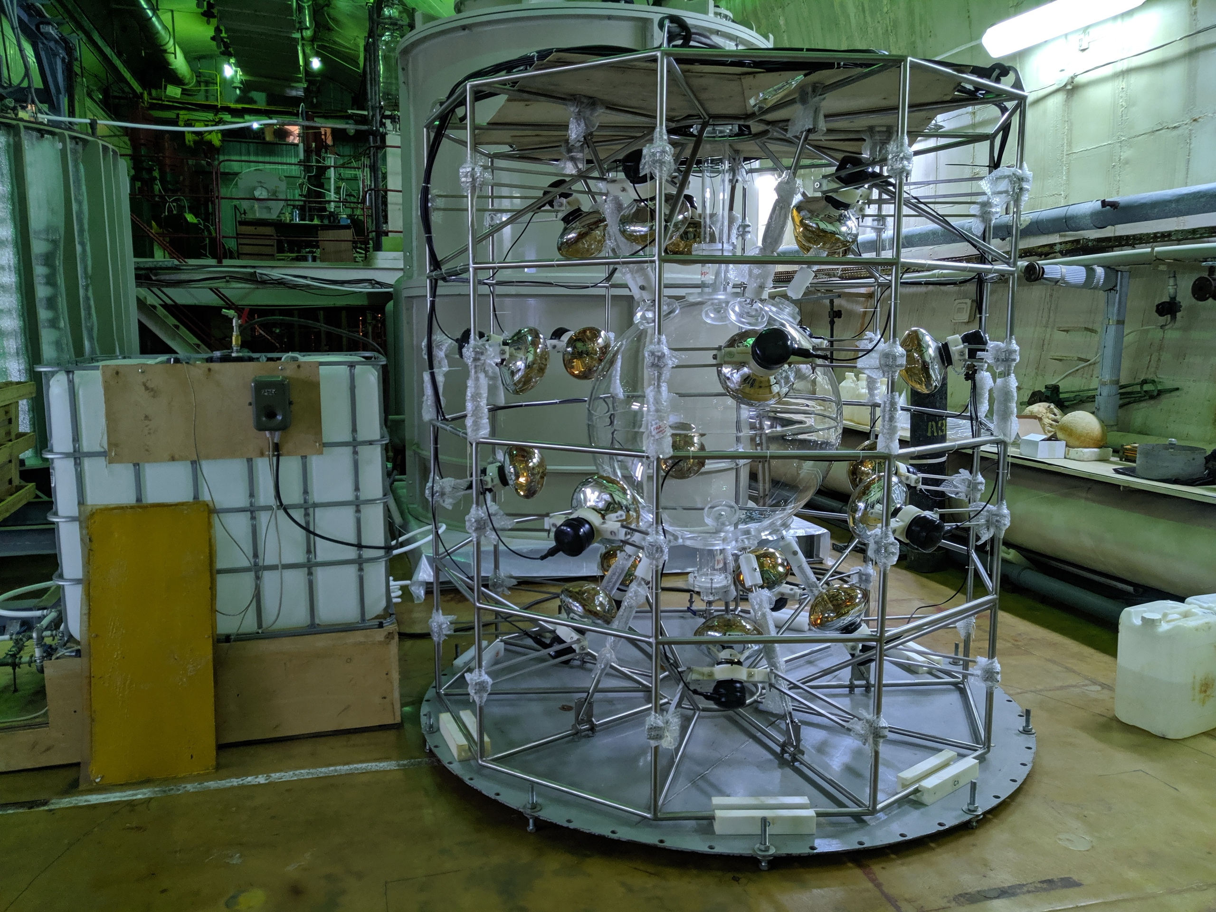
ICPPA, 2022
9

Slide 10
Liquid scintillator
Emission spectrum of PPO in LAB
Emission spectrum of bis-MSB in toluene
Plexiglass transparency spectrum
Liquid scintillator is based on linear alkyl benzene with added 2 g/l of PPO and 10 mg/l of bis-MSB
LAB is produced by Ltd KINEF
Transmission/
Emission intensity, %
Wavelength, nm
ICPPA, 2022
10

Slide 11
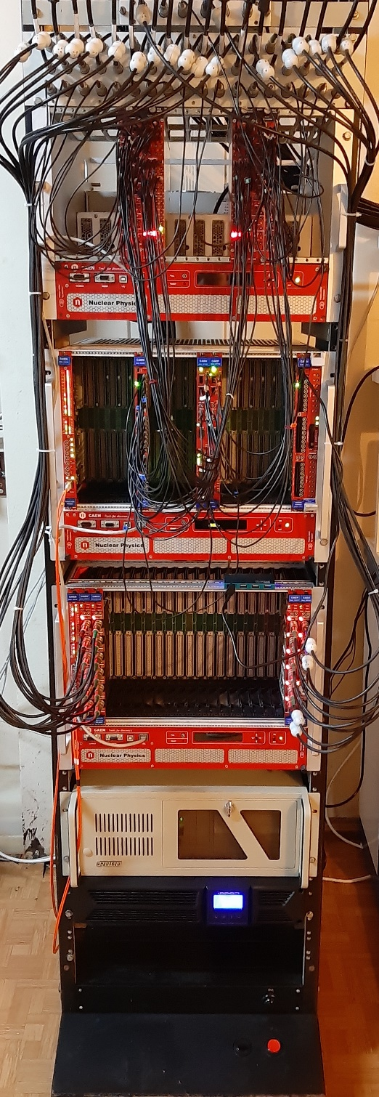
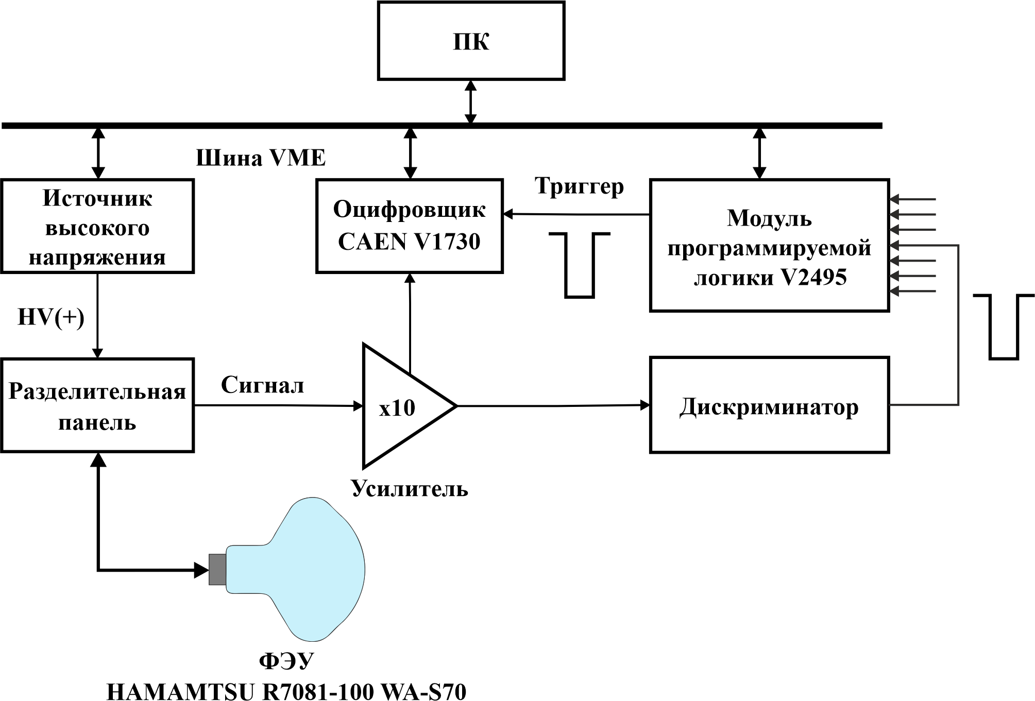
Registration system
Coincidence circuit
Veto system
Scaler
PC
VMEbus
High voltage power supply
Digitizer
Trigger
Programmable logic module V2495
Dividing panel
Signal
Discriminator
Amplifier
Sampling rate: 500 MS/s
Dynamic range: 2 V
Resolution: 14 bit
Buffer size: to 2 ms
PMT
ICPPA, 2022
11

Slide 12
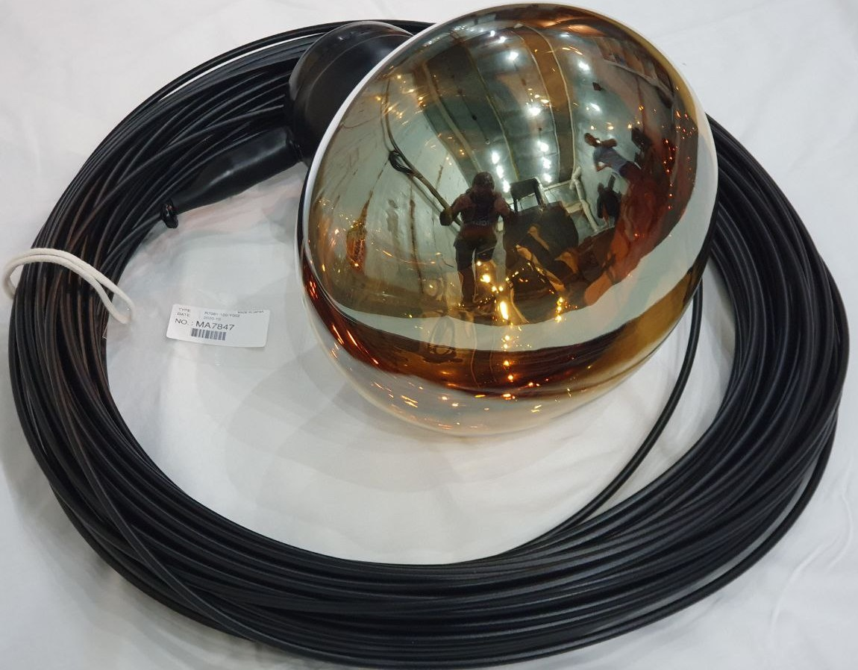
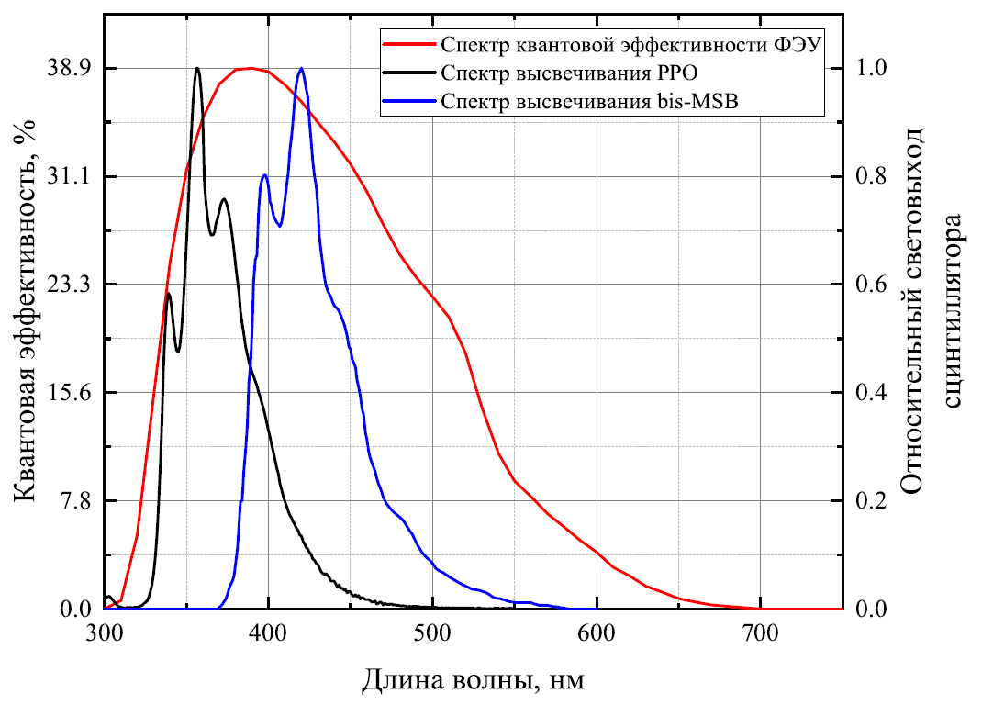
PMT Hamamatsu R7081-100 WA-S70
Quantum efficiency spectrum of PMT
Light yield spectrum of PPO
Light yield spectrum of bis-MSB in toluene
Quantum efficiency, %
Relative light yield
Parameter | Value
Dark current pulses | 1.74±0.87
Peak-to-valley | 3.73±0.56
SPE resolution | 0.68±0.06
Jitter | 3.01±0.24
Wavelength, nm
ICPPA, 2022
12

Slide 13
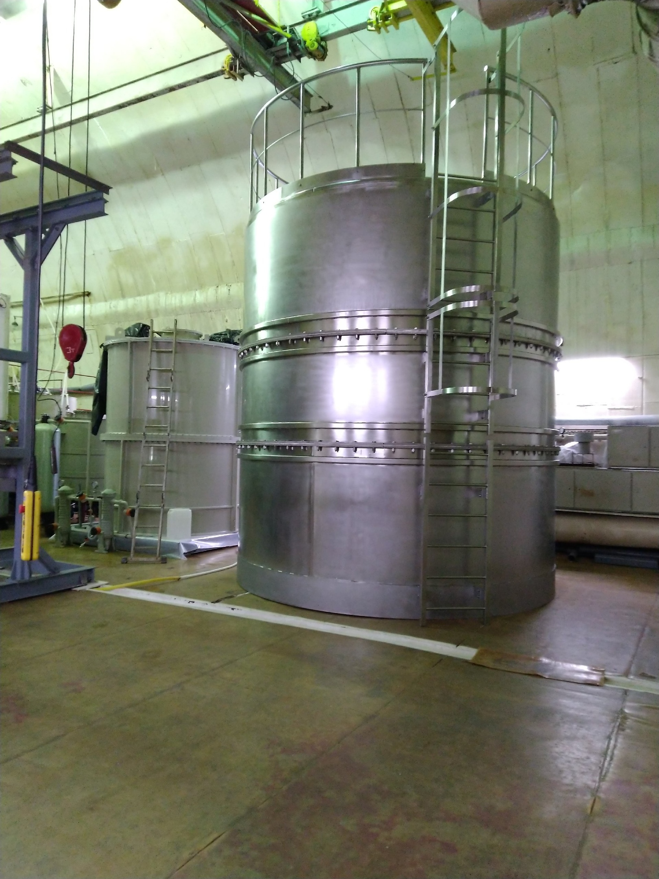
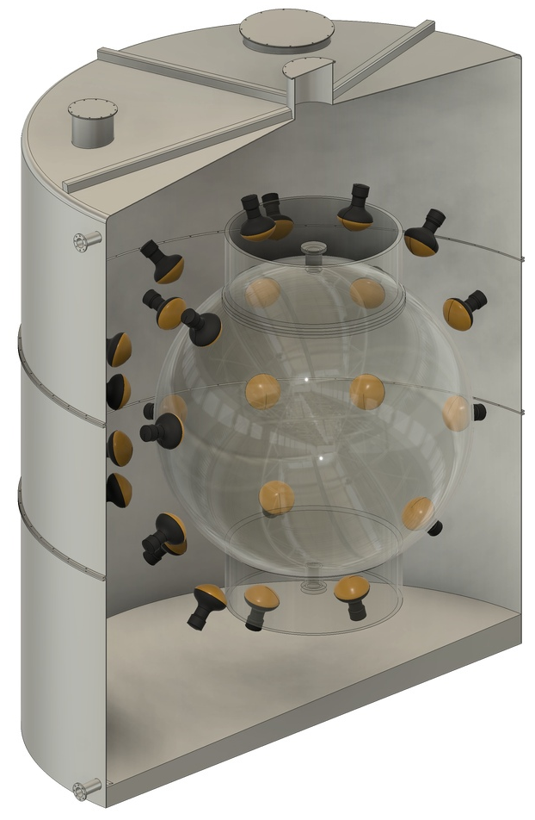
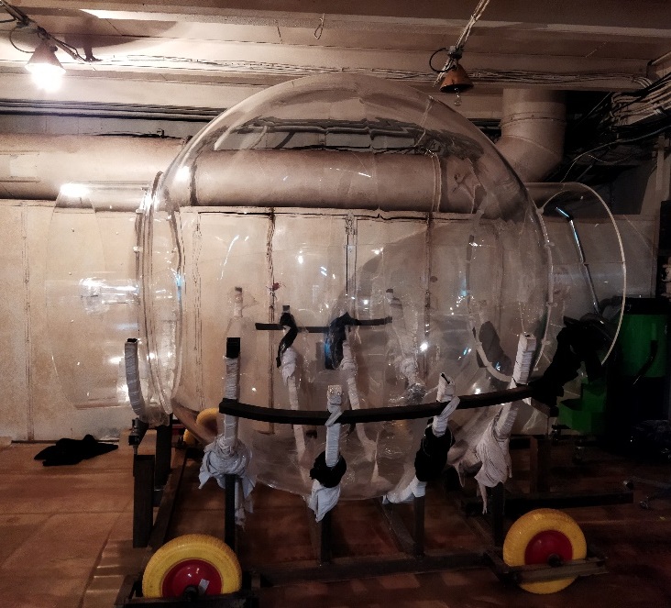
Second stage of the project
50 m³ stainless steel water reservoir
Forty two 10-inch PMTs Hamamatsu R7081-100 WA-S70
Acrylic sphere with 1.1 m radius
ICPPA, 2022
13

Slide 14
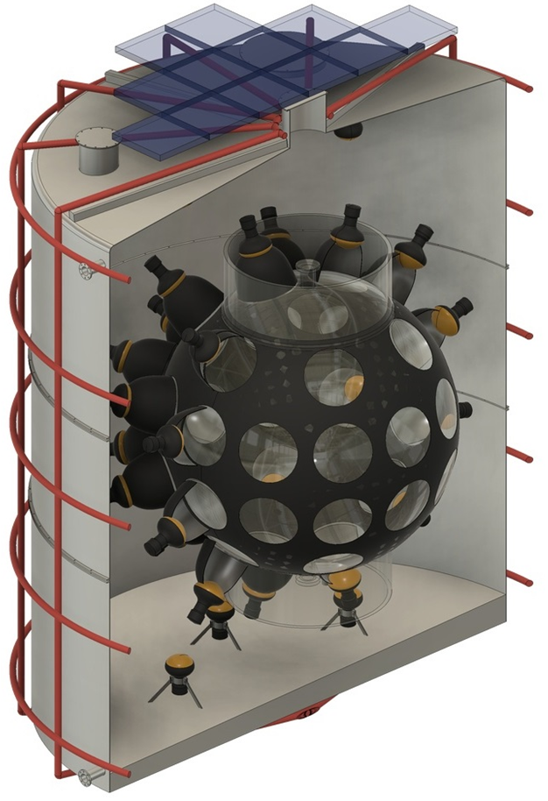
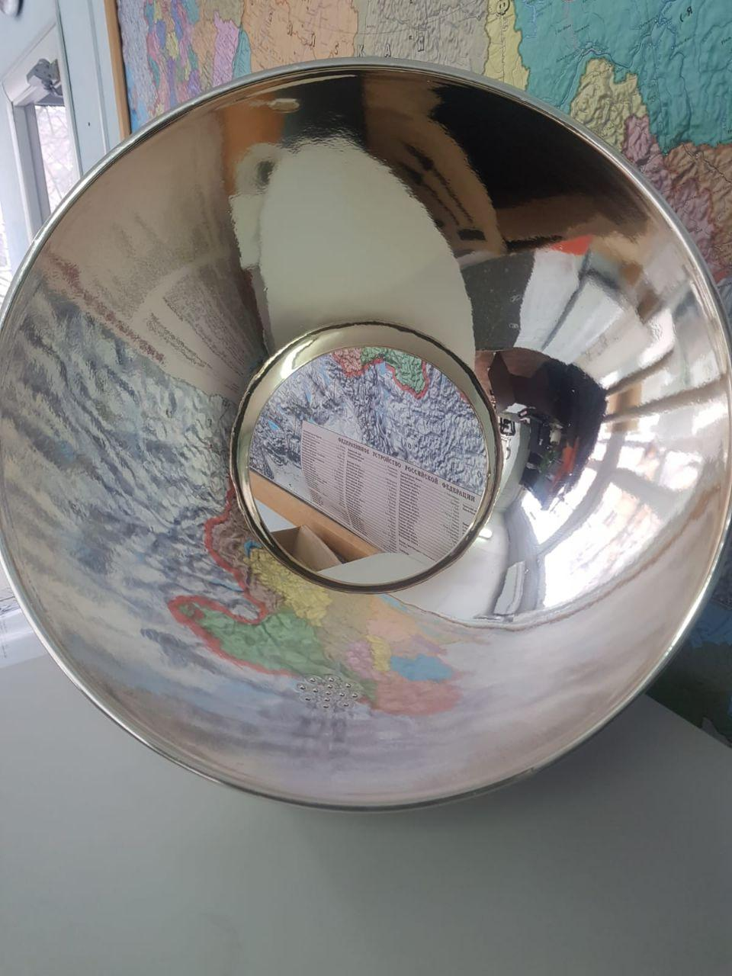
Carbon light concentrators
Muon detector based on plastic scintillator and silicon photomultiplier
Light absorbing film for separation of scintillation target and Cherenkov detector
Twelve 8-inch PMTs Hamamatsu R5912-100 WA-S70 for muon water Cherenkov detector
Magnetic field compensation system
ICPPA, 2022
14

Slide 15
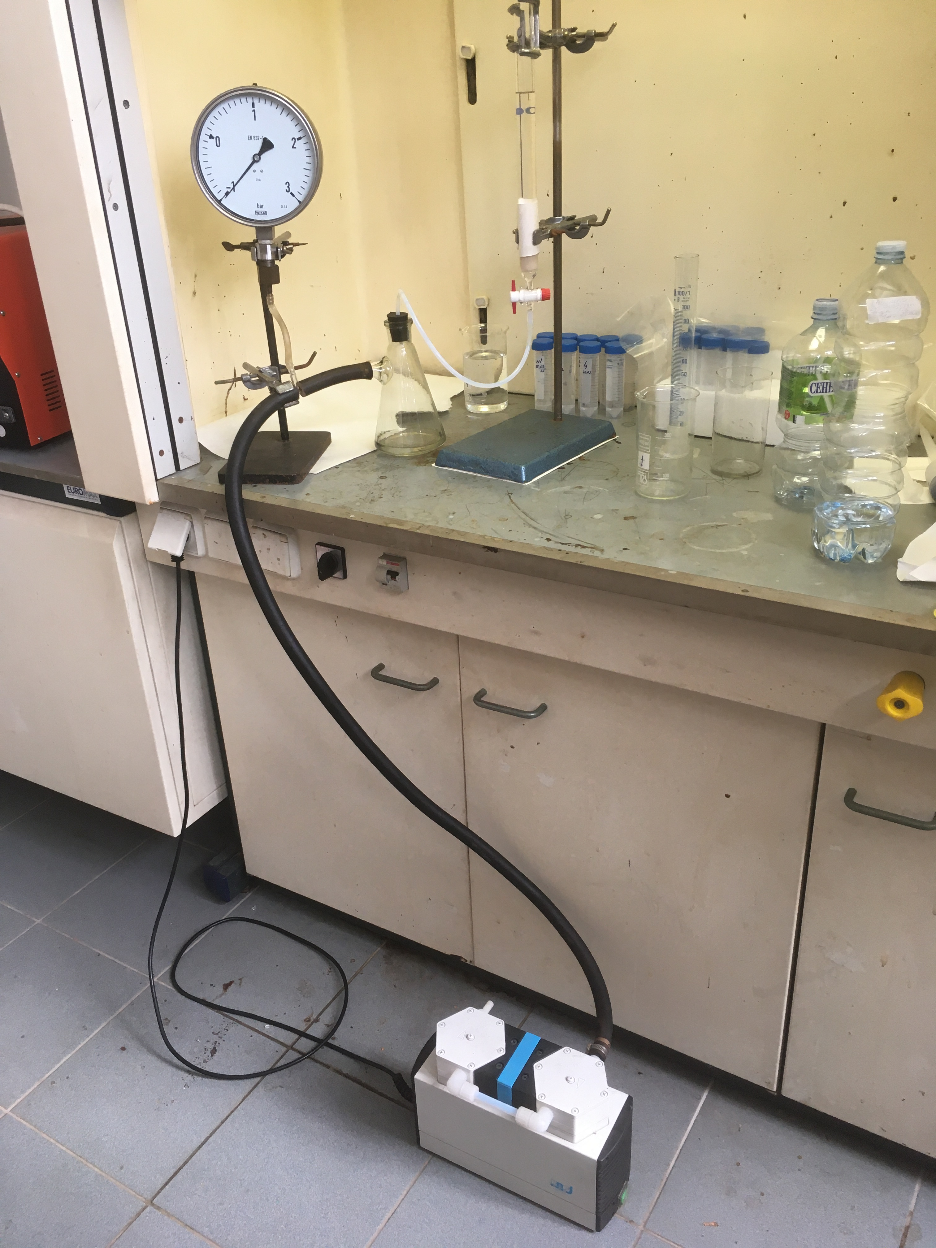
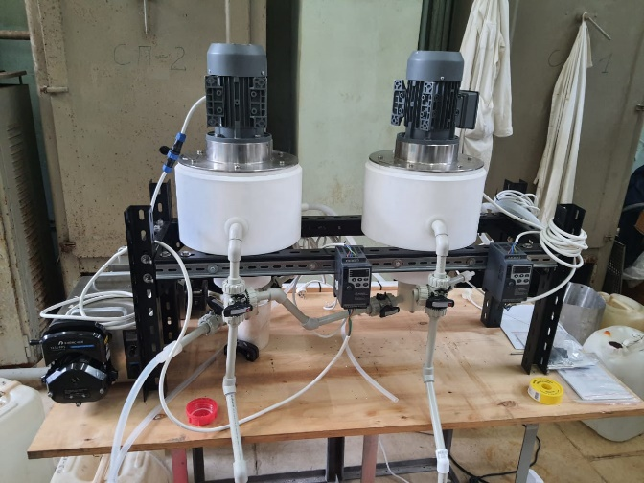
Scintillator purification
LAB purification by sorption with Al₂O₃
LAB and PPO purification from potassium by water extraction
ICPPA, 2022
15

Slide 16
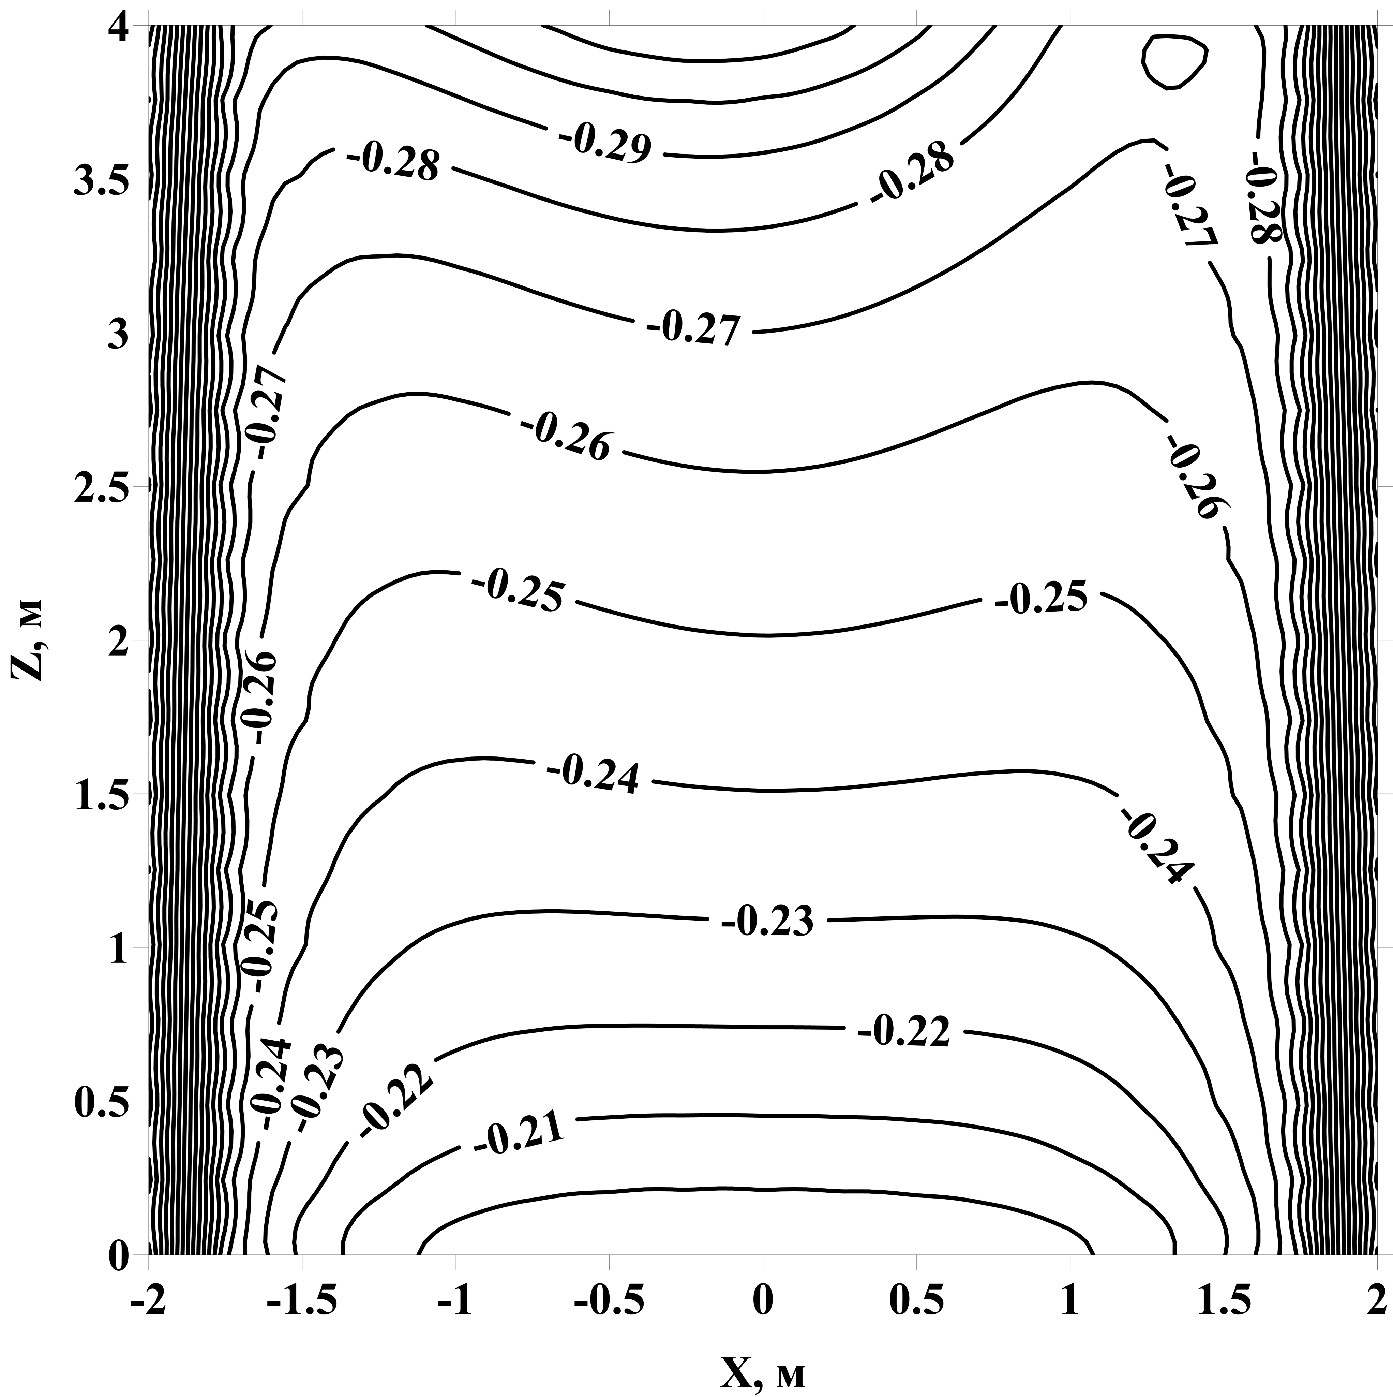
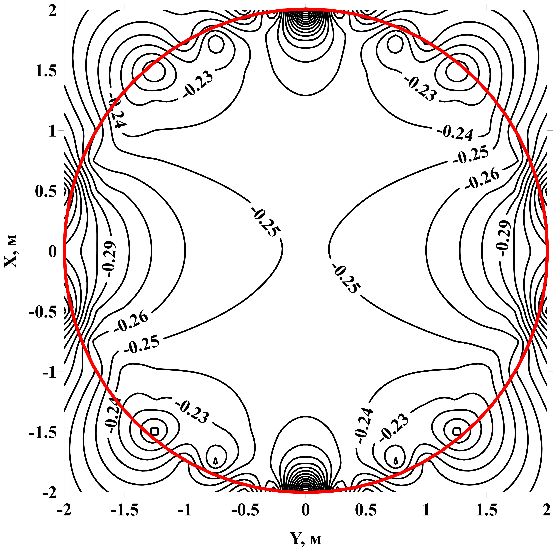
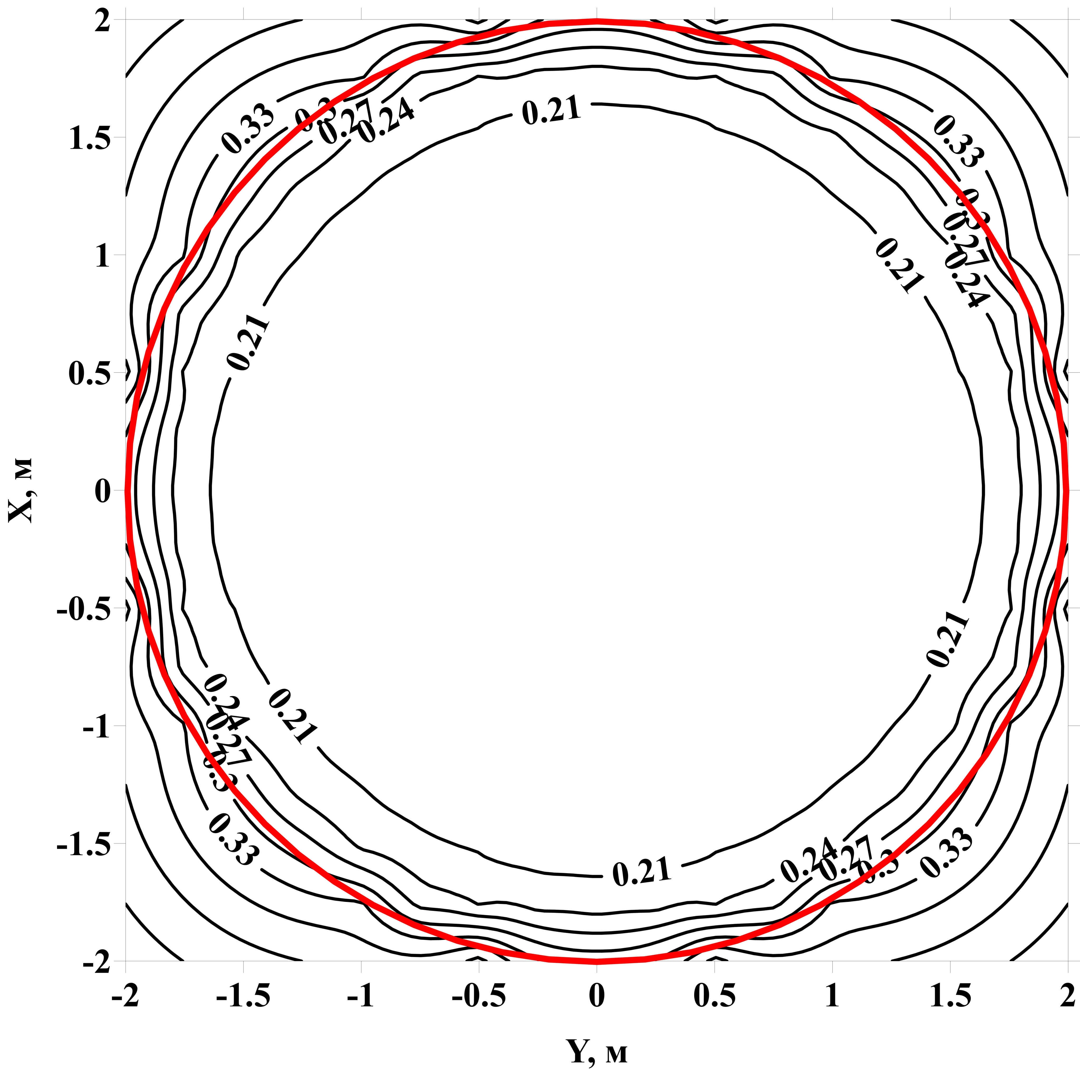
Earth magnetic field compensation system
Measured values of magnetic field in prototype location:
horizontal component – 0.265 G, vertical – 0.25 G
Horizontal component: Number of coils 12
Turns = 7
Vertical component: Number of coils 5
Turns = 10
ICPPA, 2022
16

Slide 17
Results
First stage is completed
-Muon flux has been measured ((4.02±0.24)*10⁻⁹ cm⁻²s⁻¹)
-Radioactive background of prototype materials has been measured
-Energy detector response was 172.6 photoelectrons/MeV after calibration by radioactive sources
Acrylic sphere, steel frame and steel water reservoir has been made
6 tons of LAB have been purchased, scintillator purification system has been developed
Characteristics of 10-inch and 8-inch PMTs have been measured
Optimal shape of light concentrators has been calculated, test concentrator has been produced
Earth magnetic field compensation system has been developed
ICPPA, 2022
17

