Slide 1

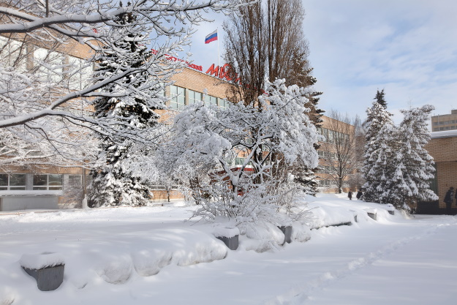
AMoRE experiment: search for the neutrinoless double beta decay of ¹⁰⁰Mo isotope
The 6th International Conference on Particle Physics and Astrophysics (ICPPA-2022)
Moscow, 29 Nov – 2 Dec 2022
Kornoukhov Vasily
on behalf of the AMoRE Collaboration
MEPhI
(Moscow, Russia)
vnkornoukhov@mephi.ru

Slide 2

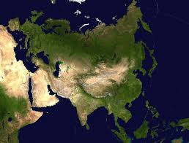









AMoRE (Advanced Mo-based Rare process Experiment): search for 0ν2β-decay of Mo-100 isotope
China
Germany
India
Indonesia
Korea
Pakistan
Russia
Thailand
Ukraine
9 countries, 23 institutes, ~ 106 members
2003 – the beginning of works on CaMoO₄ scintillation crystals growth in Korea (and in Russia)
2009 – creation of International collaboration AMoRE
2006-2012 – JSC Fomos-Materials developed the technology of ^{48free}Ca¹⁰⁰MoO₄ crystals growth.
2013 – Foundation of CUP (Center for Underground Physics IBS).

Slide 3

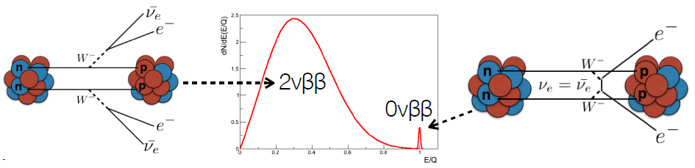
Search for neutrinoless double beta decay: motivation
(Z,A) → (Z+2,A) + 2e⁻ + 2ν_{e} (∆L=0, allowed, ⁷⁶Ge, ¹³⁰Te, ¹⁰⁰Mo, ¹¹⁶Cd)
Giulio Racah (1937) suggested: If neutrino Majorana particle, DBD occurs without neutrino emission
(Z,A) → (Z+2,A) + 2e⁻ (∆L=2, violated, never observed!)
Lepton number conservation (∆L=2): new physics?
Nature of neutrino (Majorana or Dirac particle?)
The absolute neutrino mass scale (hierarchy of neutrino masses)

Slide 4
Why is ¹⁰⁰Mo isotope chosen for AMoRE?
¹⁰⁰Mo
High Q_{ββ} = 3034 keV > ²⁰⁸Tl γ-line (2615 keV from rock and materials).
Relatively short half life (0νββ) expected from the theoretical calculation.
High natural abundance: 9.7%
Production of ¹⁰⁰Mo isotope at industrial scale: centrifuges (Russia).
¹⁰⁰Mo-based scintillation crystals for AMoRE detectors (XMoO4) operated under cryogenic temperature.
¹⁰⁰Mo-based scintillation crystals for AMoRE detectors: XMoO₄ (XMO, X =Ca, Li₂, etc, …) with simultaneous detection of light/heat signal → rejection of α-background
Detector = Source: high efficiency ~ 80÷85%.
Technology of Czochralski single crystal growth: High purity → very low intrinsic radioactive background.

Slide 5
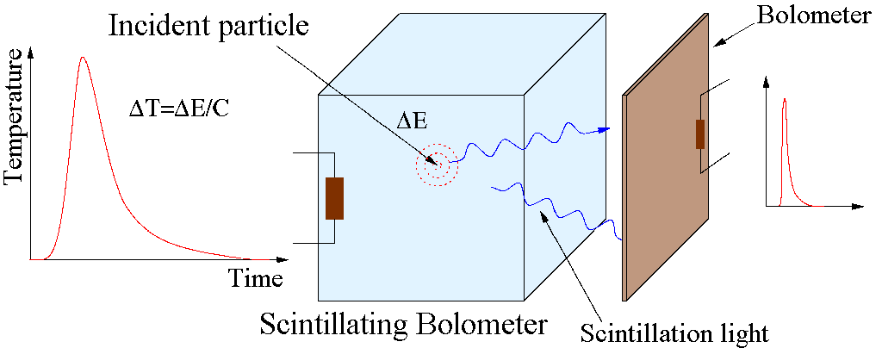
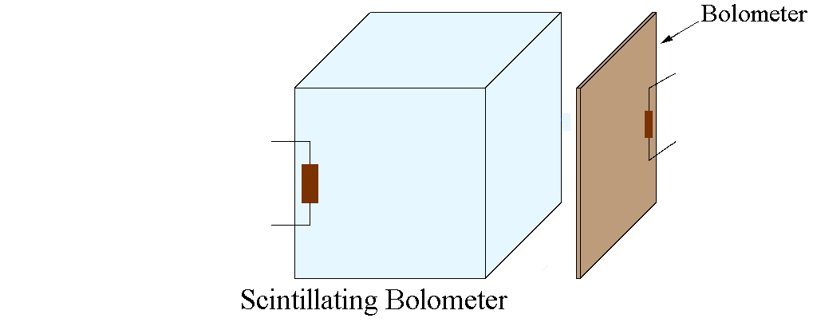
How a scintillation cryogenic bolometer woks?
τ=C/G
ΔT=ΔE/C

Slide 6
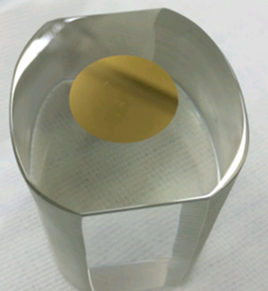


AMoRE detector module
(X¹⁰⁰MoO₄) + MMC + SQUID + Cu frame
XMoO₄ crystal
Gold film as
phonon
collector
SQUID – Superconducting Quantum Interference Device
- Fast signal timing: a few millisecond rise-time for phonon signals at mK.
- Low random coincidence background.
- High energy resolution ~ 10 keV FWHM at 2.6 MeV.

Slide 7
Implementation of AMoRE experiment (Stages Plan)
Completed
2015 ÷ 2018
6 CMO & 1.9 kg
^{48depl}Ca¹⁰⁰MoO₄
In progress
2020 - 2023
13 CMO + 5 LMO
Total mass: 6.2 kg
Since 2023 →
1st stage - 90 kg of LMO (10 towers)
Total mass of 200 kg XMoO4 (100 kg of ¹⁰⁰Mo)
50 towers ~ 450 XMoO₄ crystals
AMoRE-Pilot to demonstrate
the potential for 0νββ probe
L₂MoO₄ crystals
D 5 x 5 cm (~ 300 g)
D 6 x 6 cm (~ 520 g)

Slide 8

Cryostat with shielding/AMoRE-Pilot and AMoRE-I in YangYang lab
Pulse-tube dilution refrigerator:
Operating at 10 mK with 1.2 μW cooling power.
Damping system to reduce vibration noise signals from the impulse tube of the CF-DR cryostat.
- 15-20 cm Pb (γ), boron and polyethylene (neutrons),
- Plastic scintillator muon counter (muons veto).
YangYang underground laboratory
-700 m minimum vertical depth (2000 m.w.e)
Radon free air supplied

Slide 9
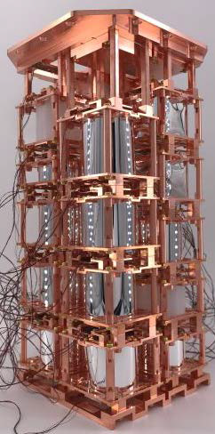
From AMoRE-Pilot to AMoRE-I detector
Period : 2020 - 2023
13 CMO + 5 LMO
(FOMOS + NIIC + CUP)
Total mass : 6.2 kg
Period: 2015 ÷ 2018
6 CMO (FOMOS) & 1.9 kg
^{48depl}Ca¹⁰⁰MoO₄
Upgrades from Pilot to AMoRE-I:
•6 CMO (1.89 kg) ➔ 18 (13 CMO (4.58 kg) + 5 LMO (1.61 kg))
-Total crystal mass = 6.19 kg, ¹⁰⁰Mo mass = 3.1 kg
• Stabilization heater for all crystals.
•MMC sensor: AuEr ➔ AgEr.
•Using same cryostat + two stage temperature control: ⟨ΔT⟩ < 1 μK.
• Shielding enhancements:
-Outer Pb: 15 cm ➔ 20 cm; neutron shields: boric acid silicon + more PE / Boron-PE.
- Better muon counter coverage (~ 4π).
- More supply of Rn-free air.

Slide 10
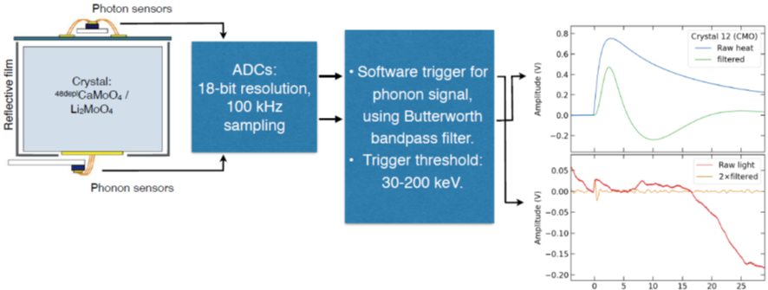
Signal processing and analysis
Heat/phonon
Light/photon
Light/photon channel parameter:
- Pulse height (RAW and / filtered)
The Butterworth bandpass filter was applied to data from each channel to improve the energy resolution (to enhance the signal dominant frequency band and suppress noise-dominant frequency bands).
The rise time of the heat signal and the light/heat signals ratio were used to discriminate alpha and beta particles
Heat/phonon channel parameters:
- Pulse height (RAW / filtered)
- Rise time
- Mean time
- Fall time
Particle identification parameters:
- Rise time
- Light/Heat ratio

Slide 11

Particle identification
CMO shows better discrimination power* — light yield: CMO > LMO.
LMO has much less α contamination.

Slide 12
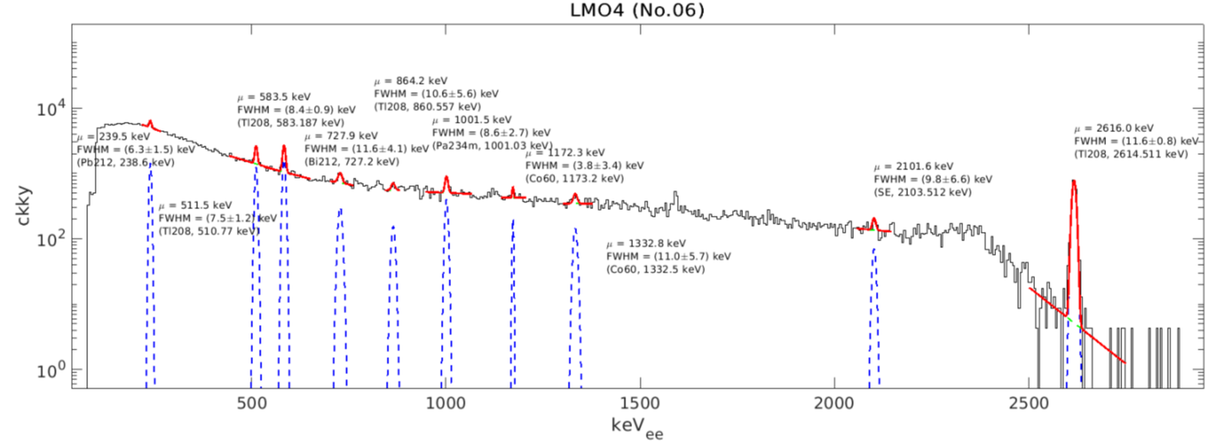
Detector performance (energy calibration & resolution)
Good E linearity, FWHM@2.6MeV = 10-20 keV
External γ source: ²³²Th-doped welding rods
outside of OVC
Internal α sources/impurities inside the crystal
Slight second order non linearity

Slide 13
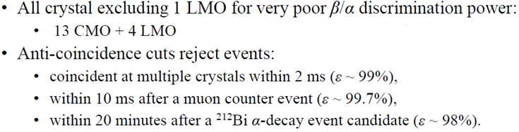

The background spectrum AMoRE-I
Background = 0.034 +/- 0.005 counts/keV/kg/year, from ROI side band

Slide 14
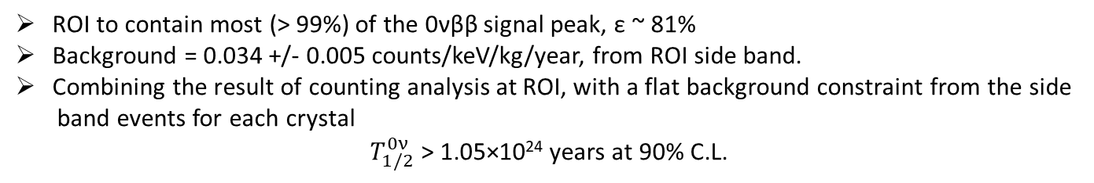
Preliminary 0νββ limit from AMoRE-I
ROI to contain most (> 99%) of the 0νββ signal peak, ε ~ 81%
Background = 0.034 +/- 0.005 counts/keV/kg/year, from ROI side band.
Combining the result of counting analysis at ROI, with a flat background constraint from the side
band events for each crystal
$T_{1/2}^{0ν}$ > 1.05×10²⁴ years at 90% C.L.

Slide 15
AMoRE-II detector
Detector array: 100 kg of ¹⁰⁰Mo, 178 kg of LMO crystals (423 modules)
Scintillating molybdate crystal Li₂MoO4 (LMO) by NIIC/CUP
Recent R &D efforts: detector performance improved significantly:
Energy resolution (FWHM) at 2.6 MeV: FWHM < 7 keV
Alpha particle discrimination power (DP): alpha rejection more than 10σ
Large individual detector mass (300 ~ 500 g for D5 x 5 cm and D6 x 6 cm)
Fast time response
JINST 17 P07034 (2022)

Slide 16
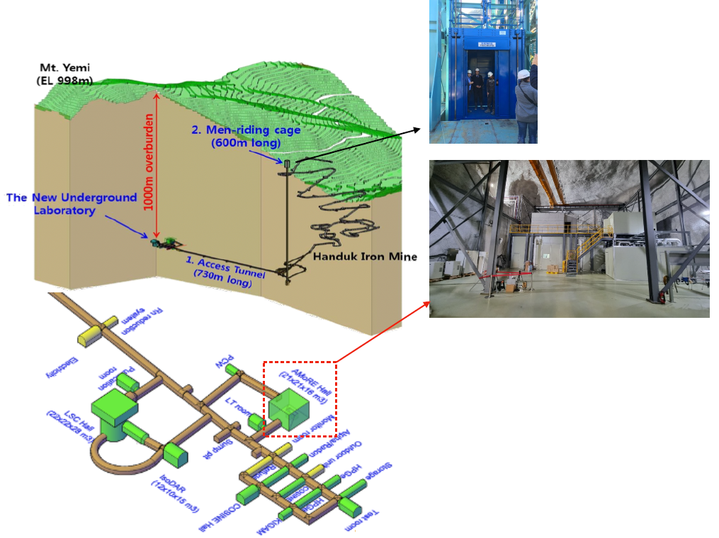
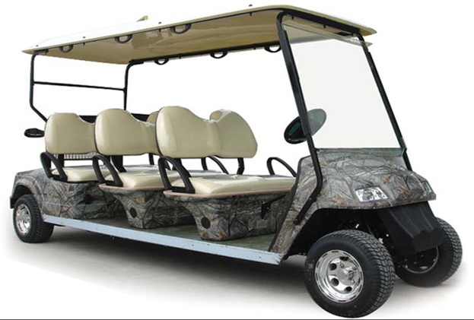
New Underground Laboratory Yemilab to host AMoRE-II
6-seats electric vehicle
The constructions have been done
(2017.09 – 2022.07)
2,500 m² of experiment dedicated area
1,000 m underground
From Sept 2022, the Yemilab is in operation

Slide 17
AMoRE Hall in Yemilab (October 2022)
60 m³

Slide 18
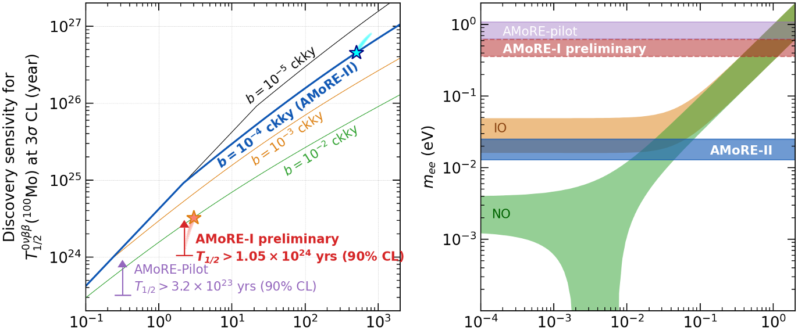
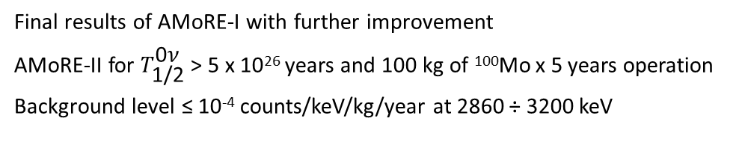
AMoRE-II expected sensitivity and limits
Final results of AMoRE-I with further improvement
AMoRE-II for ${\text{T}}_{\text{1/2}}^{\text{0}\text{ν}}$ > 5 x 10²⁶ years and 100 kg of ¹⁰⁰Mo x 5 years operation
Background level ≤ 10⁻⁴ counts/keV/kg/year at 2860 ÷ 3200 keV

Slide 19
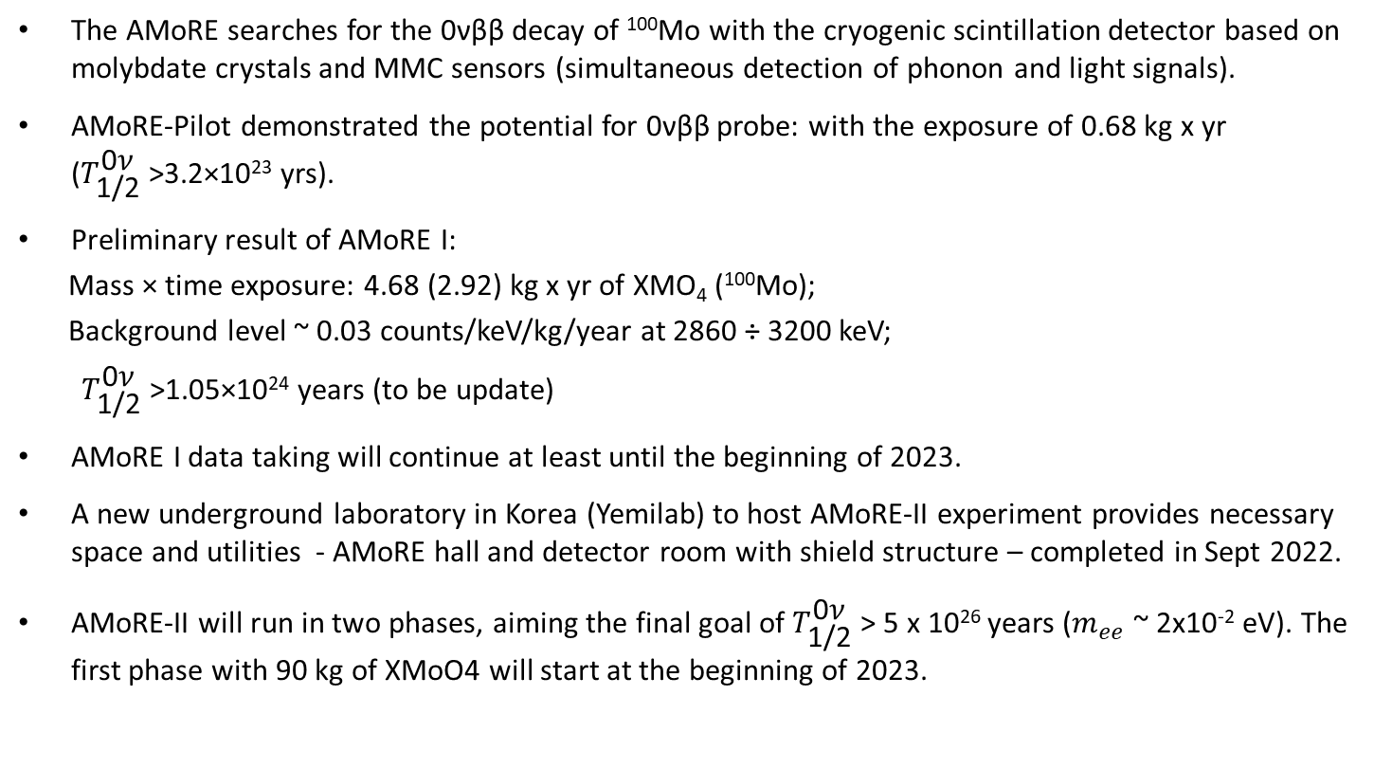
Conclusions
The AMoRE searches for the 0νββ decay of ¹⁰⁰Mo with the cryogenic scintillation detector based on molybdate crystals and MMC sensors (simultaneous detection of phonon and light signals).
AMoRE-Pilot demonstrated the potential for 0νββ probe: with the exposure of 0.68 kg x yr (${\text{T}}_{\text{1/2}}^{\text{0}\text{ν}}$ >3.2×10²³ yrs).
Preliminary result of AMoRE I:
Mass × time exposure: 4.68 (2.92) kg x yr of XMO₄ (¹⁰⁰Mo);
Background level ~ 0.03 counts/keV/kg/year at 2860 ÷ 3200 keV;
${ \text{T}}_{\text{1/2}}^{\text{0}\text{ν}}$ >1.05×10²⁴ years (to be update)
AMoRE I data taking will continue at least until the beginning of 2023.
A new underground laboratory in Korea (Yemilab) to host AMoRE-II experiment provides necessary space and utilities - AMoRE hall and detector room with shield structure – completed in Sept 2022.
AMoRE-II will run in two phases, aiming the final goal of ${\text{T}}_{\text{1/2}}^{\text{0}\text{ν}}$ > 5 x 10²⁶ years ($m_{ee}$ ~ 2x10⁻² eV). The first phase with 90 kg of XMoO4 will start at the beginning of 2023.

Slide 20
Back up slides

Slide 21
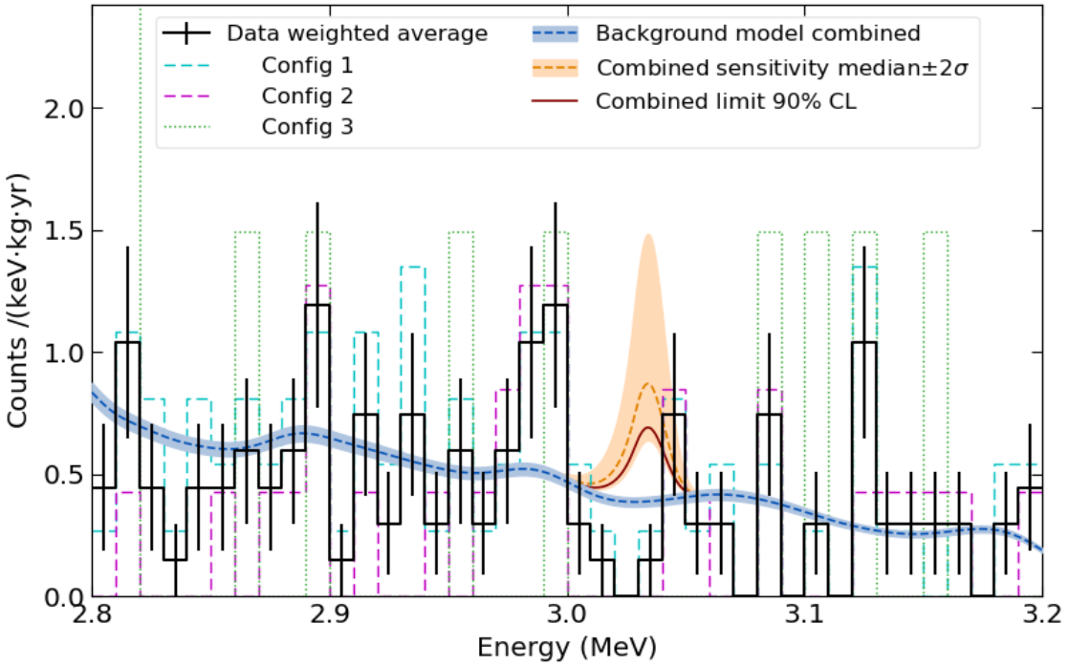
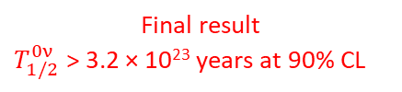
AMoRE-pilot final result
Background energy spectra of all the detectors (2.8 ÷ 3.2 MeV)
Final result
$T_{1/2}^{0ν}$ > 3.2 × 10²³ years at 90% CL
Understanding of the background components and reduction of them.
Background level of ~ 0.3 counts/keV/kg/yr at 2.8-3.2 MeV.
neutron-induced γ, crystals’ internal contamination, rock/air-radon γ.
Internal background

Slide 22
AMoRE-I data taking & all 18 crystals
> 400 days of physics data
↑ ↑
Breaks due to maintenance
and power outrage

Slide 23
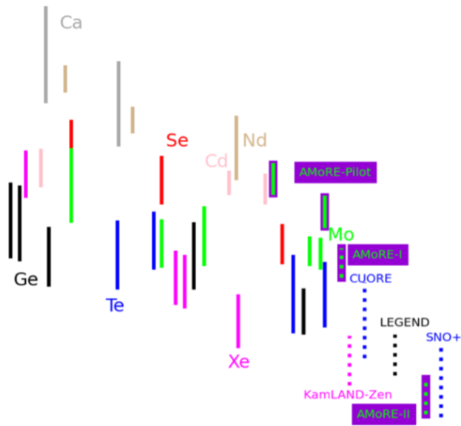
Recent Limits & Persepectives

Slide 24
Background budget for AMoRE-II

Slide 25
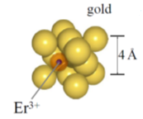
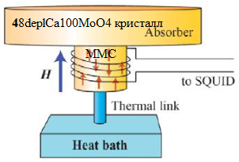
MMC (Metallic Magnetic Calorimeter): temperature sensor based on paramagnetic alloy (Au:Er) + SQUID
Energy released (∆E) in absorber leads to sequential change of following parameters:
temperature Au film (∆T)→magnetization of MMC (∆M)→magnetic flux of MMC (∆M)→ Voltage (SQUID)
at ~ mK temperature
Gold film -
phonon
collector
10 ÷ 1000 ppm
J = 15/2
loop
5 mT → Δε → 1.5 μeV
1 keV → 10⁹ spin flips
MMC cryogenic sensor
Paramagnetic material
Metallic host (Au or Ag) + Magnetic ions (Er³⁺)
Magnetization (M) very sensitive to T
MMC implemented with superconducting
current (I) loop to provide B-field
𝛥I induced by 𝛥M as a function of 𝛥T
SQUID* measures 𝛥I as a signal V
* SQUID - Superconducting Quantum Interference Device
Notes:
Mperature (

Slide 26
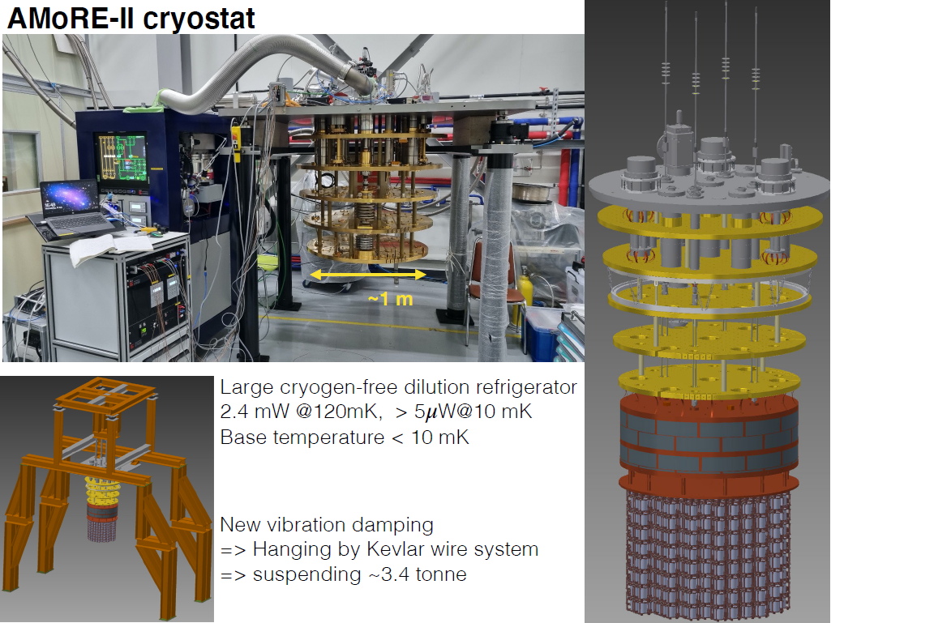
Preparation for AMoRE-II: cryostat

Slide 27
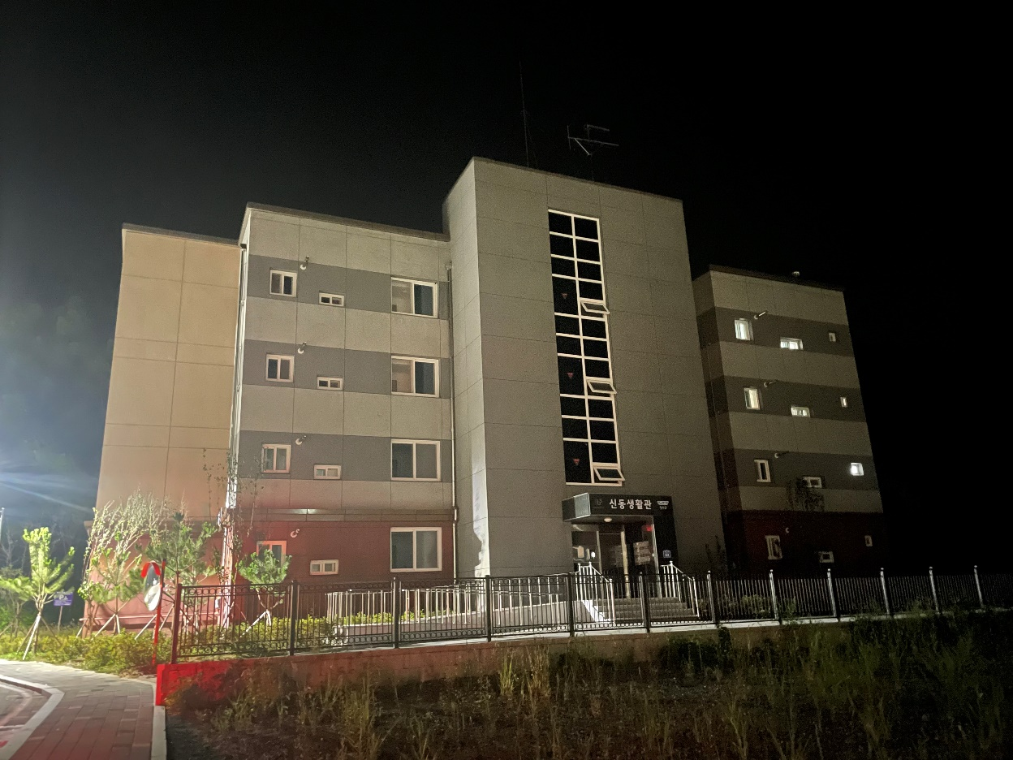
CUP town: “IBS Sindong residence”
4-story building and 12 houses total

Slide 28
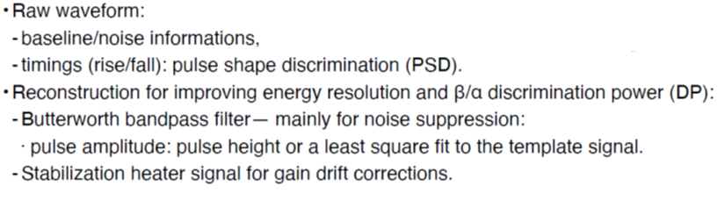
Signal processing and analysis
Heat/phonon
Light/photon
Light/photon channel parameter:
- Pulse height (RAW and / filtered)
The Butterworth bandpass filter was applied to data from each channel to improve the energy resolution (to enhance the signal dominant frequency band and suppress noise-dominant frequency bands).
The rise time of the heat signal and the light/heat signals ratio were used to discriminate alpha and beta particles
Heat/phonon channel parameters:
- Pulse height (RAW / filtered)
- Rise time
- Mean time
- Fall time
Particle identification parameters:
- Rise time
- Light/Heat ratio

Slide 29
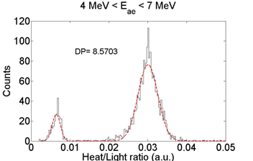
Particle discrimination
Particle discrimination by light/heat ratio
Phonon pulse shape discrimination (PSD)

