Slide 1

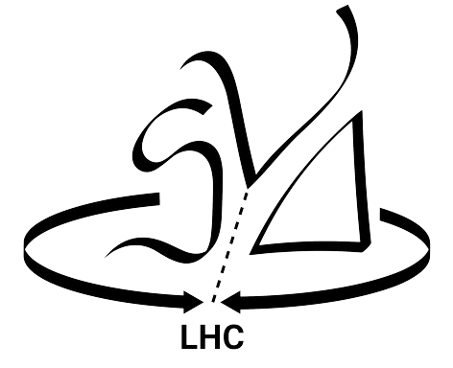
SND@LHC
THE SCATTERING AND NEUTRINO DETECTOR AT THE LHC
Prof N.G. Polukhina (Lebedev Physical Institute)
On behalf of the SND@LHC Collaboration
6th International Conference on Particle Physics and Astrophysics
29 November - 2 December 2022 National Research Nuclear University "MEPhI"

Slide 2
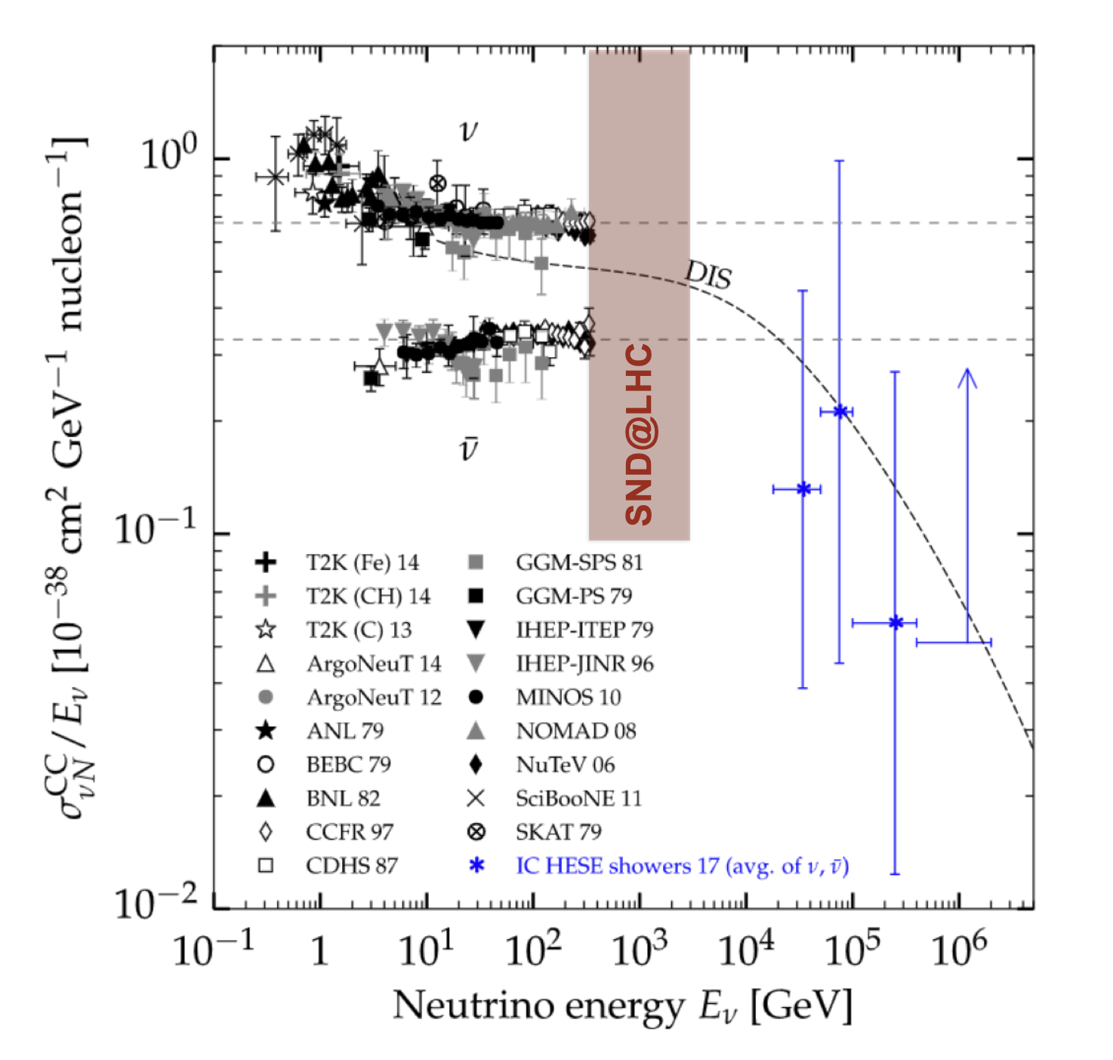
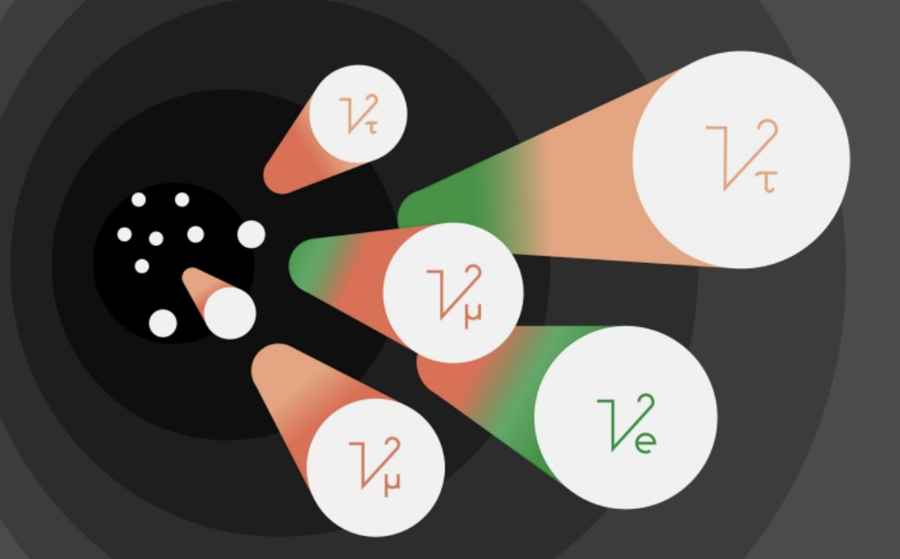
N.G. Polukhina (LPI)
Neutrino physics at the LHC
LHC can create huge amount of high energy neutrinos.
LHC is a unique facility for measuring the νN cross sections in the 350 GeV - 10 TeV range.
First detection of neutrinos produced at a particle collider.
2

Slide 3
N.G. Polukhina (LPI)
THE SND@LHC experiment location
SND@LHC is a compact and stand-alone CERN experiment to perform measurements with neutrinos produced at the LHC in a pseudo-rapidity region 7.2 < η < 8.6
About 480 m away from the ATLAS IP
Tunnel TI18: former service tunnel connecting SPS to LEP
Charged particles deflected by LHC magnets
Shielding from the IP provided by 100 m rock
3

Slide 4
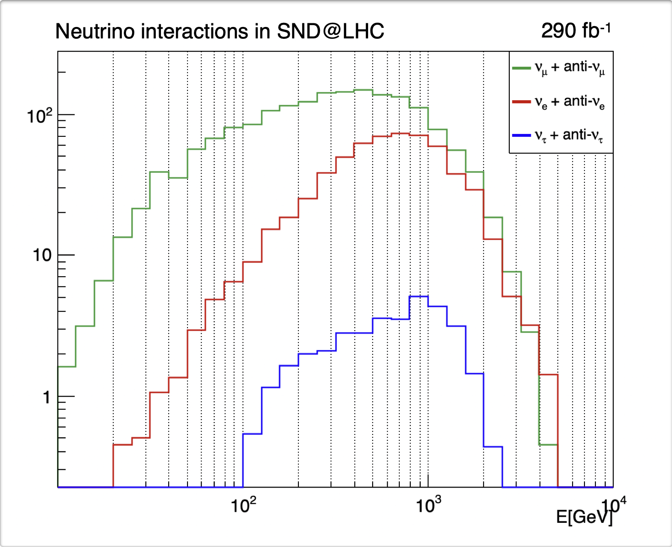
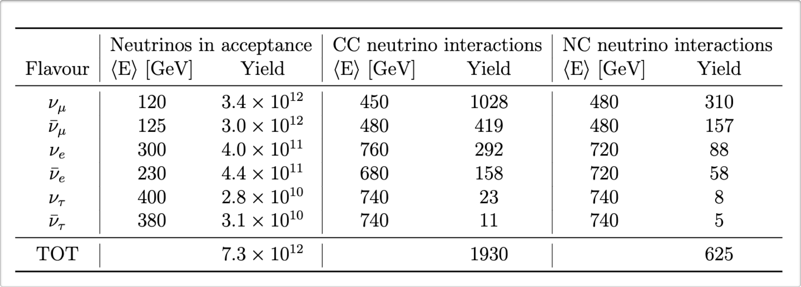
N.G. Polukhina (LPI)
SND@LHC physics goals
        Neutrino physics (7.2 < η < 8.6)
        1. Measurement of the pp⟶νeX cross-section
        2. Heavy flavour production in pp-collisions
        3. Lepton flavour universality in neutrino interactions
        4. Measurement of the NC/CC ratio
4

Slide 5
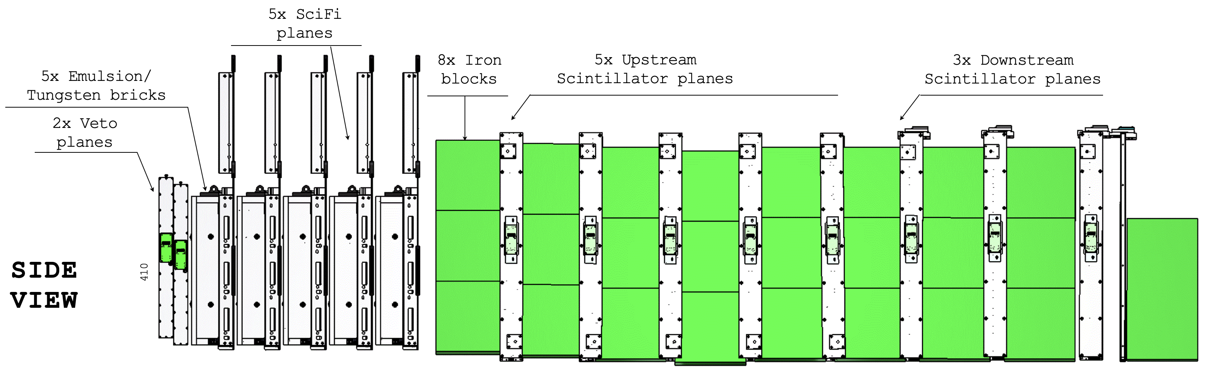
N.G. Polukhina (LPI)
THE detector LAYOUT
5

Slide 6
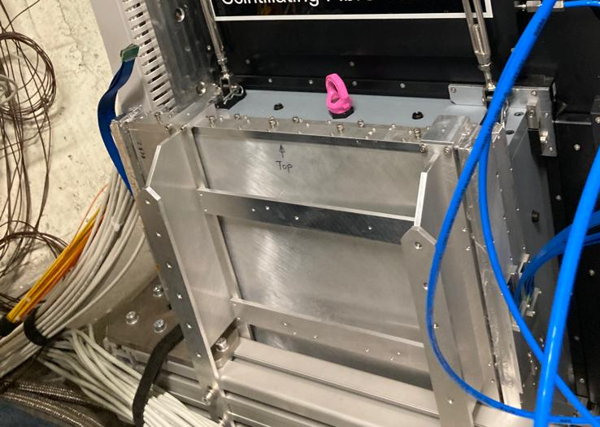
N.G. Polukhina (LPI)
Upstream veto detector
Goal: charged background particles fixation
Located upstream of the neutrino target
6

Slide 7
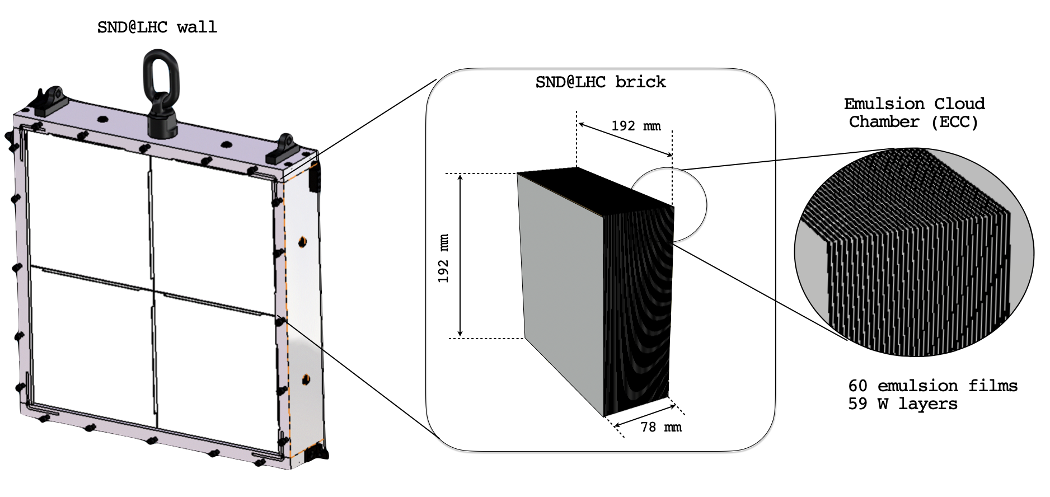
N.G. Polukhina (LPI)
Neutrino target and vertex detector
Goals:
detecting neutrino interactions (all flavours); energy measurement
search for FIPs
7

Slide 8
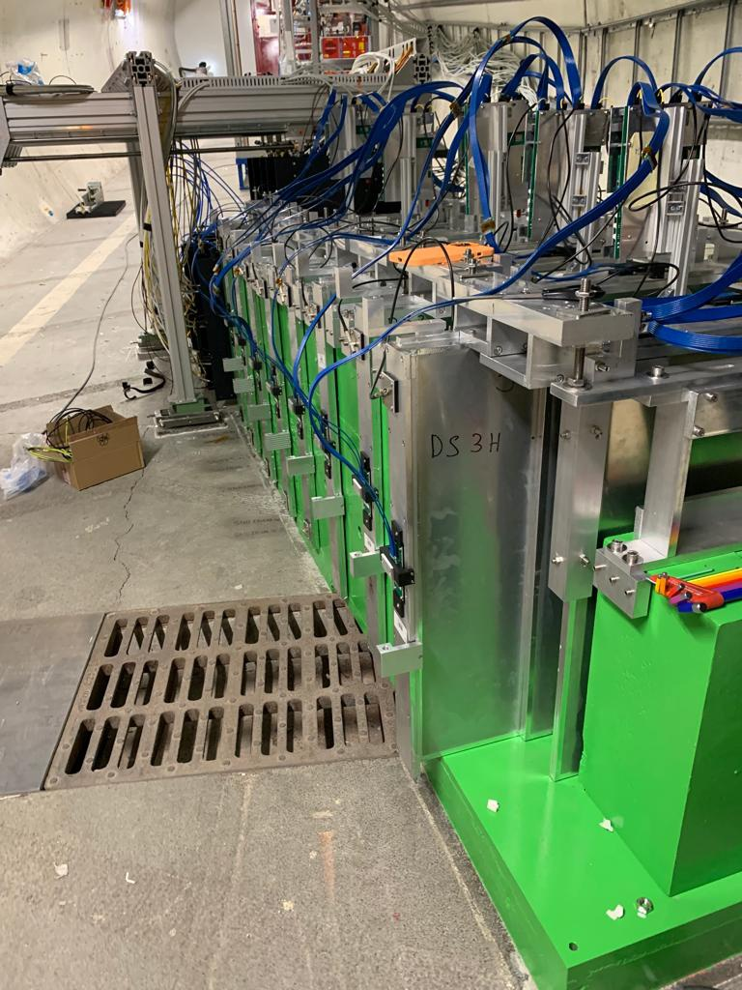
N.G. Polukhina (LPI)
Muon system and hadronic calorimeter
Goals:
muon tracking and identification
measurement of the energy of the hadronic jet
8

Slide 9
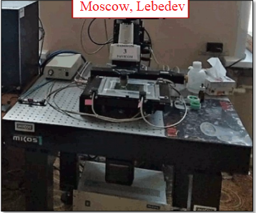
N.G. Polukhina (LPI)
CERN
Bologna: 1 system upgraded, software installation to be performed
Lebedev: 1 system upgraded, ready to scan
Napoli: 1 system upgraded, ready to scan
Zurich: 1 system upgraded, ready to scan
CERN: 1 system, upgraded, ready to scan NEW
9

Slide 10

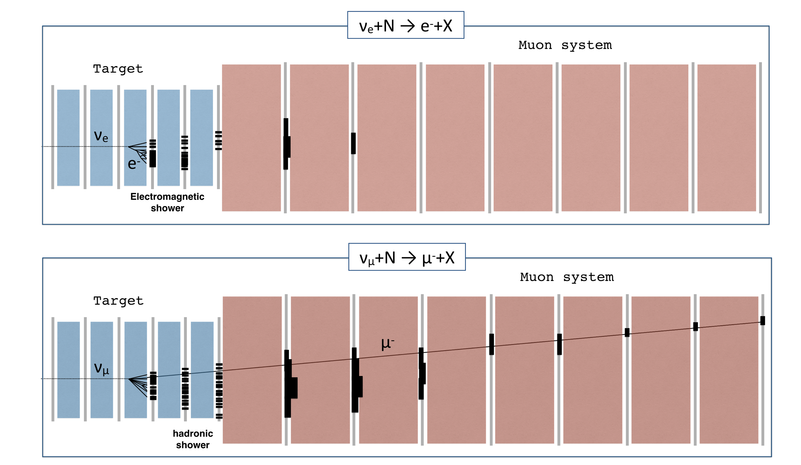

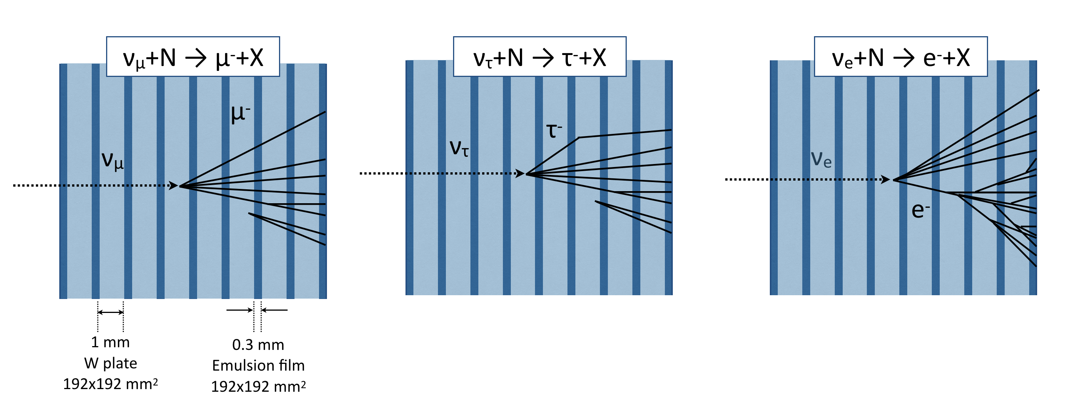
N.G. Polukhina (LPI)
EVENT reconstruction
FIRST PHASE (online, using electronic detectors):
Event reconstruction based on Veto, Target Tracker and Muon system
- Identify neutrino candidates
- Identify muons in the final state
- Reconstruction of electromagnetic showers (SciFi)
- Measure neutrino energy (SciFi+Muon)
SECOND PHASE (offline, using nuclear emulsions):
Event reconstruction in the emulsion target and search for decay vertex
- Identify e.m. showers
- Neutrino vertex reconstruction and 2ry search
- Match with candidates from electronic detectors (time stamp)
- Complement target tracker for e.m. energy measurement
10

Slide 11
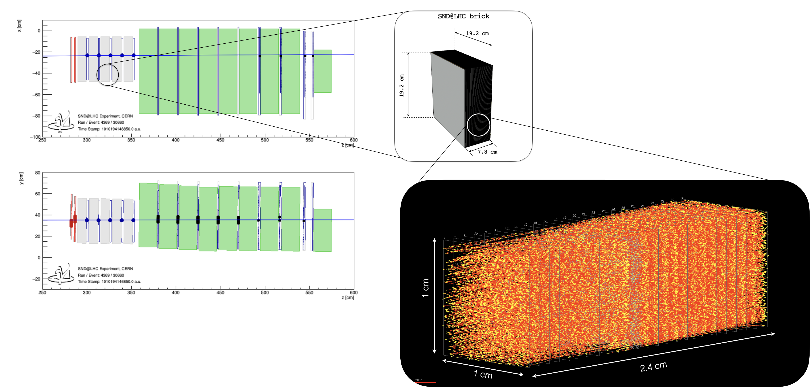
N.G. Polukhina (LPI)
RUN0 emulsion test
11

Slide 12
N.G. Polukhina (LPI)
track alignment in emulsion
Tracking resolution in x position (left) and slope as the tangent of track angle in the zx plane (right). z axis is perpendicular to the emulsion layer plane.
12

Slide 13
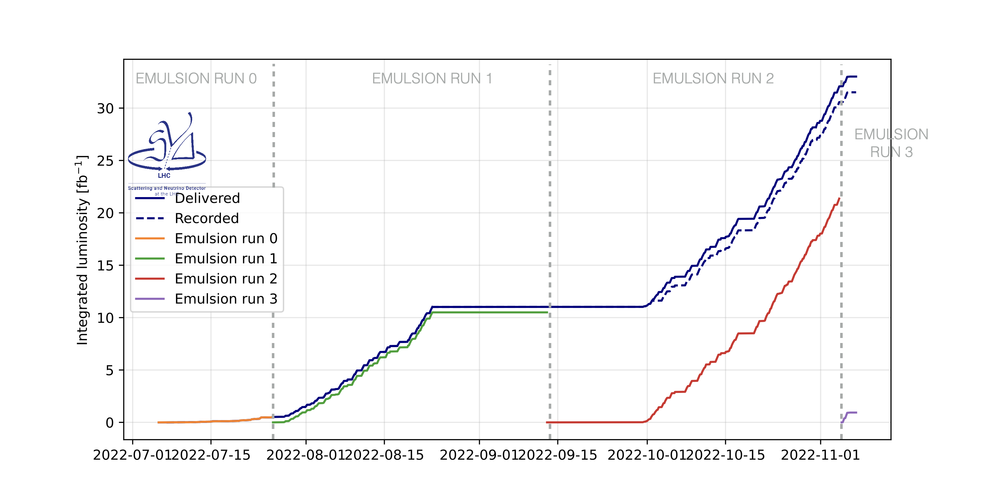
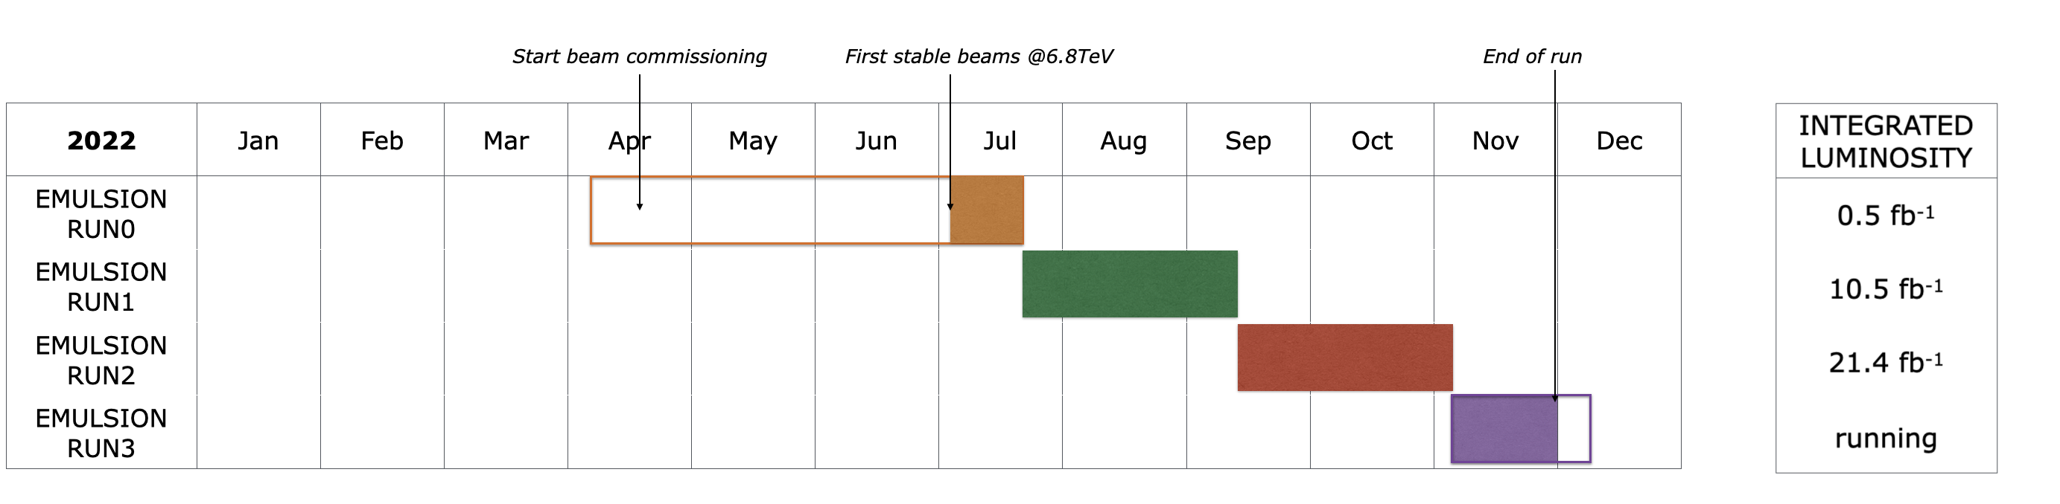
N.G. Polukhina (LPI)
EMULSION RUNS
13

Slide 14
summary
• SND@LHC is on-going experiment using LHC forward beam at CERN aiming at :
- measuring high energy neutrinos produced at the LHC in an unexplored energy and pseudo-rapidity region
searching for feebly interacting particles
• Successful data taking during 2022 proton physics run
• Analysis is ongoing
14

Slide 15

All the fun is just beginning !

