Slide 1
The discoveries of the Borexino experiment on how and why the Sun and the stars shine
Gianpaolo Bellini. Università and INFN- Milano

Slide 2
Gianpaolo Bellini. Università and INFN- Milano

Slide 3
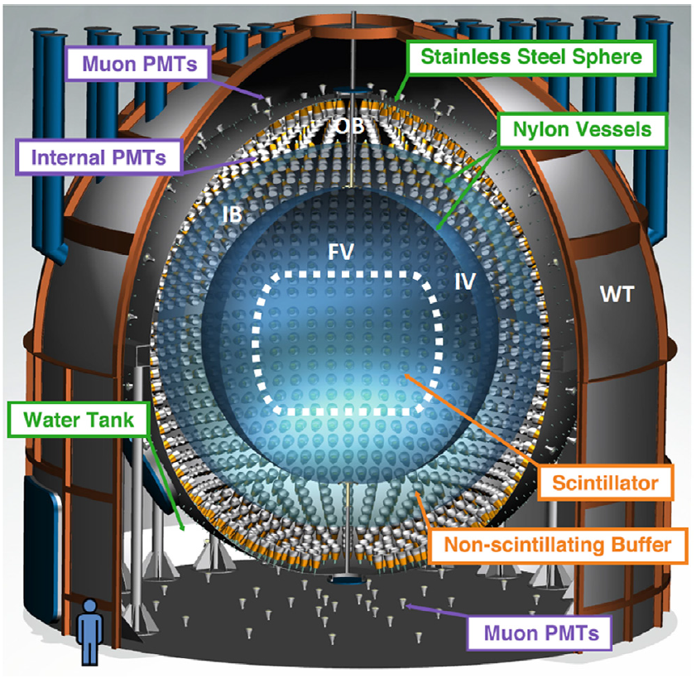
The Borexino detector @ Gran Sasso
Active volume 280 tons of liquid scintillator
2020 Jun 23
2

Slide 4
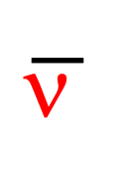
The probes to study the the Sun and stars operation mode are
the solar neutrinos
Detection principle
Delayed (τ~254 μs):
n + p -> d + γ
Detected energy: 2.2 MeV
Prompt:
E_{thr}=1.8 MeV
ν
$$\overline{\text{n} }$$
Elastic scattering off the scintillator electrons
Threshold: 1.8 MeV
The general threshold in Borexino is down to: 100 keV

Slide 5
Borexino time table and phases
1990-1995 | 1996-2007 | 2007-2010 | 2011-2016 | 2017-2022
R&D radio-purification methods | Detector construction, installation and tuning | Phase 1 | Phase 2 | Phase 3
1996-2007- the construction of the detector needed a longtime because nothing is standard in Borexino, but everything is severely selected or constructed and /or developed custom to reach a very low radioactivity
First radio-purification of the scintillator during the detector filling; further radio-purification between phase 1 and phase 2
Breakthroughs on Sun physics, Stars physics, Neutrino physics
Gianpaolo Bellini. Università and INFN- Milano

Slide 6
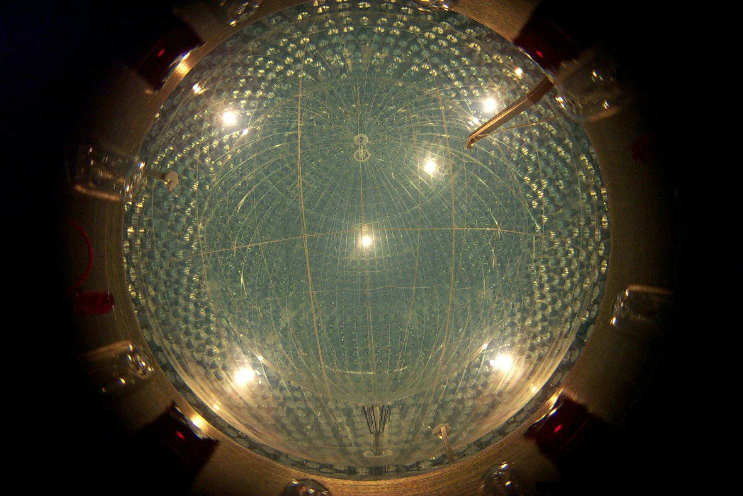

Slide 7
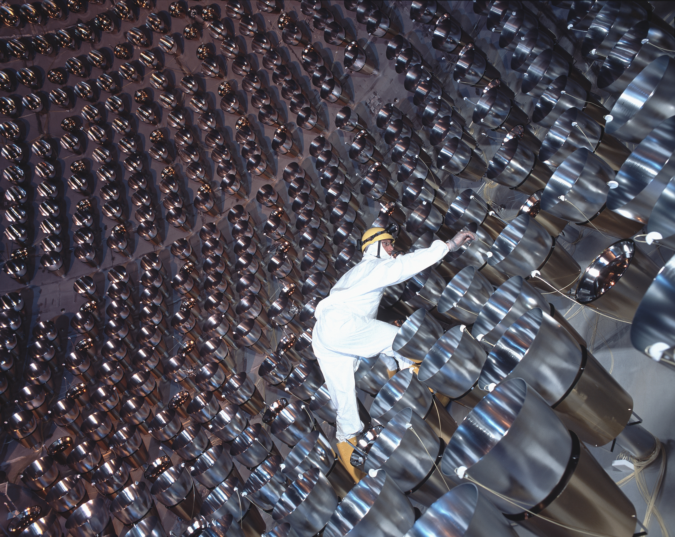

Slide 9
The physics of the Sun
Already in the ’30s of the last century the German physicist Hans Bethe hypothesized that the solar energy would be produced by a chain of nuclear fusion reactions occurring inside the core of the Sun.
This hypothesis remained a simple hypothesis until two experiments based on Cherenkov light, SNO and Superkamiokande, have been able to measure a tail at highest energy of the spectrum of solar neutrinos, the ones produced by the nuclear reaction involving ⁸B.
While these measurements were useful for understanding the so-called “solar neutrino problem”, an apparent flux deficit compared to the paradigmatic Solar Standard Model expectations, they measured only 0.01% of the entire solar flux: in fact the solar neutrinos energy spectrum spans from a few Kev up to $≥$18 MeV
The Cherenkov experiments adopted a threshold of 4-5 MeV due to the natural radioactivity present in the detector components, which have an energy spectrum ending just at $≈5 MeV$. Without this high threshold, the rare neutrino events (for instance in Borexino 47 ν events in the detector to be compared with a solar neutrino flux of 60 billions/cm² s ) would be hidden by the high rate of the radiation due to the decays of naturally radioactive nuclides.
The radiopurity needed for an experiment as Borexino is extremely much higher than all the materials, with some exception as teflon and other plastic components.
Gianpaolo Bellini. Università and INFN- Milano

Slide 10
pp chain
This chain provides in the Sun a tempetature of 10-15 Millions of °K
Gianpaolo Bellini. Università and INFN- Milano

Slide 11
Radio isotope | Source | Software reduction | Achieved Phase1 | Achieved Phase2
¹⁴C | Intrinsic PC | Threshold Fit on the shape | $≈2$10⁻¹⁸ ¹⁴C/¹²C
²³⁸U ²³⁵Th | Dust, particulate all materials | α/β tagging fit | 1.67$±0.06)$ 10 ⁻¹⁷ (4.6$±0.8)$10⁻¹⁸ g/g | <9.5 10 ⁻²⁰ <7.2 10⁻¹⁹ g/g
⁸⁵Kr | Air, weapons |  | 30$±5$cpd/100t | 6.8$±$ 0.8 cpd/100t
⁸⁵Ar | Air, cosmogenic | fit | << 1 cpd/100t
²¹⁰Po | Embedded on surfaces | fit | 500-100 cpd/100t | Natural decay
²²²Rn and its progeny | In the underground air and water | α/β tagging, delayed coincidences | < 1 cpd/100t

Slide 12
Solar physics- pp cycle (1/4)

Slide 13
Solar physics- pp chain (4/4)
Summary of the Borexino results on the pp chain
experimental evidence of the individual nuclear reactions producing neutrinos in the pp solar chain, which is the source of about 99% of the Sun’s energy.
a good agreement between the experimental data and the model, obviously within the experimental errors and the uncertainties of the model predictions
good agreement between the solar luminosities measured through photons and through neutrinos : L = ( ${3.89}_{−0.42}^{+0.35}$) x 10³³ erg s⁻¹ for neutrinos and L = (3.846 $±$ 0.015) x 10³³ erg s⁻¹) for photons the Sun is in thermodynamic equilibrium over 10⁵ years time scale
ratio between the two pp chain branches,: RI/II = 2Φ (⁷Be) / [Φ (pp) - Φ (.Be)] = ${0.178}_{−0.023}^{+0.027}$, in accordance with the expectations of the solar model that give 0.180 $±$0.011 for the high metallicity and 0.161 $±$ 0.010 for the low metallicity
Gianpaolo Bellini. Università and INFN- Milano

Slide 14
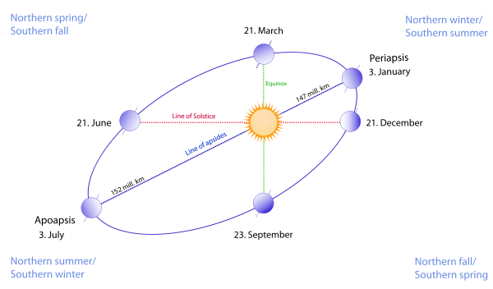
Seasonal modulation
eccentricity of the Earth orbit: 6.7% of total rate difference
Dec 11th 2011 -- Oct 3rd, 2021
energy range: 300-827 keV (⁷Be region)
Modulation analysis
sinusoidal fit
Lomb-Scargle method- an extension of the Fourier Transform approach- can treat data sets not evenly distributed in time
- null hypothesis rejected at 5.3σ
- modulation amplitude (7.1±1.9)%
- best-t period is T = 36i. 1 ±13.6 days.
Gianpaolo Bellini. Università and INFN- Milano

Slide 15
Neutrino Physics
electron neutrino survival probability: from $\sim$100 keV
to >10 MeV.
Borexino has observed for the first time the electron neutrino Pee in the vacuum regime, where, according to the MSW paradigmatic model, the vacuum dominates
With only its data, Borexino succeeded to measure the ration Vacuum/matter ν_{e} survival probability
Despite the uncertainty of the various points, that incorporate both the experimental errors and the SSM uncertainties, the experimental results seem in agreement with the predictions of the MSW-LMA model.
LMA-MSW
1 σ uncertainty
Gianpaolo Bellini. Università and INFN- Milano

Slide 16
Not Standard neutrino Interaction (NSI)
Theories beyond the Standard Model postulate the existence of Non-Standard Interactions (NSI), where flavor-changing NC is possible
exposure of 1271 days x 71.3 tons
The NSI Lagrangian :
where $∈_{αβ}^{ff^{′}C}$ parametrizes the NSI strength
nomalized to $G_{f}$, f and f’ are leptons or quarks, α,β=e,μ,τ and C is the chirality of ff’ current (L or R). In this analysis only flavor-diagonal case f=f’=e and α=β is considered, with $ε_{α}^{C}=ε_{αα}^{eeG}$.
The NSI affects the neutrino propagation in matter and in particular the vacuum-matter intermediate region.
The analysis is carried out on the ν-e elastic scattering which is very sensitive to NSI.
ν-e elastic scattering differential rate for
⁷Be solar neutrinos
with and without NSI
MSW
ε=-0.30
pp, ⁷Be, pep data
ε=-0.16

Slide 17
allowed region for ε_{τ}^{R,L} with ε_{e}^{R,L} fixed at zero.
allowed region for ε_{e}^{R,L} with ε_{τ}^{R,L} fixed
at zero
$ε_{αβ}^{ff^{′}C}$ parametrizes the strength of NSI
Gianpaolo Bellini. Università and INFN- Milano

Slide 18
In the Sun the CNO cycle contributes only for about 1%.
In the massive stars is considered dominant and reaches in their core a temperature of 100-150 °K, needed to counterbalance the gravitational force thus preventing their implosion
But this hypothesis, which dates back to the 1939 (Bethe and Von Weizsäcker ), has never been experimentally tried.
CNO Cycle
1/4
The experimental demonstration of the existence of the CNO cycle has been one of the last Borexino’s breaktroughs
W.C. Haxton, A:M Serenelli (2008)
The CNO cycle contributes only to 1% of the
Sun energy

Slide 19
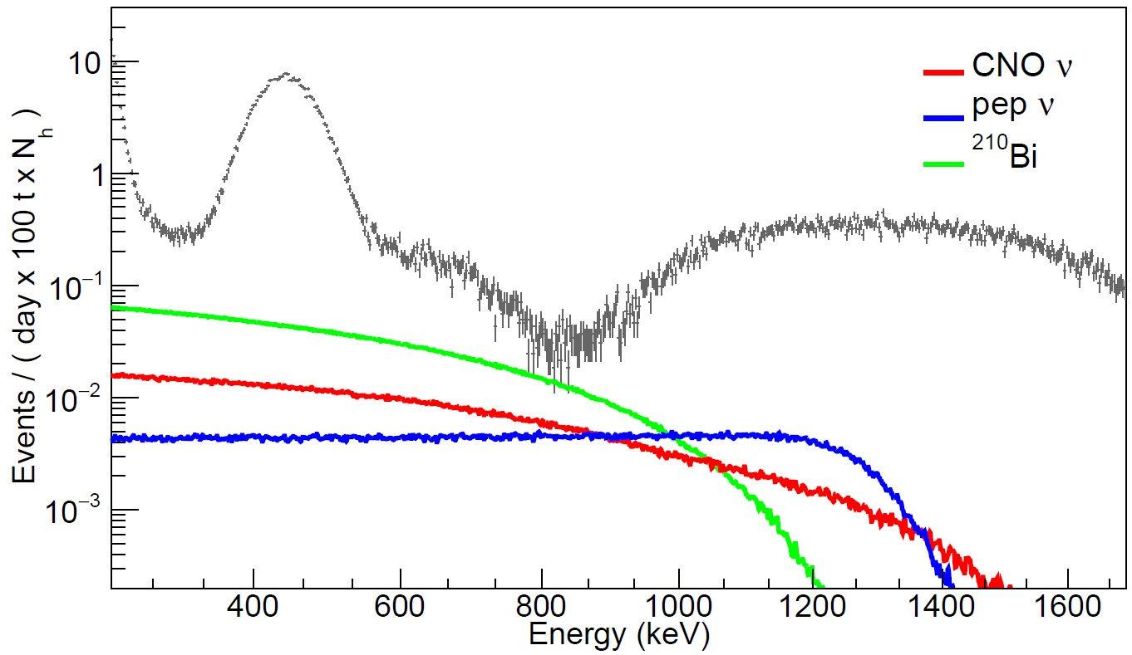
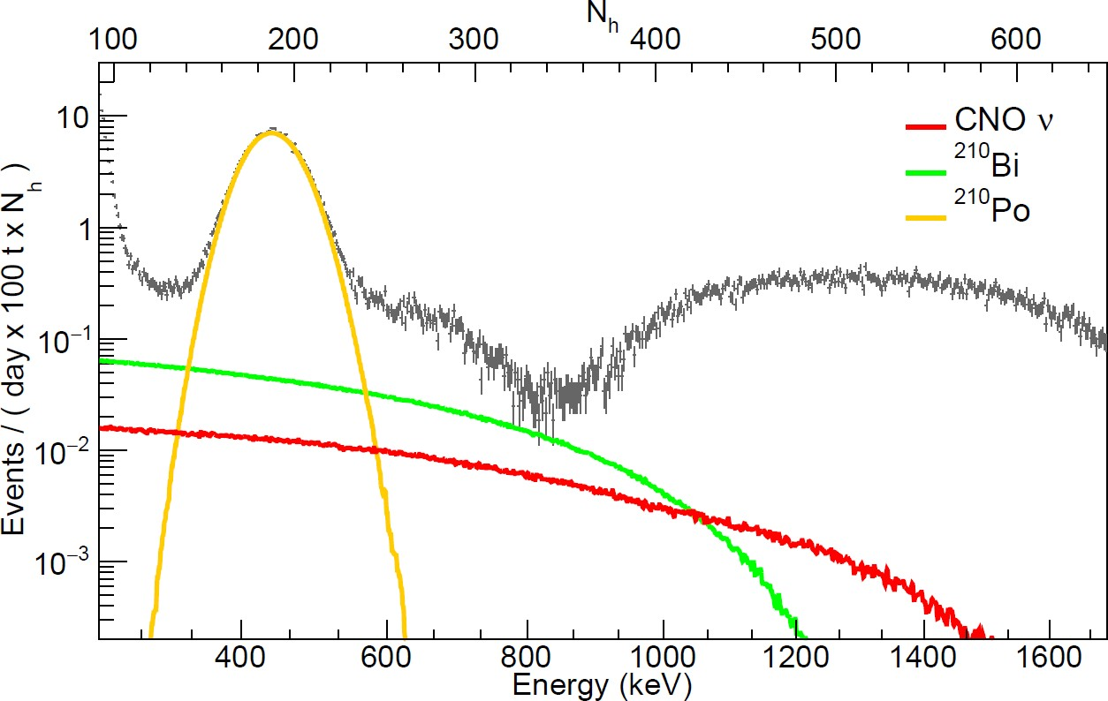
CNO Cycle
2/4
difficulties in measuring the CNO because ²¹⁰Bi, CNO, pep fall in the same
energy window and the energy spectrum of CNO has no particular tagging
Borexino data
CNO ν expected spectrum
²¹⁰Bi spectrum
pep ν spectrum
The spectral fit returns only the sum of CNO and ²¹⁰Bi, if both are left free
The pep flux can be constrained at the 1.4 % level through the solar luminosity coupled to SSM predictions on the pp to pep rates ratio and the most recent oscillation parameters- global analysis- J. Bergström et al., JHEP, 2016:132, 2016.
what is needed is a reliable determination of ²¹⁰Bi;
a constraint on it can be obtained from ²¹⁰Po
secular equilibrium
β⁻ β⁻ α
²¹⁰Pb ²¹⁰Bi ²¹⁰Po ²⁰⁸Pb (stable)
23y 5d 138 d
Gianpaolo Bellini. Università and INFN- Milano

Slide 20
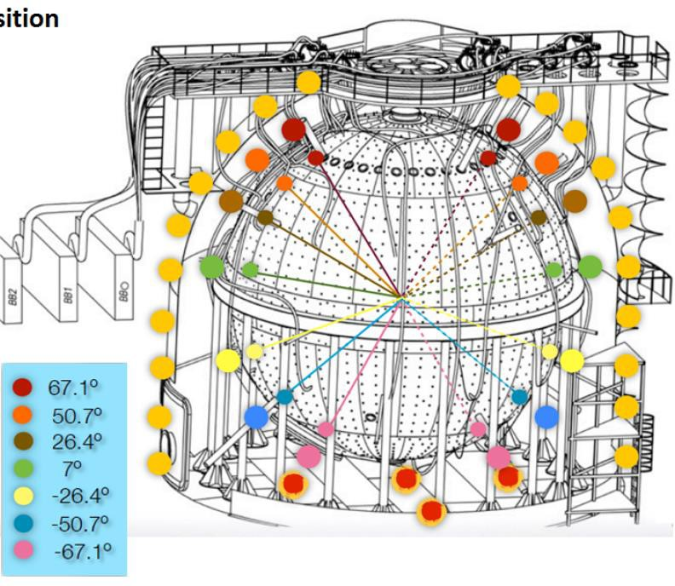
a stabilization of the temperature is necessary
Then we have to avoid the convective motions
temperature probes-
Excellent temperature stability achieved
Probes resolution 0.07 °C

Slide 21
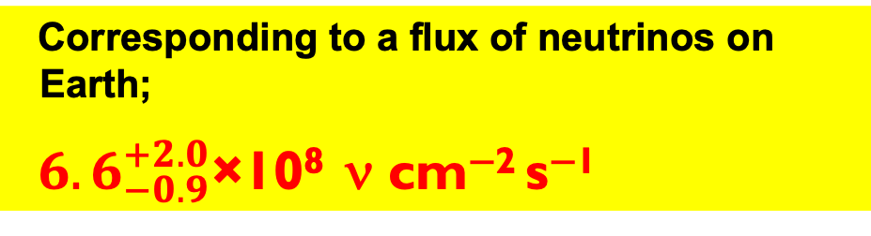
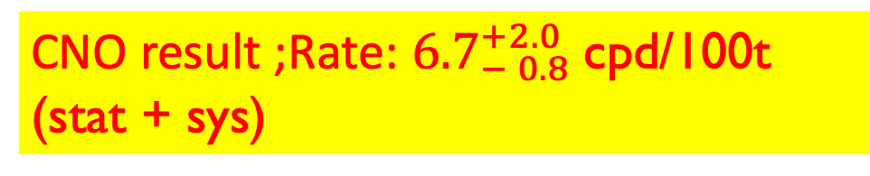

CNO Cycle
3/4
CNO result ;Rate: ${6.7}_{− 0.8}^{+2.0}$cpd/100t (stat + sys)
Corresponding to a flux of neutrinos on Earth;
${6.6}_{−0.9}^{+2.0}$×10⁸ ν cm⁻² s⁻¹
the hypothesis CNO=0 disfavored with ~ 7σ significance
Gianpaolo Bellini. Università and INFN- Milano

Slide 22

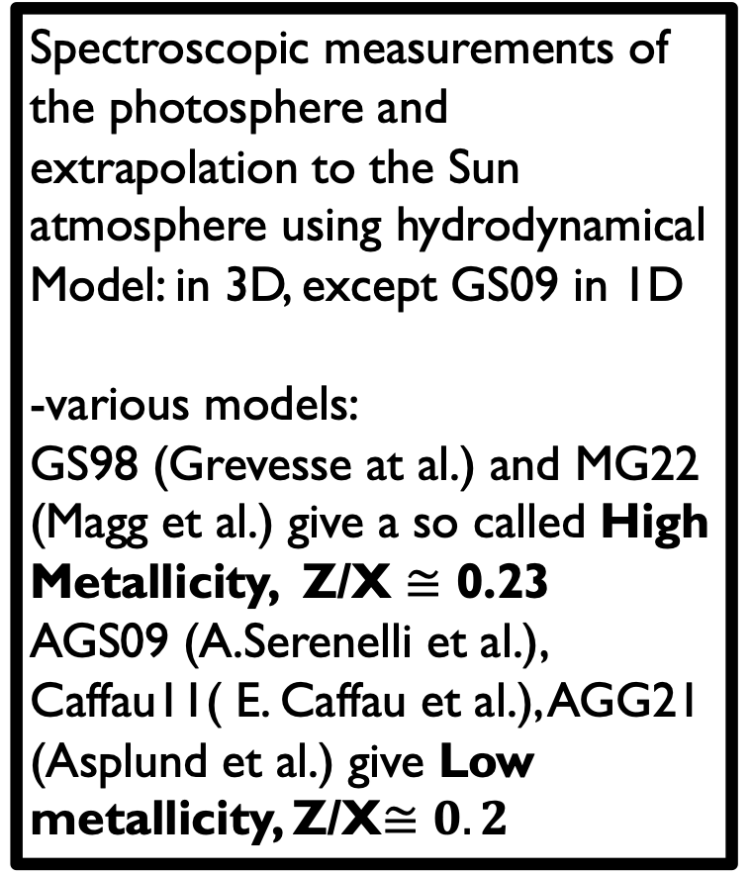
Metallicity. 1/3
= abundance of elements with Z>2 (C, N, O, Ne, Mg, Si, etc ) in the Sun photosphere
Spectroscopic measurements of the photosphere and extrapolation to the Sun atmosphere using hydrodynamical
Model: in 3D, except GS09 in 1D
-various models:
GS98 (Grevesse at al.) and MG22 (Magg et al.) give a so called High Metallicity, Z/X $≅$ 0.23
AGS09 (A.Serenelli et al.), Caffau11( E. Caffau et al.), AGG21 (Asplund et al.) give Low metallicity, Z/X$≅0.2$
Helioseismology
Sound speed waves on the Sun surface.
Good agreement with the High
metallicity models and disagreement
with the low metallicity.
Two checks
$$\sim$$
Solar neutrino fluxes from the various nuclear fusion reactions
Gianpaolo Bellini. Università and INFN- Milano

Slide 23
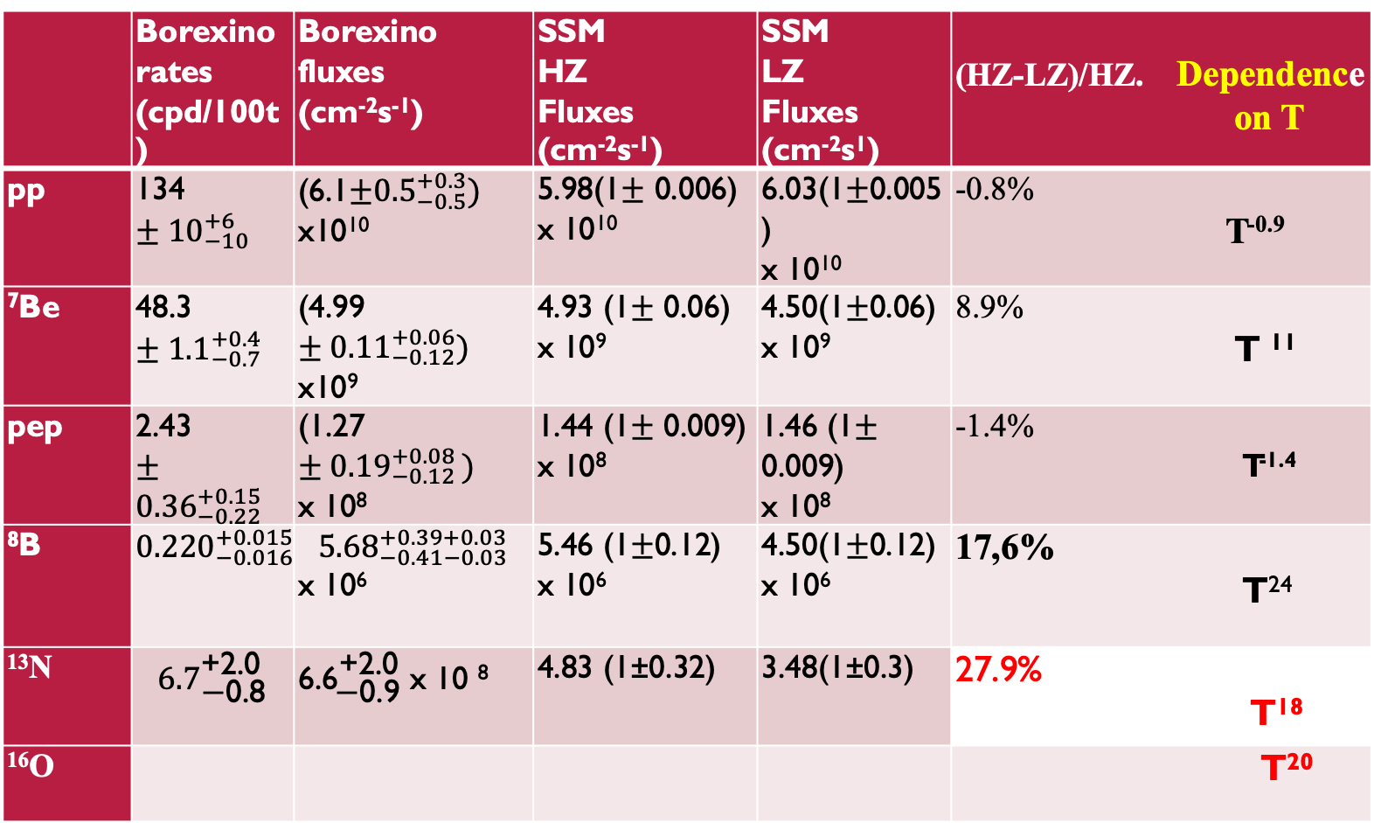
 | Borexino rates (cpd/100t) | Borexino fluxes (cm⁻²s⁻¹) | SSM HZ Fluxes (cm⁻²s⁻¹) | SSM LZ Fluxes (cm⁻²s¹) | (HZ-LZ)/HZ. Dependence on T
pp | 134$±{10}_{−10}^{+6}$ | (6.1$±{0.5}_{−0.5}^{+0.3})$ x10¹⁰ | 5.98(1$±$ 0.006) x 10¹⁰ | 6.03(1$±$0.005) x 10¹⁰ | -0.8% T^{-0.9}
⁷Be | 48.3$±{1.1}_{−0.7}^{+0.4}$ | (4.99$±{0.11}_{−0.12}^{+0.06})$ x10⁹ | 4.93 (1$±$ 0.06) x 10⁹ | 4.50(1$±$0.06) x 10⁹ | 8.9% T ¹¹
pep | 2.43$±{0.36}_{−0.22}^{+0.15}$ | (1.27$±{0.19}_{−0.12 }^{+0.08})$ x 10⁸ | 1.44 (1$±$ 0.009) x 10⁸ | 1.46 (1$±$ 0.009) x 10⁸ | -1.4% T^{-1.4}
⁸B | $${0.220}_{−0.016−0.006}^{+0.015+0.006}$$ | $${5.68}_{−0.41−0.03}^{+0.39+0.03}$$ x 10⁶ | 5.46 (1$±$0.12) x 10⁶ | 4.50(1$±$0.12) x 10⁶ | 17,6% T²⁴
¹³N | $${6.7}_{\text{−}\text{0.8}}^{\text{+2.0}}$$ | ${\text{6.6}}_{\text{−0.9}}^{\text{+2.0}}$ x 10 ⁸ | 4.83 (1±0.32) | 3.48(1±0.3) | 27.9% T¹⁸
¹⁶O |  |  |  |  | T²⁰
PP Chain
CNO cycle
Vinyoles et al. Astr.J. 835 (2017) 202 + Grevesse et al.,Space Sci.Rev. (1998)85]
Vinyoles et al. Astr.J. 835 (2017) 202 + Asplund et al., Annu. Rev. Astr. Astrop (2009) 47

Slide 24
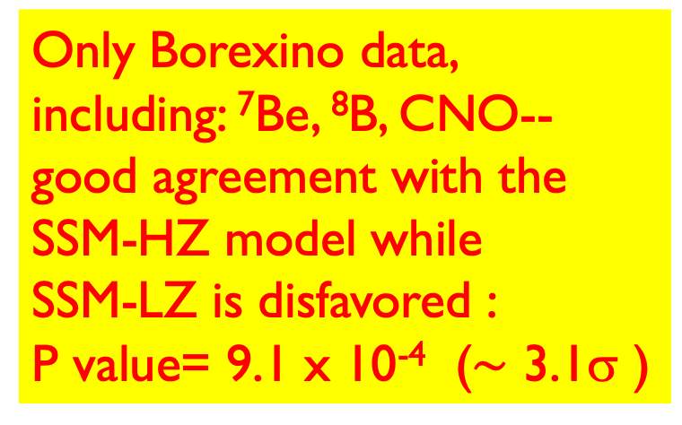
Metallicity. 3/3
Only Borexino data, including: ⁷Be, ⁸B, CNO--
good agreement with the SSM-HZ model while
SSM-LZ is disfavored :
P value= 9.1 x 10⁻⁴ ($\sim$ 3.1σ )

Slide 25
The Borexino breaktroughs can be summarized as follows
First experimental evidence of all fusion reactions of the pp chain, which produces 99% of the solar energy, via the first measurement of all the single neutrino fluxes (the one from ⁸B reaction was measured also before)
First experimental evidence of the CNO cycle discovering the mechanism that powers massive stars. In this way, with the pp chain and the CNO cycle, Borexino demonstrated how the Sun and stars of any size, shine.
3. First observation of the electron-neutrino oscillation in vacuum regime and measure of the electron-neutrino survival probability vacuum/matter regimes ratio
4. Solution of the SSM long standing metallicity puzzle in favor of the high metallicity

Slide 27
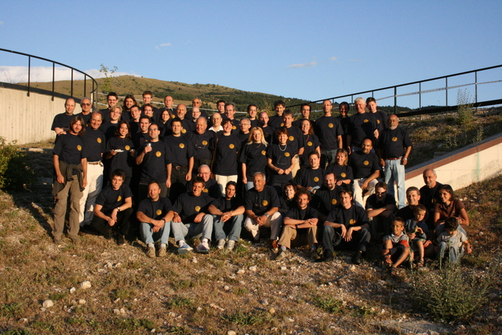
The Borexino
collaboration
Thank you !!!!

